Slide 1
PERiLS Instrument/Data
2022-2023

Slide 2
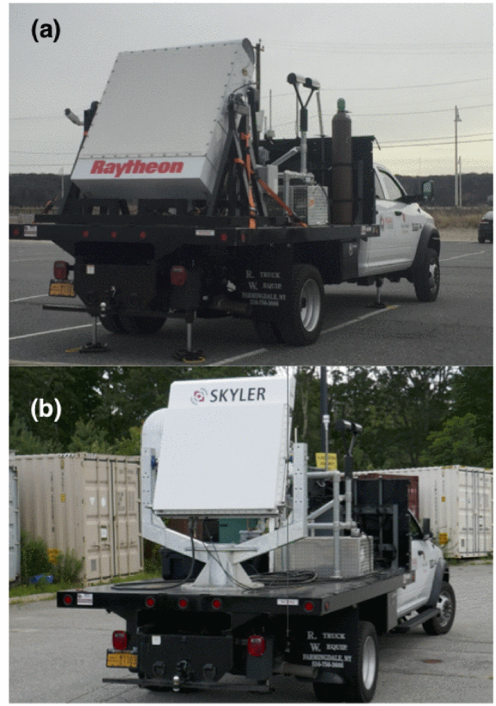
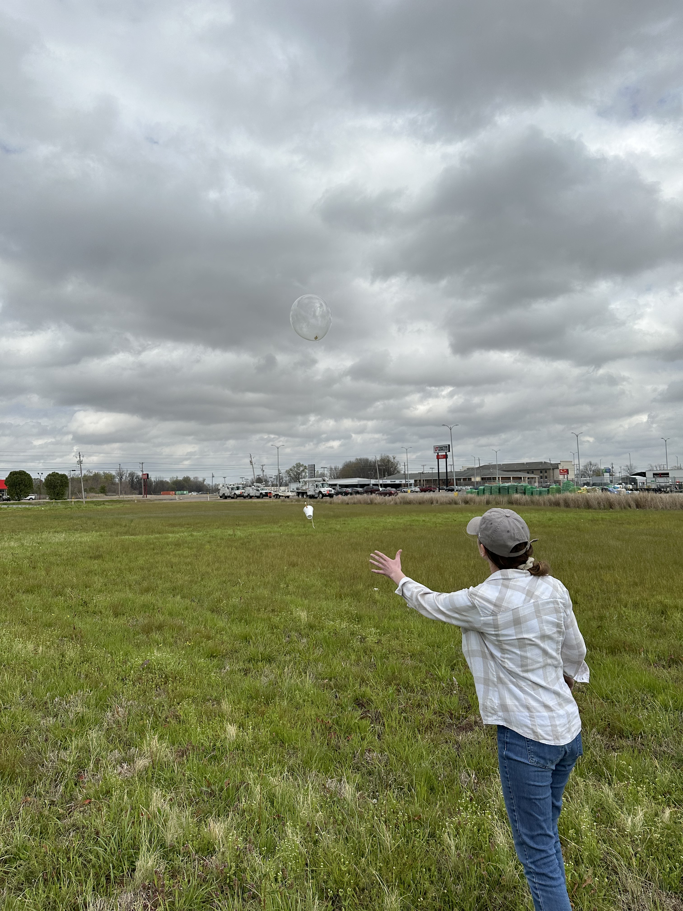
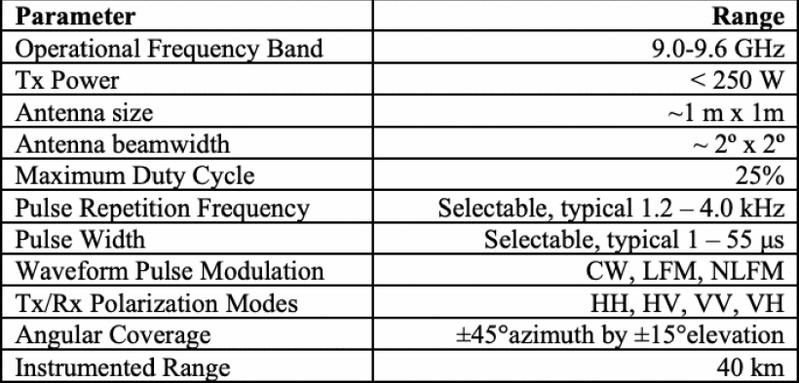
Goals
Use SKYLER-II dual-pol phased-array radar to obtain rapid-scan data of QLCS mesovortices and/or tornadoes within C/X dual-Doppler lobes
would be one of few roving radars and would target “areas of interest” within QLCS
also launch Windsonds from deployment location of truck
2023 → with availability of RaXPol, added possibility of collecting rapid-scan dual-Doppler

Slide 3
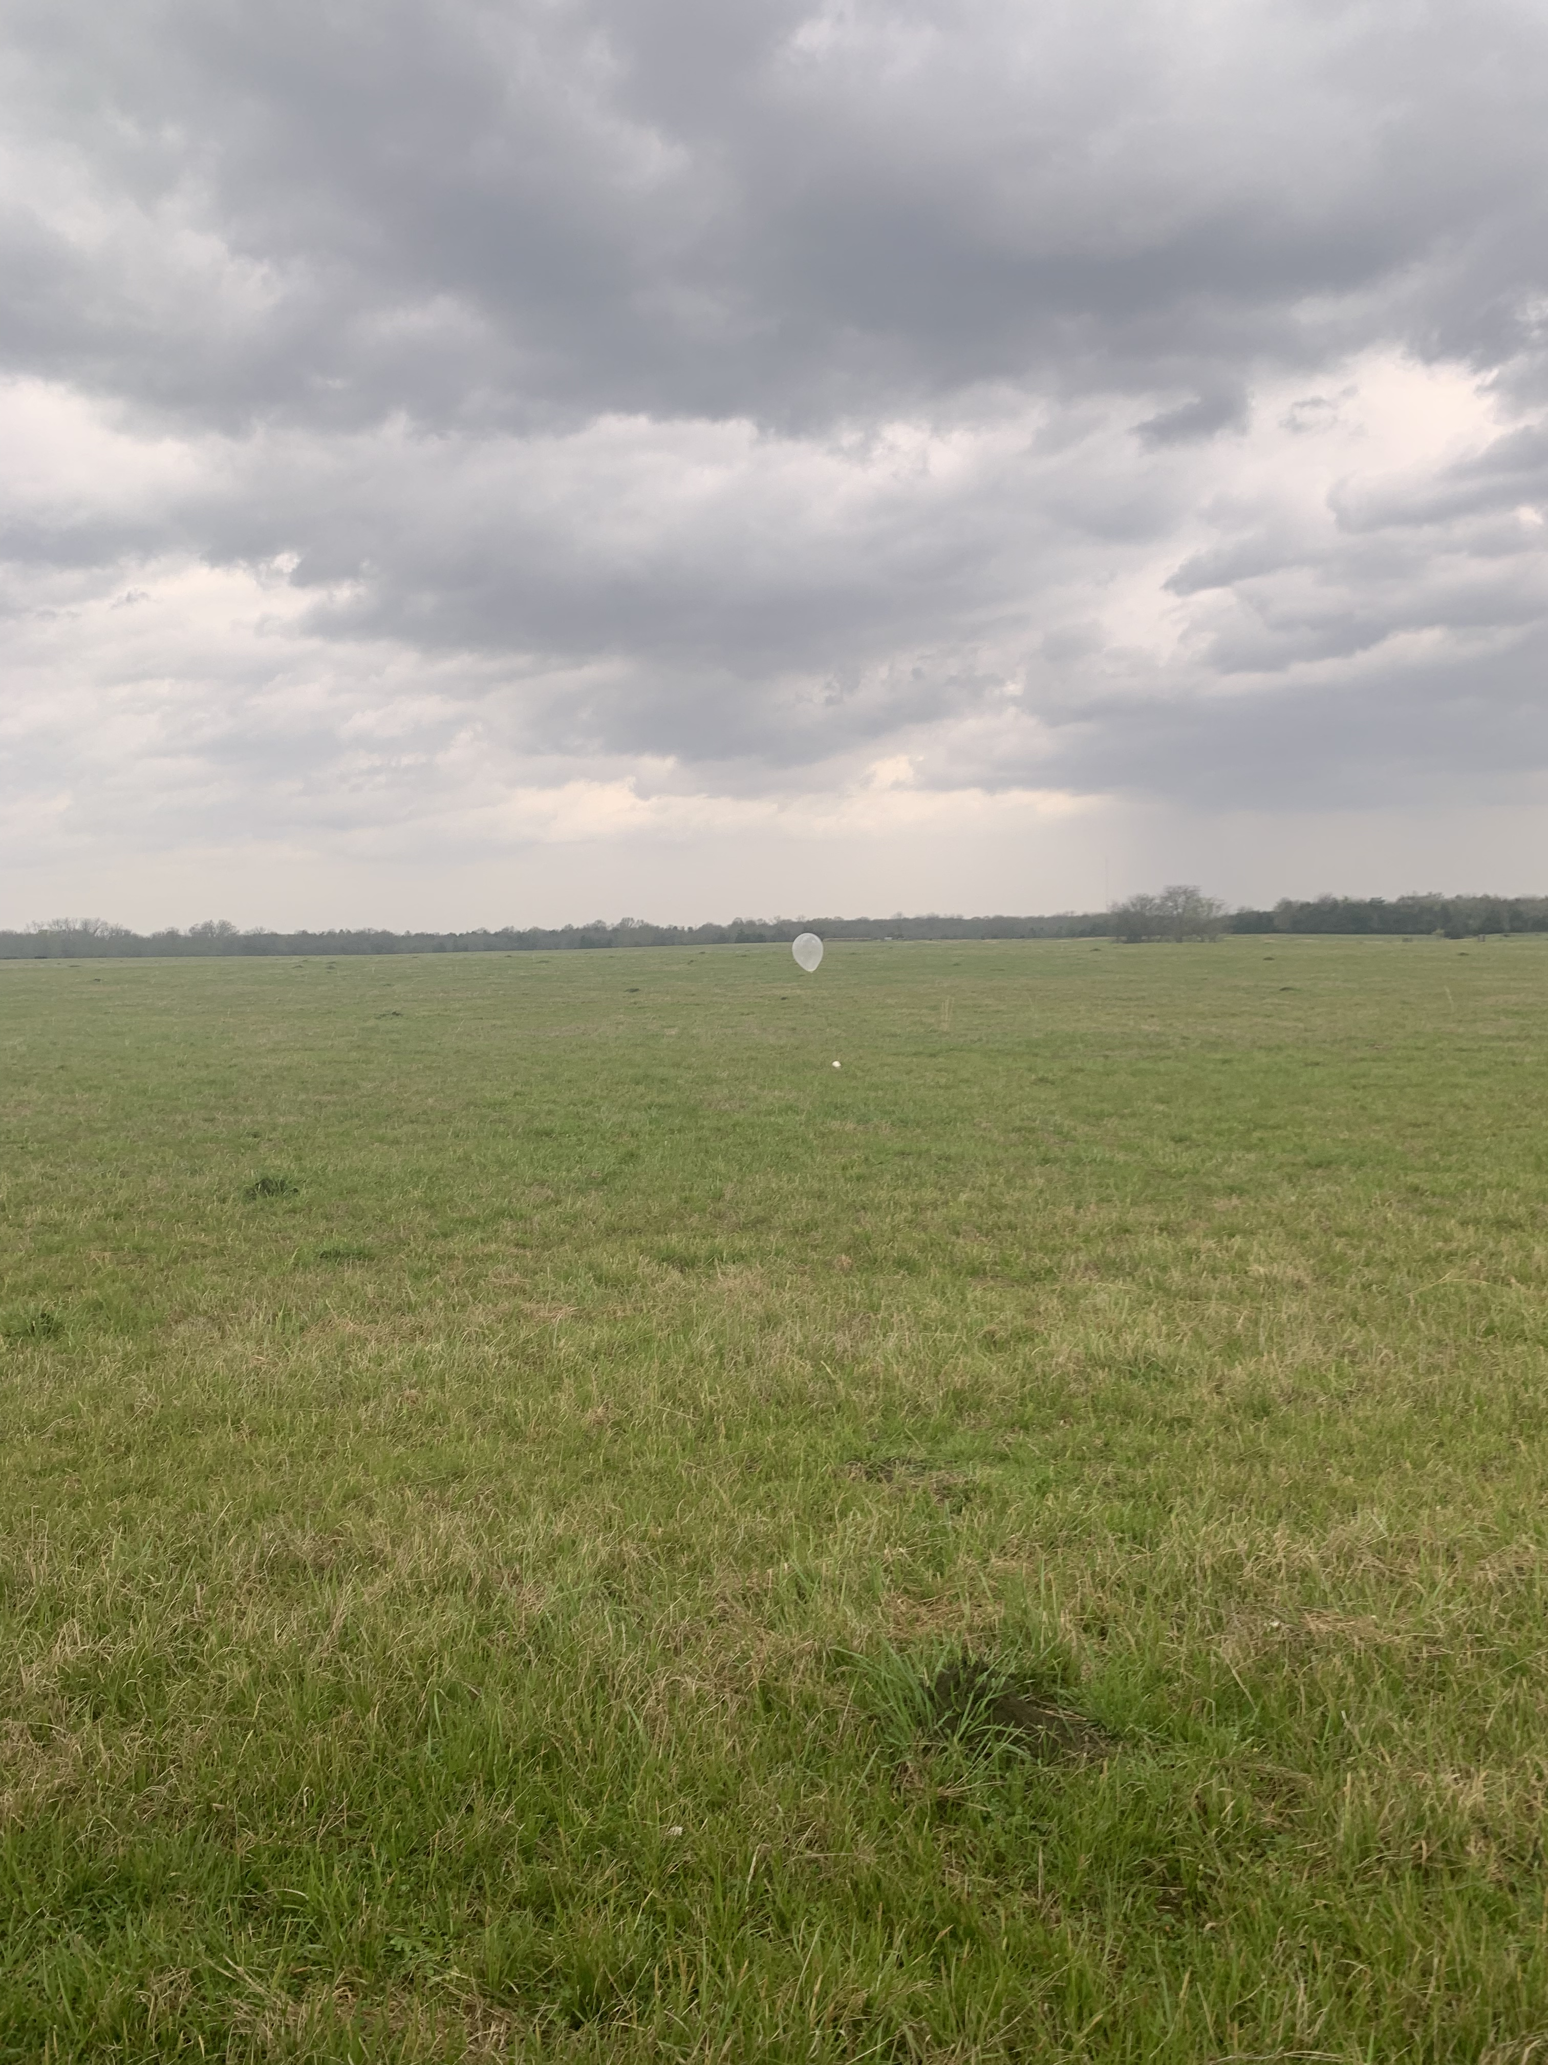
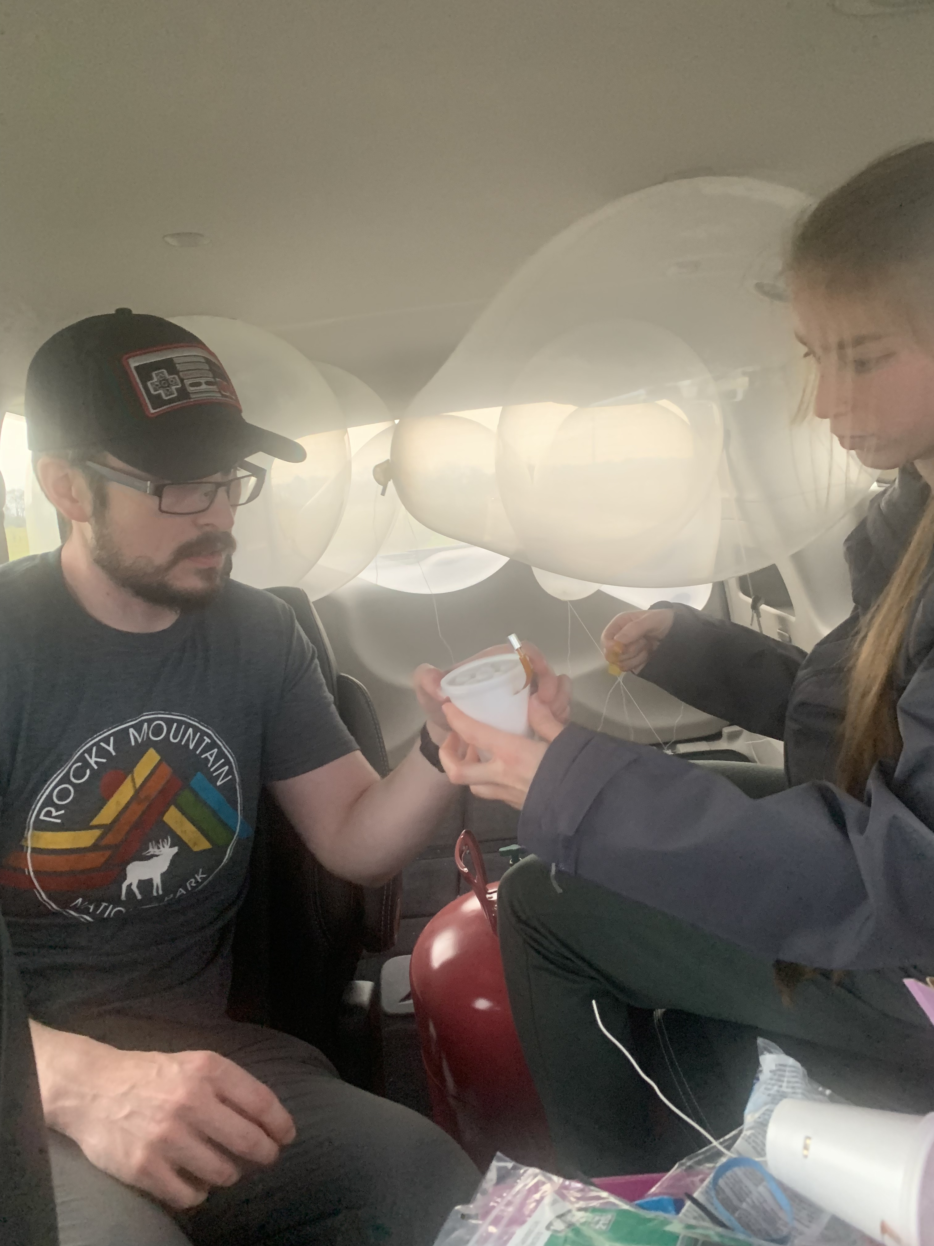
2022
SKYLER-II not available owing to safety concerns from repairs made to the radar and truck internally at SBU
still launched windsonds in IOPs 1, 2, and 4 → stuck with “area of interest” approach to prepare for 2023 with radar → 6-12 launches per IOP spaced 5-10 min as line approached

Slide 4
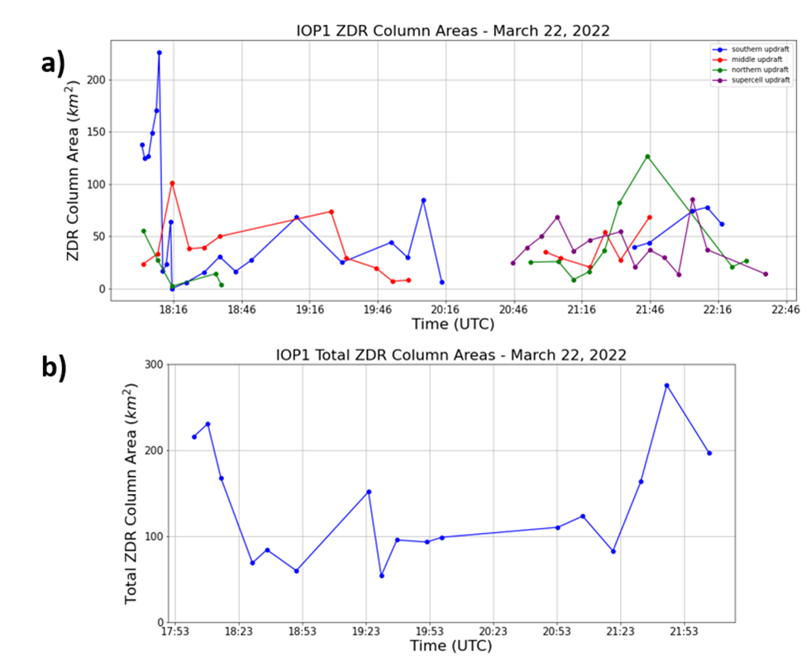
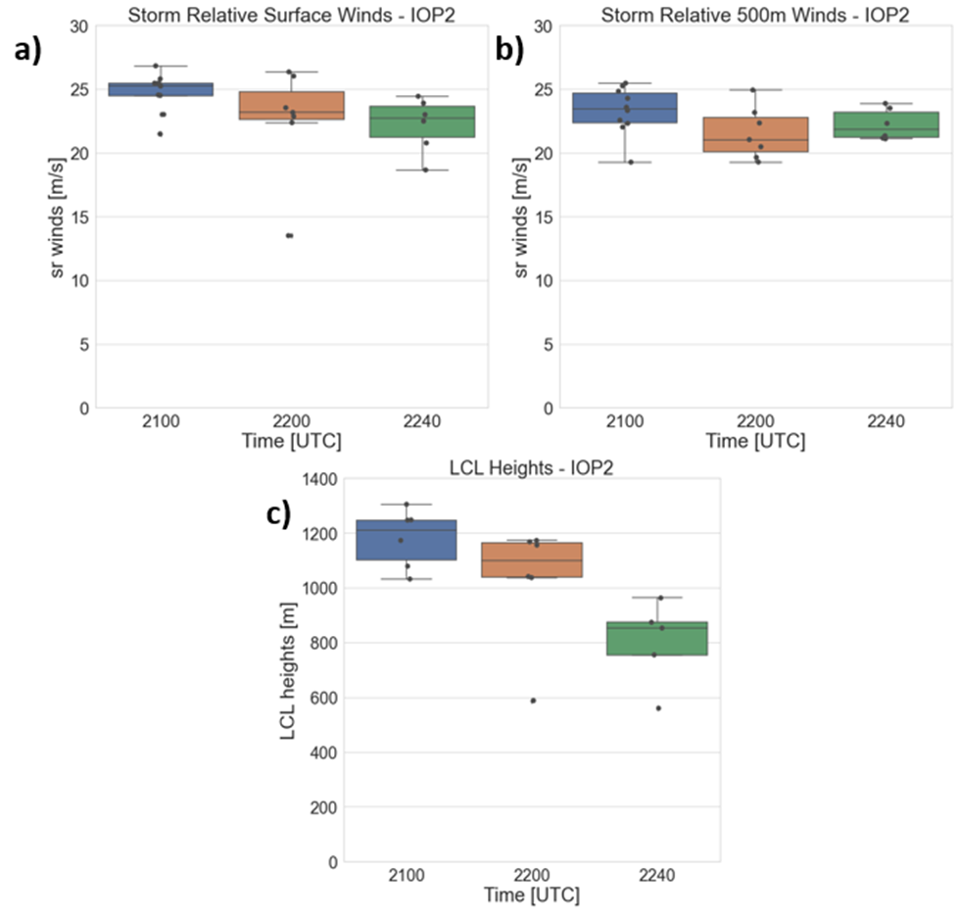
2022

Slide 5
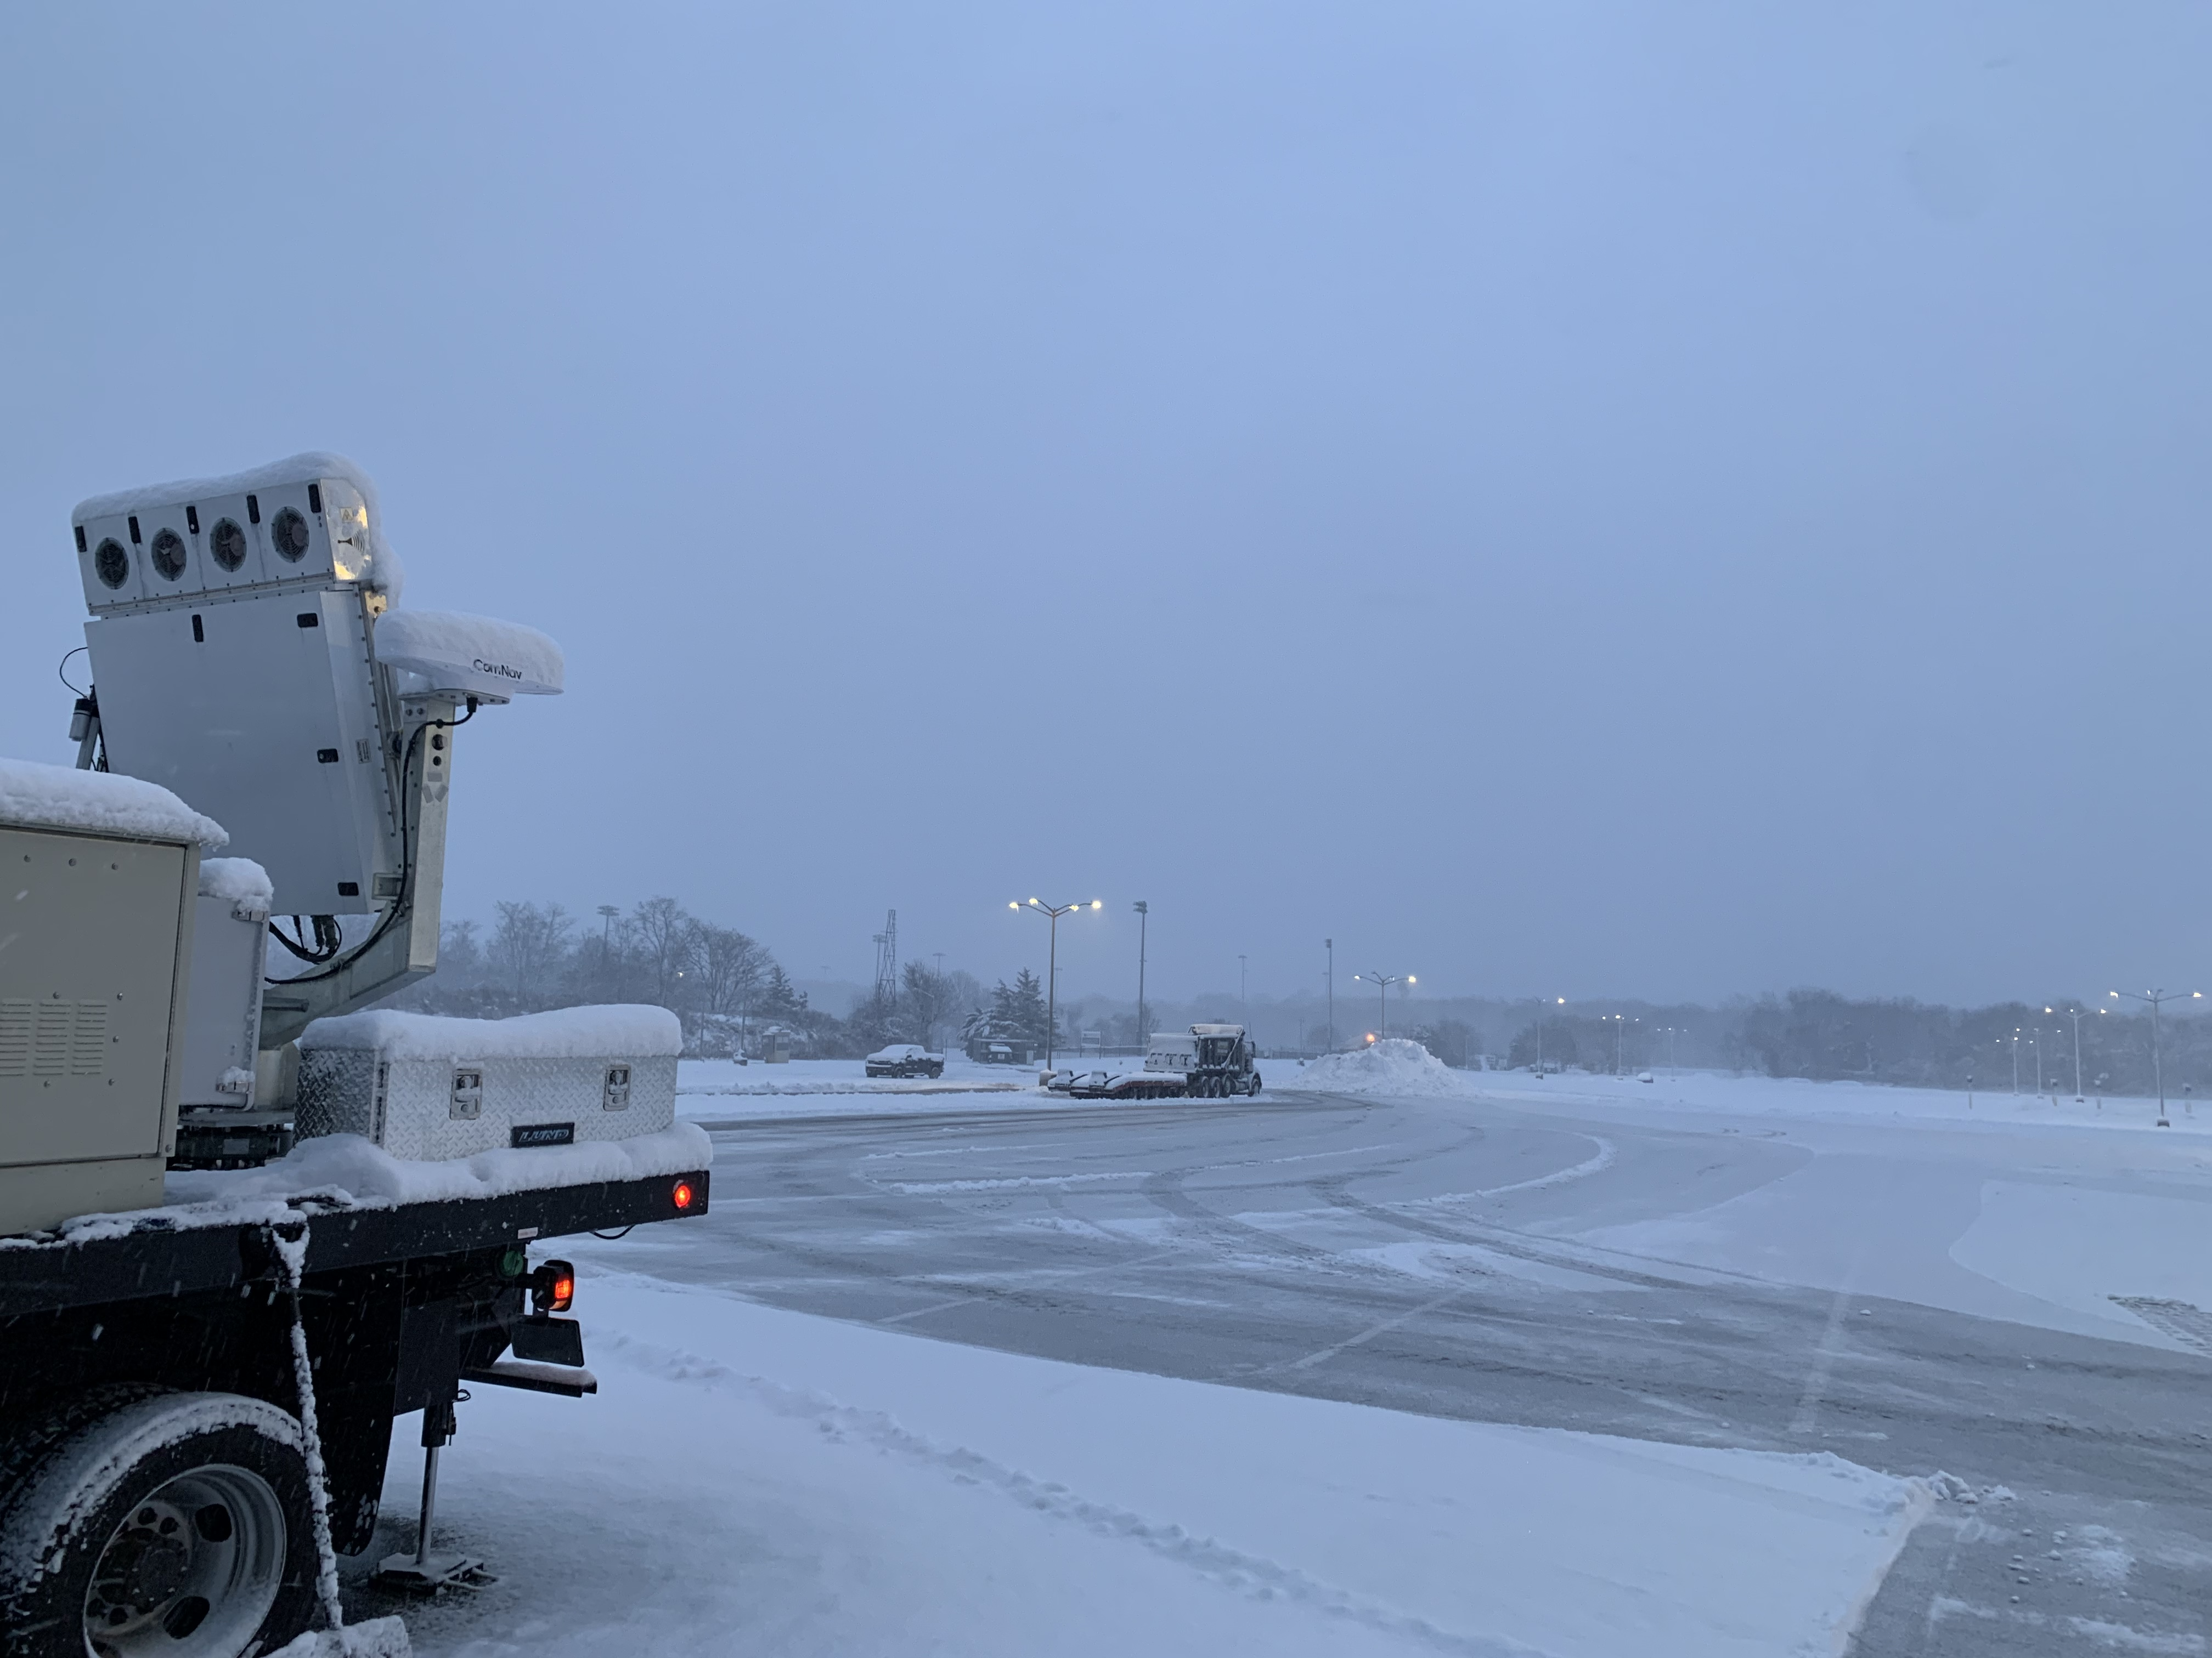
2023
SKYLER-II underwent modifications and improvements at ProSensing in Nov./Dec. of 2022
Was used in NASA IMPACTS snowstorm project Jan-Feb. 2023 to obtain data in winter storms on Long Island and upstate NY

Slide 6
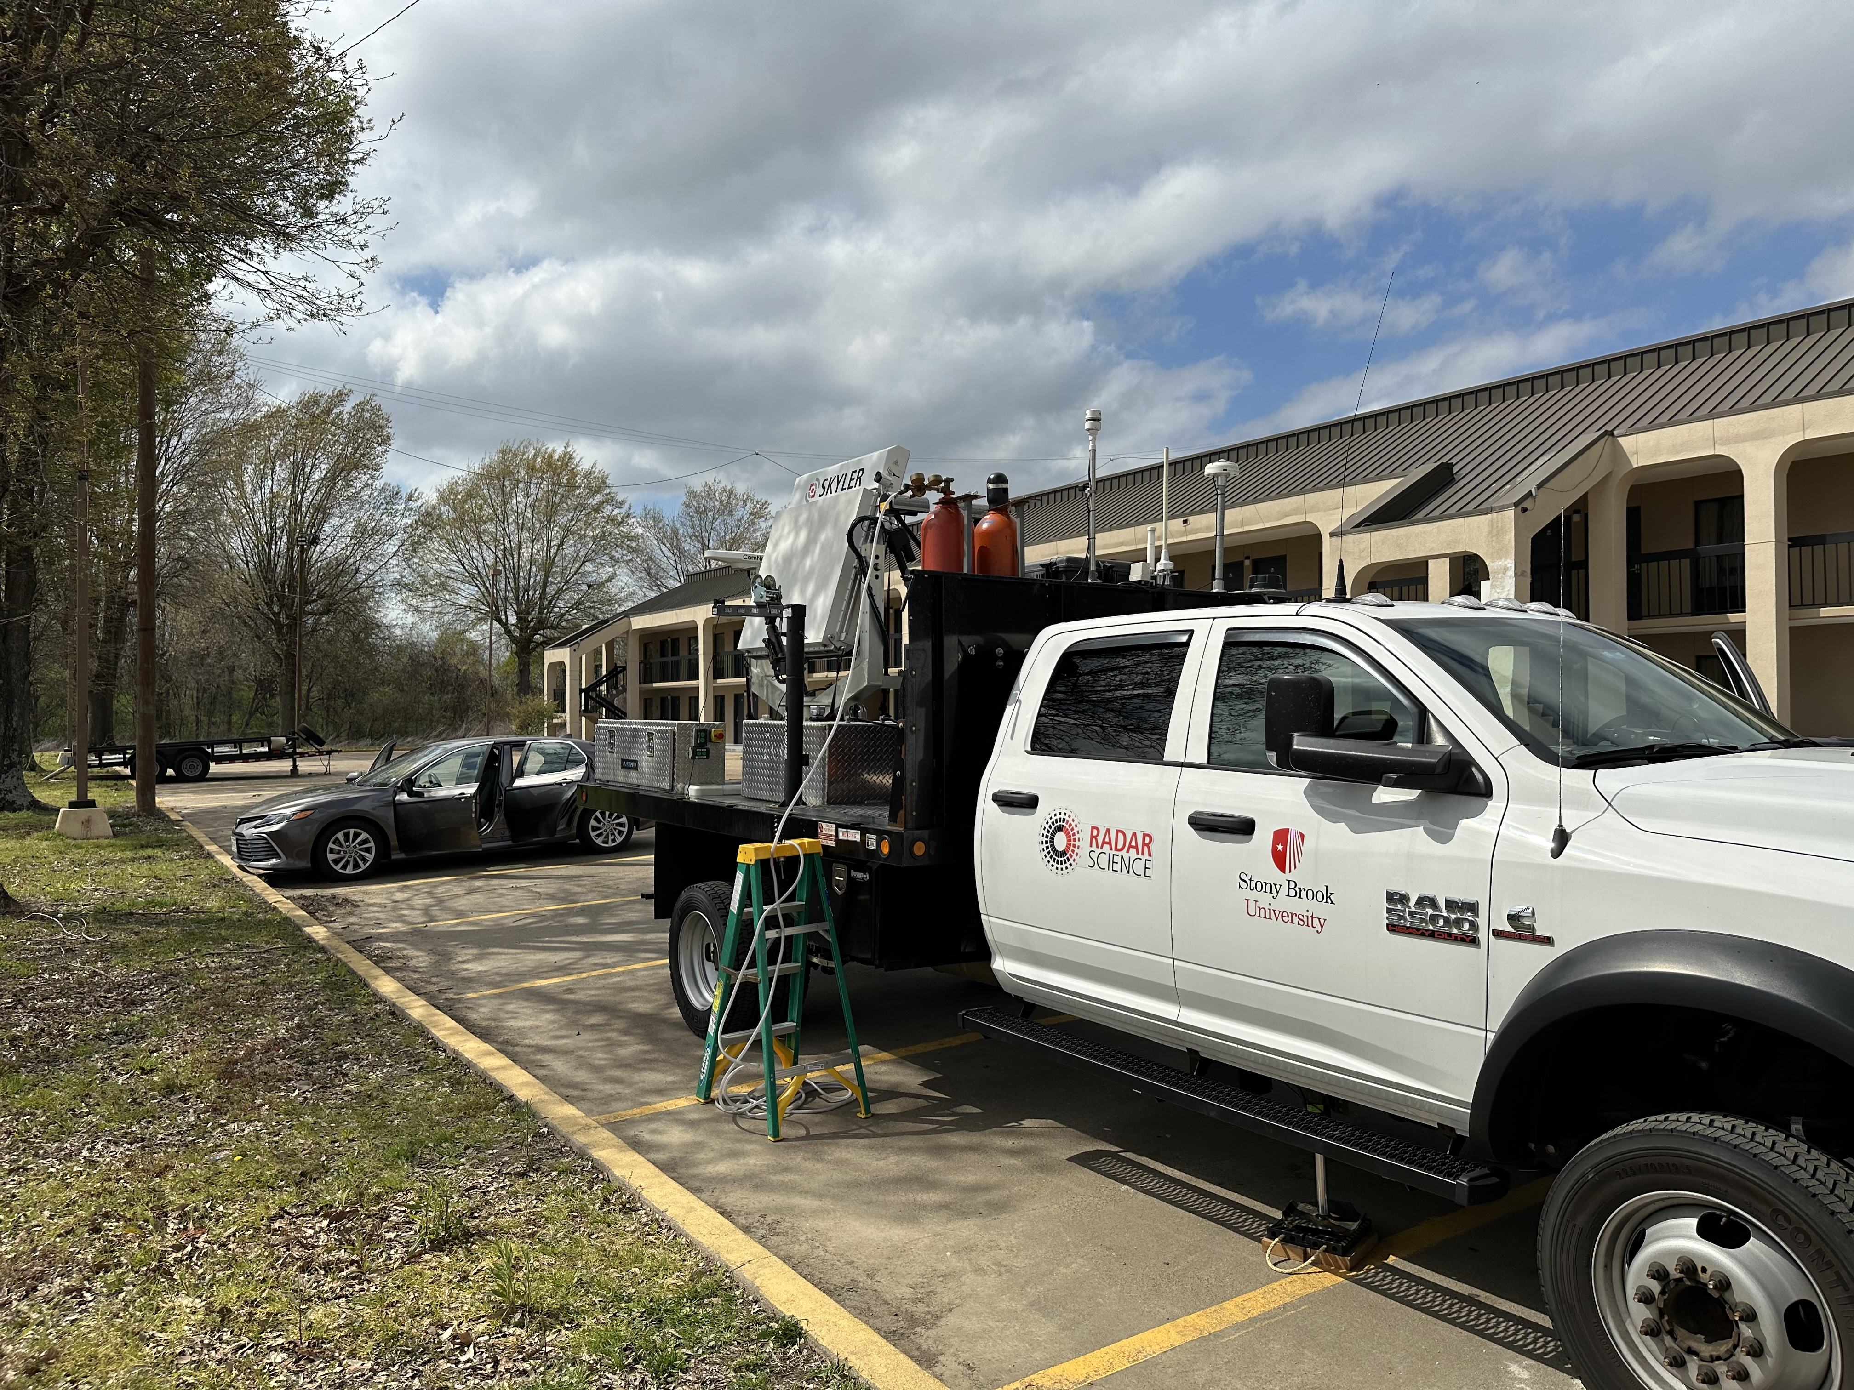
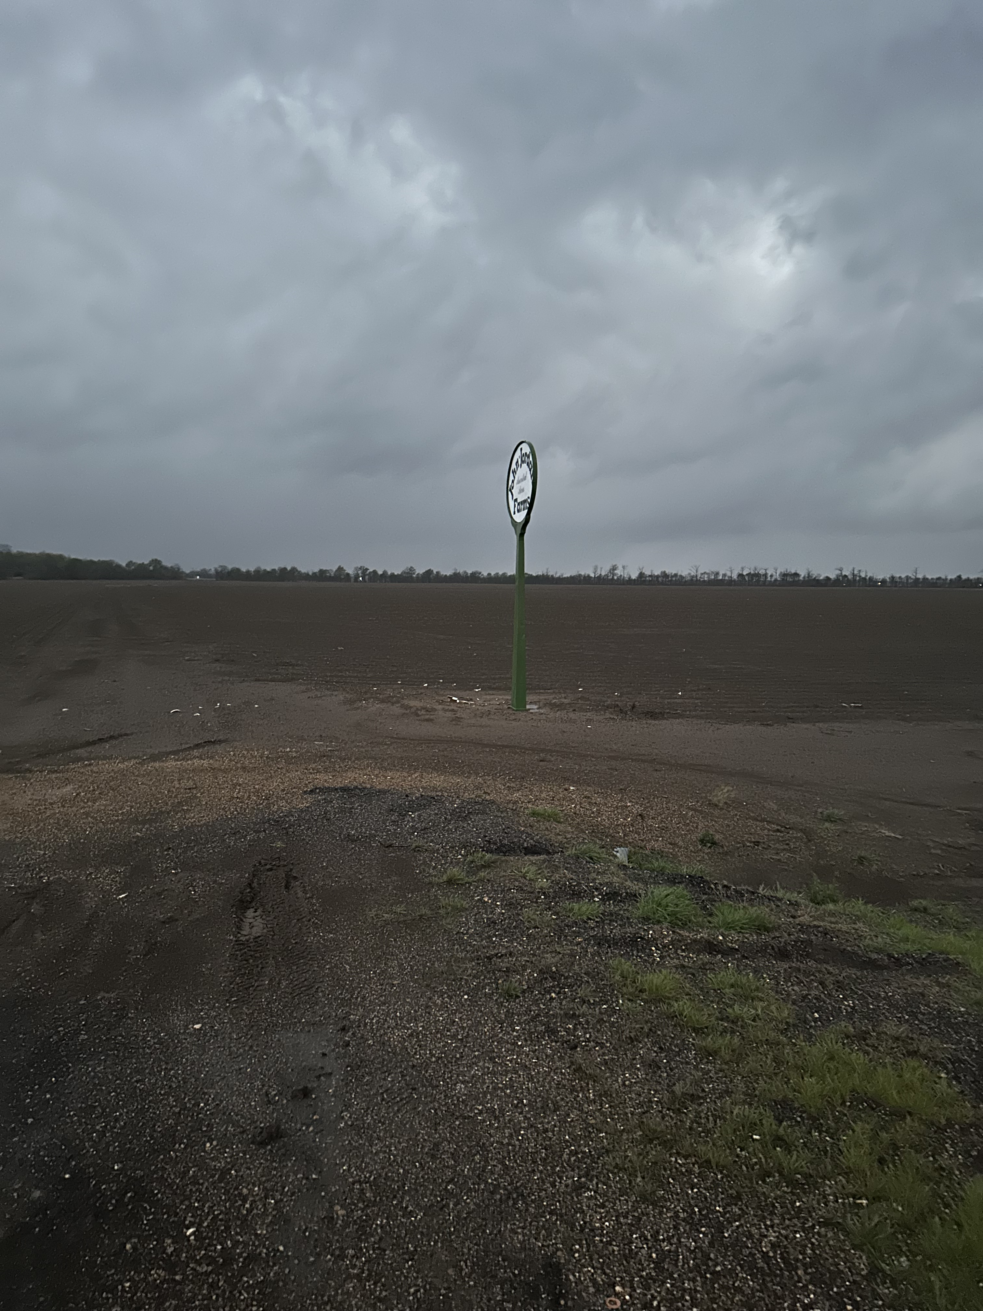
2023: IOP3
Setup N-S dual-Doppler lobe with RaXPol on Highway 65 in AR
Repeated failures in radiating and 90 min of troubleshooting, also intermittent but serious generator failures → serviced in Little Rock

Slide 7
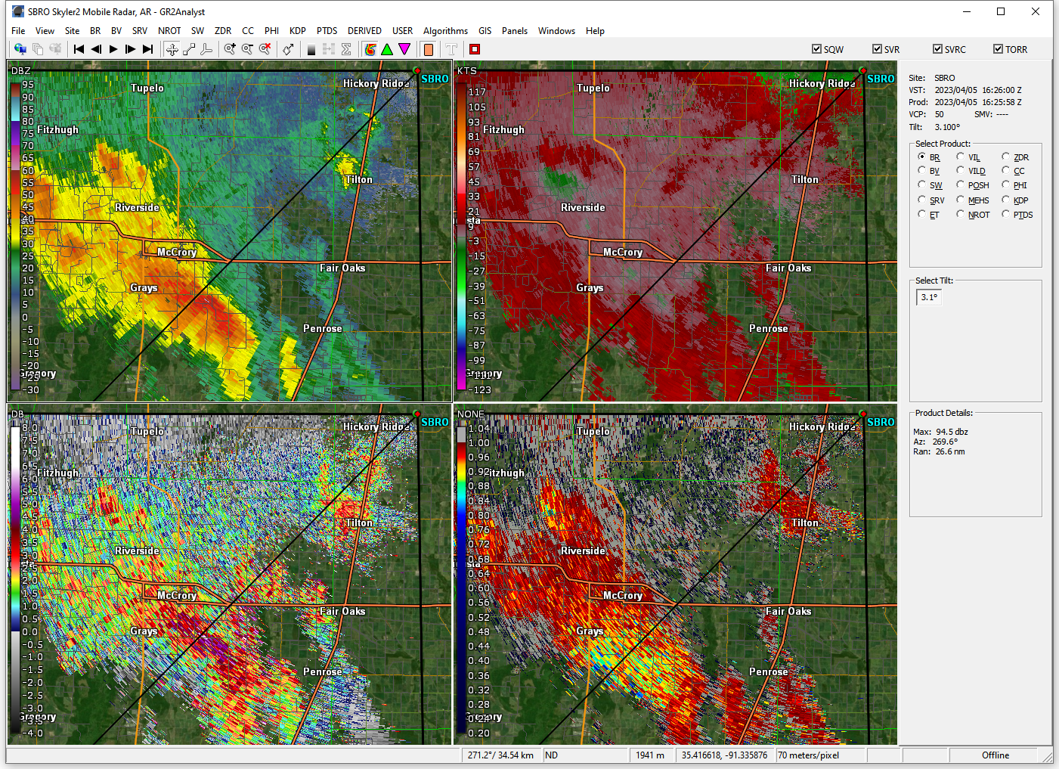
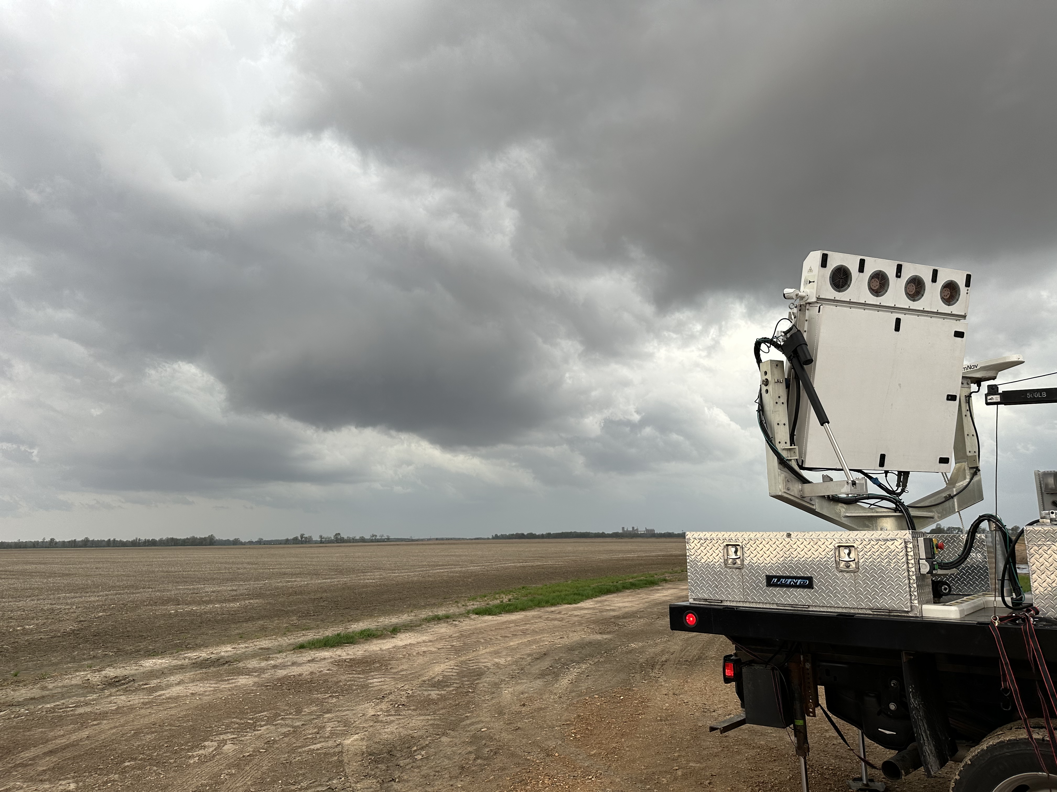
2023: IOP5
Both generator and antenna issues fixed
Goal: dual-Doppler with RaXPol → setup NW-SE baseline
1512-1757 UTC on warned cell
and line segment

Slide 8
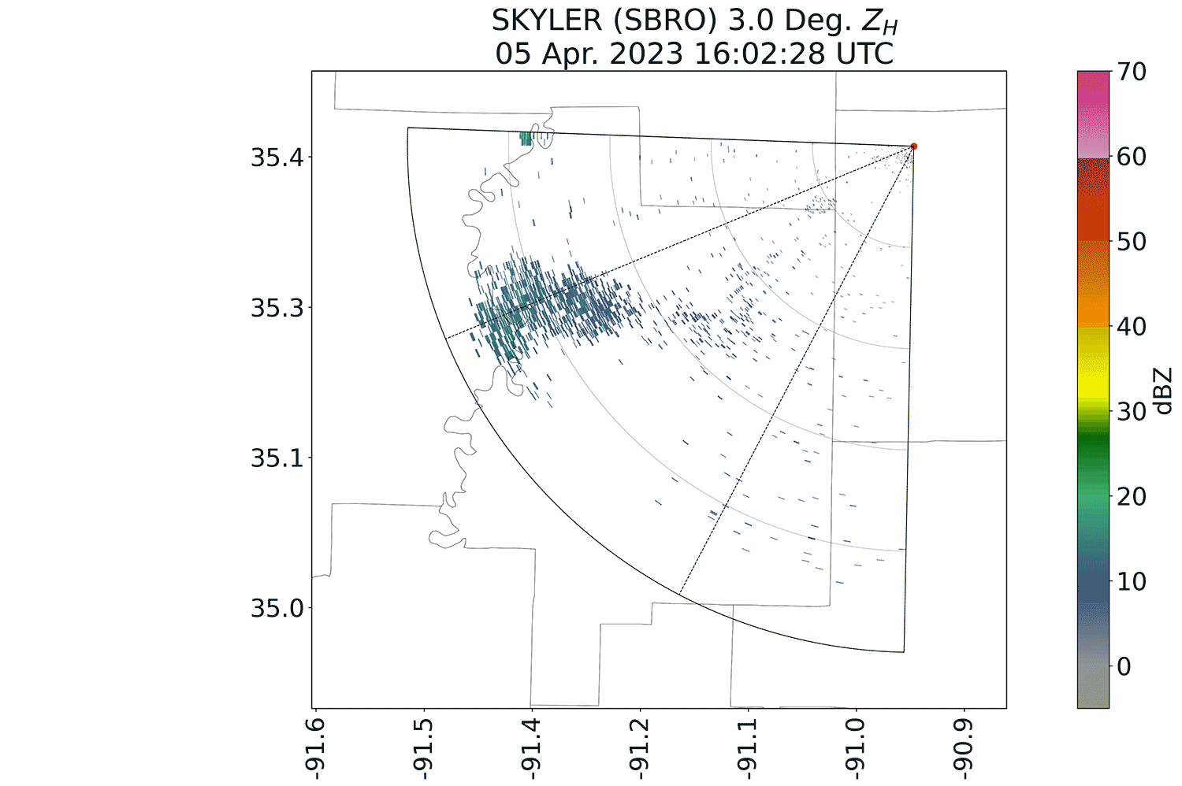
2023: IOP5
31 second volumes from 1-30˚ with 45˚ sector
DDA challenges: not perfectly level
Evaluate quality of dual-pol data with intercomparisons
Dataset processed and QCing Windsond data

