Slide 1
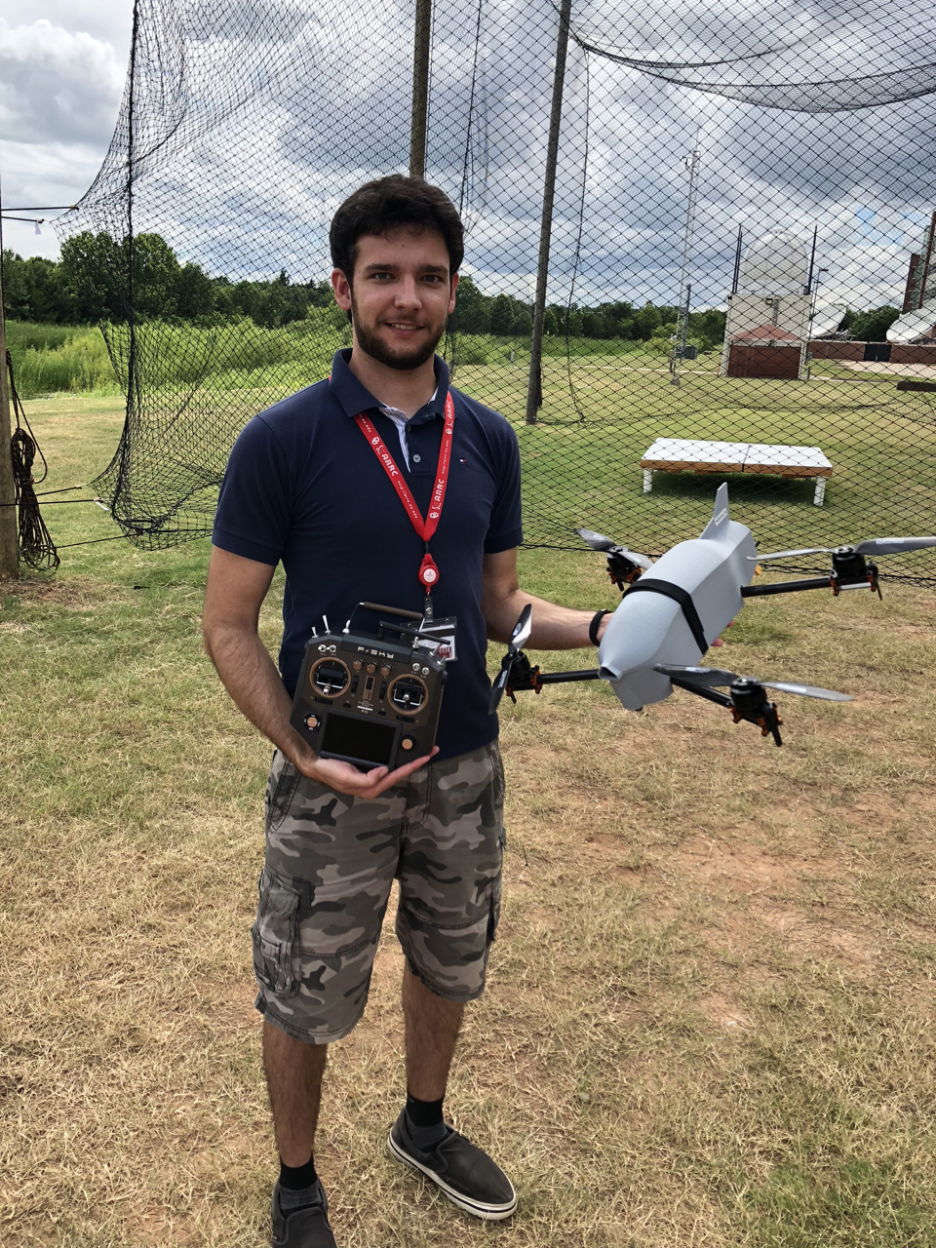
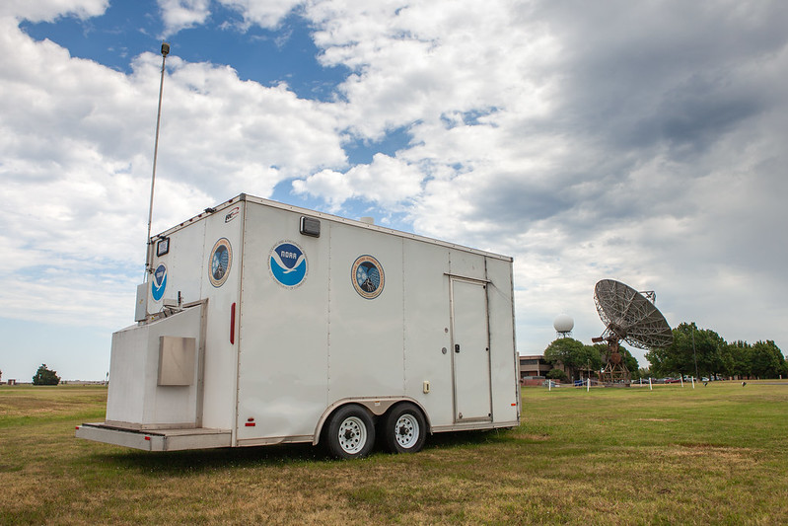
2023 – CLAMPS & CopterSondes
Lake Village, AR:
CLAMPS2 continuous deployment
Doppler lidar: VADs, vertical stares, backscatter
MWR: TROPoe temperature and humidity retrievals, sfc met
AERI not on board
CopterSonde WxUAS IOP deployment
Pressure, temperature, humidity
Wind speed and direction
Schlater, MS
CopterSonde WxUAS IOP deployment
Pressure, temperature, humidity
Wind speed and direction
Yazoo City, MS
CopterSonde WxUAS IOP deployment
Pressure, temperature, humidity
Wind speed and direction
Note: CLAMPS1 did not deploy

Slide 2
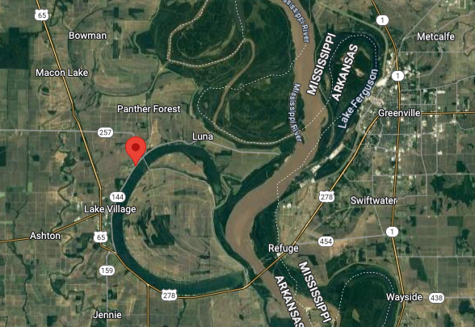
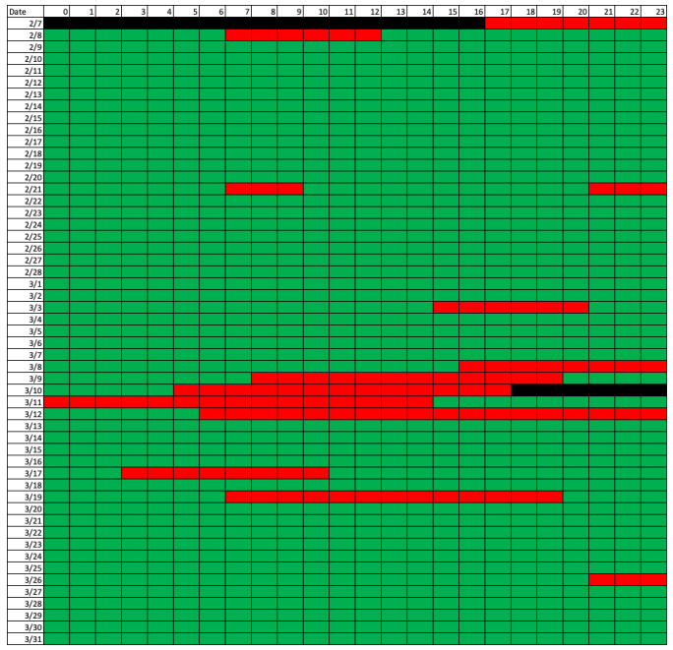
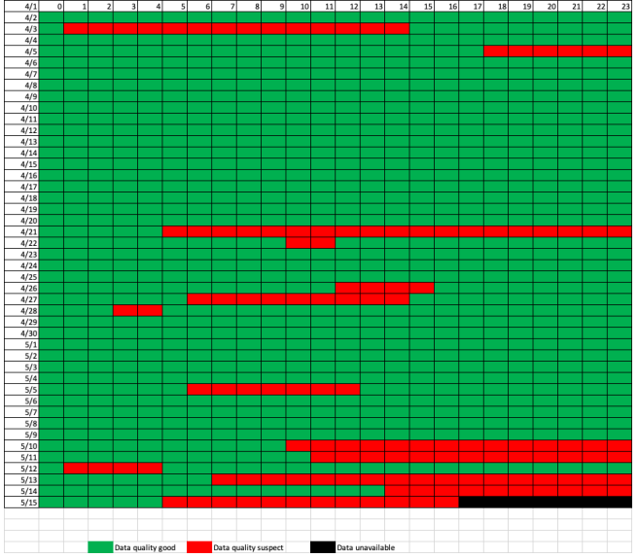
2023
Lake Village: 33.36354N, 91.262W
CLAMPS2 VAD
IOP1
IOP5
IOP2
IOP3
IOP4

Slide 3
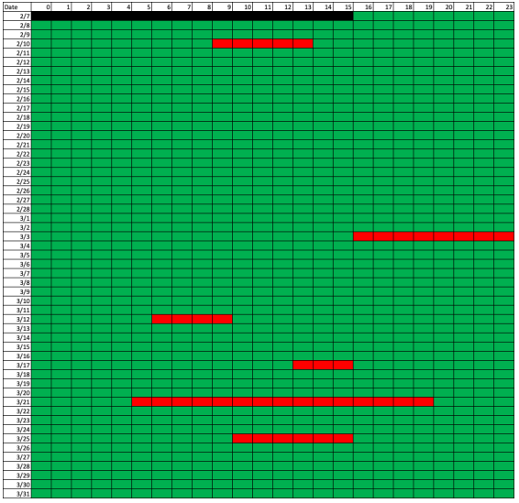
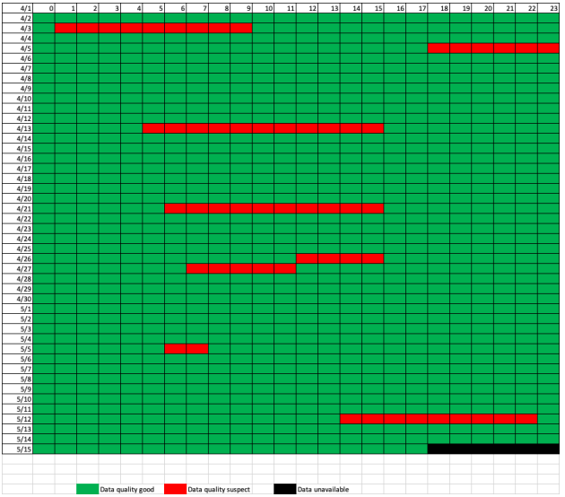
2023
Lake Village: 33.36354N, 91.262W
CLAMPS2 Stare
IOP1
IOP5
IOP2
IOP3
IOP4

Slide 4
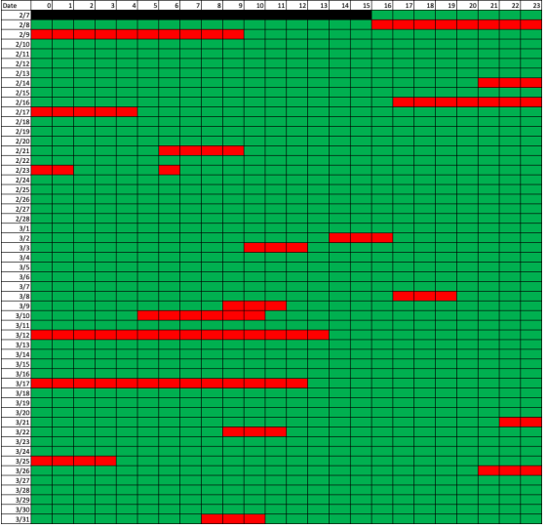
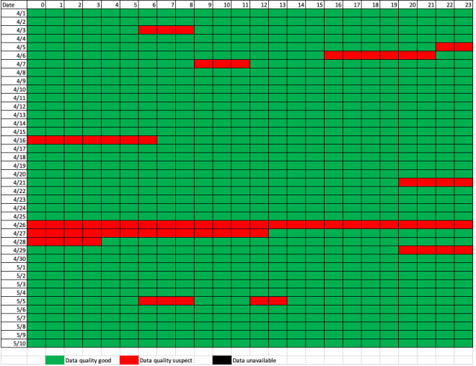
2023
Lake Village: 33.36354N, 91.262W
CLAMPS2 MWR TROPoe
IOP1
IOP5
IOP2
IOP3
IOP4

Slide 5
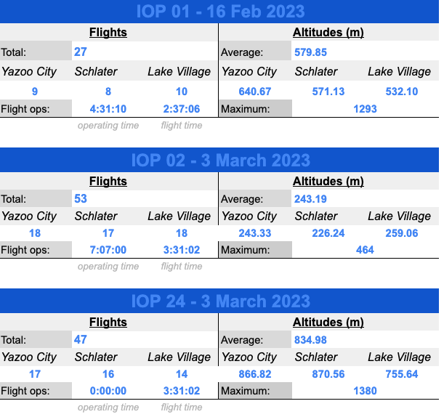
2023
Coming REALLY soon to data archive!

Slide 6
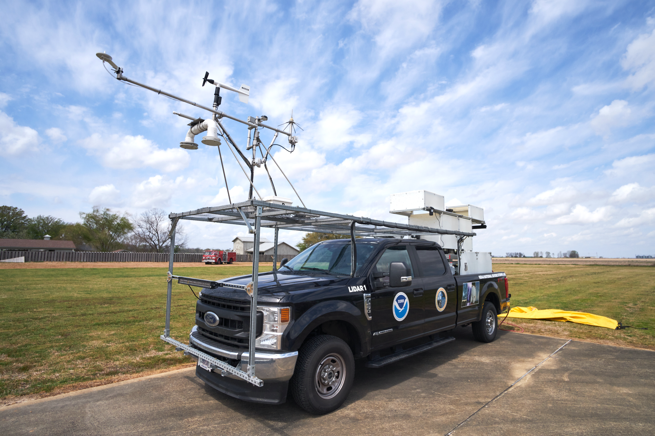
2023 NSSL lidar Truck
Halo Photonics Streamline XR+ Doppler lidar
~ 12 km range (depending on aerosol properties), but typically 1-2 km in vertical (in cloud & precip. free conditions)
Bandwidth +/- 38 m s⁻¹
8-pt VADs every 5 minutes with vertical stares in between, with 30-m range gates
Deployed for all 5 IOPs near center to southeast portion of the radar config.
Started ~t₀ – 4 h and ending as precip. overtakes location (or meso approached as in IOP4)
Data mostly complete (outside precip./fog/etc.) except for last ~2 h of IOP4 (user error ☹)
Released Windsonds within 1-h of convection, as frequently as every 3-min
Data still in the queue to be QC’ed

Slide 7
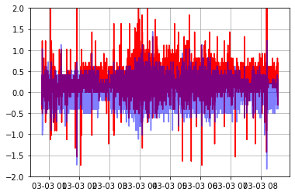
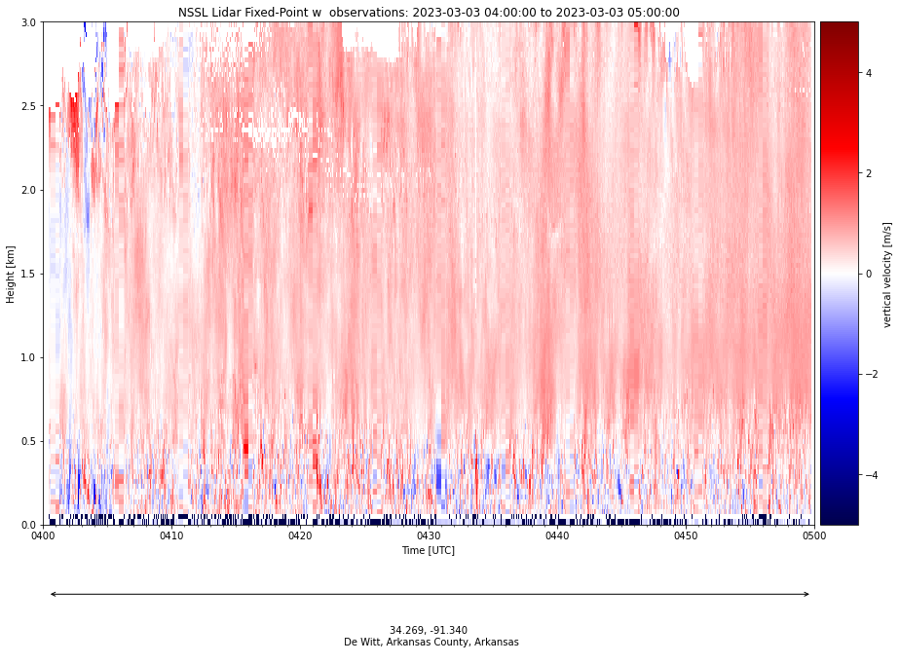
2023 Lidar Truck … data processing ongoing
Issue: Persistent + or - w fields superimposed on reasonable measurements
Source: Likely issues with lidar leveling (mechanical, user-based, or extreme broad-side winds)
Solution: Pitch/roll corrections; different for every deployment. Work ongoing
Pitch Roll

Slide 8
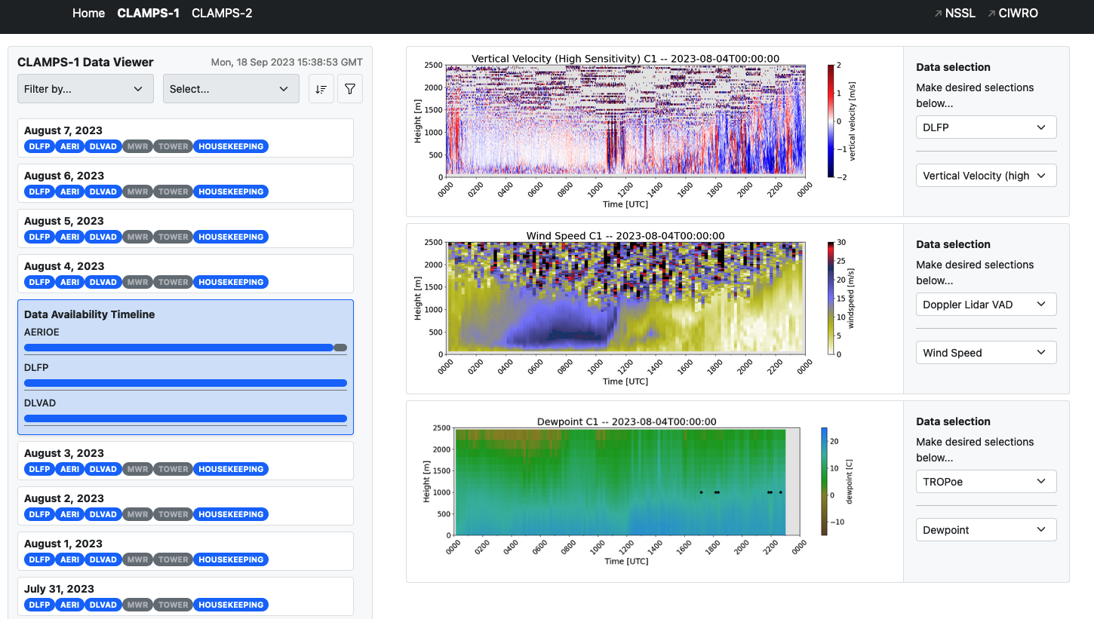
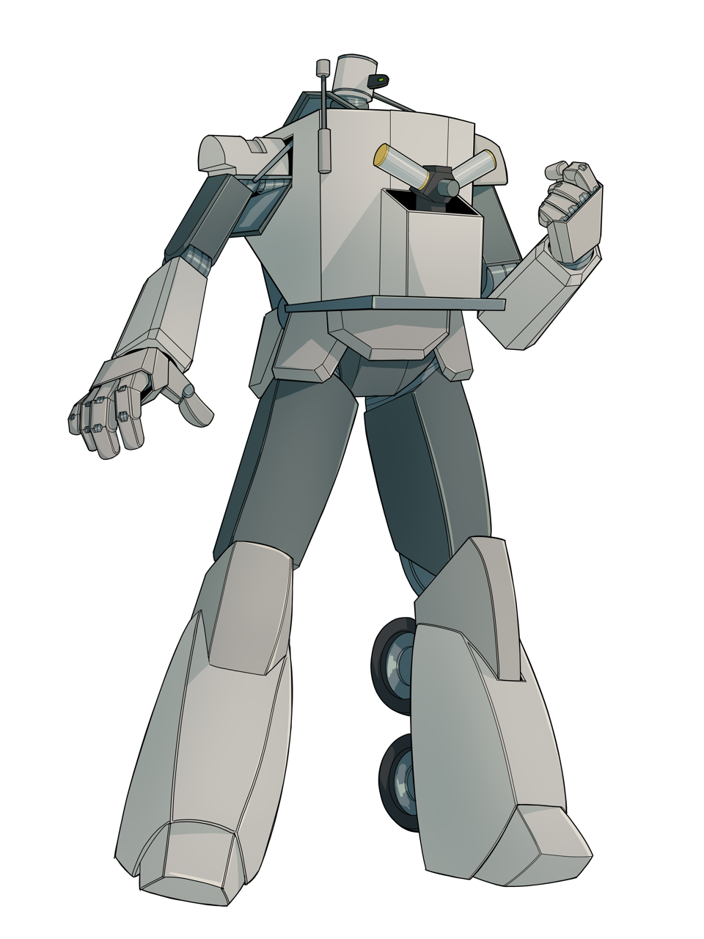
CLAMPS
Web Access
Data Viewer
THREDDS
Data Access
https://apps.nssl.noaa.gov/CLAMPS/data/
Created by OU UG Victor Alvarez
Get started using our data with tools at bliss.science/resources/code

