Slide 1
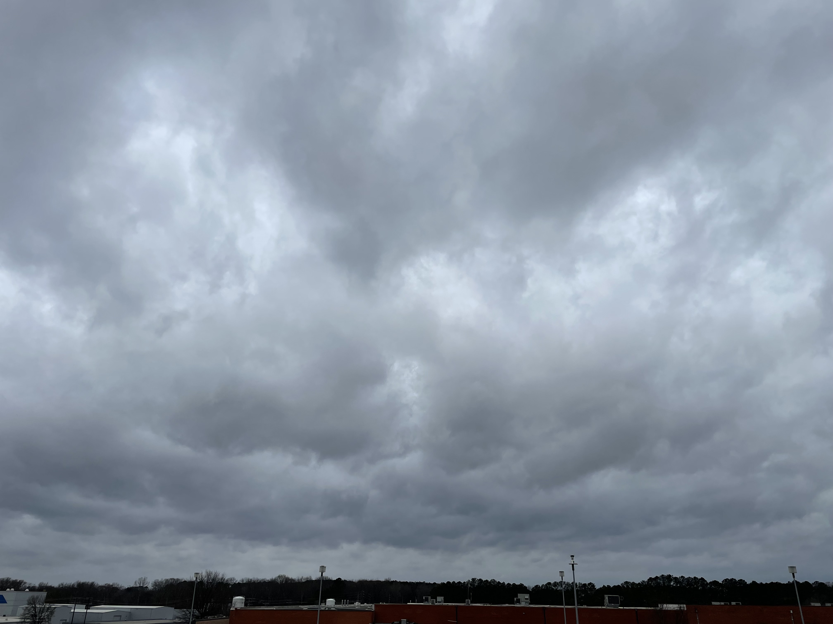
PERiLS workshop, 16 Nov 2023
Observed Low-Level Cloud and Related Boundary Layer Characteristics Preceding Severe Cold-Season QLCSs over Northern Alabama
Kevin Knupp, Timothy Coleman, and Matthew Starke
Severe Weather Institute – Radar and Lightning Laboratories
Department of Atmospheric and Earth Science
Earth System Science Center
University of Alabama in Huntsville

Slide 2
Brief Background and Motivation
1. NWP within the SE cool-season environment has been challenging (Cohen et al. 2015)
High-Shear, Low CAPE (HSLC): Marginal CAPE, Large wind shear
Rapid environmental changes, boundary layer in particular (King et al. 2017)
Incomplete knowledge of boundary layer processes and structure, HSLC in particular
2. Characteristics of Sc clouds and associated PBL in HSLC environments have not been fully explored
Premise: Sc clouds play an important role in, and provide insights on, BL processes.
→ The diurnal cycle of near-surface temperature (θ_{e}) variation is diminished.
Premise: The PBL within cool-season HSLC environments is typically statically stable ($\frac{∂θ}{∂z}>0),$ even during daytime. As a result, vertical wind shear is greater than that observed in traditional mixed layers ($\frac{∂θ}{∂z}≈0)$, since buoyant production would serve as a sink in production of TKE.
3. This study is one of the basic components of our work on PBL temporal and spatial variability.
New research thrust on the Rain-Induced Transition (RIT, Matthew Starke), with similar physics to the AET.

Slide 3
Features of interest within the Pre-QLCS PBL
a) Plan view
b) Vertical section
NW
Vertical section
QLCS
QLCS
WRS
15
30
>45
Pre-QLCS PBL
Leading stratiform
RW
J
f_{c} ~ 90%
Pre - QLCS PBL
SE
DZ
H_{cb} ~ 700 m
QLCS
Propagation
NW
Max T, T_{d}
SE
QLCS Propagation
Sc cloud layer
Stratiform rain patches
Features of interest include:
Precipitation ahead of the QLCS
Leading stratiform
Stratiform patches
Showers (RW) and Wave Reflectivity Segments (WRS)
Sc cloud layer
Cloud fraction (f_{c}) – mean value is ~90%
Cloud base height (H_{cb}) – mean value is ~700 m AGL
Mesoscale variability in both f_{c} and H_{cb}

Slide 4
Primary objectives
Define the characteristics of stratocumulus (Sc) clouds in the HSLC environment
Cloud fraction
Cloud base height
Characterize the boundary layer properties preceding cool-season QLCS’s
BL depth
BL stability
Rapid evolution and spatial heterogeneity
Relation to Sc cloud characteristics
Serves as on starting point for characterization and improved understanding of BL spatial and temporal variability in this complex, marginal, but yet sometimes very potent, environment.

Slide 5
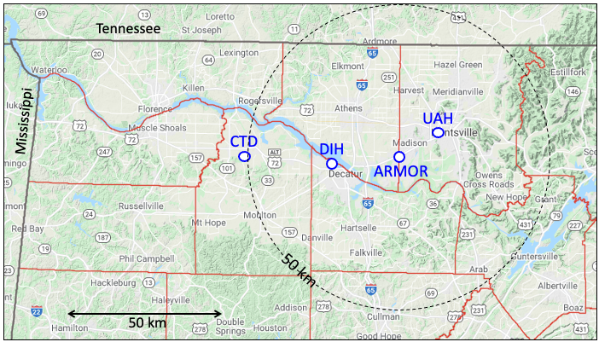
Data sources and locations
Location: Northern Alabama
UAH – primary location
CTD, DIH – supplemental locations
Data sources:
Lidar Ceilometer (Vaisala CL51) ✓
Doppler lidar (Halo Streamline) ✓
Balloon soundings (iMet-4, Windsond) ✓
ARMOR C-band radar ✓
915 MHz wind profiler
Microwave radiometer
Surface data (T at 0.5, 1, 2, and 10 m; wind at 10 m) ✓
Photos (IPhone 12, Roundshot) ✓
Pics of MAPNet instruments
Map of instrument locations
Prof
+
+
CSAPR
+
SACR
Central Fac
+
Prof
+ Prof
AMF3 additions
Total number of cases: 53 (2005-2022), Nov – mid-March
→ full spectrum: null cases to regional tornado outbreaks
MIPS – Mobile Integrated Profiling System
RaDAPS – Rapidly Deployable Atmospheric Profiling System
MoDLS – Mobile Doppler Lidar and Sounding system
MAX – Mobile Alabama X-band dual polarization radar

Slide 6
Primary cases (selected from 53, based on comprehensive data available). Listed in chronological order
Case 1: 6 November 2018 (Meso18/19)
Abundant tornado reports within the region
Long period of Sc (>12 h) observations
f_{c} = 100%, H_{cb} = 620 m
Stable (0.57), middle of nocturnal period
0-1 km bulk shear = 26 m s⁻¹, SRH = 420 m² s⁻², CAPE = 200
Case 4: 27 March 2021
Wind damage reports, unconfirmed tornadoes
Short period (4 h) of Sc observations, nocturnal formation
f_{c} = 95%, H_{cb} = 650 m
Weakly stable (0.08), middle of nocturnal period
0-1 km bulk shear = 22 m s⁻¹, SRH = 370 m² s⁻², CAPE = 760

Slide 7
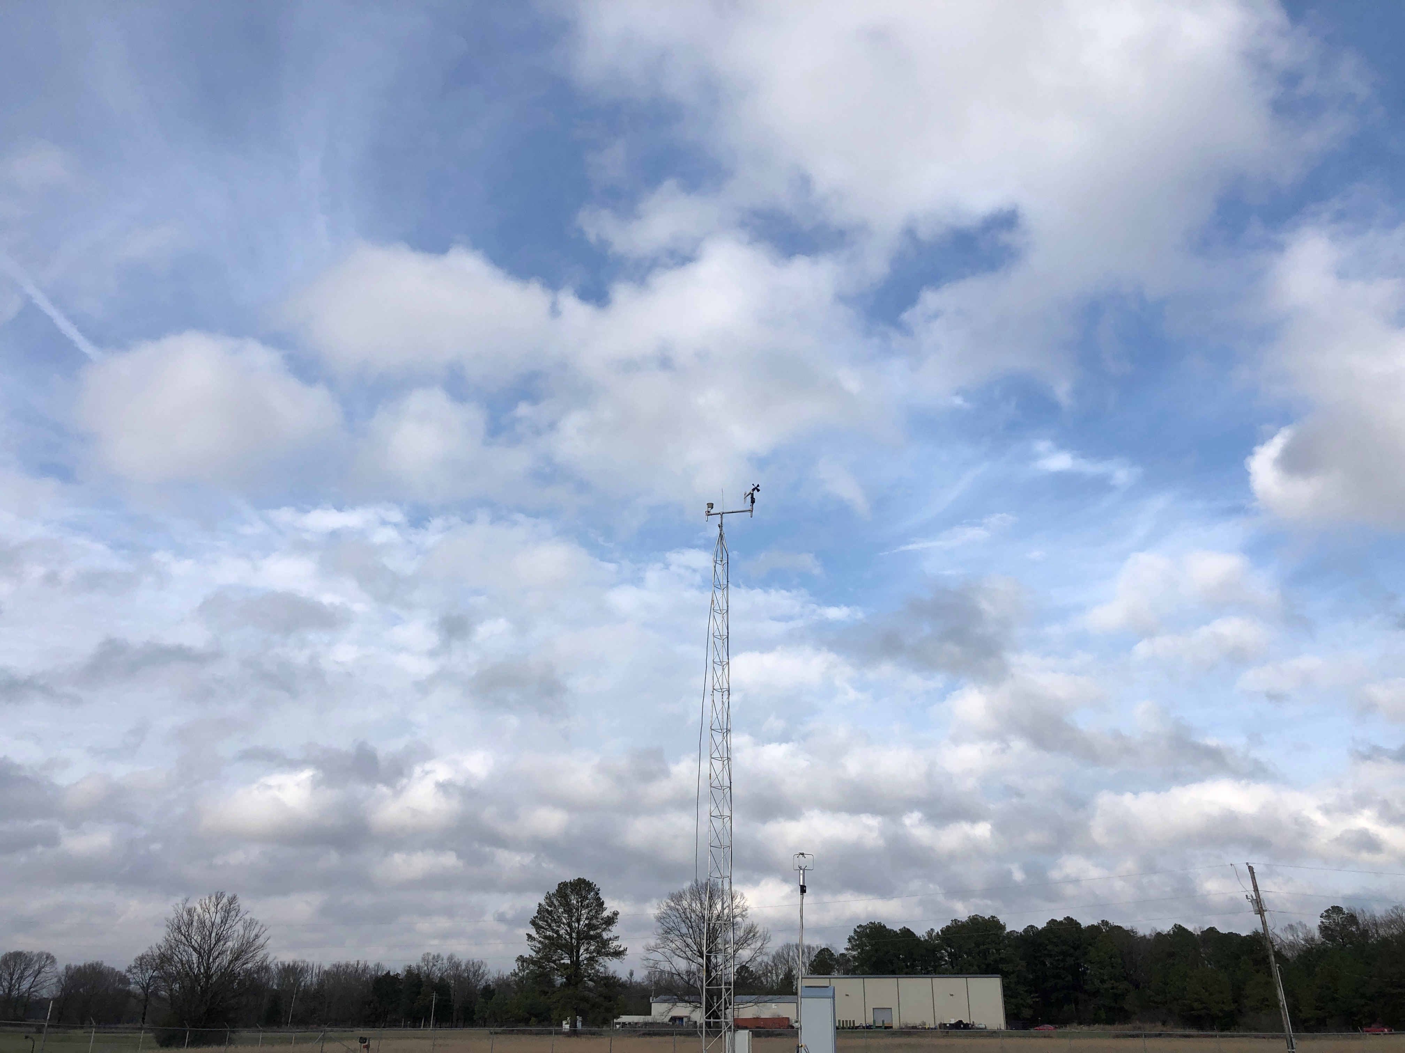
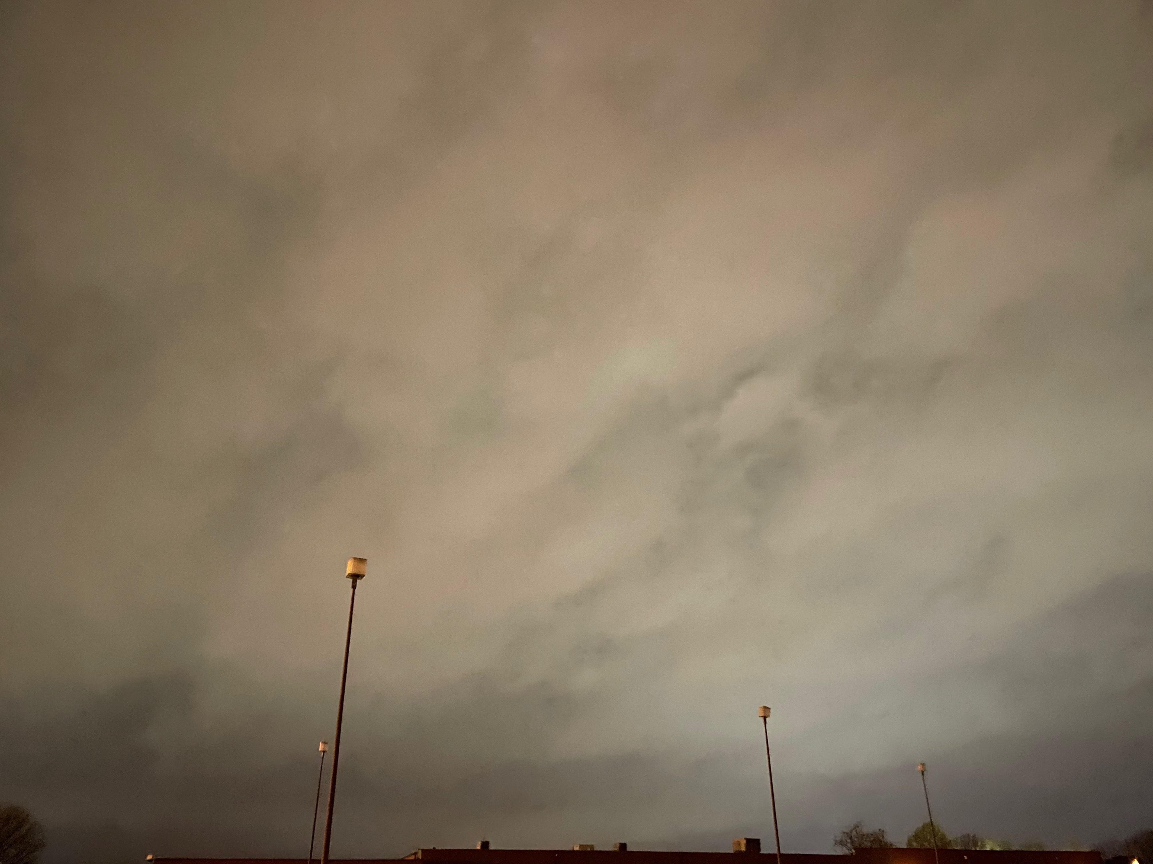
a) 2146 UTC, 2/12/20
b) 0824 UTC, 3/27/21
Sc cloud appearance
(3 cases)
Case with low f_{c} (~20%), highly sheared. Unusual case with low f_{c}.
Nocturnal formation of Sc layer.
Sc clouds revealing mesoscale structure.
a) 2146 UTC, 2/12/20
b) 0824 UTC, 3/27/21
H_{cb} = 500 m, f_{c} = 20%, view: NE
H_{cb} = 640 m, f_{c} = 100%, view: WNW
CTD
H_{cb} = 640 m, f_{c} = 100%, view: WNW
UAH
H_{cb} = 500 m, f_{c} = 20%, view: NE
CTD
UAH
c) 1530 UTC, 3/7/22
c) 1530 UTC, 3/7/22
Approaching QLCS
H_{cb} = 720 m, f_{c} = 100%, view: SW to NW
UAH
H_{cb} = 720 m, f_{c} = 100%, view: SW to NW
UAH
Figure 4. Photos of Sc clouds for three cases described in Section 5. The lower left-hand numbers define cloud base height (Hcb) and cloud fraction (fc). The lower right-hand characters define the location. The view directions are also annotated.

Slide 8
Distributions from the entire data set
→ surface properties
b) Surface Layer Stability, T₁₀ – T₂ ($℉$)
b) T₁₀ – T₂ (ºF)
unstable
stable
Number of cases
a) Temperature (T) and Dew Point Temperature (T_{d}) at 2 m
a) T, T_{d} (ºF)
<-0.75
0, 0.25
0.25, 0.5
0.5, 0.75
>0.75
-0.75, -0.5
-0.5, -0.25
-0.25, 0
T_{d}
T
Prevalence of stable surface layer (only 5 unstable cases)
Number of cases
c) Wind speed at 10 m, V₁₀*
* V₁₀ is based primarily on large z₀ around UAH campus (25% less than KHSV)
<58
58-60
60-62
62-64
66-68
68-70
70-72
72-74
>74
c) V₁₀ (m s⁻¹)
64-66
Mean T = 69 F
Mean T_{d} = 63 F
Number of cases
Figure 5. Statistics of surface conditions derived from the 53 case data set. (a) Temperature (T, orange) and dewpoint temperature (T_{d}, blue). (b) Surface layer stability, expressed as the difference between temperature at 10 and 2 m. (c) Wind speed at 10 m. All are based on 30 minute averages during the 30-60 min time interval before QLCS arrival.
<3
3-4
4-5
5-6
6-7
7-8
8-9
>9
Mean V₁₀ = 5.5 m s ⁻¹

Slide 9
Distributions from the entire data set
→ cloud properties
Fractional cloud cover (f_{c}) shows prevalence of overcast cases. Mean f_{c} = 79%, Median f_{c} = 93%
b) Fractional cloud cover, f_{c}
Mean: 79%
Median: 93%
Time of arrival shows nearly uniform distribution, 32/49 cases occurred in dark conditions.
Number of cases
a) Time of QLCS arrival
night
day
0-20
20-40
40-60
60-80
80-90
>90
f_{c} (%)
Number of cases
Cloud base height (H_{cb}) distribution is close to normal: mean = 696 m, median = 659 m
23-02
02-05
05-08
08-11
11-14
14-17
17-20
20-23
Time (UTC)
c) Cloud base height, H_{cb}
Mean: 696 m
Median: 659 m
Number of cases
<2
2-4
4-6
6-8
8-10
10-12
>12
H_{cb} (x10² m)

Slide 10
Cloud base vs. LCL (SP) height
Averages for the entire data set, H_{cb} vs. H_{sp}
$$\left\langle Hcb \right\rangle =670 m$$
$$\left\langle Hsp\right\rangle =450 m (LCL)$$
$$Generally, Hcb ≥Hsp$$
The difference, $\left(\left\langle Hcb\right\rangle −\left\langle H_{sp}\right\rangle \right)≈220 m,$ is common for cloud-topped mixed layers – continental and maritime (Jones et al. 2012).
a)
〈H_{cb}〉
1:1 line
〈H_{sp}〉
46
Outlier example: point 46 from 12/30/21 (H_{cb} = 1.3 km, H_{sp} = 0.12 km) corresponds to a case that is not surface rooted. The warm sector did not extend downward to the surface.

Slide 11
Surface layer and boundary layer stability
Surface layer
Boundary layer
Average lapse rate, 0 - 500 m (balloon soundings)
r = 0.35
〈T₁₀-T₂〉
Date | Range of sounding times (UTC) | Fraction of Γ_{d}
11/6/2018 | 0500-0730 | 0.73
2/12/2019 | 1000-1130 | 0.68
2/12/2020 | 2100-2400 | 0.75
3/28/2021 | 0600-0830 | 0.79
12/11/2021 | 0730-1300 | 0.88
3/7/2022 | 1200-1540 | 0.87
Average |  | 0.78
unstable
stable
(H_{cb} – H_{sp}) (m)
〈H_{cb}-H_{sp}〉
Fig. 7b
(T₁₀ – T₂) (ºF)
➤ Average 2-10 m temperature difference: +0.36 F.
➤ Average 0-500 m lapse rate: 0.78 Γ_{d}

Slide 12
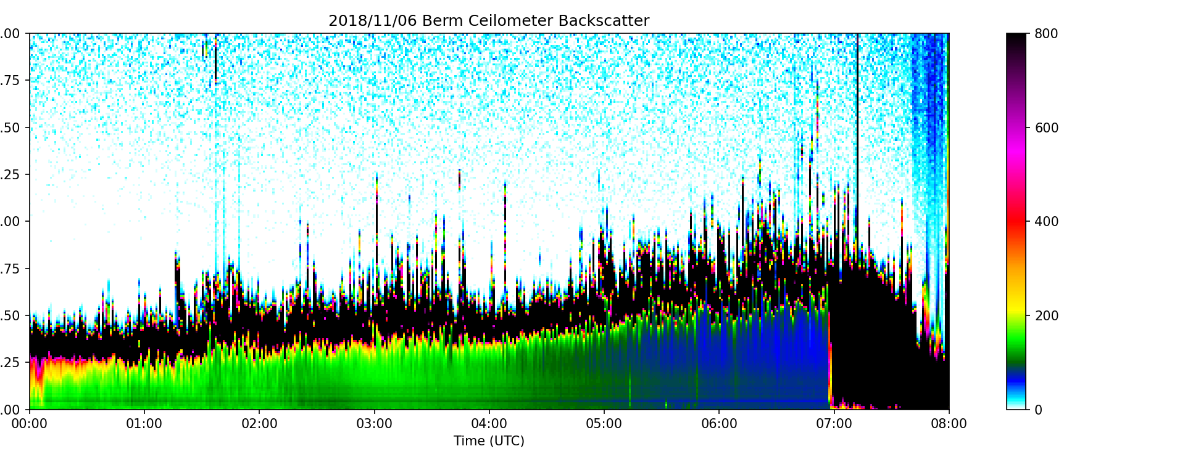
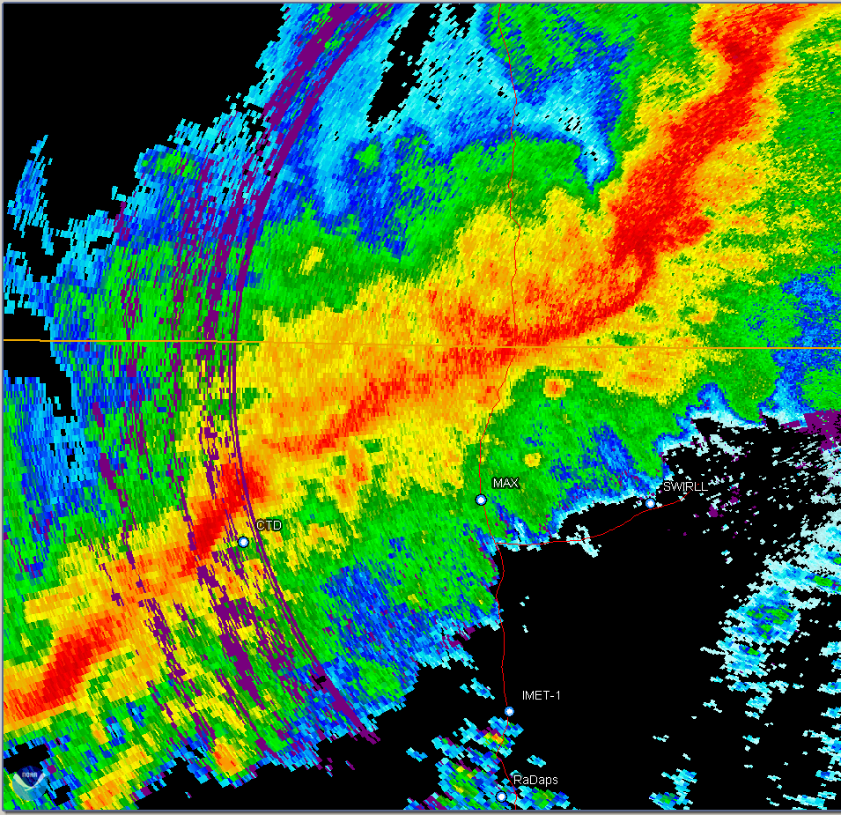
11/6/2018 (MESO)
Long period of Sc (12 h)
Increasing trend in H_{cb}
Rapid reduction in H_{cb} during RIT
2
1
0
Lidar backscatter (ceilo) and H_{sp}
0-500 m lapse rate: 0.73 Γ_{d}
+
+
+
+
+
+
+
+
+
+
+
H_{sp}
+
+
Rain
⚲
⚲
⚲
⚲
⚲
⚲
0642
gust front
⚲
Balloon soundings
Warm
Advection
RIT
UAH
71
67
KHTX

Slide 13
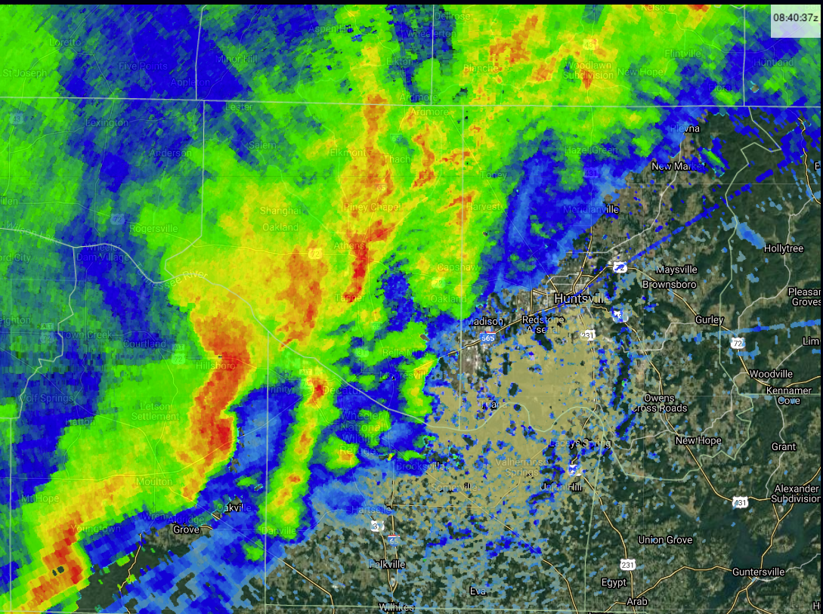
3/27/21
Formation of Sc during the NBL period (0500-0900 UTC)
Sc formed when upward-growing turbulence layer reached the SP (LCL)
The height scale of most turbulent eddies displays limited depth (~ $\frac{1}{3}$ BL depth). Similar structure in other cases.
Sounding displays inversion above top of Sc layer (not usual)
~ 0836 UTC
0824 3/27/21
Greater temporal resolution (1.5 s) resolves Sc elements
Some details of a selected case study
β
General corr between H_{cb} and +w; H_{cb} variation >200 m
~16 min
0840 UTC
w
UAH
500
0736 UTC (UAH)
+
ARMOR
600
700
2nd cloud layer
800
900
Sc layer
h
1000

Slide 14
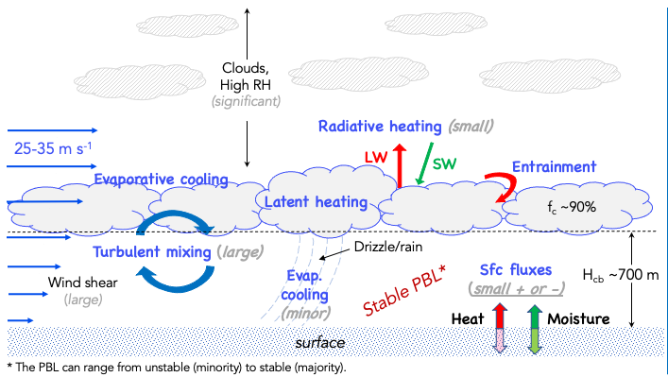
Conceptual model
of warm sector Sc
Differences from maritime Sc under lower wind (shear) conditions:
Lower surface fluxes. Heat flux is often negative.
Presence of clouds and high RH above the Sc cloud layer. → Radiative cooling at cloud top may not be significant.
Greater BL wind and wind shear. → Shear production of turbulence is the primary source of TKE.
Radiative cooling (small)
Adapted from Wood (2012)
Bold blue text represents physical processes.
Thin text depicts atmospheric parameters/conditions.
Shear production of turbulence is significant.
Sub-cloud layer is generally stable.
Sc clouds regulate day-night temperature variation.

Slide 15
Summary/Conclusions
Sc clouds are common ahead of cool-season QLCSs
H_{cb} ~ 670 m
f_{c} ~ 90%
Most cases display a statically stable surface layer and boundary layer, with lapse rate ~0.78 Γ_{d}
Static stability favors stronger vertical shear (greater SRH)
Sc clouds reduce the diurnal T variation → greater number of tornadoes during NBL period
Sc cloud fields commonly exhibit mesoscale variations in depth and f_{c}. The background image shows this.
Shear-induced turbulence is the main driver that maintains boundary layer turbulence and Sc clouds in these cases
Are these “mixed” layers? Perhaps, but not the traditional mixed layer.
Acknowledgement: Funding provided by NOAA Grant NA21OAR4590323

