Slide 1
Relating Polarimetric Radar Measurements to QLCS Cold Pool Properties & Damage Potential
Anna VanAlstine and Matthew R. Kumjian
Department of Meteorology & Atmospheric Science, The Pennsylvania State University
Cold Pool Development:
Hypotheses:
Estimates of specific attenuation (A_{H}) are a polarimetric radar proxy for cold pool strength.
Estimates of A_{H} and A_{H} – differential reflectivity (Z_{DR}) separation vectors provide information on the sources of horizontal vorticity that are thought to be important for tornadogenesis.
All processes affecting negative buoyancy production (i.e. evaporation, melting, and precipitation loading) are related to hydrometeors in the storm.
Funding from:
NOAA/VORTEX-USA Award NA21OAR4590151

Slide 2
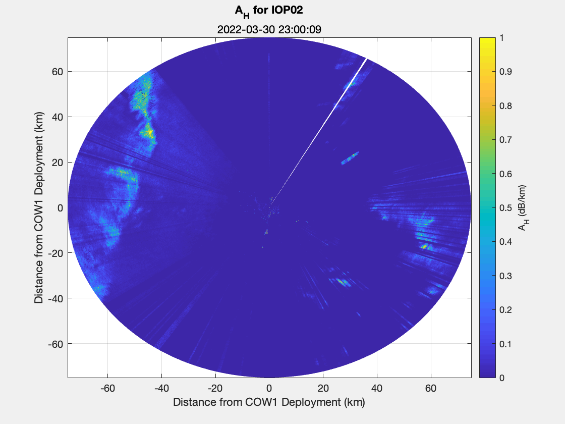
Specific Attenuation As Proxy For Cold Pool Strength
Specific Attenuation (A_{H}): extinction of radar signal power (per unit distance) through areas of precipitation
Caused by absorption and scattering of microwave radiation by hydrometeors
Raindrops << $λ$ → “absorption loss” dominates
signal loss $∝$hydrometeor concentration
For raindrops $≡$ rain rate
More closely related to hydrometeor mass
Mass of storm precipitation $∝$ amount of negative buoyancy production
Radar-estimated specific attenuation field is nearly a linear function of rain rate
∴ Illuminates cold pool strength

Slide 3
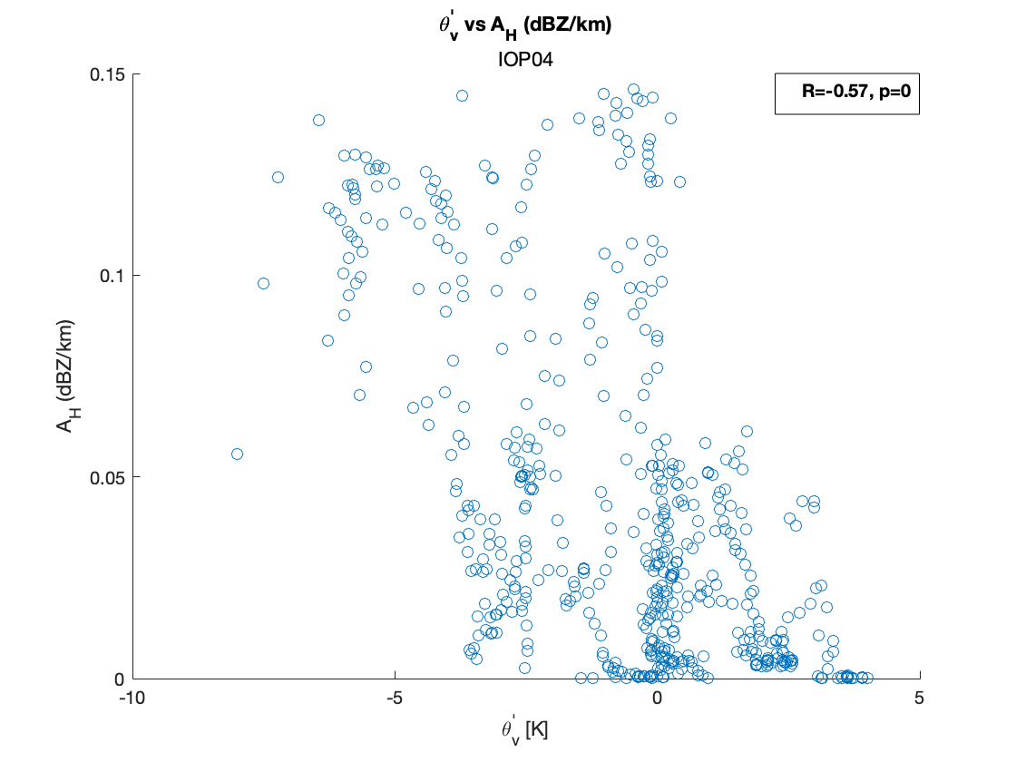
Radar-estimated A_{H} field is negatively correlated with $θ_{v}^{′}$in storm cold pools
Relationship between $A_{H}$ & Virtual Potential Temperature Perturbations ($θ_{v}^{′}$)

Slide 4
A_{H} – Z_{DR} Separation Vector
Radar-estimated A_{H} – Z_{DR} enhancement region separation vector correlated with mean storm-relative winds over the lowest few km, analogous to the Loeffler & Kumjian (2018) Z_{DR} – K_{DP} separation vector.

Slide 5
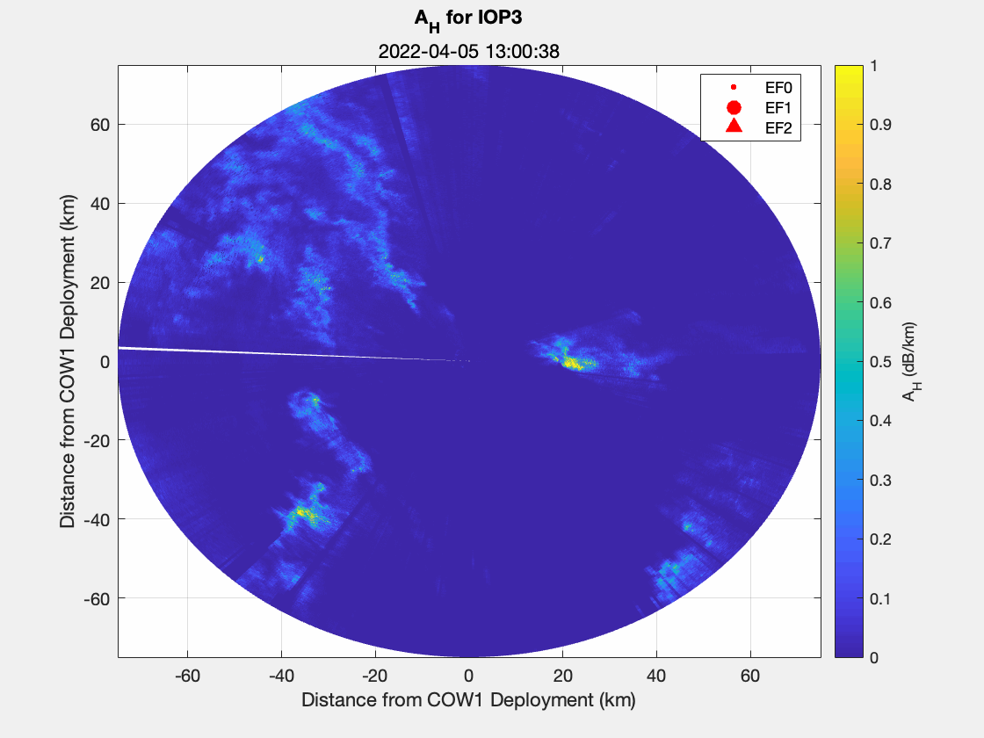
A_{H} and Damage Potential
Both the A_{H} field and the A_{H}-Z_{DR} enhancement region separation vector are related to sources of horizontal vorticity:
environmental horizontal vorticity associated with vertical wind shear
baroclinic vorticity generation along the gust front
These radar-based metrics could indicate favorable conditions for tornado development, providing advance notice.
Future work to include analysis of variations in time and space of separation vectors for all IOPs.

