Slide 1
The rain-induced boundary layer transition in QLCSs
Matthew Starke and Kevin Knupp
2023 Nov 16

Slide 2
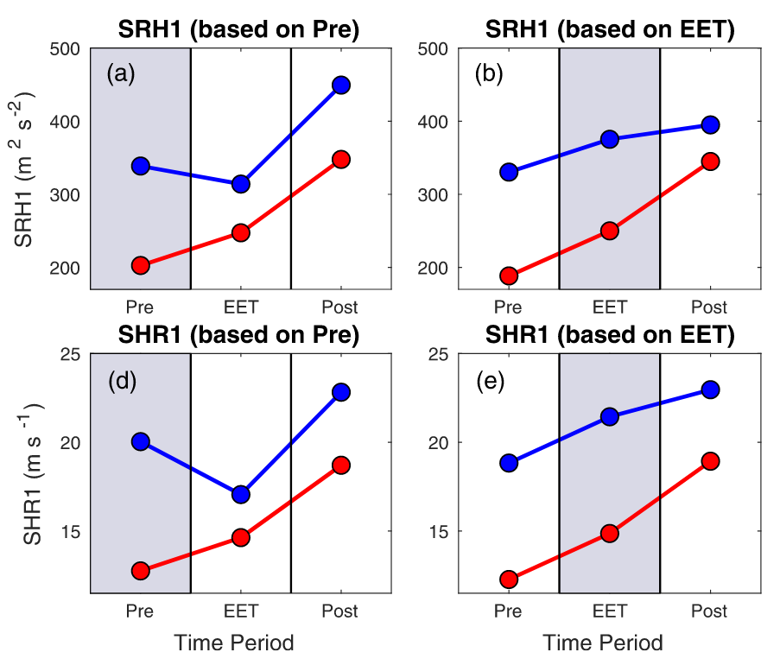
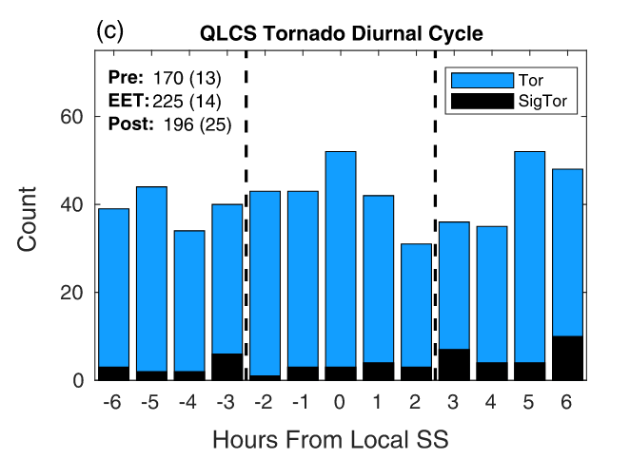
Background
The AET, a phenomenon related to the RIT, can cause rapid increase in SRH ahead of a QLCS (Brown et al, 2021).
Tornadogenesis is statistically more likely around sunset due to the AET.
The AET is gradual in comparison to the RIT - it is likely that the RIT can have a similar but more rapid effect.

Slide 3
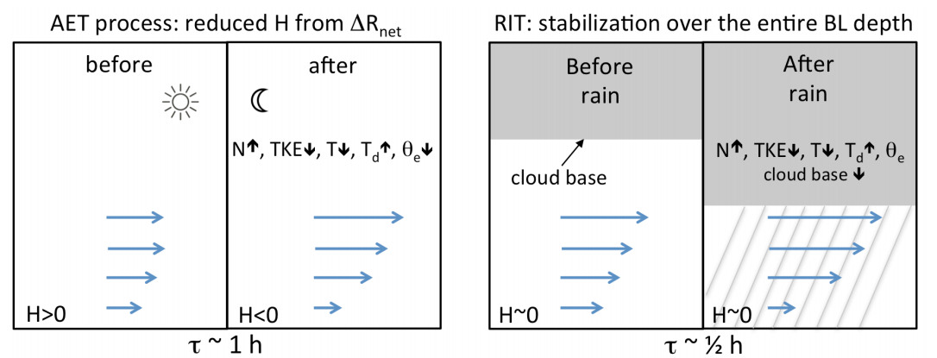
Processes
Primary research questions:
Under what conditions does pre-QLCS rain result in convective stabilization great enough to preclude tornadogenesis?
Under what conditions does pre-QLCS rain result in an increase in PBL shear great enough to be the cause of tornadogenesis?
Weak CIN in storm inflow
Low LCL in storm inflow
(Grams et al. 2012)
Increase in potential for tornadogenesis
(Markowski et al. 2003)
Stratiform precipitation in inflow
(Pangle et al. 2019)
Lowering of cloud base
Increase in SL SRH
(Coffer et al. 2019)
Wet-bulbing
(θ_{e} constant)
Increase in vertical shear
Differential evaporational cooling
Static stabilization
Cessation of turbulent mixing
Stratification of momentum
(Mahrt 1981)

Slide 4
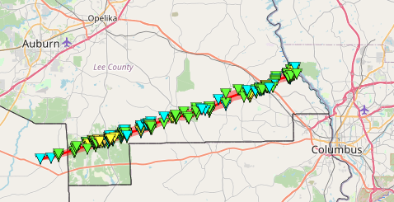
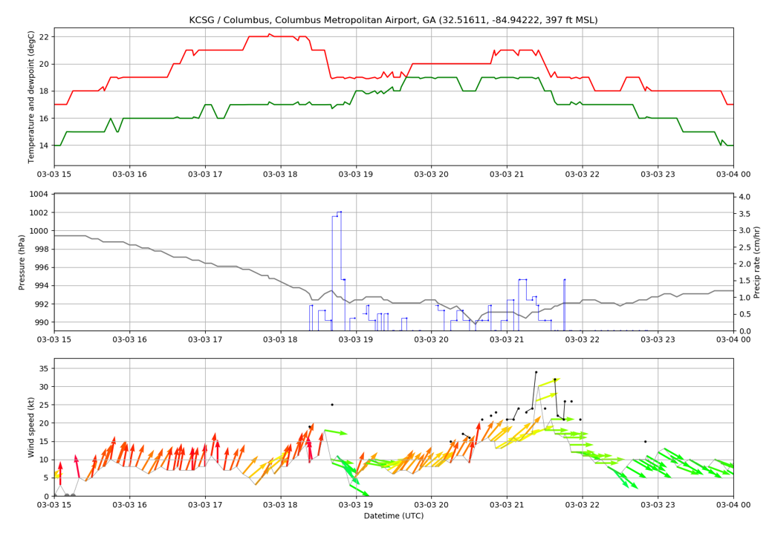
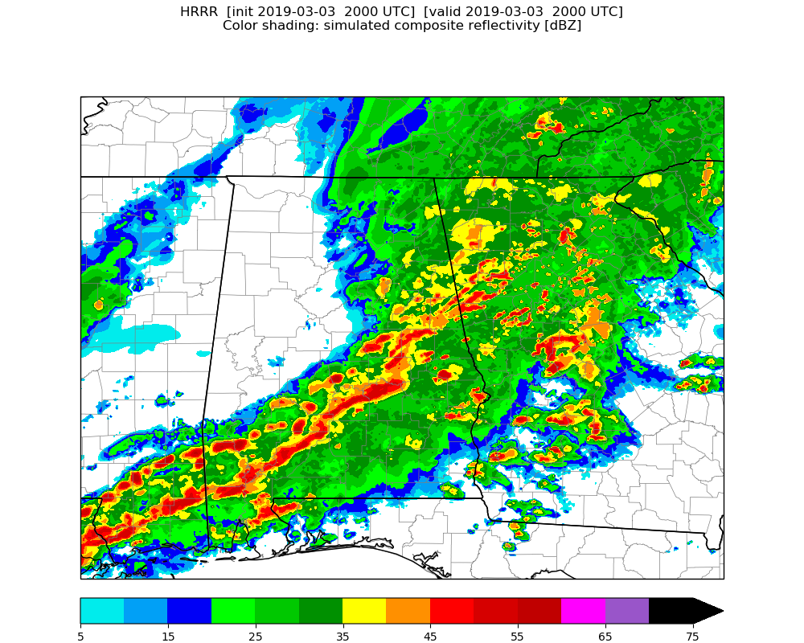
Example - 2019 Mar 03
KCSG
From NWS BMX
March 3, 2019 - Smiths Station/Beauregard, AL
(image showing tor path)
(surface plots showing rain prior to torgen)
(loop showing extent of stratiform)
(loop showing echo tops)
Genesis
Dissipation
State line
Veering at onset of rain
Subsequent backing

Slide 5
Example -
2019 Mar 03
KCSG

Slide 6
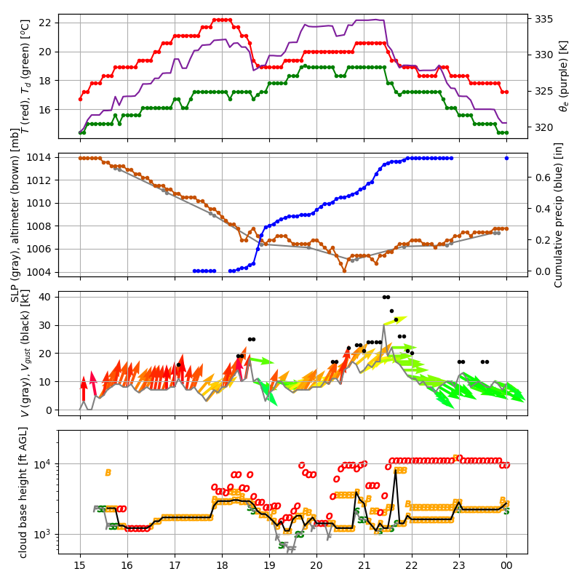
Example -
2019 Mar 03

Slide 7
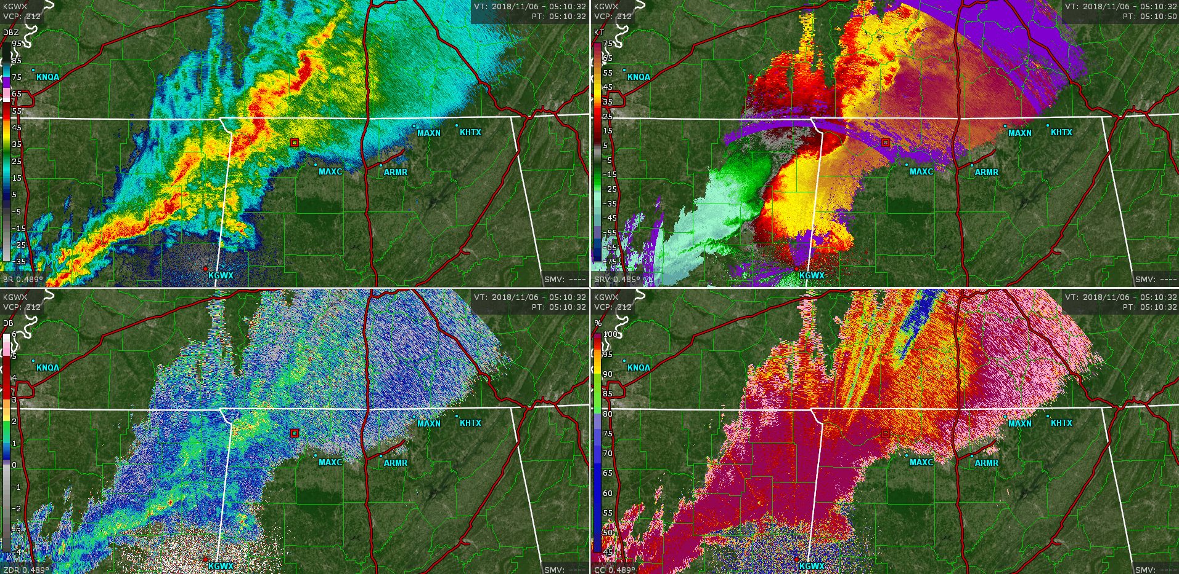
2018 Nov 06

Slide 8
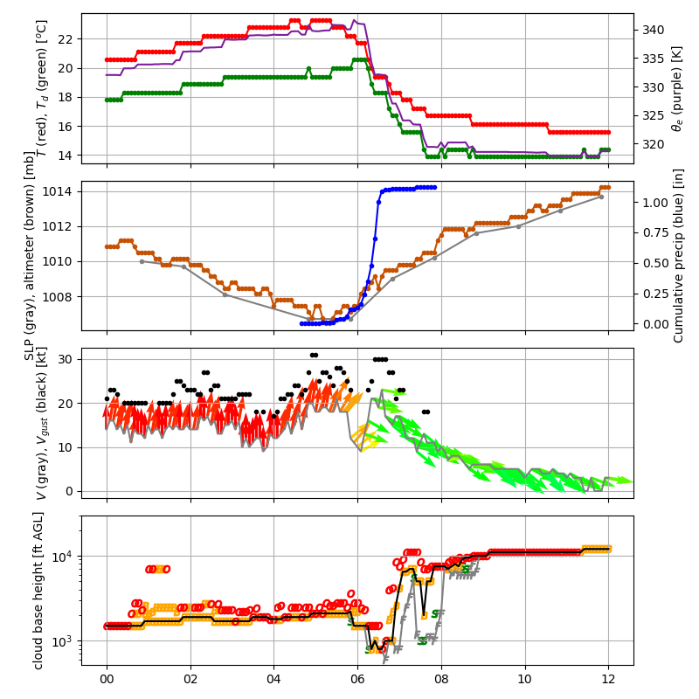
2018 Nov 06

Slide 9
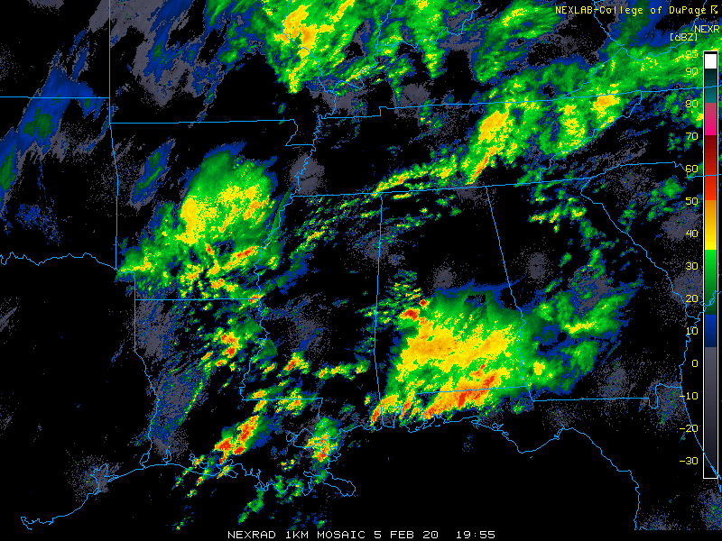
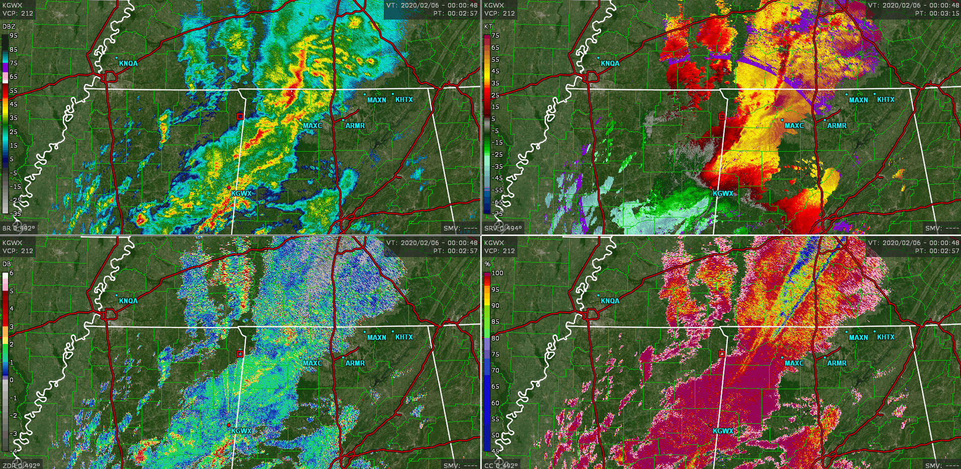
2020 Feb 05-06

Slide 10
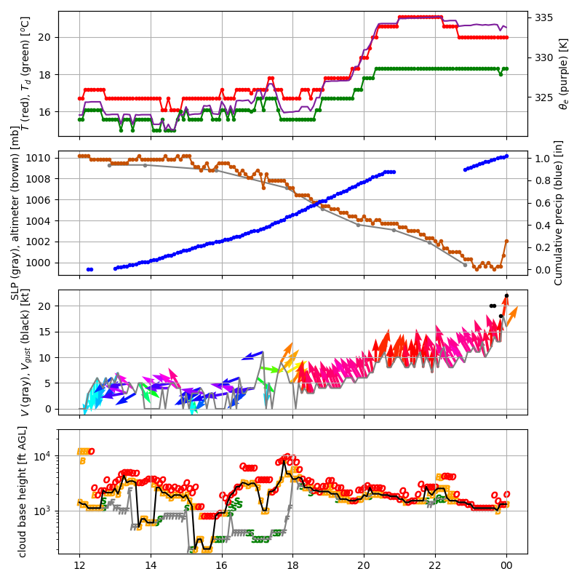
2020 Feb 05-06

Slide 11
Methods
The plan is to perform more detailed analyses of each of these cases and several PERiLS cases:
2018 Nov 6 (NW AL – mild stratiform)
2019 Mar 3 (Lee County – extensive stratiform, many embedded TOR SCs)
2020 Feb 5 (decent stratiform)
2022 IOP 1 (Brooksville, MS – mild stratiform)
2022 IOP 2 (Amory, MS – decent stratiform, some embedded cells)
2022 IOP 3 (Selma, AL – extensive stratiform, heavy, many embedded SVR SCs)
2023 IOP 1 (Brooksville, MS – extensive coastal convection)
2023 IOP 4 (TN Valley – mild stratiform)
The analysis will use primarily RWP and DWL data, since the focus is on changes in the wind profile.

Slide 12
