Slide 1
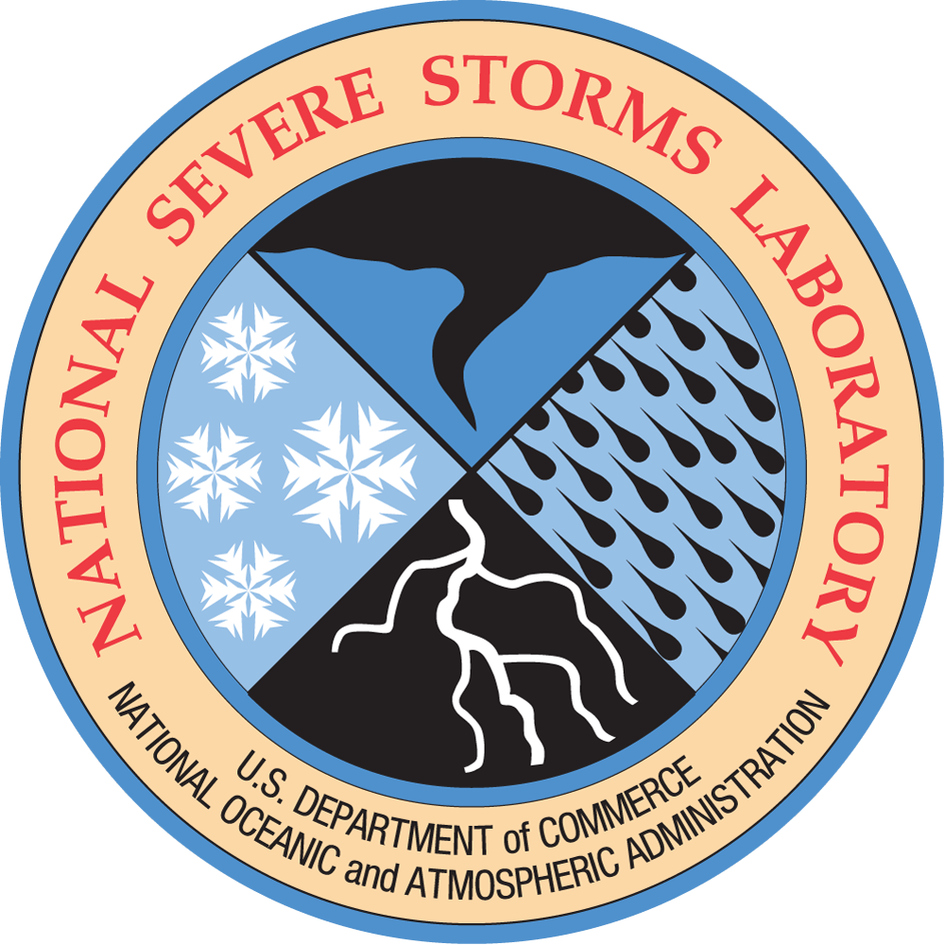
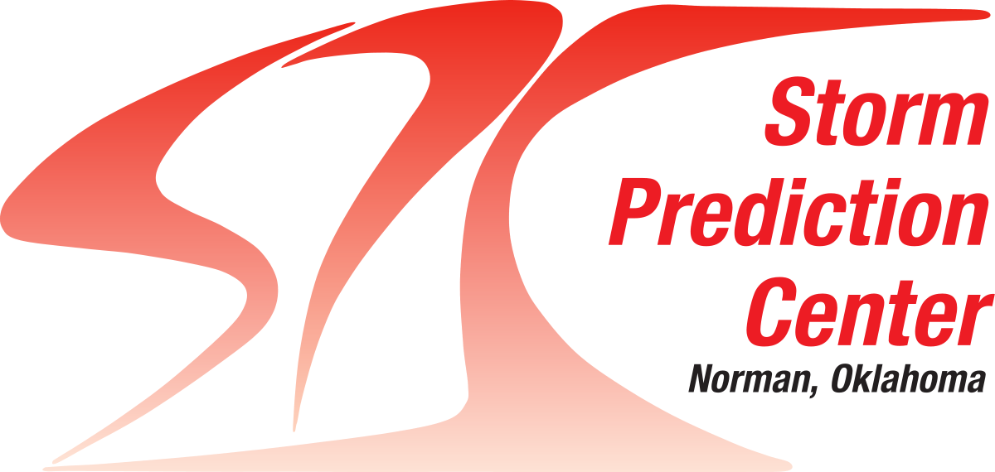
Creation of a Comprehensive Sounding and Tornado Dataset from Recent Southeast Field Campaigns
Lauren Pounds^{1,2,3}, Matthew Flournoy^{4,1,2}, and Mike Coniglio^{3,1}
¹ School of Meteorology, University of Oklahoma, Norman, Oklahoma
² Cooperative Institute for Severe and High-Impact Weather Research and Operations, The University of Oklahoma
³ NOAA/OAR/National Severe Storms Laboratory, Norman, Oklahoma
⁴Storm Prediction Center, Norman, Oklahoma
Funded through NA23OAR4590344
PERiLS Science Meeting
Memphis, TN
16-17 November 2023

Slide 2
Our research goals include…
1. Relating sounding parameters to observed storm evolution
2. Understanding how those sounding parameters evolve in the vicinity of convection

Slide 3
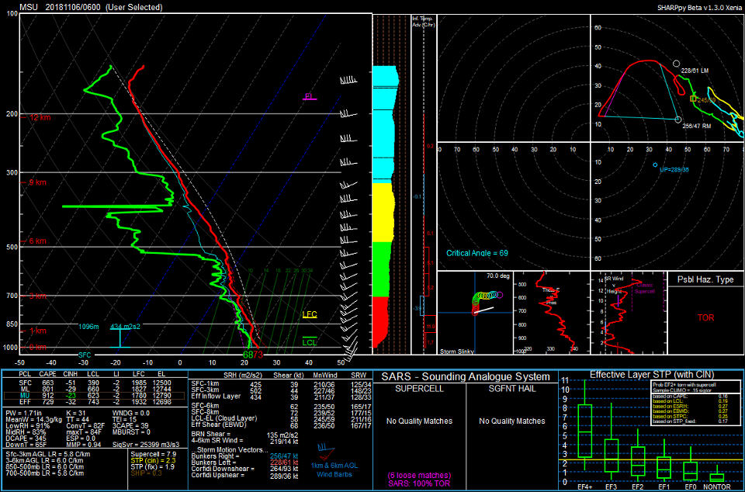
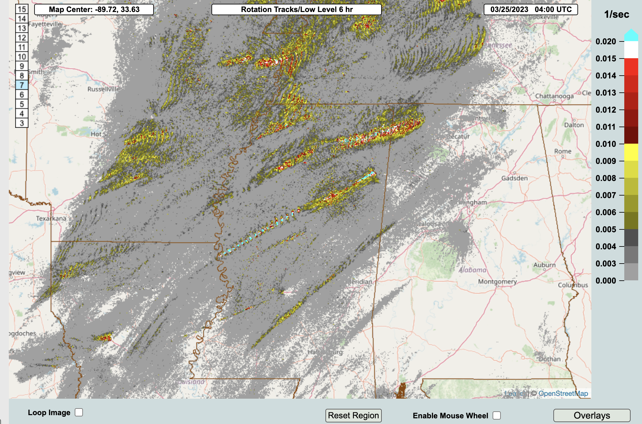
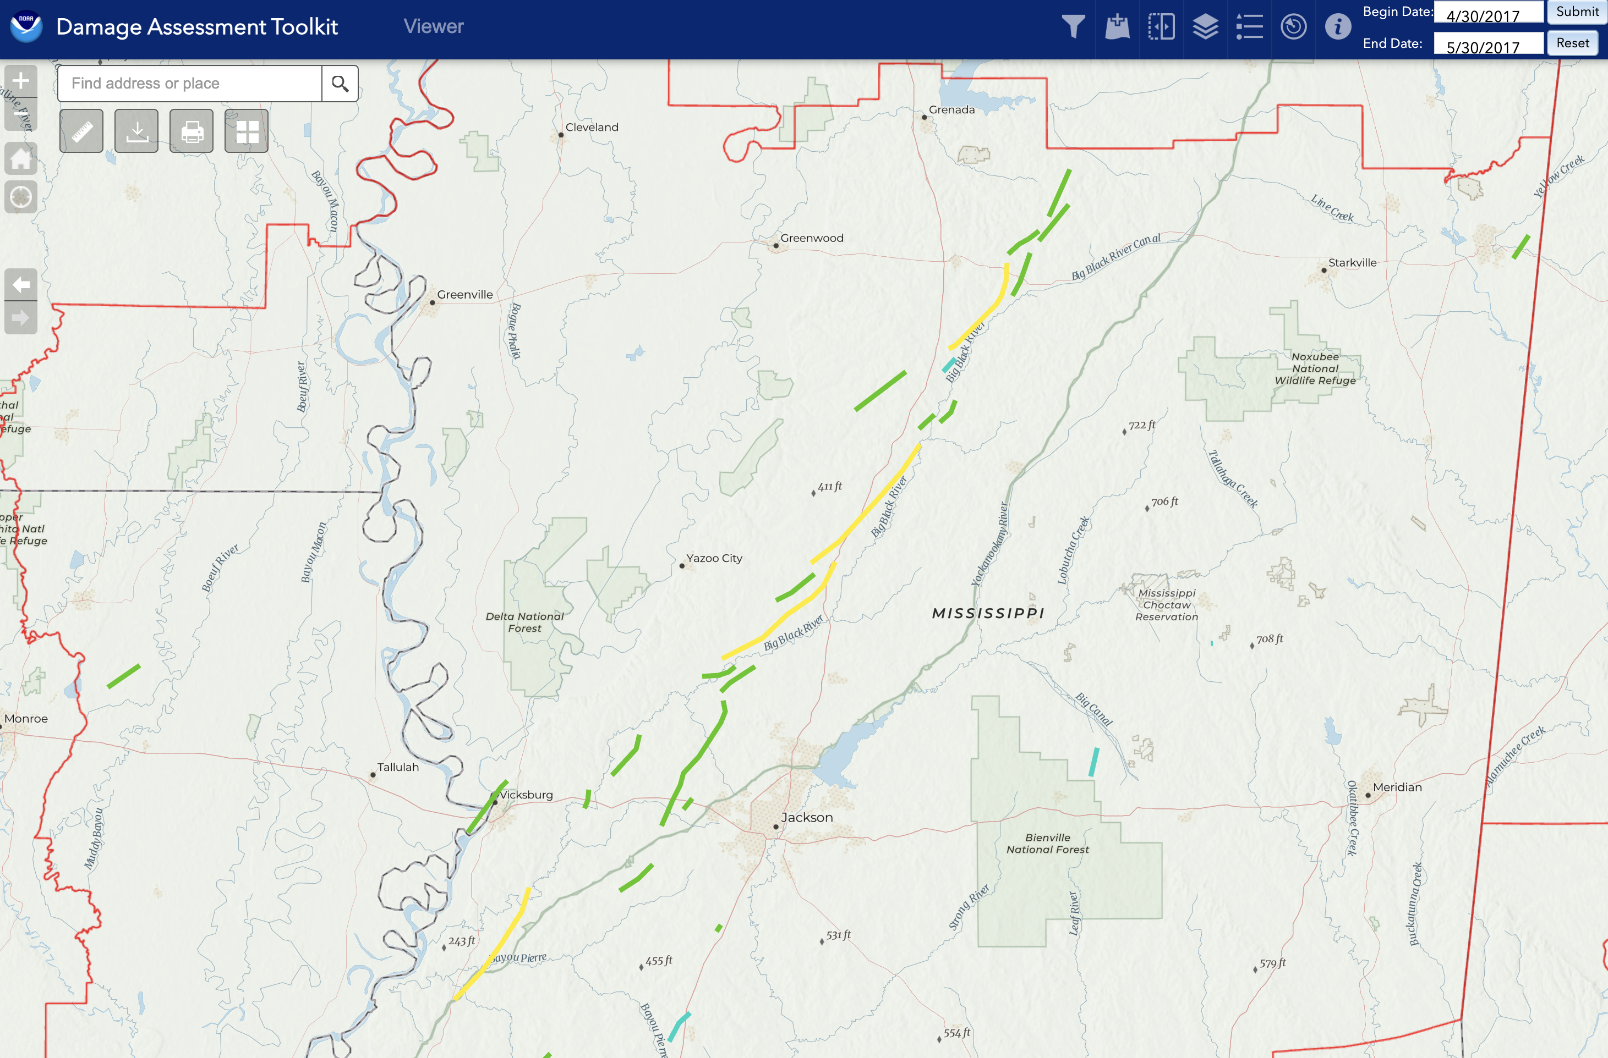
We plan to address these goals using…
All the relevant VORTEX-SE, meso18-19, and PERiLS soundings
Multi-Radar Multi-Sensor (MRMS) Az-shear and reflectivity products
Tornado survey information from OneTor and the DAT

Slide 4
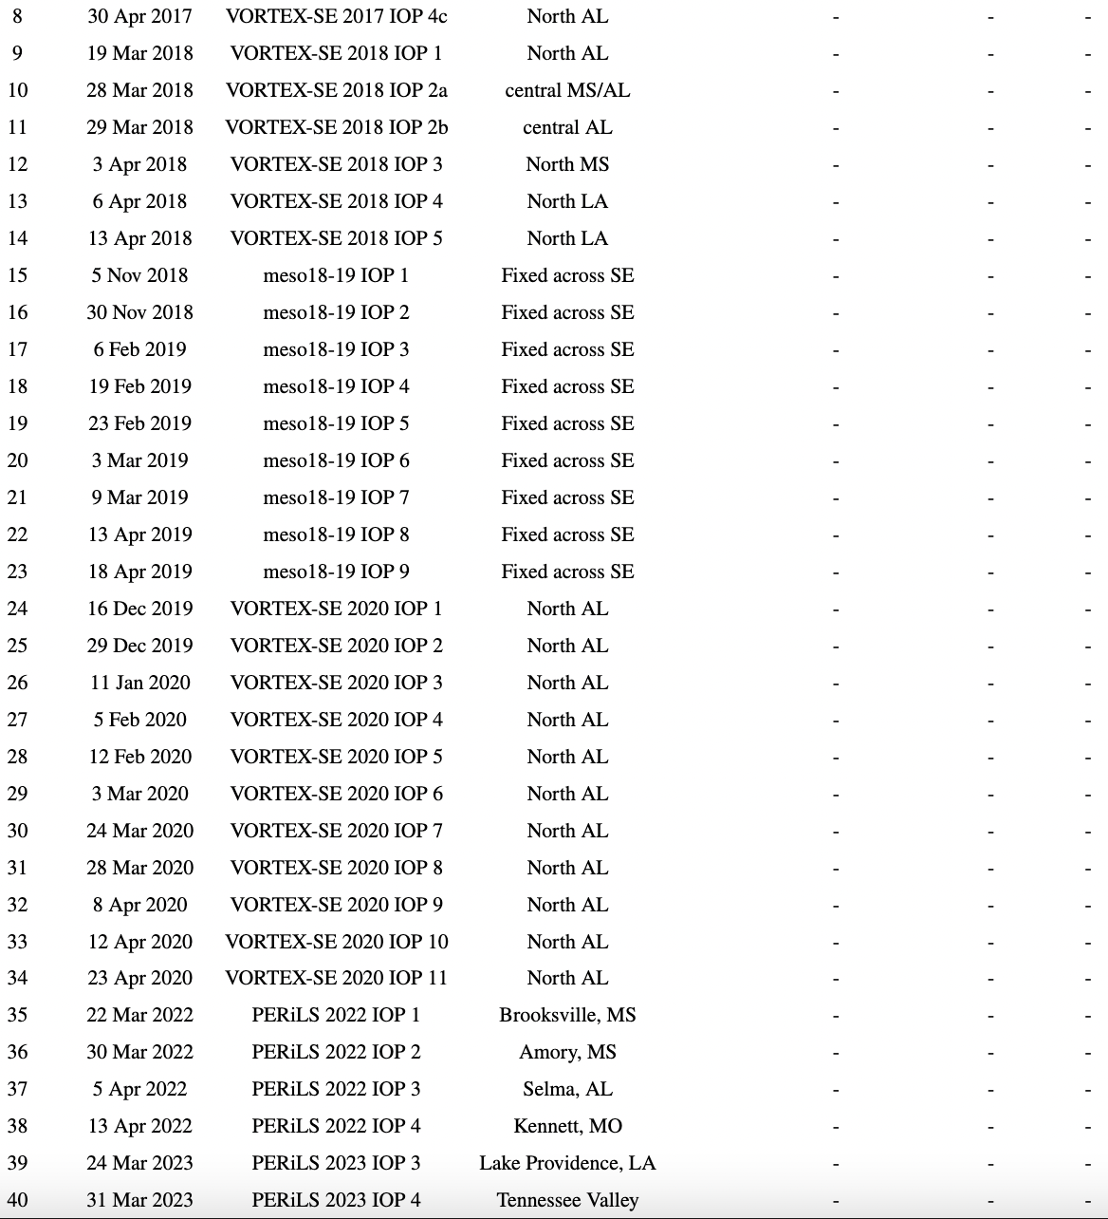
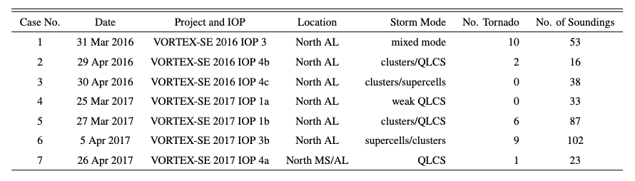
We will have a large dataset of southeast cases

Slide 5
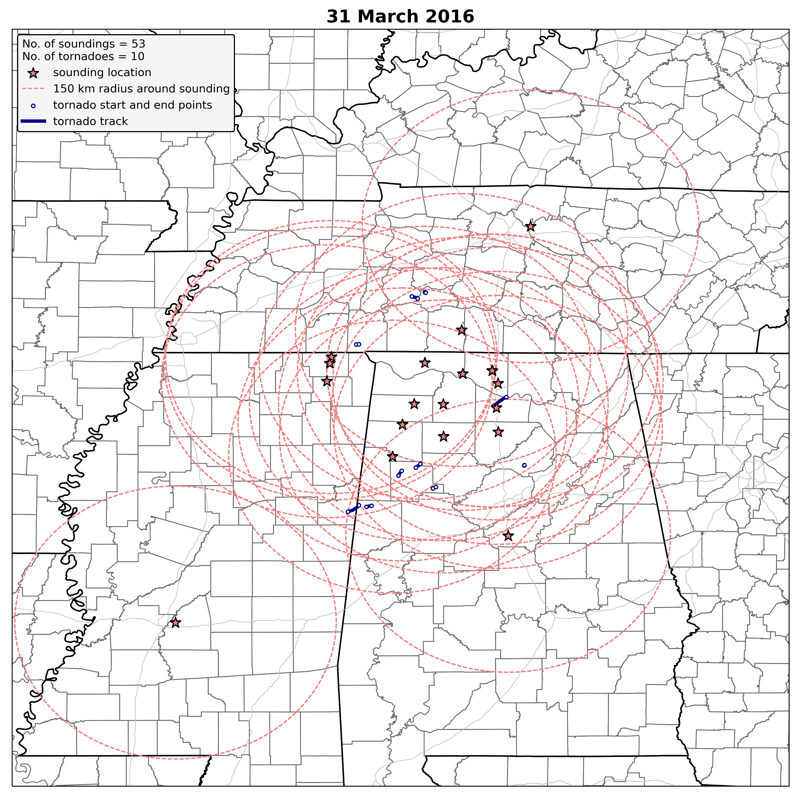
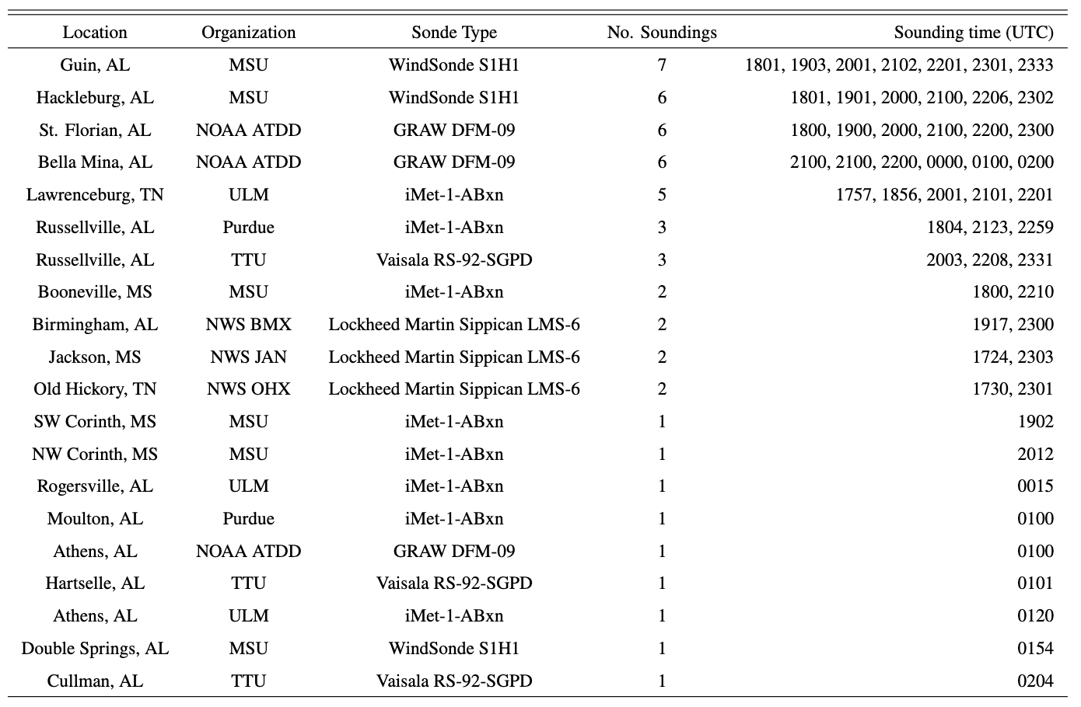
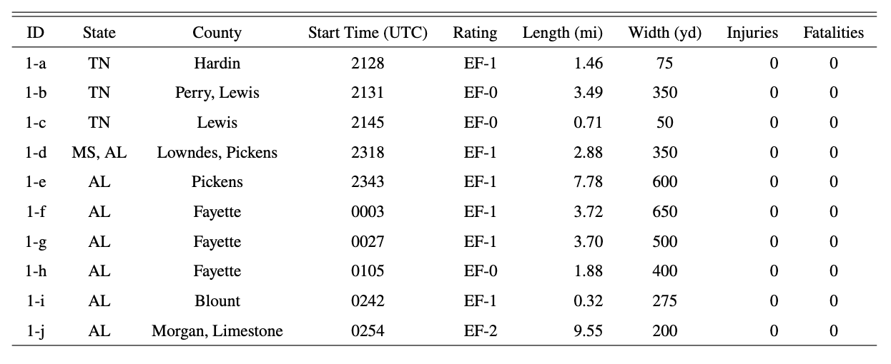
Soundings:
Tornadoes:

Slide 6
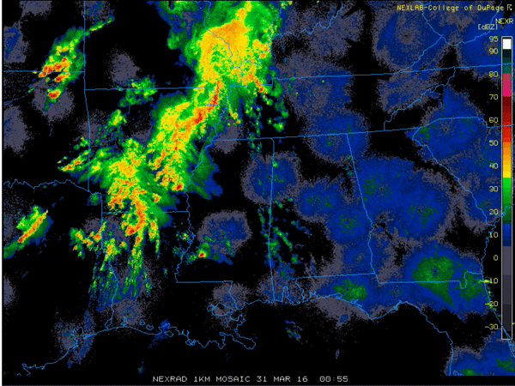
Soundings:
Tornadoes:

Slide 7
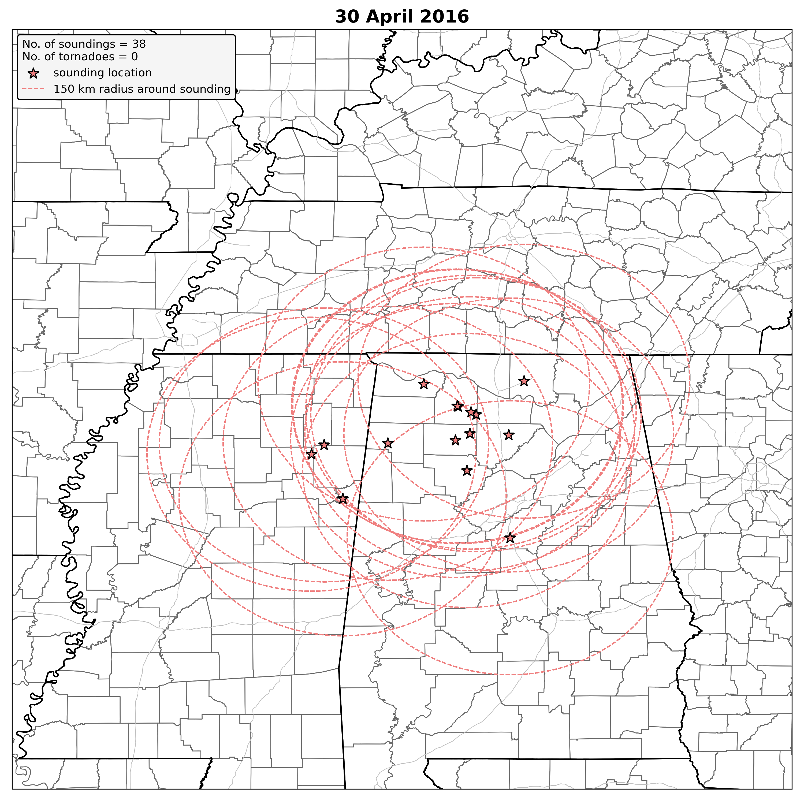
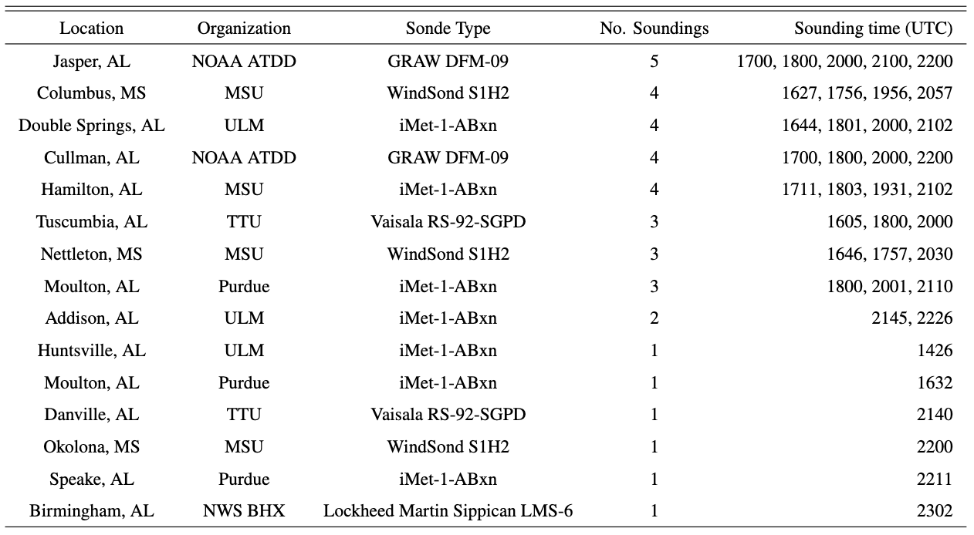
Soundings:

Slide 8
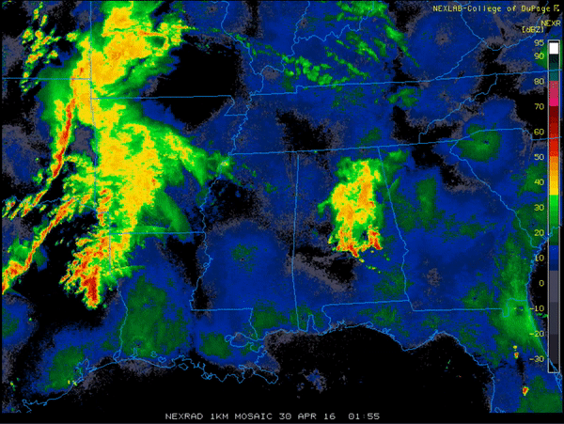
Soundings:

Slide 9
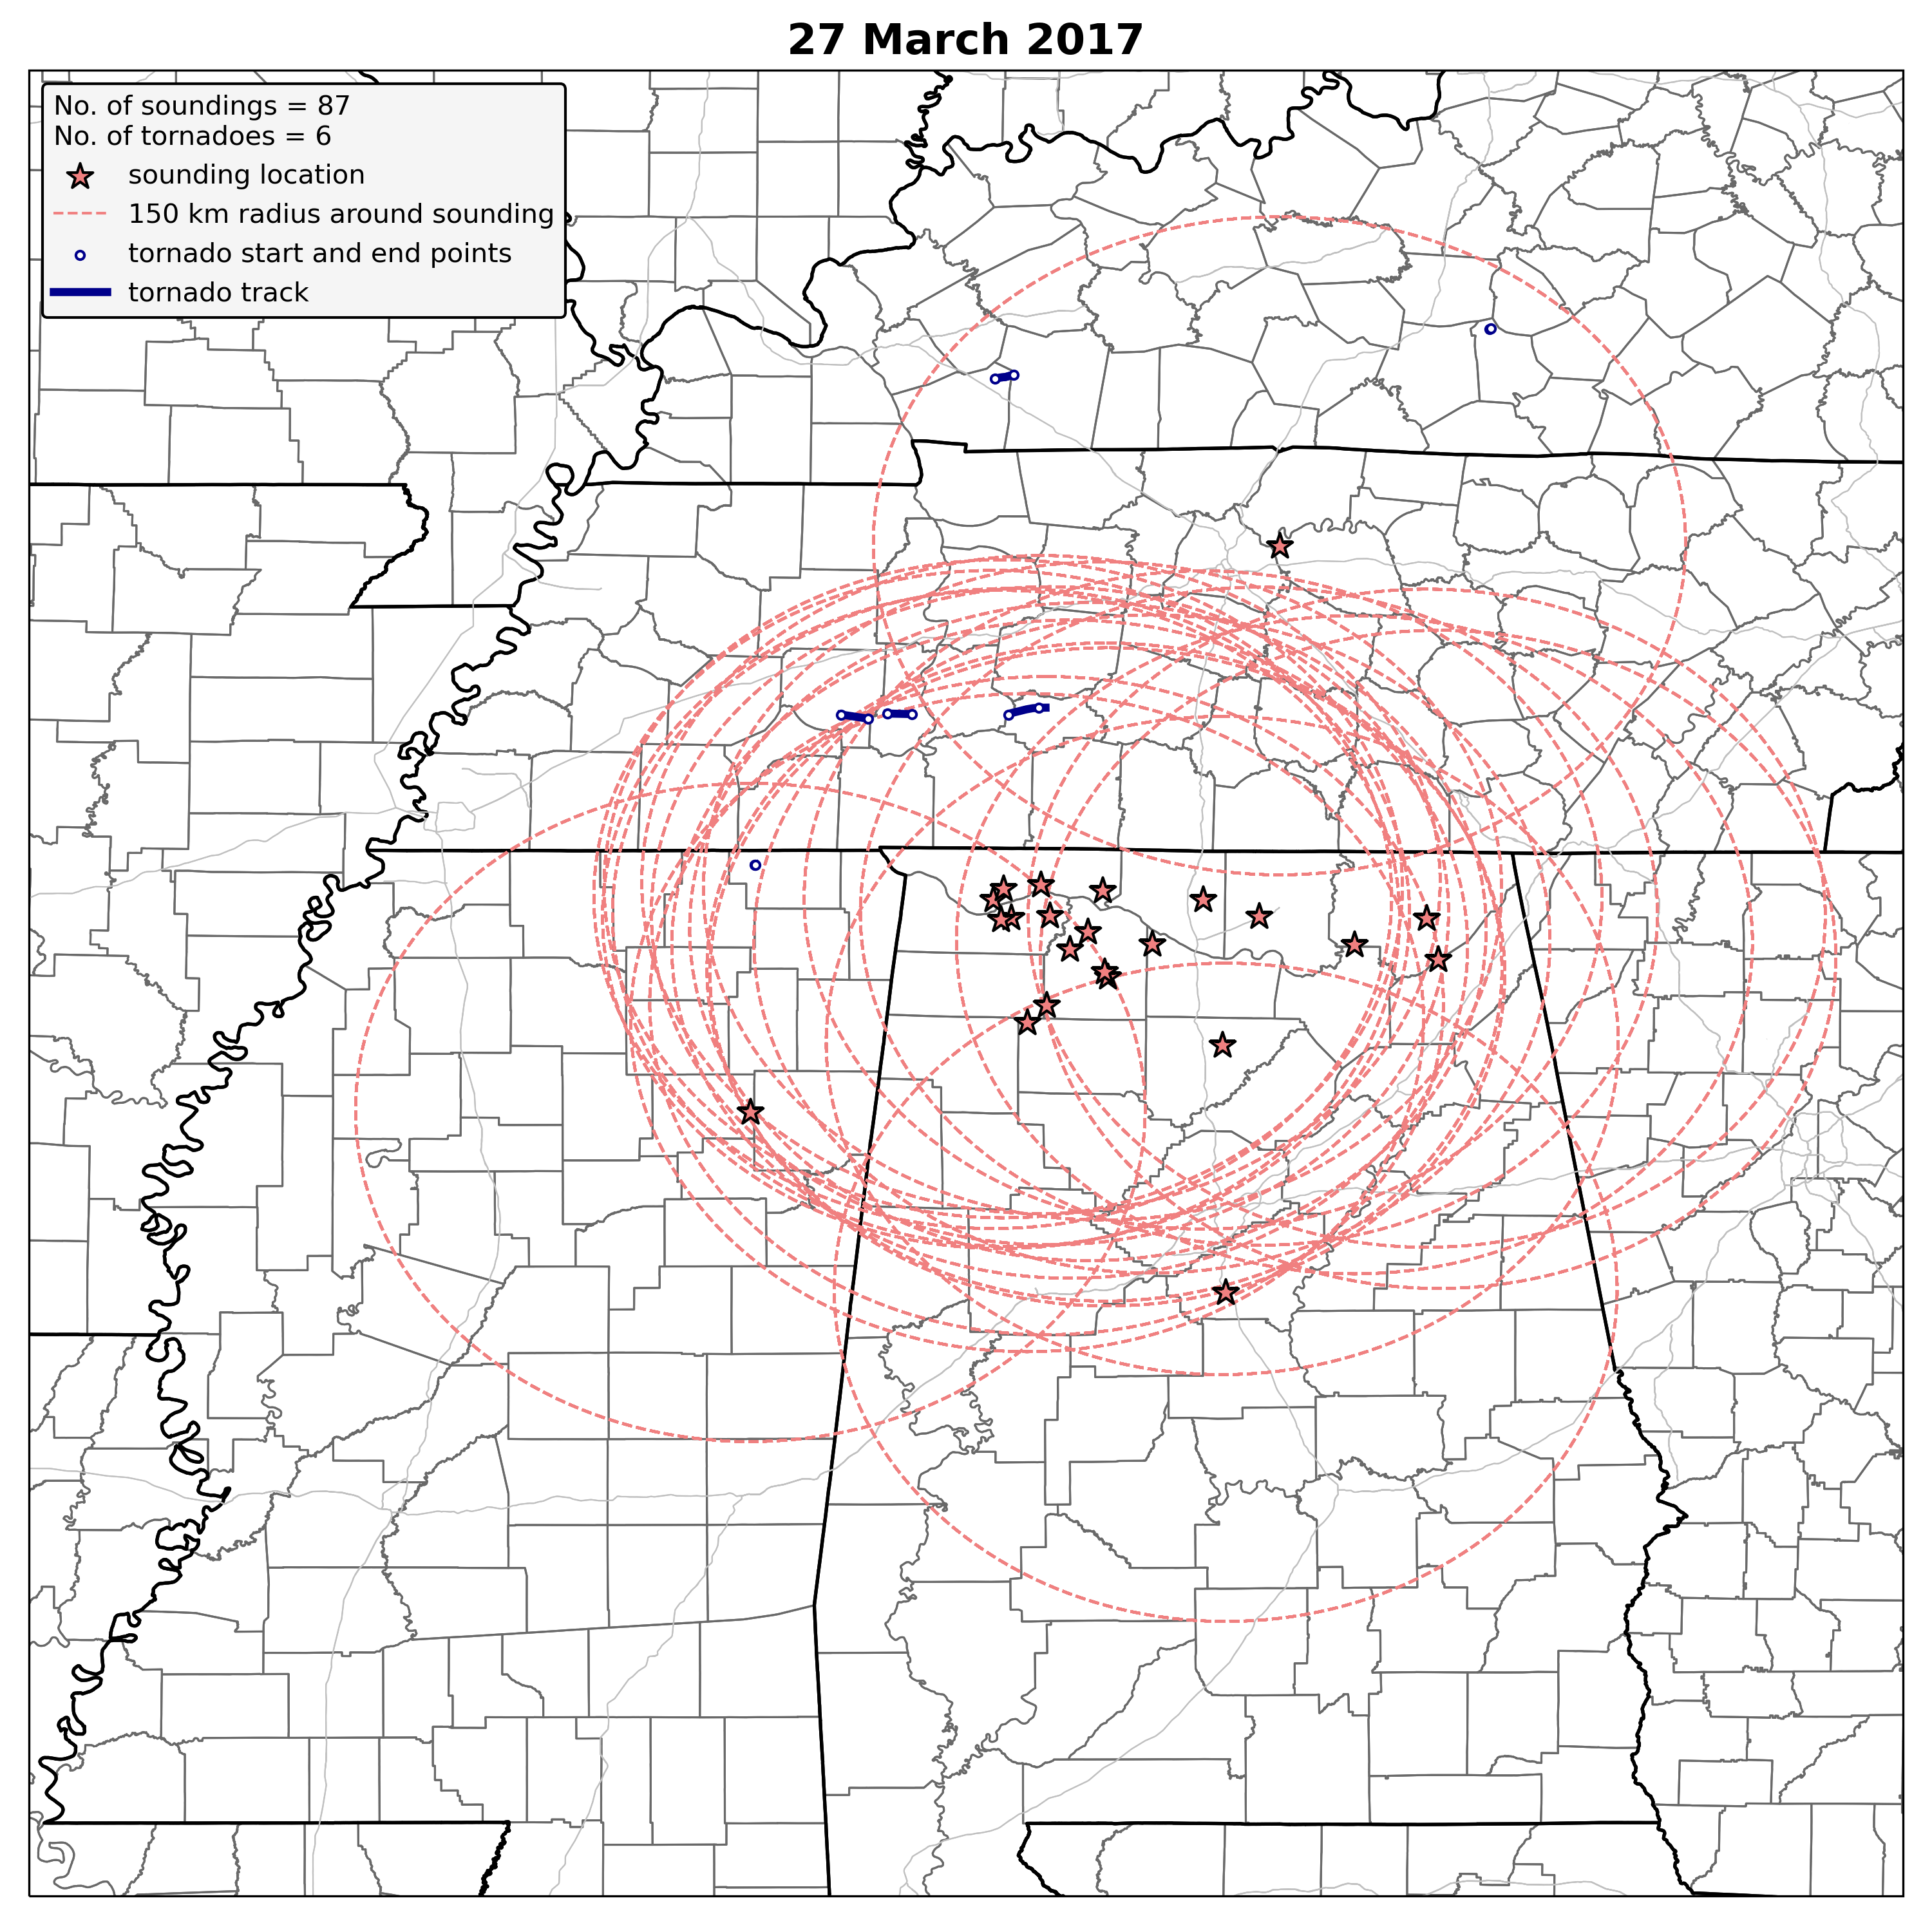
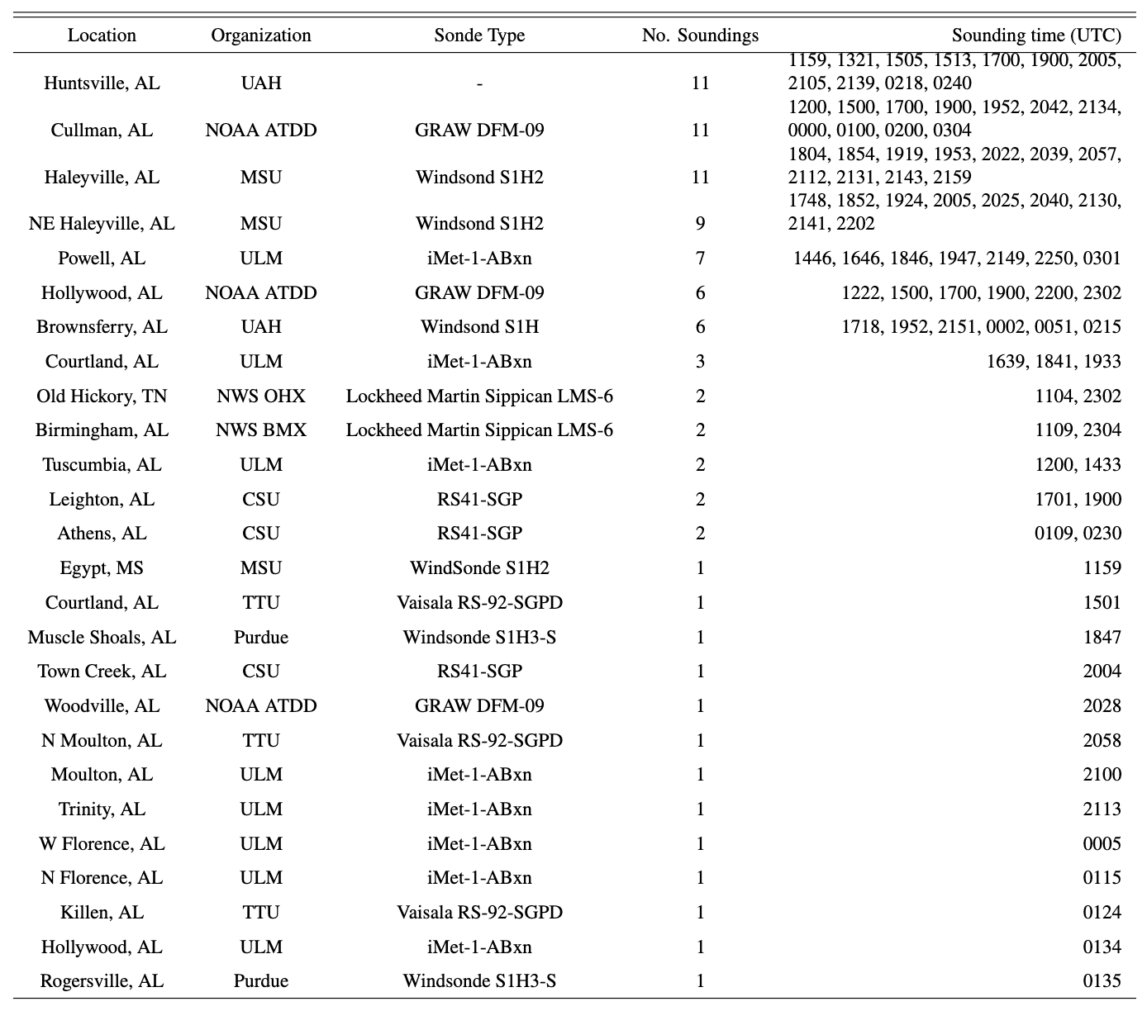
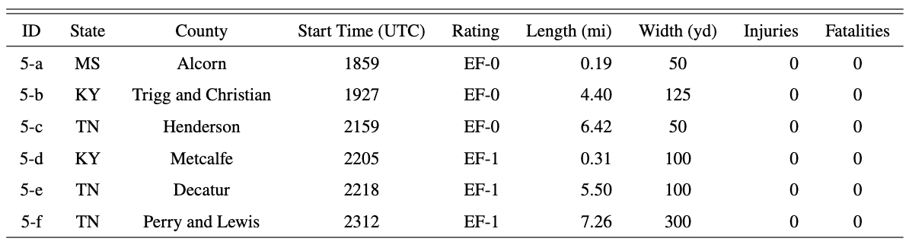
Soundings:
Tornadoes:

Slide 10
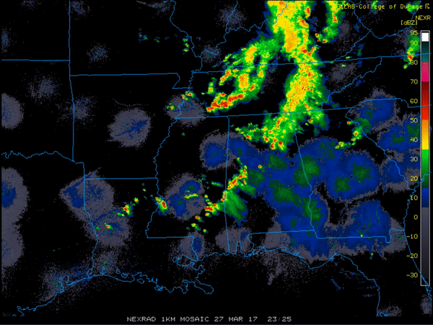
Soundings:
Tornadoes:

Slide 11
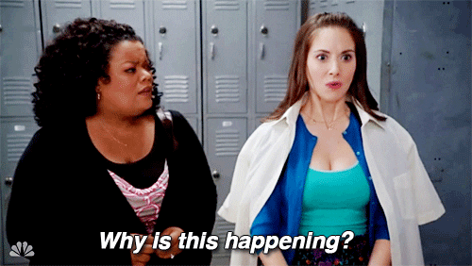
We plan to analyze the data by…
1. Relating sounding parameters to observed storm evolution
2. Understanding how those sounding parameters evolve in the vicinity of convection
1. Classifying the proximity soundings
2. Identifying differences (if any) in tornadic/non-tornadic environments and how those differences evolve
3. Is storm mode the reason for these differences?
4. WHY?

