Slide 1
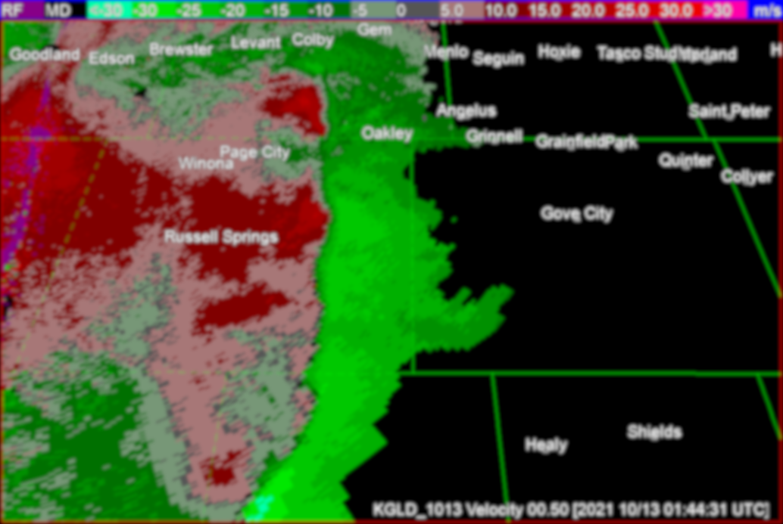
An Investigation Between Tornadic and Non-Tornadic QLCS Mesovortices using Operational and Experimental MRMS Products
Tyler Pardun^{1,2,3}, Anthony Reinhart³, Michael Coniglio^{1,3}, David Bodine^{1,4}
¹School of Meteorology, University of Oklahoma, Norman, Oklahoma;
²CIWRO, Norman, Oklahoma;
³NOAA/OAR/National Severe Storms Laboratory, Norman, Oklahoma;
⁴Advanced Radar Research Center, University of Oklahoma, Norman, Oklahoma

Slide 2
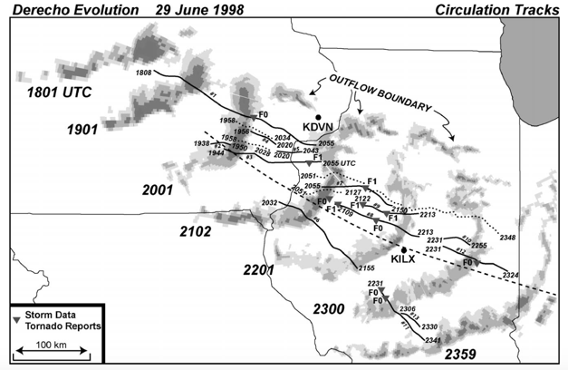
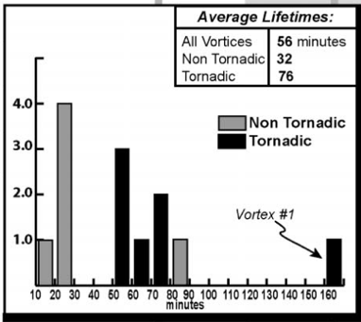
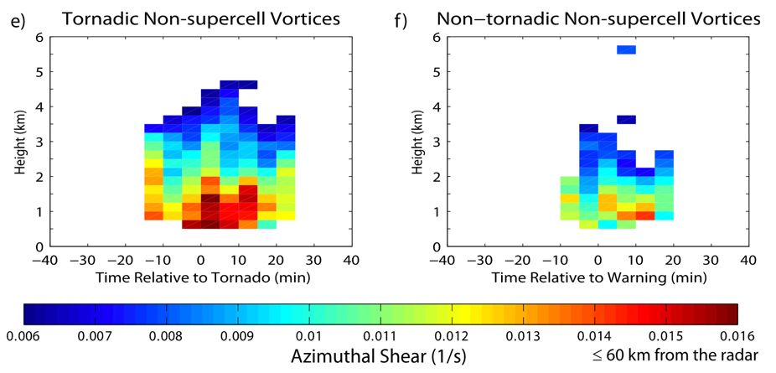
FOUNDATION STUDIES
Atkins et al. (2004, 2005):
Tornadic vortices tended to be stronger (< 2 km), longer-lived (76 min vs. 32 min), and deeper than their non- tornadic counterparts in a derecho simulation
Davis and Parker (2014):
WDSS-II processed (LLSD) single 88D obs for 225 HSLC QLCS & supercell vortices in the south-to-mid Atlantic
Median non-supercellular vortices were stronger, longer-lived (30 min vs. 20 min), and deeper (3 km vs 2 km)

Slide 3
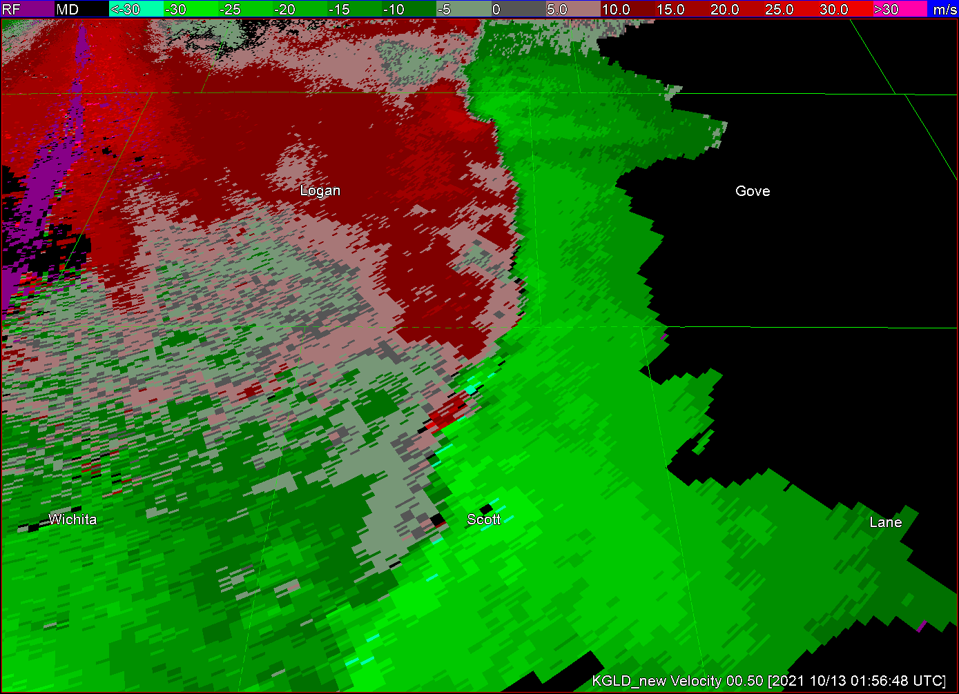
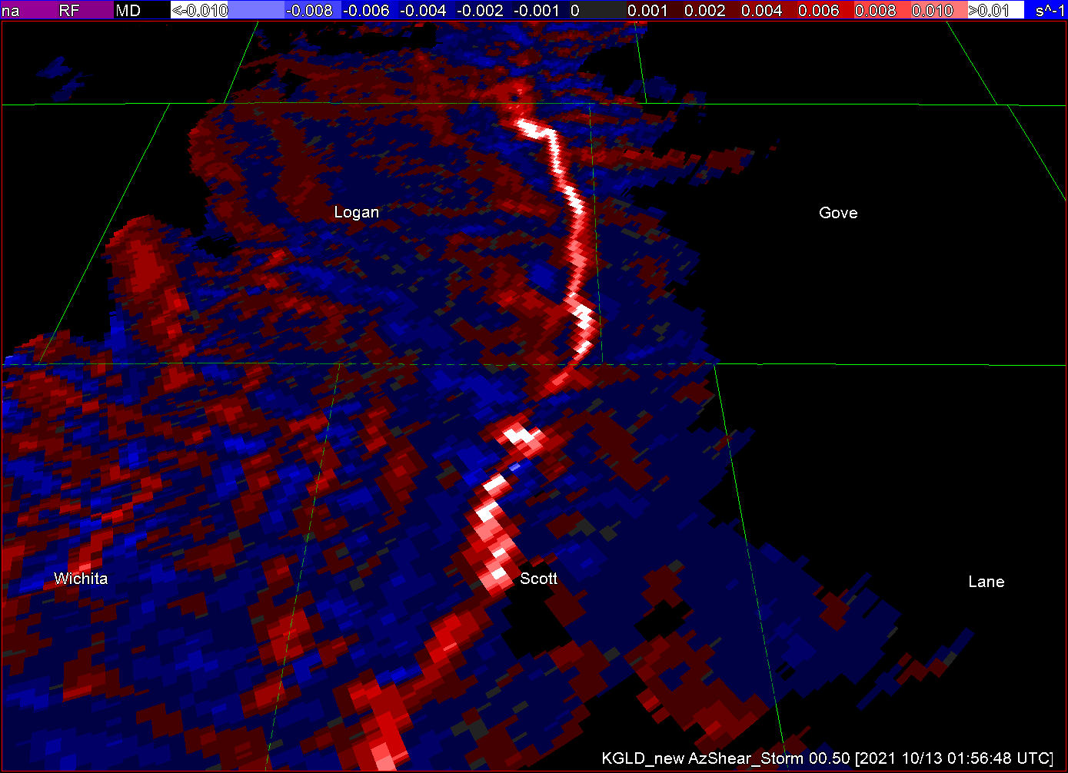
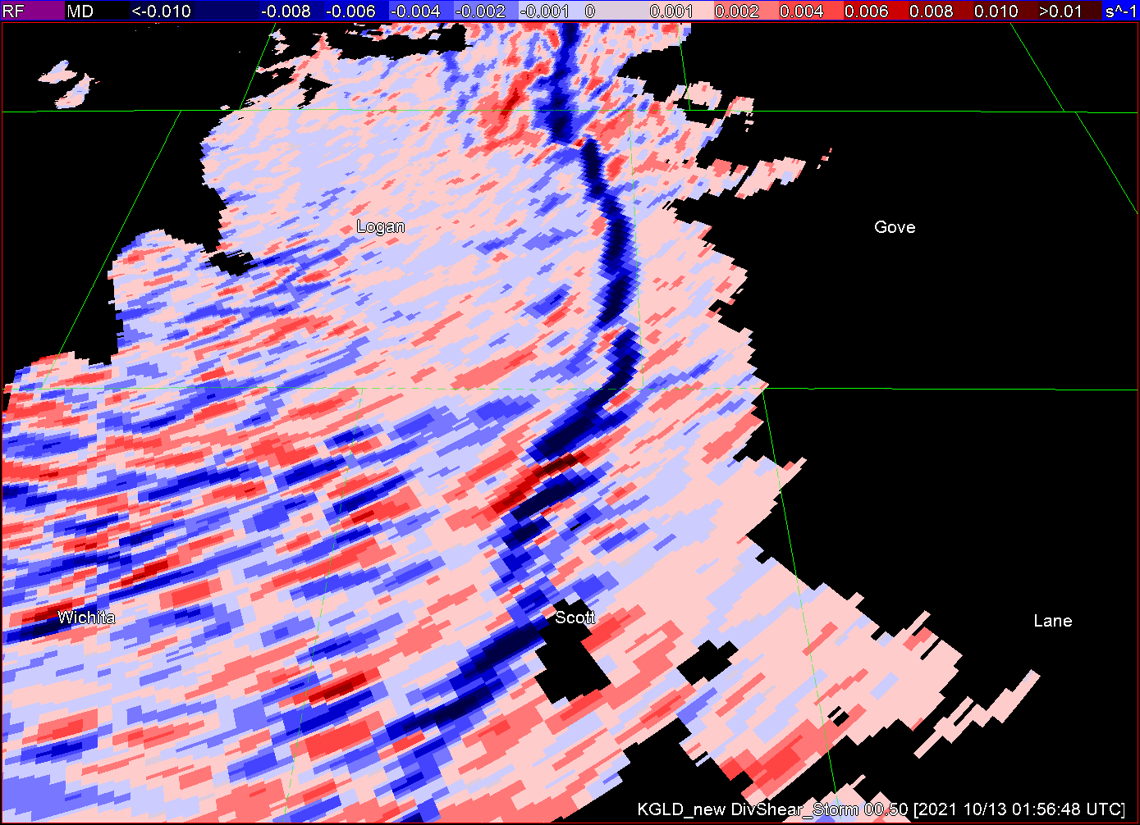
MRMS
vortex track
Blends data from multiple 88Ds onto a 3D grid (Lakshmanan et al., 2007, Mahalik et al., 2019), grid value weighted sum of input data/derived single-radar products from multiple radars:
Azimuthal Shear (A_{s}): Estimates one-half of the 2D vertical vorticity (operational).
Divergent Shear (D_{s}): Estimates one-half of the 2D horizontal divergence (experimental).
Dual-pol products! (experimental)
2-min updates,
Δ x ~500 m for AzShear & DivShear;
Δ x ~1 km for reflectivity and dual-pol products.
V_{R}
A_{s}
D_{s}

Slide 4
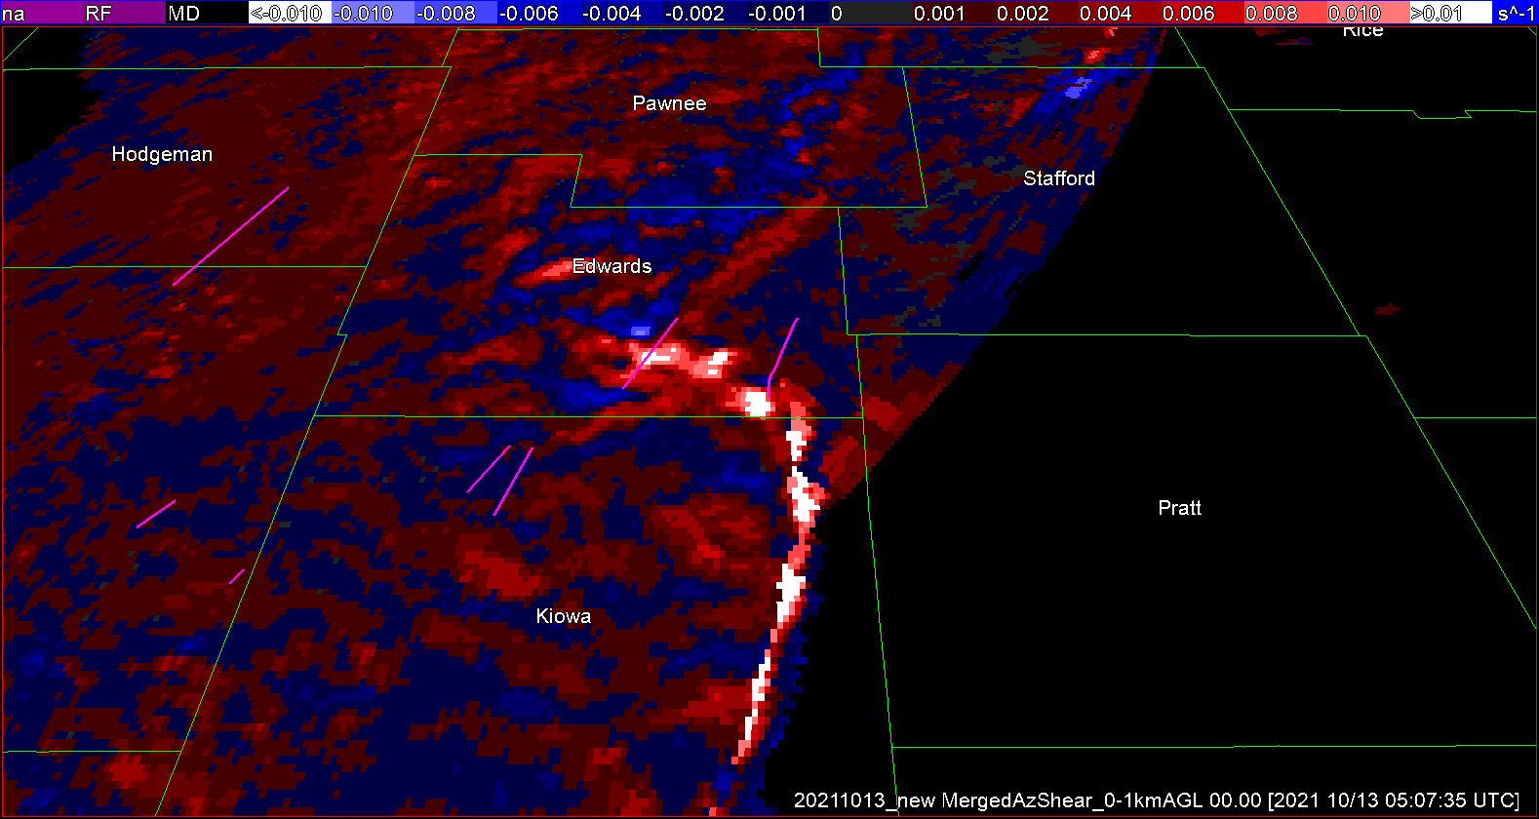
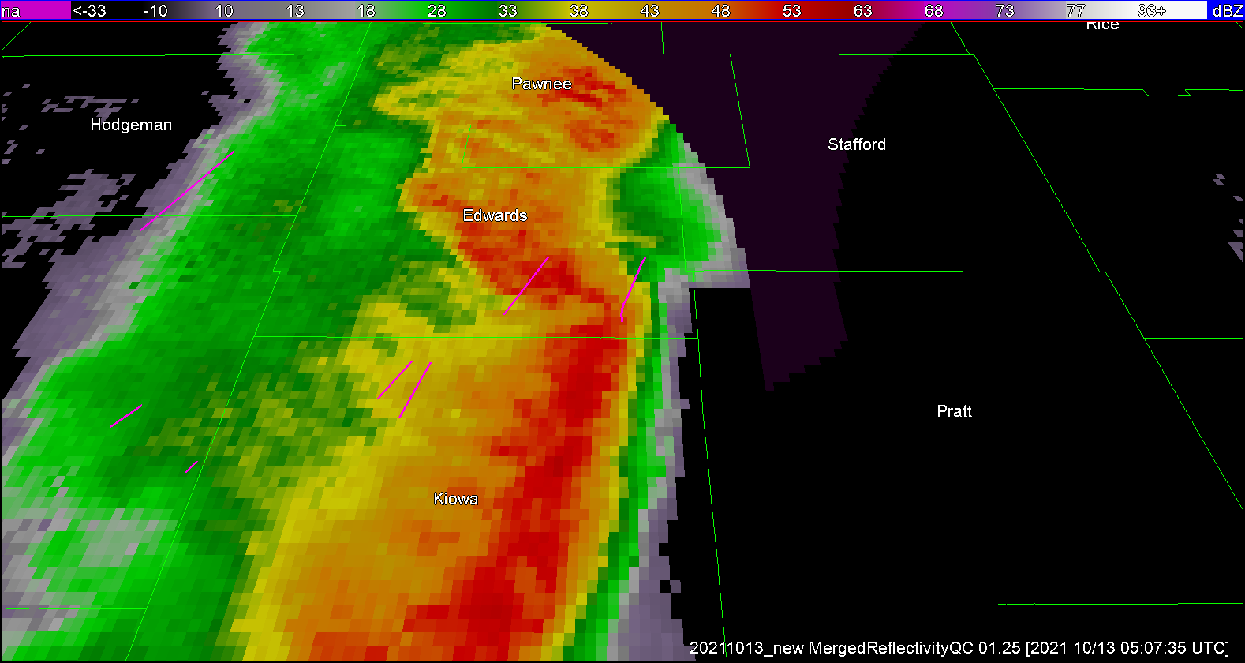
Vortex identification
Tornadic mesovortices
Non-tornadic
mesovortices
Tornadic vortices identified when 0-1-km AzShear max becomes collocated with tor damage path and tracked forward and backward in time relative to the time of collocation (t₀).
Non-tornadic (null) vortex defined as AzShear01 in excess of 0.01 s⁻¹ and resides farther than 50 km away from any damage path (Davis & Parker 2014).
Tornadic mesovortices
Non-tornadic
mesovortices
Introduction | Methodology | Vortex Cross Sections | Conclusions

Slide 5
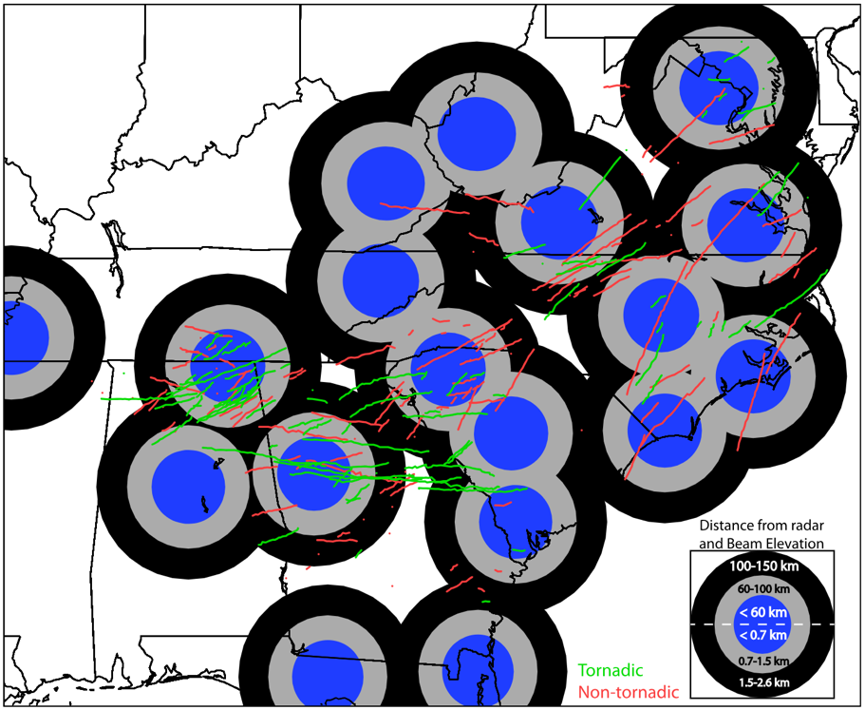
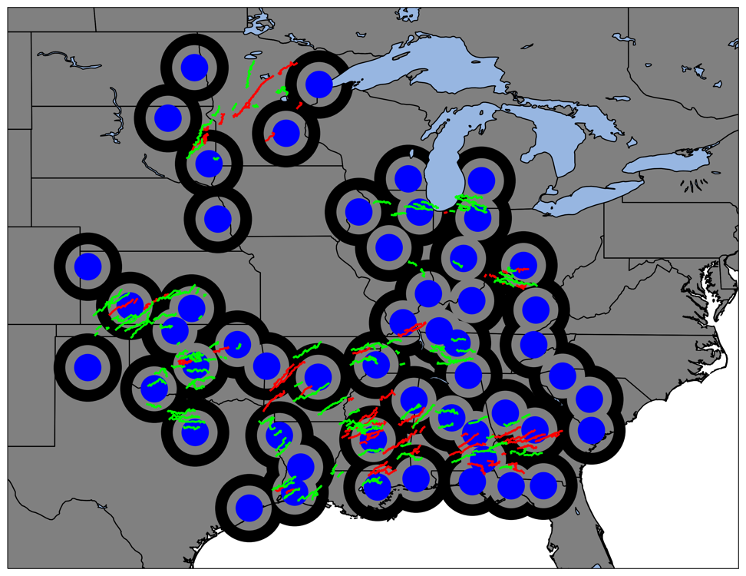
Davis and Parker (2014)
This study:
95 tornadic 135 non-tornadic
HSLC supercell + QLCS vortices
121 tornadic 171 non-tornadic
QLCS vortices (Smith et al. 2012 criteria)
Including 2022 PERiLS IOPs!

Slide 6
AzShear Time-Height cross sections
Start time of damage
Time of max 0-1-km AzShear
ALL
Composite (median) cross sections of MRMS products are computed if there are 5 or more cases on the time/height grid.
Max AzShear retained in 0.01° lat by 0.01° lon box surrounding the vortex
Tornadic vortices display deeper plumes of enhanced AzShear during pre-tornadic phase up to t₀ - 60 min
From ~ t₀ - 12 min, null vortices have higher median AzShear magnitude relative to tornadic vortices below 2 km AGL

Slide 7
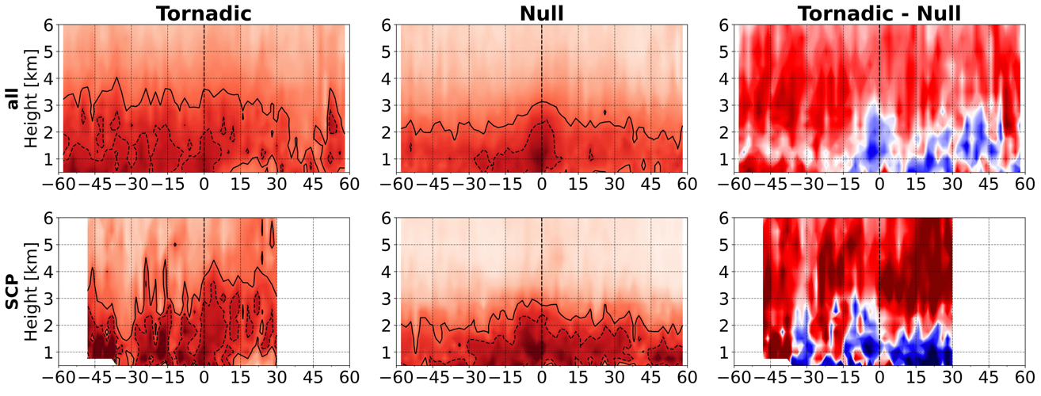
AzShear Time-Height cross sections
Start time of damage
Time of max 0-1-km AzShear
ALL
S-C Plains
Southeast

Slide 8
DIVShear Time-Height cross sections
Start time of damage
Time of max 0-1-km AzShear
ALL
DivShear minimum taken along vortex path at all levels, illustrating areas of radial convergence/divergence along the radial.
Indicative of deeper updraft plumes preceding tornadic vortices, or just a reflection of the stronger vortex?
Throughout the period prior to t₀, tornadic events are characterized with smaller DivShear magnitude (more convergence) above ~2.5 km AGL
In low-levels, more LL convergence in null vortices leading up to t₀, although no stat. sig. differences in low-levels

Slide 9
DIVShear Time-Height cross sections
Start time of damage
Time of max 0-1-km AzShear
ALL
S-C Plains
Southeast

Slide 10
K_{dP} Time-Height cross sections
Start time of damage
Time of max 0-1-km AzShear
ALL
Overall, tornadic vortices obtain significantly higher K_{DP} at all levels below 10 km AGL during the pre-tornadic / pre-maturity phase (Loeffler 2017, Kuster et al 2023)
Kdp cores for null vortices are smaller and shallower relative to their tornadic counterpart.
Indicative of more precip.-laden cores for tornadic vortices…perhaps indicating more potential for the hydrometeor-loading component to downdrafts for the tornadic MVs

Slide 11
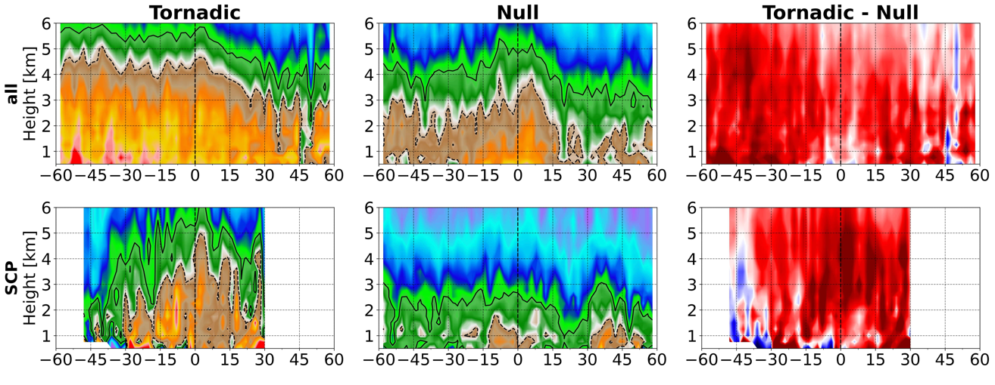
K_{dP} Time-Height cross sections
Start time of damage
Time of max 0-1-km AzShear
ALL
S-C Plains
Southeast

Slide 12
Z_{dR} Time-Height cross sections
Start time of damage
Time of max 0-1-km AzShear
ALL
Median Z_{DR} taken along vortex path at all levels shows smaller values preceding tornadic vortices
Indicates less evaporation ongoing (fewer small drops)?
BUT…..

Slide 13
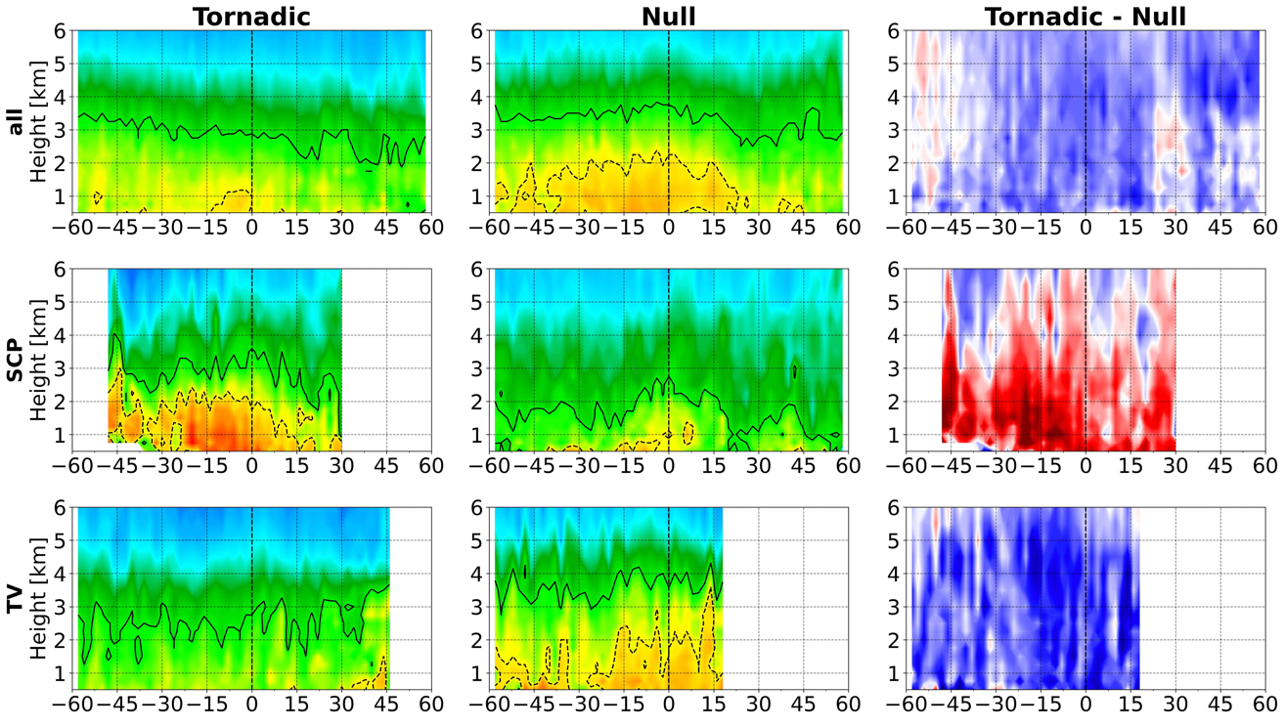
Z_{dR} Time-Height cross sections
Start time of damage
Time of max 0-1-km AzShear
ALL
S-C Plains
Tenn. Valley

Slide 14
KEY TAKEAWAYS
Tyler.Pardun@noaa.gov, Anthony.Reinhart@noaa.gov, Michael.Coniglio@noaa.gov
Tornadic mesovortices → deeper columns of AzShear during the pre-tornadic phase [consistent with Atkins et al., 2004, 2005; Davis and Parker, 2014), up to 60 min before t0, BUT null vortices display larger AzShear overall near t₀
Tornadic mesovortices → More plumes of deeper convergent shear collocated with enhanced AzShear and higher K_{DP} may indicate pulses of stronger updrafts / more precipitation-laden cores during the pre-tornadic phase up to 60 min before t₀, but may just be another reflection of stronger rotation aloft
Tornadic mesovortices → Lower Z_{DR} for longer pre-tornadic periods…maybe less evaporation…. but highly variable ….not sure what to conclude yet (Stronger Z_{DR} columns in S-C Plains but not southeast or TV cases….competing & complex processes impacting drop size distributions)
Paper ready to submit soon….hopefully provide context and hypotheses for more in-depth studies of individual V-SE / PERiLS cases regarding vortex evolution in kinematic and dual-pol products

