Slide 1
Evolution of Shear Profiles Preceding Tornadic and non-Tornadic QLCSs
Todd Murphy, Isaiah Montgomery, & Haniston Holloway
University of Louisiana Monroe
PERiLS Science Meeting
11/16/23

Slide 2
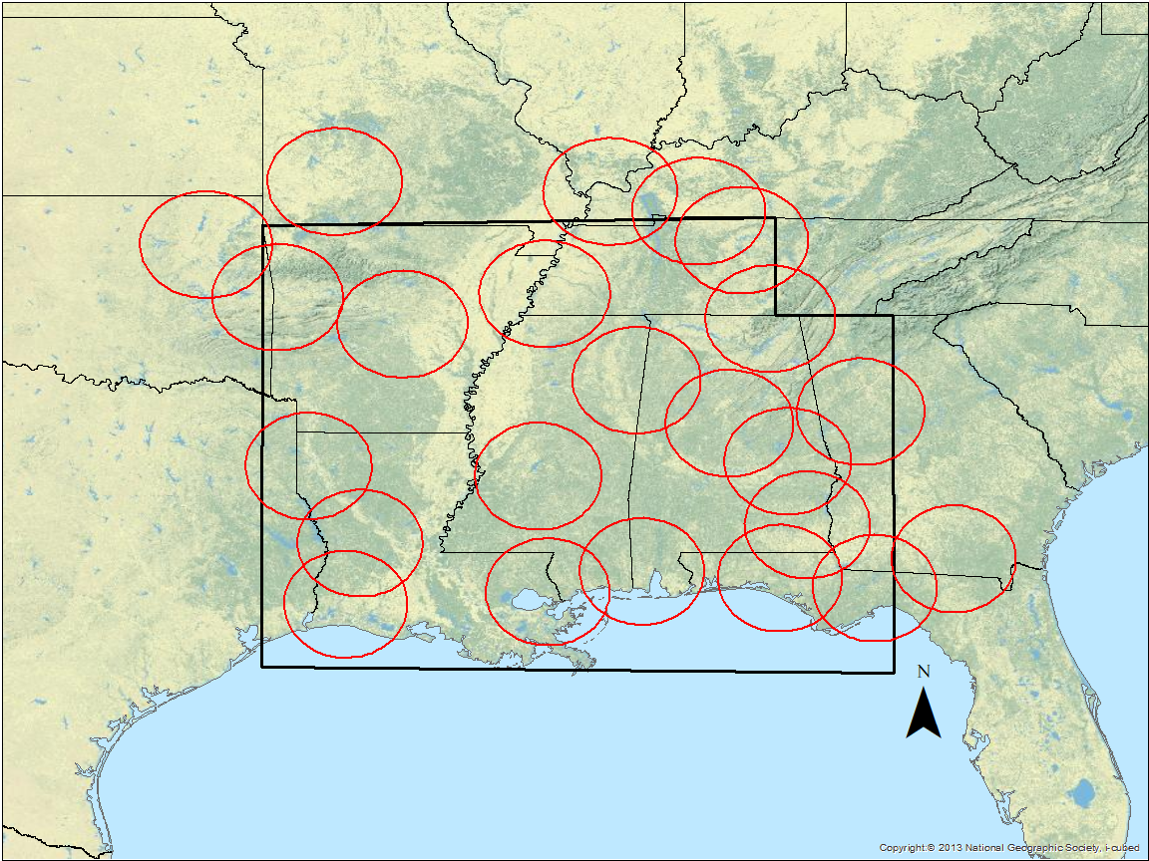
Methods
Using NEXRAD VAD wind profiles to examine temporal evolution of kinematic profiles ahead of:
Non-tornadic QLCSs (but must produce wind damage)
Weakly tornadic QLCSs (only 1 TOR report within 100-km radius of NEXRAD)
Strongly tornadic QLCSs (≥ 5 TORs within 100-km radius of NEXRAD)
Black outline = primary study domain
Red circles = 100-km NEXRAD range ring

Slide 3
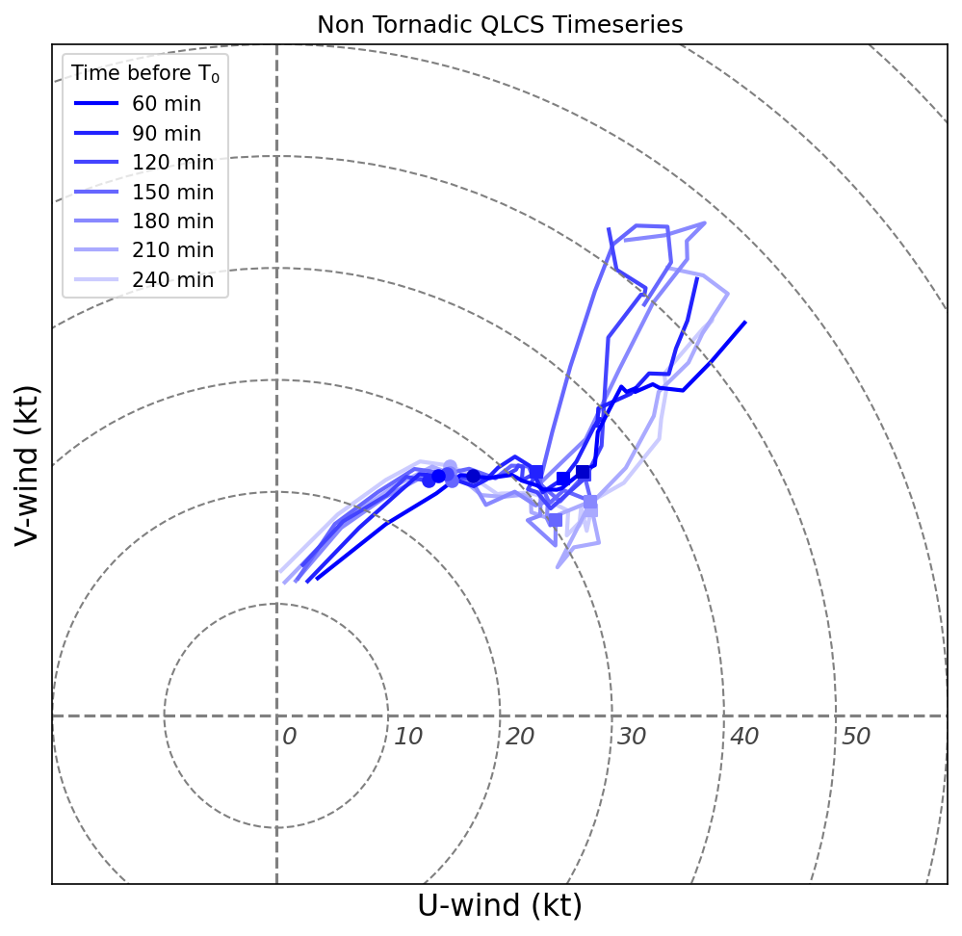
Mean Wind Profiles
Mean wind profiles created at 15-min intervals beginning 4-hours prior to QLCS passage over NEXRAD
VAD retrieval data quality issues
At T < 60 min convection has typically entered domain, increasing wind field temporal variability and thus VAD retrieval error
Only using wind profiles where RMSE is minimized across entire profile
Mean hodographs for non-tornadic QLCSs at 30-min intervals from 4-hrs (lightest color) to 1-hr (darkest color) prior to passage over NEXRAD
Circles = 1 km; Squares = 3 km; profiles truncate at 6 km

Slide 4
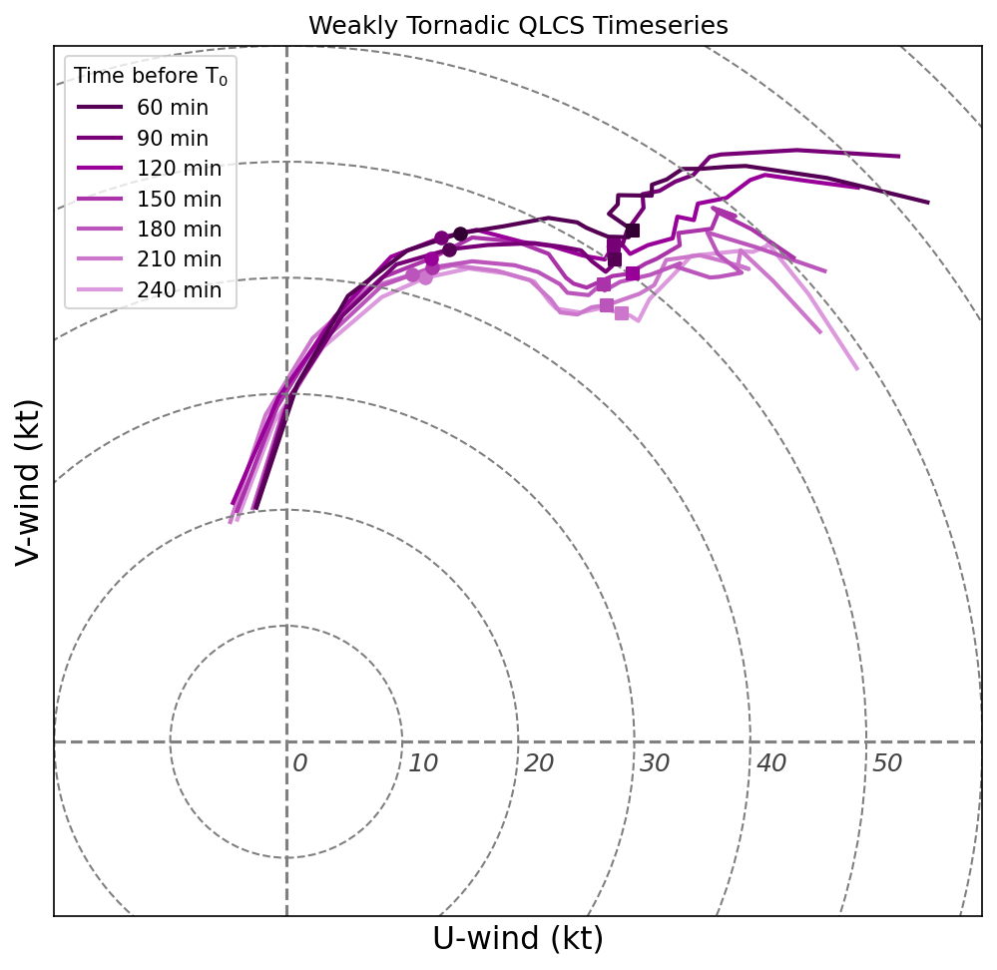
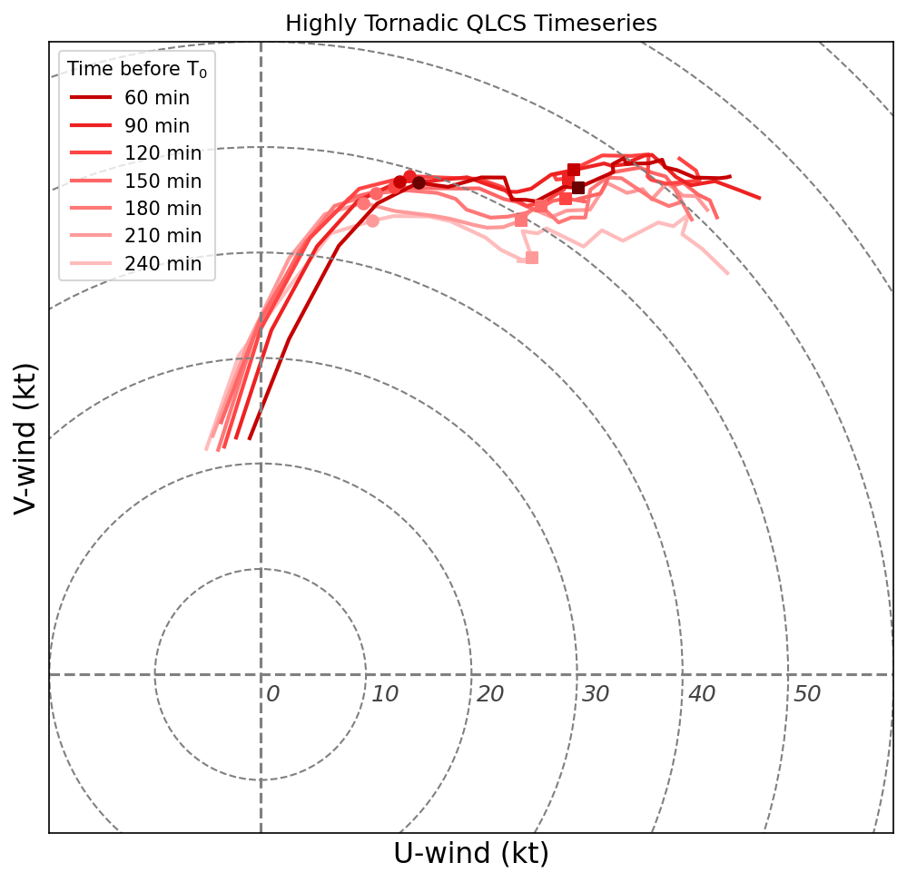
Mean Hodograph Evolution
Weak winds
Little hodograph evolution
Shape suggests little tornado potential
Recall: these cases still produced damaging wind
Stronger 1- and 3-km flow
Significant hodograph curvature
But apparent backing near 3-km
Similar to weakly tornadic except
Stronger 1- and 3-km flow
Less 3-km backing
Notes:
Each has about 30 cases

Slide 5
To Do
Adding additional cases
Comparison with PERiLS datasets

Slide 6
Thanks!
Email: murphy@ulm.edu

Slide 7
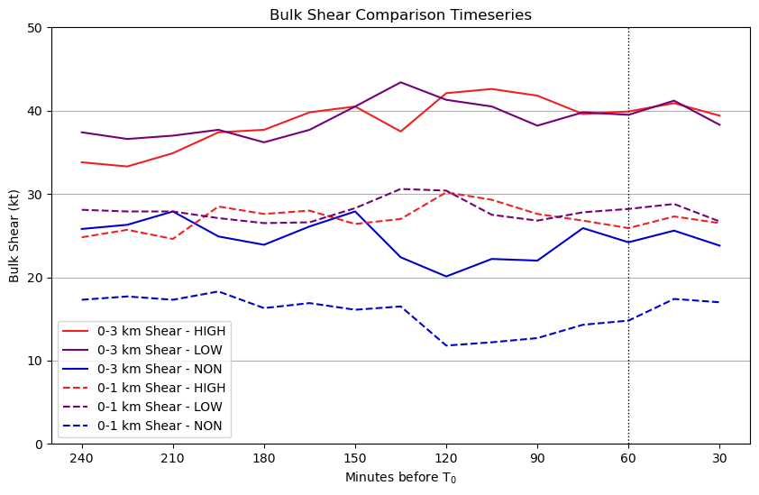
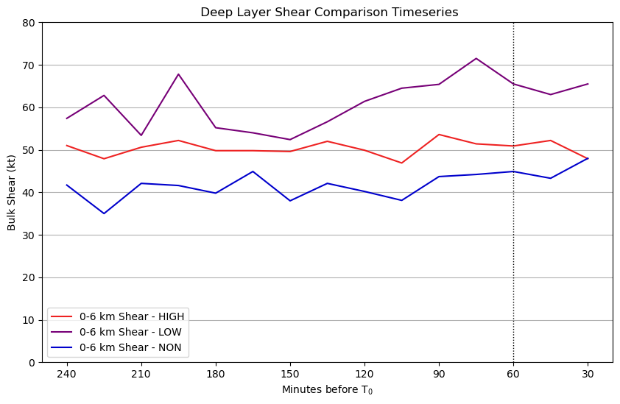
Bulk Shear Evolution
Weakly and highly tornadic cases have similar magnitudes and evolution of 1- and 3-km bulk shear
Weakly tornadic cases greater 6 km shear than highly tornadic

Slide 8
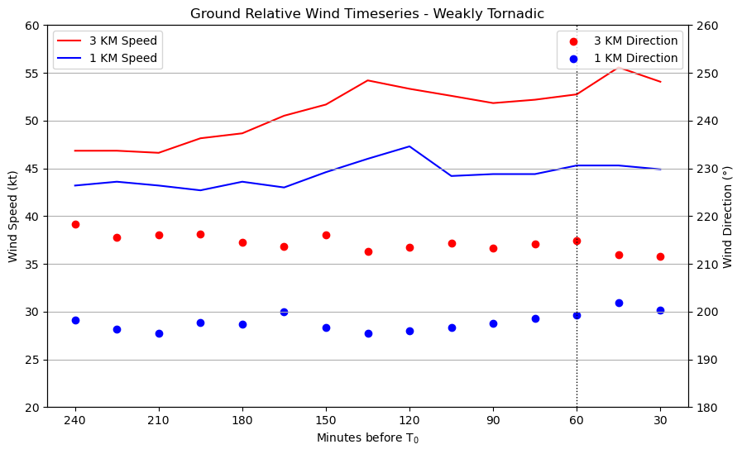
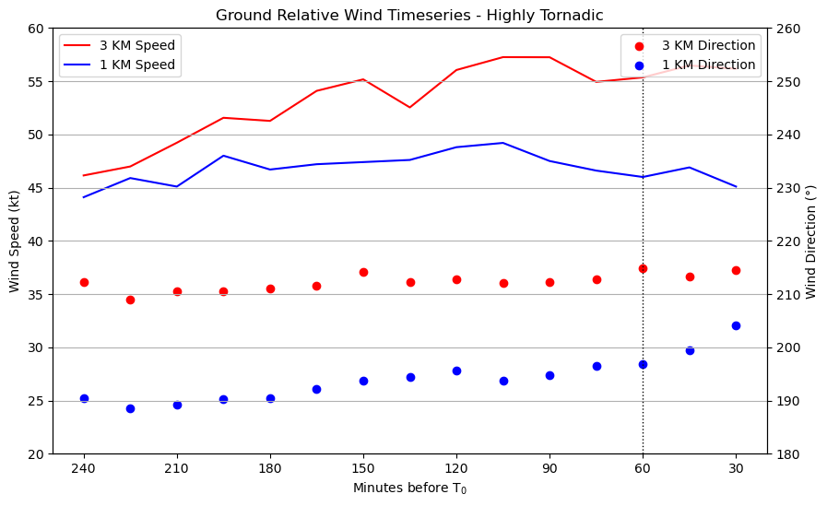
Mean Hodograph Evolution
Highly tornadic has strong 1- and 3-km ground relative winds compared to weakly tornadic
1-km wind veers with time

