Slide 1
A Detailed Examination of a High Shear, Low CAPE Mesovortex
Geoff Marion, Matthew Brown, Tom Galarneau, and Mike Coniglio
National Severe Storms Laboratory

Slide 2
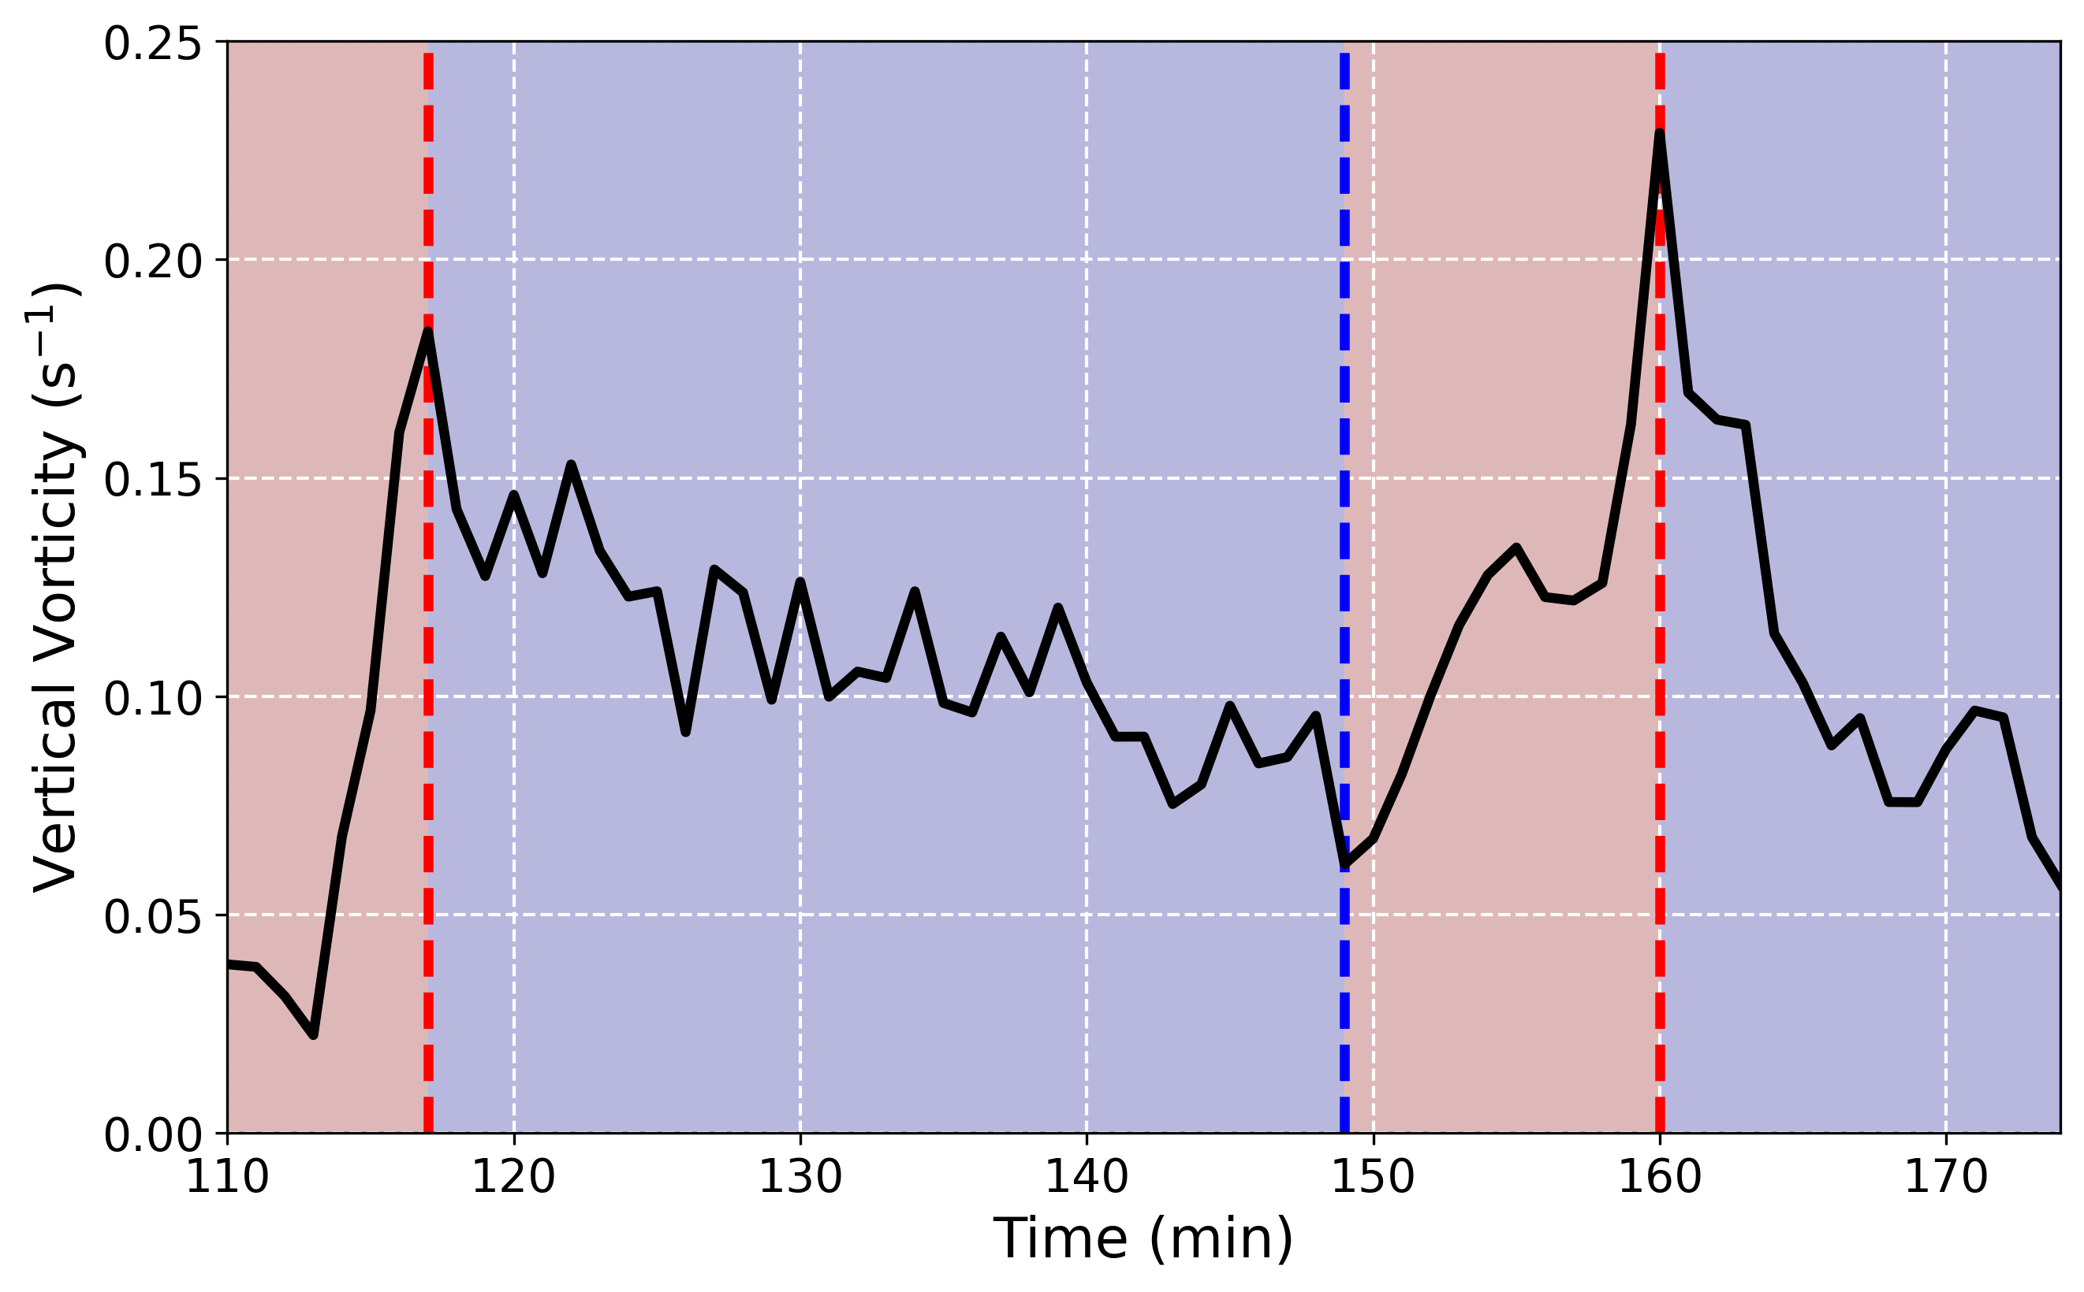
Methodology
CM1 simulation using PERiLS HSLC environment (30 March 2022)
Simulation details:
201x201x16 km domain
100 m horizontal grid spacing
30 m grid spacing in lowest 3 km

Slide 3
(Some) Key Findings
Updraft cores key to intensifying vortices
Shear effects/convergence along cold pool important for sustaining small, shallow vortices over long periods
Vortex feedbacks on system promote vortex-updraft alignment
Evidence points to variety of mechanisms responsible for vortex formation, maintenance, and intensification
HSI
Baroclinity (streamwise and crosswise)
Friction
Environment

Slide 4
Vertical Accelerations
Buoyancy Pressure
$${p′}_{B}∝−\frac{∂\left(\overline{ρ}B\right)}{∂z}$$
Dynamics Pressure
Deformation tensor
$$p_{D}^{′}∝e_{ij}^{2}−\frac{1}{2}{\left|\vec{ω}\right|}^{2}$$
$$e_{ij}^{2}=\frac{1}{4}\sum_{i=1}^{3}{\sum_{j=1}^{3}{{\left(\frac{∂u_{i}}{∂x_{j}}+\frac{∂u_{j}}{∂x_{i}}\right)}^{2}}}$$

Slide 5
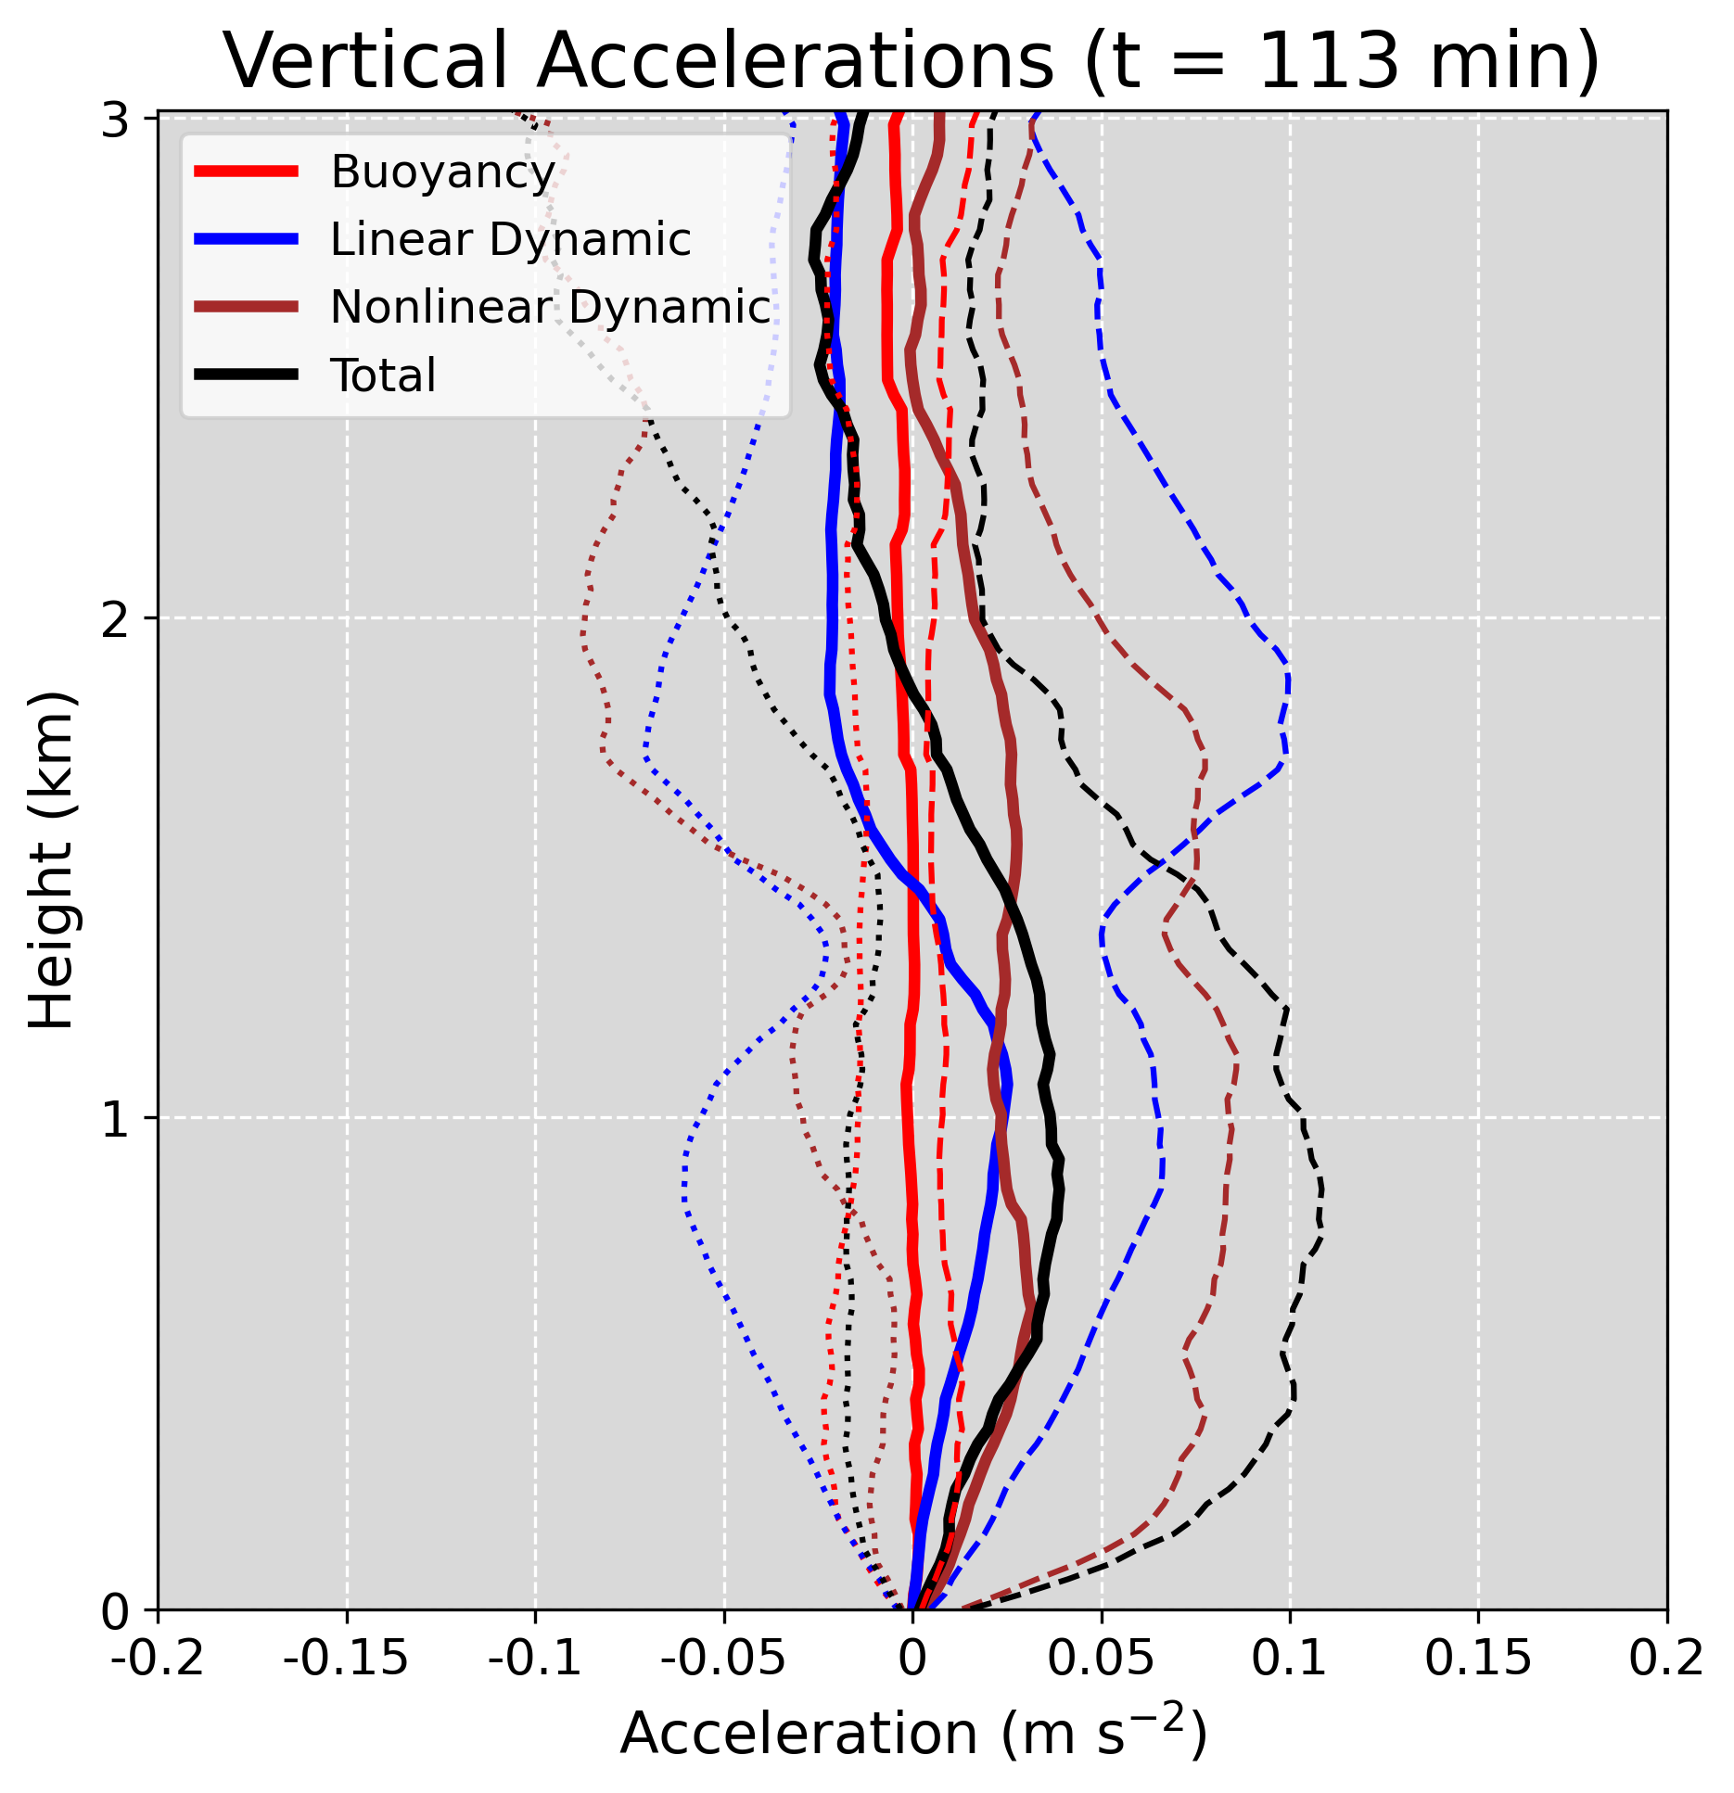
Rotating updraft - dynamic contributions to updraft dominant
Persistent updraft rotation aloft and cold pool near ground
Relatively deep net upward acceleration
Solid: Median
Dotted: 10th Percentile
Dashed: 90th Percentile

Slide 6
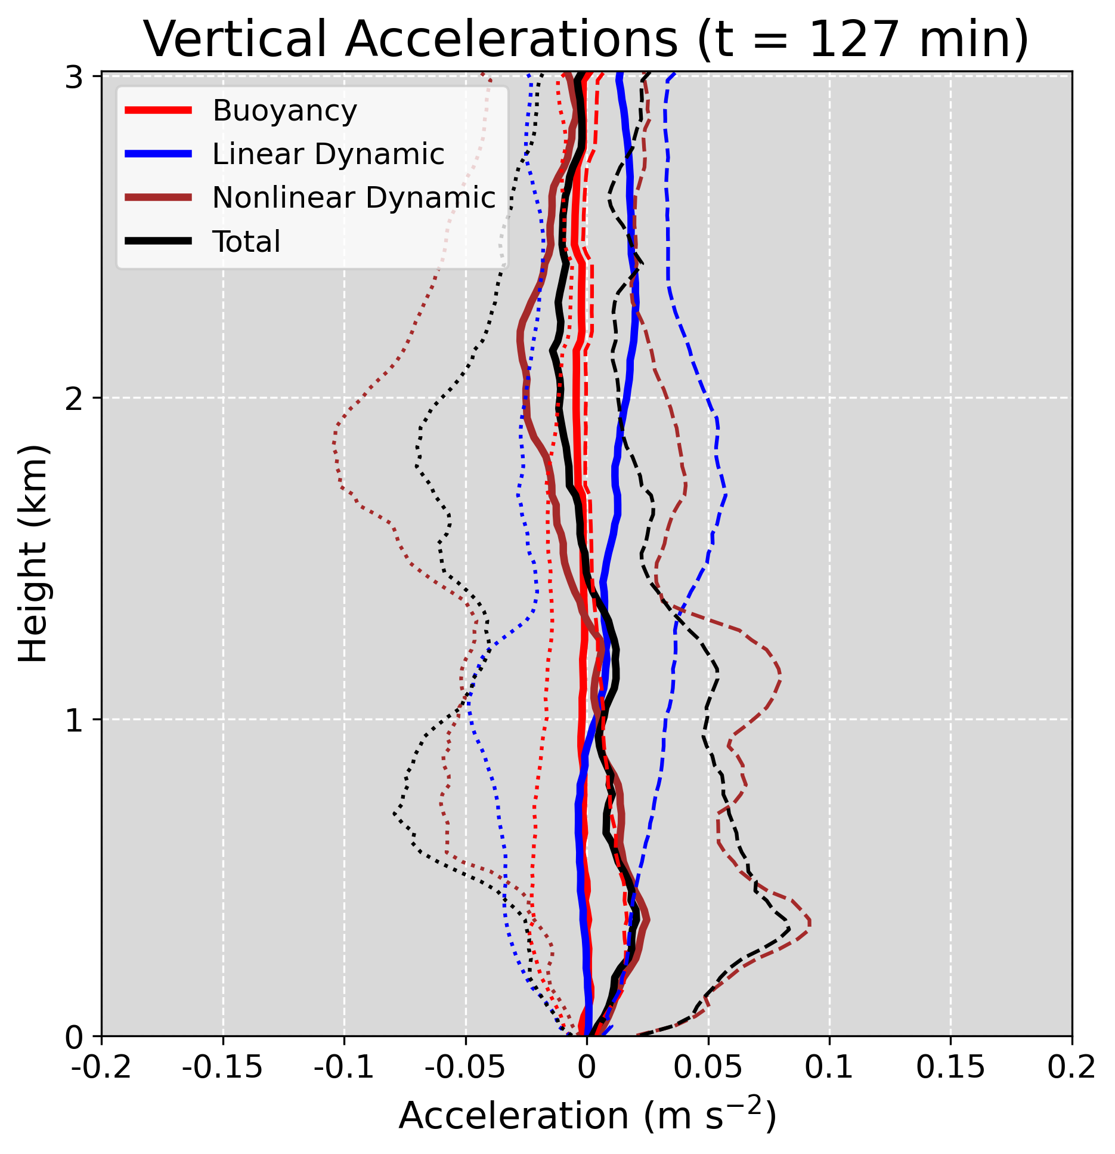
Disorganized updraft
Shallower, weaker layer of net positive accelerations
Near-ground convergence along cold pool primarily drives upward motion
Solid: Median
Dotted: 10th Percentile
Dashed: 90th Percentile

Slide 7
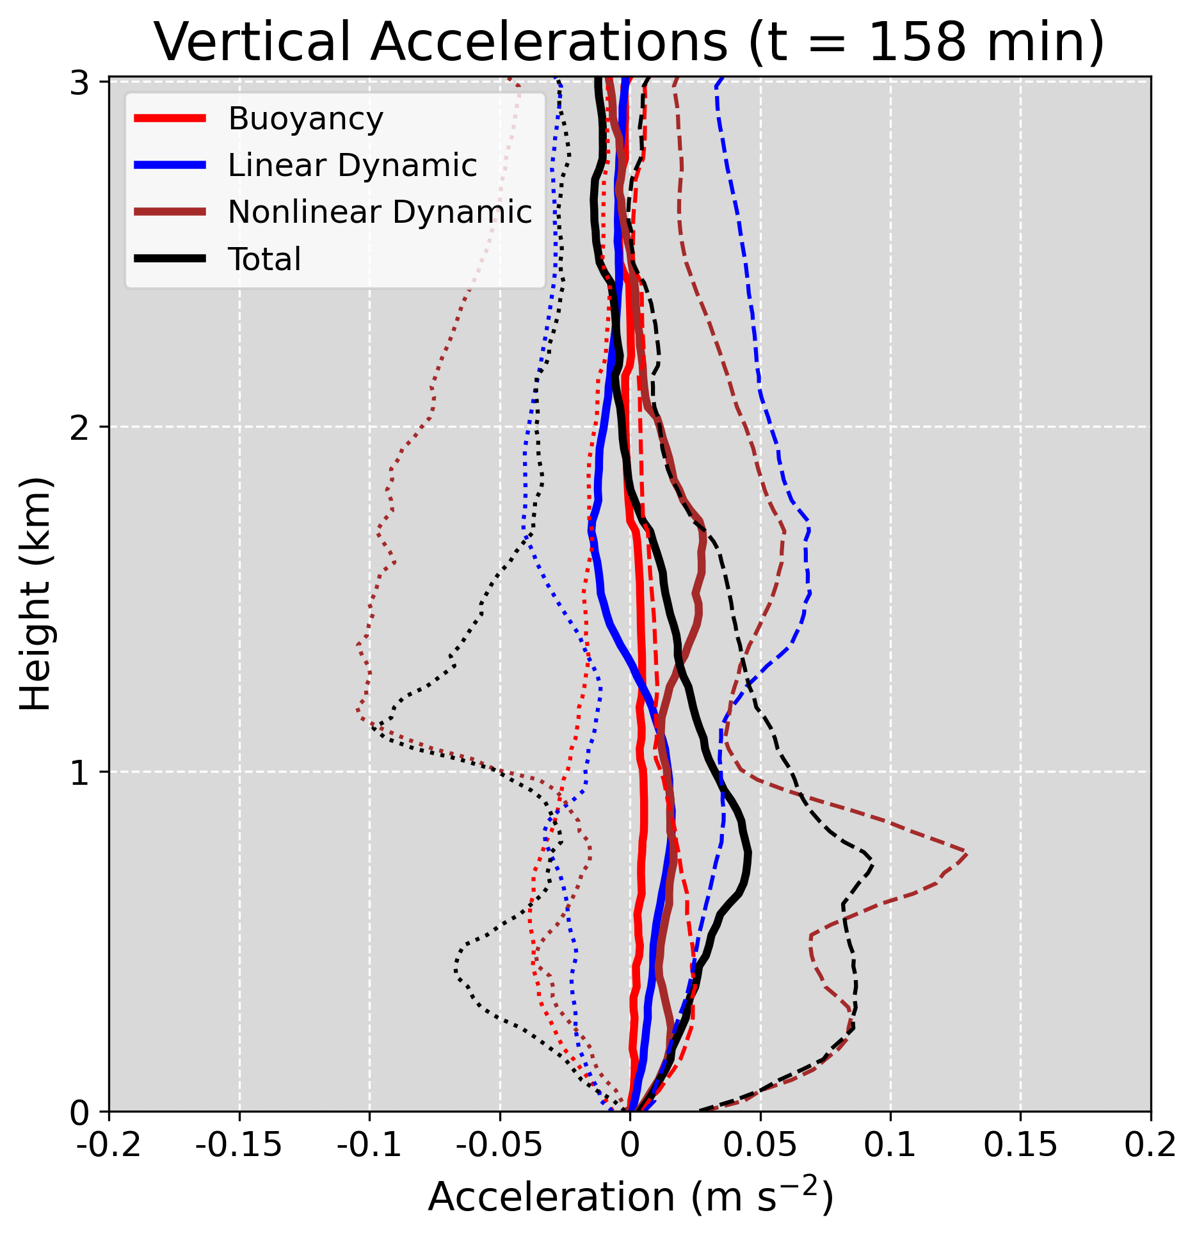
Dynamic contributions to updraft dominant
Cold pool near ground and intermittent rotation aloft
Strong downward acceleration above ~1 km due to lack of updraft rotation
Solid: Median
Dotted: 10th Percentile
Dashed: 90th Percentile

Slide 8
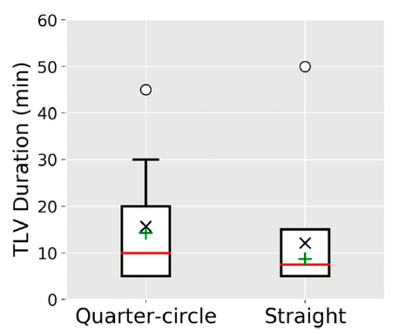
Vortex-updraft alignment
Marion and Trapp 2020, Fig. 9

Slide 9
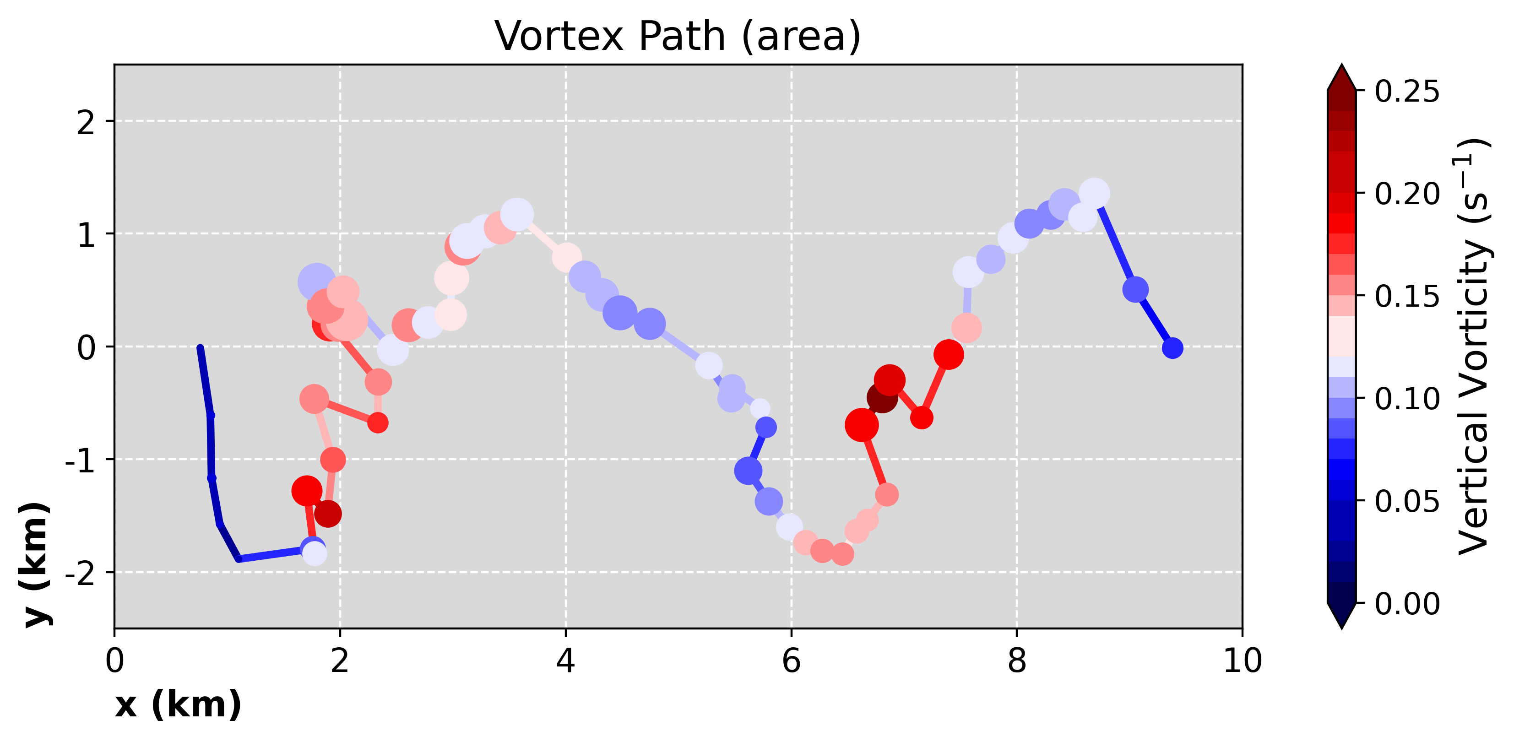
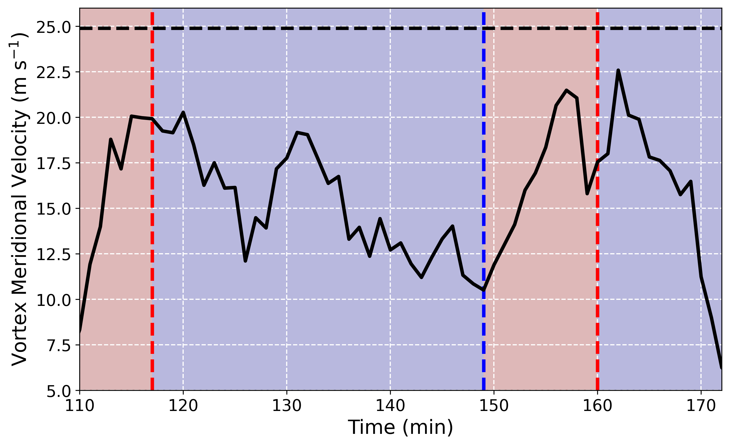
Vortex Motion

Slide 10
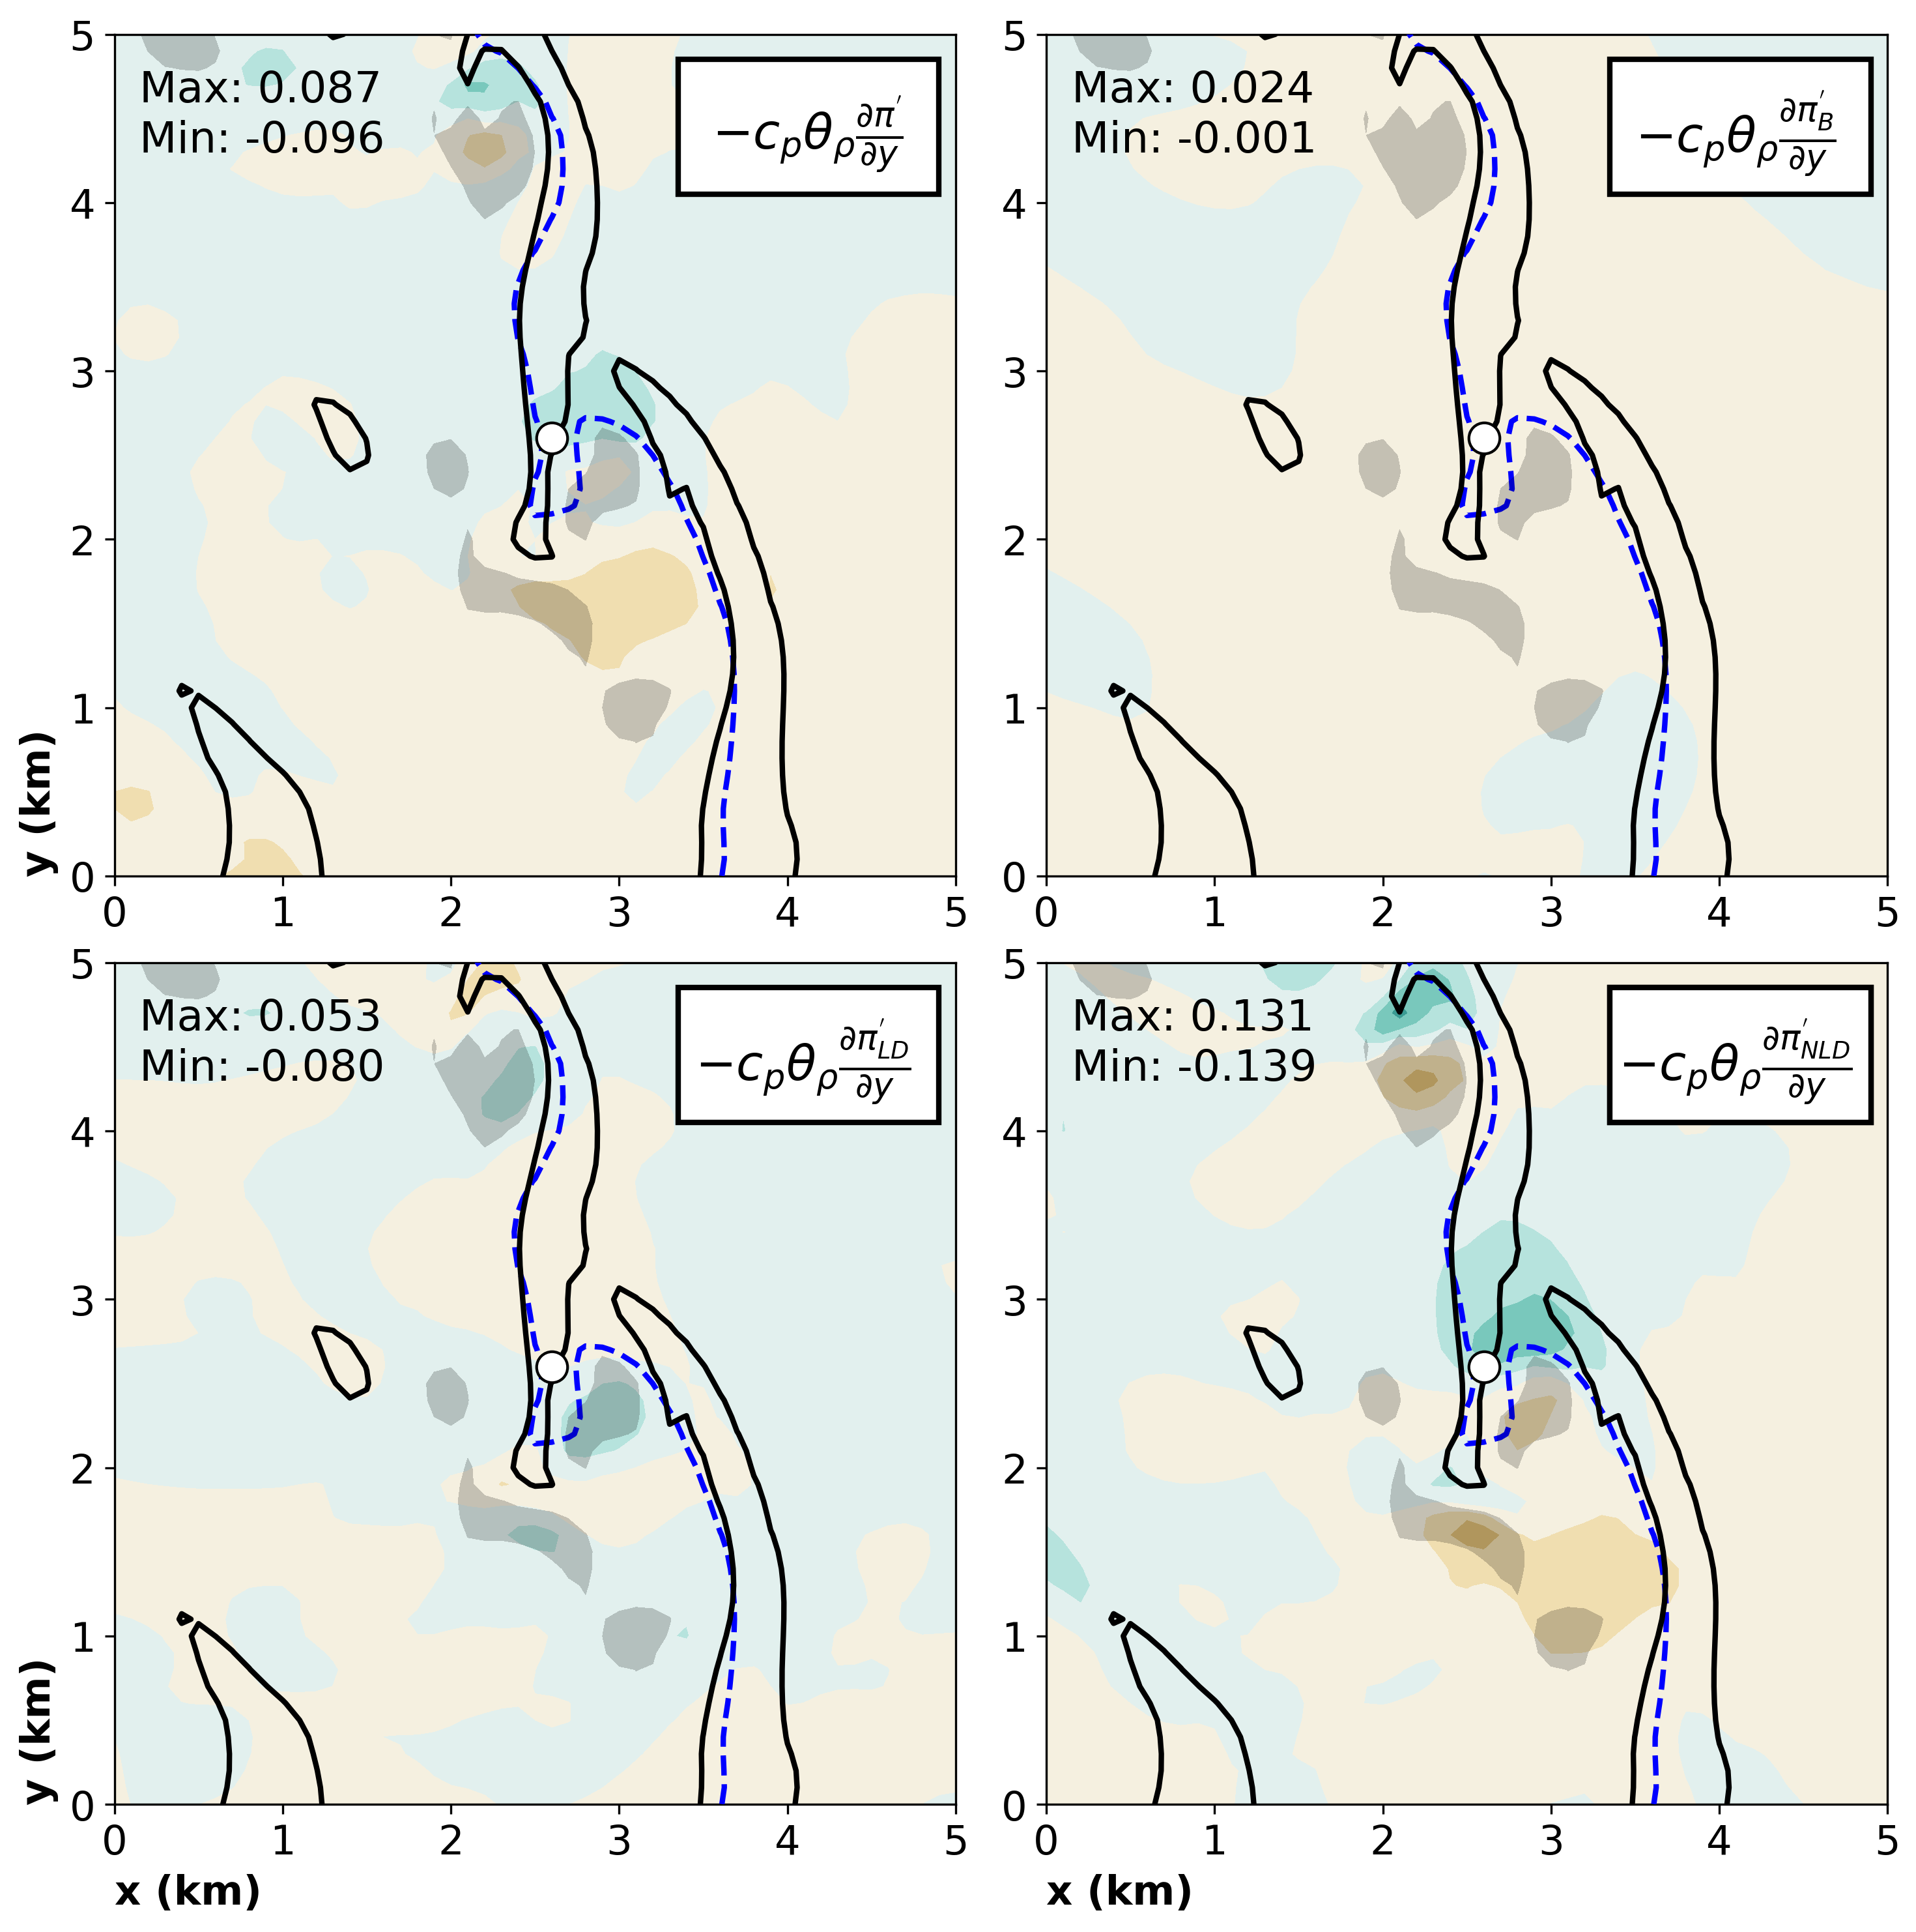
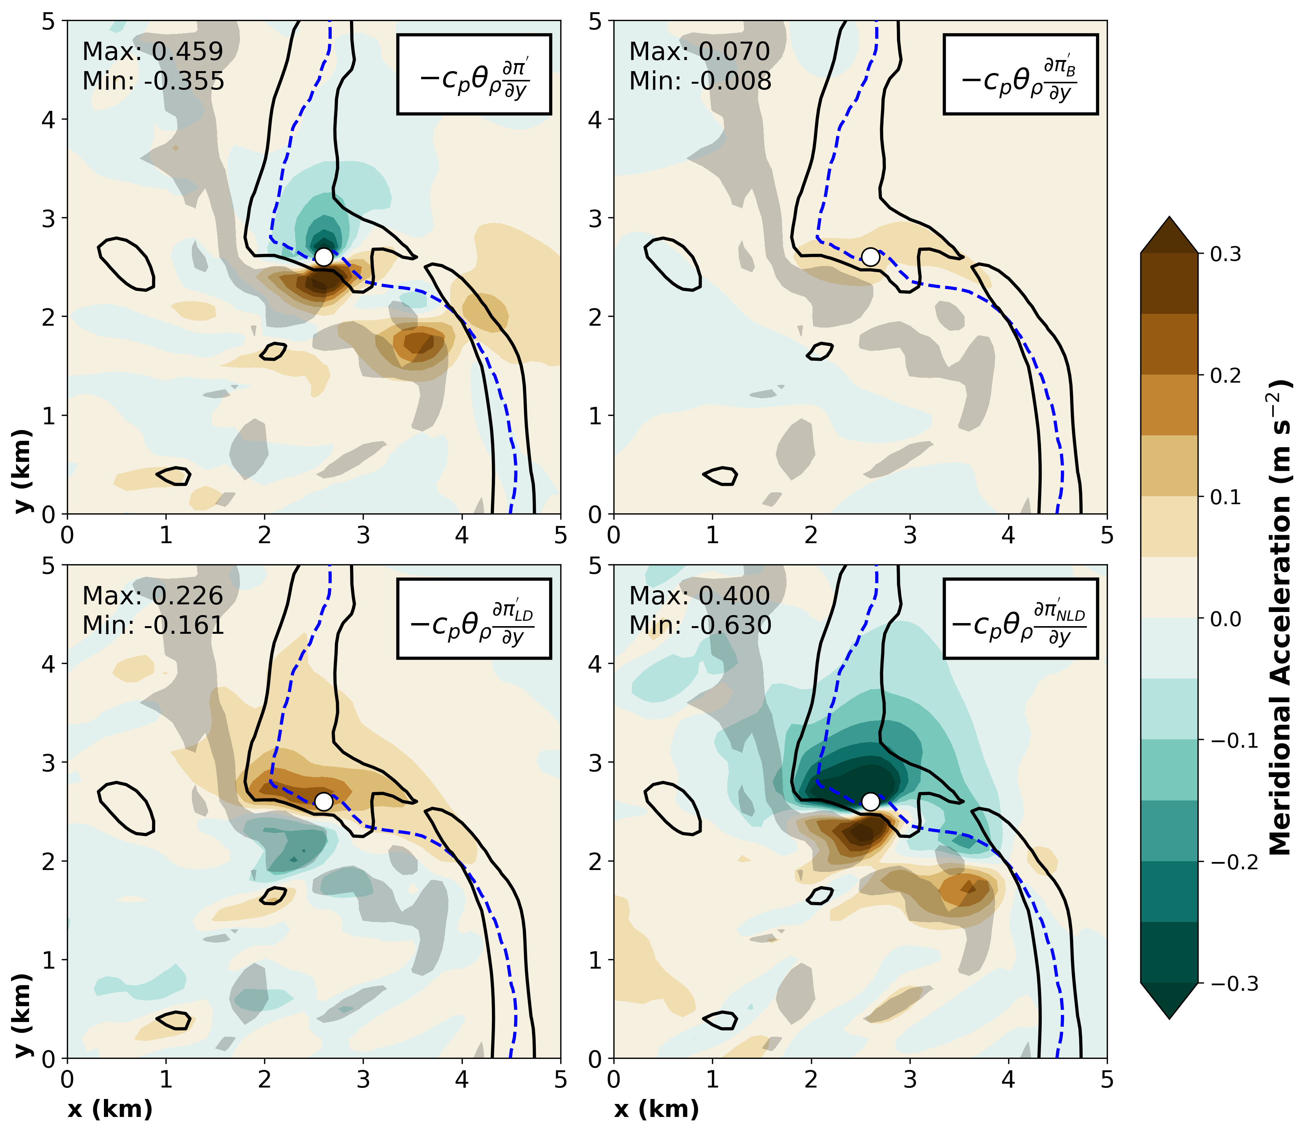
Meridional Accelerations
t = 150 min
t = 159 min
Total
Buoyancy
Total
Buoyancy
LD
NLD
LD
NLD

Slide 11
Vortex-updraft alignment
Line-normal shear
Line-parallel shear
L
H
L
H
Marion and Trapp 2020, Fig. 9

Slide 12
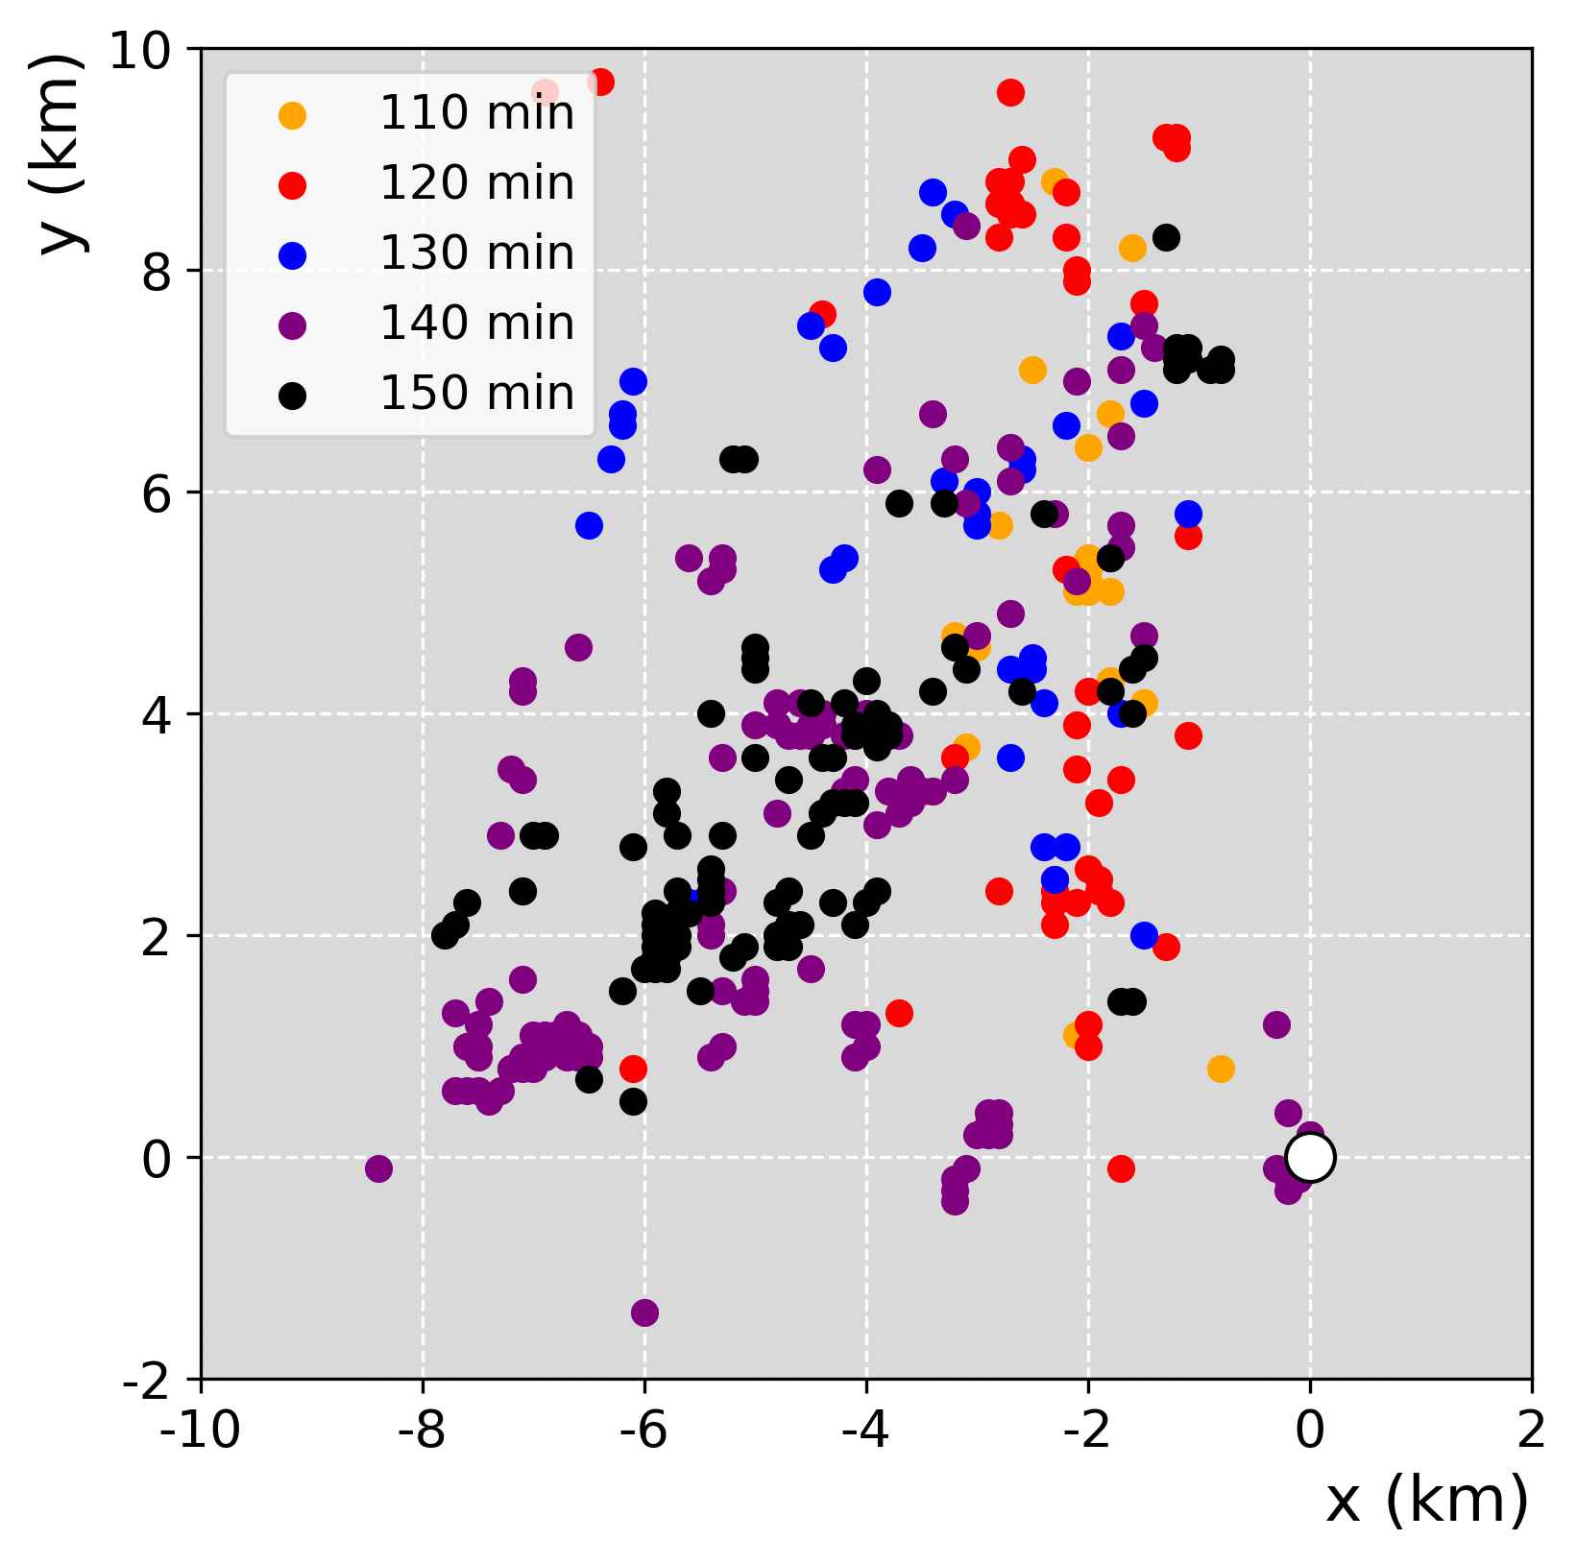
Parcel trajectories
Initialized every 10 min
Parcels that enter the lowest 100 m of vortex
Differences in sources/source regions throughout lifetime

Slide 13
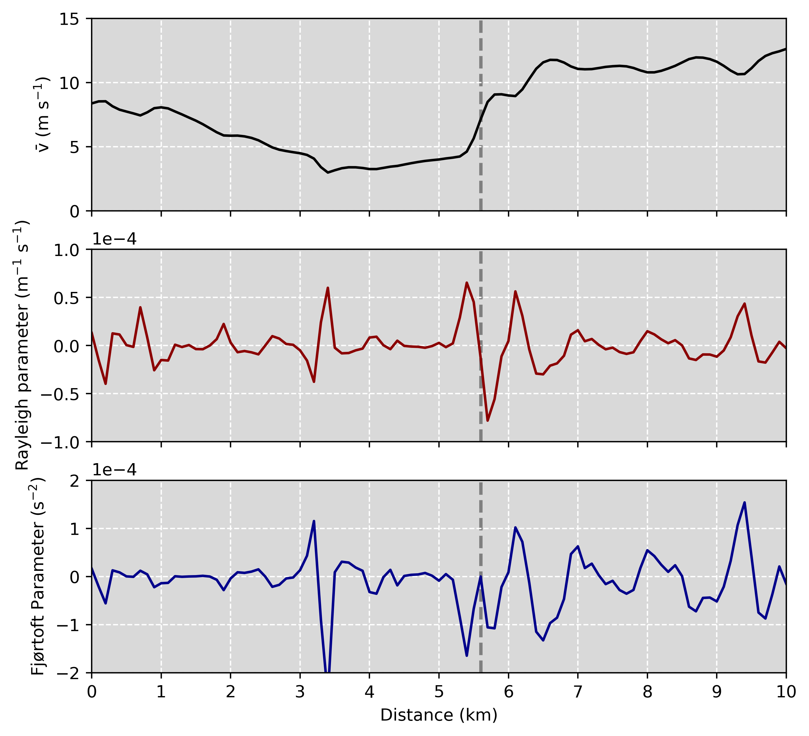
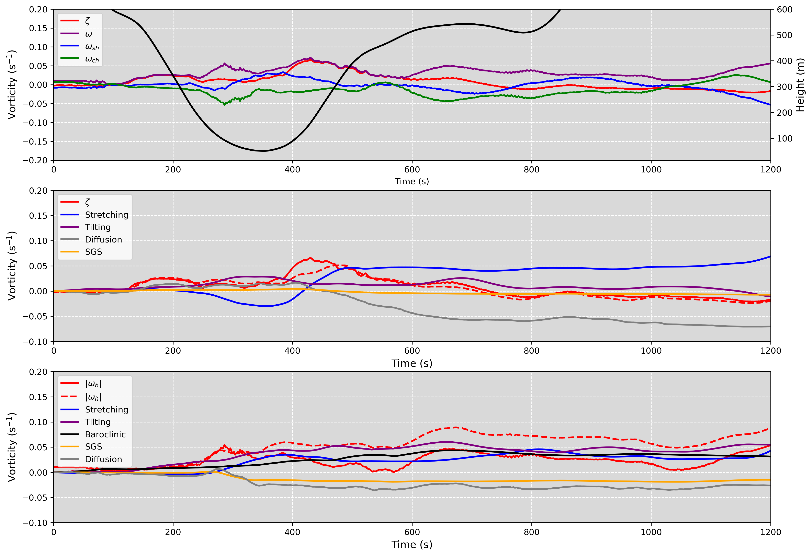
Vorticity Sources - Examples
Formation - HSI
Maintenance – TW03

Slide 14
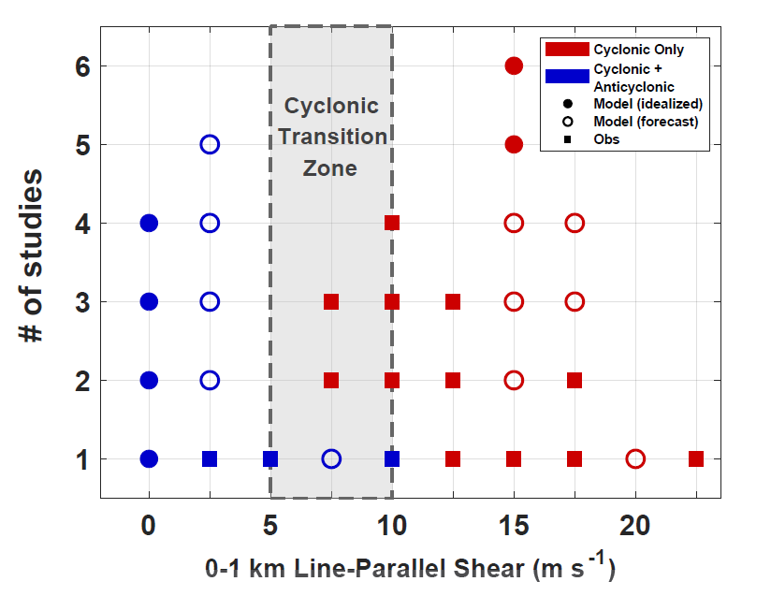
Ongoing and Future Work
Matthew Brown (NSSL): impact of low-level hodograph curvature on draft, mesovortex production
Revisiting the Trapp and Weisman (2003) mechanism
The role of planetary vorticity and hodograph curvature on cyclonic/anticyclonic vortex production
Understanding dynamical differences between high-to-moderate and low-CAPE QLCSs
Brown et al., submitted to MWR

