Slide 1
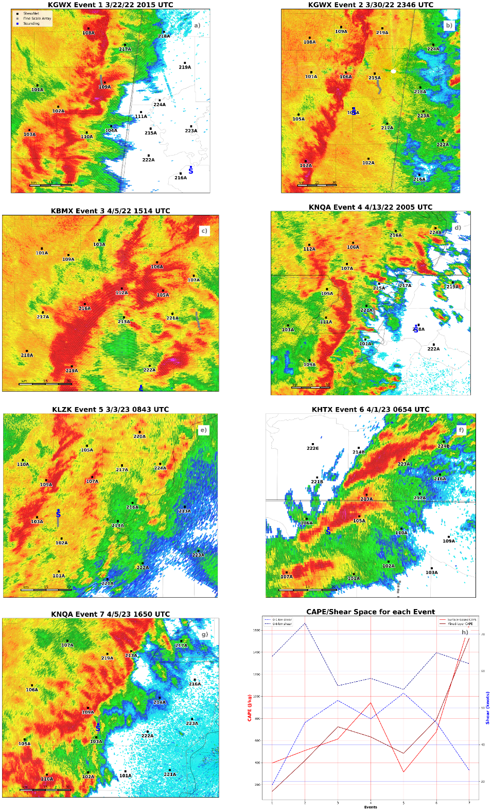

Texas Tech StickNet Near-Mesovortex Observations during PERiLS
Joshua Ostaszewski and Christopher Weiss
Ostaszewski J. S., and C. C. Weiss, 2023: Surface Cold Pool Observations near Tornadic and Nontornadic QLCS Mesovortices during PERiLS. In Prep.
Acknowledgements: Jessica McDonald, TTU PhD Candidate
Alex Schueth, TTU PhD Candidate
Kelcy Brunner, TTU Postdoc

Slide 2
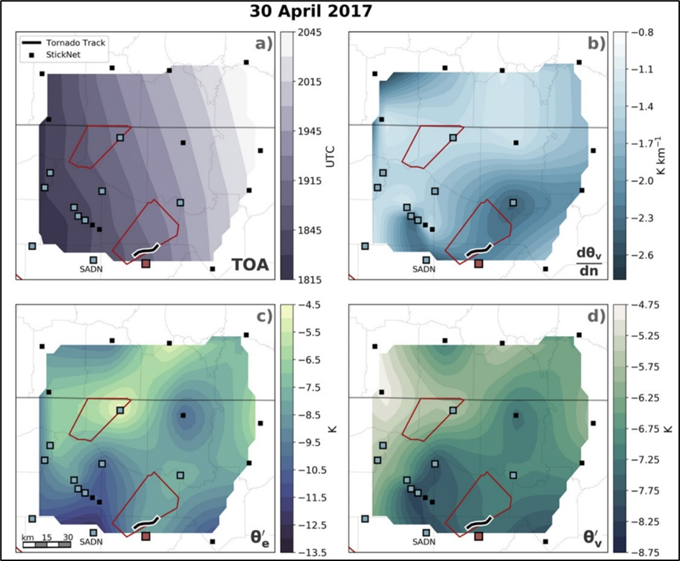
McDonald and Weiss 2021 found during the VORTEX-SE field project that the strongest horizontal θ_{ν} gradients were near tornadic portions of the QLCS
  Greater relative baroclinity near rotation
  A possible source of vorticity for tornadogenesis through the implied baroclinic vorticity generation
  Same correlation not found in the deficits
  Contradicts supercell cold pool studies
Do similar thermodynamic gradient and deficit findings from McDonald and Weiss (2021) translate to the QLCSs observed during PERiLS?
How do thermodynamic gradients and deficits change north vs. south of a mesovortex?
Are thermodynamic gradients and deficits near tornadic mesovortices dependent on the time relative to the tornado occurring?
Do supercells in HSLC environments have weaker overall cold pools?
What are the differences in cold pool characteristics of ‘hybrid mesovortices’ that are attributed to supercell-QLCS mergers?
Correlation between Horizontal Baroclinic Vorticity Generation and Tornado likelihood
McDonald and Weiss 2021 (Fig.8)

Slide 3
PERiLS Overview and StickNet Intercept Totals
166 total cold pool intercepts!
142 HSLC intercepts!
Year One
Year Two
Y1+Y2
*56 HSLC MVs
*10 HSLC H
*33 HSLC NT MVs
*4 HSLC NT H
*Does not include the 17 NT MCs from IOP2 and the 26 NT MCs from IOP3 due to not being HSLC

Slide 4
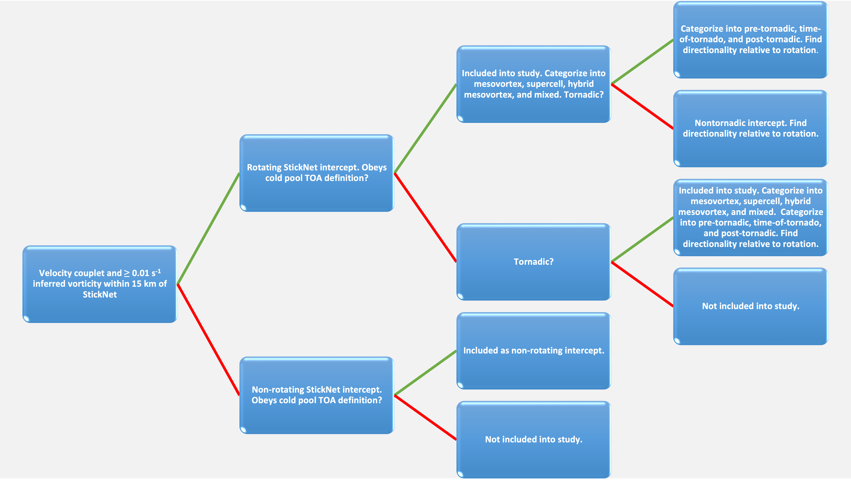
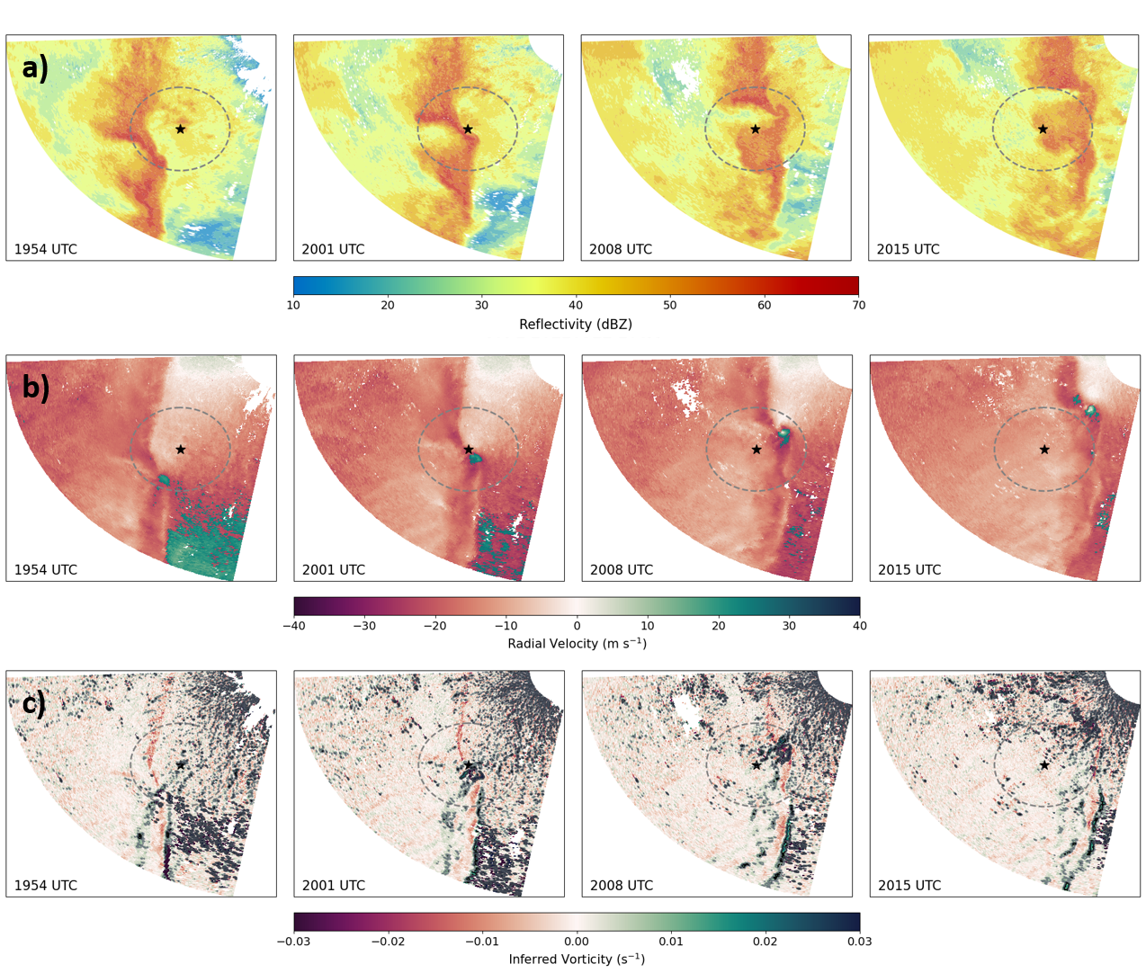
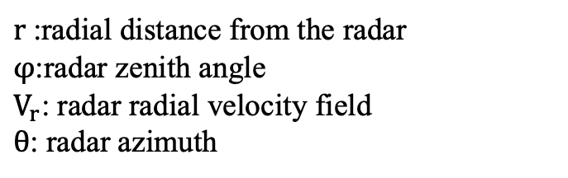
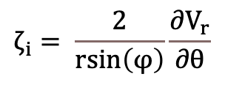
StickNet Intercept Definition
A StickNet intercept is deemed near rotation if a collocation of a radial velocity couplet and inferred vorticity > 0.01 s⁻¹ occurred within a 15 km radius of the probe
*Used the closest WSR-88D
$r$:radial distance from the radar
$φ$:radar zenith angle
$V_{r}$: radar radial velocity field
$θ$: radar azimuth
$$ζ_{i}= \frac{2}{rsin\left(φ\right)}\frac{∂V_{r}}{∂θ}$$

Slide 5
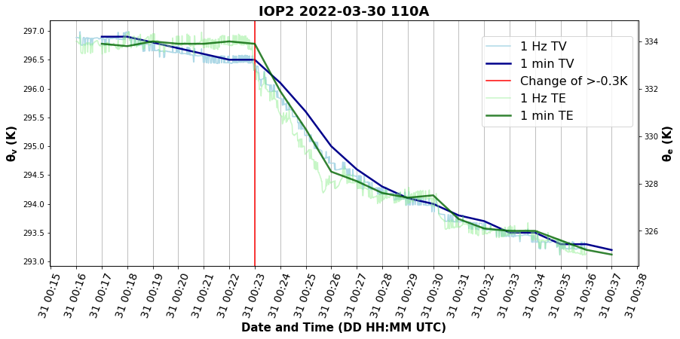
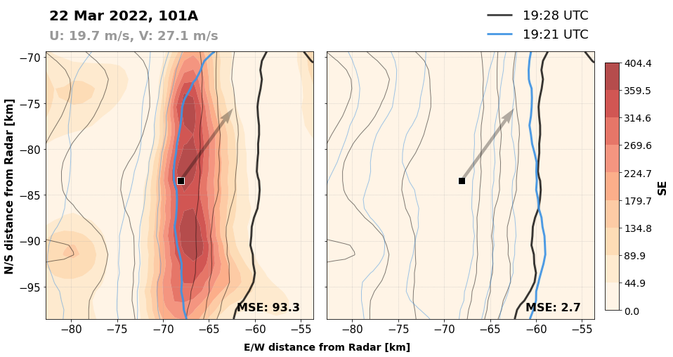
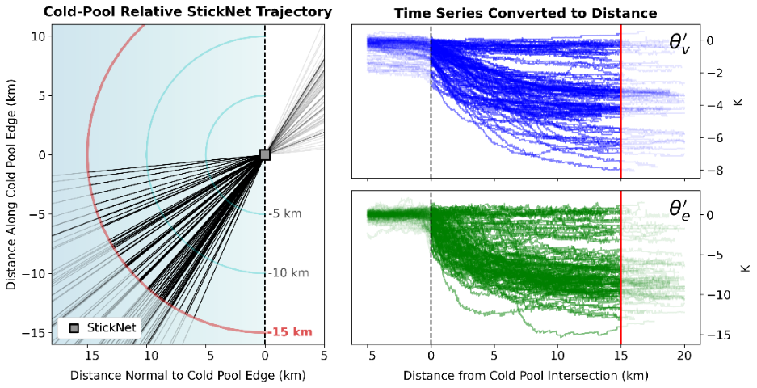
Characterization of Cold Pools
Storm Mode Types
Linear-NR: Non-rotating segments of QLCS
Mesovortex (MV): Embedded circulation along leading edge of QLCS
Hybrid (H): MV with part of circulation attributed and traced back from MC/QLCS merger upstream
Mesocyclone (MC): Discrete circulation clearly separated from QLCS
Mixed (M): Sampled QLCS with a MC within 15 km. Unable to separate cold pools
Identify cold pool TOA
A one-minute decrease in θ_{v} of 0.3 K, 0.2 K, or 0.1 K that occurs over at least two consecutive minutes
Calculate Storm Motions
Two ref scans are interpolated on a 1 km grid, subset to a 30 km box, and the first scan is shifted to the next to find the exact orientation that minimizes the MSE
Tornadic Intercepts
Calculate Base State and Deficits
BS: Time-to-space conversions then averaging 10-15 km before TOA.
Deficits: Subtract BS from minimum found within 15 km of the cold pool
Time of Tornado: Tornado occurred within 15 km of a probe
Pre-Tornadic: Tornado occurred >15 km radius, -30 mins of TOA
Post-Tornadic: Tornado occurred >15 km radius, +30 mins of TOA

Slide 6
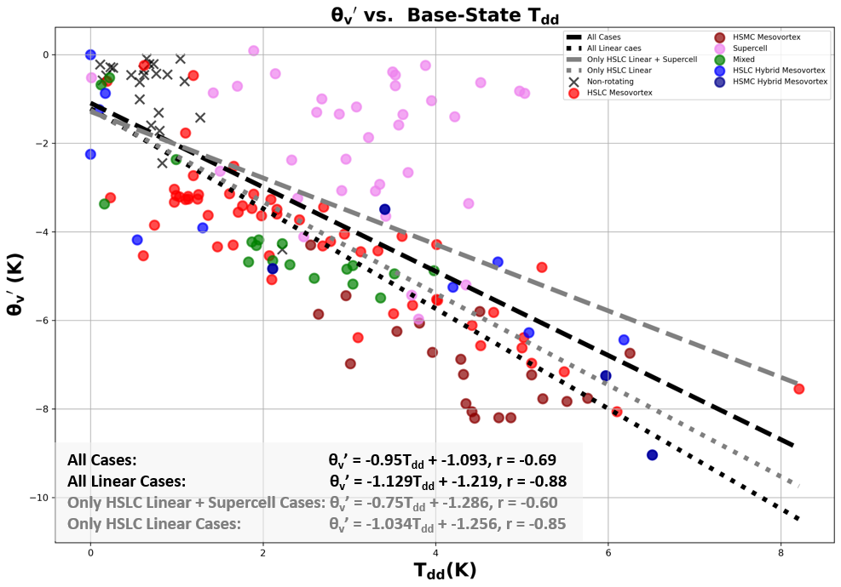
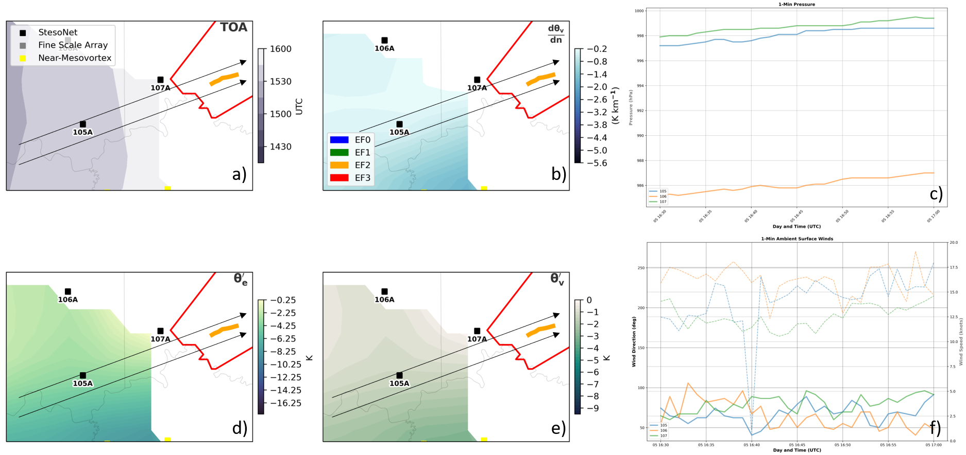
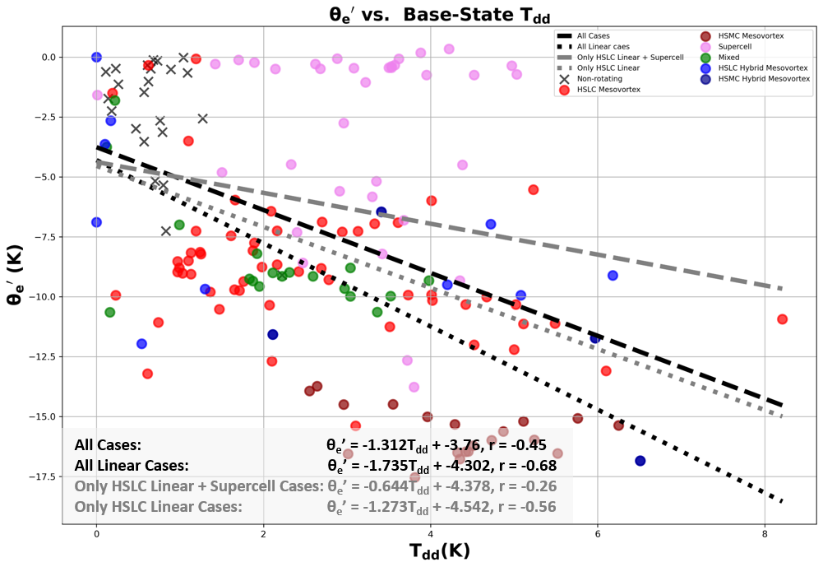
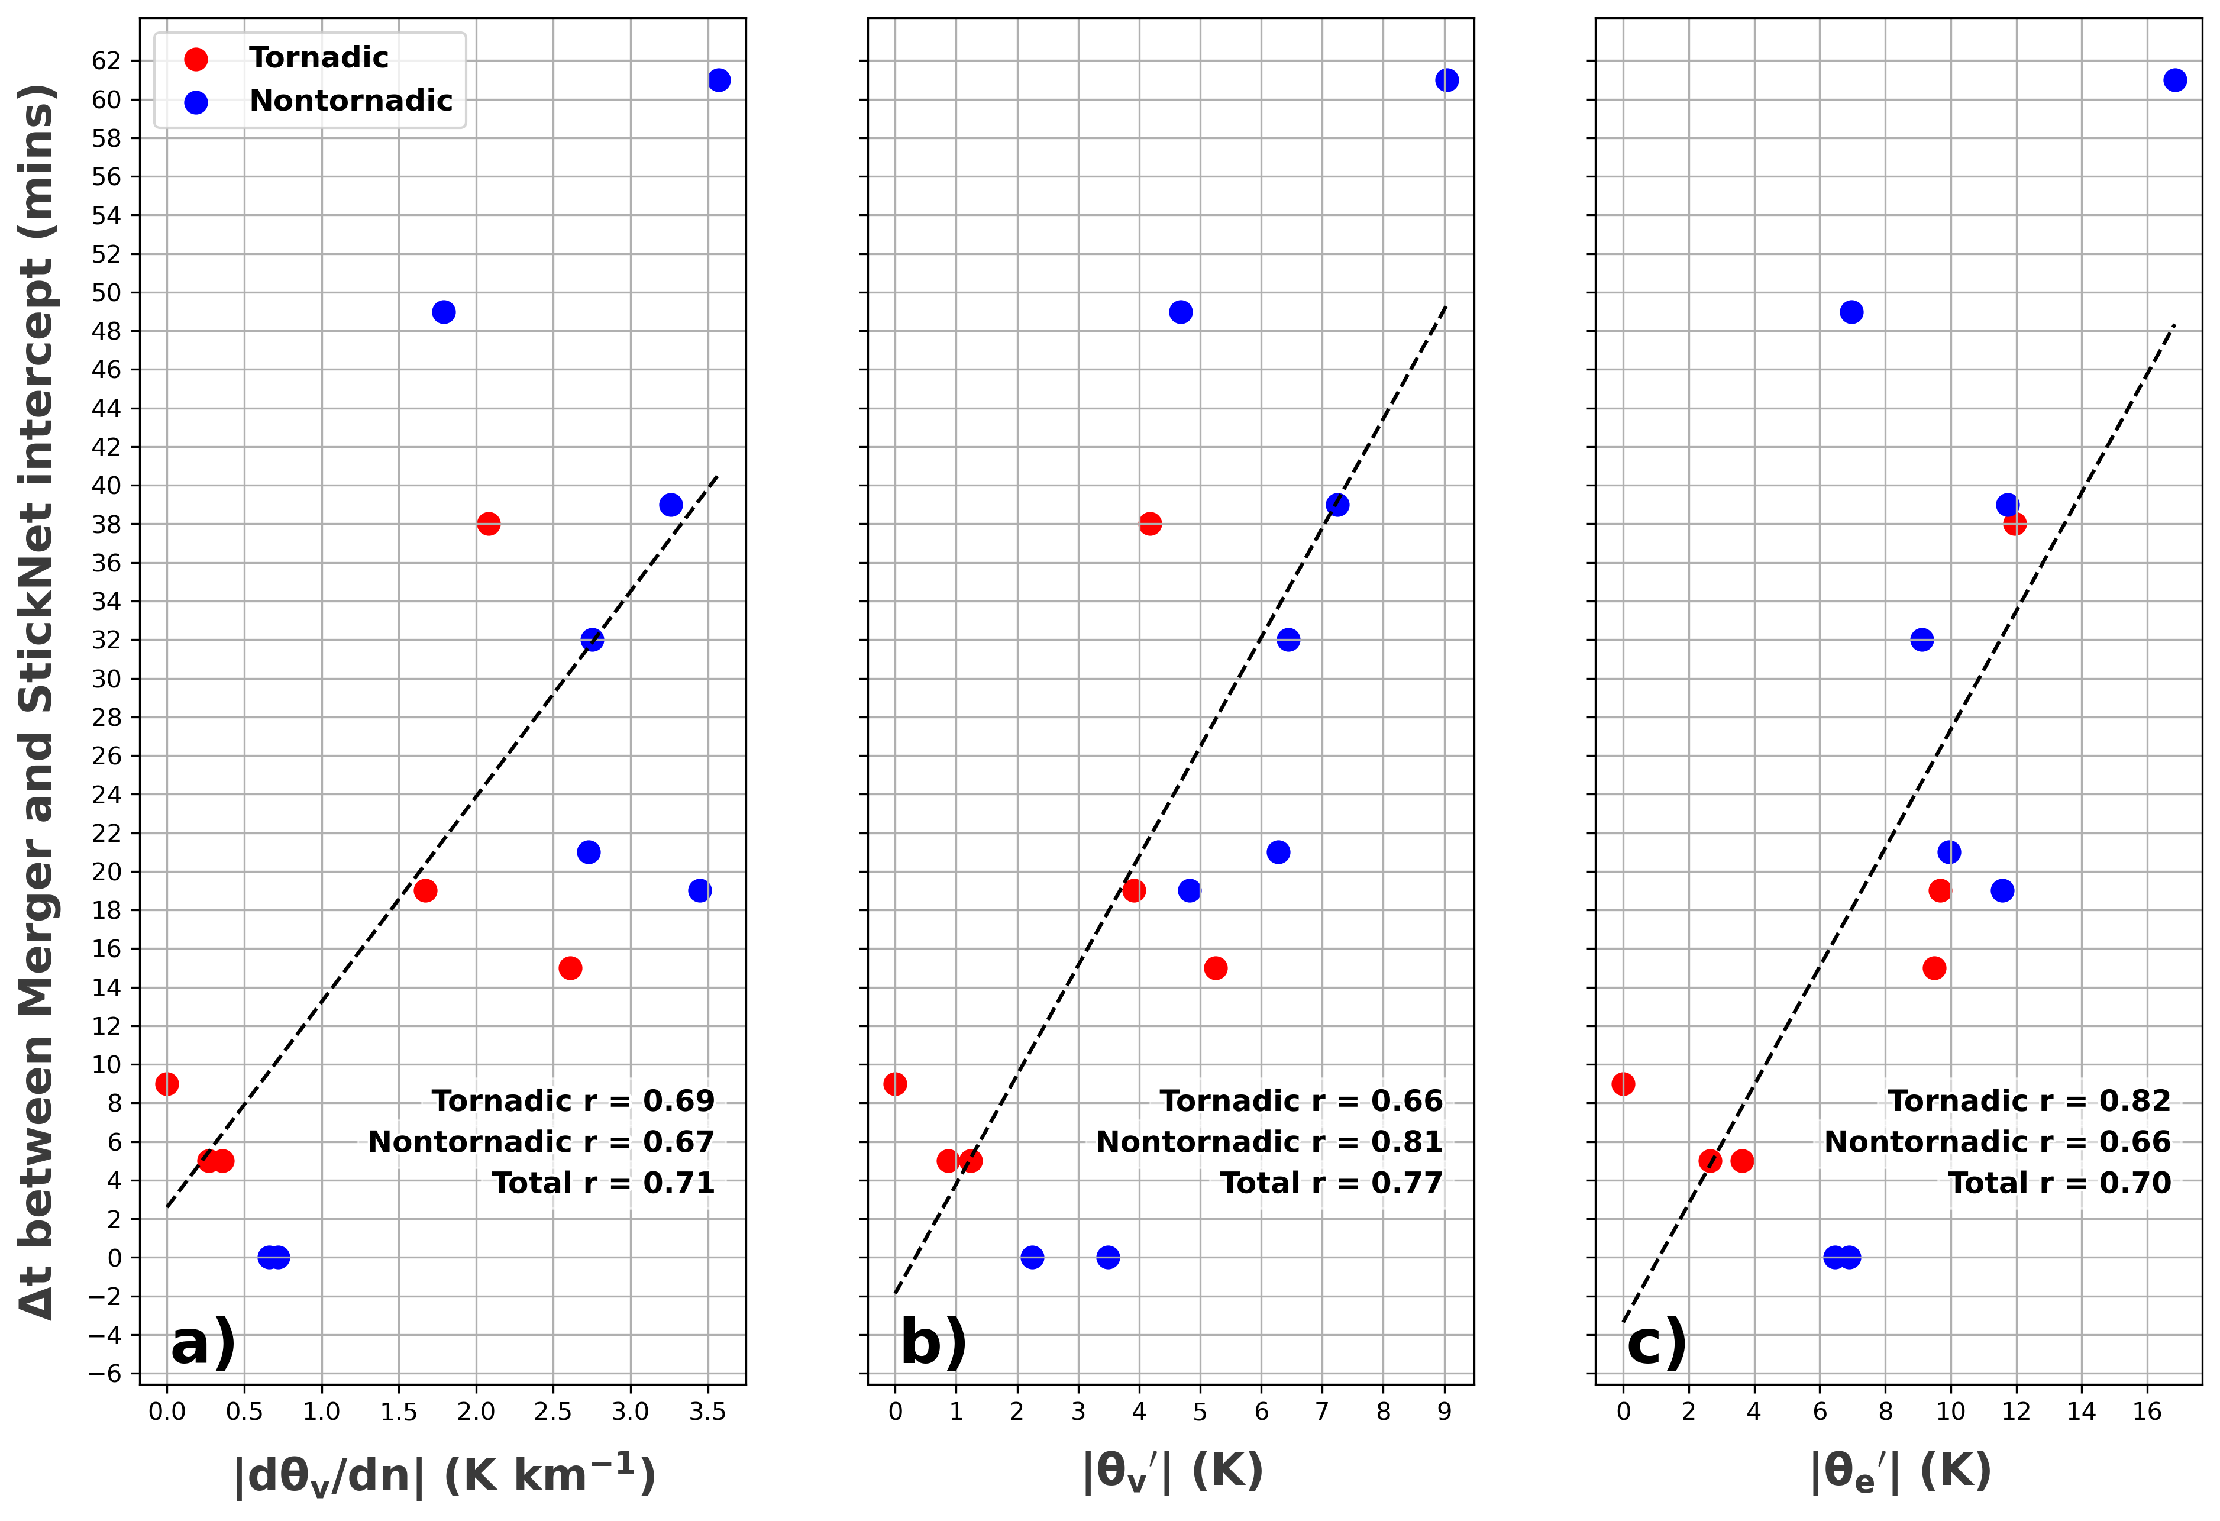
Hybrid Mesovortex Intercepts
-Correlation between deficits and Tdd similar to other cold pool studies
-Supercells have weaker cold pools
-Cold pool properties are weakened closest to time-of-merger

Slide 7
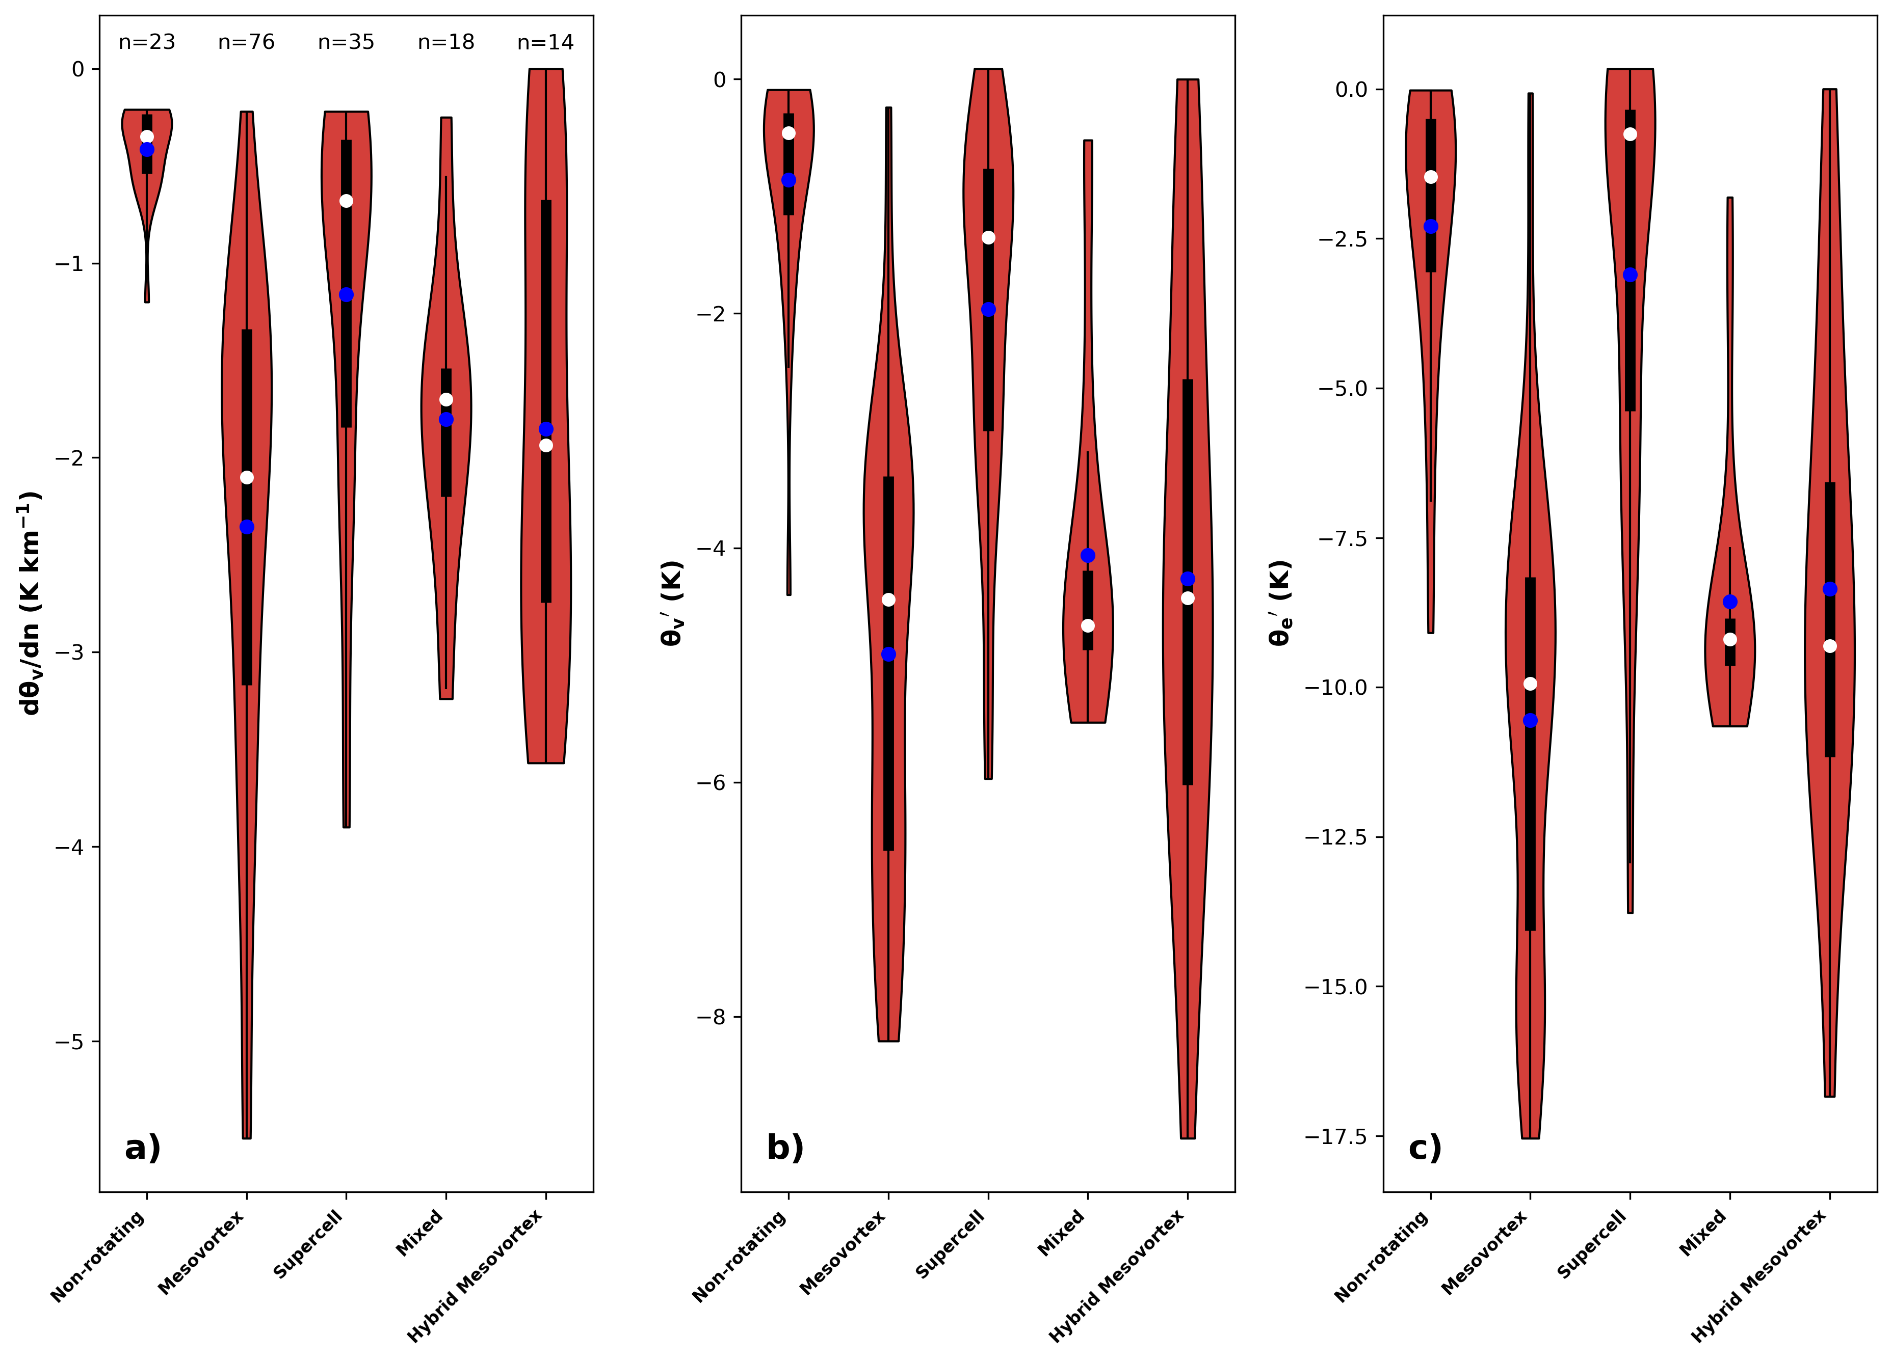
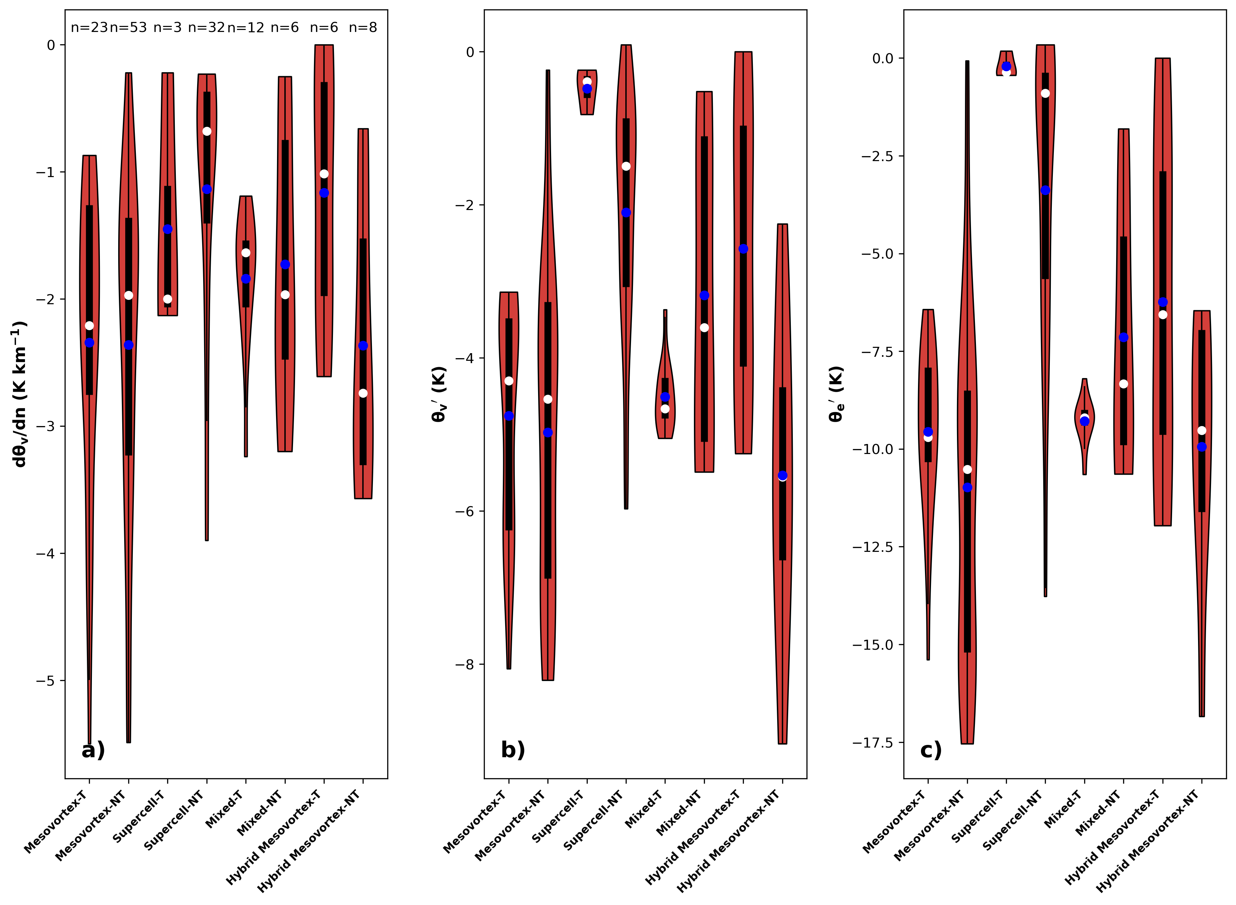
Rotating vs Non-rotating
Tornadic vs Nontornadic

Slide 8
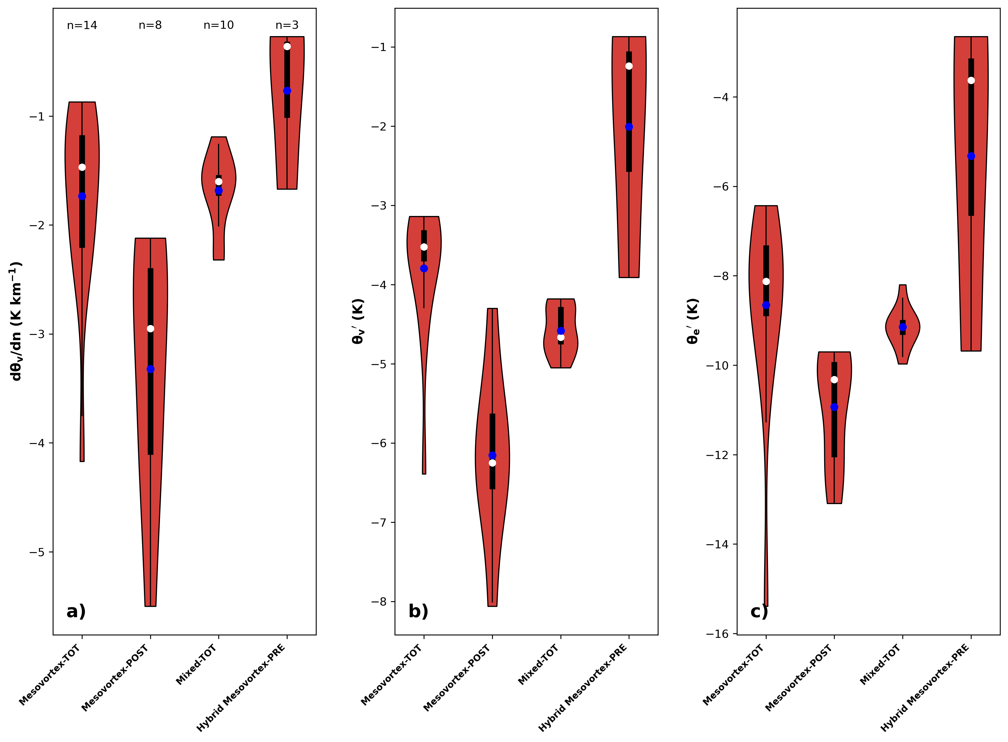
Time-Relative to Tornado
-Lack of pre-tornadic mesovortex intercepts
-No pre-mesovortex intercepts
-Strongest baroclinic zones occurred near post-tornadic intercepts, although, how did these baroclinic zones evolve to this state?

Slide 9
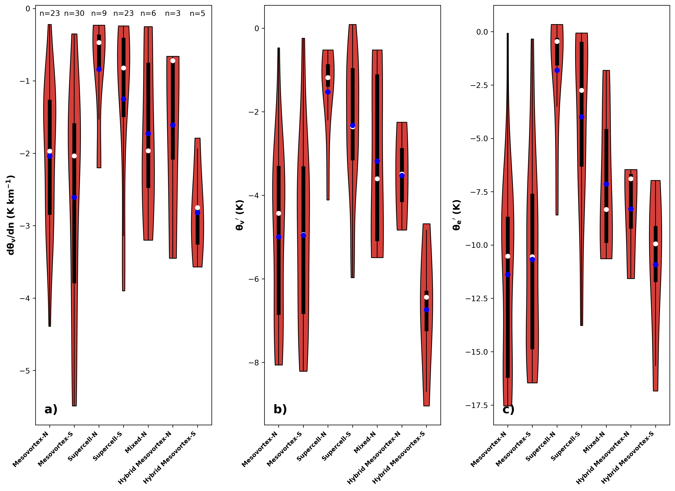
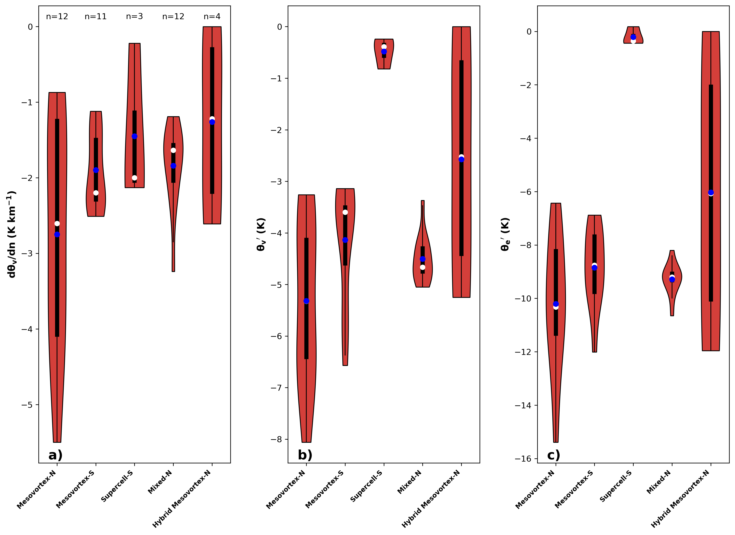
Directionality
Nontornadic Samples
Tornadic Samples

Slide 10
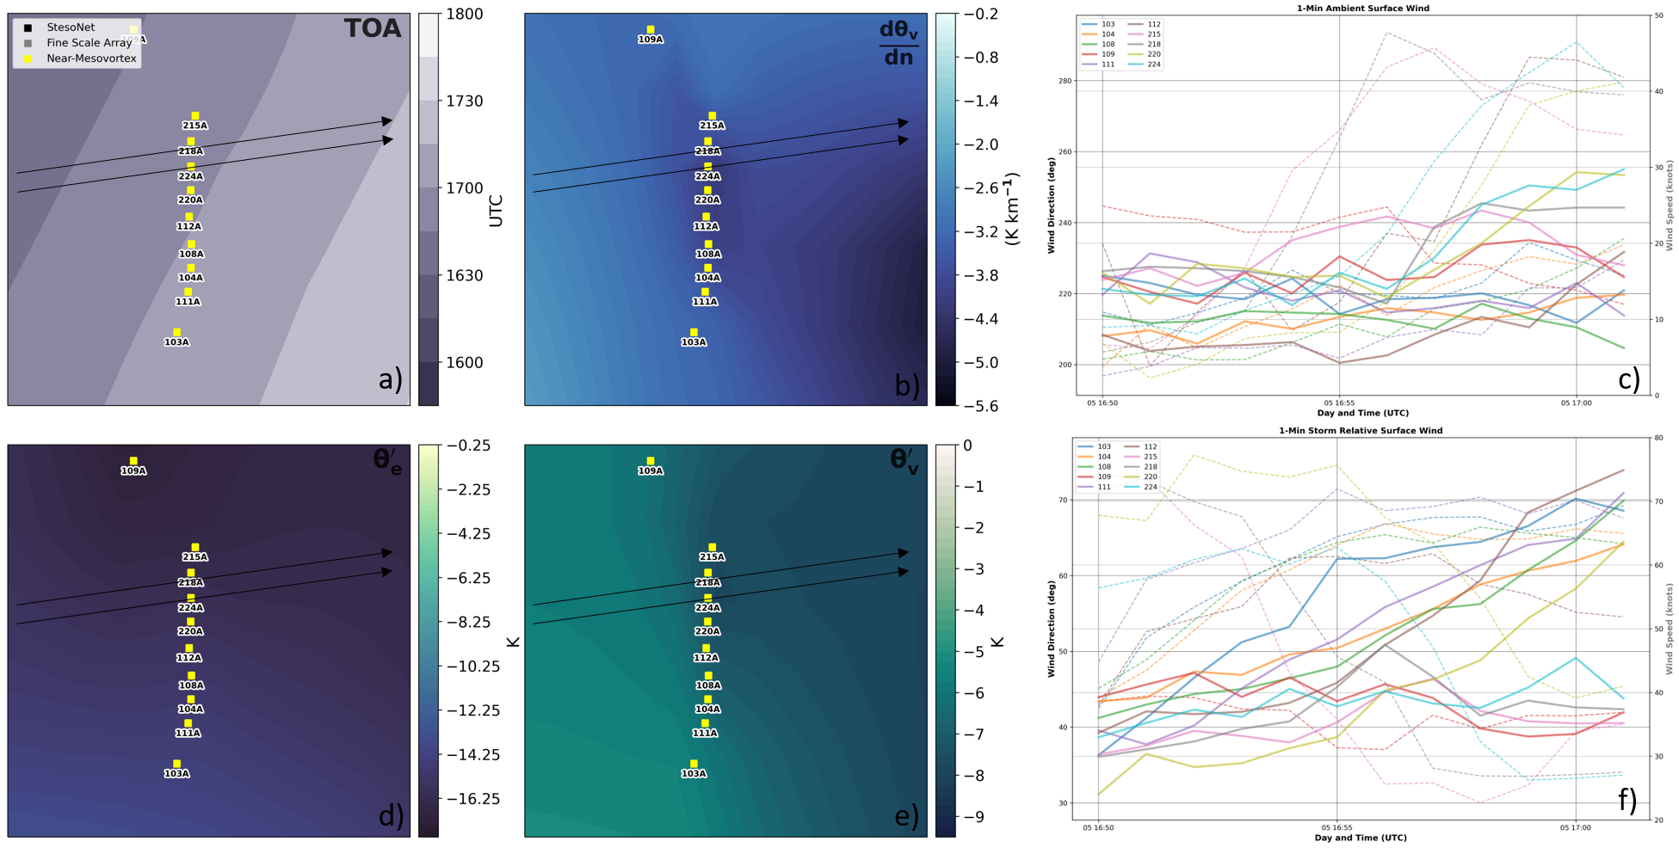
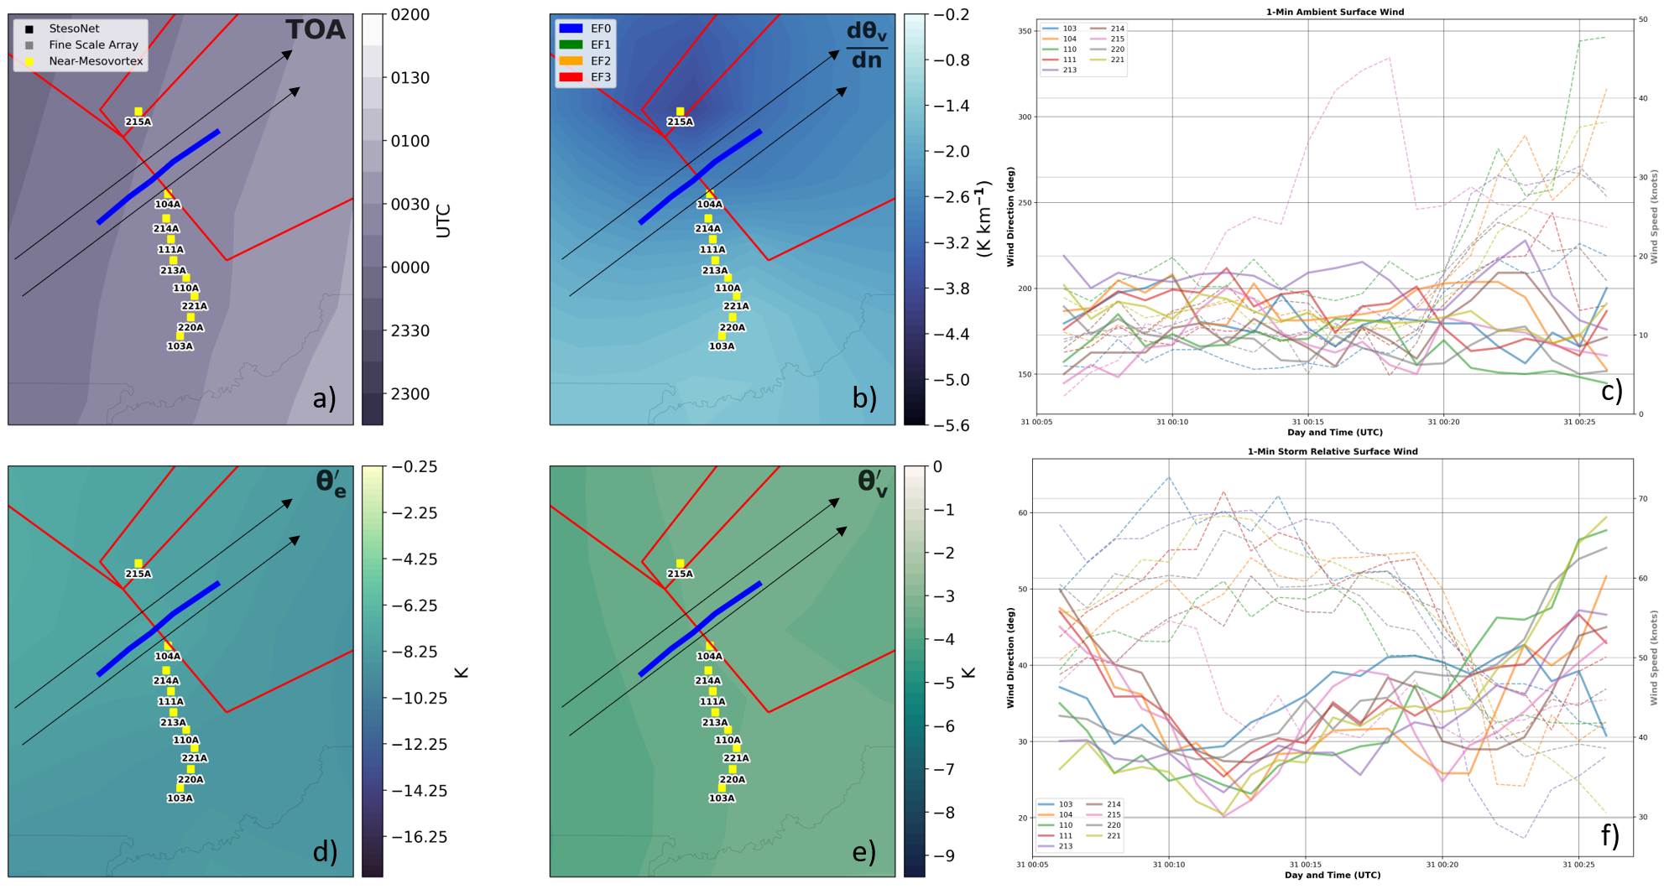
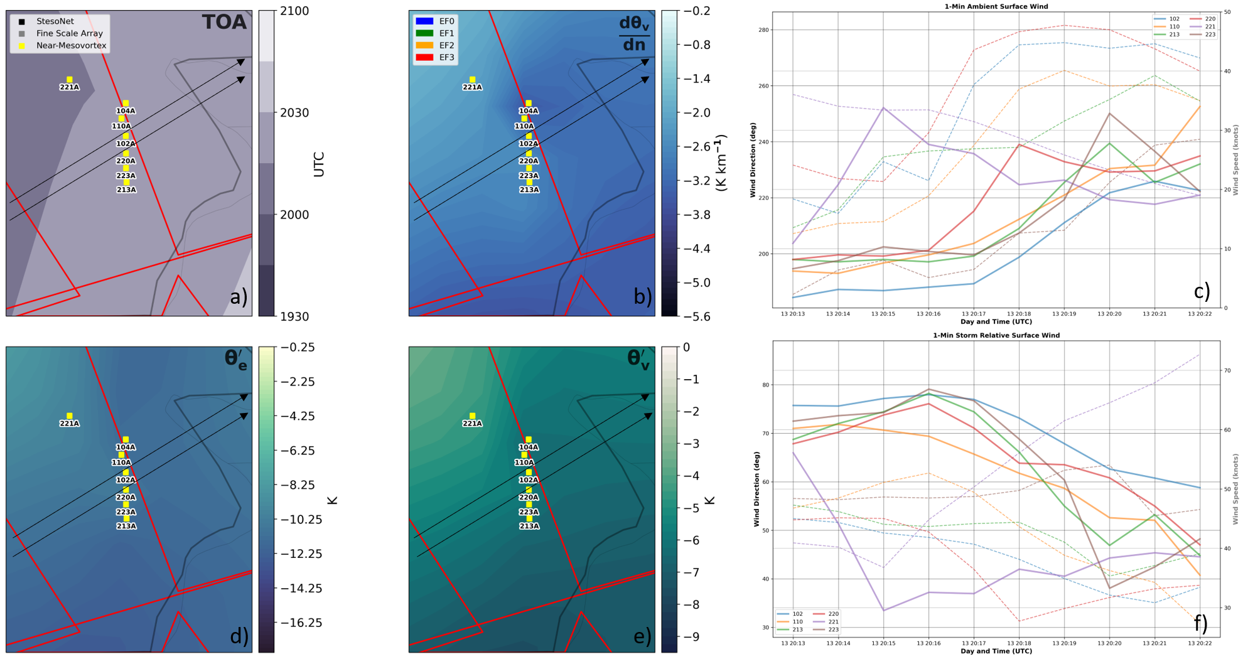
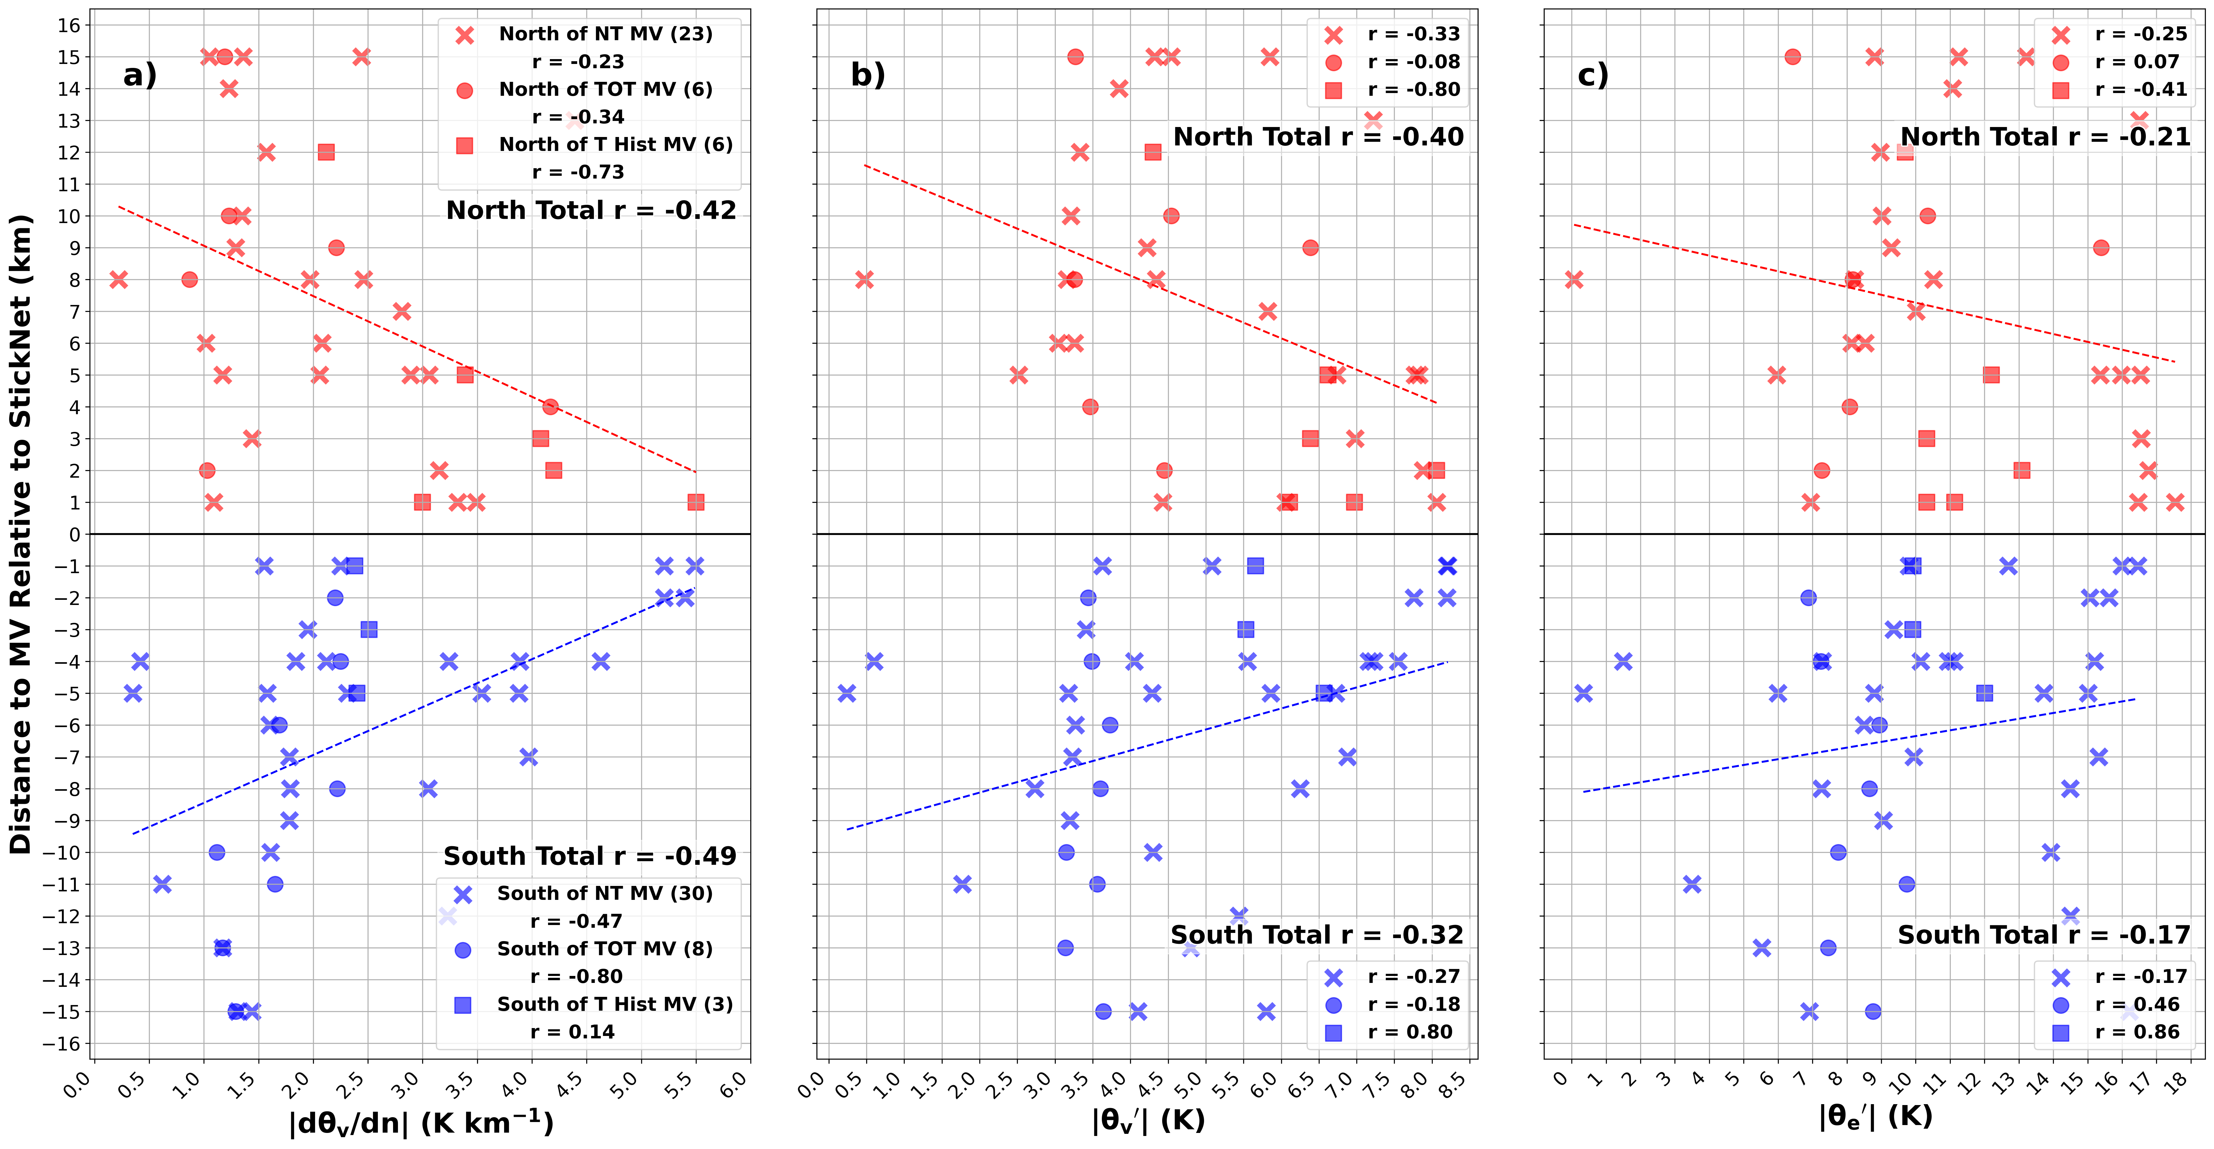
Nontornadic MV
Time-of-Tornado MV
Post-Tornadic MV
All MV intercepts

Slide 11
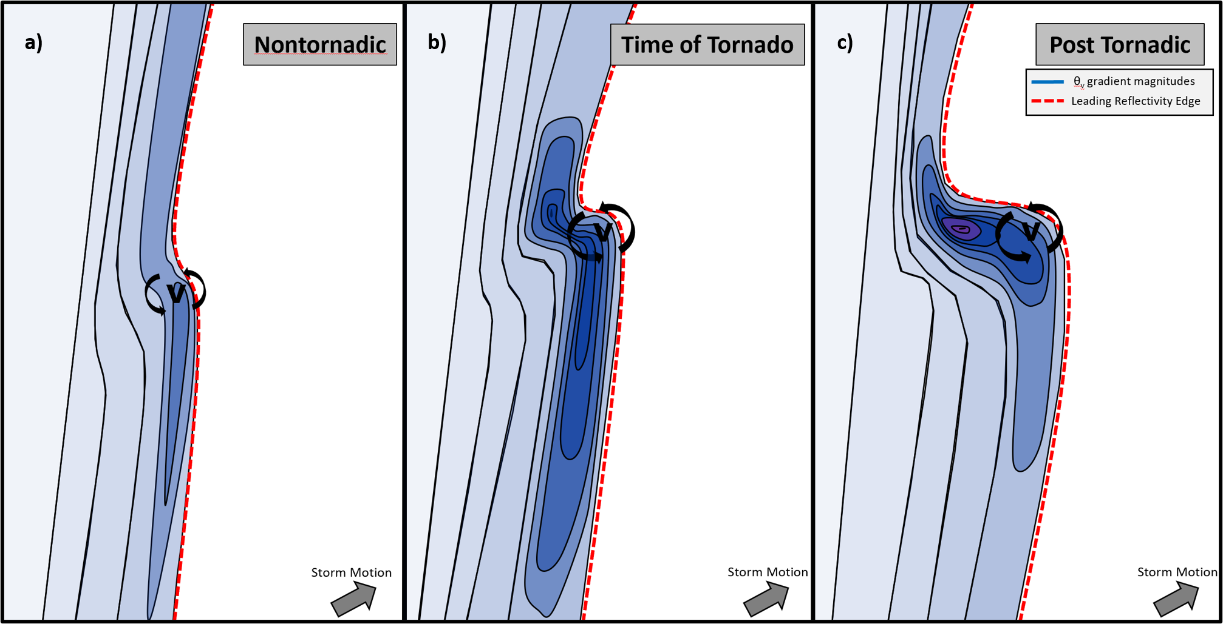
Conclusions
Challenges
No pre-mesovortex/-tornadic samples
No parcel trajectories (lack of dual Doppler)
Only surface measurements. What is happening just above (~lowest 100 m)?
Baroclinity present but cannot discredit other vorticity sources simultaneously present
Future Work
Explore frictional and barotropic effects
Assess rapid destabilization within the StesoNet
Add a modeling component to explore how much baroclinic vorticity is important during and downstream of HSLC QLCS-supercell mergers
Greater baroclinity found near rotating segments than the parent QLCS
Preferential baroclinic zones evolve during an already present MV lifecycle
HSLC supercell cold pools are weaker than supercells in larger buoyancy environments, and supercells leading a QLCS tend to weaken the immediate cold pool when absorbed by the QLCS (i.e., hybrid MV)

