Slide 1
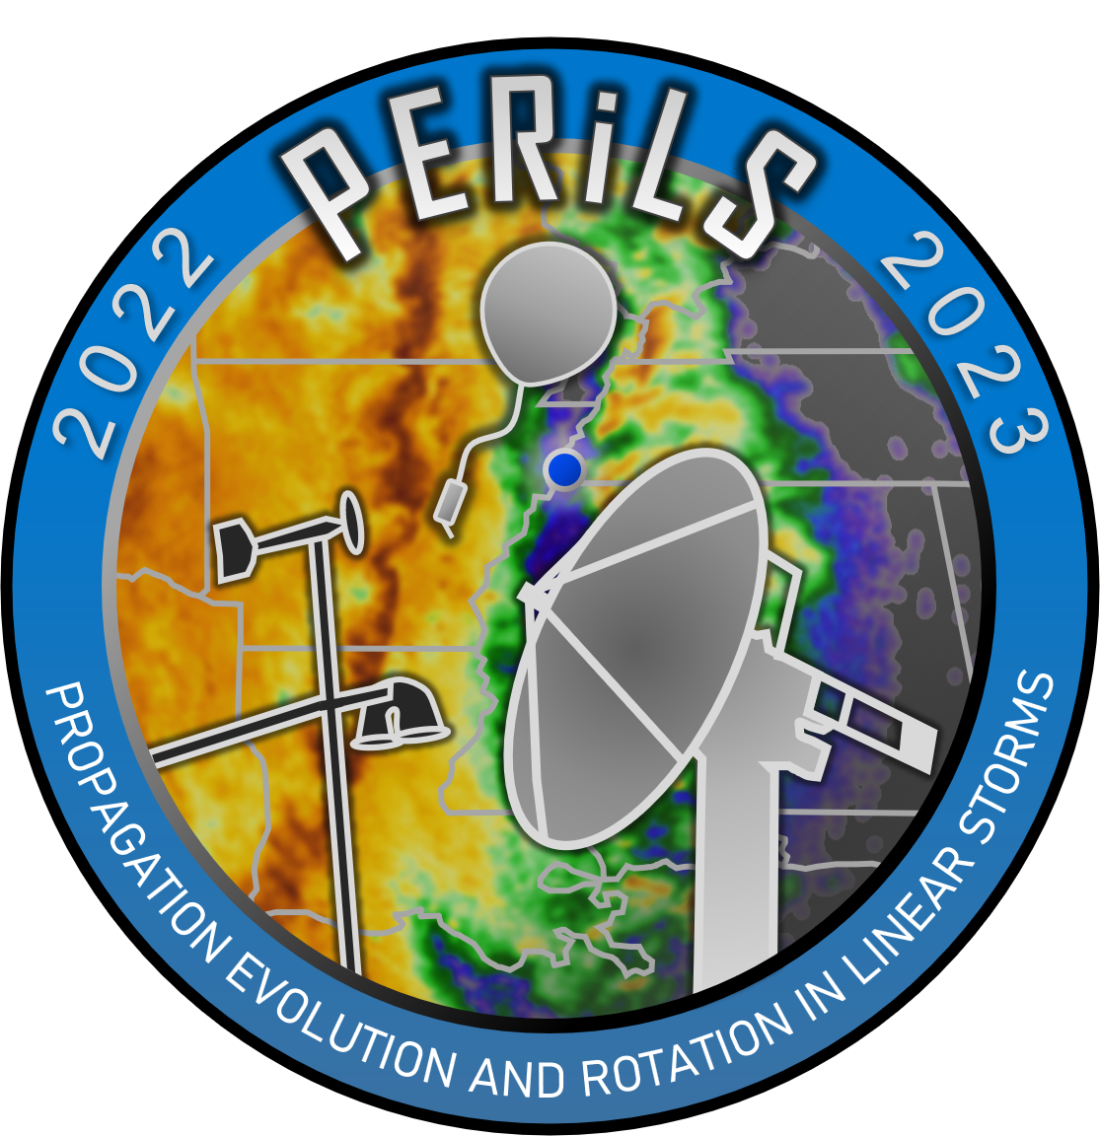
Characteristics of Tornadic and Nontornadic QLCS Mesovortices Observed Using Radar and Pod Data from PERiLS
Leanne Blind-Doskocil¹, Robert J. Trapp¹, Stephen W. Nesbitt¹, Karen A. Kosiba¹, Joshua Wurman¹, Matthew D. Parker²
¹ University of Illinois Urbana-Champaign (UIUC)
² North Carolina State University

Slide 2
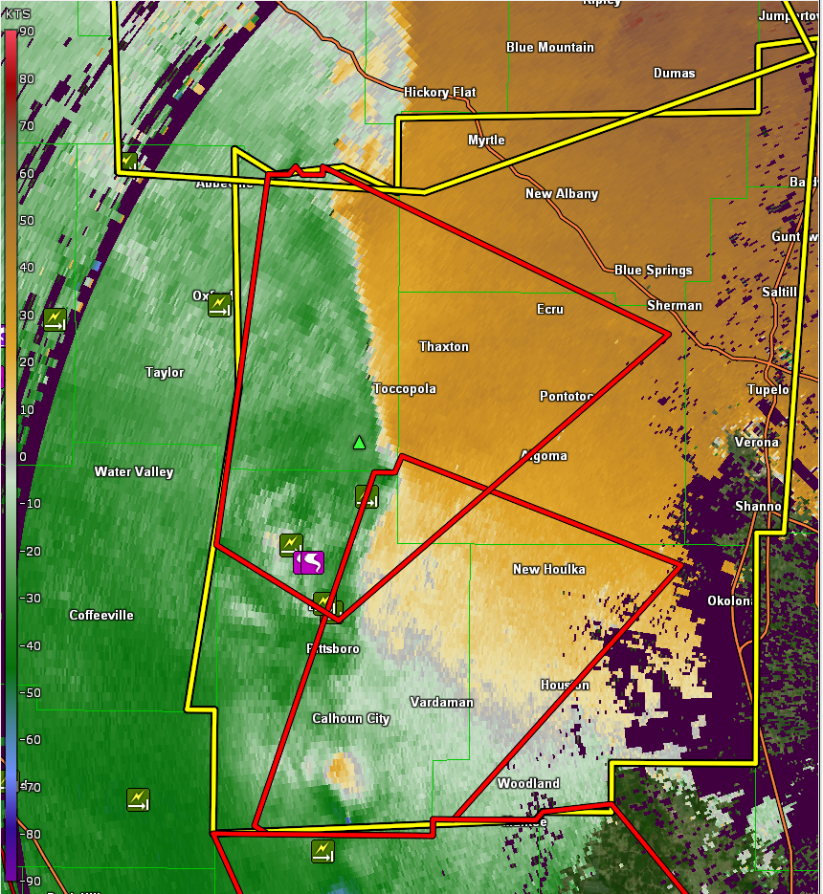
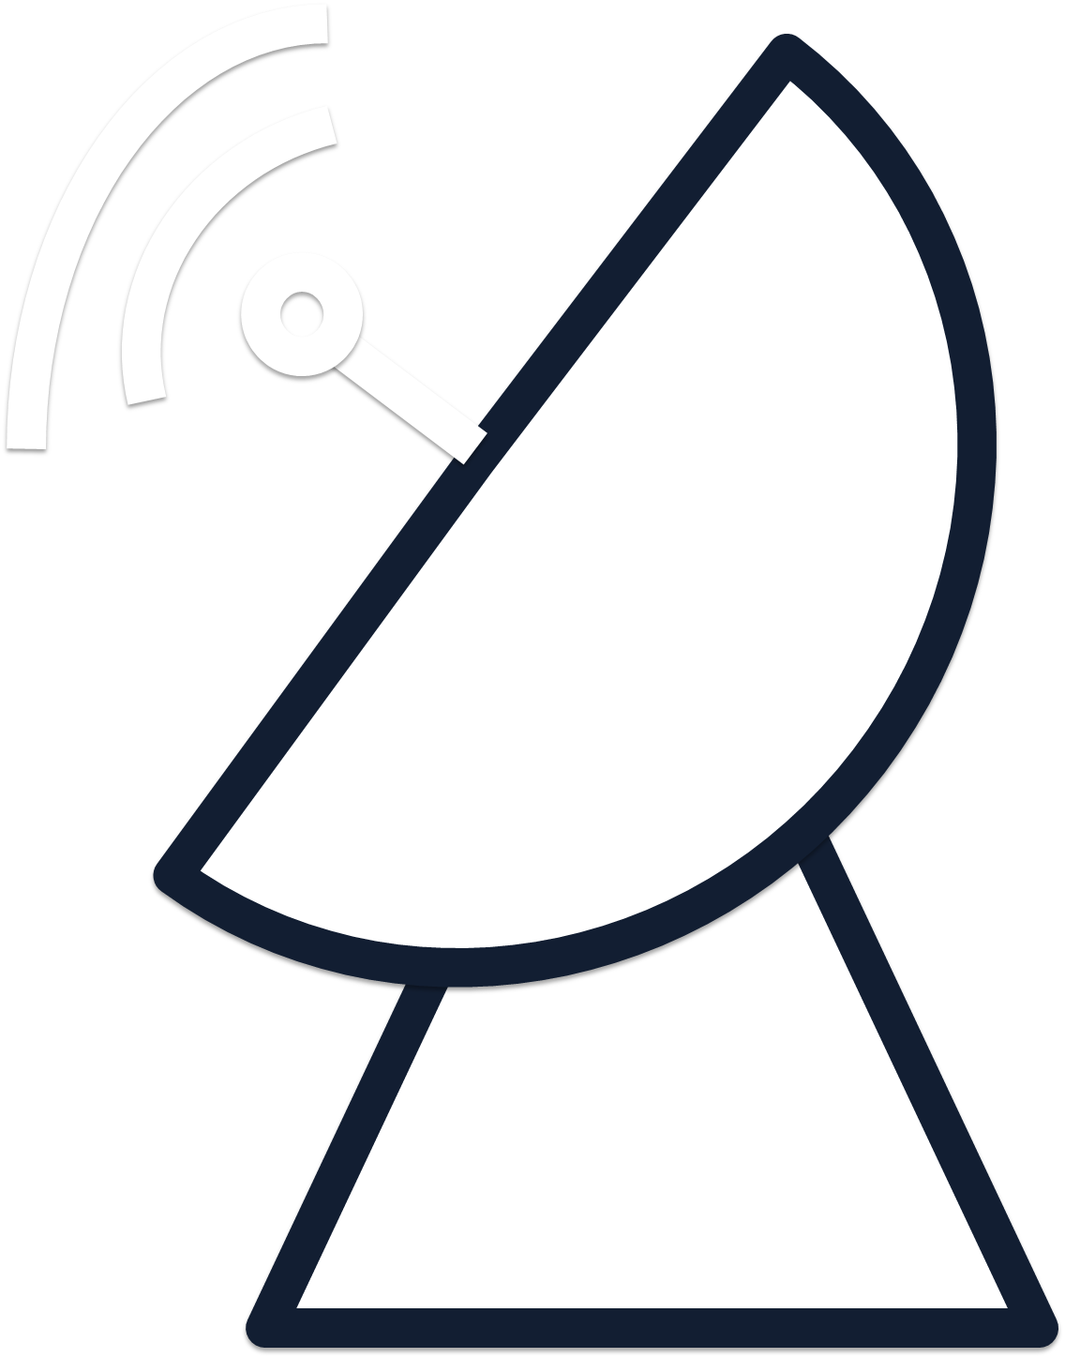
QLCS Tornadoes and the Trouble of Mesovortices
Nowcasting quasi-linear convective system (QLCS) tornadoes is challenging (Trapp et al. 1999)
QLCS tornadoes typically form within mesovortices (MVs)
Small-scale (< 10 km), convectively produced centers of vertical vorticity (Weisman and Trapp 2003)
Not all MVs are tornadic (Trapp and Weisman 2003)
Focusing on MVs at low-levels, which have been found in observational and modeling studies (Trapp and Weisman 2003; Atkins et al. 2005; Atkins and St. Laurent 2009a; Davis and Parker 2014)
Base velocity image depicting 3 MVs (circled) using the 0.5° scan from WSR-88D KGWX at 2235 UTC 30 Mar 2022 during PERiLS IOP2.
Notes:
QLCS tornadoes typically form within a parent vortex known as a mesovortex (MV), which are small-scale convectively produced centers of vertical vorticity
To further exacerbate the nowcasting challenge, not all mesovortices are tornadic; some cause damaging straight-line winds while others are non-damaging
Of interest are QLCS MVs that occur at low-levels, particularly from 0-1 km, because low-level MVs have been found in observational and numerical modeling studies (Trapp and Weisman 2003; Atkins et al. 2005; Atkins and St. Laurent 2009a; Davis and Parker 2014).
The image on the right is an example of 3 different MVs observed during PERiLS IOP2.
The true frequency of tornadic versus non-tornadic MVs is unknown, due to a lack of reliable, comprehensive data on mesovortex structure (Wheatley et al. 2006).

Slide 3
Research Questions
My research focuses on the following objective of the PERiLS project:
To identify the characteristics and mechanisms that distinguish between tornadic and nontornadic QLCS MVs
Research Questions
1. How do radar-based characteristics differ between tornadic (TOR), wind-damaging (WD), and non- damaging (ND) MVs in QLCSs?
2. What is the low-level structure of QLCS MVs?
Used WSR-88D and C-band on Wheels (COW) radar data along with in situ Pod data collected during PERiLS
Notes:
My research focuses on using the PERiLS data to address one of the PERiLS project objectives, which is to identify the characteristics and mechanisms that distinguish tornadic and nontornadic QLCS MVs.
This has lead to my 2 main research questions….
This part of my project was really tailored to try to help forecasters in the hot seat actively warning MVs. I primarily investigated Doppler velocity data which is heavily used operationally to see if there are any differences between the different types of MVs that could be useful in issuing warnings
To answer these questions, I used WSR-88D and C-band on Wheels (COW) radar data along with in-situ Pod data collected during PERiLS

Slide 4
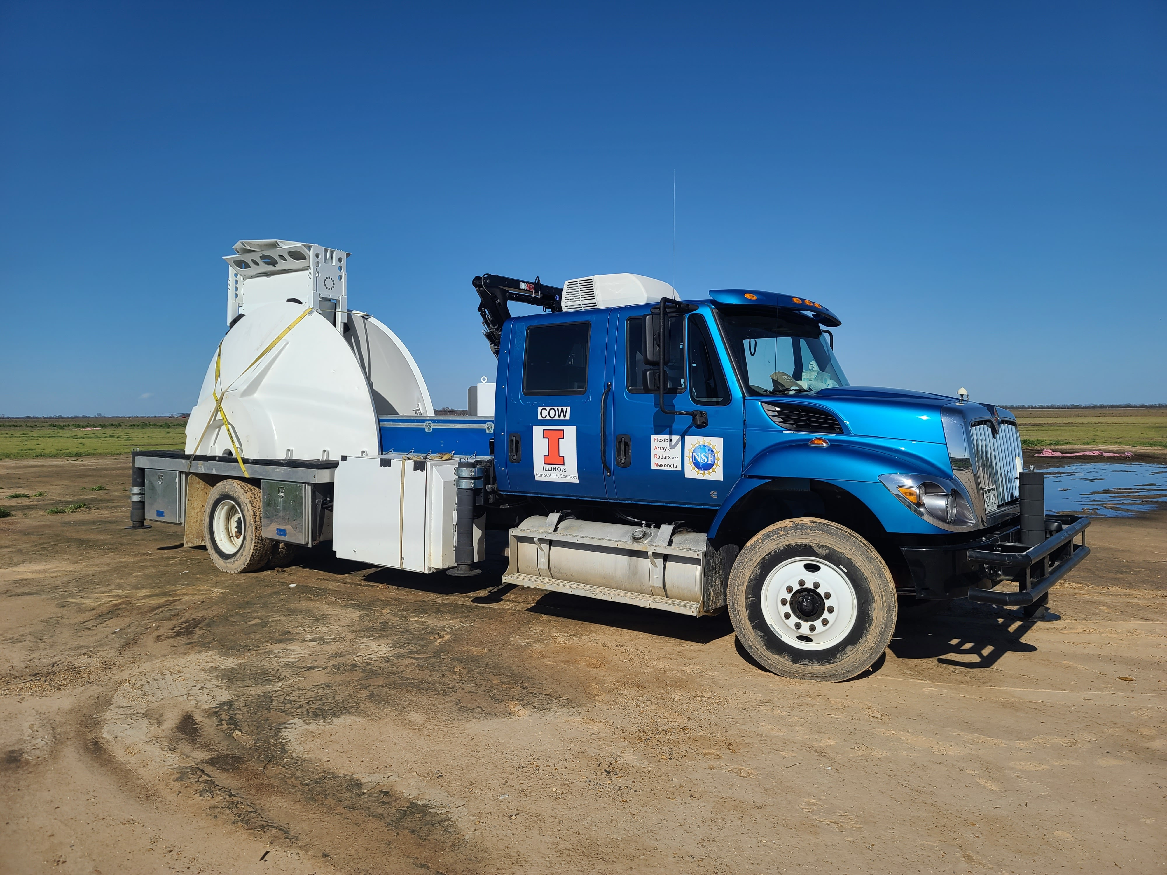
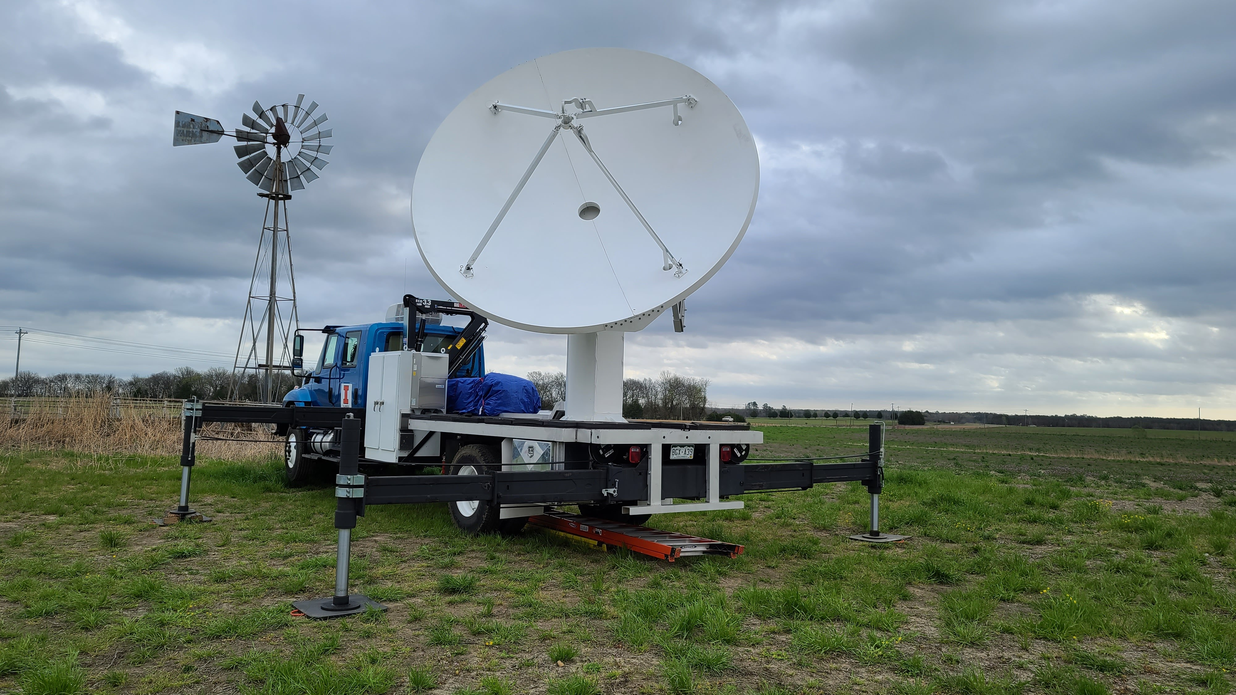
C-band On Wheels (COW)
Maintained by the Flexible Array of Radars and Mesonets (FARM) at UIUC
“Quickly deployable” (Wurman et al. 2021)
Due to the long wavelength of radiation transmitted, a larger antenna is needed to still obtain a narrow beamwidth
Requires antenna assembly as opposed to fully mobile radars
Assembly to operations takes about 2.5 hours
Picture courtesy of Josh Aikins
COW Specifications
Wavelength | C-band, 5 cm
Polarization | Dual-Pol, Dual-Frequency
Transmitter (kW peak) | 2x 1000
Beamwidth | 1.05°
Antenna diameter | 3.8 m
Products | Z, V, SW, ZDR, Rho-HV, KDP (standard single and dual-pol products)
PRFs used in PERiLS | 5400 Hz, 2160 Hz, both with stagger
Pulse Lengths used in PERiLS | 0.5 µs, 0.667 µs
Gate Lengths used in PERiLS | 75 m, 100m
Nyquist velocities used in PERiLS | 67.5 m/s, 27 m/s
Maximum unambiguous ranges used in PERiLS | 89 km, 148 km
Picture courtesy of Josh Aikins
Notes:
As mentioned, I used radar data collected by the C-band on Wheels or COW radar during the first year of PERiLS to analyze QLCS MVs.
I was also heavily involved in setting up, operating, and tearing down the COW during both years of PERiLS.
This radar is maintained and funded by the Flexible Array of Radars and Mesonets or FARM at UIUC
The COW radar is known to be quickly deployable as opposed to fully mobile like the Doppler On Wheels or DOWs
This radar transmits microwave radiation at a wavelength of 5 cm (C-band), which is longer than that transmitted by the DOW radar (3 cm).
The COW also obtains a narrow beamwidth of just over 1°, which allows for high spatial resolution data collection.
To operate at a longer wavelength while still obtaining a narrow beamwidth, the antenna must be larger and therefore cannot be mounted on the truck at all times
Instead, the antenna is stored in halves on the truck and must be assembled prior to operations.
The assembly process is as follows: the halves are removed from the truck and bolted together, the waveguide is assembled and attached to the antenna, and the antenna is lifted onto the truck pedestal and mounted. It takes about 2.5 hours with a well-oiled crew to assemble the radar and get it operational.
Listed are some of the other specifications of the COW for reference.

Slide 5
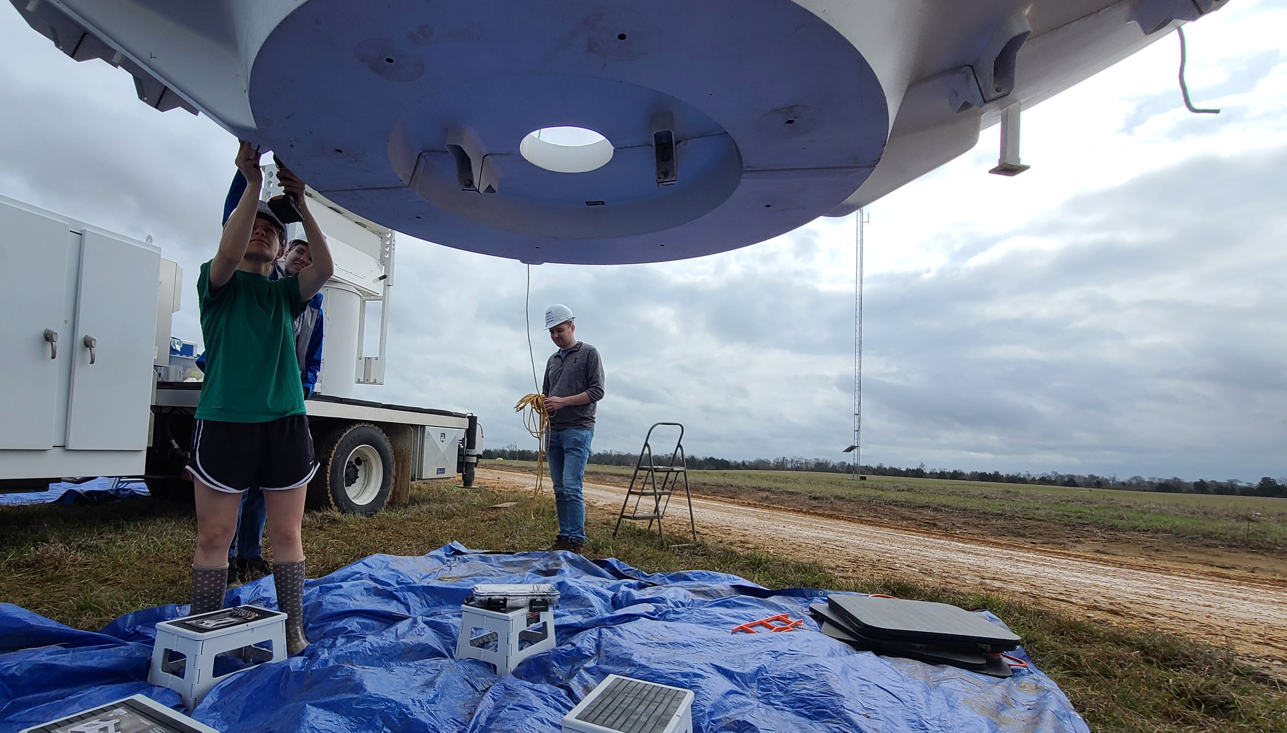
C-band On Wheels (COW)
Maintained by the Flexible Array of Radars and Mesonets (FARM) at UIUC
“Quickly deployable” (Wurman et al. 2021)
Due to the long wavelength of radiation transmitted, a larger antenna is needed to still obtain a narrow beamwidth
Requires antenna assembly as opposed to fully mobile radars
Assembly to operations takes about 2.5 hours
Picture courtesy of Josh Aikins
COW Specifications
Wavelength | C-band, 5 cm
Polarization | Dual-Pol, Dual-Frequency
Transmitter (kW peak) | 2x 1000
Beamwidth | 1.05°
Antenna diameter | 3.8 m
Products | Z, V, SW, ZDR, Rho-HV, KDP (standard single and dual-pol products)
PRFs used in PERiLS | 5400 Hz, 2160 Hz, both with stagger
Pulse Lengths used in PERiLS | 0.5 µs, 0.667 µs
Gate Lengths used in PERiLS | 75 m, 100m
Nyquist velocities used in PERiLS | 67.5 m/s, 27 m/s
Maximum unambiguous ranges used in PERiLS | 89 km, 148 km
Picture courtesy of Josh Aikins
Picture courtesy of Josh Aikins
Notes:
As mentioned, I used radar data collected by the C-band on Wheels or COW radar during the first year of PERiLS to analyze QLCS MVs.
I was also heavily involved in setting up, operating, and tearing down the COW during both years of PERiLS.
This radar is maintained and funded by the Flexible Array of Radars and Mesonets or FARM at UIUC
The COW radar is known to be quickly deployable as opposed to fully mobile like the Doppler On Wheels or DOWs
This radar transmits microwave radiation at a wavelength of 5 cm (C-band), which is longer than that transmitted by the DOW radar (3 cm).
The COW also obtains a narrow beamwidth of just over 1°, which allows for high spatial resolution data collection.
To operate at a longer wavelength while still obtaining a narrow beamwidth, the antenna must be larger and therefore cannot be mounted on the truck at all times
Instead, the antenna is stored in halves on the truck and must be assembled prior to operations.
The assembly process is as follows: the halves are removed from the truck and bolted together, the waveguide is assembled and attached to the antenna, and the antenna is lifted onto the truck pedestal and mounted. It takes about 2.5 hours with a well-oiled crew to assemble the radar and get it operational.
Listed are some of the other specifications of the COW for reference.

Slide 6
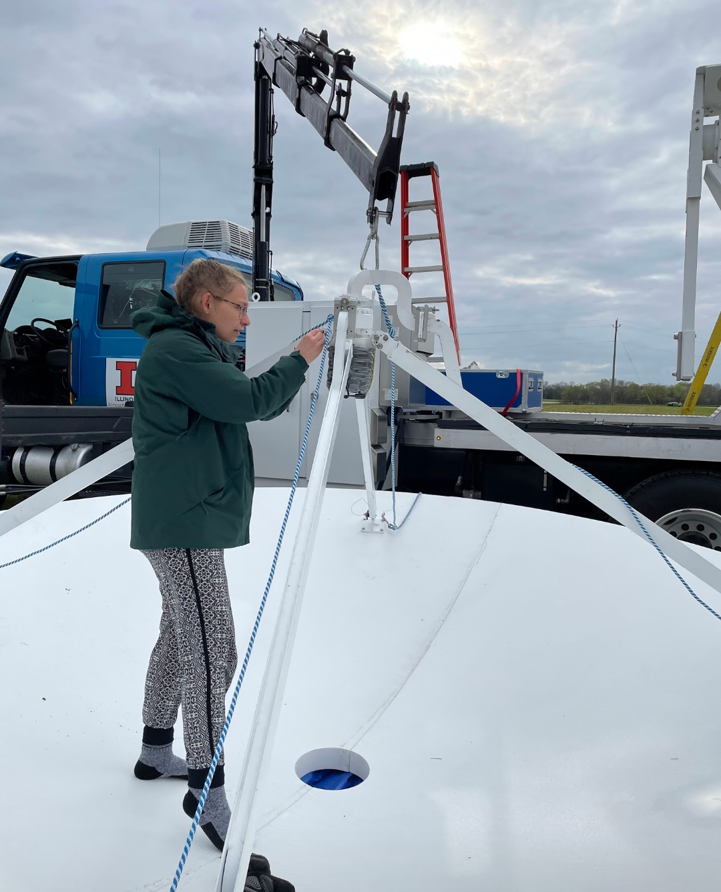
C-band On Wheels (COW)
Maintained by the Flexible Array of Radars and Mesonets (FARM) at UIUC
“Quickly deployable” (Wurman et al. 2021)
Due to the long wavelength of radiation transmitted, a larger antenna is needed to still obtain a narrow beamwidth
Requires antenna assembly as opposed to fully mobile radars
Assembly to operations takes about 2.5 hours
Picture courtesy of Josh Aikins
COW Specifications
Wavelength | C-band, 5 cm
Polarization | Dual-Pol, Dual-Frequency
Transmitter (kW peak) | 2x 1000
Beamwidth | 1.05°
Antenna diameter | 3.8 m
Products | Z, V, SW, ZDR, Rho-HV, KDP (standard single and dual-pol products)
PRFs used in PERiLS | 5400 Hz, 2160 Hz, both with stagger
Pulse Lengths used in PERiLS | 0.5 µs, 0.667 µs
Gate Lengths used in PERiLS | 75 m, 100m
Nyquist velocities used in PERiLS | 67.5 m/s, 27 m/s
Maximum unambiguous ranges used in PERiLS | 89 km, 148 km
Picture courtesy of Anna del Moral Mendez
Picture courtesy of Josh Aikins
Picture courtesy of Josh Aikins
Notes:
As mentioned, I used radar data collected by the C-band on Wheels or COW radar during the first year of PERiLS to analyze QLCS MVs.
I was also heavily involved in setting up, operating, and tearing down the COW during both years of PERiLS.
This radar is maintained and funded by the Flexible Array of Radars and Mesonets or FARM at UIUC
The COW radar is known to be quickly deployable as opposed to fully mobile like the Doppler On Wheels or DOWs
This radar transmits microwave radiation at a wavelength of 5 cm (C-band), which is longer than that transmitted by the DOW radar (3 cm).
The COW also obtains a narrow beamwidth of just over 1°, which allows for high spatial resolution data collection.
To operate at a longer wavelength while still obtaining a narrow beamwidth, the antenna must be larger and therefore cannot be mounted on the truck at all times
Instead, the antenna is stored in halves on the truck and must be assembled prior to operations.
The assembly process is as follows: the halves are removed from the truck and bolted together, the waveguide is assembled and attached to the antenna, and the antenna is lifted onto the truck pedestal and mounted. It takes about 2.5 hours with a well-oiled crew to assemble the radar and get it operational.
Listed are some of the other specifications of the COW for reference.

Slide 7
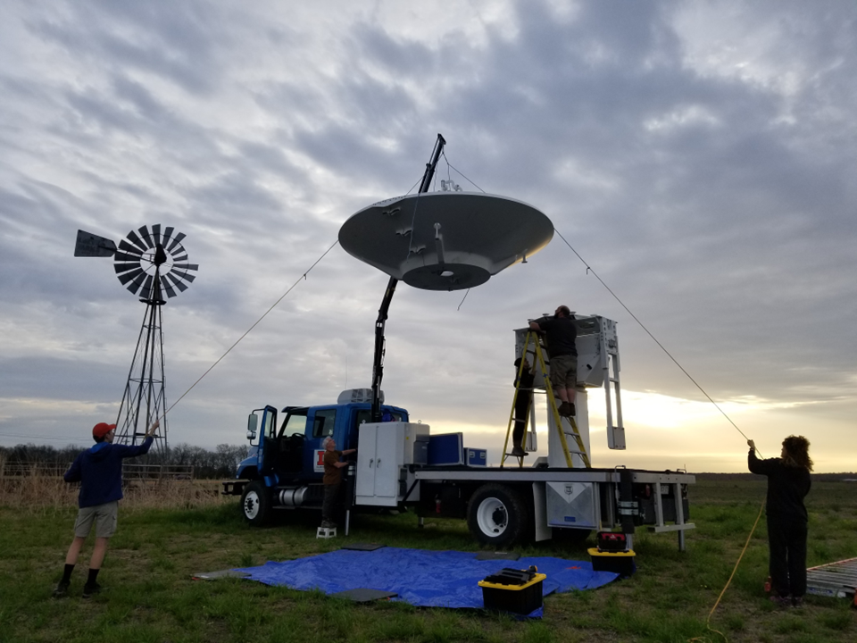
C-band On Wheels (COW)
Maintained by the Flexible Array of Radars and Mesonets (FARM) at UIUC
“Quickly deployable” (Wurman et al. 2021)
Due to the long wavelength of radiation transmitted, a larger antenna is needed to still obtain a narrow beamwidth
Requires antenna assembly as opposed to fully mobile radars
Assembly to operations takes about 2.5 hours
Picture courtesy of Josh Aikins
COW Specifications
Wavelength | C-band, 5 cm
Polarization | Dual-Pol, Dual-Frequency
Transmitter (kW peak) | 2x 1000
Beamwidth | 1.05°
Antenna diameter | 3.8 m
Products | Z, V, SW, ZDR, Rho-HV, KDP (standard single and dual-pol products)
PRFs used in PERiLS | 5400 Hz, 2160 Hz, both with stagger
Pulse Lengths used in PERiLS | 0.5 µs, 0.667 µs
Gate Lengths used in PERiLS | 75 m, 100m
Nyquist velocities used in PERiLS | 67.5 m/s, 27 m/s
Maximum unambiguous ranges used in PERiLS | 89 km, 148 km
Picture courtesy of Anna del Moral Mendez
Picture courtesy of Josh Aikins
Picture courtesy of Josh Aikins
Notes:
As mentioned, I used radar data collected by the C-band on Wheels or COW radar during the first year of PERiLS to analyze QLCS MVs.
I was also heavily involved in setting up, operating, and tearing down the COW during both years of PERiLS.
This radar is maintained and funded by the Flexible Array of Radars and Mesonets or FARM at UIUC
The COW radar is known to be quickly deployable as opposed to fully mobile like the Doppler On Wheels or DOWs
This radar transmits microwave radiation at a wavelength of 5 cm (C-band), which is longer than that transmitted by the DOW radar (3 cm).
The COW also obtains a narrow beamwidth of just over 1°, which allows for high spatial resolution data collection.
To operate at a longer wavelength while still obtaining a narrow beamwidth, the antenna must be larger and therefore cannot be mounted on the truck at all times
Instead, the antenna is stored in halves on the truck and must be assembled prior to operations.
The assembly process is as follows: the halves are removed from the truck and bolted together, the waveguide is assembled and attached to the antenna, and the antenna is lifted onto the truck pedestal and mounted. It takes about 2.5 hours with a well-oiled crew to assemble the radar and get it operational.
Listed are some of the other specifications of the COW for reference.

Slide 8
Manual Analysis of WSR-88D and COW Data
Manually identified QLCS MVs from the PERiLS IOPs of 2022 and 2023
Utilized the lowest elevation scan (typically 0.5°) of the nearest Weather Surveillance Radar ‘88 Doppler (WSR-88D) using GR2 Analyst software
MVs had to pass through the COW’s domain
MVs had to be produced by a QLCS, defined as a continuous area of 35 dBZ radar reflectivity over at least 100 km at the lowest elevation scan (Smith et al. 2012)
Identified MVs by locating a thunderstorm wind damage report, a tornado report, or a tornado warning that didn’t produce a tornado (these make up the non-damaging cases) in/near the COW’s domain
Tracked the MV from its genesis to its decay
MV criteria (Smith et al. 2012)
Discrete circulation with a maximum dV ≥ 10 m/s (difference between the maximum outbound and minimum inbound velocities at a constant range) with a diameter ≤ 7 km
Notes:
I started by manually identifying QLCS MVs from the four PERiLS IOPs of 2022 and two MVs from PERiLS IOP2_2023 using the lowest elevation scan (usually 0.5°) of the nearest relevant WSR-88D using GR2Analyst
These MVs had to pass through the COW’s domain at some point during their lifetimes so this process could be repeated using the higher resolution COW data
The MV had to be produced by a QLCS, defined as a continuous area of 35 dBZ radar reflectivity over at least 100 km when viewed from the lowest elevation angle
The MV identification process started by locating a thunderstorm wind damage report, a tornado report, or a tornado warning that didn’t produce a tornado for some null cases in/near the COW’s domain
I tracked this report back in time to see when the MV started and then tracked the MV throughout its entire lifetime.
The objective criteria for identifying QLCS MVs included the existence of a discrete circulation with a maximum differential velocity (dV; i.e., the difference between the maximum outbound and minimum inbound velocity at a constant range) of at least 10 m/s over a distance less than or equal to 7 km.
A severe thunderstorm warning was used for only one ND case that did not have a tornado warning.

Slide 9
Manual Analysis of WSR-88D and COW Data
Cataloged the following MV characteristics at each low-level velocity scan:
To analyze MVs over their whole lifetimes, each MV was classified as tornadic (TOR), wind-damaging (WD), or non-damaging (ND) based on the damage report(s) or lack thereof that occurred over the entire lifetime of the MV
Subsequently, to analyze the pretornadic/predamaging period of a MV, each MV was classified based on the first damage report
Repeated cataloging process of MV characteristics using the higher resolution COW radar data using Solo3
Notes:
I catalogued several radar-based MV characteristics at each low-level radar scan, which are listed, but I primarily analyzed maximum rotational velocities (Vrots), the durations, and the diameters of the MVs
To analyze MV charactertics over the whole lifetimes of the MVs, first, I classified each MV as tornadic (TOR), wind-damaging (WD), or non-damaging (ND) based on the damage reports/warnings that happened over the whole lifetime of the MV
For example, if a MV produced thunderstorm wind damage and a tornado during its lifetime, the MV was classified as tornadic.
Non-damaging cases were ones that had tornado warning issued on them but never produced because I wanted to target the strongest non-damaging MVs and ones that forecasters thought could be tornadic
I then repeated this cataloging of MV characteristics using the higher resolution COW radar data using Solo3.
Reports were given precedence over warnings (i.e., if a tornado warning was issued before a tornado report, the time before the first report was used).
A severe thunderstorm warning was used for only one ND case that did not have a tornado warning.
In some cases, the lowest scan of the COW data (0.5°) was not usable due to beam blockage or bad velocity data, and the 1.2° scan was used.
Subsequently, MVs were classified based on the damage/warning associated with the first damage report/warning

Slide 10
Overview of PERiLS QLCS MVs
*Labeled by the damage associated with each MV over their entire lifetime
Out of the 13 tornadic QLCS MVs observed by the WSR-88D network, only 4 had positive warning-report lead times
Notes:
This table gives an overview of the 25 QLCS MVs that I have cataloged so far during the 2 years of PERiLS
This table breaks down the MVs observed during each IOP by their classification and radar source used
25 QLCS MVs were identified by the WSR-88D that passed near/through the COWs domain.
Fewer MVs were visible by the COW radar due to beam blockage at the lowest two elevation angles, attenuation, and/or bad base velocity data.
In this prez, I will also be focusing on 14 MVs out of 25 that were visible by the COW from the start of each MV before the first report/warning was issued.
The time before a report/warning is issued on a MV is critical from a forecasting perspective as this is when forecasters are trying to decide whether to issue a warning on a MV and if so what type of warning should be issued
An important note is that out of the 13 tornadic QLCS MVs observed by the WSR-88D network, only 4 had tornado warnings on them before producing a tornado.
This again motivates the need for the PERiLS field campaign and this project.
While there are caveats associated with using a report-based MV classification scheme (i.e., dependence on population density and time of day, structures to create debris, etc.; Trapp et al. 2006; Doswell and Burgess 1988), all tornadoes reports were confirmed by NWS storm surveys

Slide 11
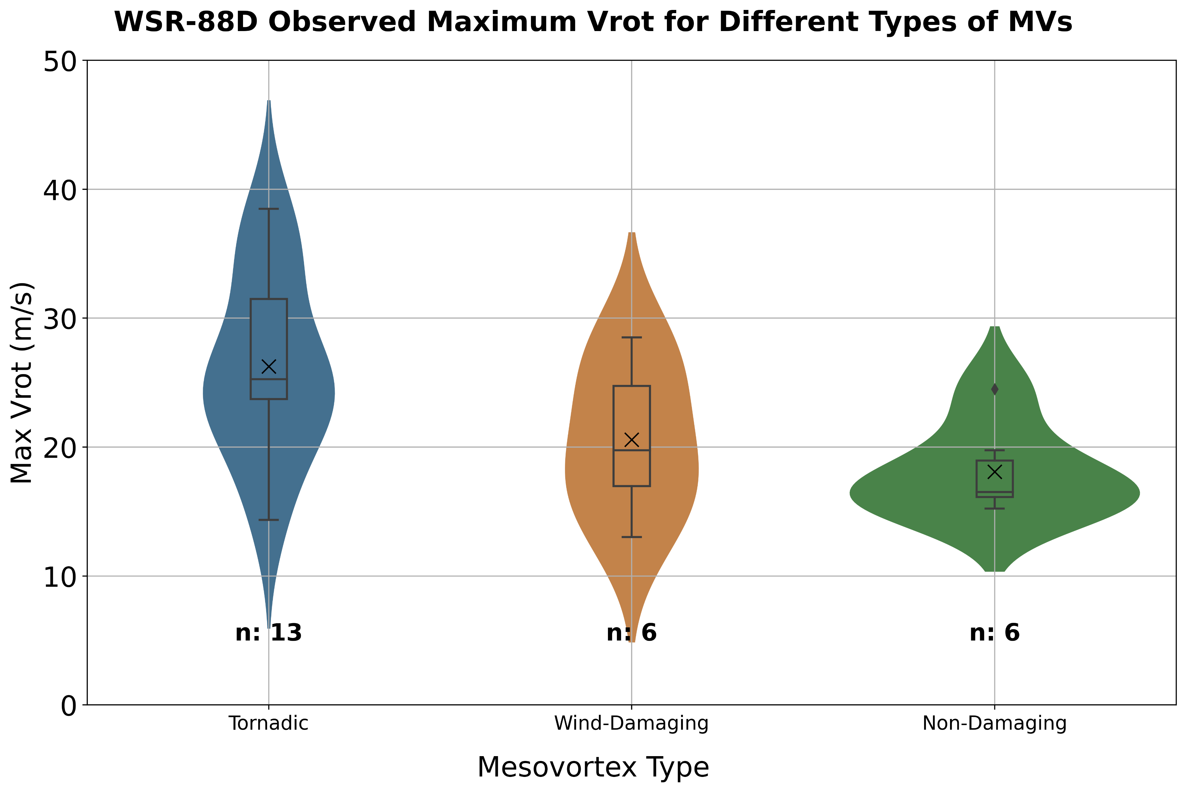
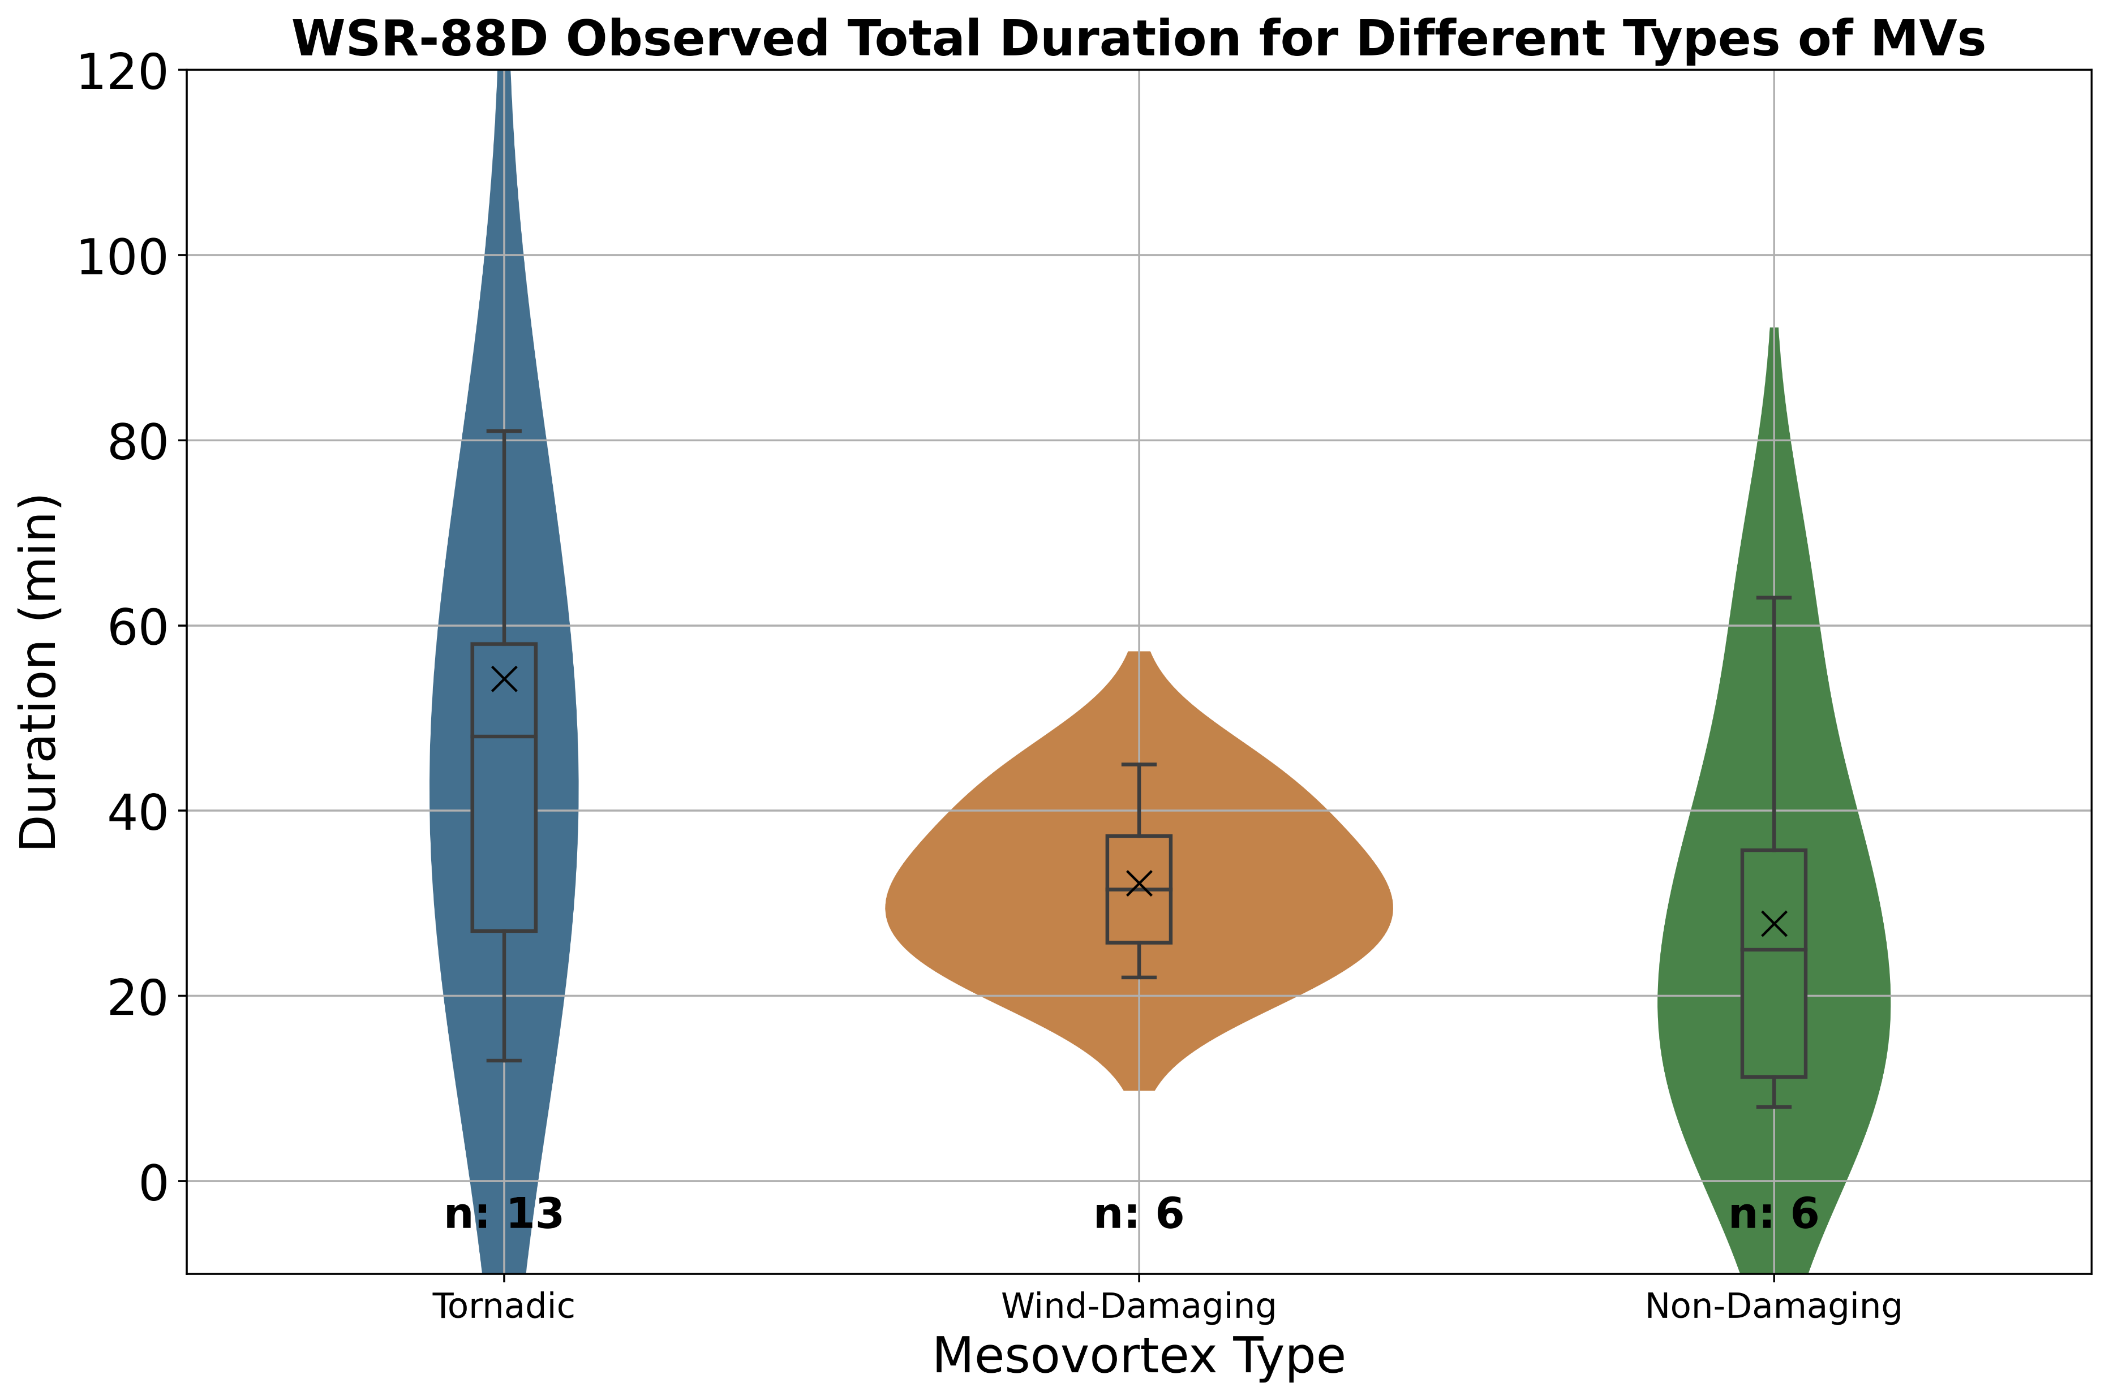
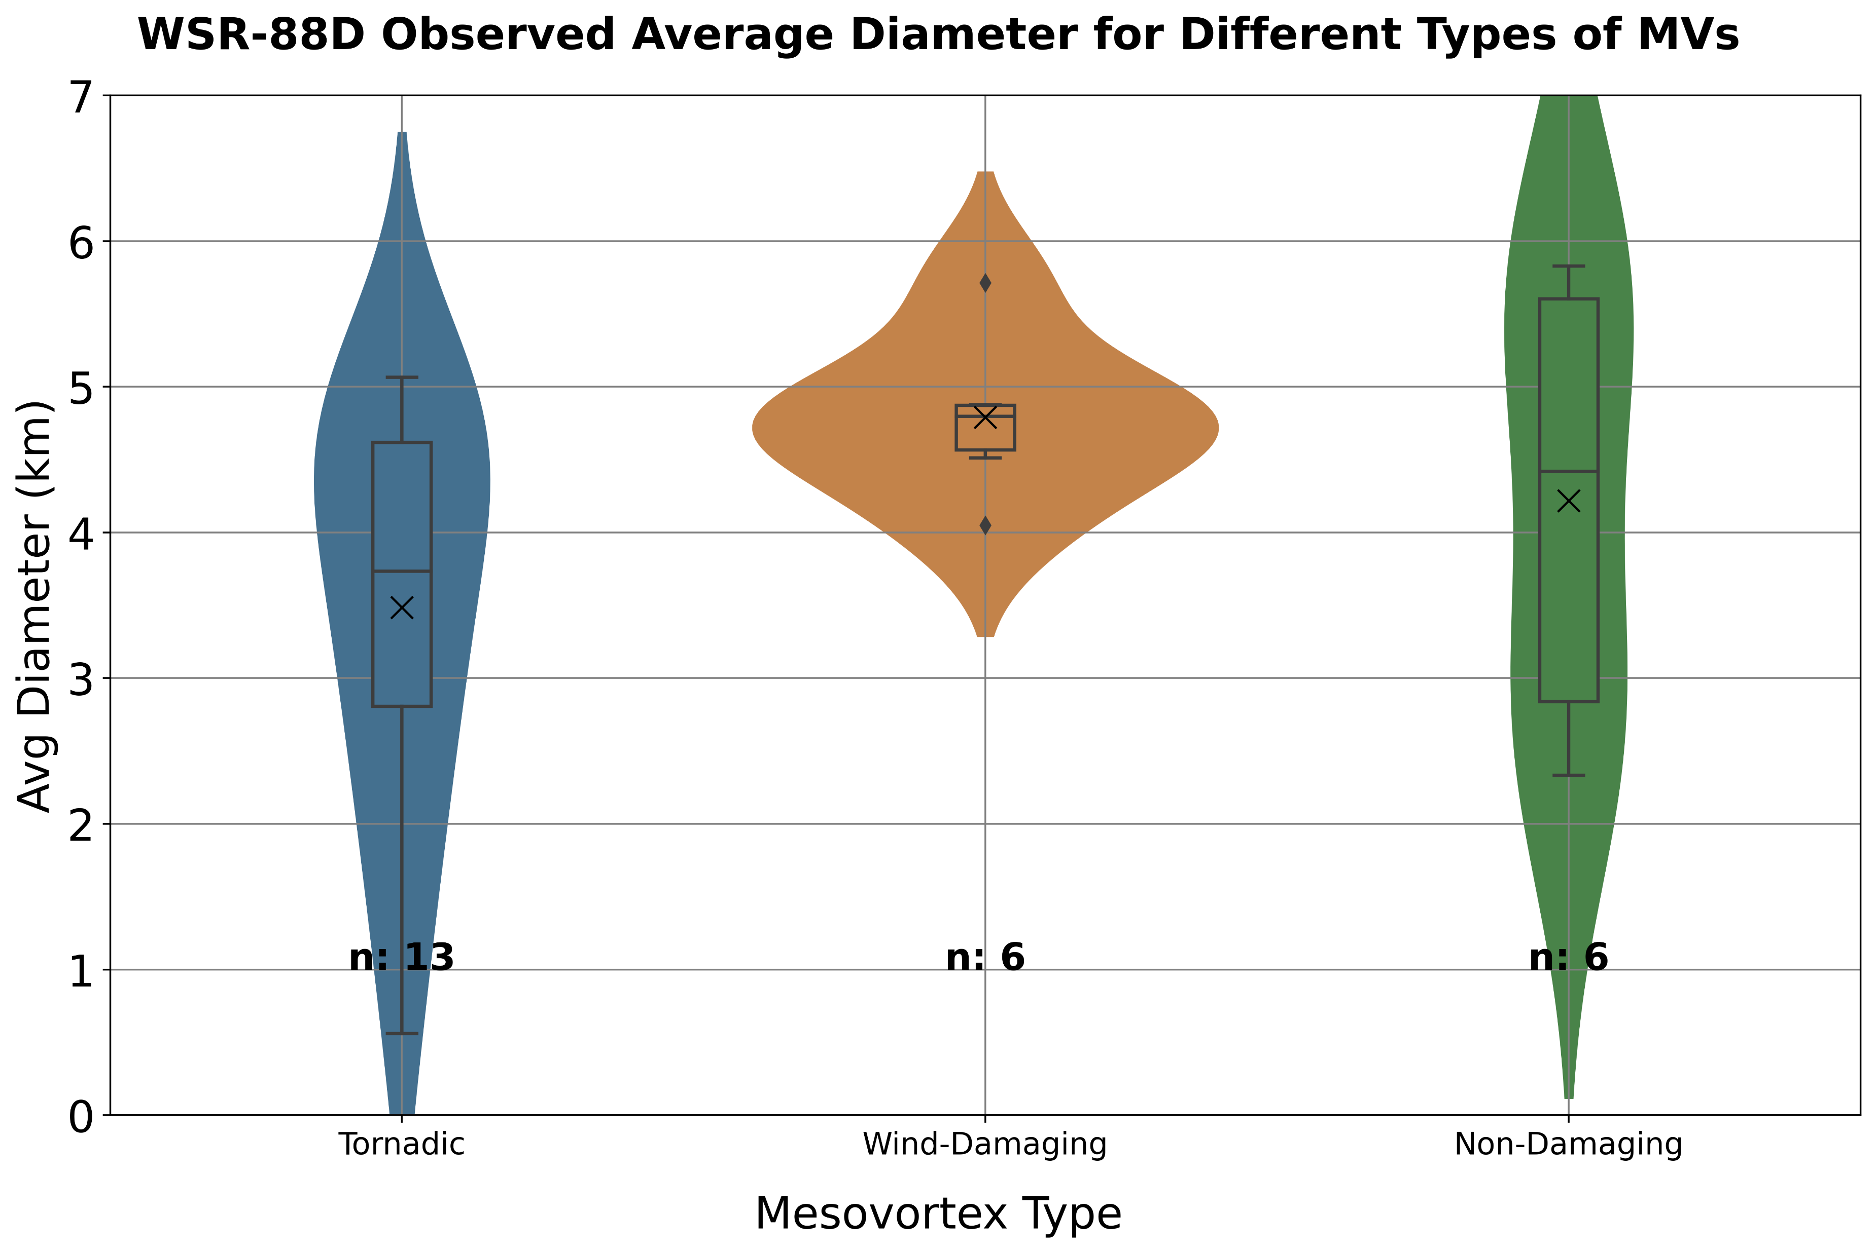
Entire Lifetimes of WSR-88D MVs
1. How do radar-based characteristics differ between TOR, WD, and ND MVs in QLCSs?
TOR MVs generally have smaller diameters
TOR MVs have stronger Vrots
TOR MVs have longer lifetimes, but WD MVs also tend to be persistent
*Reminder: the MVs were analyzed using the lowest tilt of the radar
Notes:
I will start by examining the first research question of this section which is”how do radar-based characteristics differ between tornadic, wind-damaging, and non-damaging MVs in QLCSs”
For these box and whisker plots, I am examining maximum Vrot, average diameters, and durations of the different types of MVs over their entire lifetimes as viewed by the WSR-88Ds
25 QLCS MVs were observed by the WSR-88D, with 13 of those being TOR in blue, 6 WD in orange, and 6 ND in green
Keep in mind that these box and whisker plots were made by analyzing MVs at the lowest tilt of the WSR-88Ds
Starting from the left…next slide

Slide 12
Entire Lifetimes of WSR-88D MVs
1. How do radar-based characteristics differ between TOR, WD, and ND MVs in QLCSs?
TOR MVs generally have smaller diameters
TOR MVs have stronger Vrots
TOR MVs have longer lifetimes, but WD MVs also tend to be persistent
*Reminder: the MVs were analyzed using the lowest tilt of the radar
Notes:
Starting from the left, TOR MVs have stronger rotational velocities during the whole duration of the MVs
However, keep in mind that with the tornadic MVs, when we view them over their whole lifetime, the MV circulation being measured is likely contaminated by the rotation associated with the tornado, thus producing higher Vrots
TOR MVs generally have smaller diameters and longer lifetimes
The intensities of TOR vs NT MVs at low-levels is also consistent with Atkins et al. (2004)
TOR MVs have smallest diameters of about 4km, suggests that MVs are spatially contracting as vertical vorticity becomes concentrated and stretched.
WD MV durations more concentrated around the median
ND MVs persist for the least amount of time

Slide 13
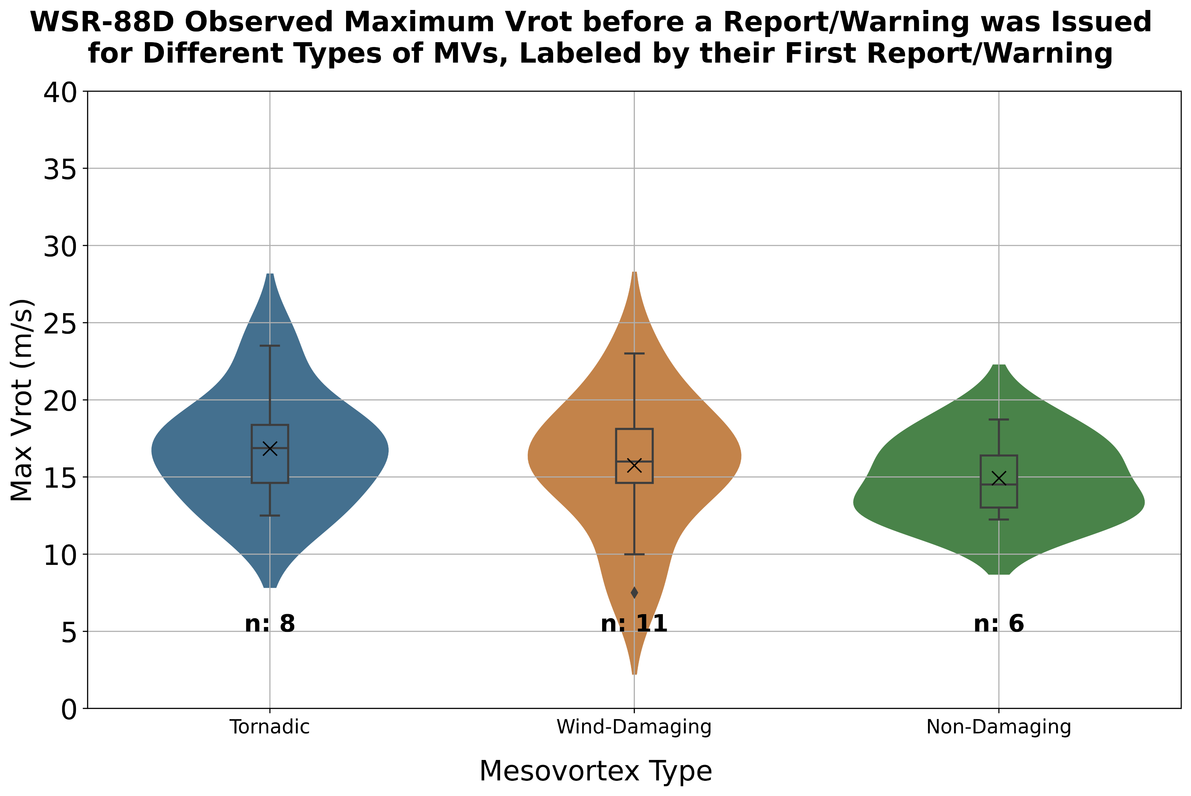
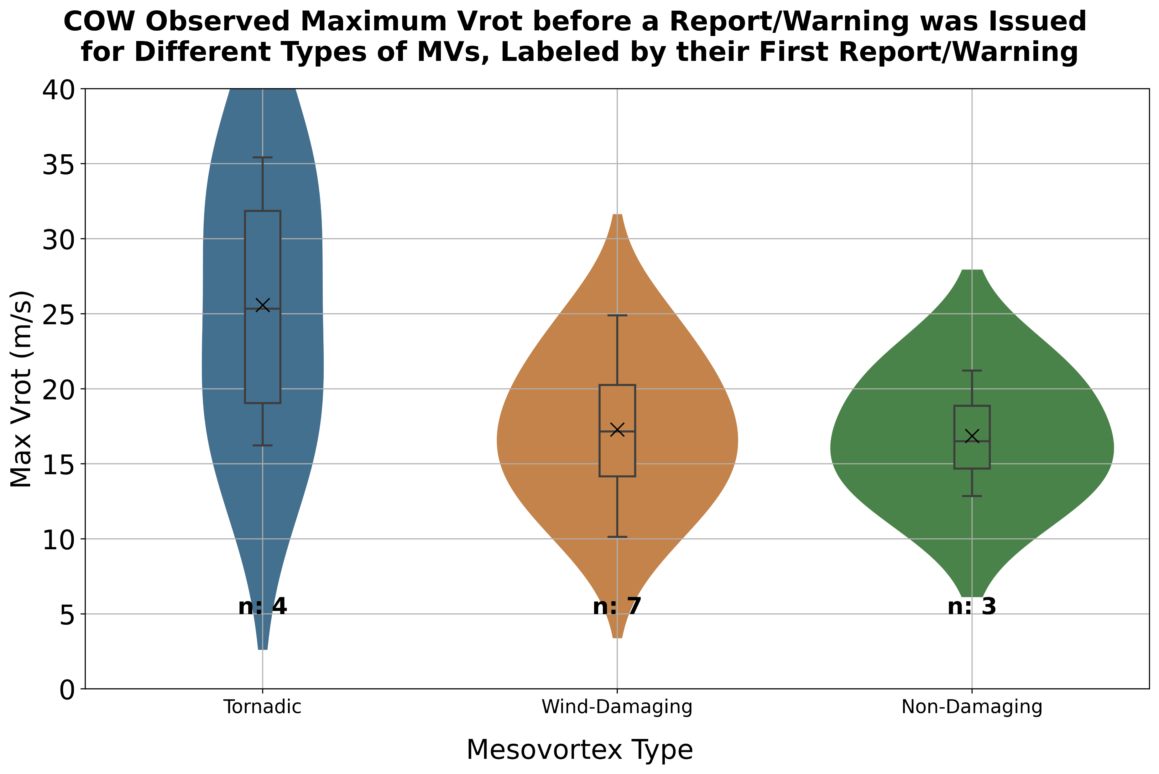
WSR-88D vs. COW MVs Before Reports: Vrot
Little differentiation between the median max Vrot values and the separation of boxes in the WSR-88D data
Better distinction in the COW data, likely due to less beam filling
WSR-88D
COW
*Reminder: the MVs were analyzed using the lowest tilt of each radar
Notes:
As mentioned earlier, looking at the radar-based characteristics of MVs before they first produced damage or were warned is important from a forecasting perspective.
These box and whisker plots compare maximum rotational velocities for the different MVs before they first produced damage or were warned with the MVs labeled by the damage they first produced with the WSR-88D data on the left and COW data on the right.
You can see now that there is little differentiation between the median max Vrot values and the seprations of the boxes in the WSR-88D data.
This highlights one of the challenges forecasters face when warning QLCS MVs; forecasters must decide what types of warnings to place on MVs that have seemingly similar strengths when viewed at the lowest elevation angle of the radar.
There is better separation between the MV types in the COW data, which is likely due to less beam filling with a closer range radar more accurately resolving the velocities
Vrot median values NEXRAD – TOR: 16.7, WD: 16.1, ND: 14.5
Vrot median values COW – TOR: 25.3, WD: 17.2, ND: 16.5
The Vrots calculated from the COW data are generally higher than those calculated from the WSR-88D data; with a closer range radar, there is less beam filling, which allows higher velocities to be resolved.
The time before a report/warning was issued is defined from mesovortexgenesis to the time of the low-level scan that precedes the report/warning time and is not contaminated by the report/warning.
For example, if low-level scans happened at 1935 UTC, 1936 UTC, and 1938 UTC and a tornado was reported at 1937 UTC, then 1935 UTC was used as the time of the low-level scan that precedes the tornado;
based on the report time, this is the last complete low-level scan that was likely not contaminated by the tornadic circulation.

Slide 14
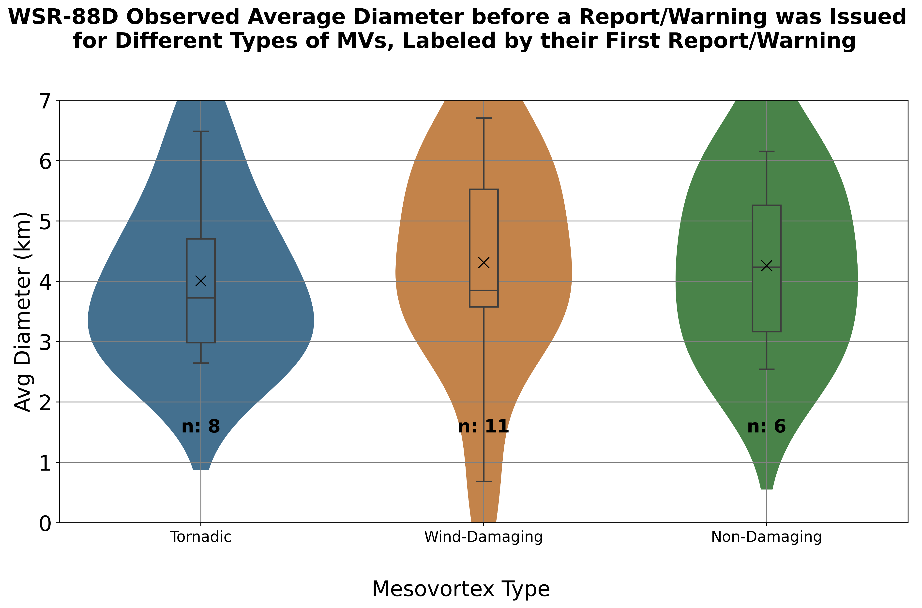
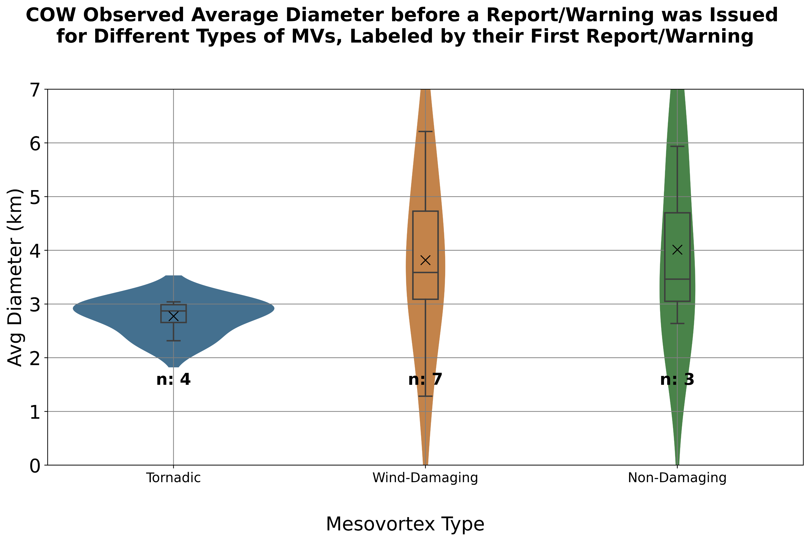
WSR-88D vs. COW MVs Before Reports: Diameter
Over the whole period prior to a report/tornado warning, large overlap in MV diameters in the WSR-88D data
Greater differentiation seen when using the higher resolution COW radar data
WSR-88D
COW
*Reminder: the MVs were analyzed using the lowest tilt of each radar
Notes:
However, if we examine the the average diameters of each MV before the first report/warning was issued with the MVs labeled the same as before, tornadic MVs are overall smaller in dimeter in both data sources
In the WSR-88D data, more than half of the tornadic MVs are less than 4 km in diameter and more than half of the WD and ND MVs have diameters greater than 4 km
This may be caused by the TOR MVs tightening as vertical vorticity becomes more concentrated and stretched before a tornado is produced, although this needs to be examined further.
Although a limited sample size is presented here, this is a characteristic that could increase the confidence that forecasters have in issuing the first tornado warning on a MV
In the previous slide and this one, you will notice that the WD MVs are larger than the ND ones. I am not sure why this is and I haven’t had time to investigate it yet, but this is something I plan on looking into in the future.
Diameter median values NEXRAD – TOR: 3.4, WD: 4.8, ND: 4.2
DIameter median values COW – TOR: 2.9, WD: 3.6, ND: 3.5

Slide 15
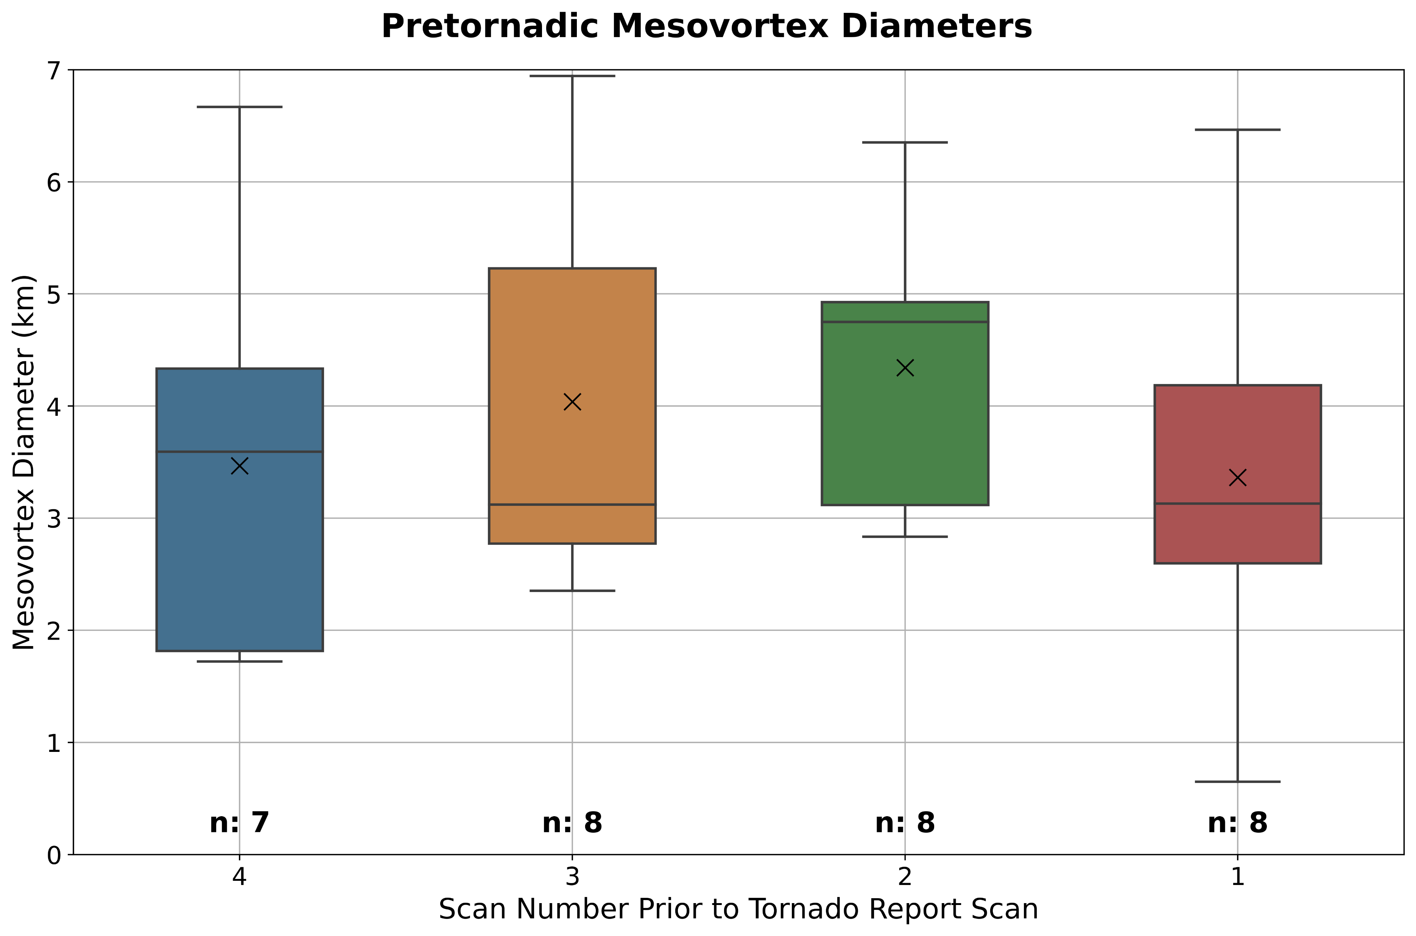
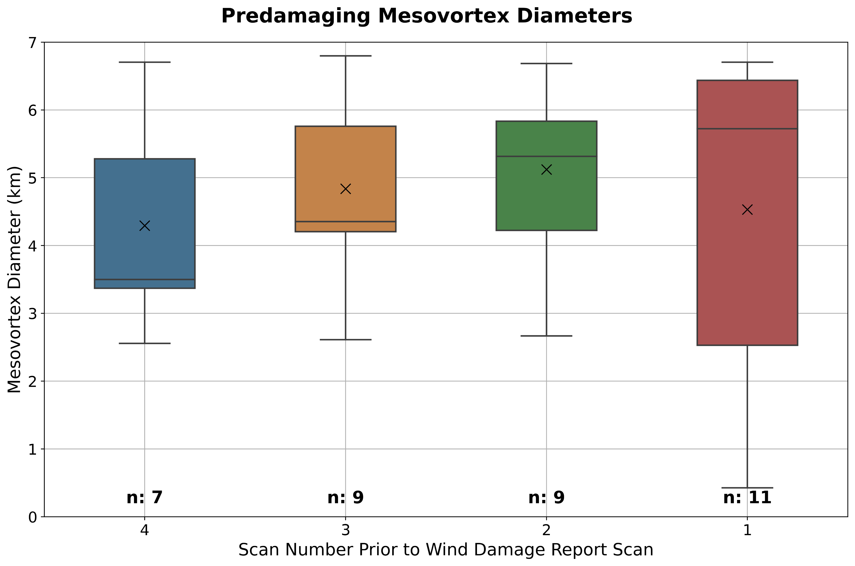
Pretornadic and Predamaging MV Diameters
Some distinction in MV diameters between TOR and WD MVs in the few scans prior to damage
Closer to tornadogenesis
Closer to wind damage

Slide 16
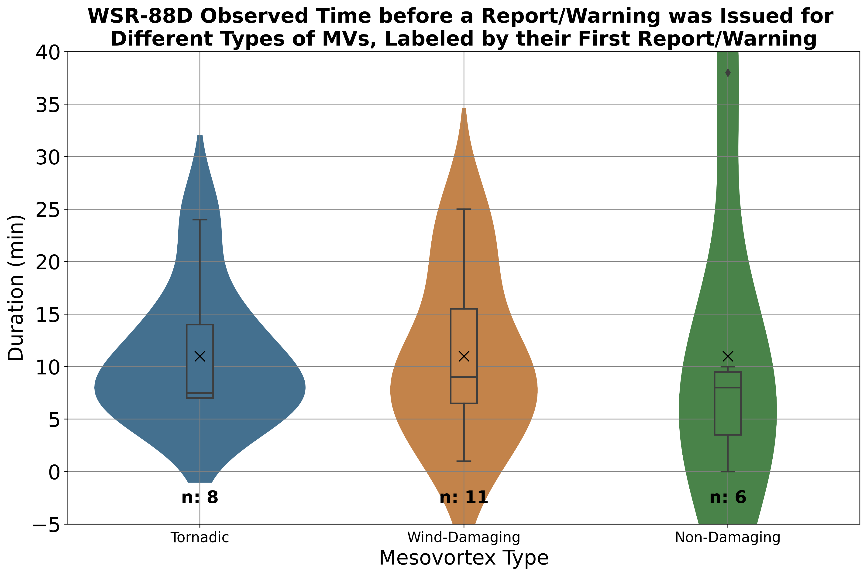
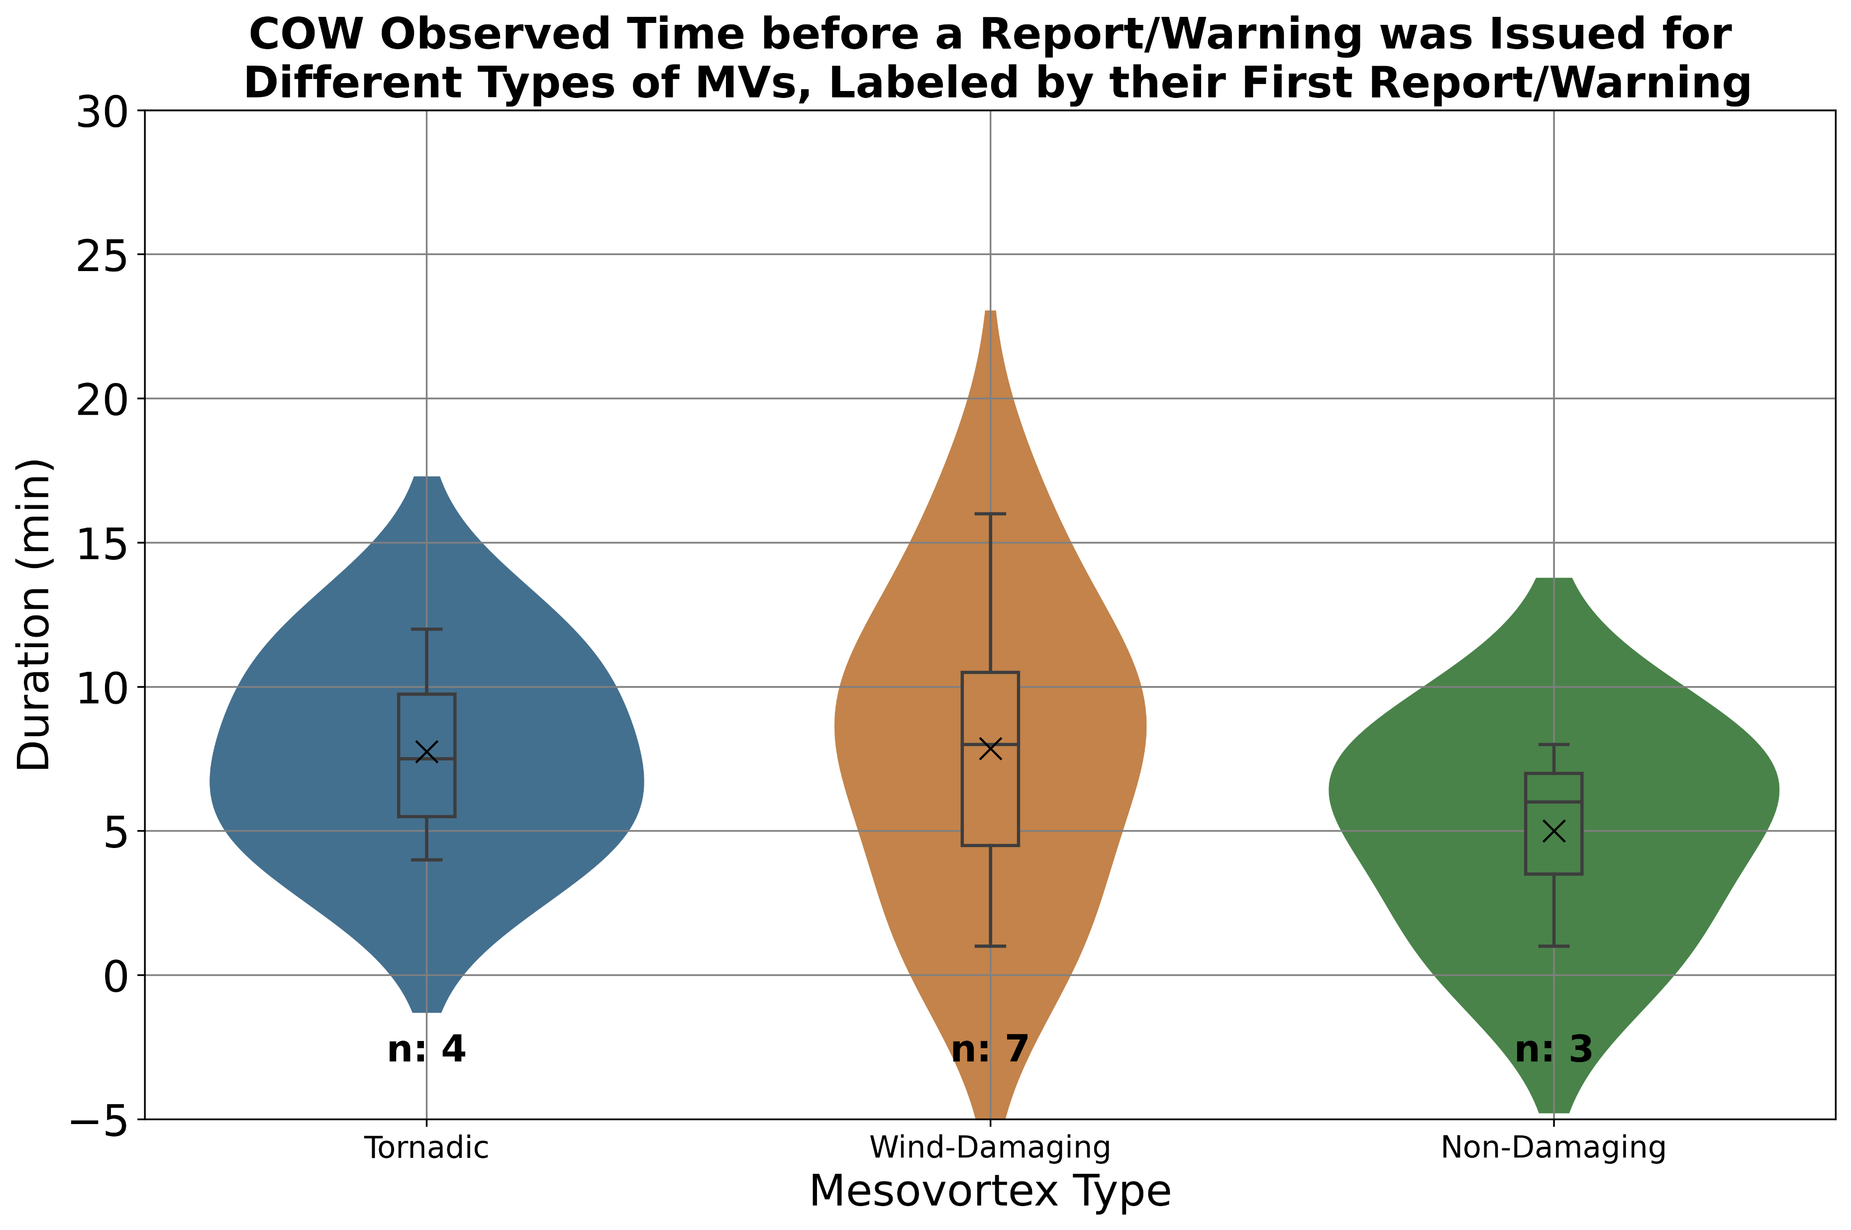
WSR-88D vs. COW MVs Before Reports: Time
Often ≤ 10 minutes between the time a MV forms and when it produces damage or a warning is issued
WSR-88D
COW
Notes:
Comparing the same types of plots as before, but now looking at the time before a report/warning was issued, you can see that it is often 10 minutes or less between the time a MV forms and when it first produces damage or has a warning placed on it in both radar sources.
This demonstrates the rapidly evolving nature of QLCS MVs and is one example of why QLCS MVs are difficult to warn.
Sessa and Trapp (2020) also show that pretornadic QLCS mesocyclones have an average lifetime of 10 minutes.

Slide 17
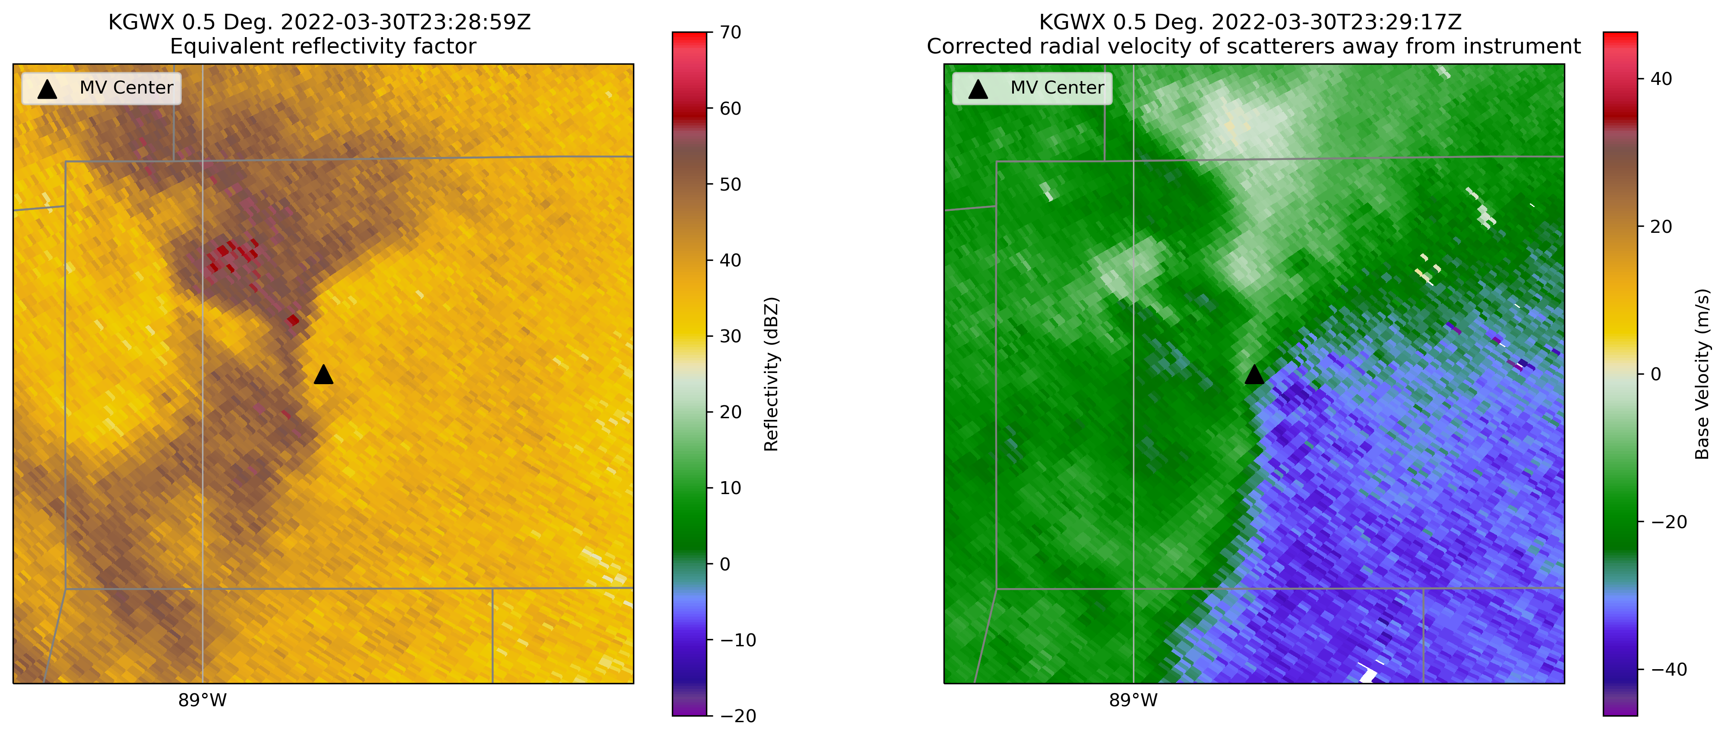
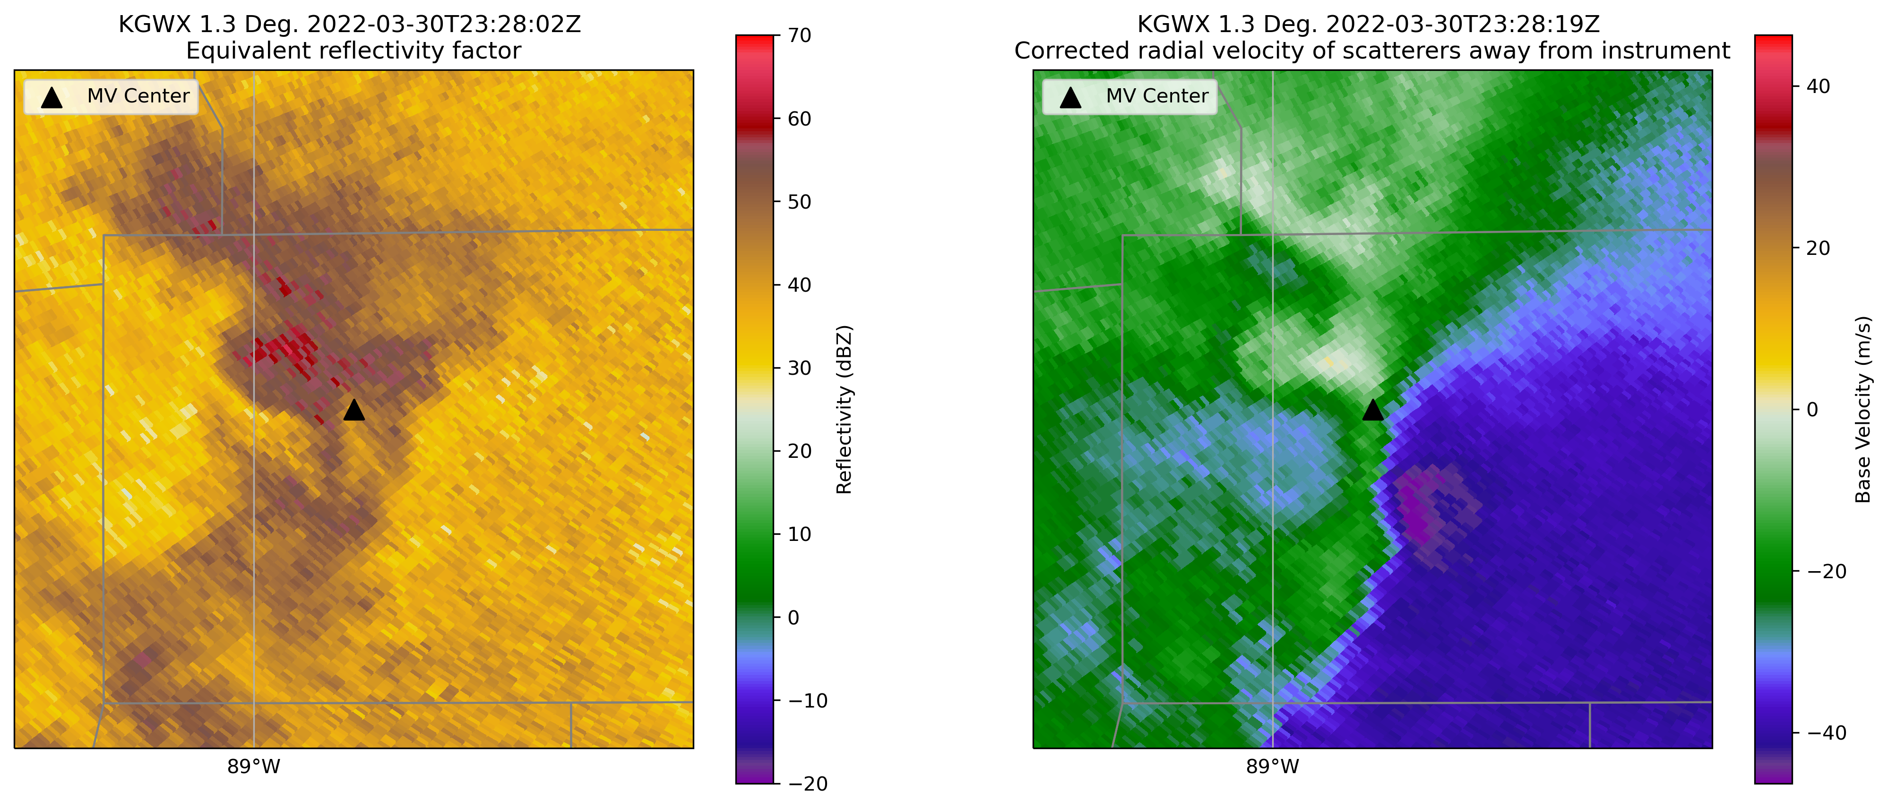
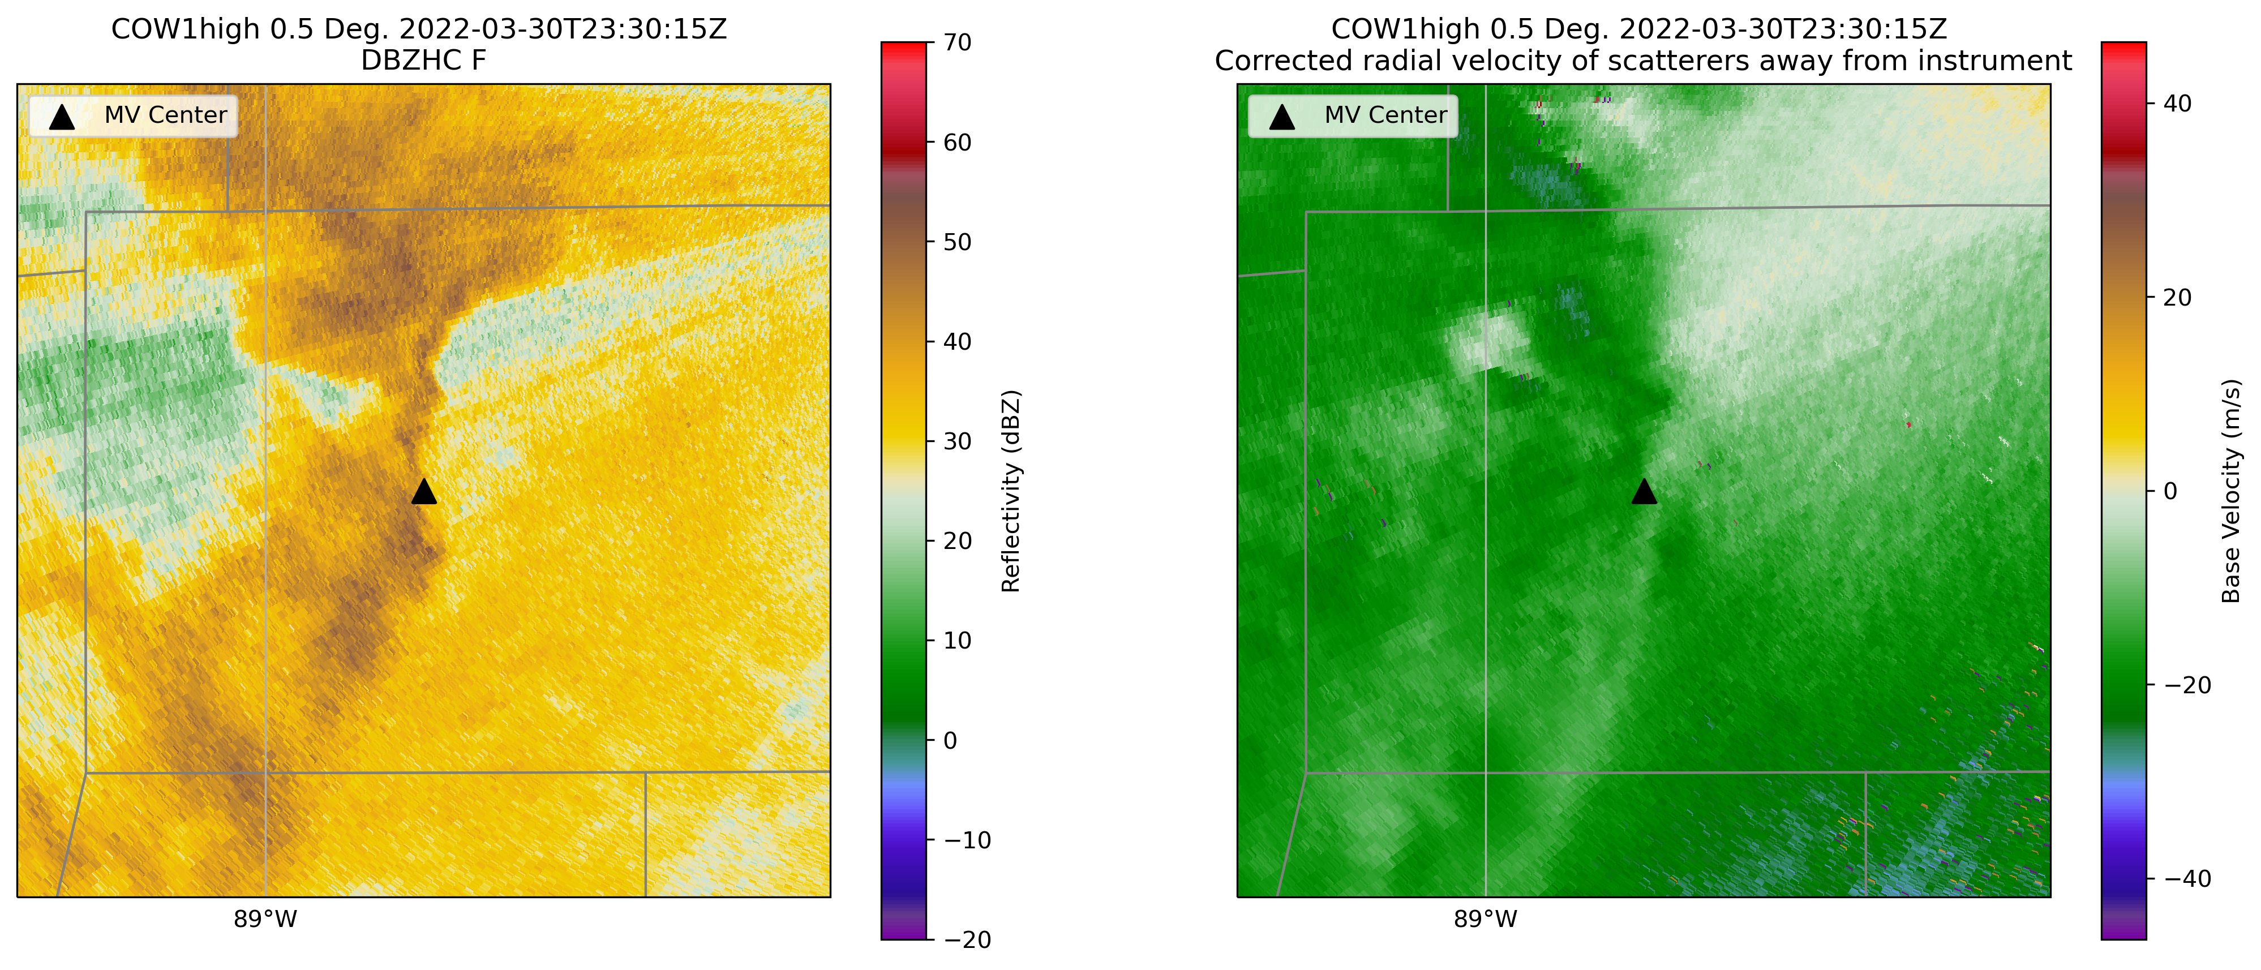
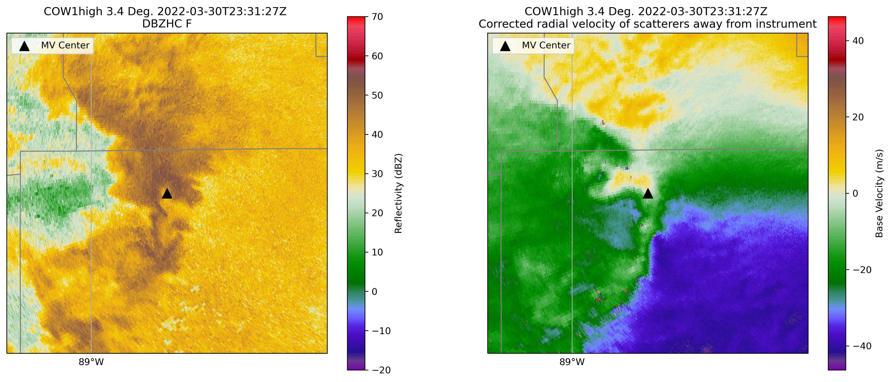
What is the Low-Level Structure of MVs?
979 m ARL
1988 m ARL
WSR-88D
Low-level vertical variation in MV structure may not be captured by the WSR-88Ds
285 m ARL
2069 m ARL
COW
?
MV formed at 2225 UTC
Produced tornado at 2232 UTC
Tornado warned at 2317 UTC
Dissipated at 2343 UTC
Notes:
Most radar observations that we currently have on QLCS MVs are from the WSR-88Ds.
Some of the observations that we collected with the COW during PERiLS sampled MVs at lower altitudes than the WSR-88D did, which helped investigate my second research question of what is the low-level structure of MVs?
I found 3 cases where there was a MV at the lowest elevation scan of the WSR-88D data, but this MV was not present at the lowest elevation scan of the COW over some duration of the lifetimes of the MVs
I will take you through one of these cases, starting with its lifetime, which is at the bottom of the screen
This MV formed around 2225Z as visible by the lowest elevation scan of WSR-88D KDGX.
This MV produced a tornado at 2232Z.
A little less than an hour later, at 2317Z, a tornado warning was issued on this MV.
The image on the top left shows base reflectivity on the left and base velocity on the right of this MV at 2329Z as viewed by the WSR-88D KGWX at the lowest elevation scan, which is 0.5deg. The radar is viewing this MV at 979m ARL.
Although not particularly strong at this point, a MV is seen at this level along with a kink or hook-like feature in reflectivity.
If we go up a few elevation angles to 1.3deg, you can now see that the MV is very intense higher aloft, at 1988m ARL.
However, if we look at the 0.5 deg scan from the COW radar at the same time, a MV is not visible.
As we go up in elevation angles to 3.4 deg, now a broad circulation is visible
This is one piece of evidence that there is low-level vertical variation in MV structure that may not be captured by the WSR-88Ds
This is the first high-resolution observational evidence that we are aware of that displays this

Slide 18
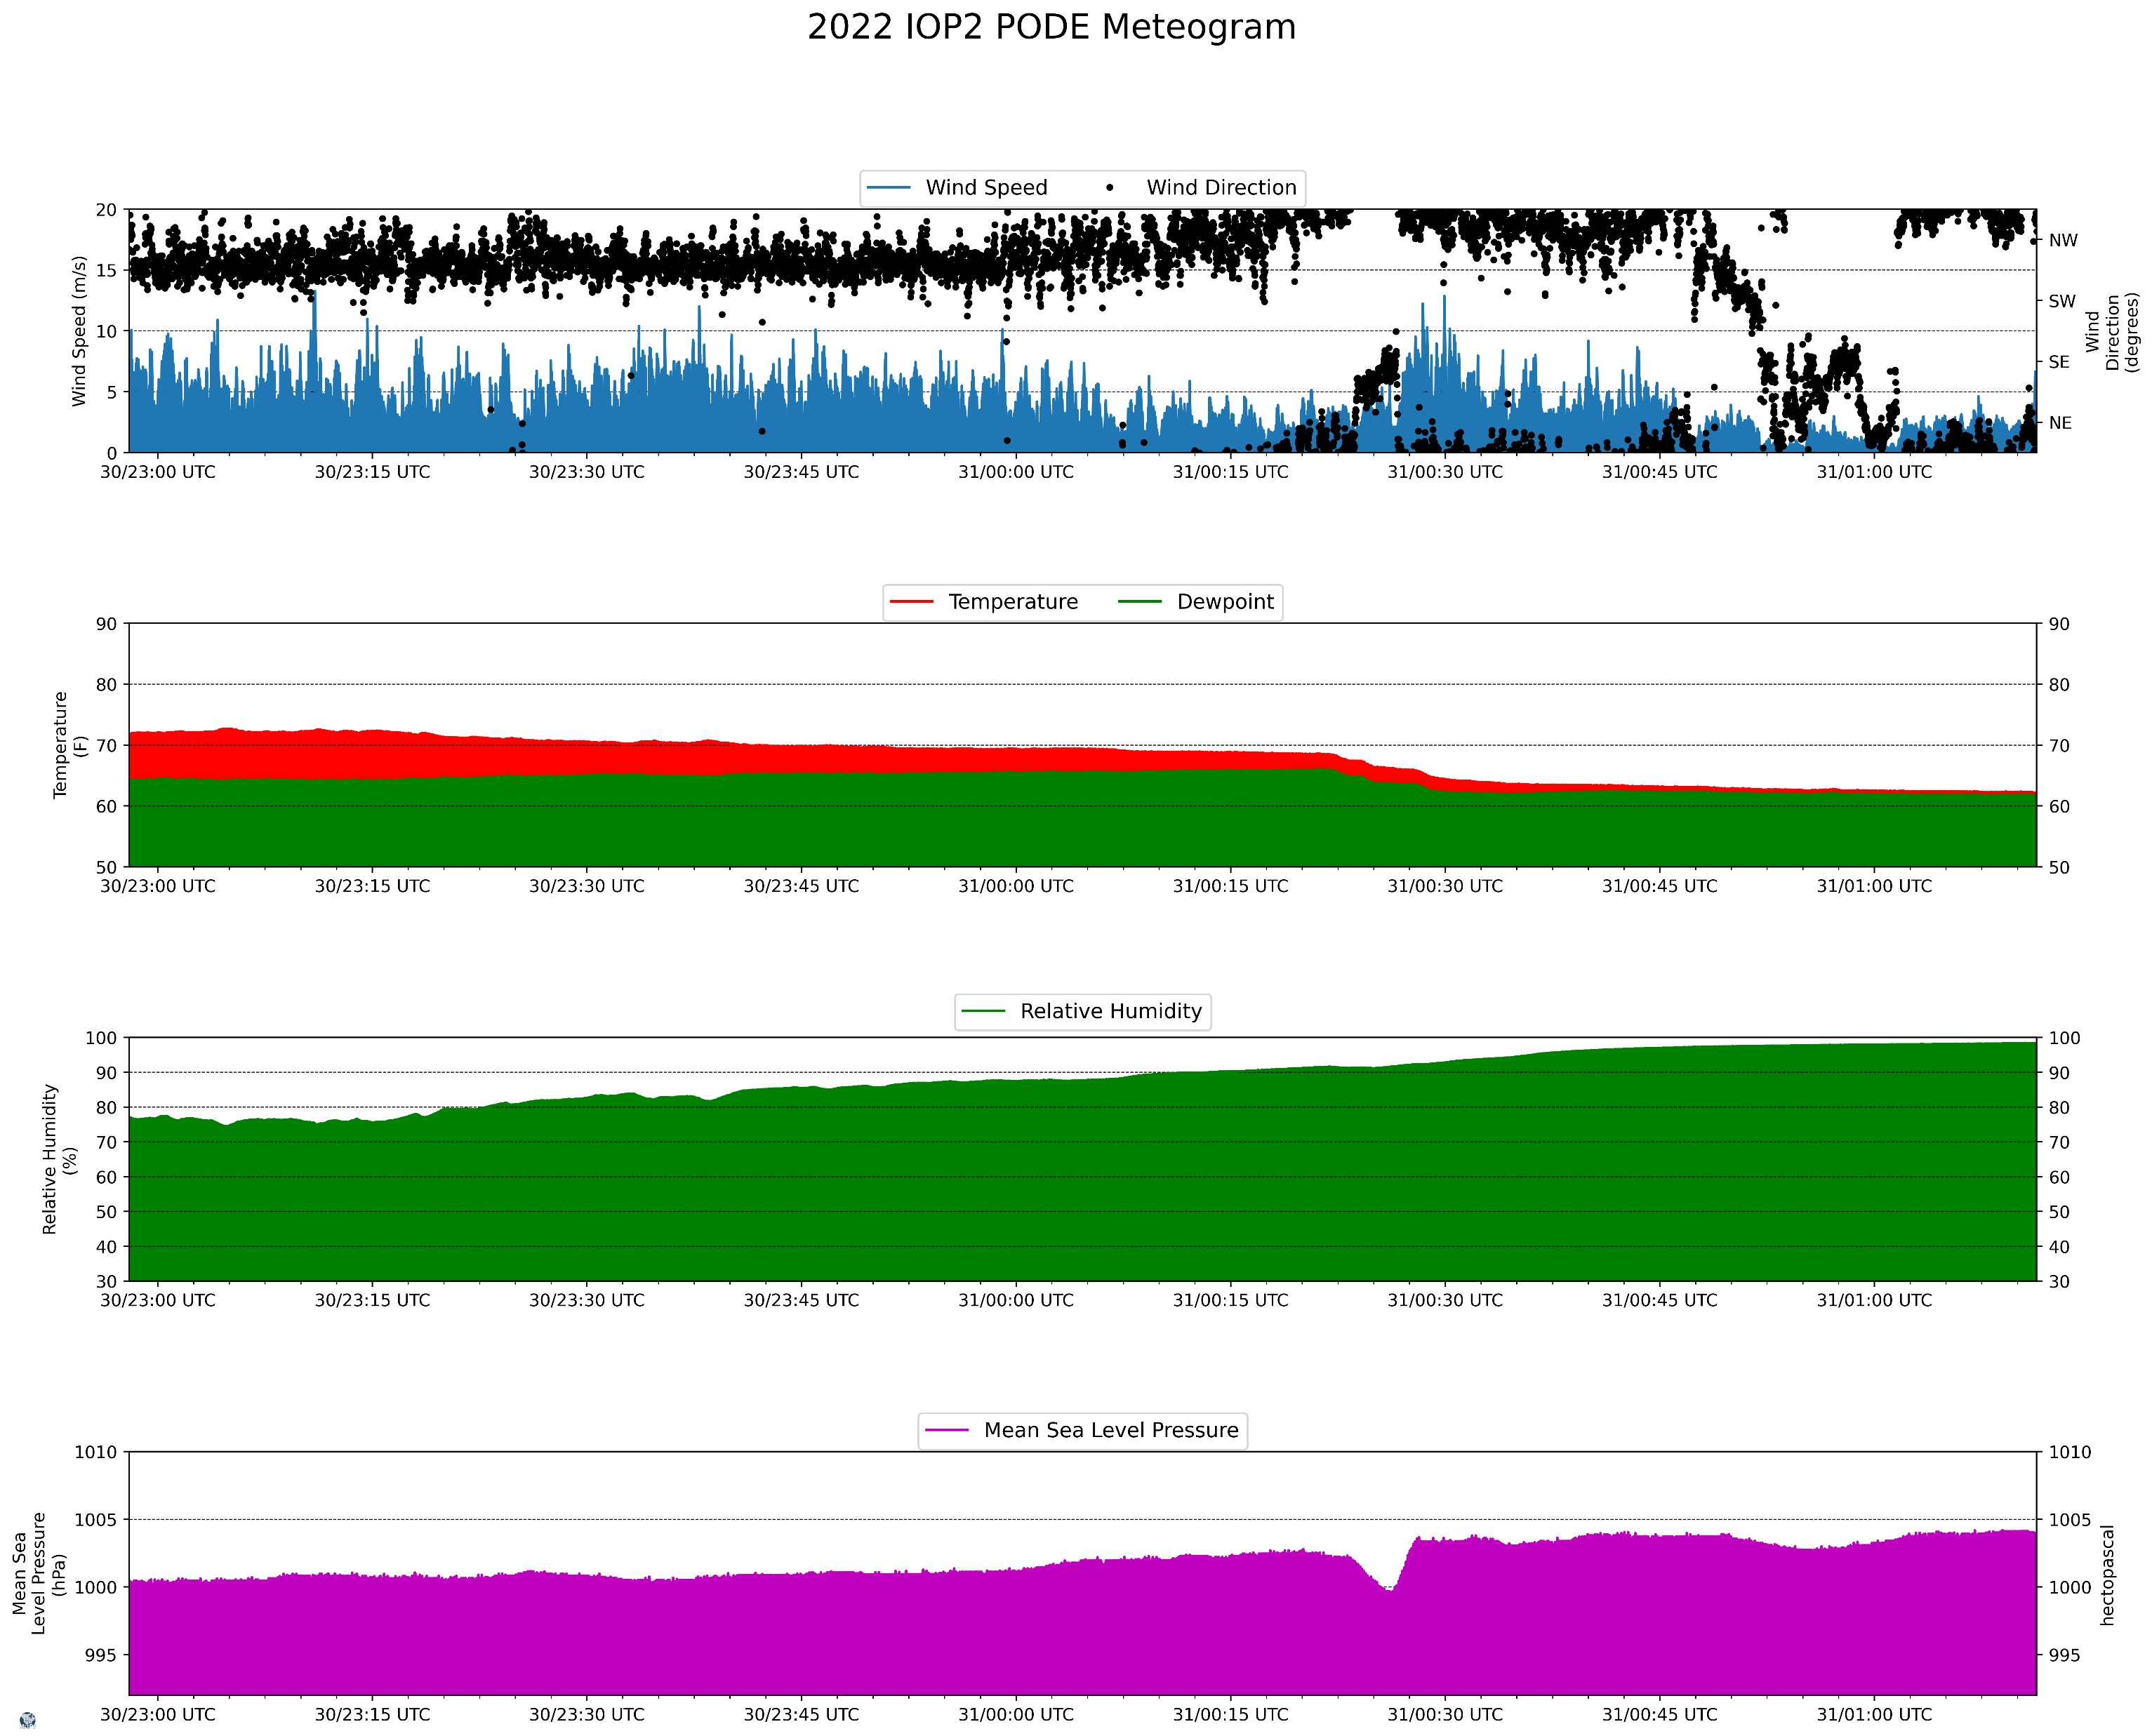
In-Situ Pod Data from PERiLS 2022 IOPs
A MV was considered to have intercepted a Pod if its center came within 5 km of the Pod
3 QLCS MVs intercepted 6 Pods when viewed from the lowest scan of the nearest WSR-88D
None of the MVs were actively producing damage at the time of intercept
When a MV passes over the pods, there is usually:
A pressure drop, 2.1 mb on average
A shift in the wind direction
An increase in wind speed, but limited to 13 m/s or less
Picture courtesy of Ruth Aikins
Notes:
To supplement the radar observations of the low-level structure of QLCS MVs, we had some MVs that intercepted in-situ Pods during PERiLS when viewed from the lowest tilt of the WSR-88Ds
3 QLCS MVs intercepted 6 pods at some point during their lifetimes.
While all three MVs produced straight-line wind or tornado damage(s) during their lifetimes, none of the MVs were actively producing damage at the time of intercept.
In this meteogram when the MV passed over the Pod around 0028 UTC, a drop in pressure was seen, which was also present in almost all of the other intercept cases
There was also a shift in the wind direction and an increase in wind speed, but the increase in wind speed was limited to12 m/s or less in all cases
Although MVs can look strong at the lowest angle of the WSR-88D, the near-surface structure as seen by this Pod data and COW radar data, can be drastically different
However, most notably, the wind speeds did not peak over 12 m/s when MVs passed over the Pods
When viewed from the lowest scan of the WSR-88D radars, outbound/inbound velocities of QLCS MVs typically exceed 12 m/s
Indeed, the weaker wind speeds observed by the Pods could be attributed to friction or blockage from nearby obstructions.
The Pods are also 1 m off the ground where the lowest scan of the WSR_88D could be as high as 1000 m
Some of the MVs produced damage before and some after and some both for passing over the Pods

Slide 19
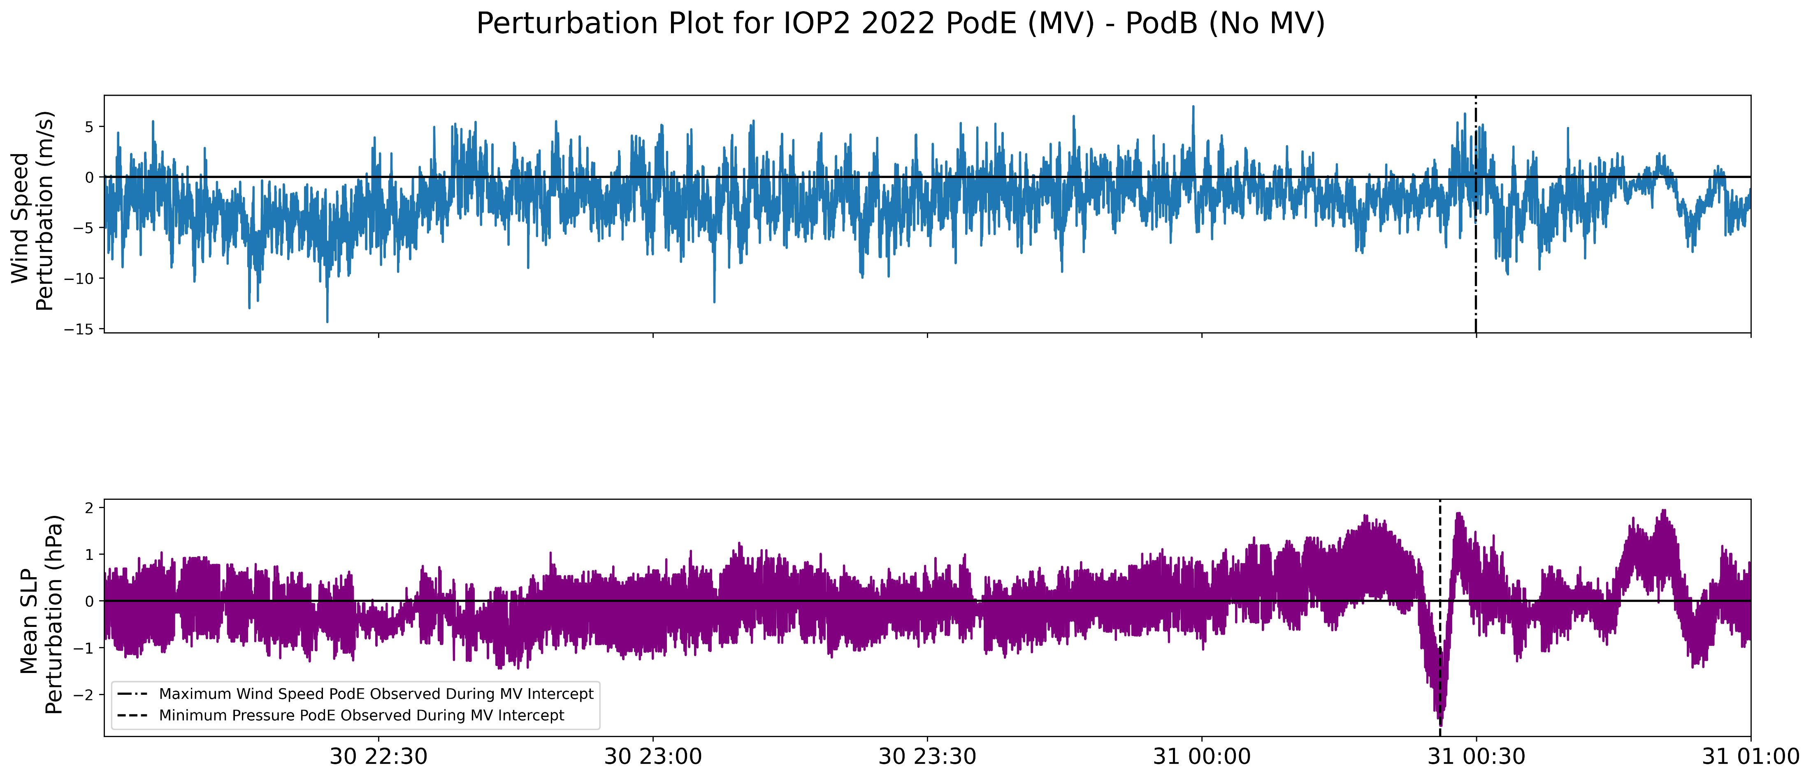
Difference between a Pod with a MV Intercept and One Without
Pressure drop is associated with the MV
Can’t conclude the increase in wind speed was caused by the MV, probably a combination of the MV and the QLCS
MV intercept Pod had a greater wind speed
MV intercept Pod had a lower pressure
Notes:
So now that you have seen an example of a Pod that had a MV intercept, you might be wondering, well how much of the increase in wind speed and drop in pressure is attributed to the MV, versus the QLCS?
We know dynamically that vortices have lower pressure and QLCSs generally cause a buildup in pressure known as “splat” at the leading edge (piling up of mass from cool descending air), but what about the wind speed?
MVs and QLCSs have been noted to cause increases in wind speeds
To help answer this, I took a data from a Pod that did not have a MV intercept and subtracted its data at each time step from a Pod that had a MV intercept at a nearby location.
On the top panel in blue is the wind speed perturbation and on the bottom in purple is the pressure perturbation.
Because of the way I have subtracted the 2, positive values mean the MV intercept Pod had greater values.
Now we can clearly see that the pressure drop is caused by the MV as we expected
However, I am less confident to conclude that the increase in wind speed was mainly caused by the MV and it is probably a combination of both the MV and the QLCS

Slide 20
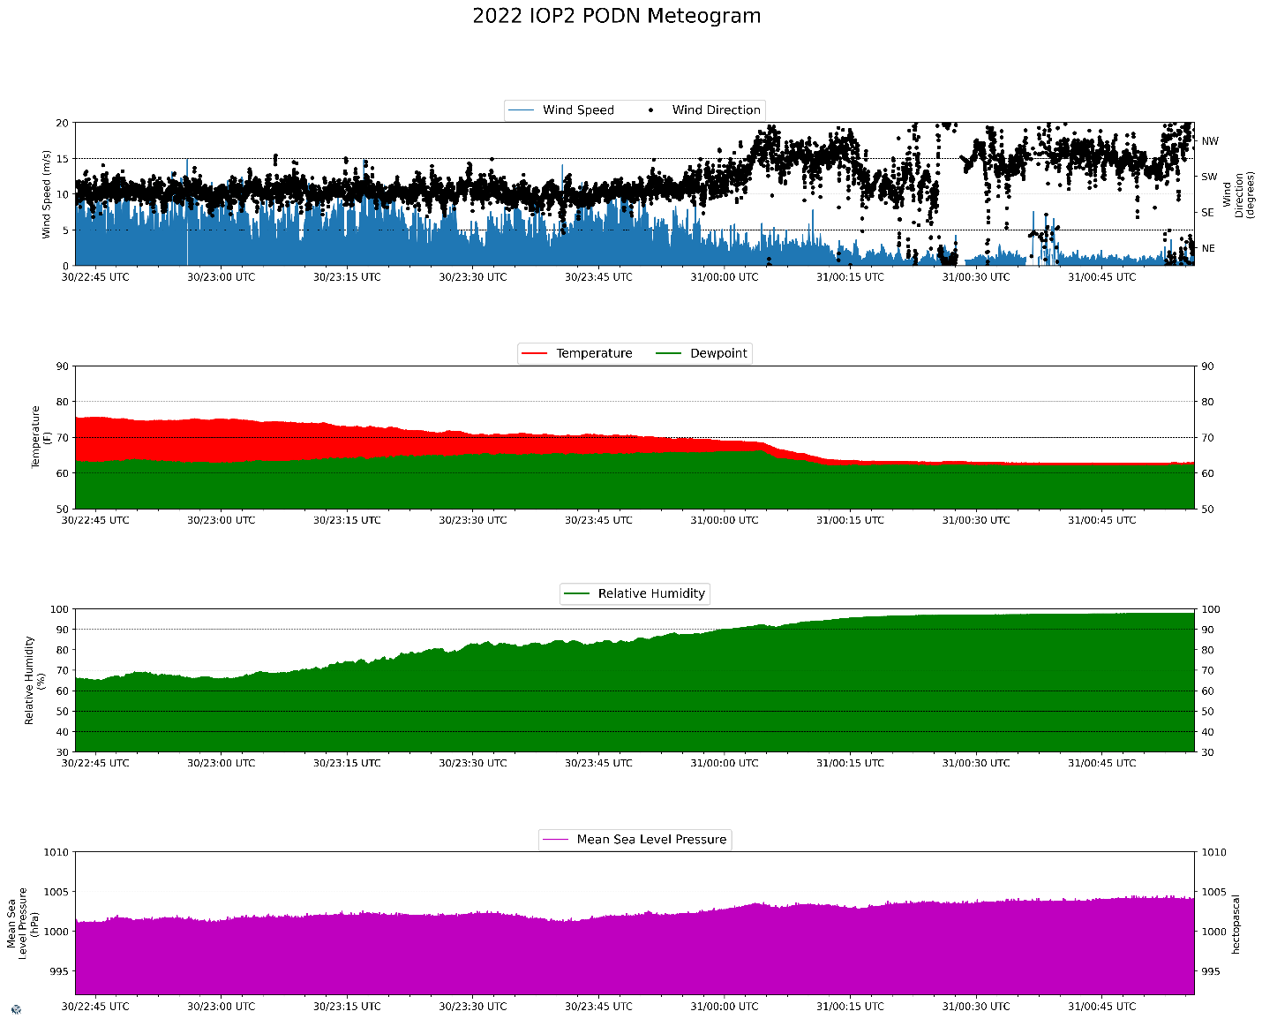
Notes:
Pod N during PERiLS IOP2_2022
An MV did not intercept at the time of line passage.
A shift in the wind direction and a decrease in temperature and dewpoint are displayed as with Pod E.
However, a drop in pressure was not observed; instead, a slight rise was seen.
This rise in pressure near the surface is a key feature associated with the passing of a QLCS (Houze et al. 1989);
this is colloquially known as “splat” and is caused by the piling up of mass from cool descending air.
The wind speeds observed by this Pod were relatively weak, with a maximum of 5.89 m/s, although higher wind speeds were associated with the line passage over other Pods.

Slide 21
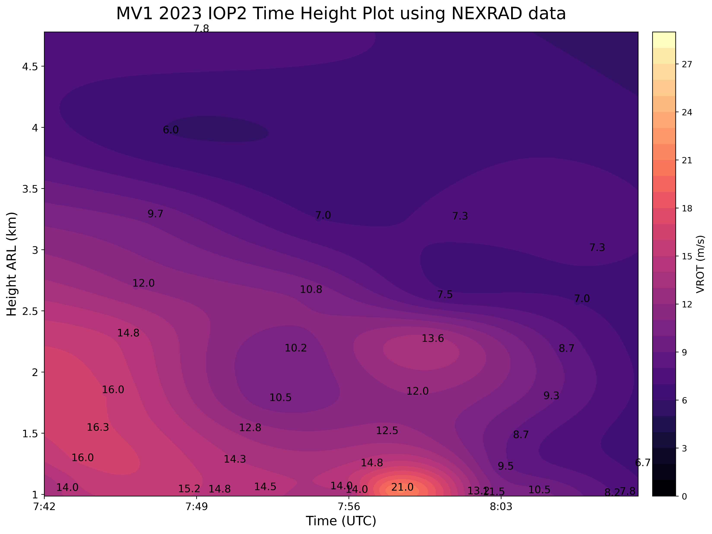
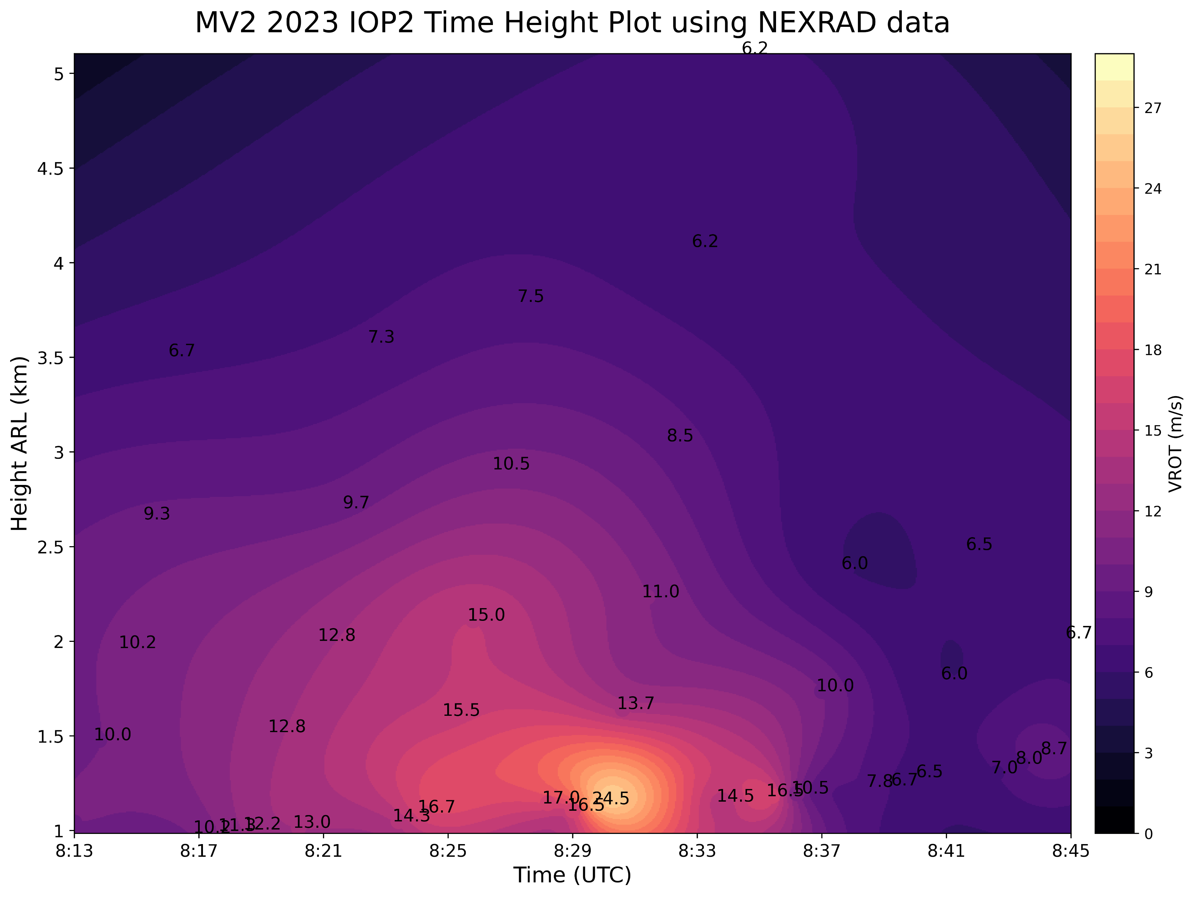
Time-Height Profiles of Vrot for a TOR and a ND MV
At the time of tornadogenesis, low-level and “mid-level” circulations were present
MV had a greater vertical extent
Exhibited a stronger max Vrot than the TOR MV
However, the low-level circulation was not co-located with a circulation aloft at its peak intensity
EF0 TOR at 0757Z, 25 min lifetime
ND but tornado warned, 37 min lifetime
Tornado
Notes:
While most of my work so far has focused on low-level observations of QLCS MVs from PERiLS, I also analyzed time-height profiles of maximum Vrot for 2 MVs, one TOR and one ND, during IOP2_of 2023 using WSR-88D KLZK
Looking higher aloft is one of the next things to examine on my to-do list, so I decided to start with two cases.
The plots have time on the xaxis, height on the yaxis, and are colored by their rotational velocities
The TOR MV on the left lasted 25 minutes and produced an EF0 tornado 14 minutes after its genesis (started at 0743 and tornado at 0757).
At the time of tornadogenesis, a strong circulation is apparent near 1 km, and there is also a mid-level circulation is present too
Due to the discontinuities in radar elevation scans, the stronger Vrots aloft manifest themselves as a mid-level circulation, but in reality, this MV is likely continuous and has a greater vertical extent
The ND MV on the right lasted longer than the TOR MV for a total of 37 mins and this MV was tornado warned for most of its lifetime
This MV exhibited a stronger maximum Vrot than the TOR MV of 24.5 m/s
However, a mid-level circulation was not co-located with the low-level circulation at the time of maximum intensity.
Despite its strength at low-levels, it is hypothesized that the absence of a mid-level circulation with the ND case limited the vertical stretching required to produce a tornado.
I think this is something to keep in mind that can be forgotten with QLCS MVs. Yes, when compared to supercells, these MVs are typically shallower, but this does not mean that we should neglect higher elevation scans
Unlike the TOR MV, this MV intensified at low-levels prior to its peak intensity.
This is contradictory to Atkins et al. (2004), but the maximum Vrot is only 3.5 m/s higher in the ND case presented here.
Note that peak Doppler velocity values can also be distorted depending on the location of the beam relative to the circulation (Wood and Brown 1997).
The circulation aloft likely induced an upward-directed pressure gradient force and thus contributed to updraft accelerations, which stretched and amplified the low-level MV.

Slide 22
Conclusions
TOR and WD MVs have similar Vrots and diameters when analyzed over the whole period prior to the first report/warning
However, TOR MVs typically have smaller diameters in the few scans prior to tornadogenesis when compared to WD MVs
Evidence that there is significant vertical variation in low-level MV structure from COW radar and in-situ Pod data that may not be captured by WSR-88Ds
For MVs that intercepted Pods, a maximum wind gust of 13 m/s was observed, and most of the Pods observed a decrease in pressure
Time-height profiles of Vrot displayed that the TOR MV was associated with a “mid-level” circulation/was deeper at the time of tornadogenesis
Notes:
I have bolded the conclusions that I think could be the most useful from a forecasting perspective
The lowest scanning angle of the WSR-88D is not necessarily representative of the MV structure below that level

Slide 23
Future Work
Investigate the depth of more MVs
Why are WD MVs larger?
Examine environmental parameters such as CAPE and shear
A manuscript in the works…
Blind-Doskocil, L., R. J. Trapp, S. W. Nesbitt, K. A. Kosiba, J. Wurman, and M. D. Parker, 2023: Characteristics of tornadic and nontornadic QLCS mesovortices observed using radar and Pod data from PERiLS. In prep for submission to Mon. Wea. Rev.
Notes:
Talk about caveats? Local storm reports, limited sample size, MV criteria still somewhat subjective, confined to lower levels

Slide 24
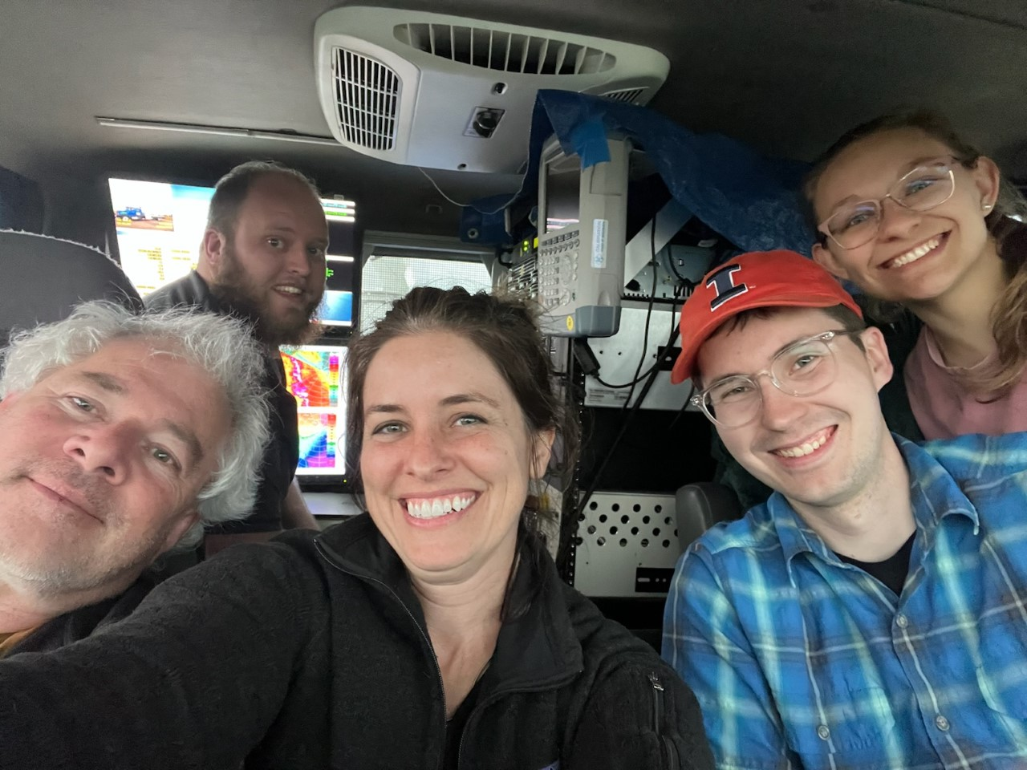
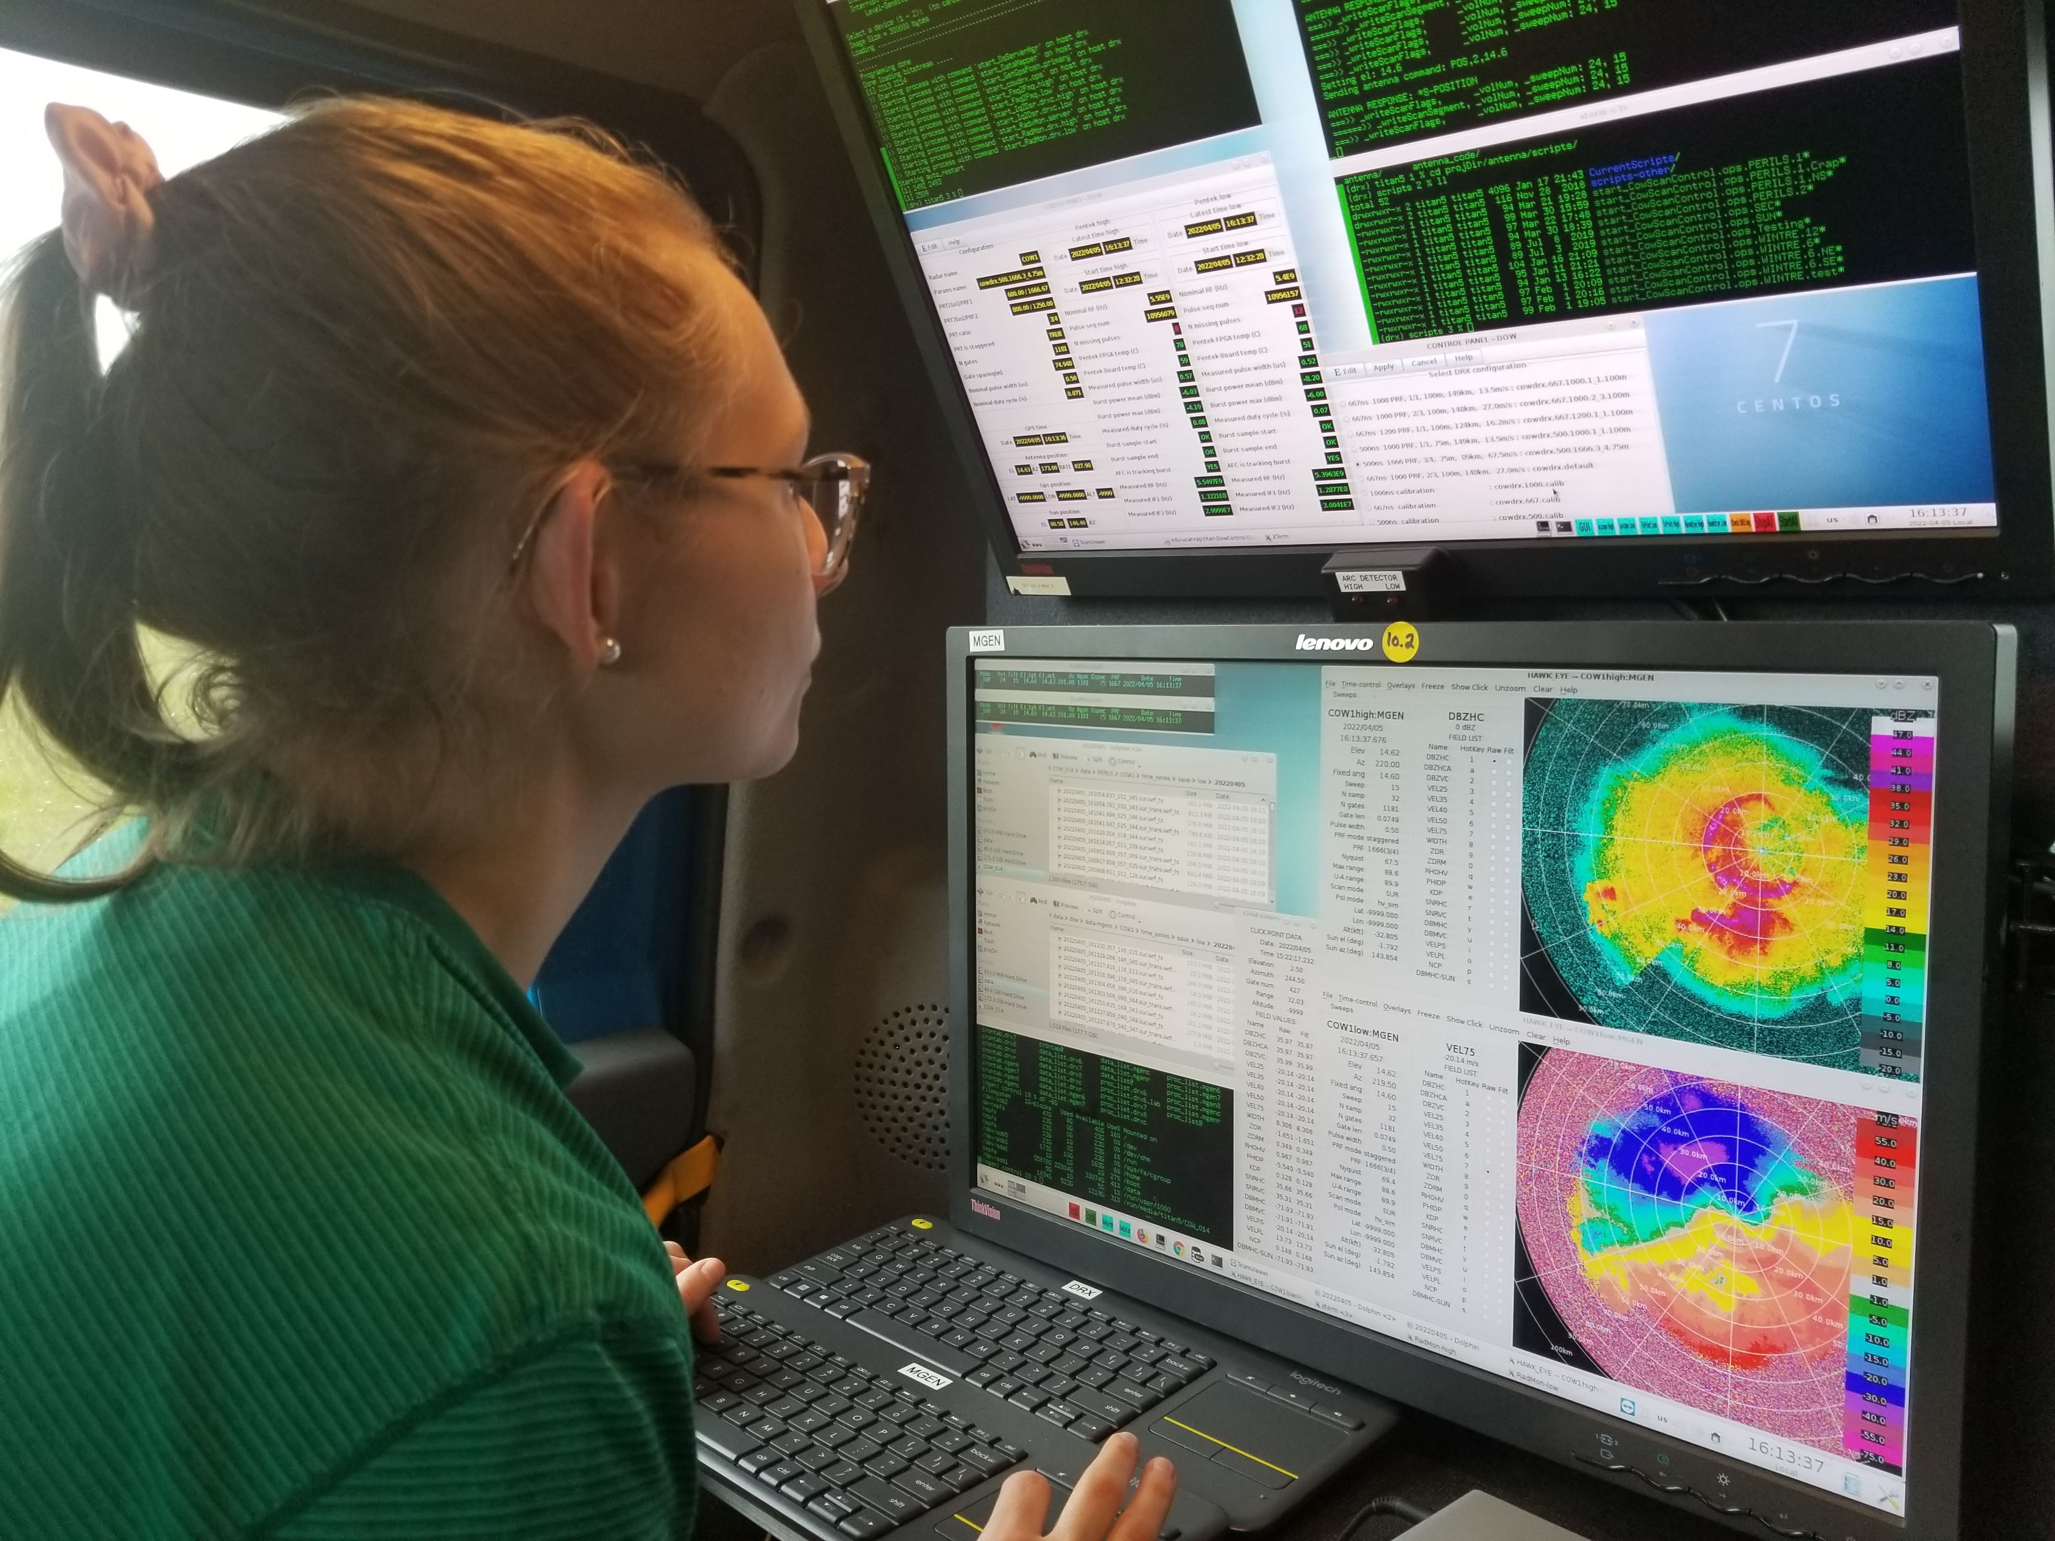
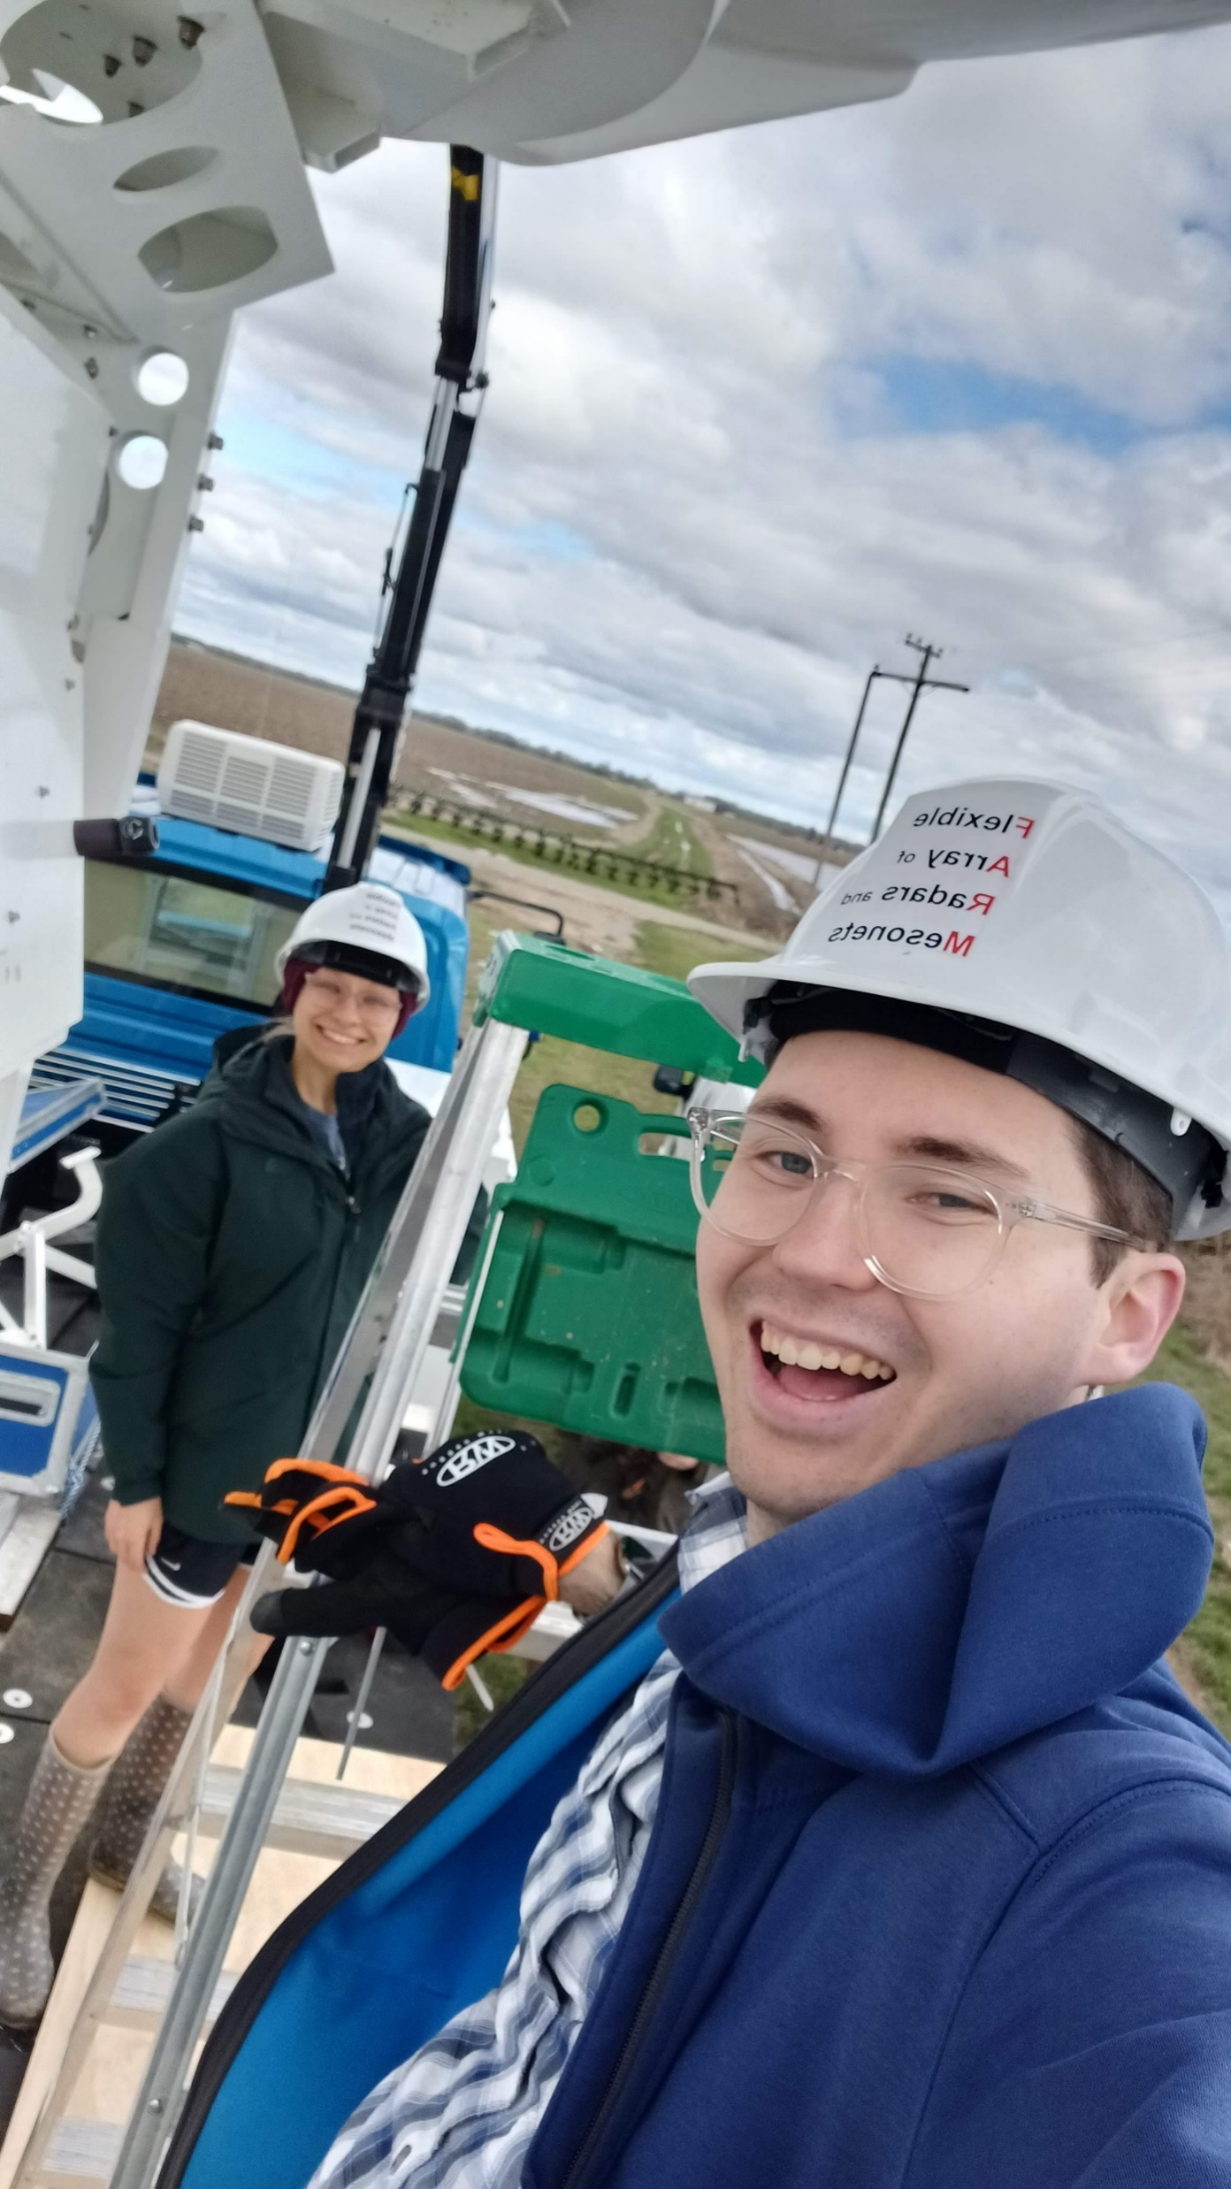
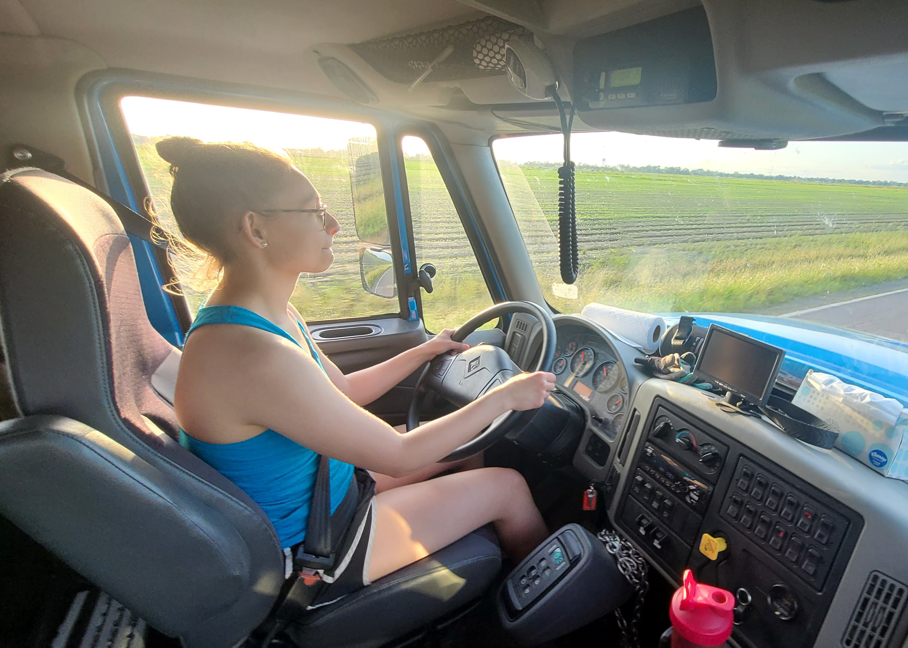
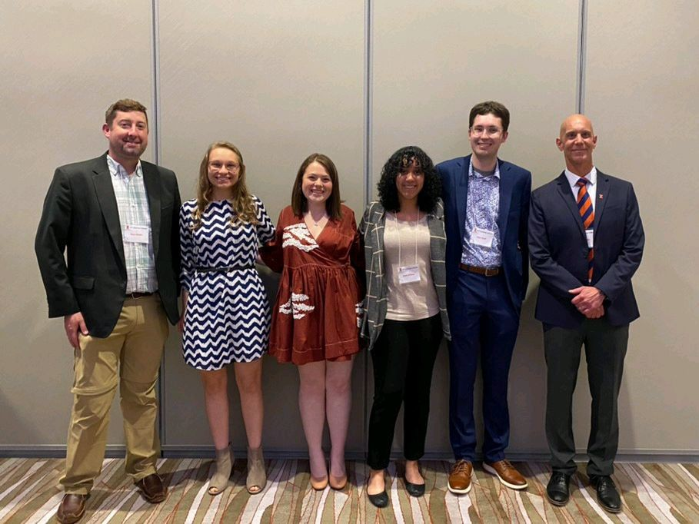
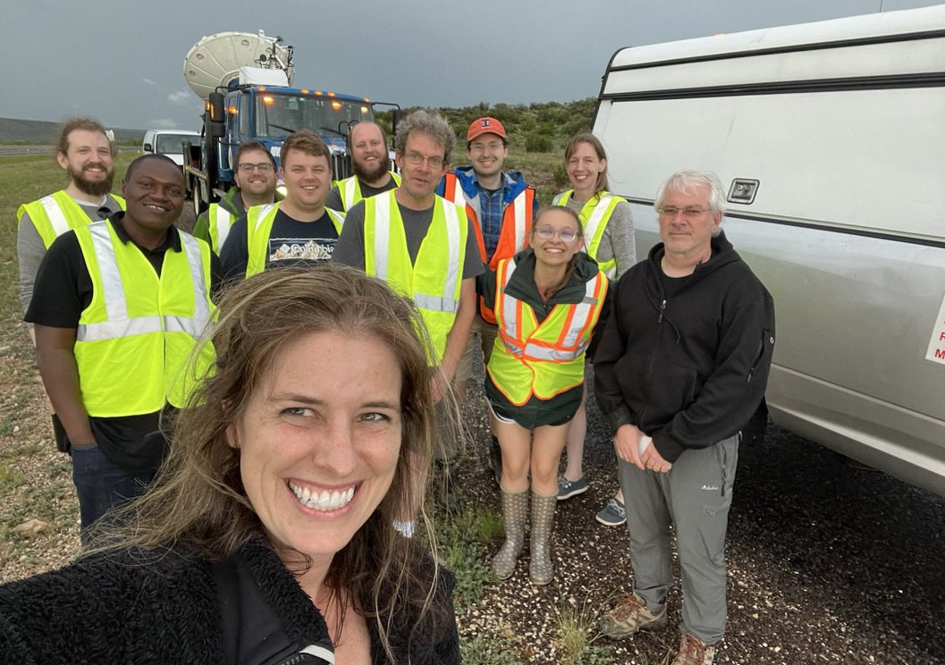
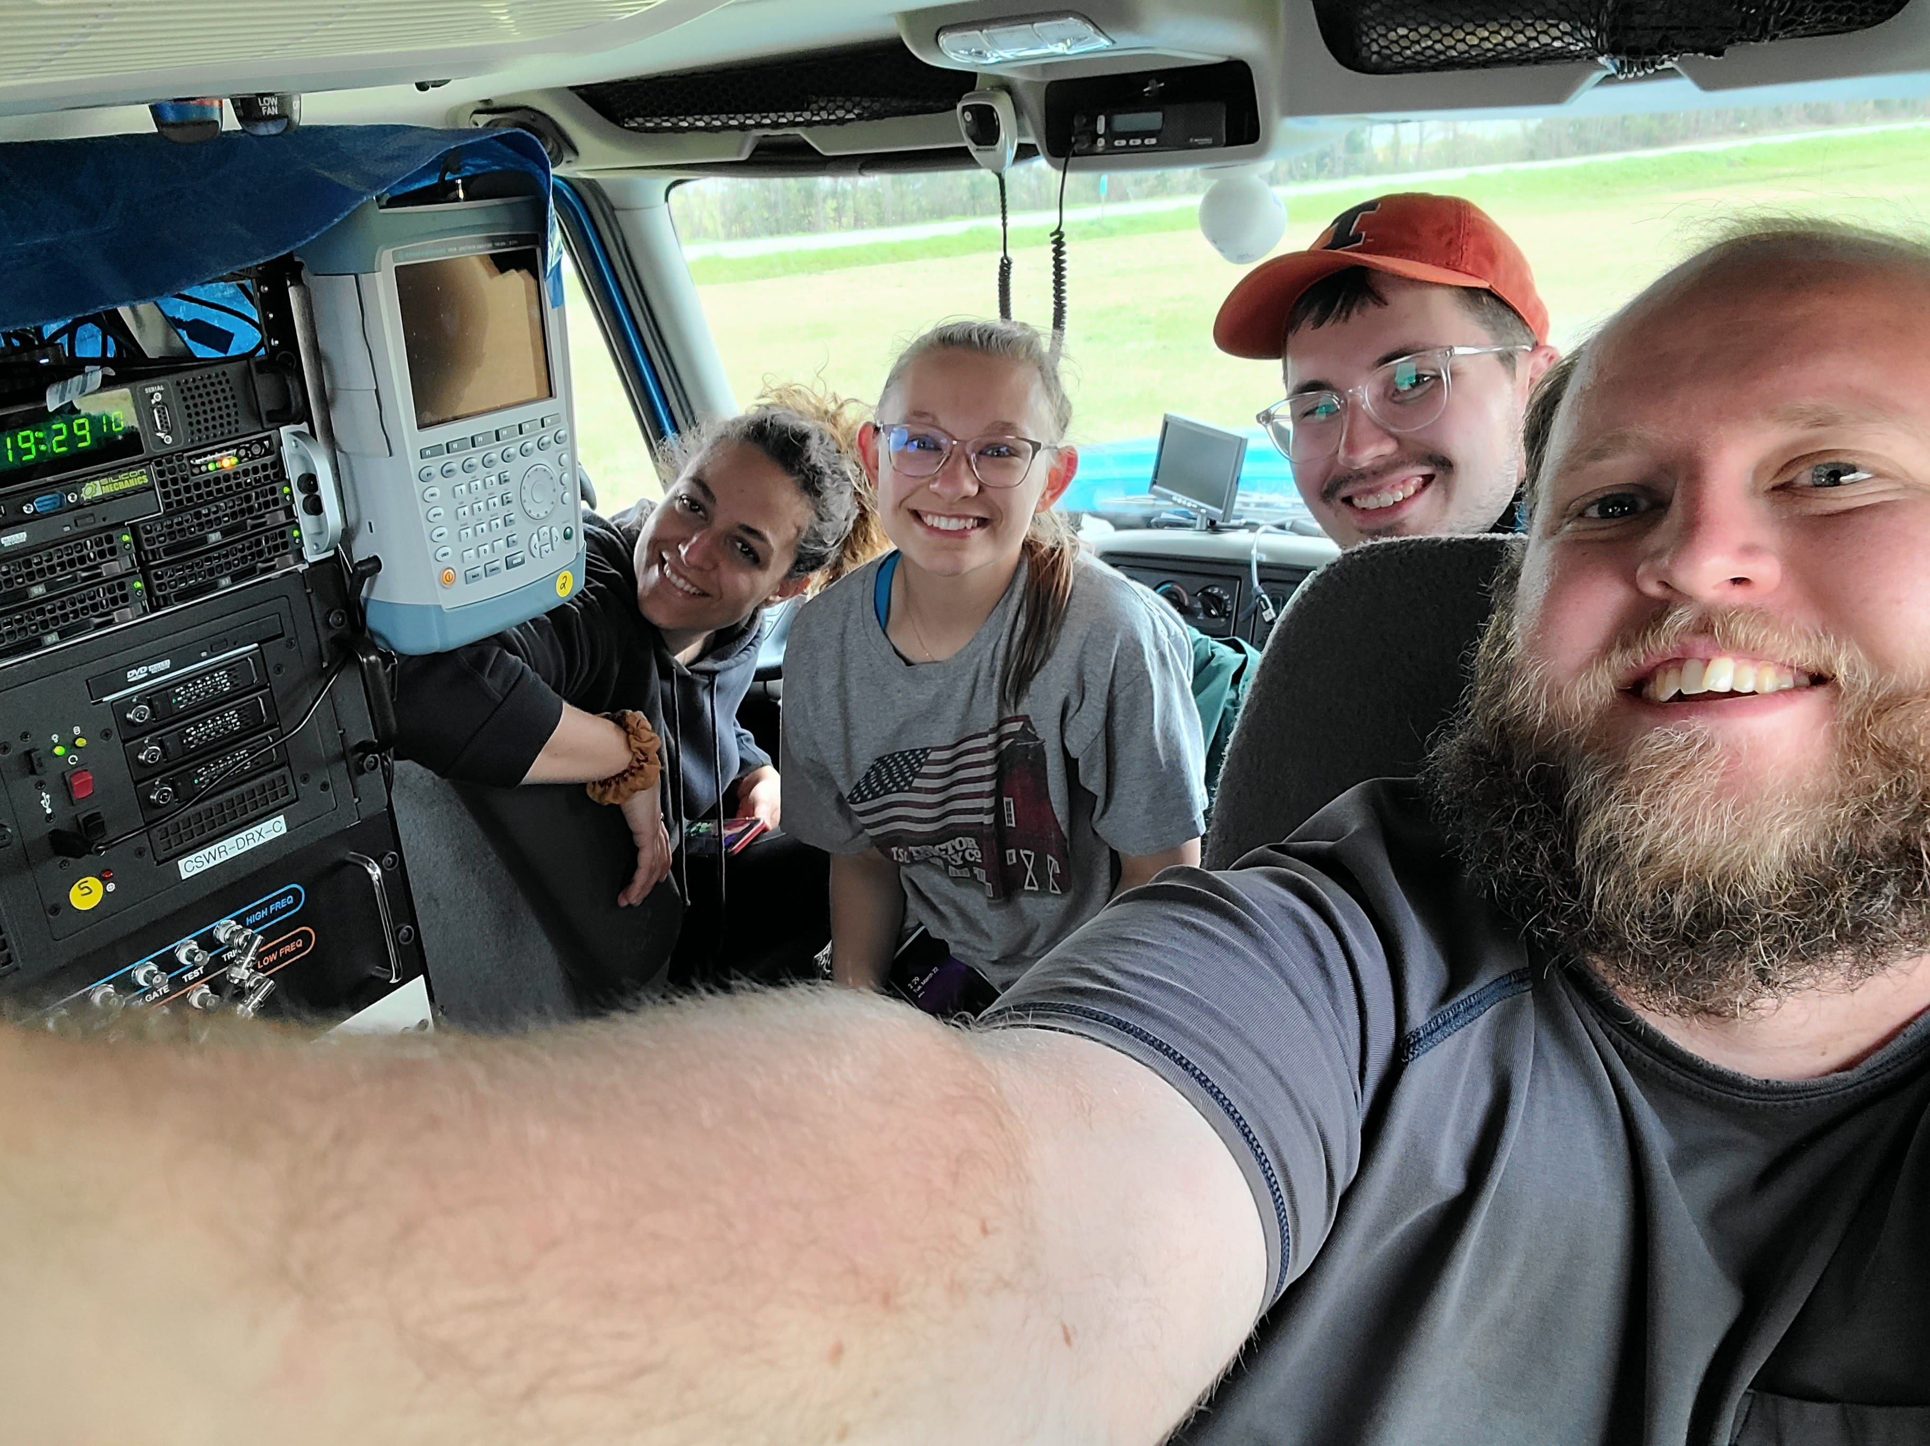
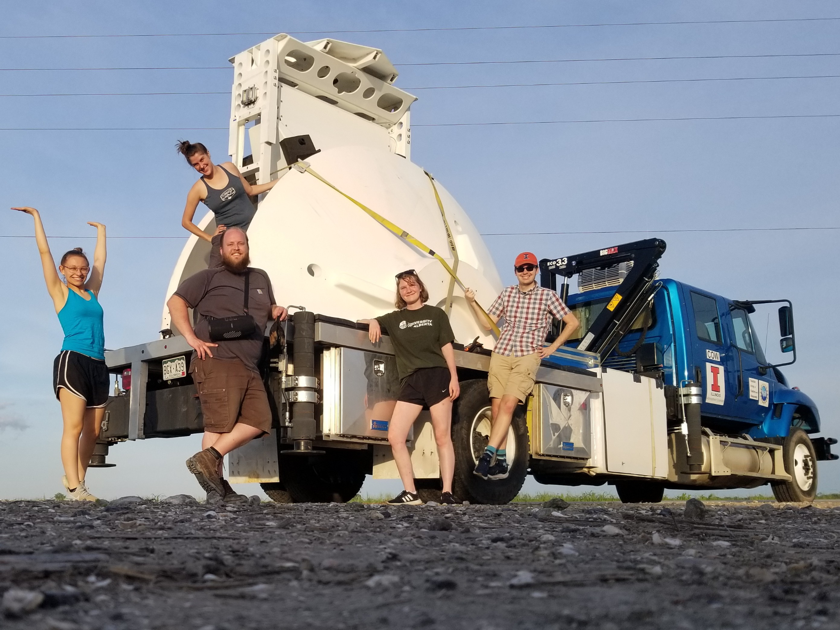
Acknowledgements
Advisors, Jeff and Steve, for their unwavering support and research guidance
Committee member and mobile radar guru, Karen Kosiba
Josh Aikins and Paul Robinson for FARM data QC
FARM Family and PERiLS Project
UIUC graduate student, Eddie Wolff, for this beautiful slide template and for being a great fellow PERiLS COW operator
Keith Sherburn and Charles Kuster for discussions about this work
Funding agencies: PERiLS NSF Grant (NSF AGS 2020462), NSF GRFP
Research group mates, past and present
Family and friends
Questions? Comments? Thanks for attending!
Contact info: leanneb2@illinois.edu

