Slide 1
Radar and Mobile Mesonet Analysis of a Nontornadic Mesovortex on 3 March 2023
Morgan Schneider, Matthew Flournoy, Michael Coniglio, David Bodine, Erik Rasmussen, Anthony Lyza, and Sean Waugh
PERiLS Science Meeting
16 November 2023

Slide 2
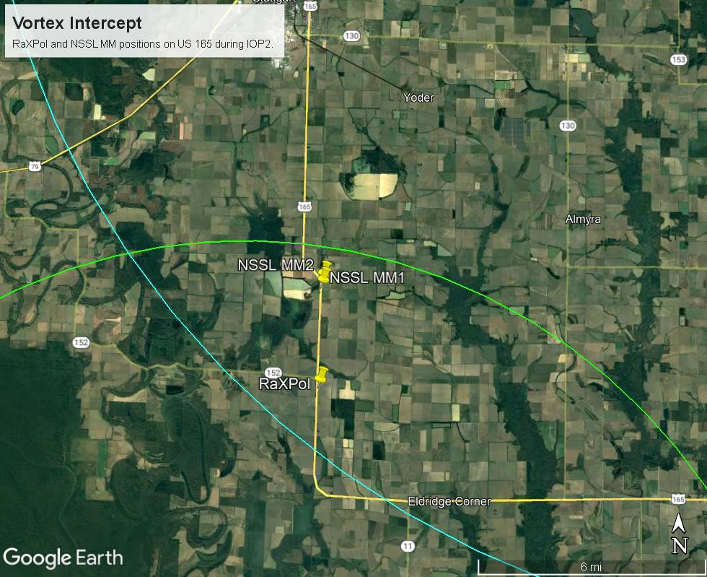
IOP2 – 3 March 2023
RaXPol collected close-range observations within 5 km of a nontornadic mesovortex near Stuttgart, AR
Shallow, rapid 30-s volumes with PPIs every 1.5° from 1°-19°
Simultaneous NSSL mobile mesonet transects surrounding the target mesovortex

Slide 3
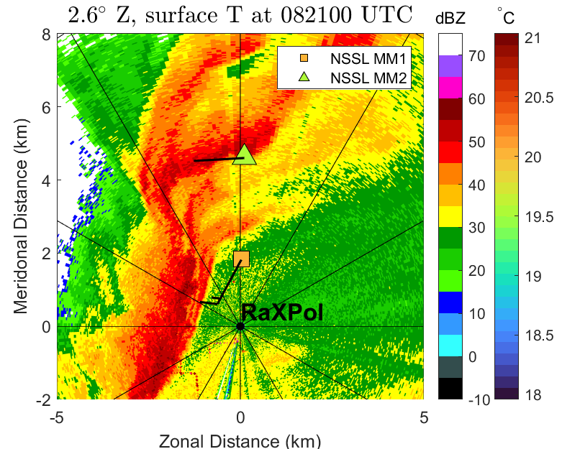
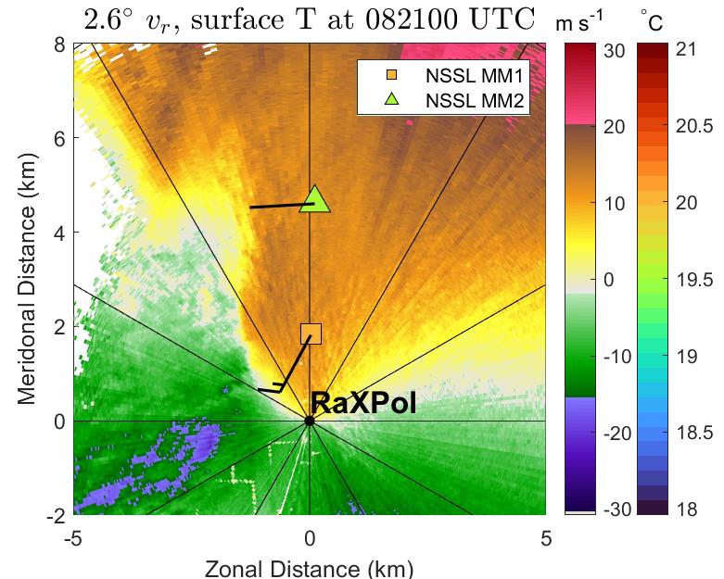
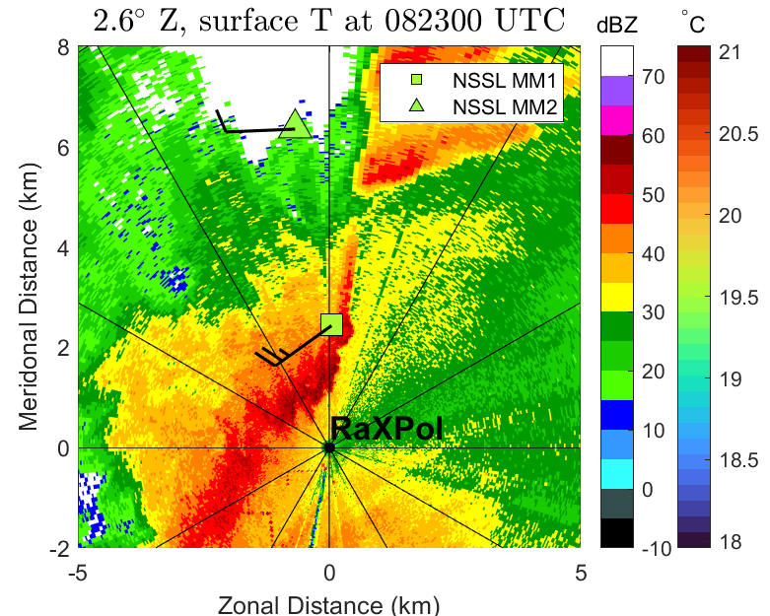
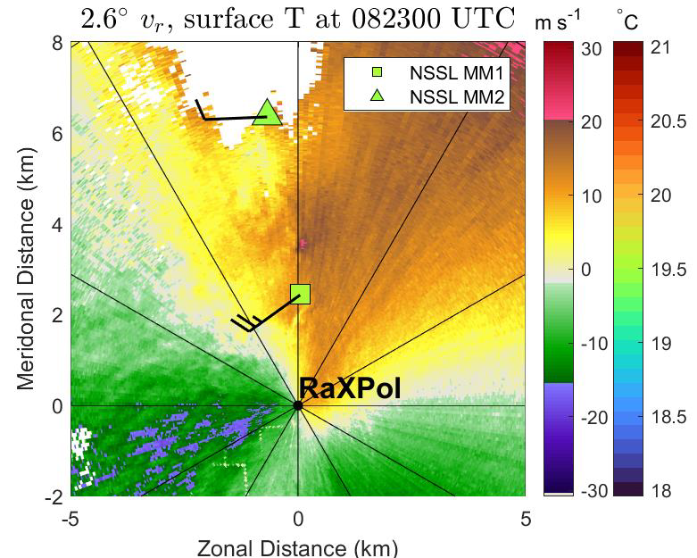
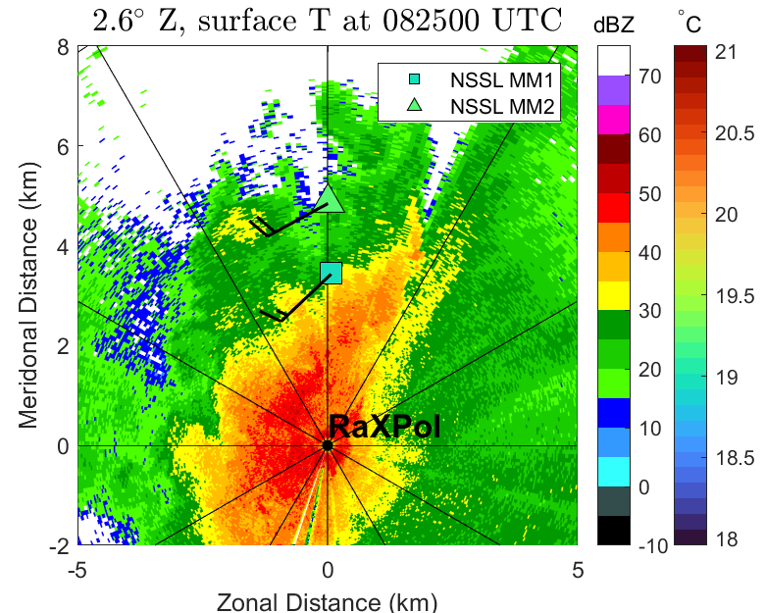
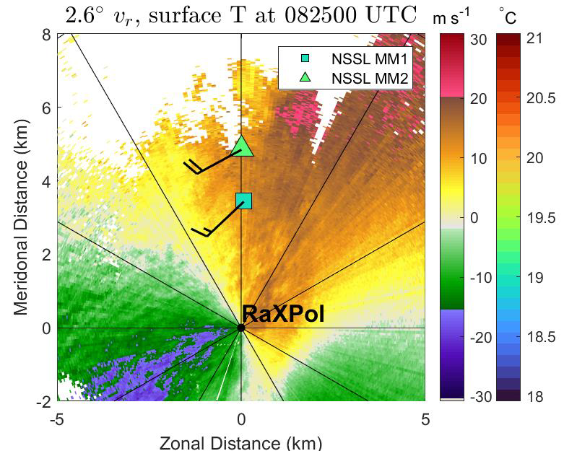
Preliminary Findings
Weak cold pool → Observed temperature deficits < 2°C
Small-scale features along the leading edge of convective precipitation

Slide 4
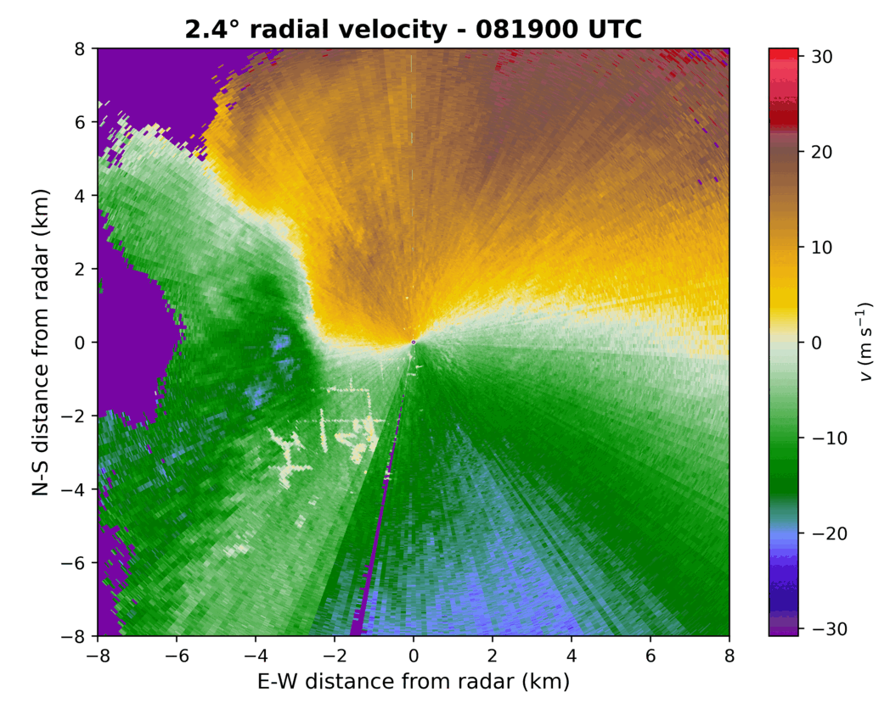
Preliminary Findings
Embedded misovortex forms 2 km NW of RaXPol around 082100 UTC
Strongest rotation between 082330–082430 UTC
Attenuated after ~082500 due to heavy rain

Slide 5
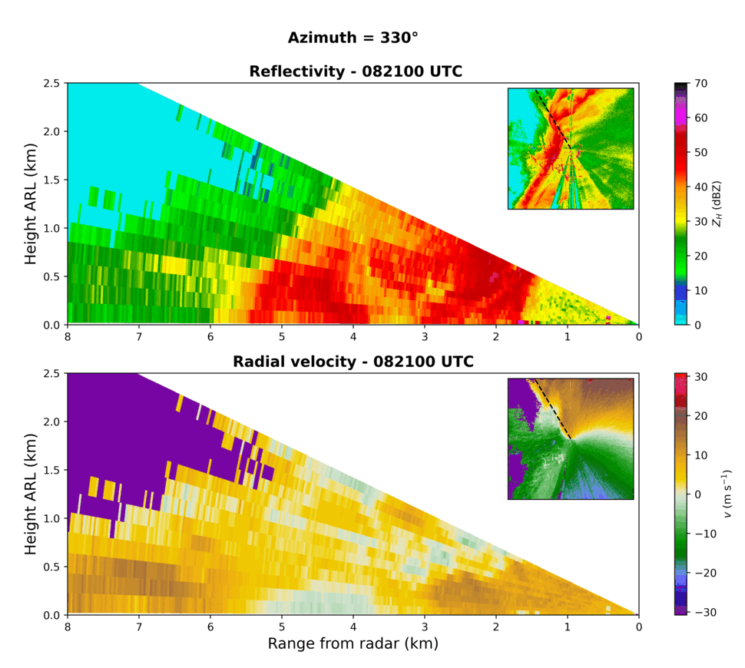
Preliminary Findings
Reconstructed RHIs at 0821 UTC show a low-level horizontal rotor along the line’s leading edge
Originates from above the surface and north of the developing misovortex
Intensifies and descends to near-surface as it approaches the misovortex
Associated with a slight weak echo column in Z

Slide 6
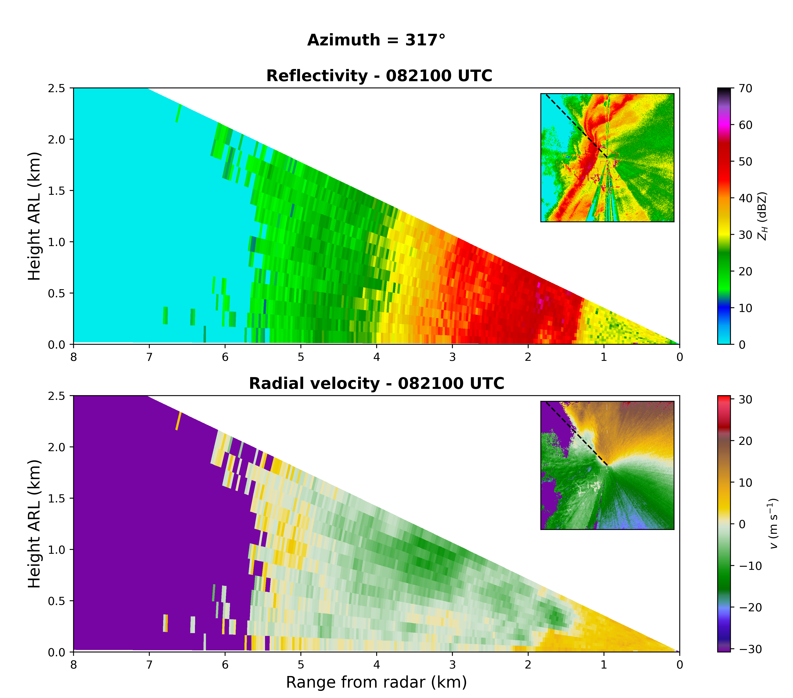
Preliminary Findings
Reconstructed RHIs at 0821 UTC show a low-level horizontal rotor along the line’s leading edge
Originates from above the surface and north of the developing misovortex
Intensifies and descends to near-surface as it approaches the misovortex
Associated with a slight weak echo column in Z

Slide 7
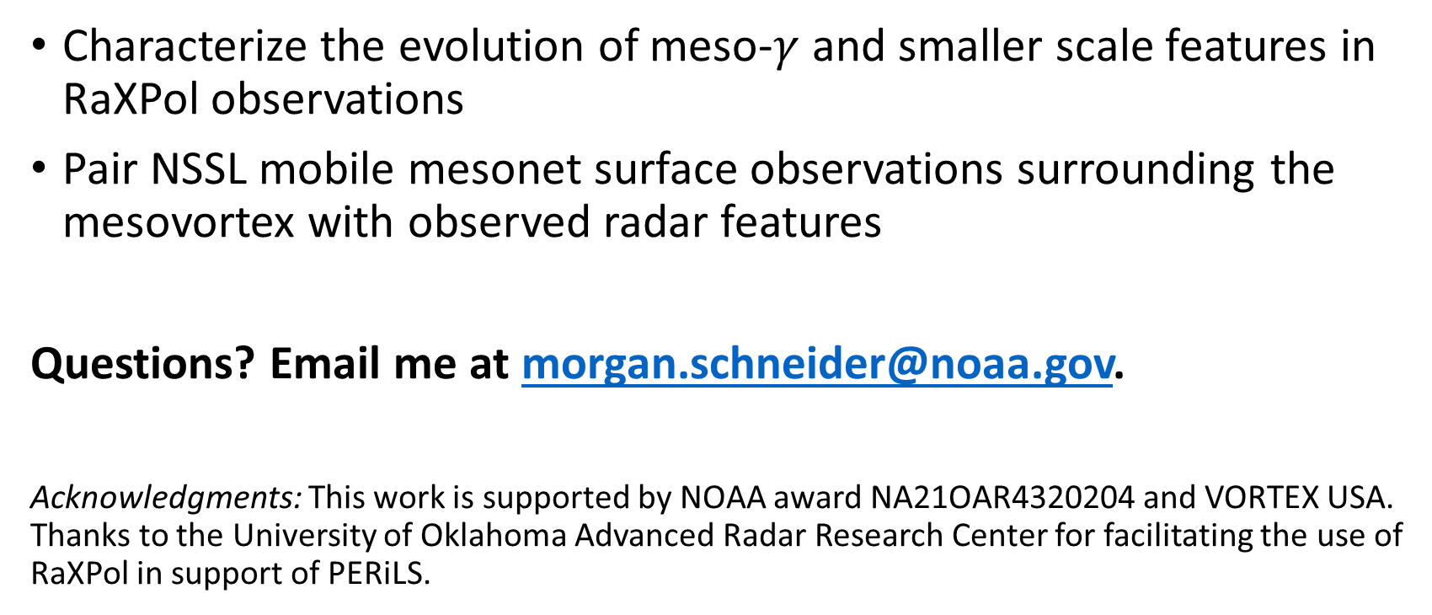
Planned Future Work
Characterize the evolution of meso-$γ$ and smaller scale features in RaXPol observations
Pair NSSL mobile mesonet surface observations surrounding the mesovortex with observed radar features
Questions? Email me at morgan.schneider@noaa.gov.
Acknowledgments: This work is supported by NOAA award NA21OAR4320204 and VORTEX USA. Thanks to the University of Oklahoma Advanced Radar Research Center for facilitating the use of RaXPol in support of PERiLS.

