Slide 1
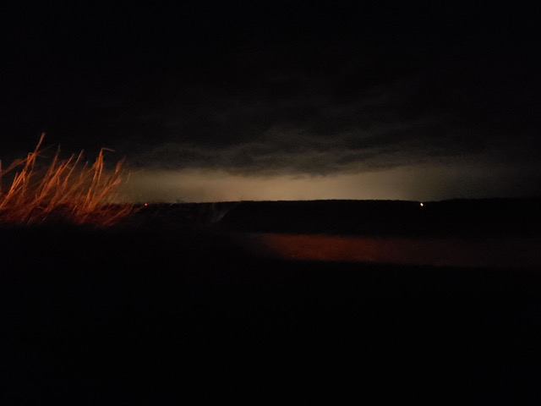
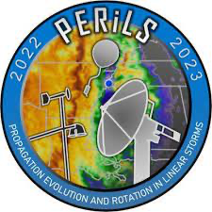
What Happened?
A Preliminary Study on the Nocturnal Evolution of IOP3’s Supercells to QLCS Development
Meredith Bean
Dr. Kevin Knupp
University of Alabama in Huntsville AES
SWIRLL (Severe Weather Institute Radar and Lightning Laboratories)
Picture description: Lightning illumination at Wilmont, MS. RaDAPS site.

Slide 2
Objective
To document and understand the changes in environmental parameters (and associated MCS structure) as the system evolves from its supercell inception in South/Central Mississippi to its QLCS ending in North Alabama

Slide 3
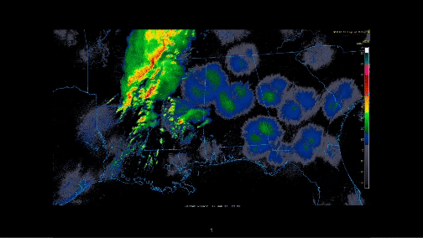

Slide 4
Beginning of Severe 0125z
Beginning of Severe 0057z

Slide 5
Current Methodology
Targeting the “South Cell” inception
Using Ground Based PERiLS assets such as Lidars, Profilers, Soundings, and Meteograms
SRH, CAPE, Shear (1km and 3km), θe
Compare with 16z HRRR forecast values at one hour intervals
Target “North Cell” inception
Repeat previous Methodology
Follow Both Cells to North Alabama
Repeat Methodology but use any available field stations, profilers etc
Repeat Methodology for QLCS in North Alabama

Slide 6
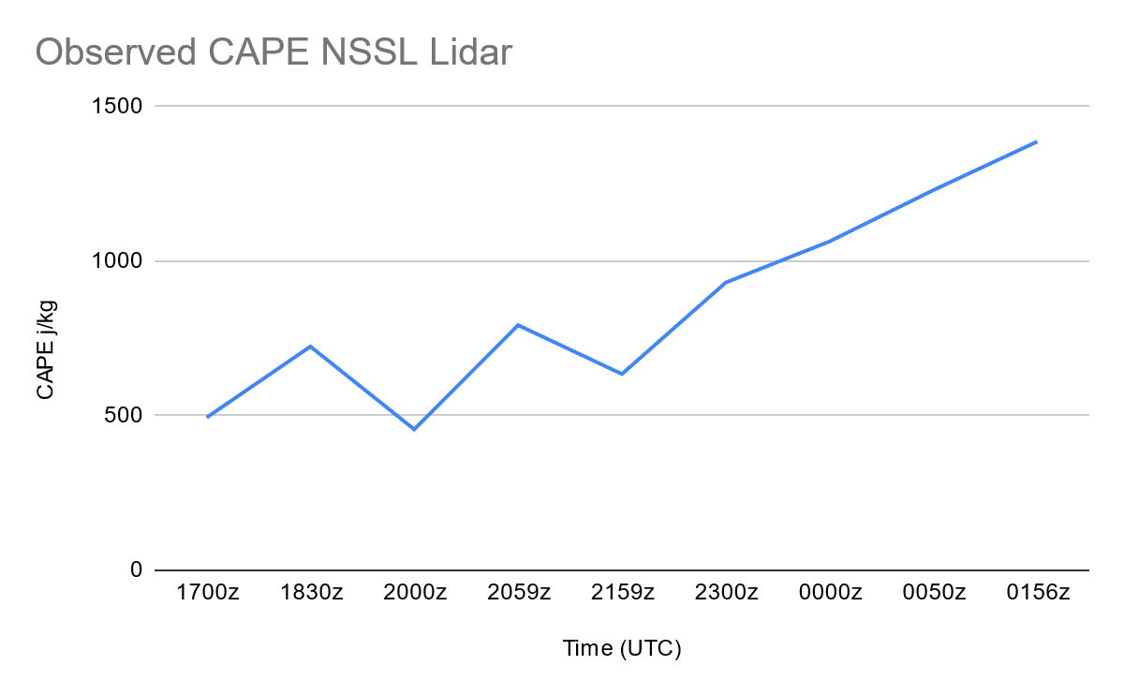
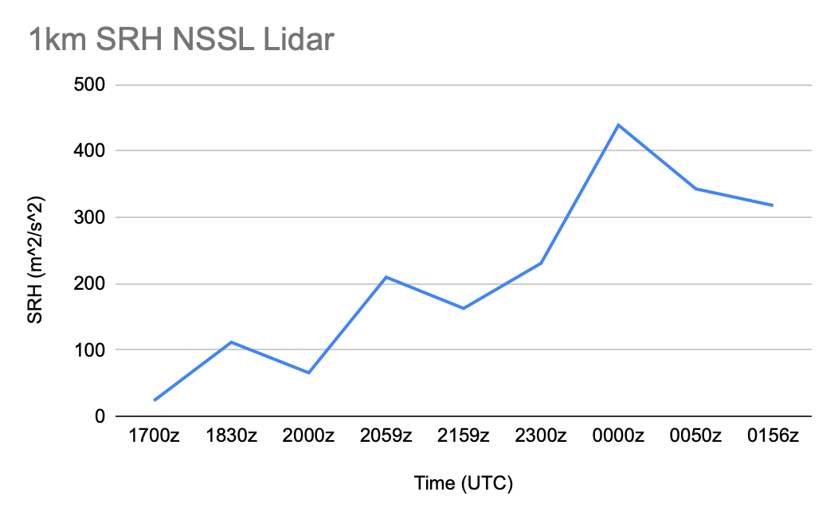
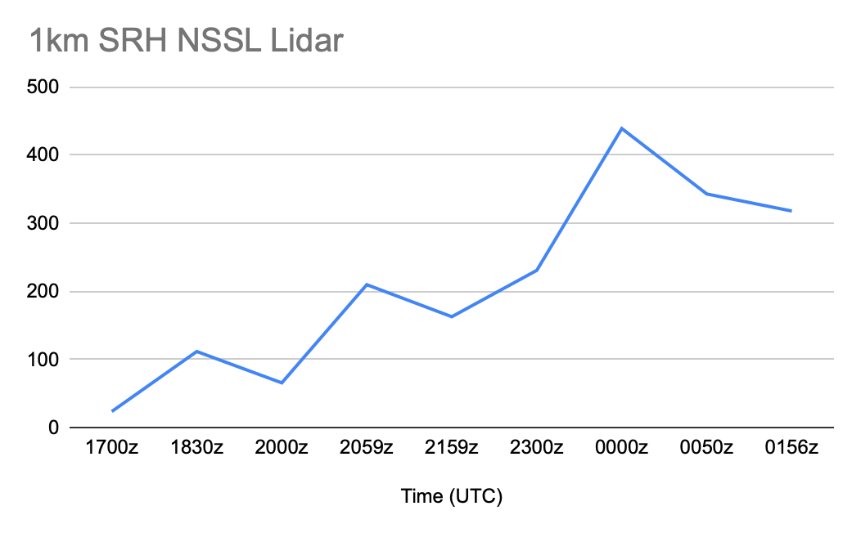
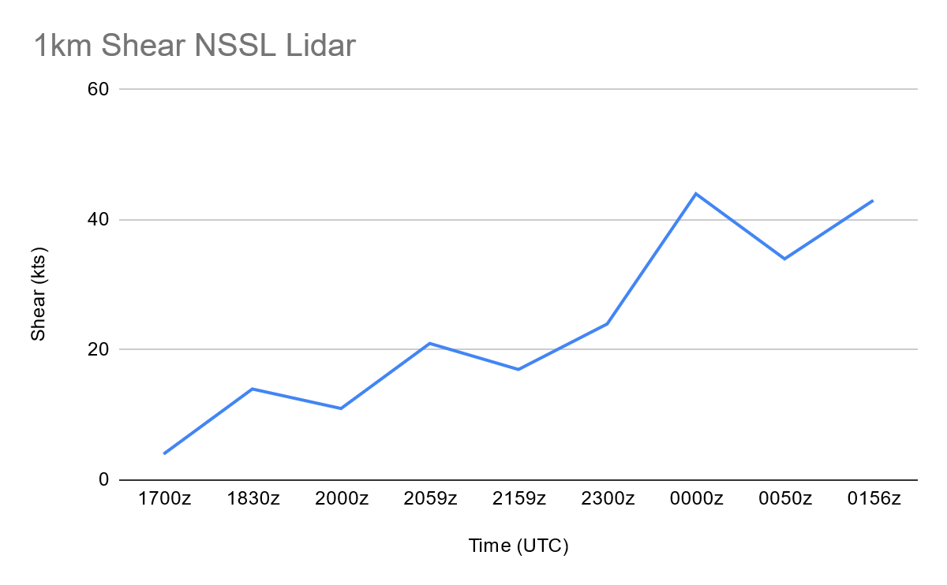
Preliminary Results
Surface NSSL Lidar Site

Slide 7
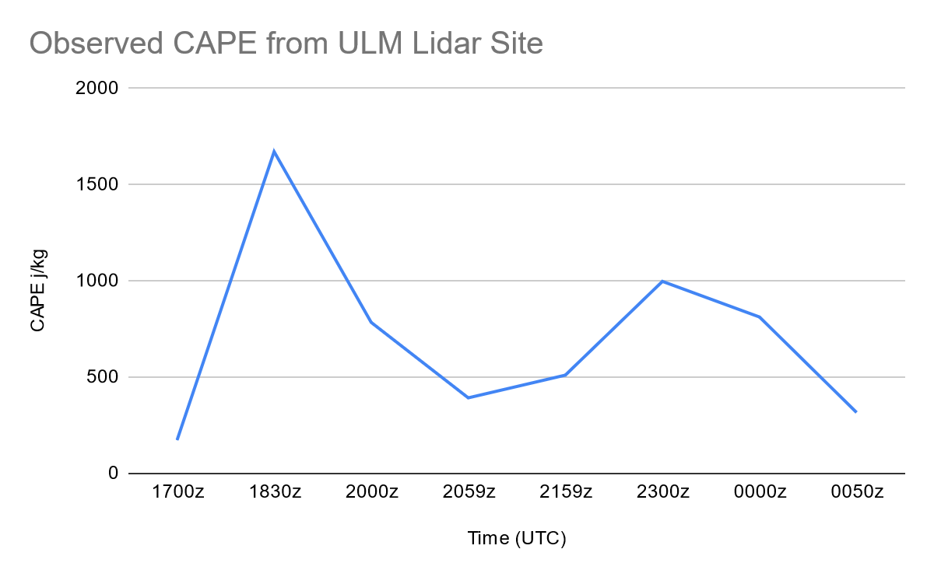
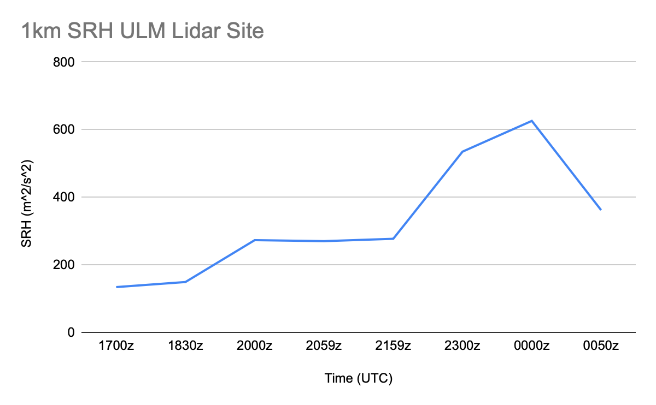
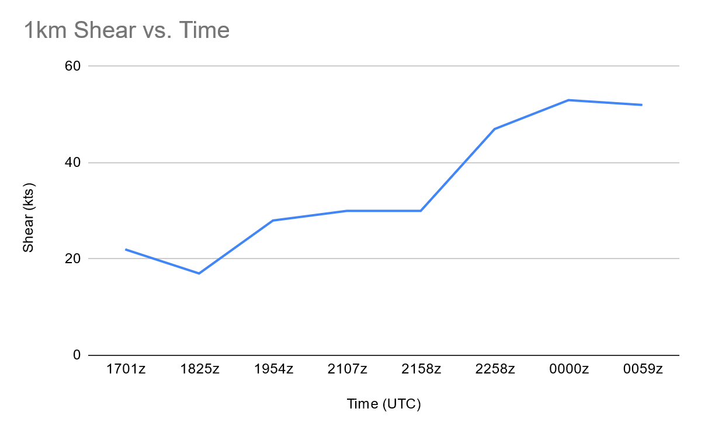
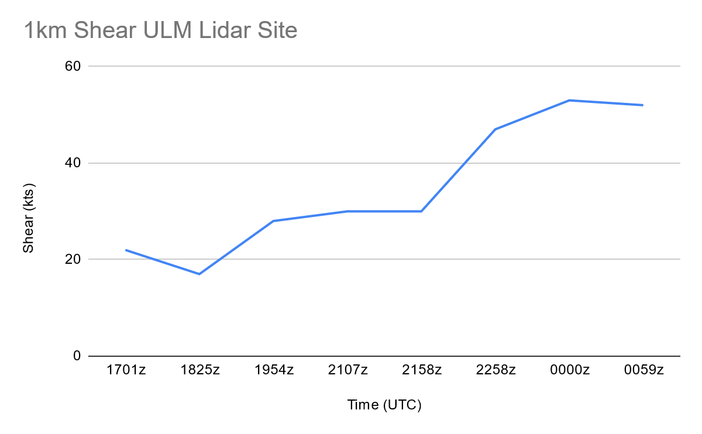
Preliminary Results
Surface ULM Lidar Site

Slide 8
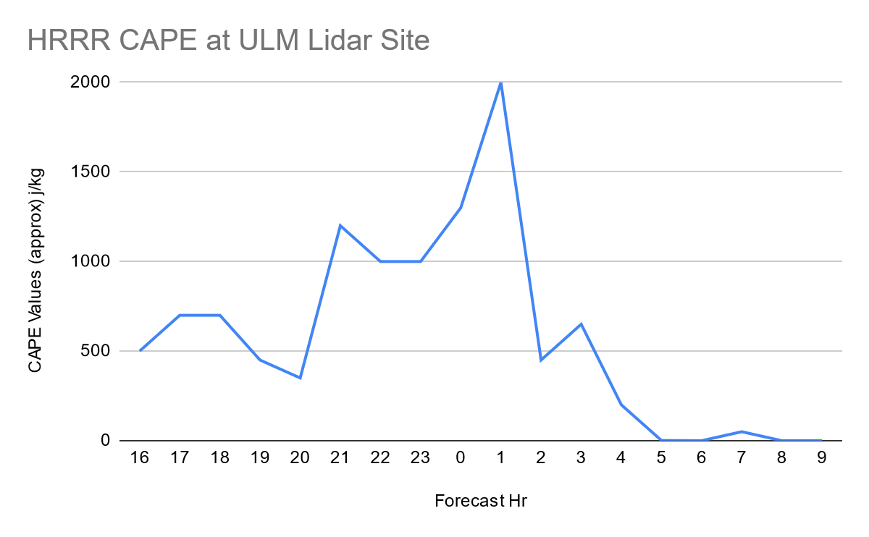
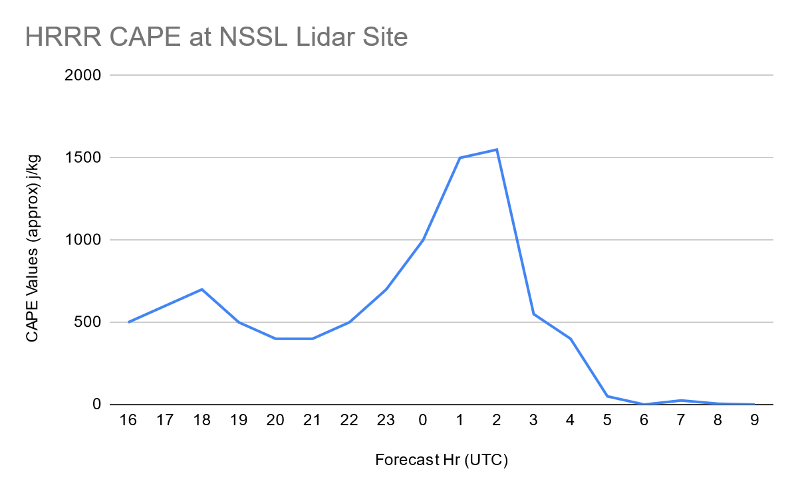
Preliminary Results
HRRR (Approximate)

Slide 9
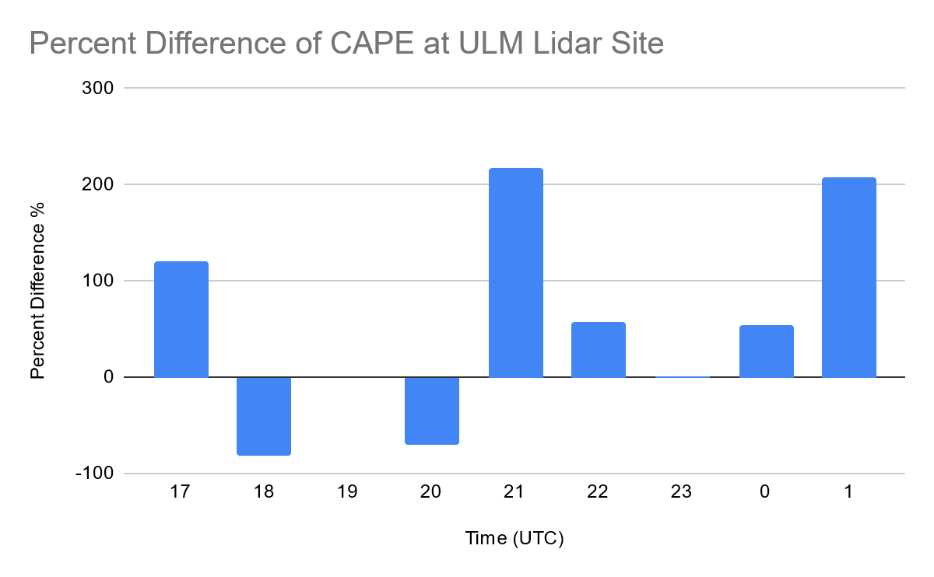
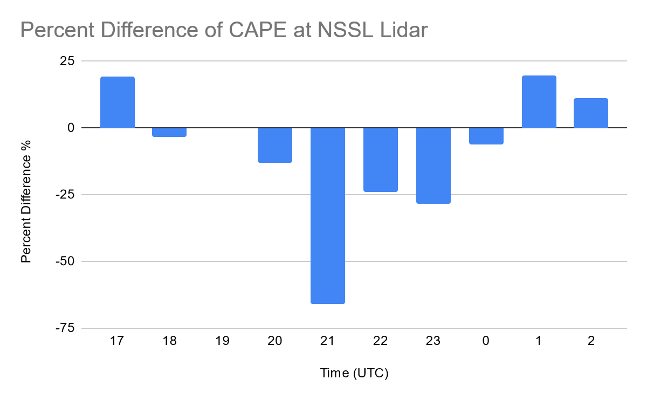
Preliminary Results
Comparison

Slide 10
Preliminary Conclusions
Variability in Surface variables over a relatively short distance (approx. 40 miles)
Some feature occurs around 0z
Suspect AET plays a part
HRRR underestimates CAPE for NSSL site and overestimates CAPE for ULM Site
Potential for over/under estimates with other variables

Slide 11
Immediate Future of Project
Complete Analysis with the other surface variables
Confirm HRRR Estimations using ZARR/HRRR soundings
Add more target sites to Analysis
Look for HRRR bias patterns
Picture description: Clouds before sunset at Wilmont, MS. RaDAPS site.

Slide 12
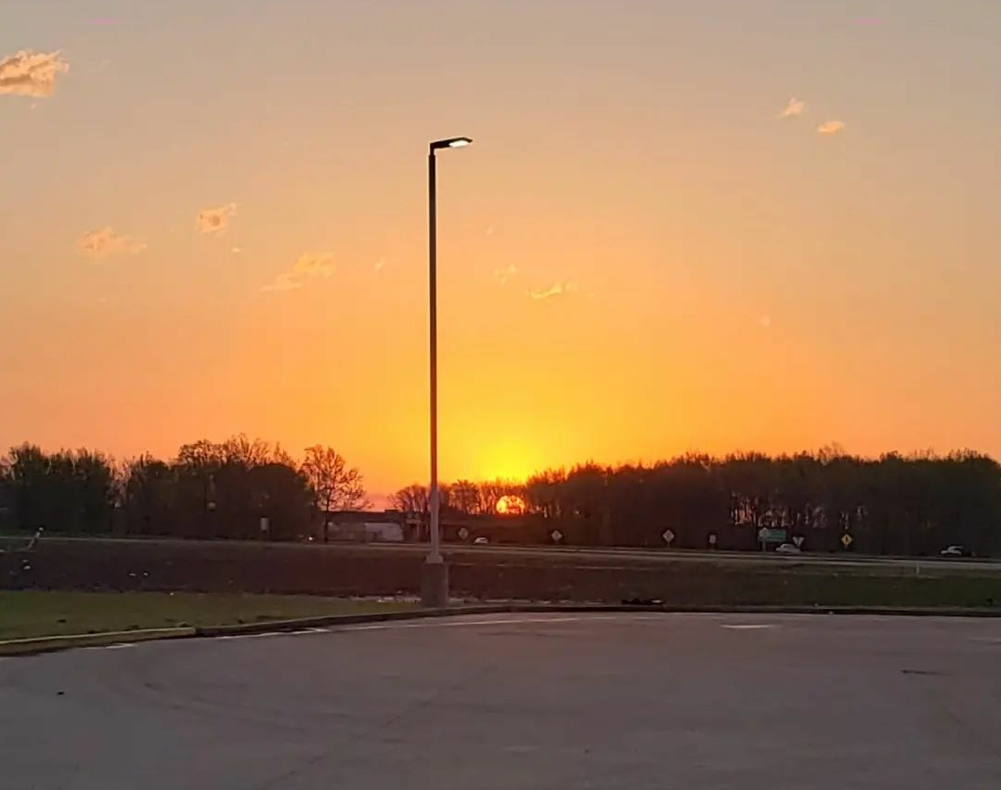
End Goal
To answer the “What Happened?”
both from observations and the HRRR model and finally be able to state “How this happened”.
mlb0060@uah.edu
Picture description: Sunrise in Greenville, MS morning after ops.

Slide 13
Far into the future
Performing VADs
MAX or other PERiLS radar(s)
Columbus AFB (KGWX)
ARMOR
Hytop (KHTX)
Introduce thermodynamic variables such as Theta-e
Lightning Density context

