Slide 1
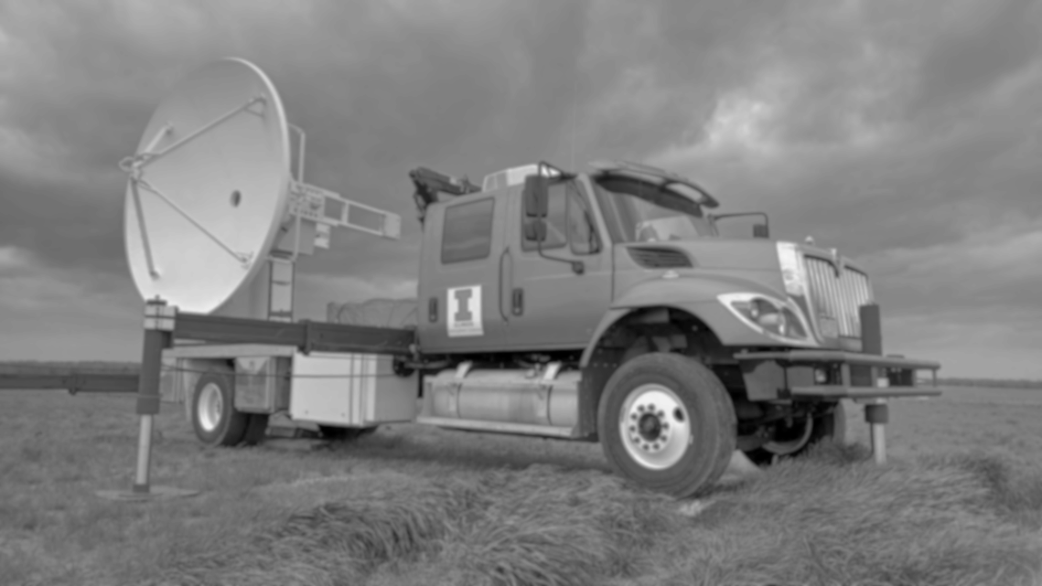
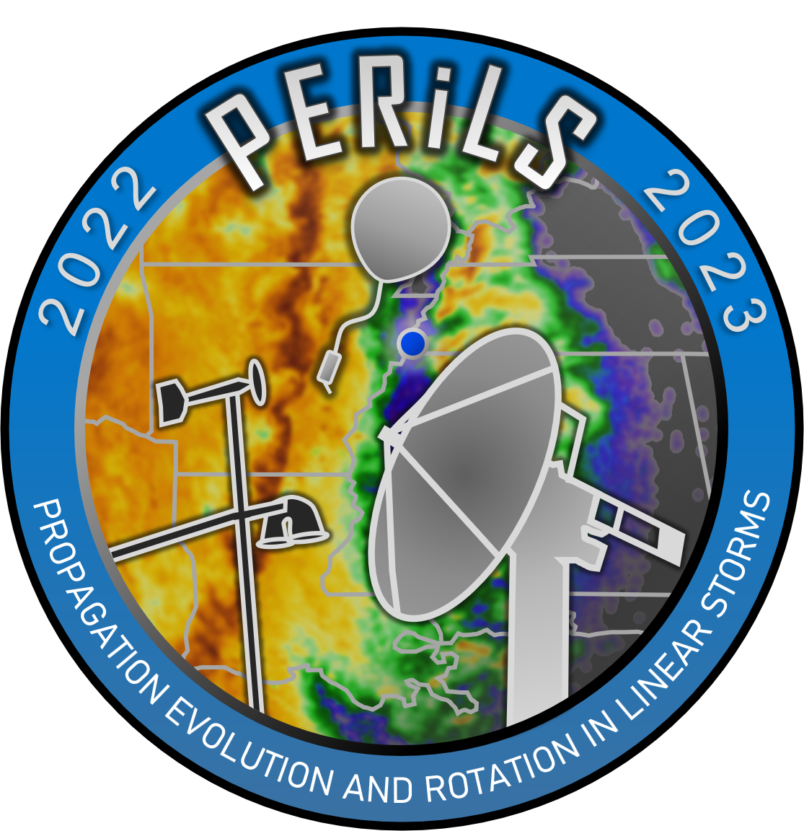
Radar and Satellite-Based Tools for Predicting Locations of Mesovortex Formation within QLCSs
Edward Wolff,
Robert Trapp, and Stephen Nesbitt
University of Illinois Urbana-Champaign
PERiLS Science Meeting | November 17, 2023

Slide 2
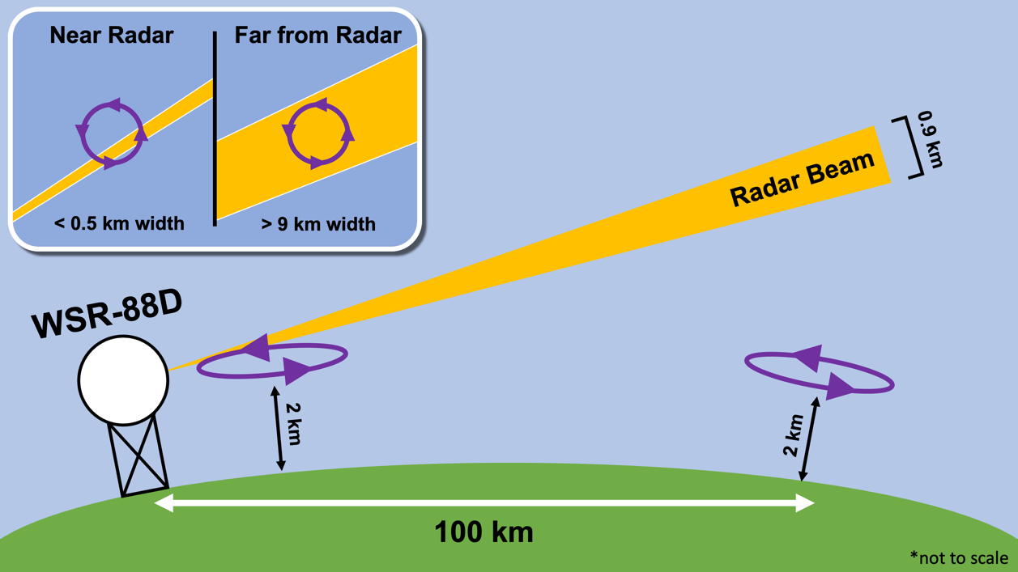
Shallow Vortices
QLCS vortices can be shallow and thus can appear quickly on radar
Developing below the lowest radar scans and between sweeps
Significant drop in POD farther from radar sites (Brotzge et al. 2013)
Beam is higher above the surface and data is less detailed (Davis & Parker 2014)
However, deep convection still important
Updrafts and downdrafts vital for vorticity generation (tilting/stretching)
Illustration of radar beam height/width and QLCS vortex depth as distance from the radar increases
2

Slide 3
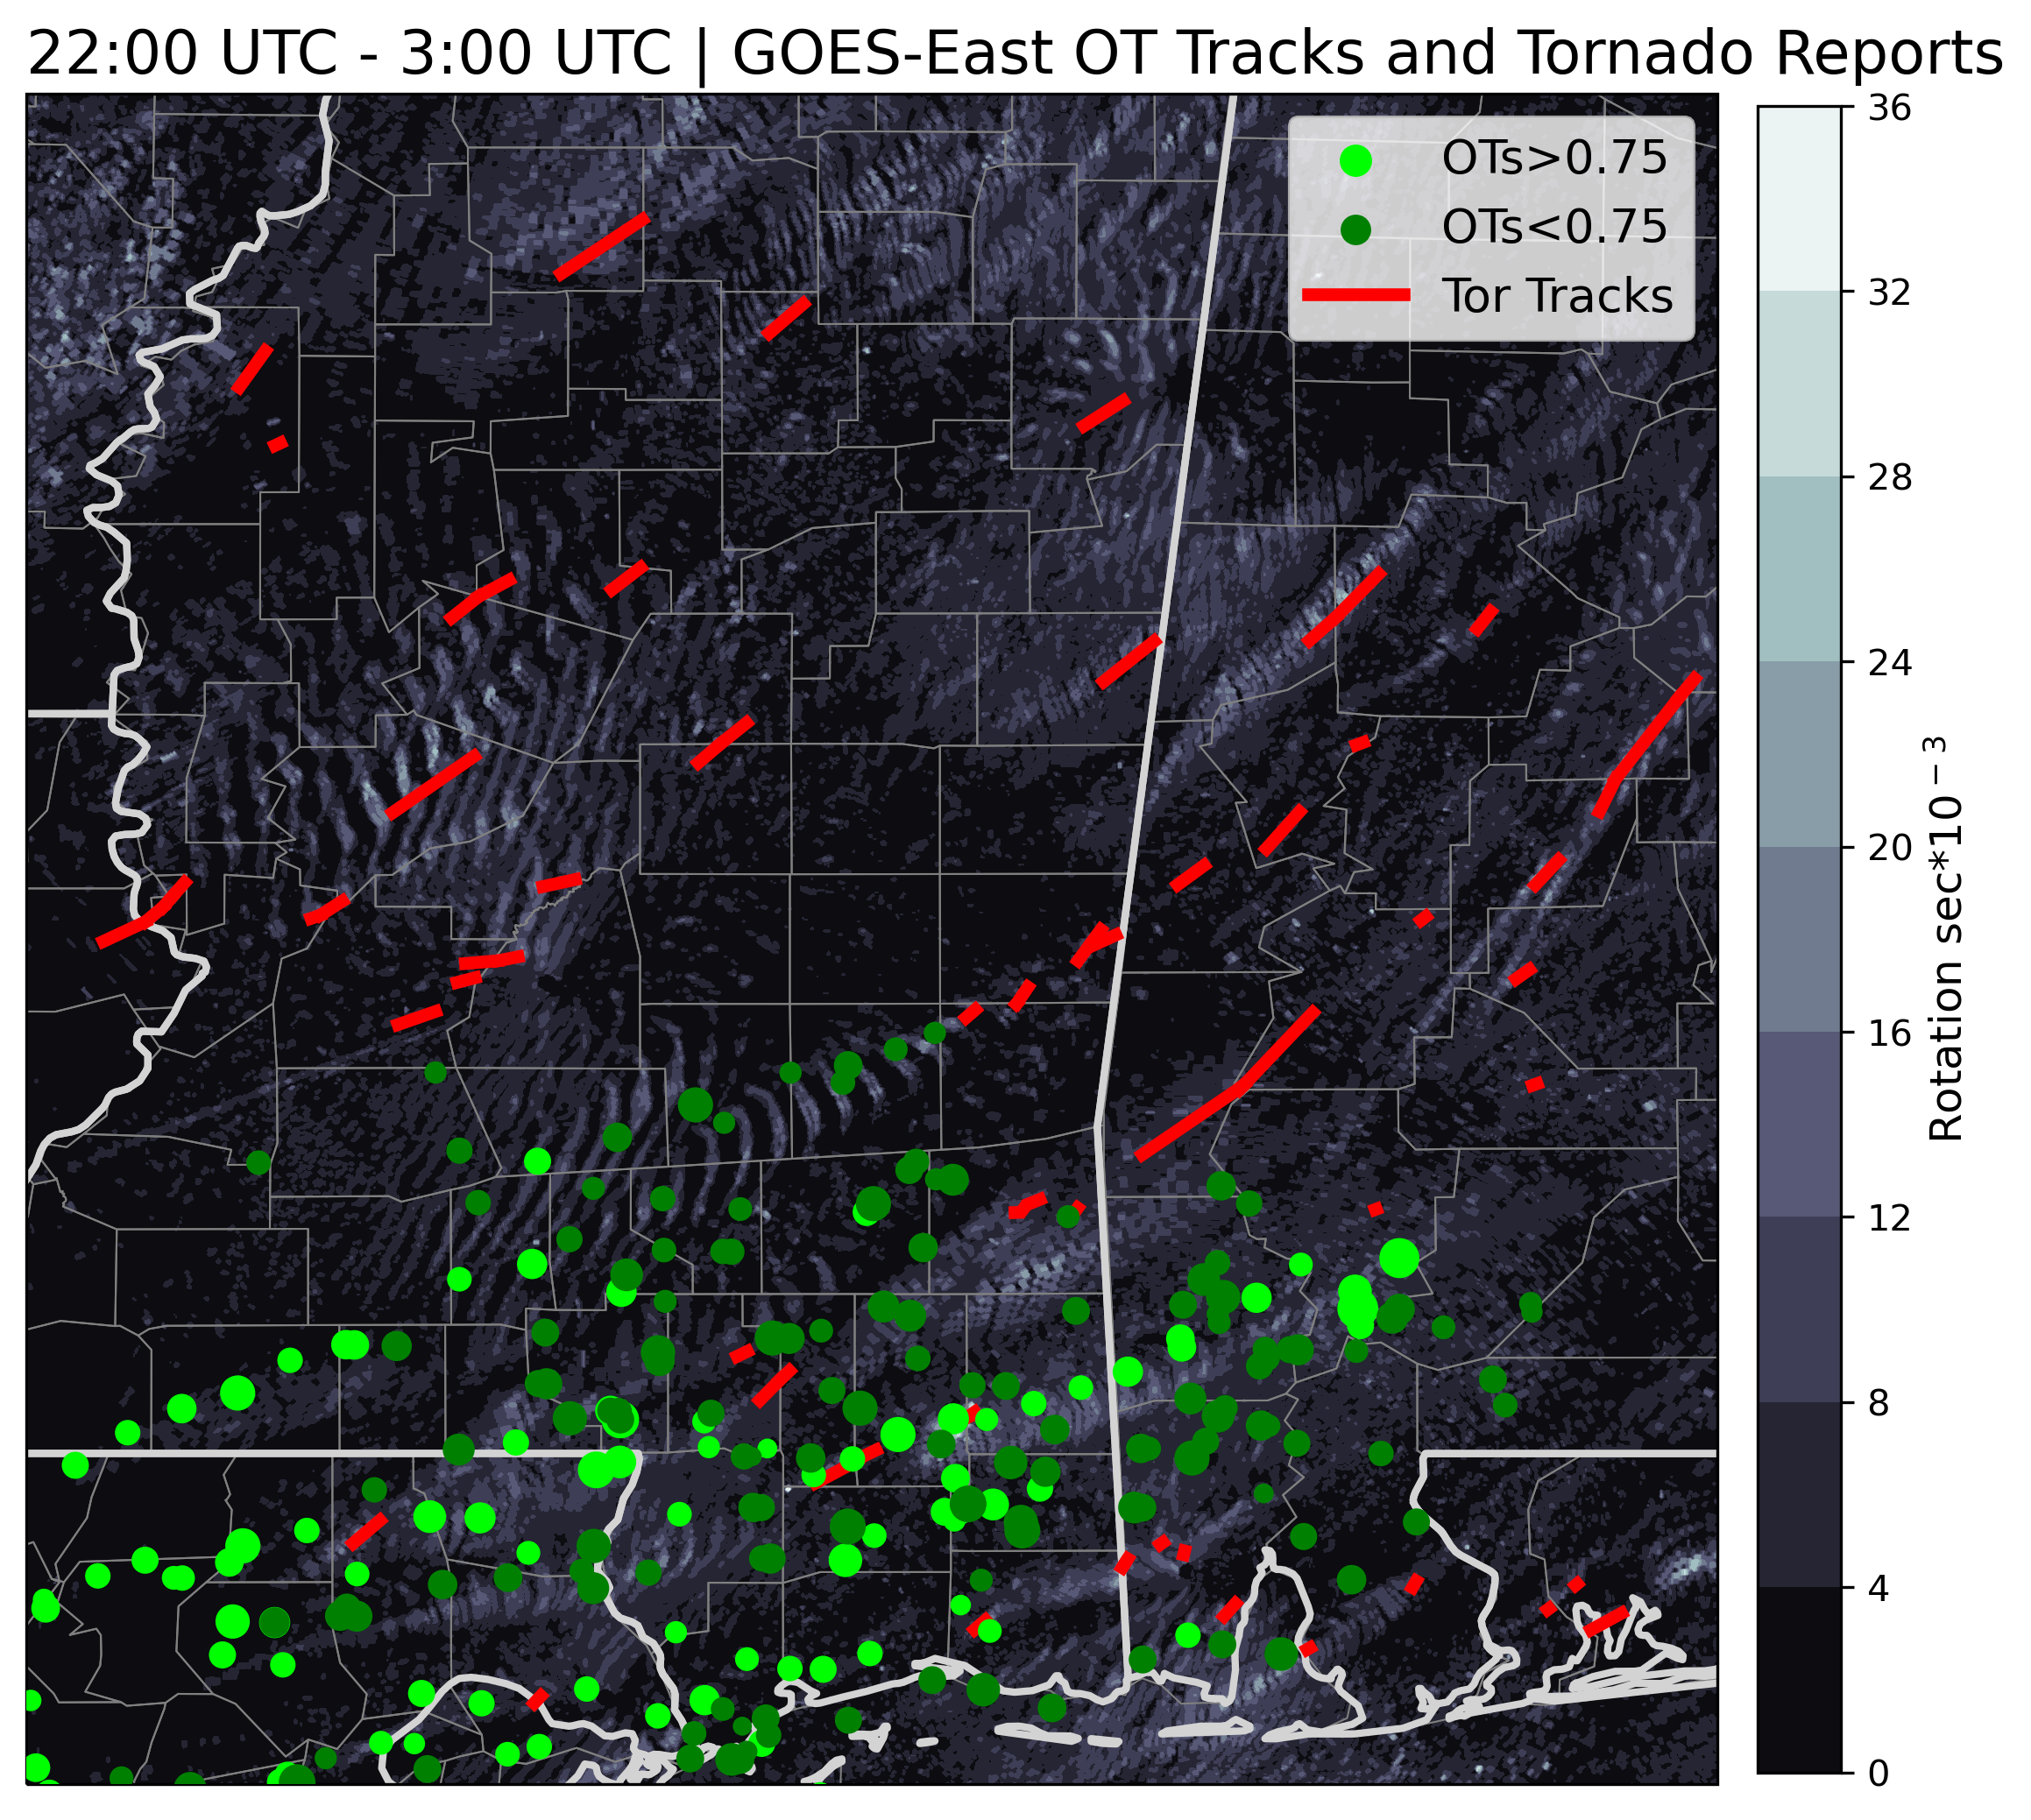
Updrafts Shown By OTs
Past work has shown links between updrafts and mesovortices or mesocyclones
Updrafts observed using overshooting tops (OTs)
Idea: Identifying deep updrafts could reveal regions of the QLCS conducive for genesis and maintenance of vortices
Case Study: PERiLS 2022 IOP 2
OTs line up well with tornado tracks (where OTs occur)
No OTs detected north of approximately 32° N
Why?
Tracked OTs, NCEI tornado tracks, and MRMS rotation swaths. Color denotes OT probability
3
Notes:
Mention OT algorithm; tornado tracks here are a rough proxy for vortices (obviously many non-tornadic ones as well)

Slide 4
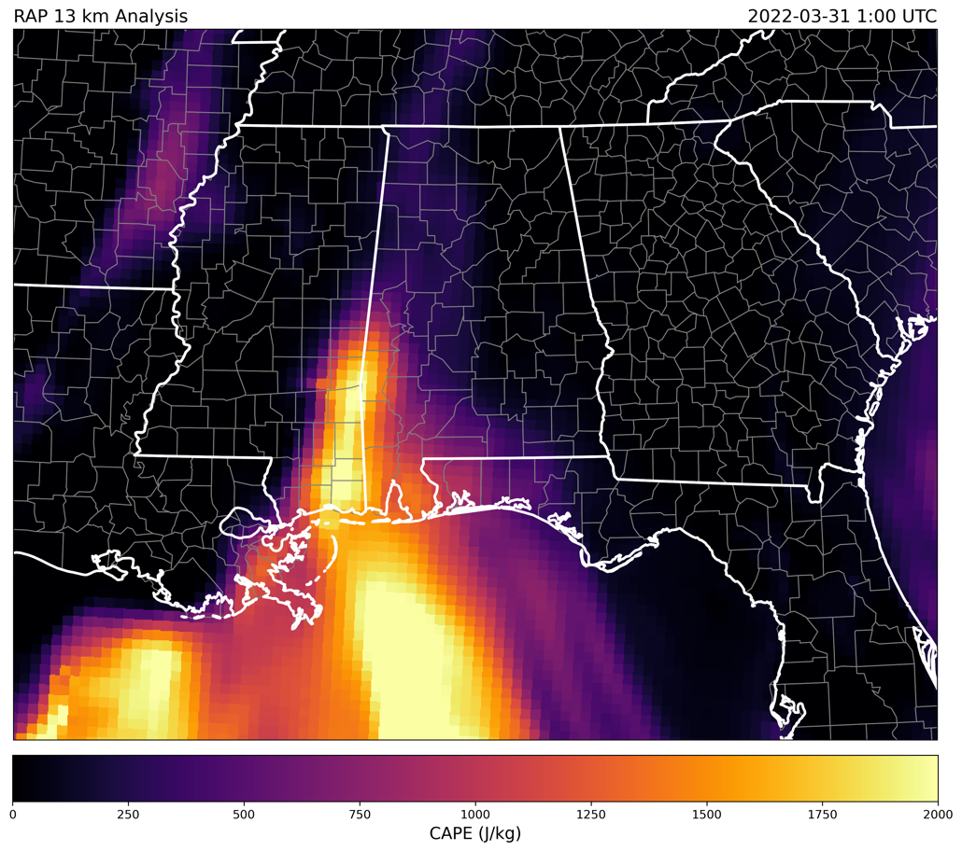
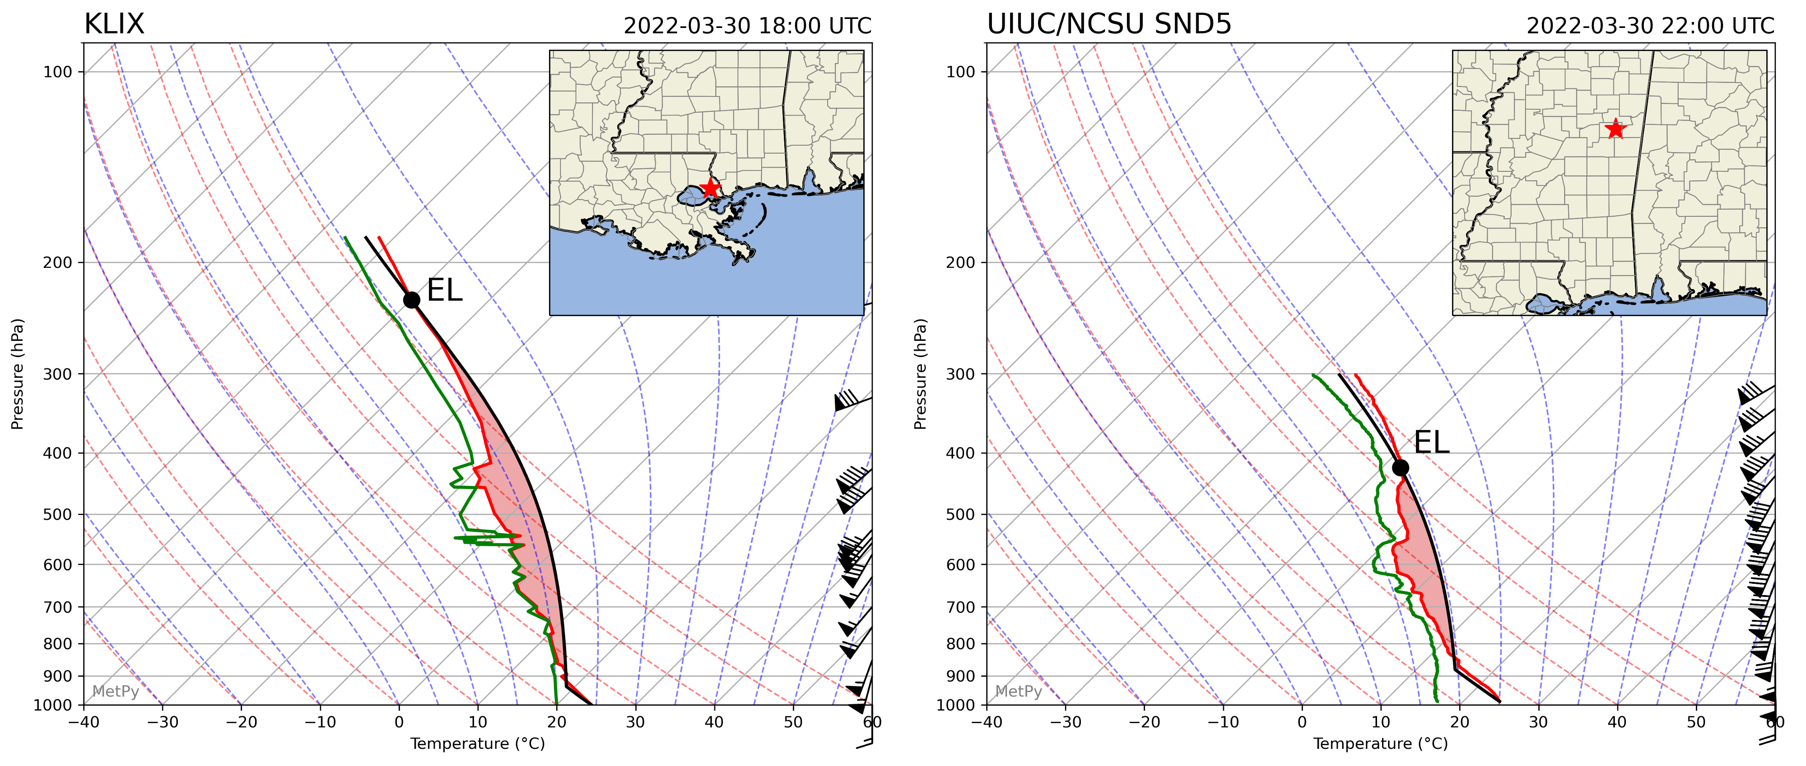
Limitations to OTs
Found that OT development is dependent on CAPE
Especially the vertical extent of positive buoyancy
Lower equilibrium levels and less CAPE result in shallower, weaker updrafts that do not reach the tropopause
This is what is seen in the northern portion of the QLCS
RAP 13 km analysis surface-based CAPE
Soundings from KILX (left) and a PERiLS team farther north along the QLCS (right)
4

Slide 5
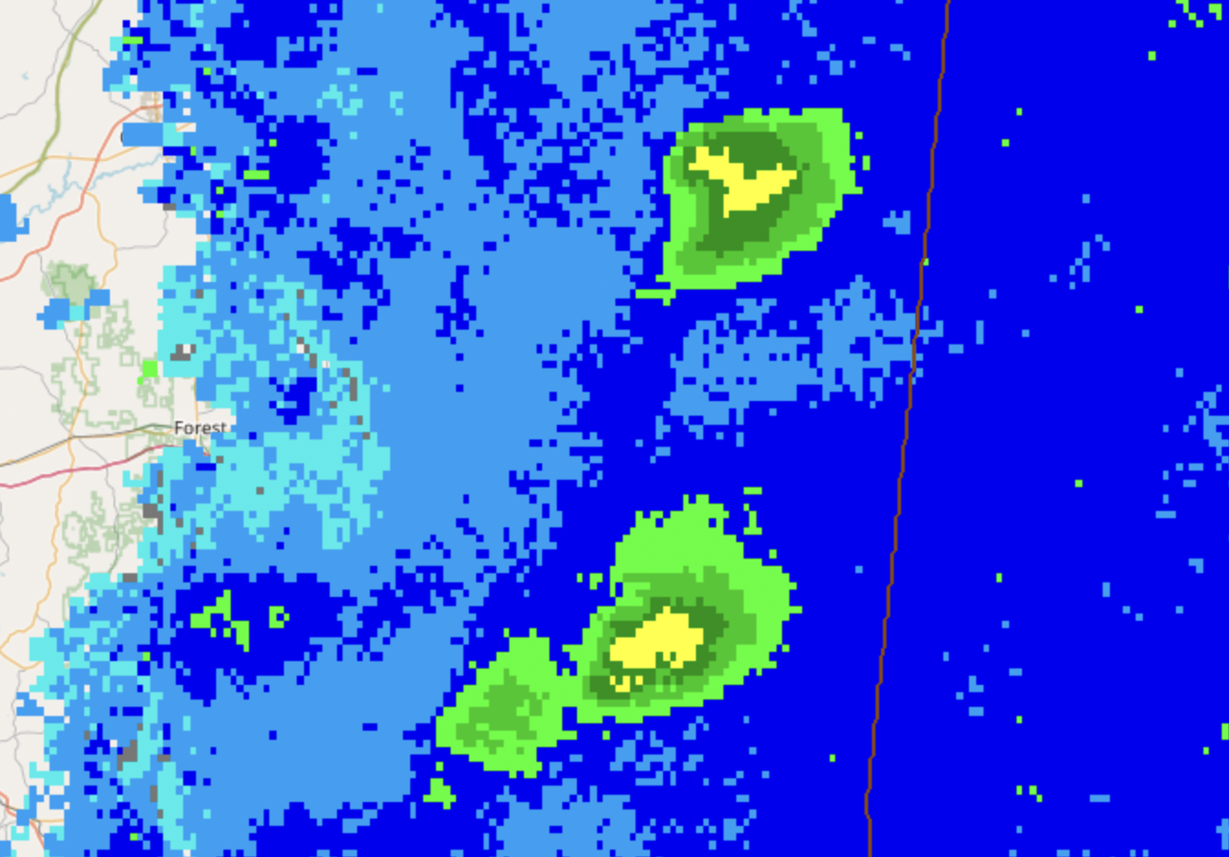
Updrafts Shown By Radar
Composite radar data were obtained using the NSSL’s Multi-Radar Multi-Sensor viewer
Specifically:
9 km AGL constant height reflectivity
This level was chosen as it was just below the equilibrium level on the nearest NWS sounding (theoretically the top of any deep updrafts)
Reflectivity cores are defined as areas of reflectivity greater than 25 dBZ
Only cores associated with the QLCS are recorded
All values and locations manually recorded from the NSSL viewer
9 km AGL Reflectivity
9 km AGL composite reflectivity shown in the NSSL MRMS data viewer
5

Slide 6
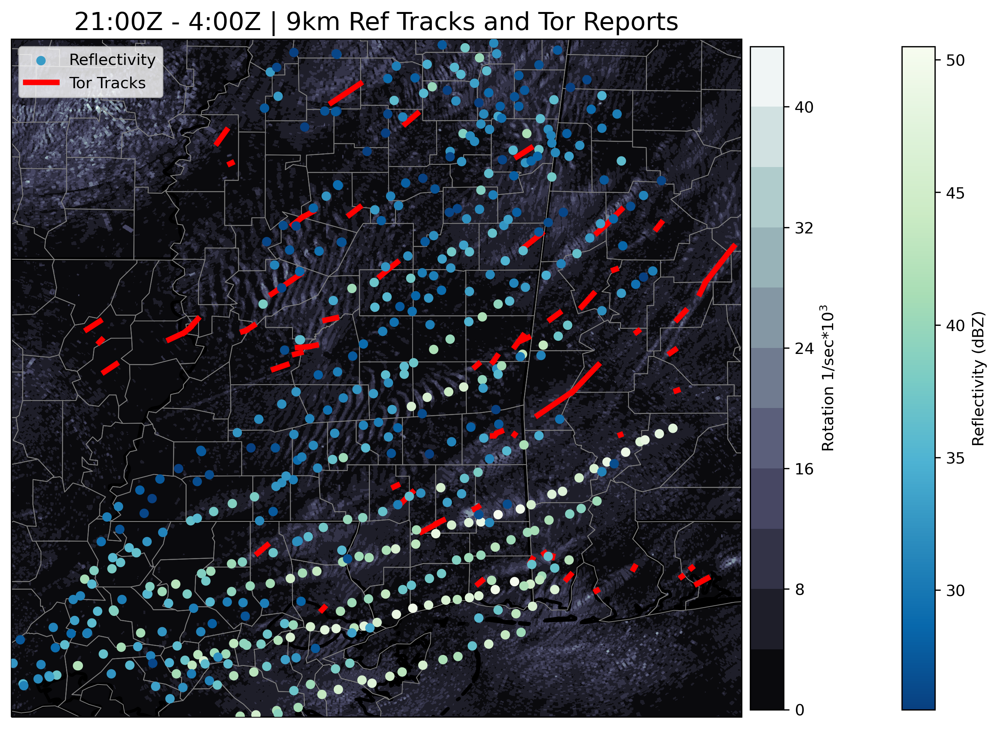
Updrafts Shown By Radar
Similar to OTs, 501 reflectivity cores (obtained at 10 minute intervals) are plotted alongside tornado tracks
Spacing and orientation very similar to tornado tracks
Unlike OTs, reflectivity cores appear as far north as the northernmost tornado tracks
Nearly every QLCS tornado track is spatially correlated to a series of reflectivity cores
Reflectivity cores are often visible well before tornadoes occur
Tracked MRMS 9 km reflectivity cores, NCEI tornado tracks, and MRMS rotation swaths. Color indicates max reflectivity of the core at 9 km
6

Slide 7
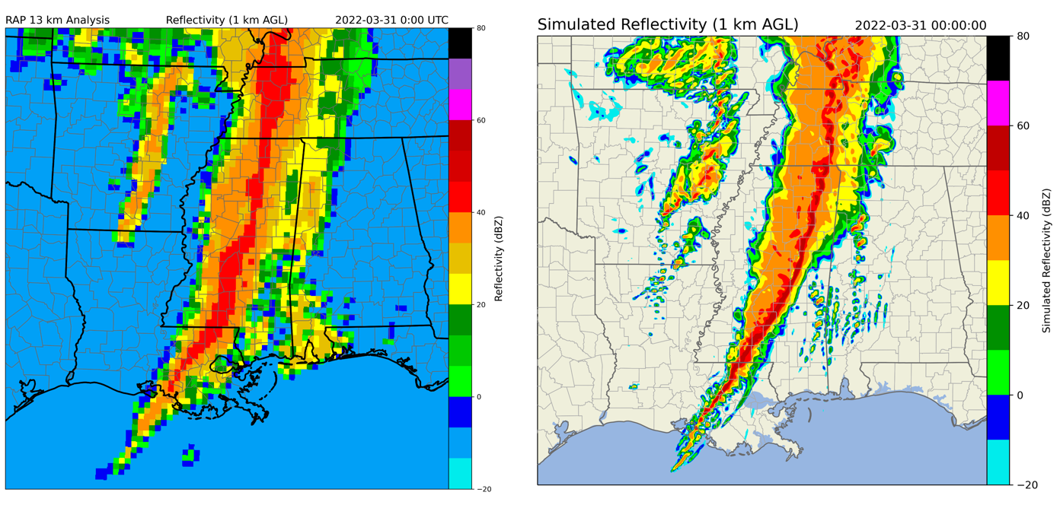
WRF Modeling
Wanted to understand the physical link between these updrafts and the co-located vortices
Ran a 3 km grid spacing WRF simulation with a 1 km nested grid
Produced a QLCS similar to the observed system
(Left) RAP 13 km analysis of 1 km AGL reflectivity and (right) WRF 3 km parent domain simulation of 1 km AGL reflectivity; both at 1:00 UTC
7
Notes:
Updraft is necessary but insufficient

Slide 8
Do Mesovortices Form Updrafts?
Vertical Rotation-Induced Forcing
Horizontal Convergence-Induced Forcing
First question: does a pre-existing vortex result in deep updrafts? (No)
Evaluating updraft forcings shows that, prior to “tornadogenesis”, the parent mesovortex has minimal impact on vertical motions
Greater forcing occurs later after vortex intensifies
Could contribute to low-level intensification of vertical motions, would suppress deep updrafts
00:35 UTC
Cross sections at the vortex just prior to “tornadogenesis”; vertical velocity (black) and Okubo-Weiss parameter (magenta) are contoured
8
Notes:
From the equation for perturbation pressure; highly simplified; getting relative magnitudes and vertical gradients

Slide 9
Do Updrafts Form Mesovortices?
Next question: does a pre-existing updraft result in strong vortices? (Yes)
Parcel trajectories terminating in the mesovortex originate largely in the environmental inflow
These parcels ascend as they reach the vortex/updraft
Only attain vorticity once ascent occurs
Tilting/stretching by the updraft appears responsible for vorticity generation
Parcel trajectory paths colored by height and mesovortex location (pink)
Heights (left) and absolute vorticity (right) for parcels entering the vortex
9
Notes:
Backwards trajectories; again, many sources for error; looking at the general trends

Slide 10
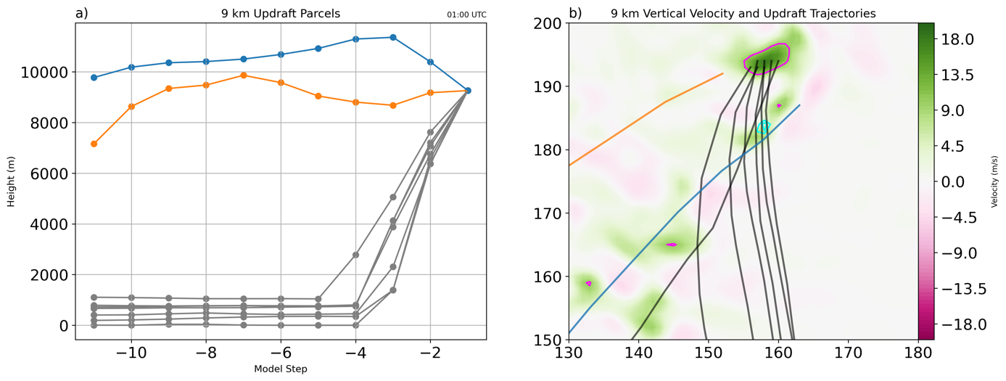
Conclusions
Many QLCS updrafts are deep enough to be observed on upper-tropospheric radar sweeps
Data that is available for a much larger portion of the country than low levels
Locations of these deep updrafts indicate where conditions are favorable for vortex formation
Deep updrafts appear to be an important precursor to vortex formation (necessary but insufficient condition)
Main takeaway: QLCS research often focuses on low levels (with good reason), but evidence of surface processes are also apparent aloft
Heights (left) and parcel paths (right) for parcels making up the updraft at 9 km (gray) and other 9 km parcels (orange/blue)
10

Slide 11
Future Work
Future work will expand this analysis to a larger number of events and make use of idealized simulations
Are these signatures always apparent? If not, what constrains them?
Do signatures aloft vary based upon the mesovortex genesis mechanism?
What can the width, intensity, and longevity of reflectivity cores tell us?
Thank You!
Questions?
Funding provided by NSF AGS 2020462
11

