Slide 1
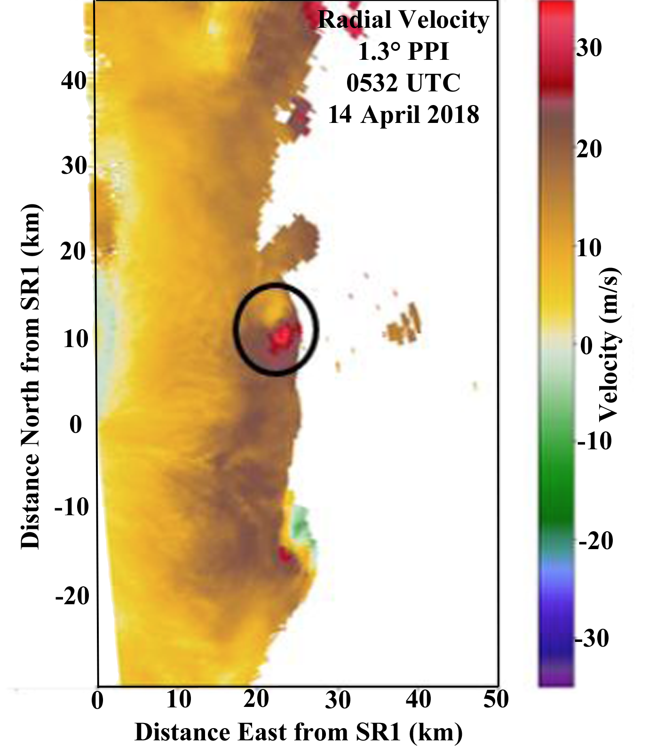
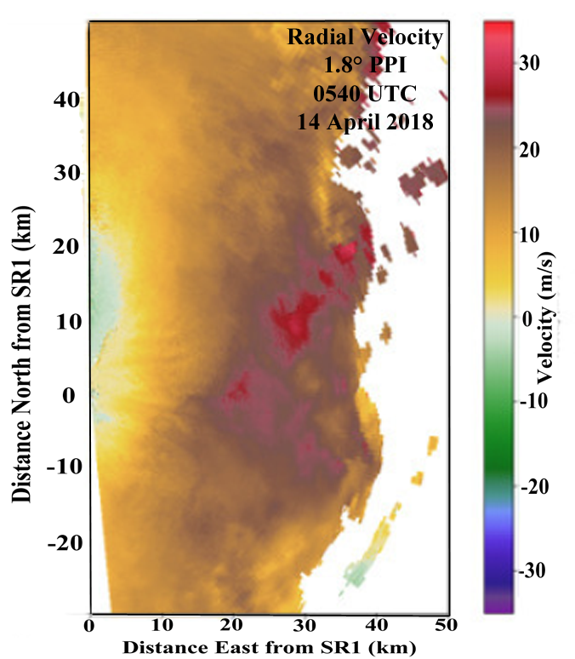
Evolution of a Tornadic Mesovortex in a QLCS
Alec J. Prosser, Michael I. Biggerstaff, Gordon D. Carrie
University of Oklahoma

Slide 2
Large-Scale View of Multi-Vortex QLCS
(Courtesy of C. Ziegler)
17 ‘confirmed’ tornadoes in Shreveport CWA; 2 were in our observing network
Vortex of interest
2
M. Biggerstaff, PERiLS Workshop 2023

Slide 3
Animation of 0.8° PPI SR1 Reflectivity and Radial Velocity 0501-0532 UTC
3
M. Biggerstaff, PERiLS Workshop 2023

Slide 4
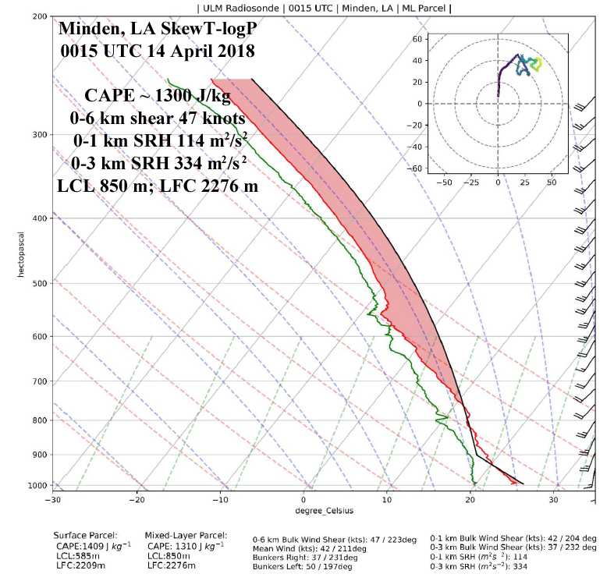
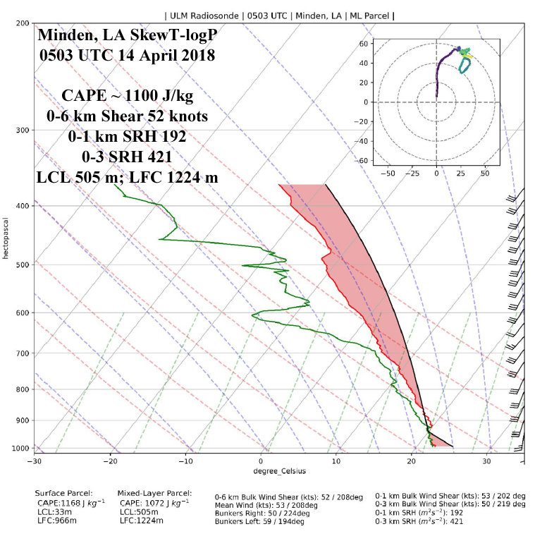
Environmental Characteristics
(Courtesy T. Murphy)
4
M. Biggerstaff, PERiLS Workshop 2023

Slide 5
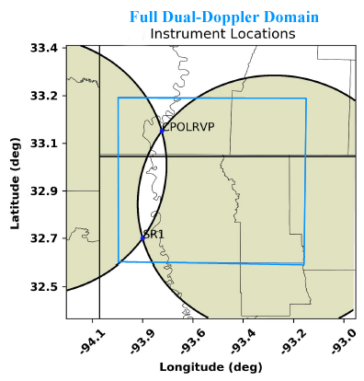
Radar Analysis Domain and Methods
SR1-SR2 Baseline: 45.6 km
(lowest real altitude 500 m AGL)
Data Interpolated using Natural Neighbor Method (Betten et al. 2018)
Data advected to Central Analysis Time using Vortex motion of 20.6 m/s towards 60°
Wind Retrieval using 3D VAR
Potvin et al. (2012)
Grid Center on SR1: X -10 to 65 km
Y -10 to 60 km
Z=0.25 to 10 km
Grid spacing 250 m
5
M. Biggerstaff, PERiLS Workshop 2023

Slide 6
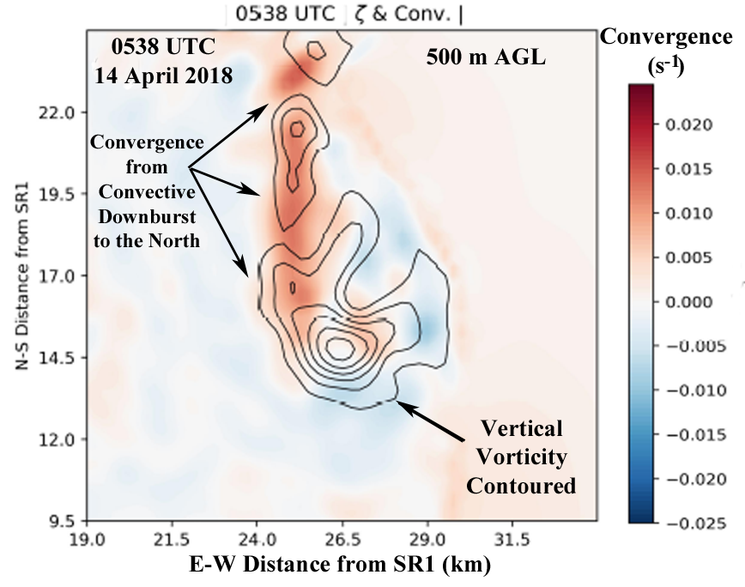
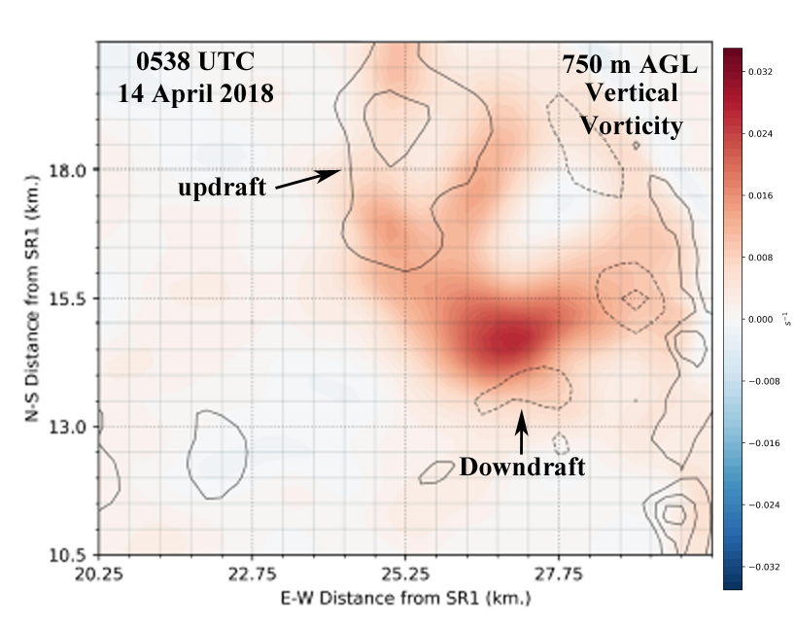
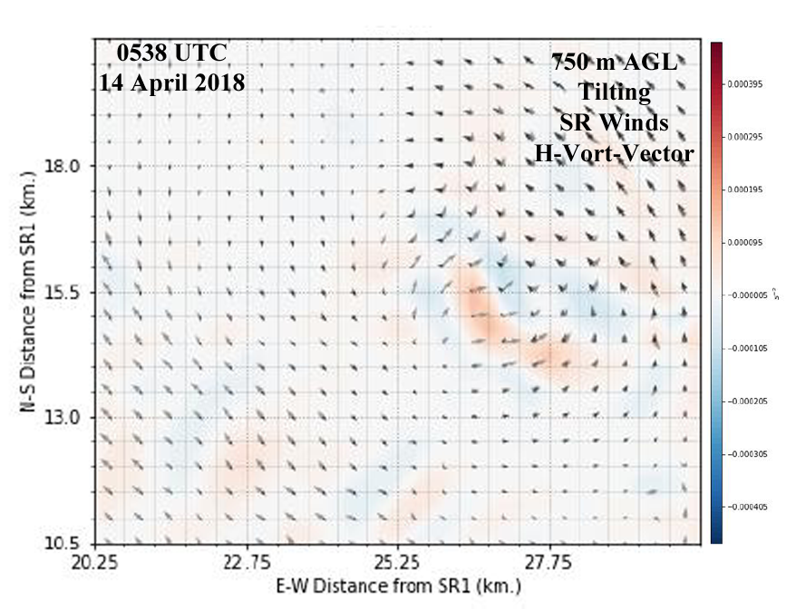
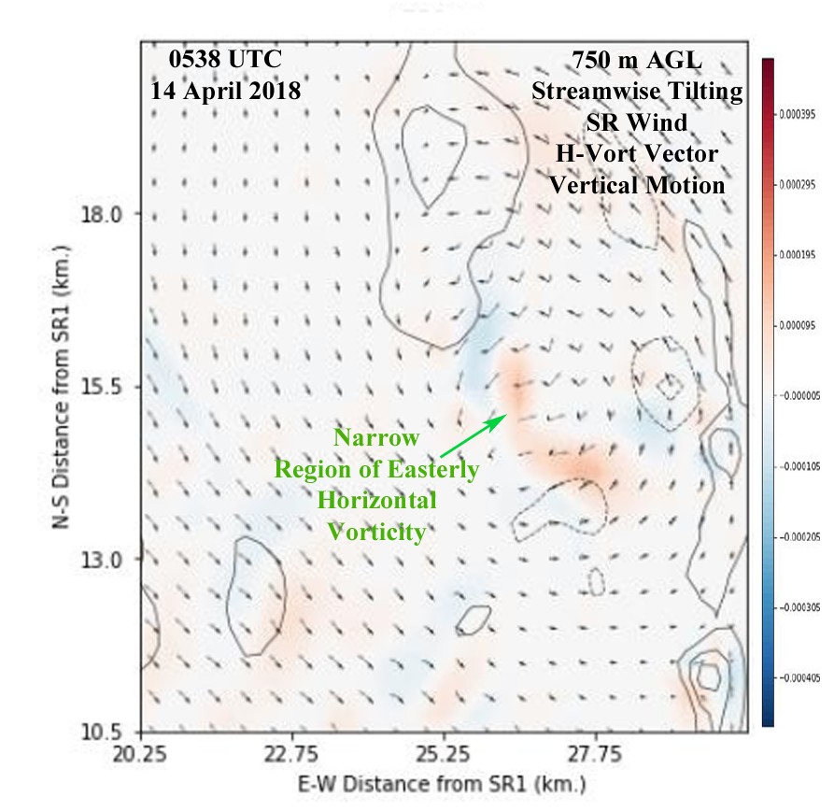
4-minutes Before Tornadogenesis
North of vortex, a reflectivity burst occurred prior to 0538 UTC. Convergence fed into pre-existing vorticity center. Secondary stretching signature east of vortex center.
Gradients between updraft to NW and downdraft to S of vortex led to areas of streamwise tilting on the western side of the vortex, where SR winds fed into vortex. Additional positive tilting along southern edge of vortex.
6
M. Biggerstaff, PERiLS Workshop 2023

Slide 7
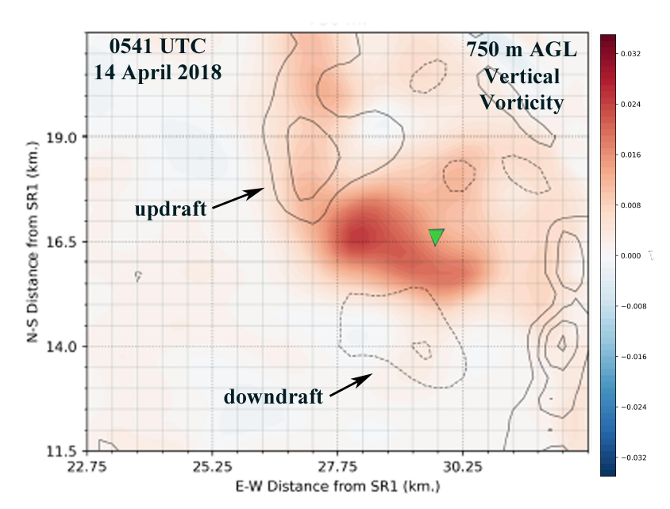
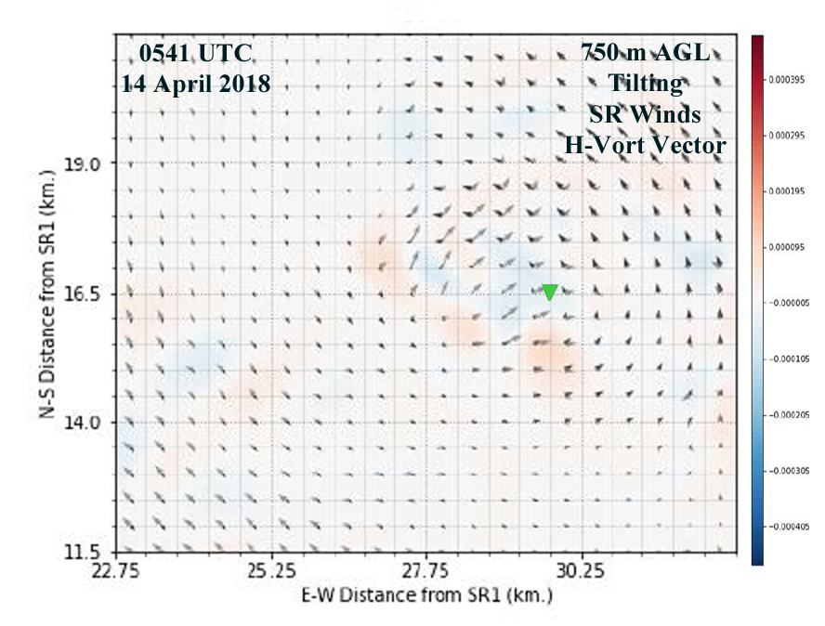
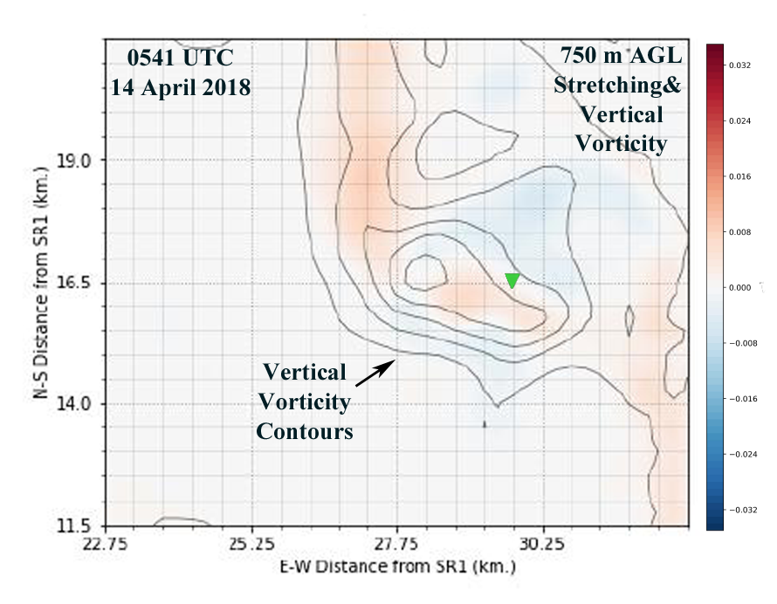
Approximate Time of First Tornado Damage
Vorticity max increased by 50% in 3 minutes at 500 m, but was mostly unchanged at 750 m.
Positive (deep-- up to 1.5 km) stretching in vicinity where tornado formed; crosswise tilting positive to south of suspected tornadogenesis.
Complex structure as ascending inflow branch of vortex had positive (negative) stretching (tilting)
While descending branch had negative (positive)
stretching (tilting).
7
M. Biggerstaff, PERiLS Workshop 2023

Slide 8
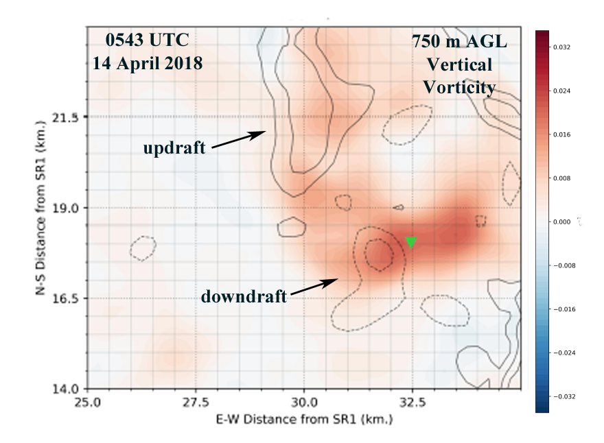
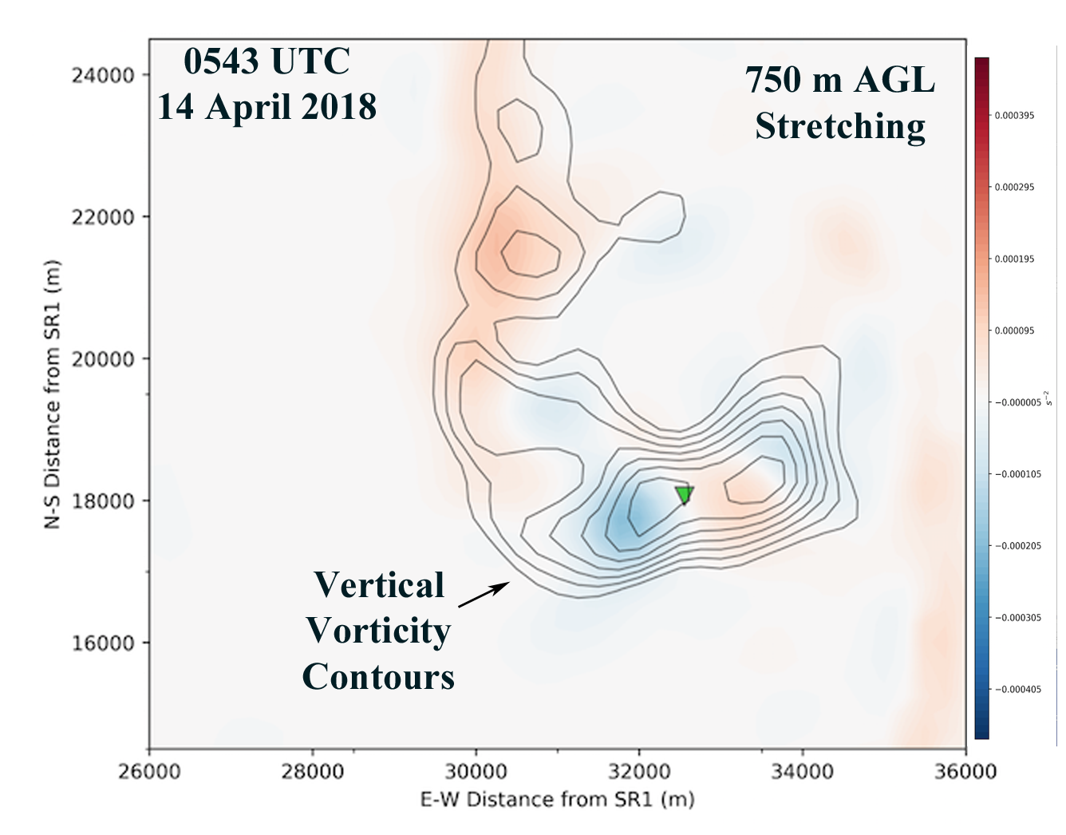
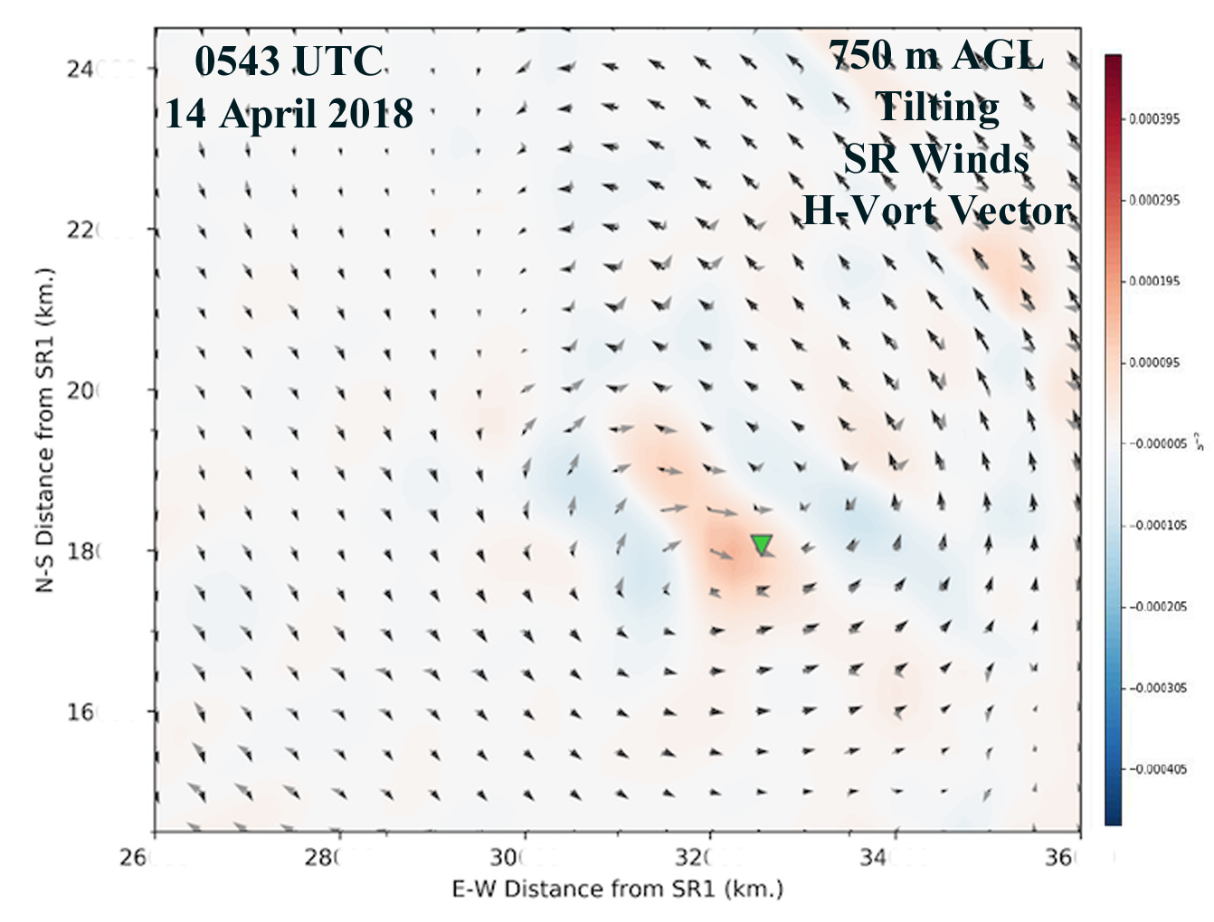
Mature Tornado Stage
Vorticity max decreased by 40% since tornadogenesis. Rapid spin down due to downdraft.
Occlusion downdraft west of tornado created region of positive tilting (slightly biased toward crosswise component at 750 m) in tornado region.
SR 3D-flow in that area was near zero, as was stretching. Hence, tilting of horizontal vorticity by the occlusion downdraft likely sustained the tornado.
8
M. Biggerstaff, PERiLS Workshop 2023

Slide 9
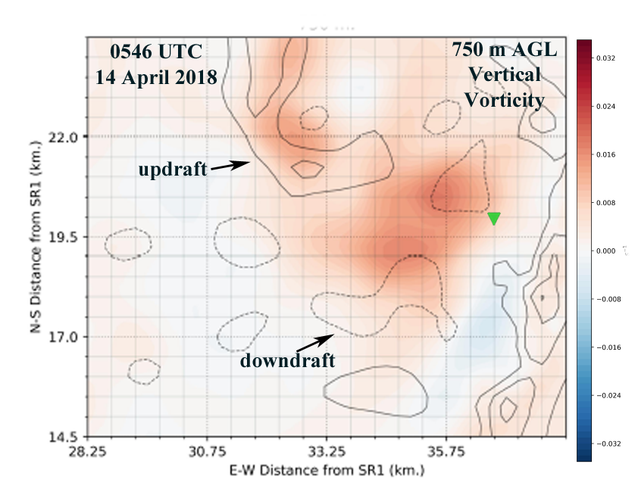
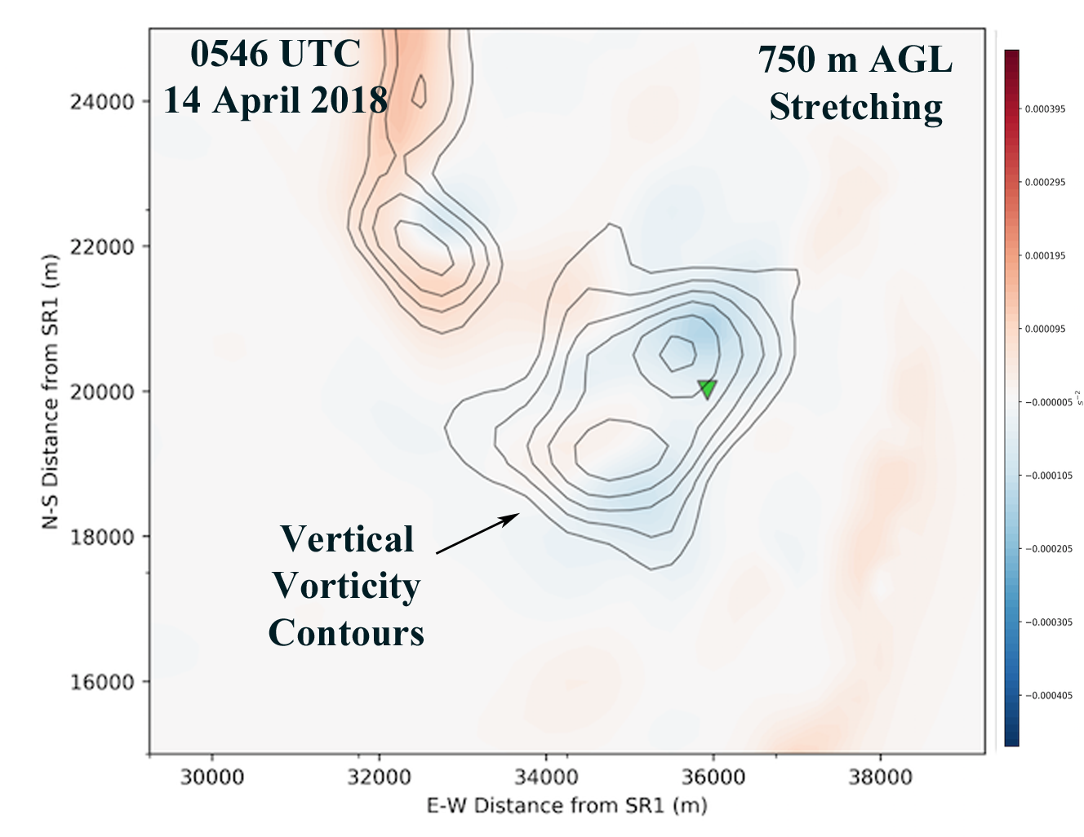
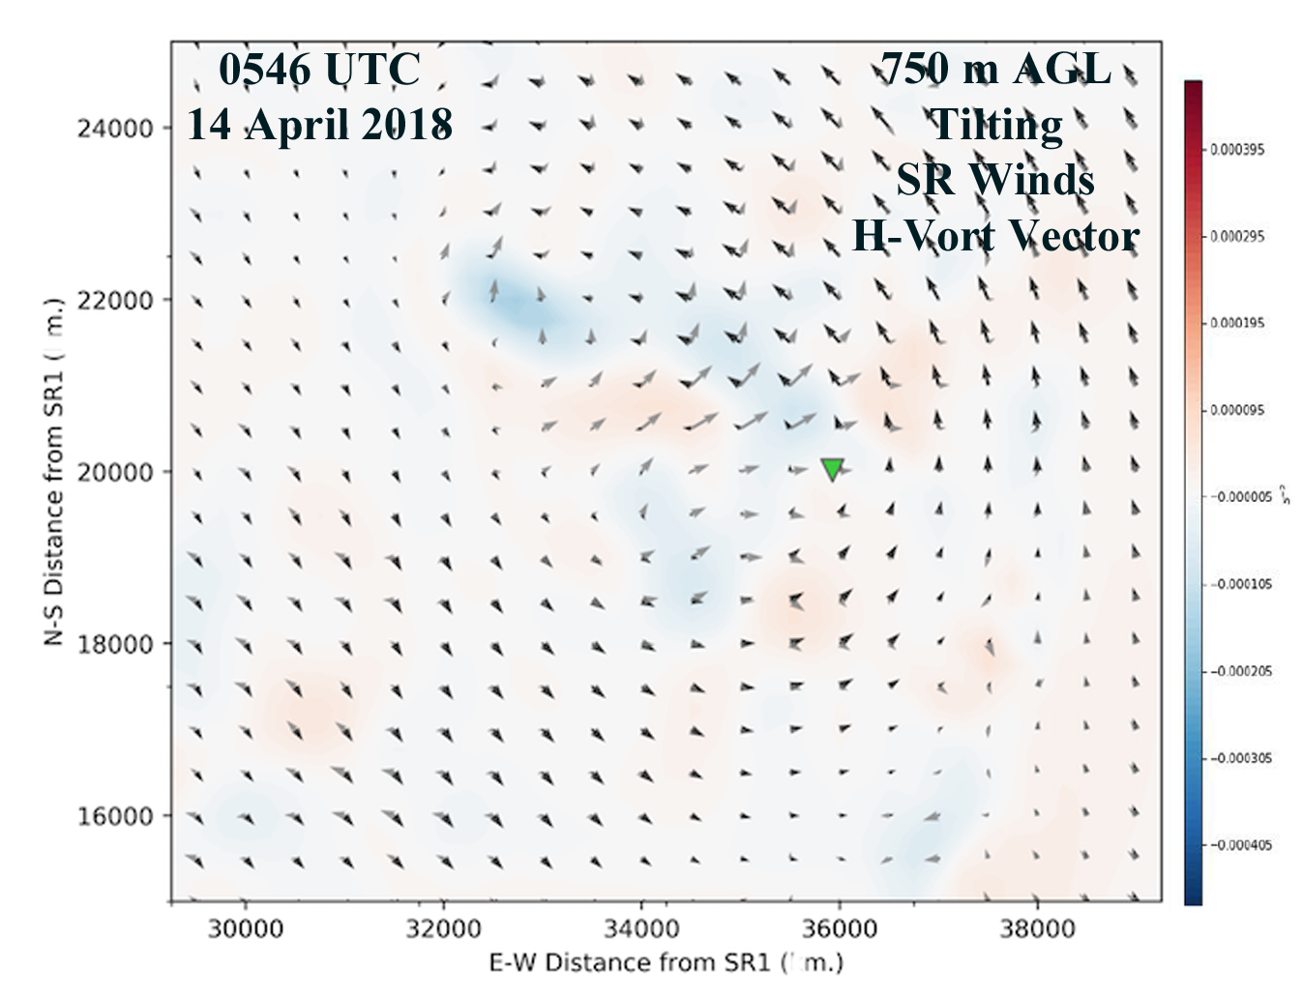
Dissipating Tornado Stage
New downdraft formed to NW of tornado vortex location, resulting in significant negative stretching and weak negative tilting.
Larger-scale mesovortex becoming elongated and more multicellular.
New vorticity centers forming in updrafts along leading edge of convective line.
9
M. Biggerstaff, PERiLS Workshop 2023

Slide 10
CONCLUSIONS
QLCS mesovortex vorticity tendency evolved rapidly despite long-lasting kinematic features.
Most important processes occurring below 1 km altitude with horizontal scales of 1-5 km.
Vorticity magnitude increased considerably in the lowest kilometer of the analysis, 1-3 minutes prior to tornadogenesis.
Intensification process appears to have resulted from the tilting of storm-induced, narrow, zone of easterly-oriented horizontal vorticity between updraft (downdraft) along northwest (southern) flanks of existing vorticity maxima.
Stretching was augmented by convergence from descending reflectivity core to the northwest of mesovortex a few minutes before tornadogenesis.
Vorticity magnitude diminished rapidly after tornadogenesis due to occlusion downdraft. But occlusion downdraft created tilting that appears to have helped sustain the tornado in a weak storm-relative flow regime.
Stretching during the tornadic phase was negative.
Dissipation resulted from additional downdrafts further spinning down and elongating the vorticity field.
10
M. Biggerstaff, PERiLS Workshop 2023

Slide 11
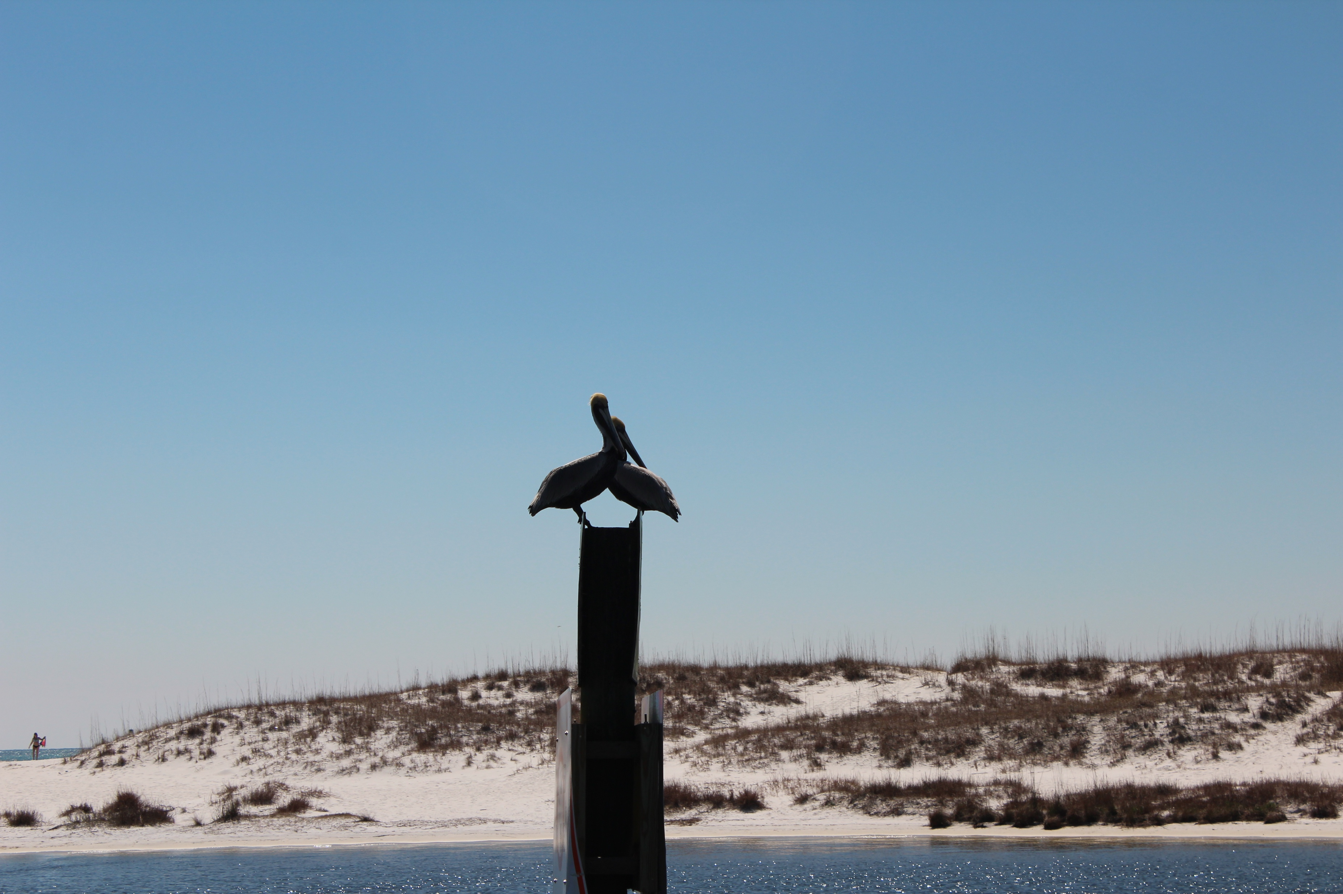
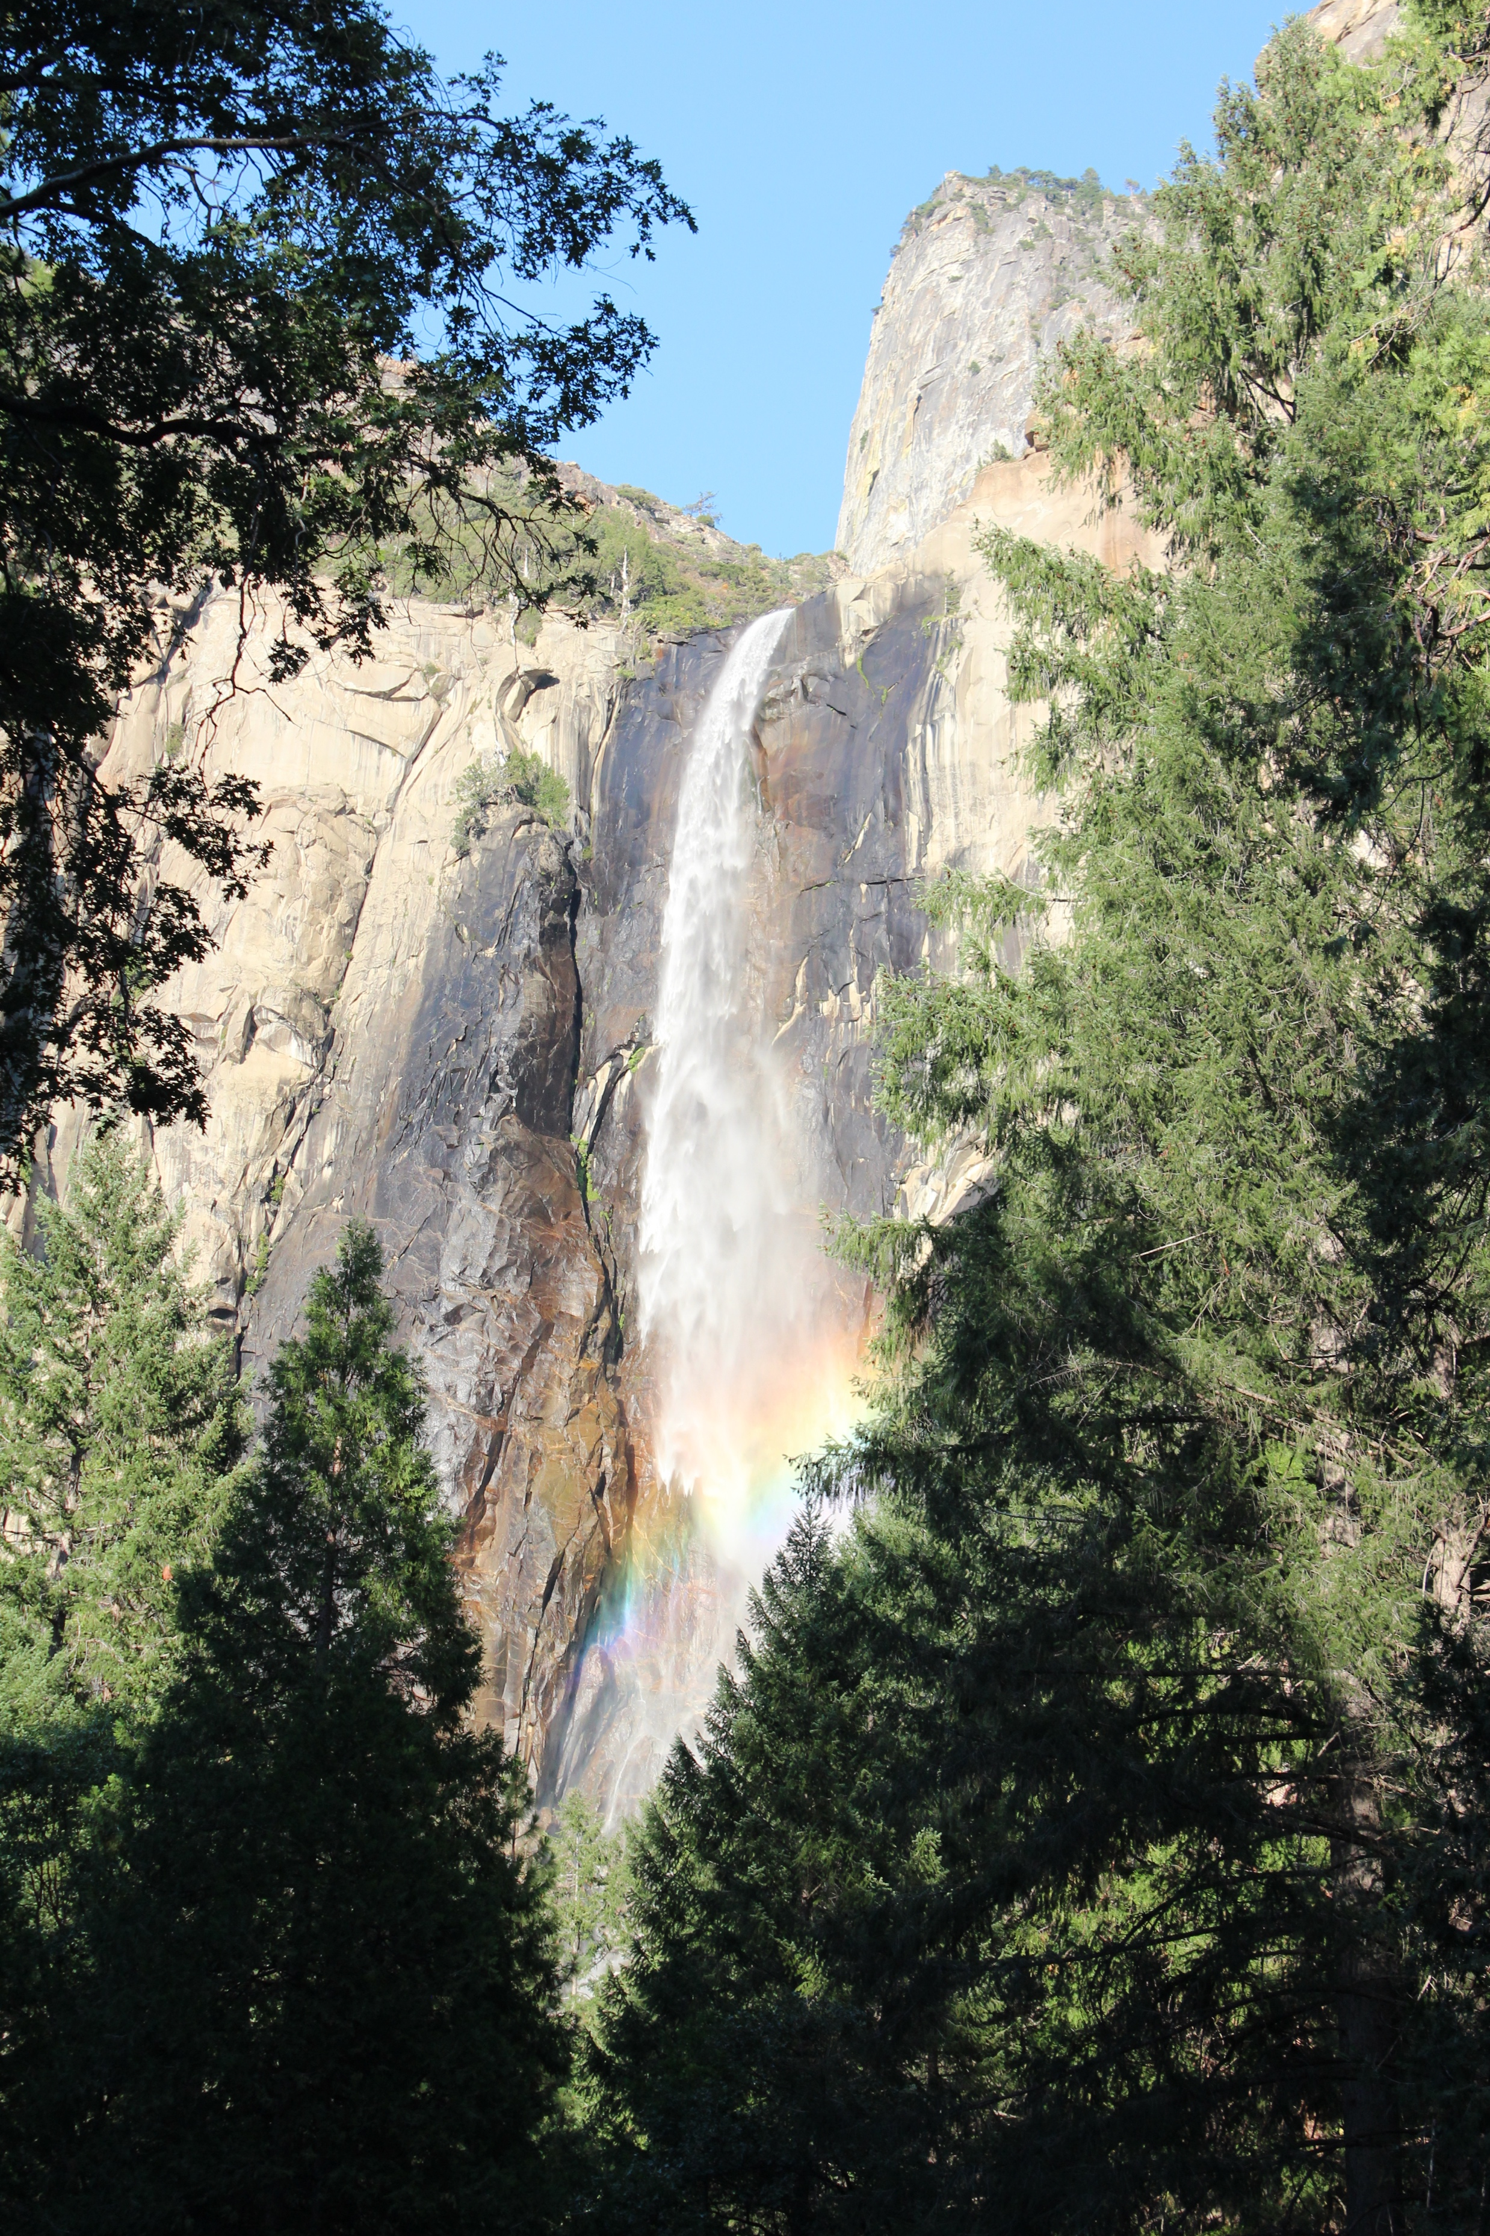
Questions?
11
M. Biggerstaff, PERiLS Workshop 2023

Slide 12
