Slide 1
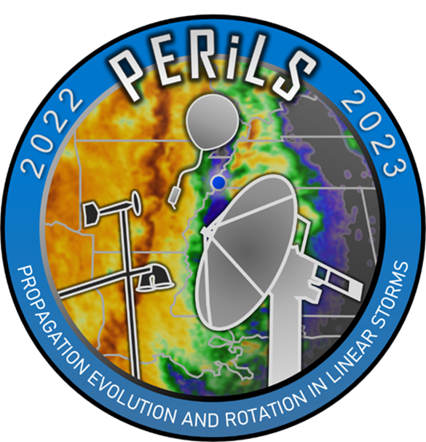
Preliminary dual-Doppler Syntheses of a PERiLS QLCS Mesovortex
Sean D. Melanson & Matthew D. Parker, NC State University
Paul Robinson, Karen Kosiba, Stephen Nesbitt, Robert J. Trapp, & Joshua Wurman, University of Illinois at Urbana-Champaign, Champaign, IL
Michael Biggerstaff, University of Oklahoma, Norman, OK

Slide 2
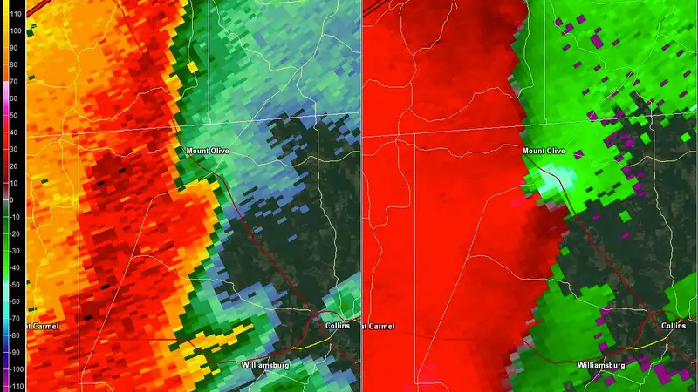
The Mesovortex Genesis Problem
QLCS mesovortices and the tornadoes they produce are notoriously difficult to predict
Mesovortices are shallow, transient, and difficult to see on radar
The mechanism describing mesovortex development is still ambiguous although several theories exist:
Downward tilting of horizontal gust front vorticity
Horizontal shearing instability
Tilting of frictionally-generated horizontal vorticity
Supercell-like processes
***Different vortices may be produced by different pathways, including possibly a pathway not yet fully identified***
Image Courtesy of National Weather Service Jackson, MS

Slide 3
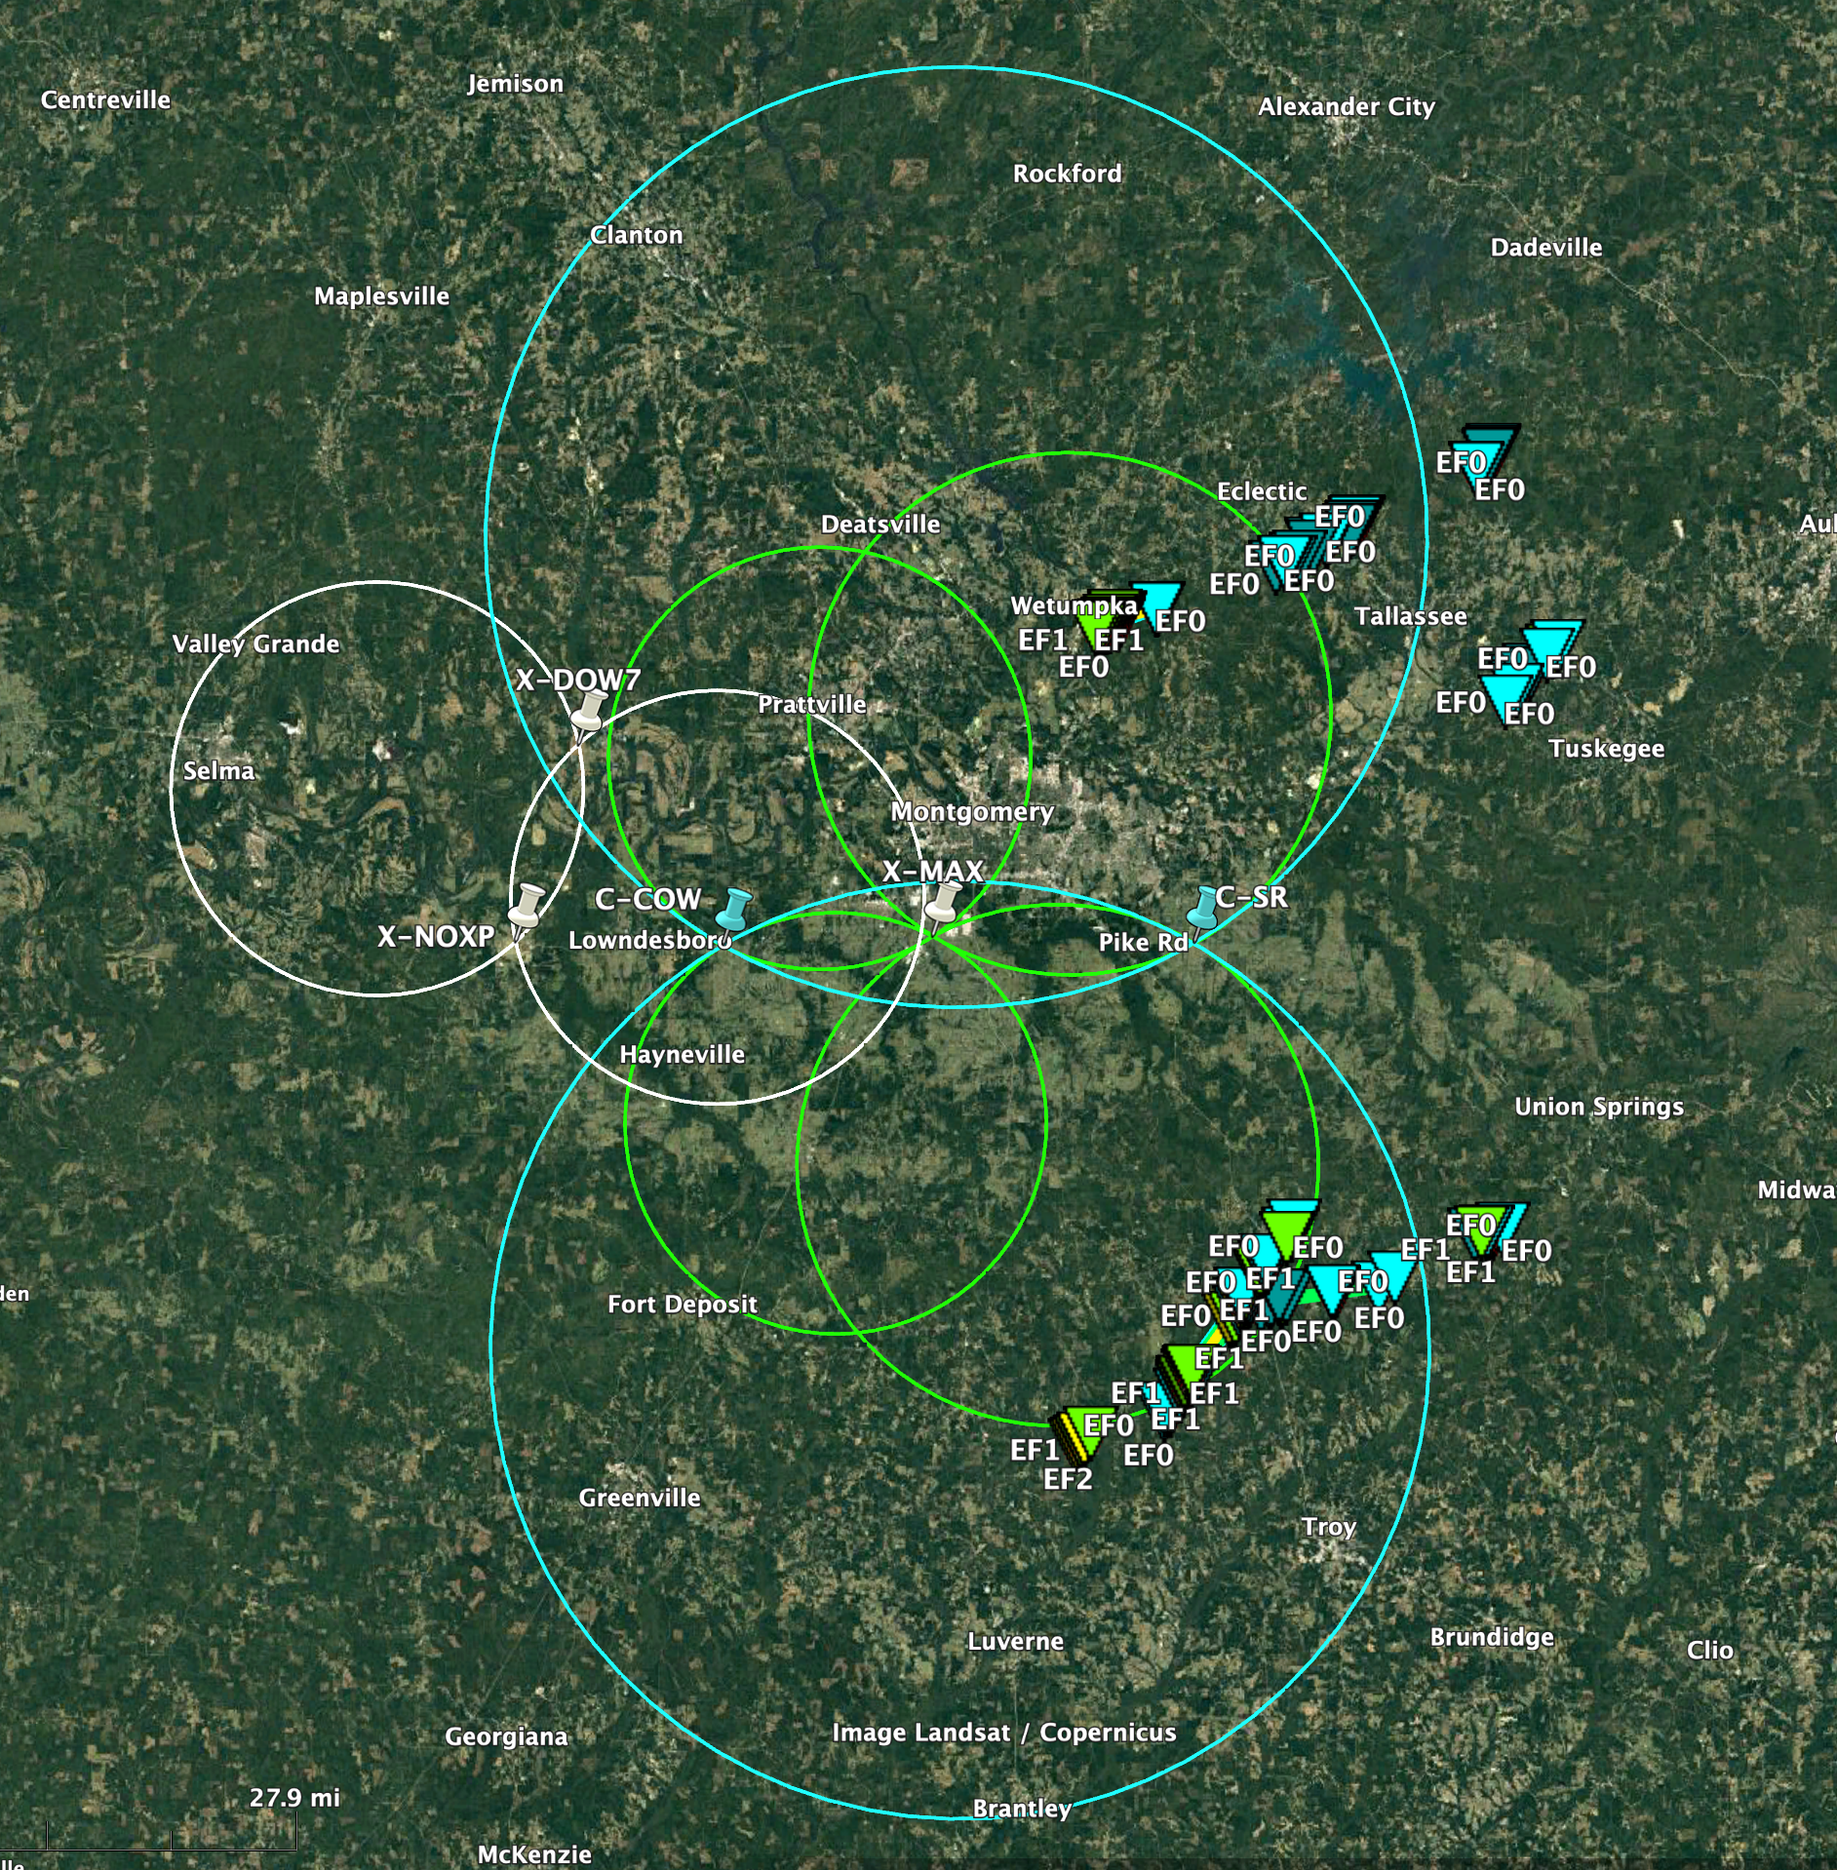
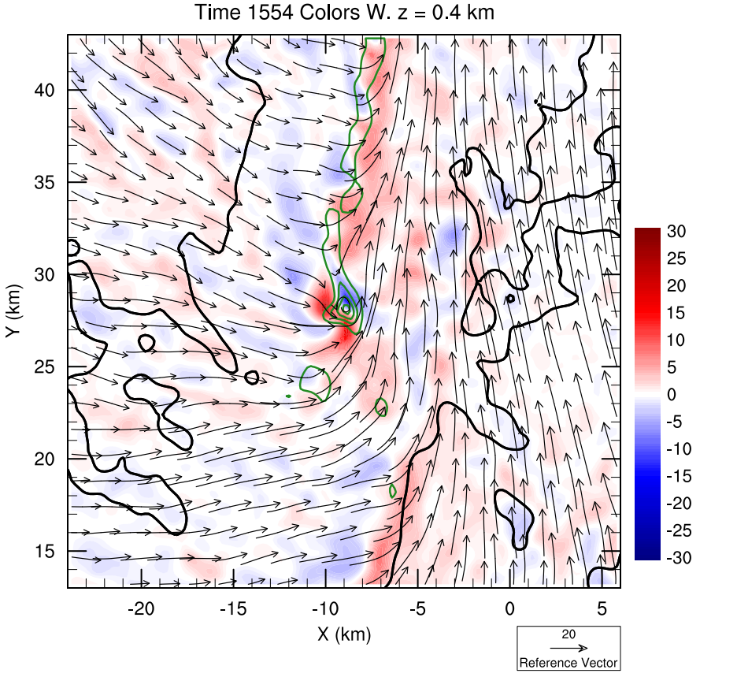
Using Dual-Doppler Syntheses to Investigate Mesovortex Genesis
Compile a dataset of all well-sampled QLCS mesovortices in the dual-doppler lobes
Create time series of dual-doppler syntheses over the lifetime of a mesovortex (genesis through demise)
Look for patterns and features in the dual-doppler wind field that help describe mesovortex genesis and evolution
Exit
Genesis
Dual-doppler synthesis
Track of a QLCS mesovortex from genesis to when it exited the dual-doppler lobes
The dual-doppler radar configuration from April 5, 2022 (Y1 IOP3)

Slide 4
Preliminary dual-Doppler Syntheses of a PERiLS QLCS Mesovortex

Slide 5
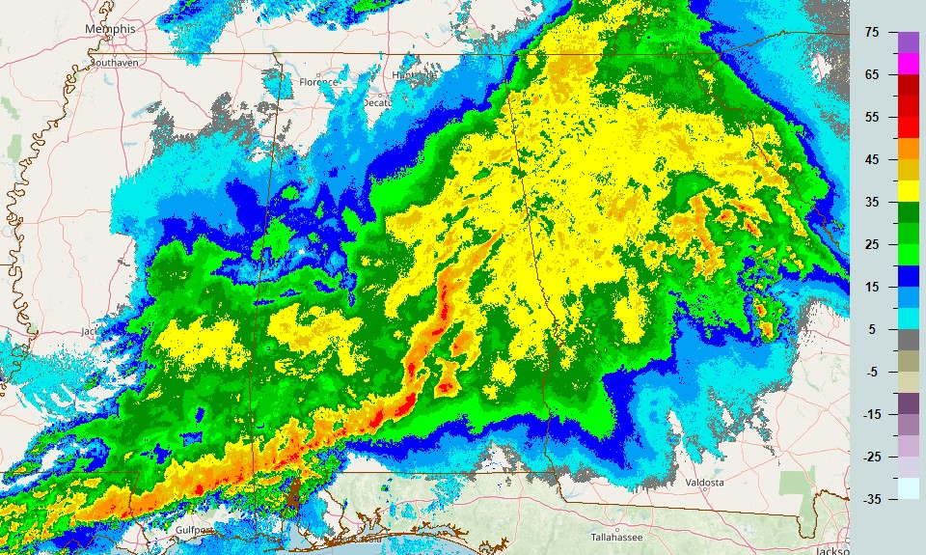
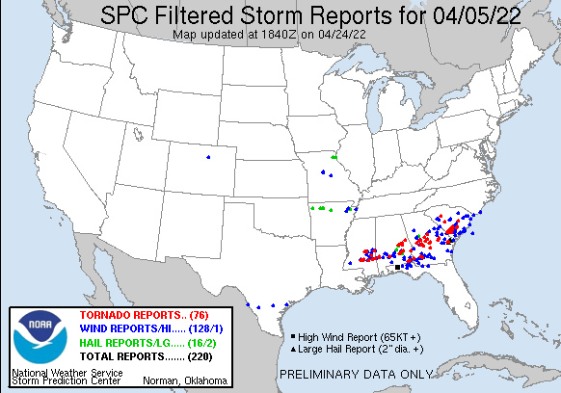
April 5, 2022 (Y1 IOP3) Case Overview
Composite Reflectivity at 15:55z 4/5/2022
dBZ
Approximate PERiLS Deployment Region
Image Courtesy of the NSSL Multi-radar Multi-Sensor (MRMS)
High Shear Low CAPE (HSLC):
0-6 km shear in excess of 60 kts and 0-1 km SRH in excess of 400 m2/s2
MUCAPE < 1000 J/kg
Strongly Forced: Strong upper-level trough and jet streaks

Slide 6
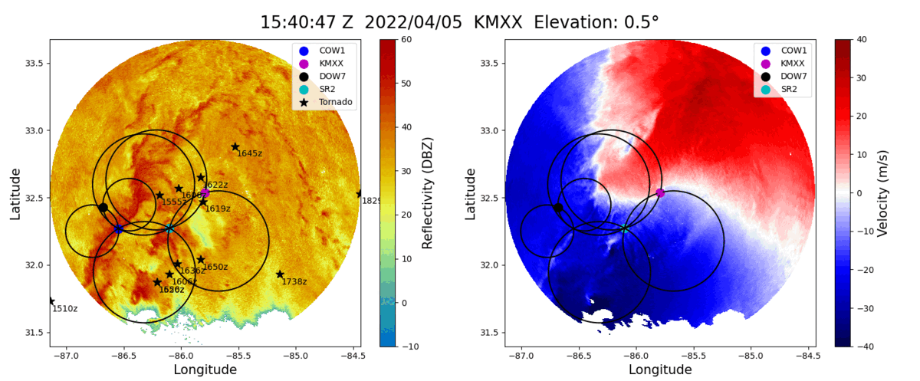
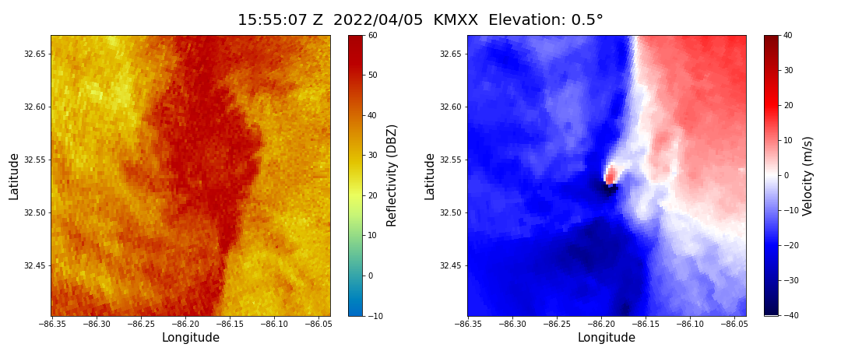
The April 5, 2022 Wetumpka, AL Mesovortex
A tornadic mesovortex occurred on April 5, 2022 at 15:55z near Wetumpka, AL (pink box)
This mesovortex was particularly intense, well-defined, and well sampled by 3 different radars making it an excellent dual-doppler candidate
A dual-doppler synthesis was possible in 2 different dual-doppler lobes: COW1/SR2 and KMXX/SR2
Mesovortex Location and Approximate dual-doppler domain

Slide 7
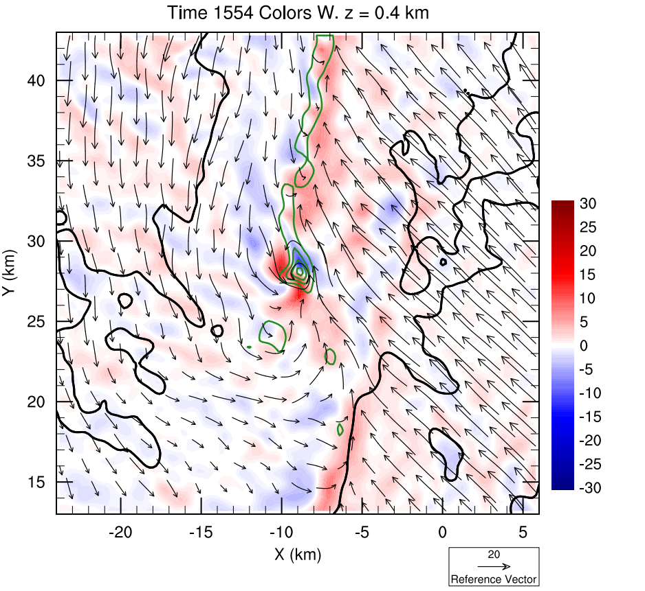
KMXX/SR2 Lowest Tilt Dual-Doppler Synthesis of the Wetumpka Mesovortex (Max Strength)
Ground-Relative Winds
Storm-Relative Winds
Gust Front
Vertical Velocity (m/s)
Vertical Velocity (m/s)
35 dBZ Reflectivity Contour
Vertical Vorticity contoured from 0.015 s-1 at 0.04 s-1 intervals
Very intense mesovortex present at the edge of a break in the gust front and in heavy precipitation
Horizontal shearing instability (HSI) implied along the northern gust front segment
Strong downdraft just northeast of the mesovortex and a weaker one wrapping in from the west

Slide 8
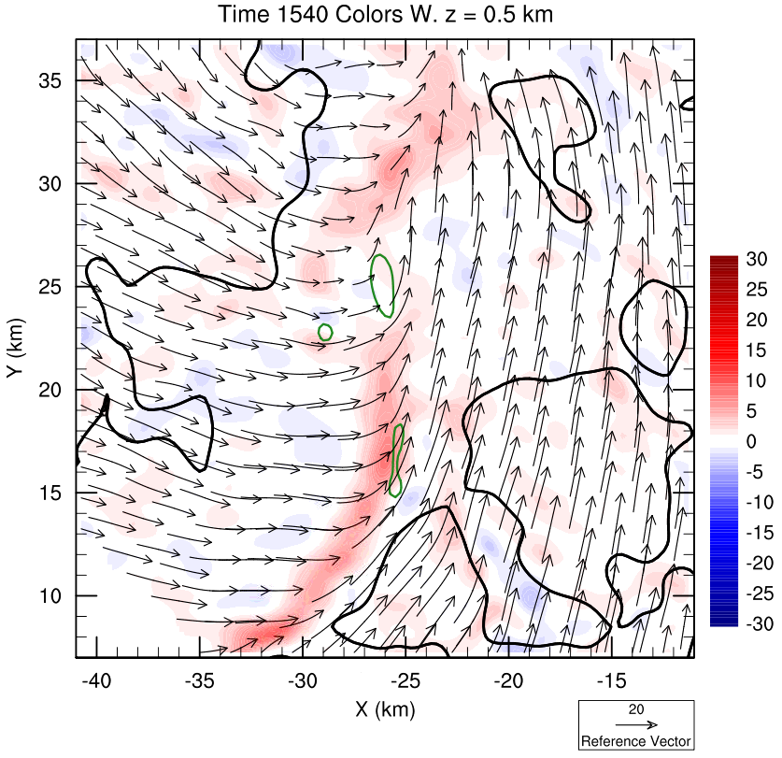
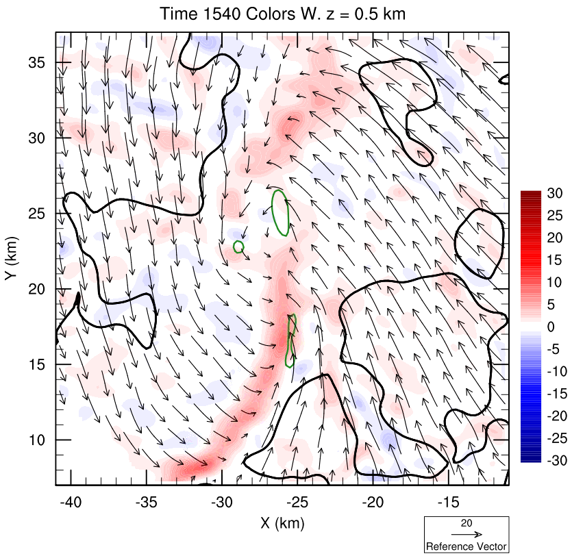
KMXX/SR2 Lowest Tilt Dual-Doppler Synthesis of the Wetumpka Mesovortex (Development)
Ground-Relative Winds
Storm-Relative Winds
Vertical Velocity (m/s)
Vertical Velocity (m/s)
Gust Front
35 dBZ Reflectivity Contour
Vertical Vorticity contoured at
0.015 s^-1
Broad circulation develops at a gust front break and in heavy precipitation
Strong outflow surge in southern line segment accompanies mesovortex genesis
This stage of development is characterized by broad, weak rotation prior to stretching by an updraft

Slide 9
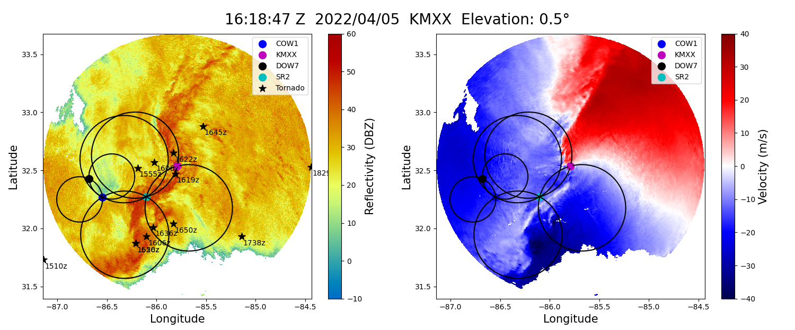
Next Steps
Complete a time series of dual-doppler syntheses on the Wetumpka mesovortex from genesis to demise
Develop dual-doppler time series for all well-sampled, intense mesovortices observed in the PERiLS project
Analyze the dual-doppler time series for recurring features accompanying mesovortex genesis and evolution
Another example of a tornadic QLCS mesovortex occurring at 16:20z near Petrey, AL
Mesovortex Location and approximate dual-Doppler Domain

