Slide 1
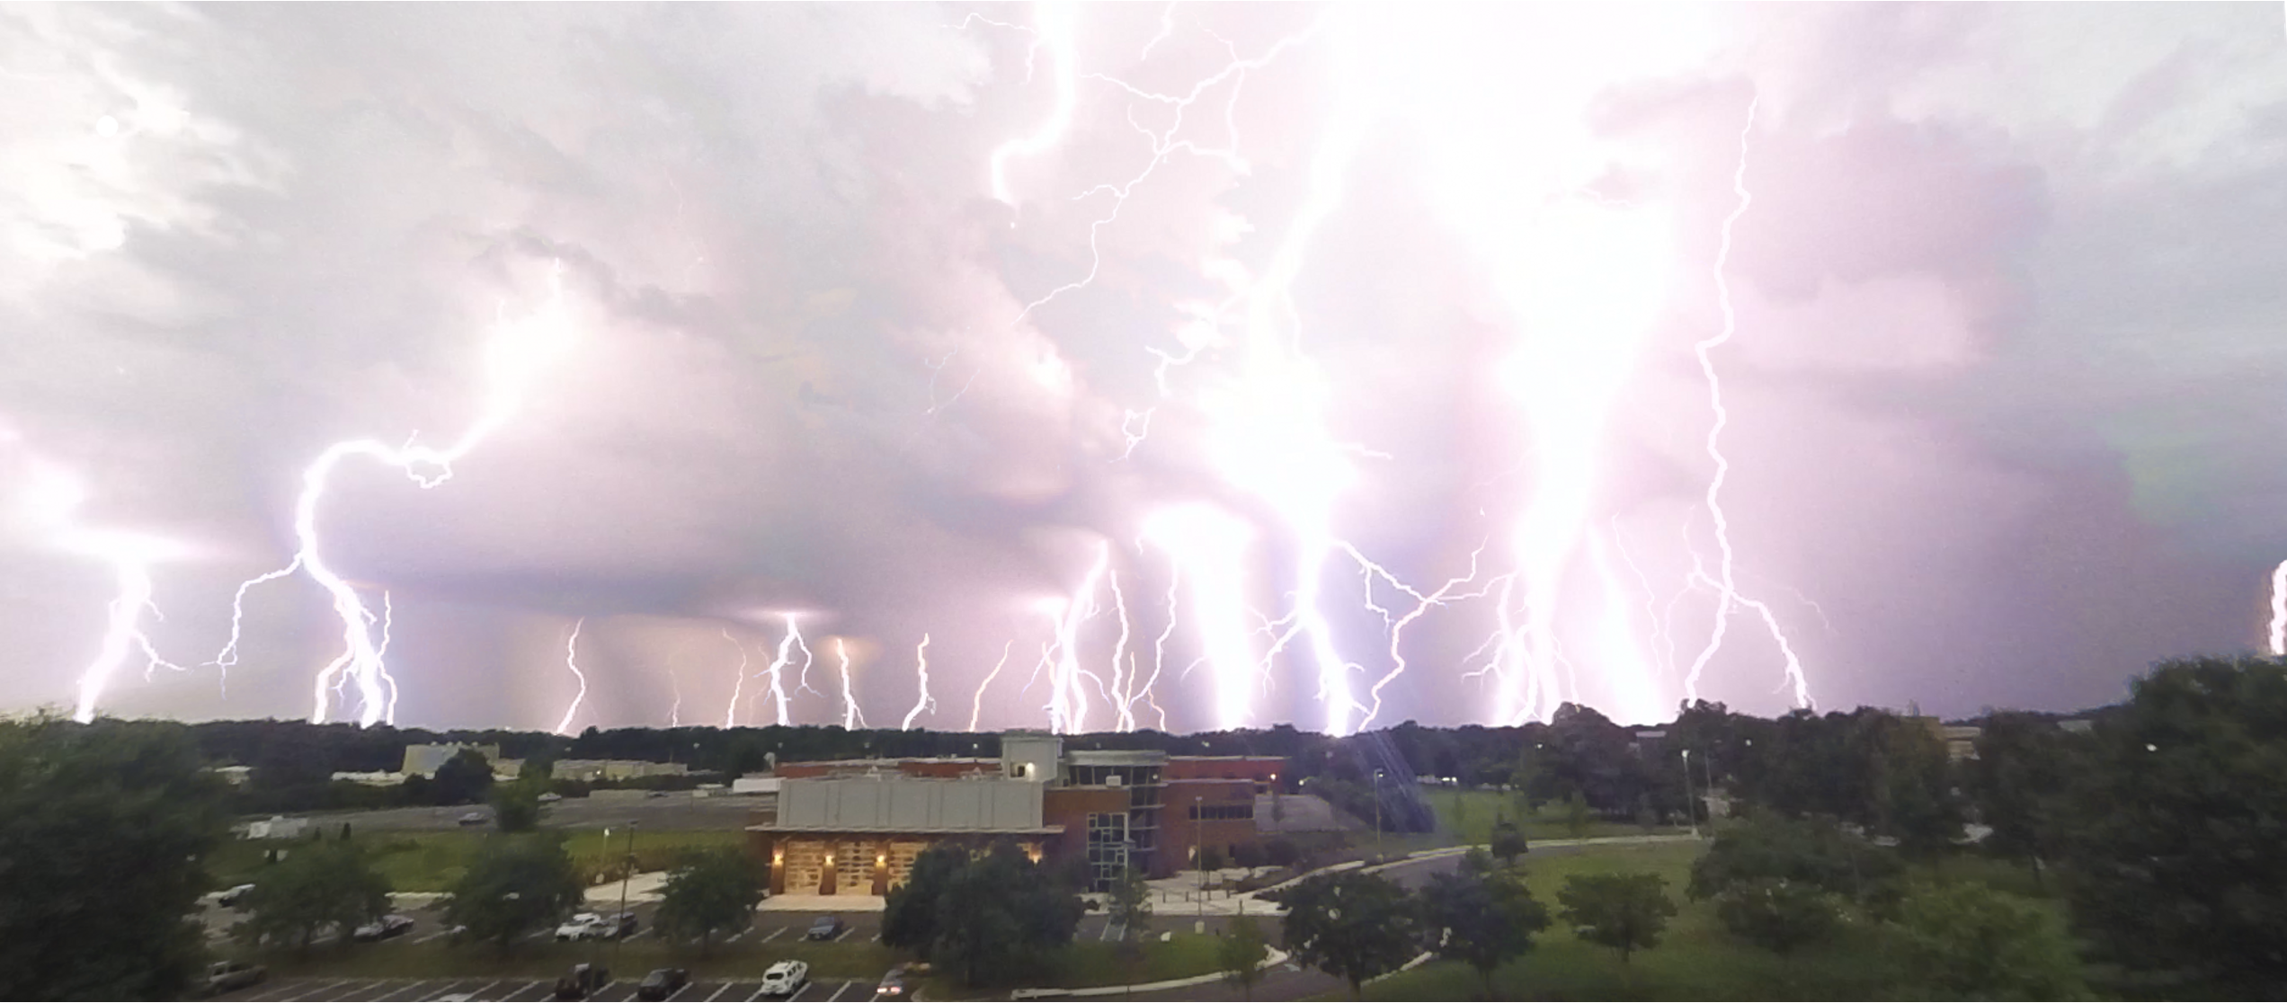
Relationships between Lightning and Thunderstorm Microphysics: Insights from
StickNets, LMA, and WSR-88D
Drs. Kelcy N. Brunner¹, Eric C. Bruning¹,
Christopher C. Weiss¹, and Vanna C. Chmielewski²
Texas Tech University Geosciences Dept.
National Severe Storms Lab
Cooperative Institute for Severe and High-Impact Weather Research and Operations

Slide 2
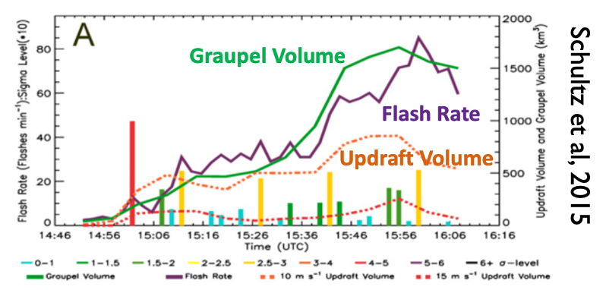
Lightning Signals in Thunderstorms
Schultz, et al., 2015 (A), 2017 (B, C)
Bruning, ARM/ASR 2022
Notes:
What are we really looking at when we look at graupel volume or the updraft volume?
We’re looking at max ZDR, or KDP. If we’re interested in what’s colliding and electrifying then we’re looking at and above the melting level in the mixed phase region.
We’re looking at polarimetric columns in a reflectivity field.
Updraft volume?
How do we identify a consistent signal of electrification in a complex kinematic field?
Thunderstorms are engines - updraft is producing energy, lightning is an energy dissipator
Kdp is hard to process -
Rhohv columns
Multi-cell
Meso scale memory of previous electricity
Same as Eric’s graph pulled out by lightning flash size, and by lightning vs. refl. tracking
Tracer - zdr + lightning, is the kdp not processed, or is it too small to see

Slide 3
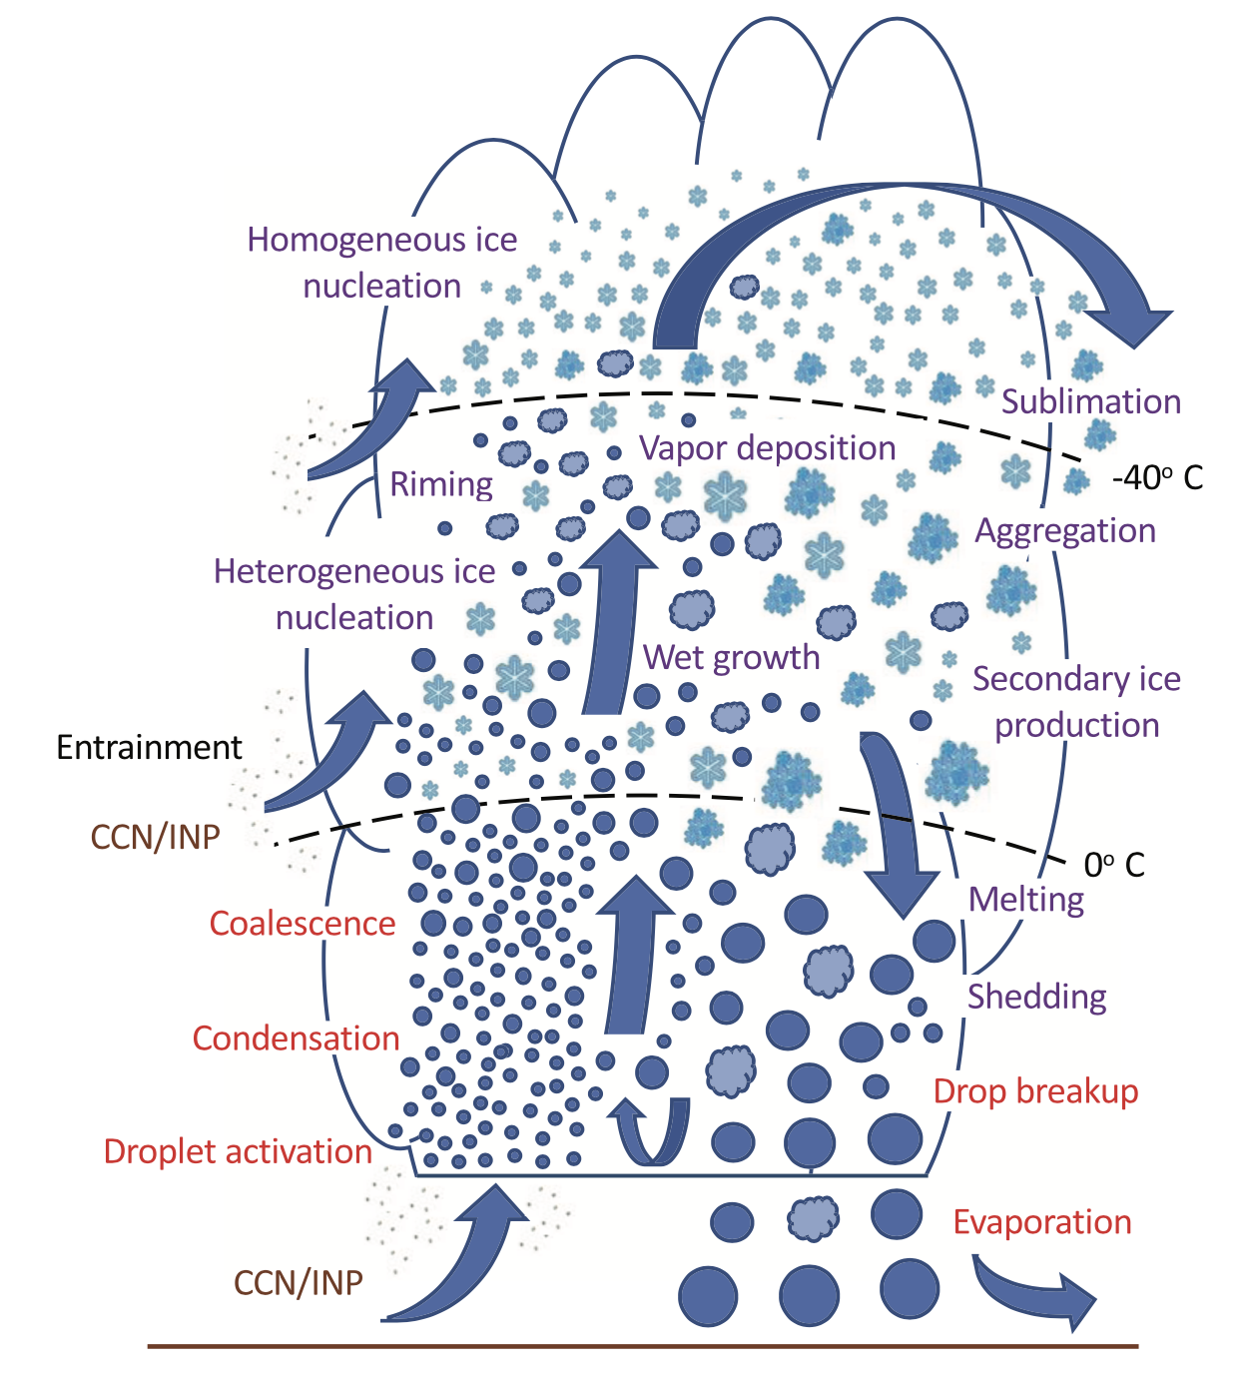
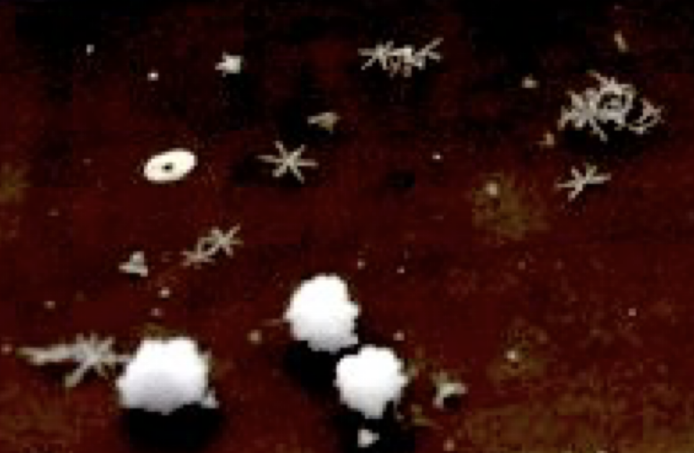
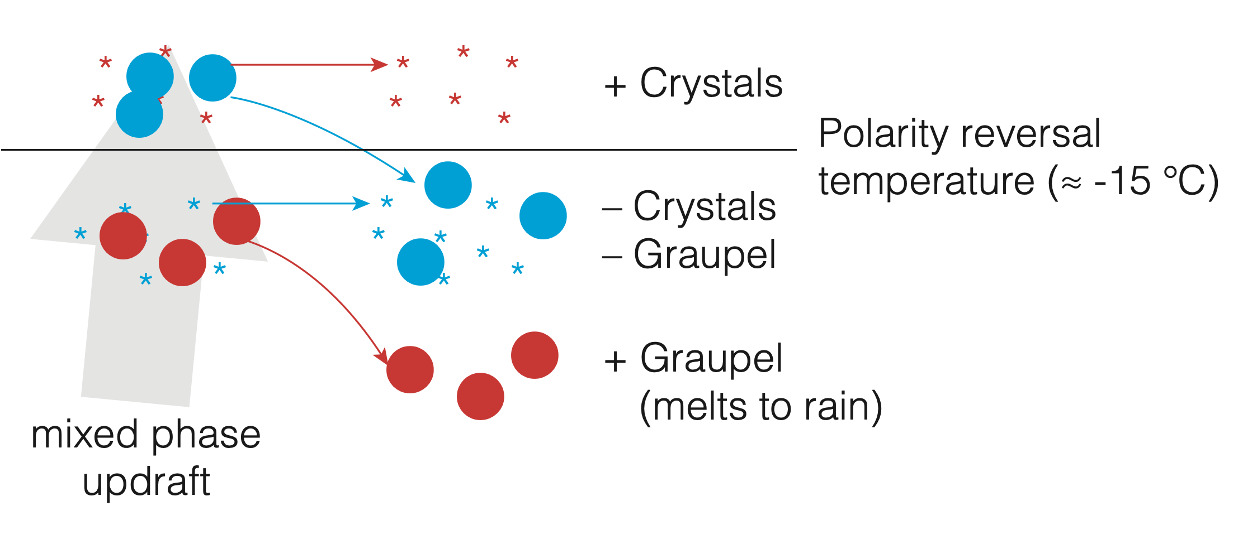
Microphysics and Electrification
From microphysical charging to regions of net charge
Thunderstorm primary electrification results from collisions of ice crystals of graupel in the presence of supercooled liquid water. Non-inductive: operates independently of background electric field.

Slide 4
Microphysics and Electrification
From microphysical charging to regions of net charge
Thunderstorm primary electrification results from collisions of ice crystals of graupel in the presence of supercooled liquid water. Non-inductive: operates independently of background electric field.

Slide 5
Lightning Signals in Thunderstorms
Single-cell storms
Single cell storms follow a conceptual model:
Updraft lofts supercooled water in the mixed phase region, we have glaciation, graupel grows in the mixed phase region, charging occurs as graupel and ice collide, charge regions form and lightning begins
Small flashes peak first, larger flashes occur more slowly through dissipation
How are QLCS, multi cell Thunderstorms different?
Lower flash rates
High Shear/Low Cape
Convolutions of the conceptual processes
Fridlind et al. (2019, AMT)
Notes:
How do we identify a consistent signal of electrification in a complex kinematic field?
Thunderstorms are engines - updraft is producing energy, lightning is an energy dissipator
Let’s go in with our overarching assumptions about lightning, and apply them on a scale beyond a case study. To what extent do these patterns hold, and where do they breakdown

Slide 6
Lightning in Southeast Thunderstorms
Multi-cell storms: overlapping phases
What do stronger polarimetric columns mean for electrification?
What’s the time lag between a polarimetric column and lightning?
What signals are consistent between storm types?
Single cell vs. complex/multicell
What kinematic and microphysical relationships can be observed in the environment?
Sticknet observations
Fridlind et al. (2019, AMT)
Notes:
A two pronged problem here:
How do we deconvolve patterns to understand direct connections between lightning and thunderstorm microphysics,
And two, how common are the conceptual patterns we have between lightning and microphysics.
How prevalent is the conceptual model?
Are we seeing Kdp/Zdr columns frequently in relatively benign cells?
How do we identify a consistent signal of electrification in a complex microphysical and kinematic field?
First focusing on glaciation signals
Patterns can be very convolved
Cells aren’t experiencing a ‘true’ dissipation phase
Updrafts can be lower but over a larger area
HSLC cases might not clearly separate by flash size near the updraft
What do polarimetric signals tell us about lightning?
Do stronger or larger columns mean a stronger electrification signal?

Slide 7
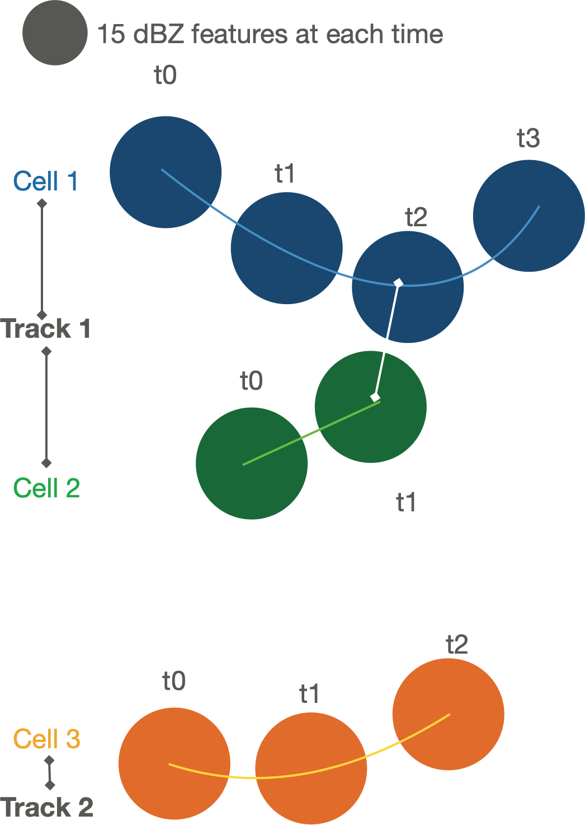
Tracking and Object-Based Analysis of Clouds
TOBAC:
Tracking methods
Tracking using the open source package tobac:
https://github.com/tobac-project/tobac
Heikenfeld, et al., 2019
Based on watershed + TrackPy linking, including merge/split
Creates Features, 2d id mask, cells, and Tracks
Radar: composite reflectivity at 30dBz
Date
20160331
20160430
20170405
20170430
20220322
20220330
20220405
20220413
VORTEX-SE
PERiLS

Slide 8
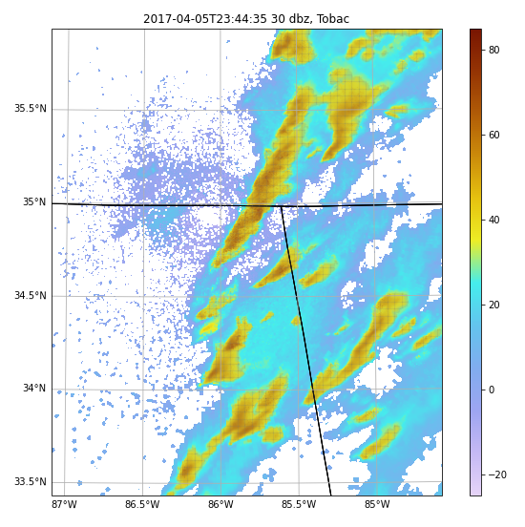
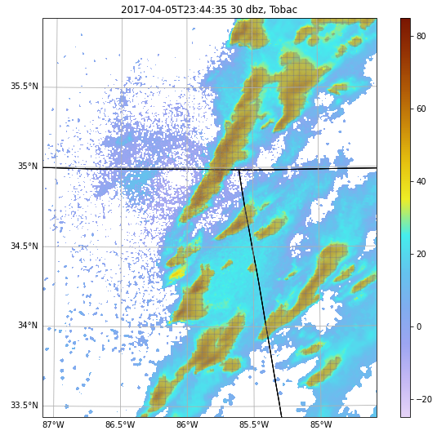
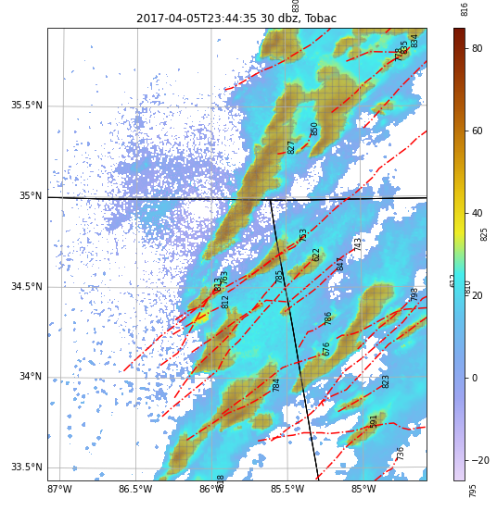
Tracking and Object-Based Analysis of Clouds
TOBAC:
Tracking methods
Identify Features
Feature Mask
Link Features

Slide 9
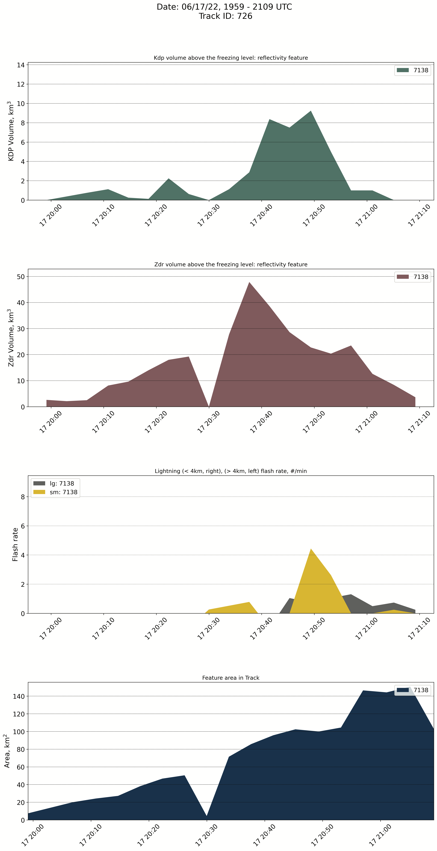
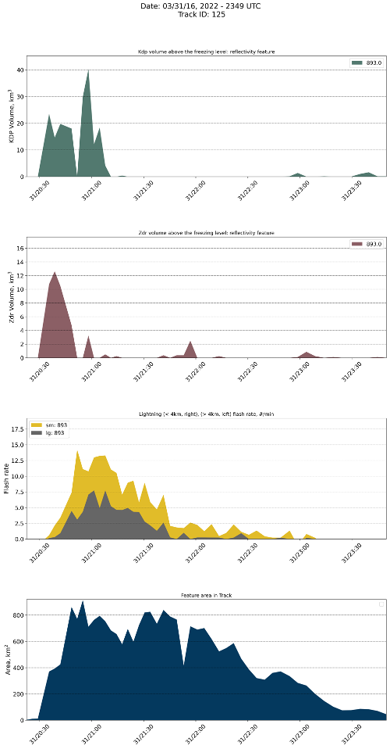
What can we do with Tracks:
Microphysical patterns
Radar and dual-polarimetry methods
Zdr/Kdp column:
Volume in 3km above the melting level
Column Strength – vertically integrated in same 3km slab
Cell area/max reflectivity
Flash rate by size:
Small flashes with area < 4km
Large flashes with area > 4km
Notes:
Perhaps first or second order variables - column volume above the melting level, is step back from these very convolved processes
Identify frequency of storms with polarimetric signals - how often are we seeing via radar particles lofted above the melting level in the mixed phase region that also glaciate, and result in changes to the flash rate - i.g., where are we seeing non-inductive charging ingredients and the result of NIC.

Slide 10
How can we dig in the data?
Track type
Environment influences
Column Strength
Temporal offsets between polarimetry and lightning

Slide 11
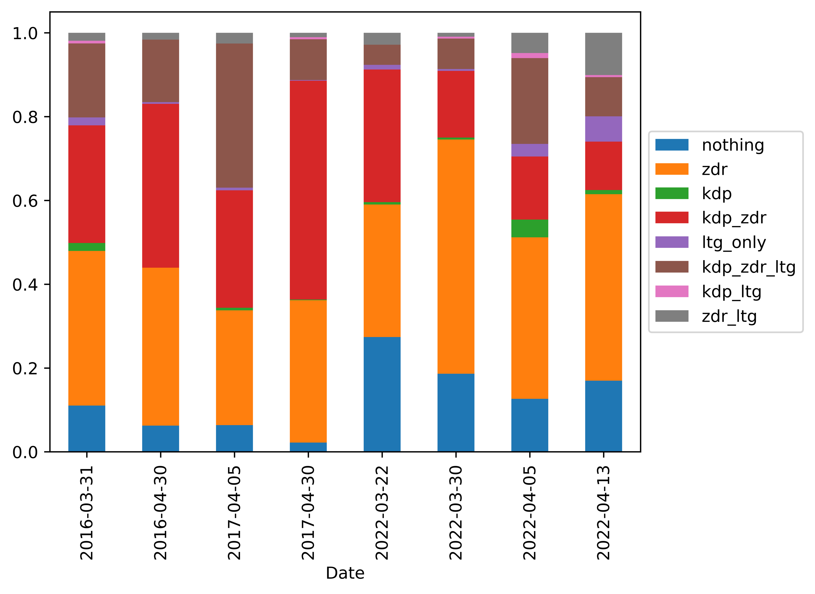
What can we do with Tracks:
Microphysical patterns
Complex/Multicell Dominant
Sorting by timeseries ‘flavor’
Tracks that have ‘idealized’ cell development
Tracks that have ZDR and KDP columns, NO lightning
Tracks with only a ZDR Column
Tracks without lightning and NO ZDR and NO KDP column
317 | 496 | 157 | 586 | 354 | 220 | 166 | 813

Slide 12
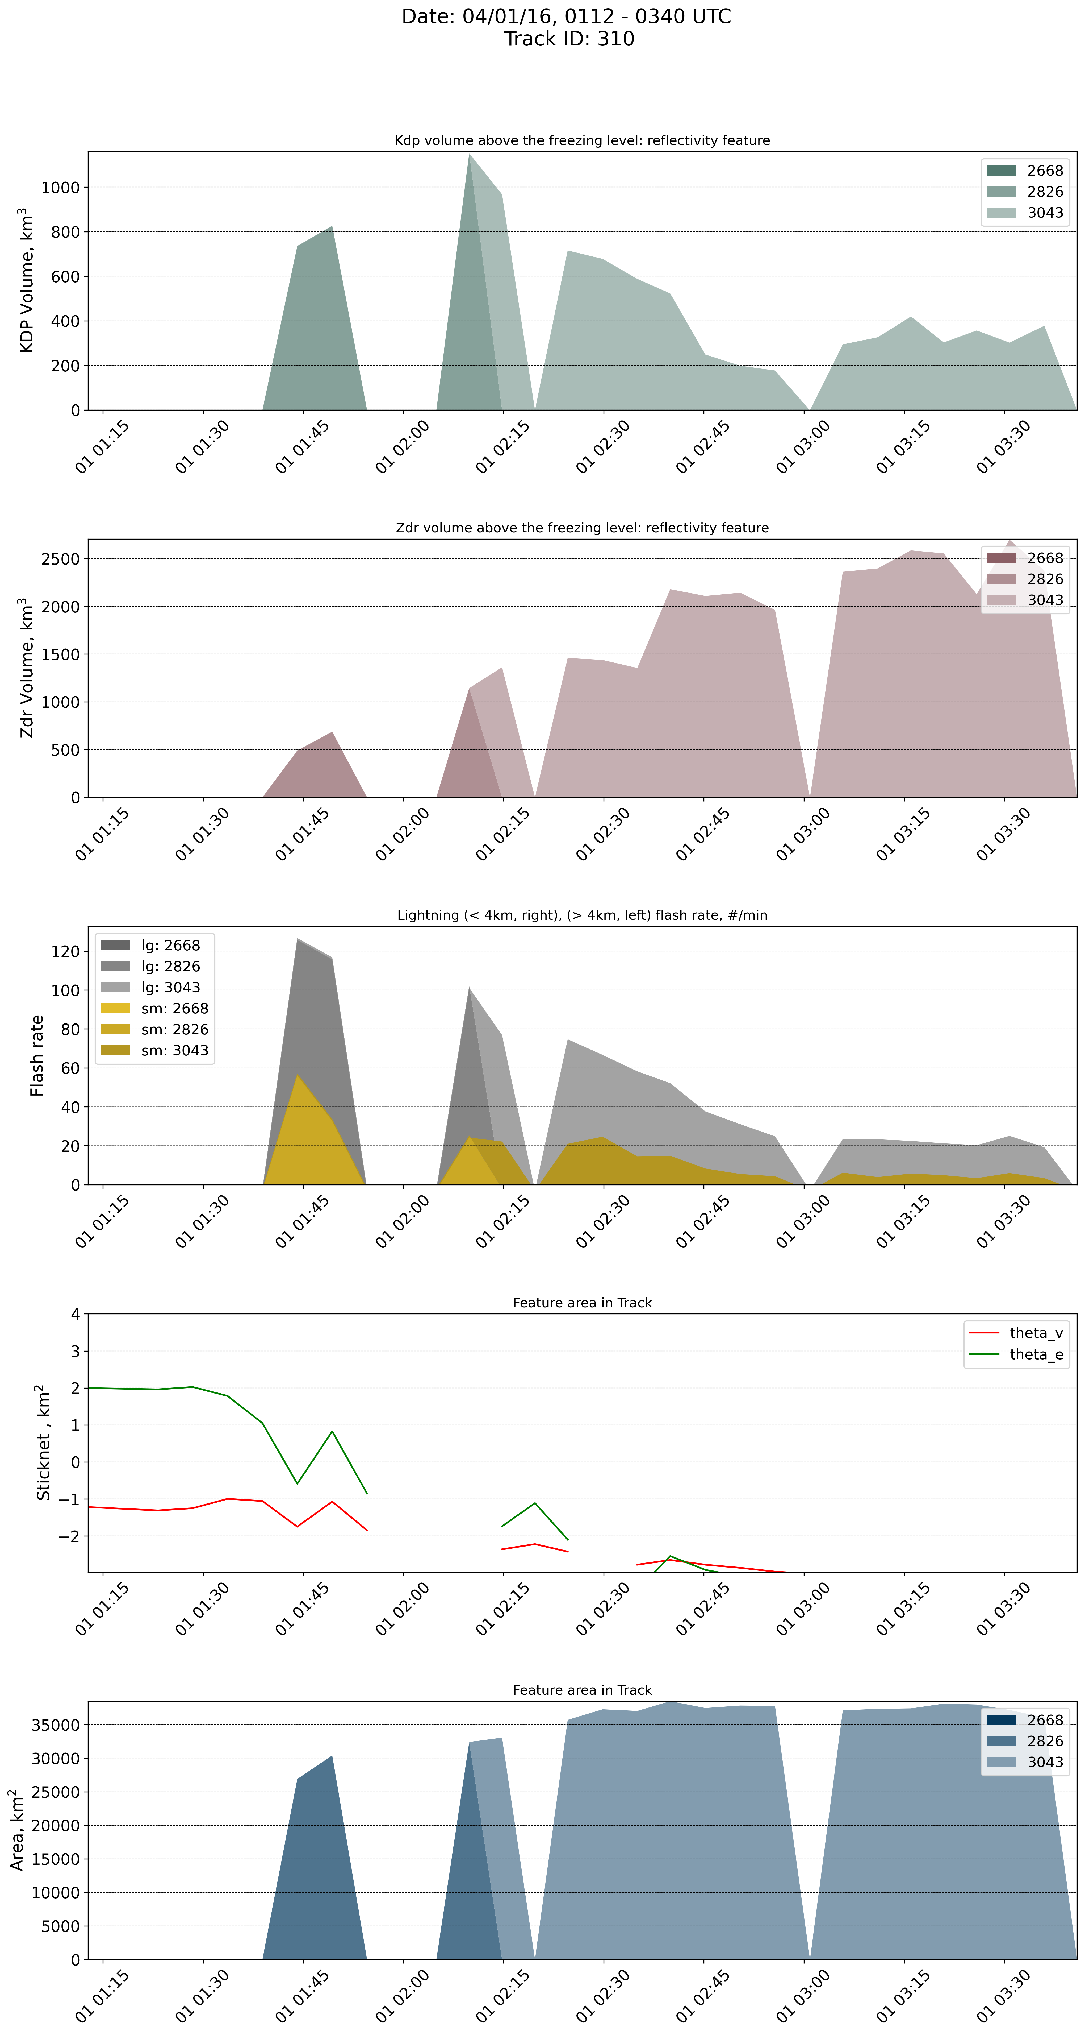
Environment: StickNets
“Rapidly” deployable 2.25 m meteorological observing station
Temp, Pressure, Relative Humidity, Wind, and the occasional lightning sensor
10Hz Sample Rate
20% of tracks fall within the StickNet array
5% of tracks are targets, even fewer fall within the array
Overwhelmingly, tracked cells with Z_{DR,},K_{DP}, and lightning have a sharp decrease in both θ_{v} and θ_{e} – signatures of a cold-pool deficit
Notes:
Theta-v: virtual potential temperature
Theta-e: pseudoequivalent potential temperature
Base state; averaging the data collected between 10 and 15 km ahead of the point of cold pool intersectio

Slide 13
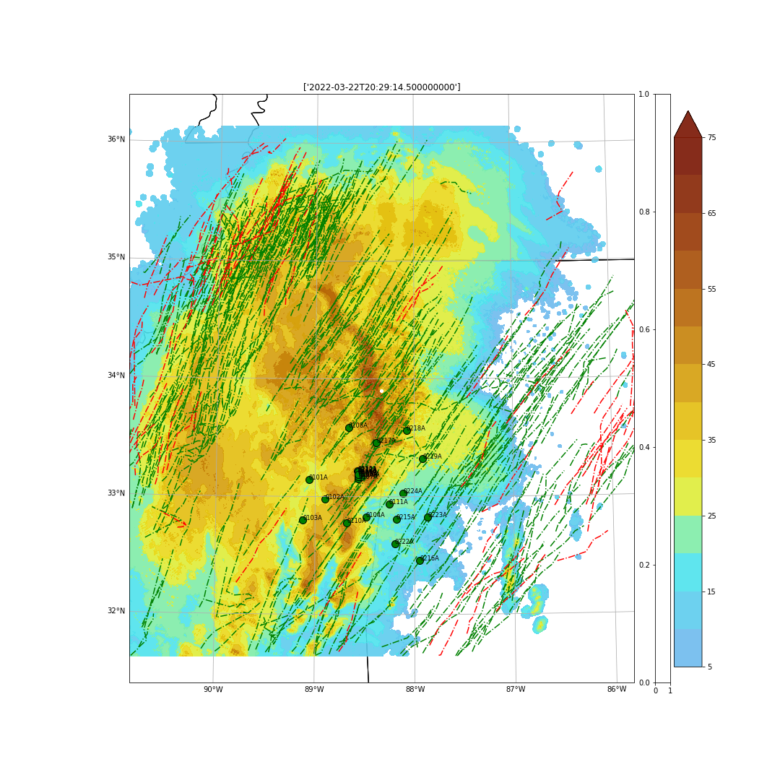
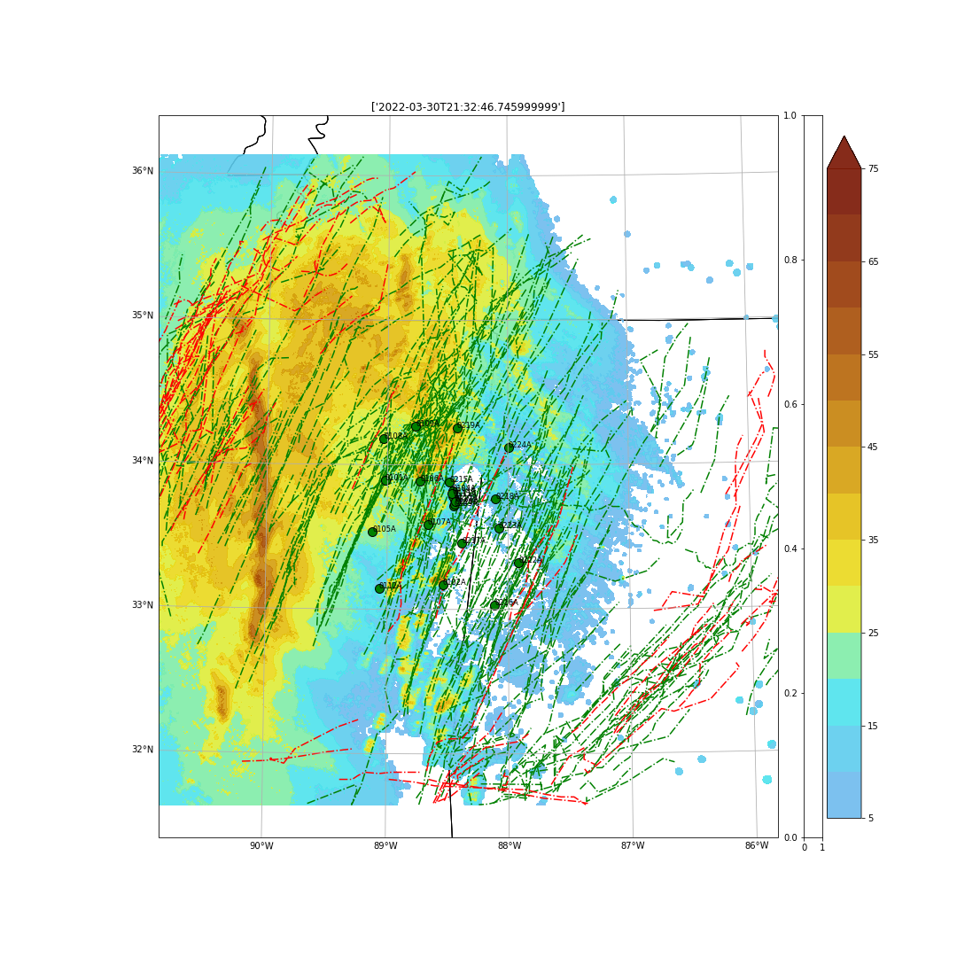
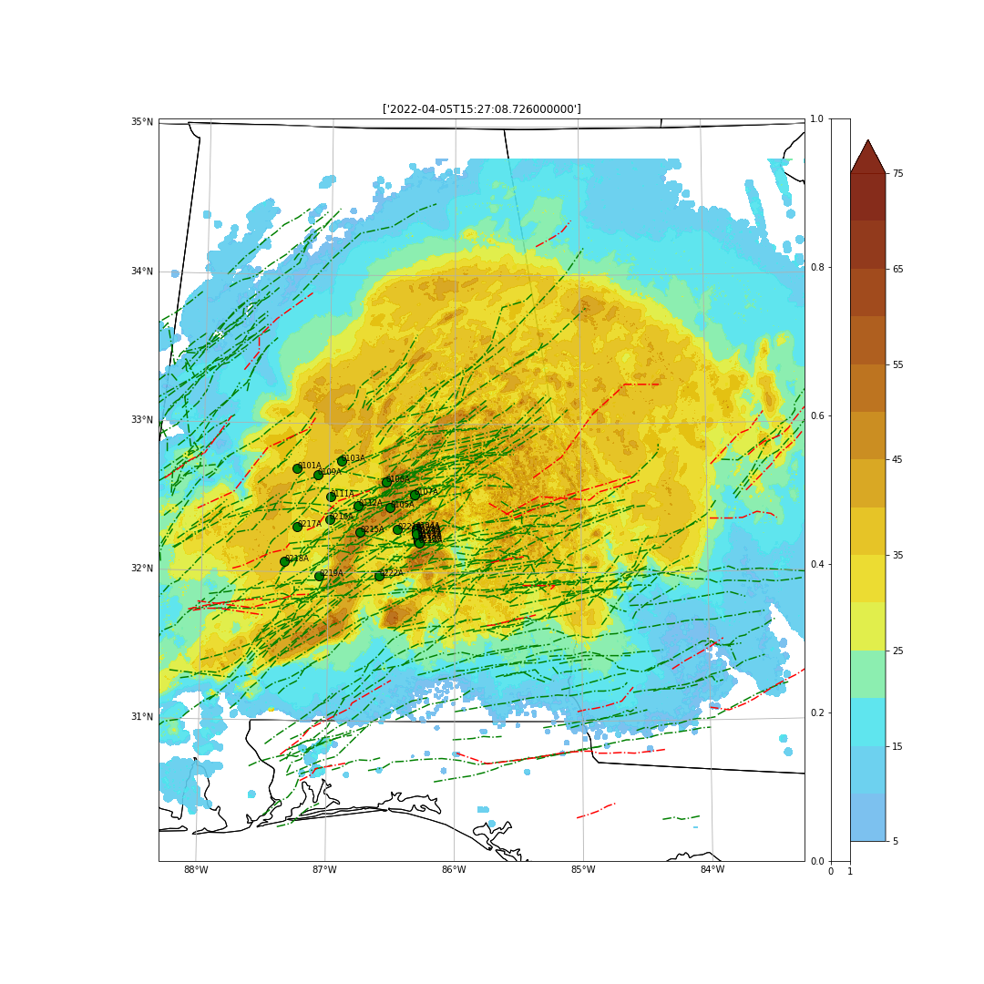
What can we do with Tracks: Forecast Performance
03/22/2022/IOP1
03/30/2022/IOP2
04/05/2022/IOP3
Polarimetric columns
Benign Cells

Slide 14
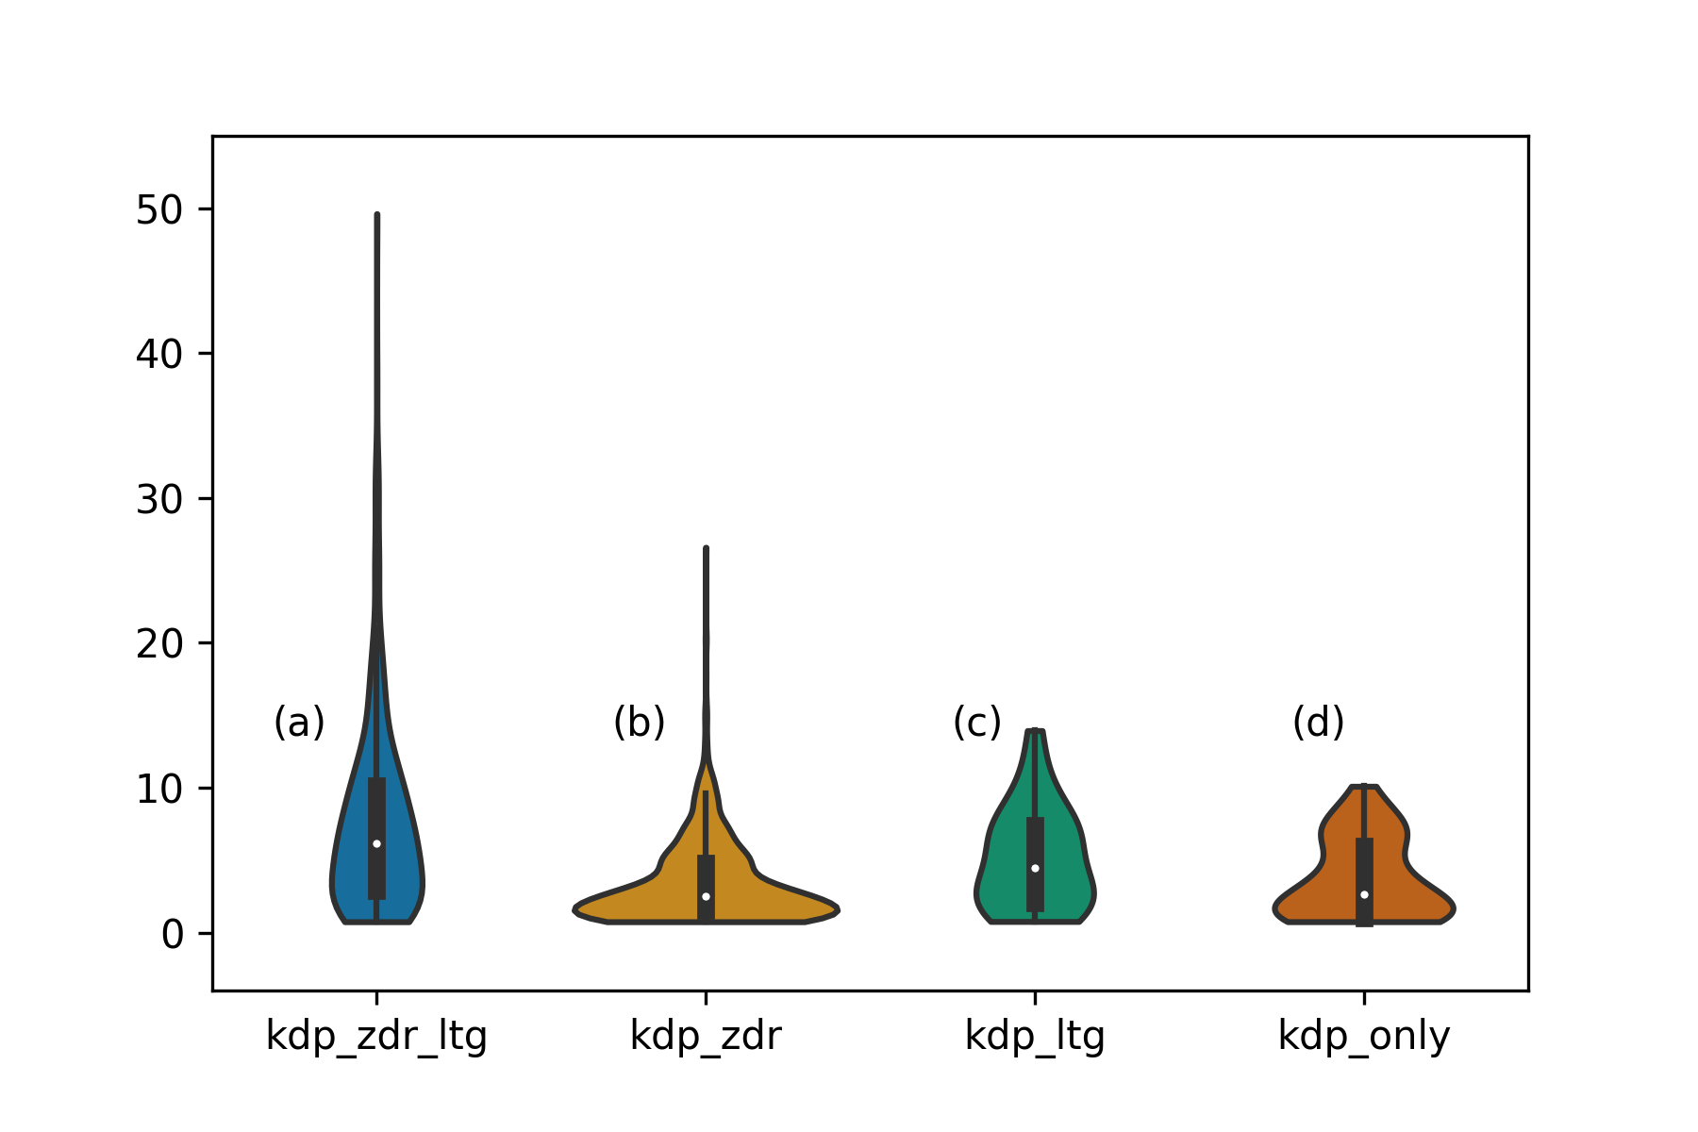
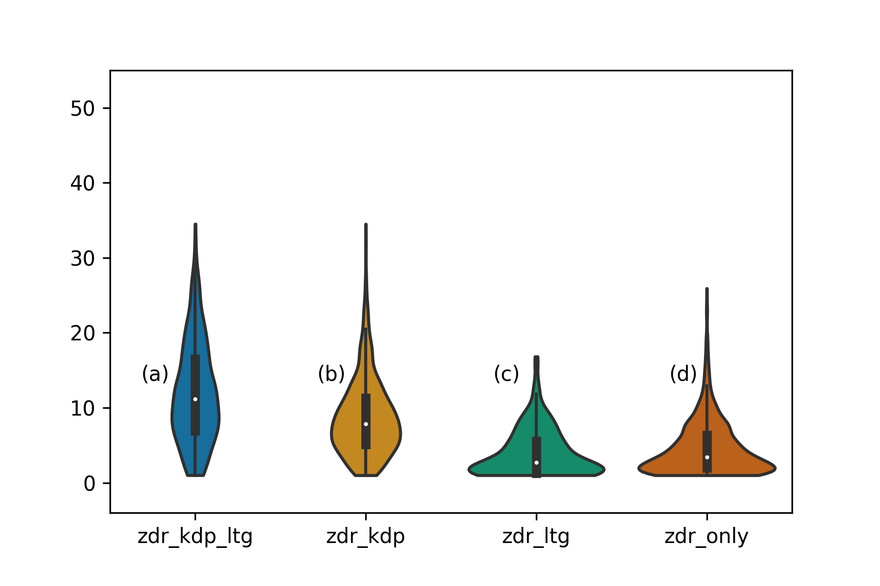
KDP Column Strength
Specific Differential Phase (KDP) Column Strength
Differential Reflectivity (ZDR) Column Strength
Vertically Integrated KDP
Vertically Integrated ZDR
With Lightning
With Lightning
No Lightning
No Lightning
Vertically integrated KDP describes the column strength
KDP columns are more intense when they occur with lightning
Mean KDP column strength is ~2.5x larger when lightning is produced in both single cell and complex storms
Vertically integrated ZDR describes the column strength
ZDR column strength can be similar with and without lightning

Slide 15
Temporal evolution: columns and lightning
Cells with KDP/ZDR Columns with Lightning
Time Delta (minutes) | Raw (median) | Sum Version (median) | Raw (Houston) | Sum Version (Houston)
First Zdr peak | 13 | 11 | 12 | 9
First Zdr – LTG peak | 13 | 10 | 16 | 17
First Zdr – Kdp peak | 9 | 8 | 18 | 18
First Kdp – LTG peak | 0 | 0 | 0 | 0
Cells with KDP/ZDR Columns
Time Delta (minutes)6 | Raw | Sum Version | Raw (Houston) | Sum Version (Houston)
First Zdr peak | 12 | 6 | 11 | 6
First Zdr – Kdp peak | 10 | 8 | 16 | 14
Notes:
Takeaways:
The timedelay between when ZDR gets above the melting level to lightning is shorter for more energetic storms, but not terribly different.
Stronger storms, more complex storms have a slightly faster electrification rate, but for all storm types, the average time delay between when a glaciation signal
Occurs and lightning, is so small they can be considered coexistant. Up to one time step but not more than that. It’s even shorter when you’re looking at
Isolated storms.
Similarly, that zdr to kdp peak, the time between when graupel occurs and when we have a glaciation signal above the melting level in the mixed phase region,
It’s small. So that’s not the time delay that’s important – it doesn’t tell us much about the environment. A kdp column means electrification is imminent, and we’re about to reach the
Break down field. You’re about to get a butt ton of lightning. You’re welcome thor.

Slide 16
Temporal evolution: columns and lightning
Cells with KDP/ZDR Columns with Lightning
Time Delta (minutes) | Raw (median) | Sum Version (median) | Raw (Houston) | Sum Version (Houston)
First Zdr peak | 13 | 11 | 12 | 9
First Zdr – LTG peak | 13 | 10 | 16 | 17
First Zdr – Kdp peak | 9 | 8 | 18 | 18
First Kdp – LTG peak | 0 | 0 | 0 | 0
Cells with KDP/ZDR Columns
Time Delta (minutes)6 | Raw | Sum Version | Raw (Houston) | Sum Version (Houston)
First Zdr peak | 12 | 6 | 11 | 6
First Zdr – Kdp peak | 10 | 8 | 16 | 14
Storm type influences time to between Zdr and Kdp, and Zdr and lightning
Kdp columns have little/no lag time with lightning, regardless of storm type
Column strength doesn’t impact (generally) how quickly we see a Kdp column
Notes:
Takeaways:
The timedelay between when ZDR gets above the melting level to lightning is shorter for more energetic storms, but not terribly different.
Stronger storms, more complex storms have a slightly faster electrification rate, but for all storm types, the average time delay between when a glaciation signal
Occurs and lightning, is so small they can be considered coexistant. Up to one time step but not more than that. It’s even shorter when you’re looking at
Isolated storms.
Similarly, that zdr to kdp peak, the time between when graupel occurs and when we have a glaciation signal above the melting level in the mixed phase region,
It’s small. So that’s not the time delay that’s important – it doesn’t tell us much about the environment. A kdp column means electrification is imminent, and we’re about to reach the
Break down field. You’re about to get a butt ton of lightning. You’re welcome thor.

Slide 17
Takeaways and Acknowledgements
Single-cell storms
How prevalent is the conceptual model and what is consistent across storm type?
K_{dp} column intensity and onset are consistent signals with lightning
K_{dp} column intensity is not tied to first flash, but columns associated with lightning are 2-2.5x more intense
Columns of K_{dp} indicate little to no lag with the onset of lightning
ZDR Columns occur frequently, at a large range of values, volumes, and intensity with and without lightning.
Lightning is the end result of many processes, and regardless of storm type the timing of lightning is consistent
Acknowledgements
PERiLS collaborators: Jessie McDonald, Alex Schueth, Josh Ostaszewski, Jackie Ringhausen

