Slide 1
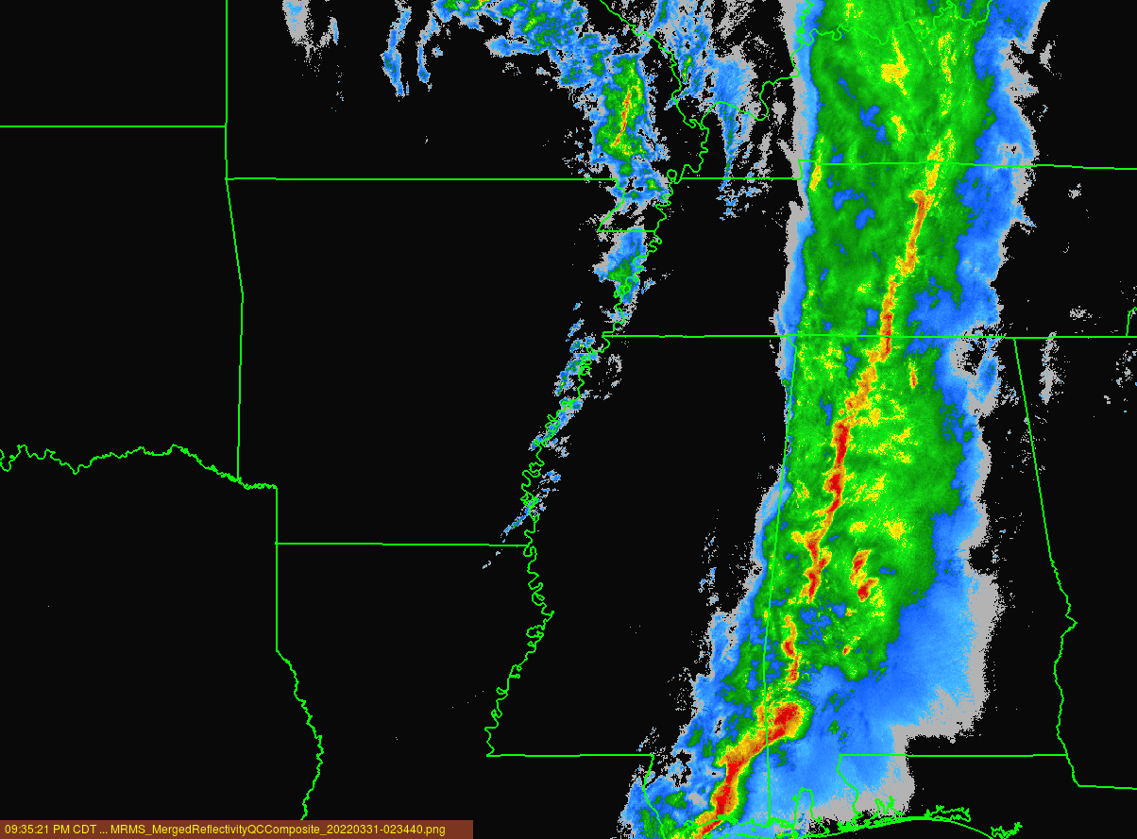
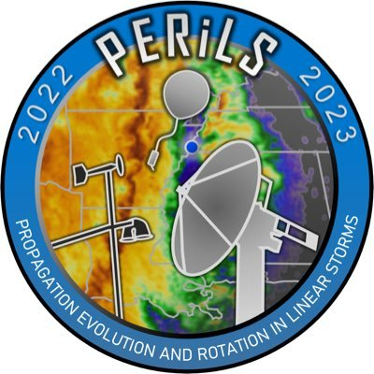
DSD Characteristics and Evolution of the Leading Stratiform Region of a Tornadic QLCS during PERiLS-2022 IOP#2 (30 March 2022).
NOAA/DOC awards #1305M320PNRMA0628SEP and #21B053-03
Hamid Ali Syed­¹
Daniel Dawson¹
Faith Vendl¹
Robin Tanamachi¹
Matthew Parker²
Department of Earth, Atmospheric, and Planetary Sciences, Purdue University, IN
Department of Marine, Earth, and Atmospheric Sciences, North Carolina State University, Rayleigh, NC
syed44@purdue.edu | dandawson@purdue.edu | #PERiLS Meeting
Notes:
Good morning, everyone. I'm Hamid. I am a second-year PhD student at Purdue University, and I am working with Dr. Dan Dawson. I extend my gratitude to my co-authors, with a special mention to my advisor, Dr. Dawson, for their invaluable assistance and unwavering support throughout the duration of this endeavor, and we also thank our funding agency NOAA for this grant.
Today, I’ll be talking about Drop Size Distribution Characteristics and Evolution within the Leading Stratiform Region of a Tornadic Quasilinear Convective System. Our exploration centers around an event that transpired on the 30th of March, 2022 during IOP2 of the PERiLS Project. This occurrence traversed across the targeted domain from 22:00 UTC on March 30 to approximately 02:00 UTC on March 31.
I must emphasize that our findings remain a work in progress, and the presentation I'm about to deliver can best be described as a progress report. The insights I'll be sharing today represent an early steps in our ongoing journey toward a comprehensive understanding of this complex phenomenon.

Slide 2
Event Overview
We investigate a tornado-producing quasi-linear convective system (QLCS) that occurred during the PERILS IOP2 event. This event crossed the PERiLS domain from 30th March 2022, 22 Z, to 31st March 02 Z.
4 PIPS were deployed during this time on highways 45 and 8 near and north of Hamilton,
PIPS 2A and 3B were collocated at the northern end of the array
Notes:
So let’s talk briefly about this event,
so,
4 PIPS were deployed ahead of an approaching tornadic QLCS during this time on highways 45 and 8 near Hamilton, MS
PIPS 2A and 3B were collocated at the northern end of the array
PIPS1A and PIPS1B were deployed off of Highway 45 approximately 8 and 13 km south of PIPS2A3B, respectively.
The DSD time series from all PIPS showed a clear transition from a leading stratiform to convective to trailing stratiform pattern with clear differences in DSD characteristics between the leading and trailing stratiform regions which we will see in the upcoming slides.

Slide 3
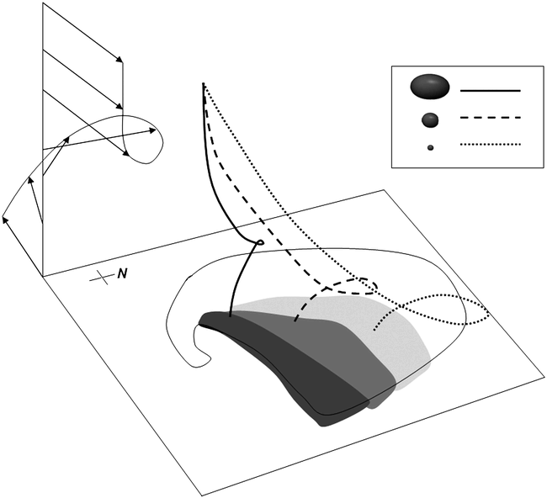
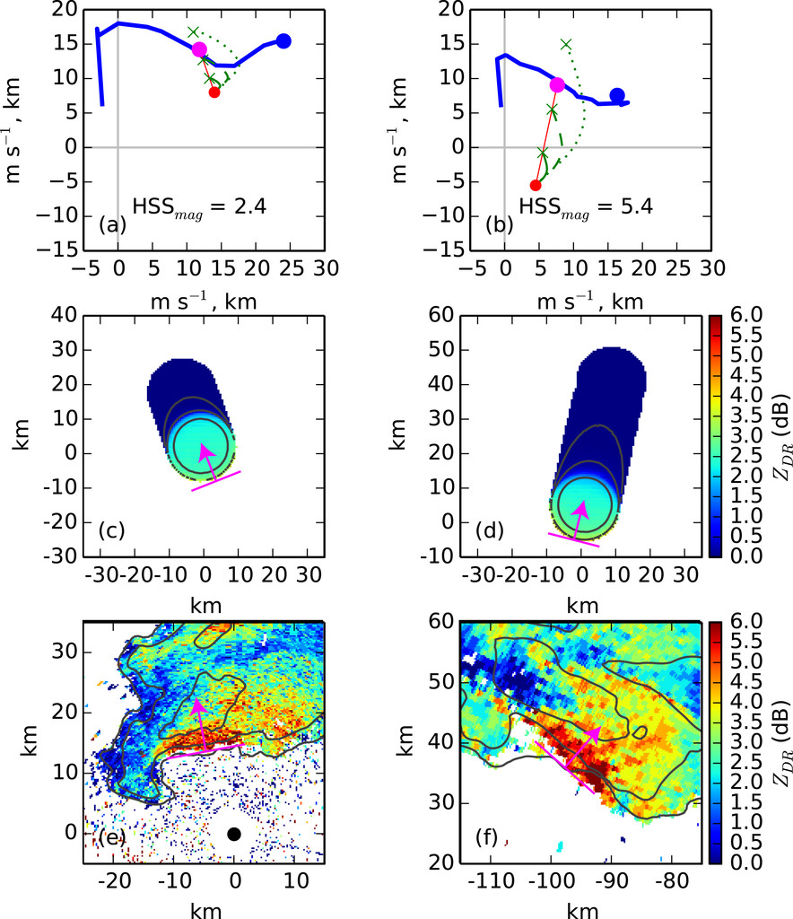
Motivation & Objectives
To understand the potential impacts on tornadogenesis within the line of near-surface thermodynamic changes in the inflow region of the QLCS associated with Leading Stratiform precipitation
To investigate the influence of size sorting from the storm-relative winds on DSD evolution between the radar level and the surface.
Kumjian and Ryzkhov, 2009.
What is size sorting, and why is it important?
Dawson et. al., 2015.
Hydrometeor size sorting results from varying fall speeds of different-sized particles, and it is a dominant process that contributes to DSD evolution.
Sedimentation rate differences can narrow particle size distribution by favoring specific sizes.
Size sorting tell us about the wind profile at lower levels and specifically information about the mean storm-relative winds and their direction. (Dawson et al., 2015; Kumjian & Ryzhkov, 2012).
Notes:
Our focus revolves around two key motivations and objectives that drive our research. Firstly, near-surface thermodynamic changes along the inflow region of the QLCS’ Leading Stratiform precipitation line. Our goal is to unravel how these changes might influence the formation of tornadoes within this system.
Our investigation extends further to explore the interplay between storm-relative winds and the evolution of Drop Size Distribution (DSD) between radar level and the surface. We're curious about the role storm-relative winds play in shaping the intricate dance of particle sizes within these storm systems, which will be the main focus of this talk.
Let's take a moment to appreciate the importance of size sorting. As you all know that this phenomenon emerges from the diverse fall speeds of particles of varying sizes. As sedimentation rates differ, so specific particle sizes become more concentrated, leading to the narrowing of the drop size distribution. Crucially, the persistence of this process is upheld by updrafts or storm-relative winds, often associated with wind shear, which is discussed in detail in Dawson et al. (2015) and Kumjian & Ryzhkov (2012).

Slide 4
Motivation & Objectives
To understand the potential impacts on tornadogenesis within the line of near-surface thermodynamic changes in the inflow region of the QLCS associated with Leading Stratiform precipitation
To investigate the influence of size sorting from the storm-relative winds on DSD evolution between the radar level and the surface.
Kumjian and Ryzkhov, 2009.
What is size sorting, and why is it important?
Dawson et. al., 2015.
Hydrometeor size sorting results from varying fall speeds of different-sized particles, and it is a dominant process that contributes to DSD evolution.
Sedimentation rate differences can narrow particle size distribution by favoring specific sizes.
Size sorting tell us about the wind profile at lower levels and specifically information about the mean storm-relative winds and their direction. (Dawson et al., 2015; Kumjian & Ryzhkov, 2012).
Notes:
But what does size sorting tell us exactly?
Size sorting provides insights into the wind profile at lower levels. It offers valuable information about the mean storm-relative winds and their direction. For instance, referencing the figure from Dawson et al., (2015), we observe how the ZDR gradient relates to the mean storm-relative direction within that specific layer.
Furthermore, the influence of low-level winds is not to be underestimated. Strong low-level winds in a shallow layer can significantly promote size sorting. This insight resonates with studies like Dawson et al. (2015), which highlight the correspondence between ZDR arc signatures and low-level scans. The unique location and shape of the ZDR arc offer valuable clues about wind profiles as shown in this schematic by Kumjian and Ryzkhov (2009).

Slide 5
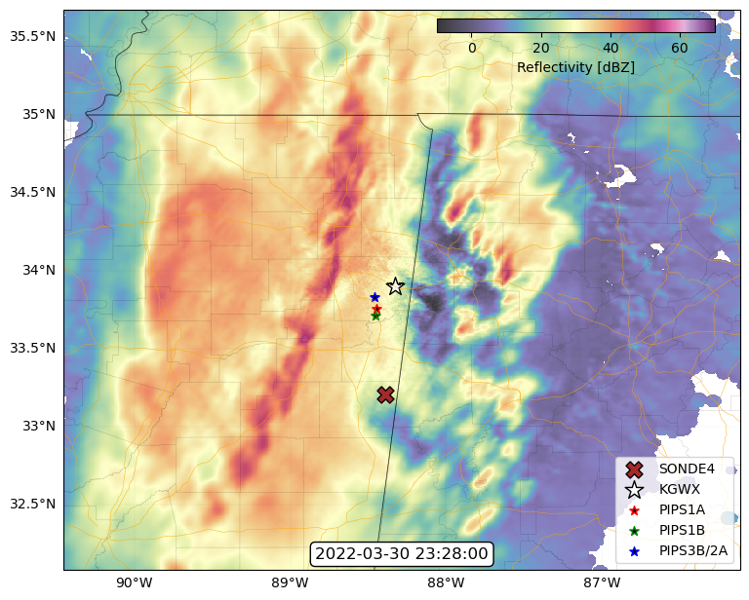
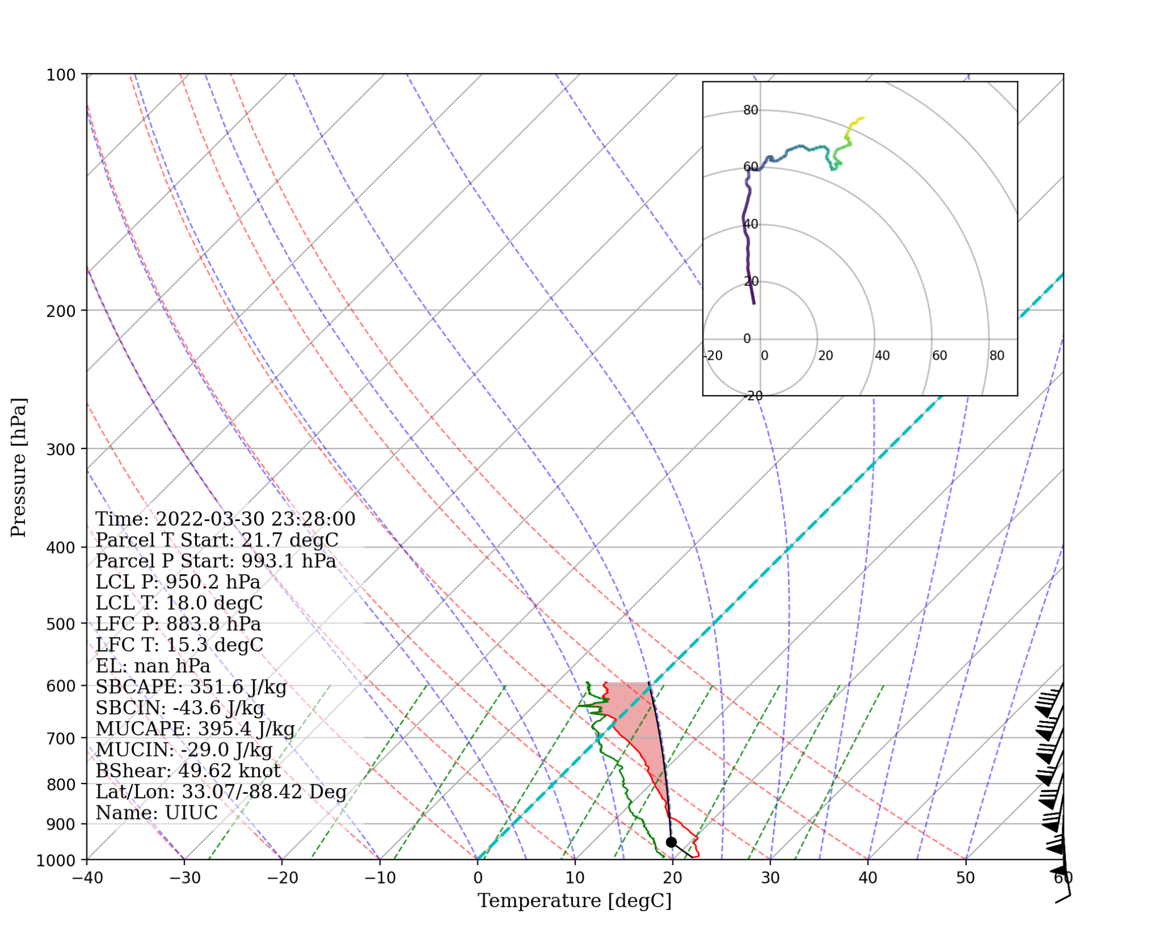
Data
Radar: KGWX
Purdue Portable In-situ precipitation stations (PIPS) (Dawson D., 2022)
Special nearby soundings launched by UIUC (Wurman, J., Kosiba, K. 2022)
23:28
Methodology
Investigated size sorting's impact on DSD evolution using raindrop trajectory model (Dawson et. al., 2015).
Used moments & constrained-gamma DSD model to initialize DSDs from lowest radar sweeps of Z and ZDR, see Zhang et al. (2001).
Utilized nearby PERiLS sounding for low-level wind profiles for initializing multiple trajectories for discrete drop-size bins.
Analytically solved trajectory surface endpoints to compare model DSDs with PIPS observations and quantify size sorting effect.
Notes:
In this process
We used KGWX radar data, which has been instrumental in capturing this event.
We also used Purdue PIPS data which offers a ground-level perspective of the DSD.
And then finally we utilized Nearby Special Sounding launched by UIUC that provided atmospheric profiles.

Slide 6
Data
Radar: KGWX
Purdue Portable In-situ precipitation stations (PIPS) (Dawson D., 2022)
Special nearby soundings launched by UIUC (Wurman, J., Kosiba, K. 2022)
23:28
Methodology
Investigated size sorting's impact on DSD evolution using raindrop trajectory model (Dawson et. al., 2015).
Used moments & constrained-gamma DSD model to initialize DSDs from lowest radar sweeps of Z and ZDR, see Zhang et al. (2001).
Utilized nearby PERiLS sounding for low-level wind profiles for initializing multiple trajectories for discrete drop-size bins.
Analytically solved trajectory surface endpoints to compare model DSDs with PIPS observations and quantify size sorting effect.
Notes:
Now coming to the methodology.
To observe the impact of size sorting on DSD evolution, we employed a simple raindrop trajectory model based on Dawson et al. (2015).
Initializing DSDs from the lowest radar sweeps of Z and ZDR, we adopted moments & constrained-gamma DSD model, following the methodology introduced by Zhang et al. (2001).
We used this nearby PERiLS sounding for low-level wind profiles, which formed the basis to initialize multiple trajectories across discrete drop-size bins.
We analytically solved these trajectory surface endpoints, that facilitated a direct comparison between sorting model DSDs and PIPS observations, and that is how this comparison enabled us to observe the effect of size sorting.

Slide 7
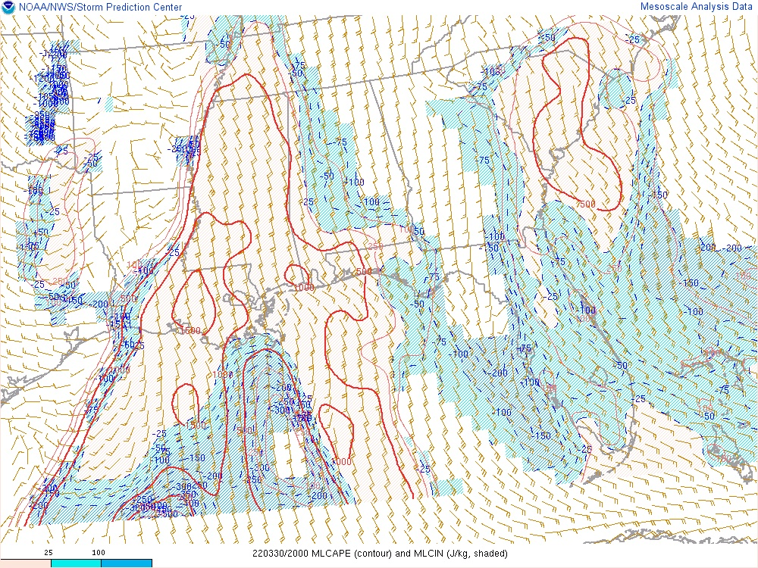
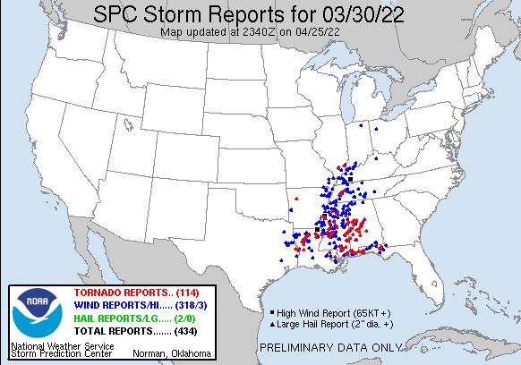
Environmental Conditions
114 Tornado reports with some EF0 to EF2.
High shear low cape. (Sherburn and Parker, 2014)
The shear vector in the (0-1) km layer varied from 20 to 60 knots.
100 mb MLCAPE figure suggests the presence of instability in the mixed layer.
Notes:
During this event, a total of 114 tornado reports were documented, encompassing confirmed tornadoes spanning EF0 to EF2 categories.
The atmospheric conditions prevailing at the time were characterized by high shear and low cape.
Also, by looking at this 100 mb MLCAPE, we can see that there was some instability already present in this region.

Slide 8
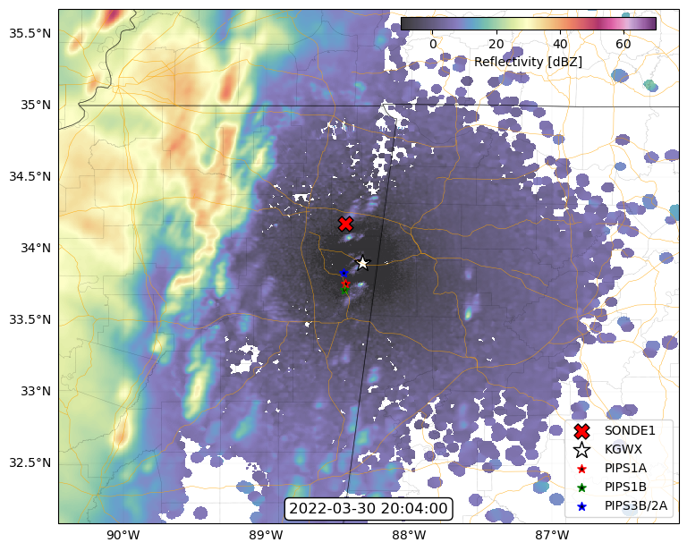
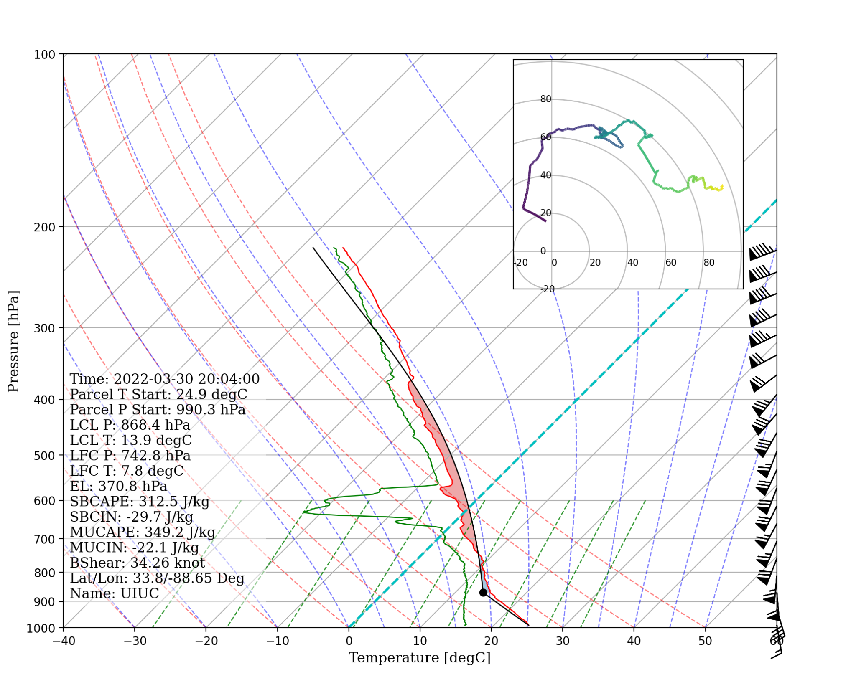
Mar 30, 2022, 20:04 UTC
0-1 km shear: ~34 knot
Notes:
Upon analyzing the environmental soundings further, several trends emerge. In the highlighted layer, we can see that there is moistening occurring as well as cooling. As we progress further, we notice a distinctive trend of moistening and cooling in said layer.
This is consistent as one can expect given the presence of leading stratiform precipitation within this region.
The changes in the local environment in this particular region can be attributed to two factors. First, there's the effect of diabatic cooling resulting from the evaporating rain. Additionally, it could be coming from dynamic lifting—both on a synoptic scale and on a meso-scale.
Also, if we look at this hodograph, we can see how strong 0-1 km layer shear was, like 30 to 60 knots.

Slide 9
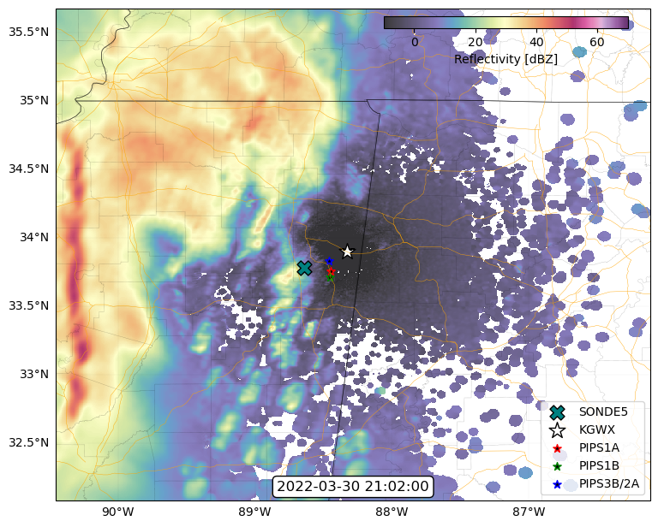
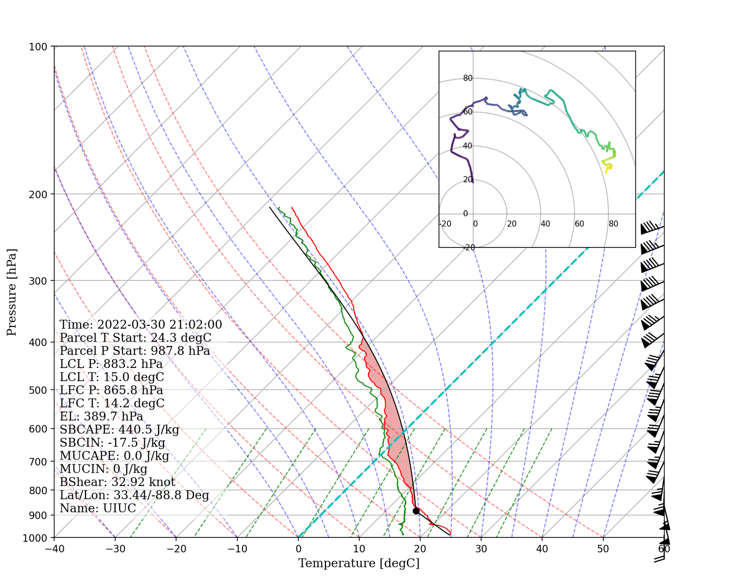
Mar 30, 2022, 21:02 UTC
0-1 km shear: ~33 knot
Notes:
Upon analyzing the environmental soundings further, several trends emerge. In the highlighted layer, we can see that there is moistening occurring as well as cooling. As we progress further, we notice a distinctive trend of moistening and cooling in said layer.
This is consistent as one can expect given the presence of leading stratiform precipitation within this region.
The changes in the local environment in this particular region can be attributed to two factors. First, there's the effect of diabatic cooling resulting from the evaporating rain. Additionally, it could be coming from dynamic lifting—both on a synoptic scale and on a meso-scale.
Also, if we look at this hodograph, we can see how strong 0-1 km layer shear was, like 30 to 60 knots.

Slide 10
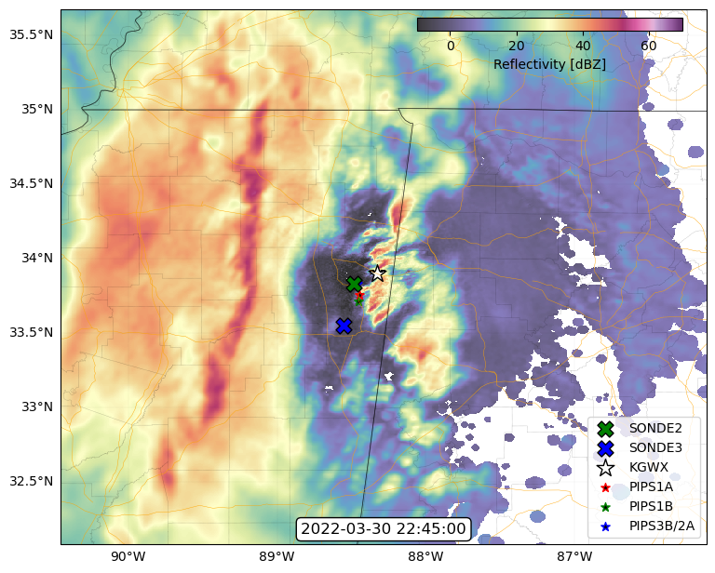
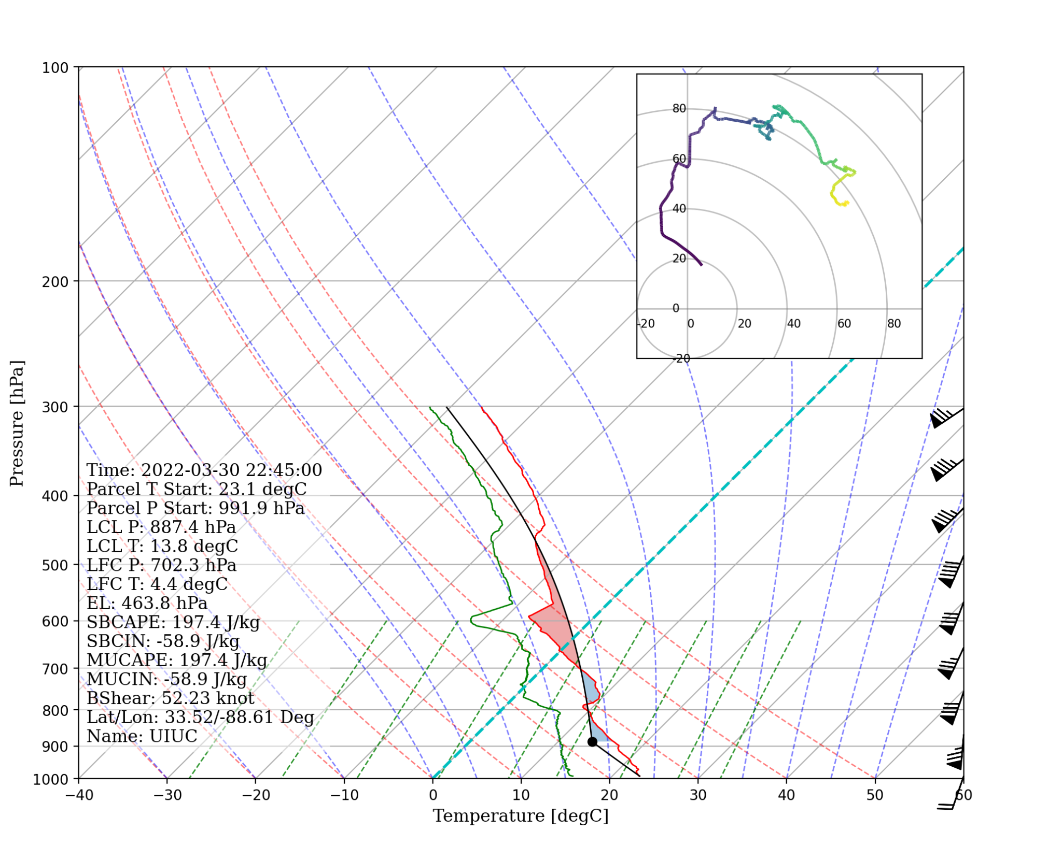
Mar 30, 2022, 22:45 UTC
0-1 km shear: ~52 knot
Notes:
Upon analyzing the environmental soundings further, several trends emerge. In the highlighted layer, we can see that there is moistening occurring as well as cooling. As we progress further, we notice a distinctive trend of moistening and cooling in said layer.
This is consistent as one can expect given the presence of leading stratiform precipitation within this region.
The changes in the local environment in this particular region can be attributed to two factors. First, there's the effect of diabatic cooling resulting from the evaporating rain. Additionally, it could be coming from dynamic lifting—both on a synoptic scale and on a meso-scale.
Also, if we look at this hodograph, we can see how strong 0-1 km layer shear was, like 30 to 60 knots.

Slide 11
Mar 30, 2022, 23:28 UTC
0-1 km shear: ~50 knot
Notes:
Upon analyzing the environmental soundings further, several trends emerge. In the highlighted layer, we can see that there is moistening occurring as well as cooling. As we progress further, we notice a distinctive trend of moistening and cooling in said layer.
This is consistent as one can expect given the presence of leading stratiform precipitation within this region.
The changes in the local environment in this particular region can be attributed to two factors. First, there's the effect of diabatic cooling resulting from the evaporating rain. Additionally, it could be coming from dynamic lifting—both on a synoptic scale and on a meso-scale.
Also, if we look at this hodograph, we can see how strong 0-1 km layer shear was, like 30 to 60 knots.

Slide 12
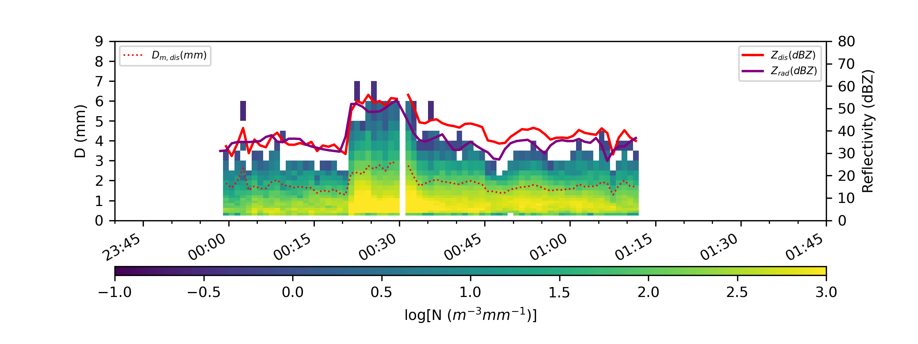
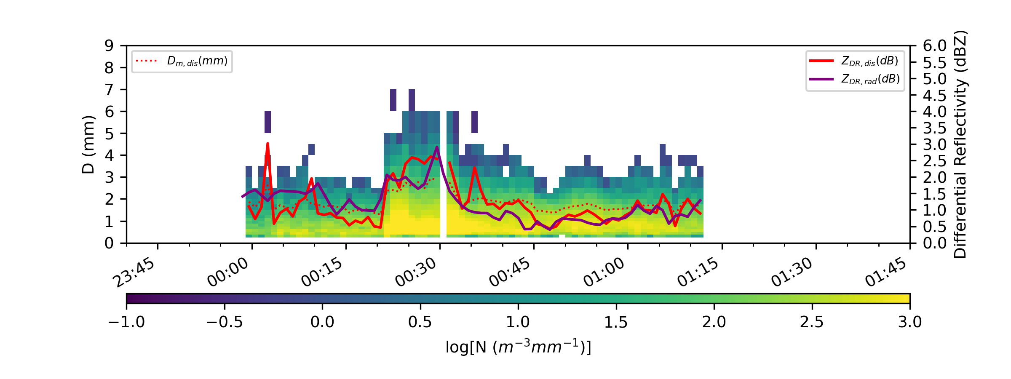
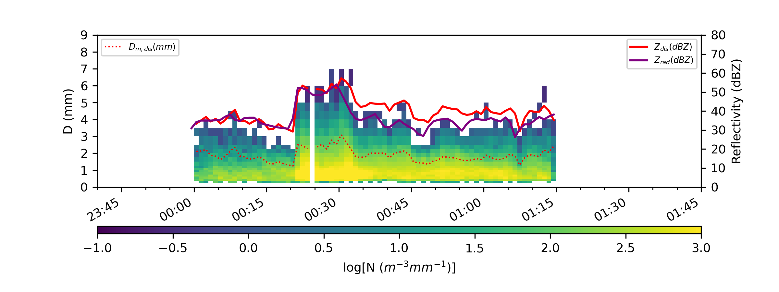
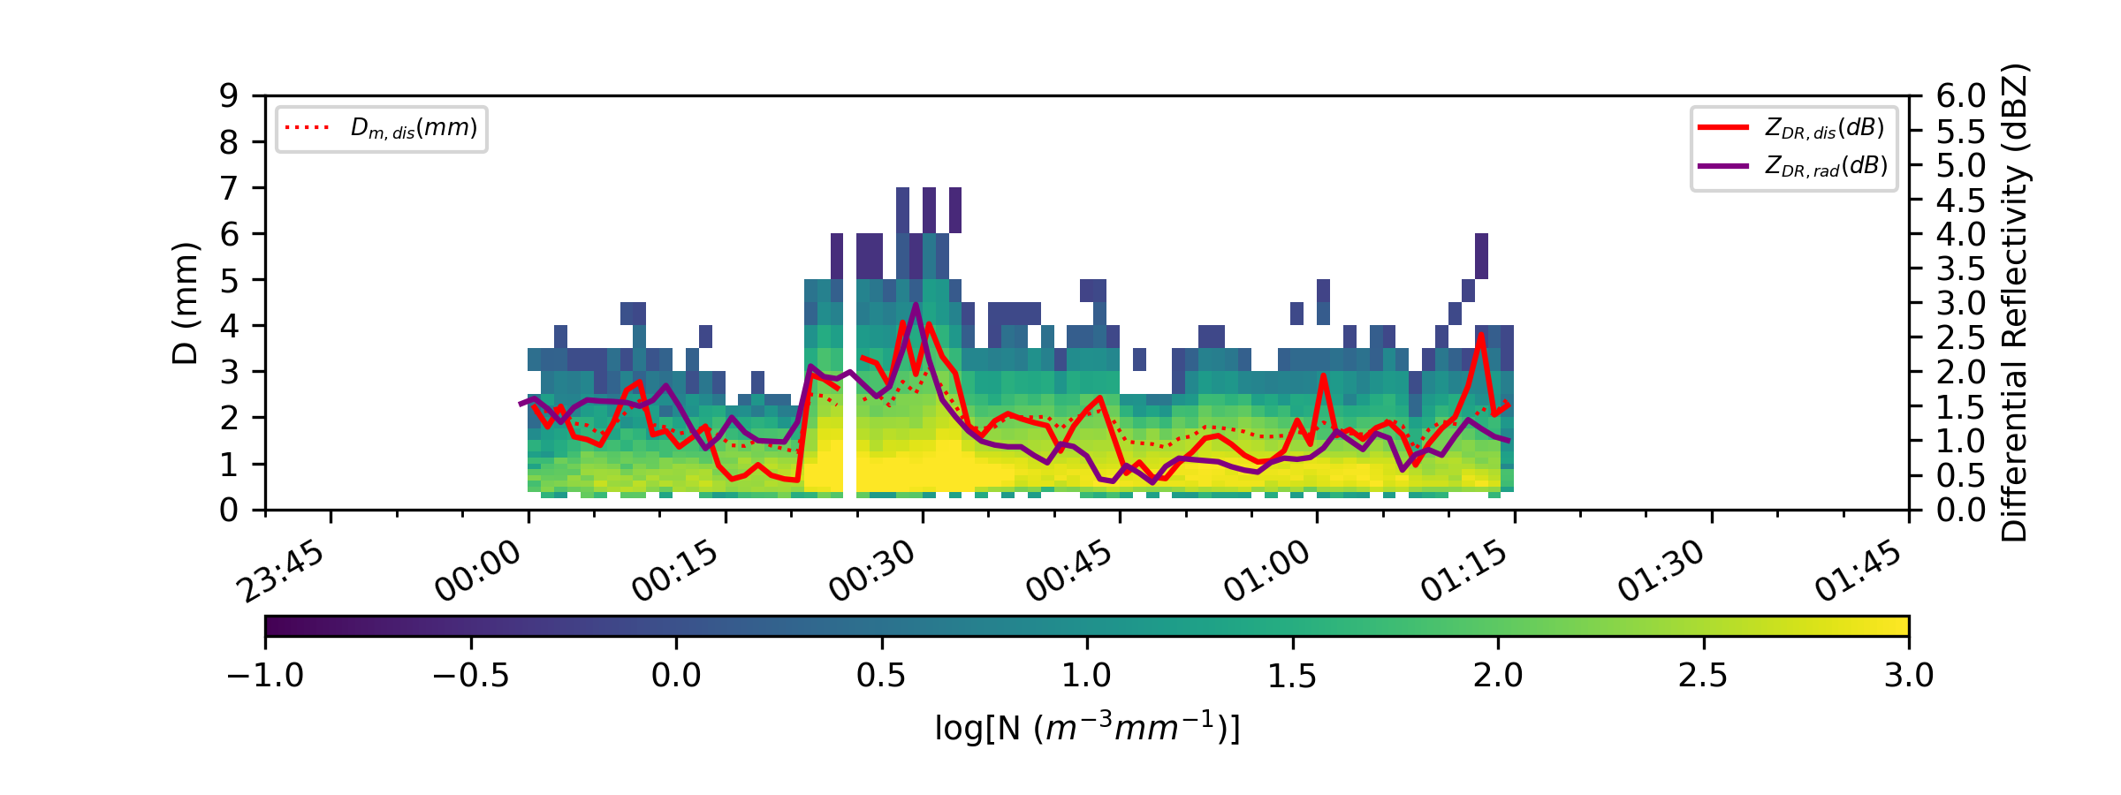
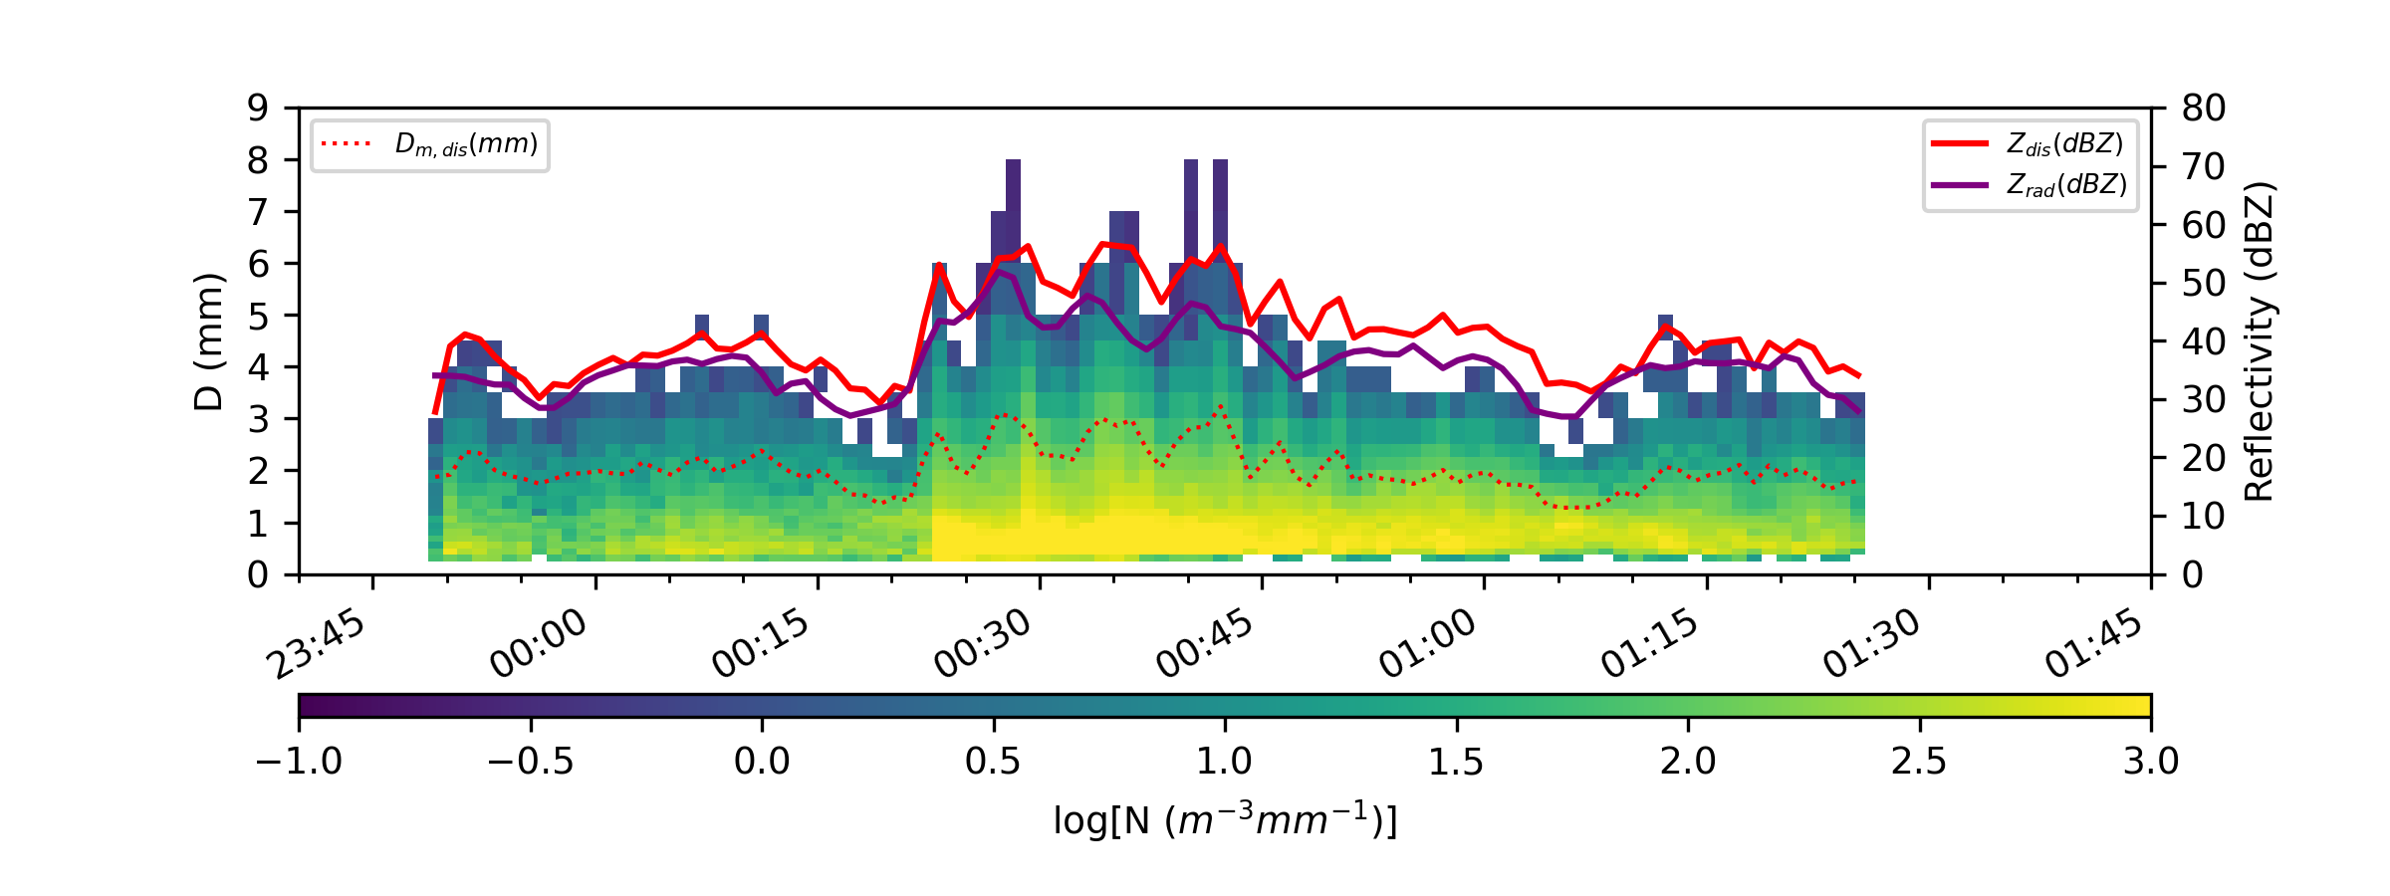
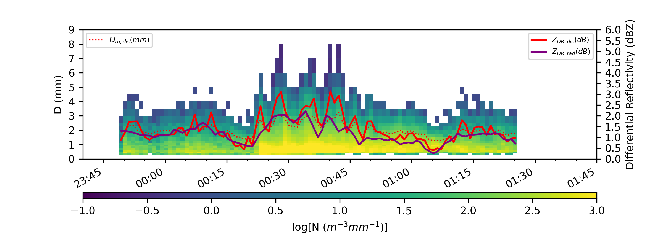
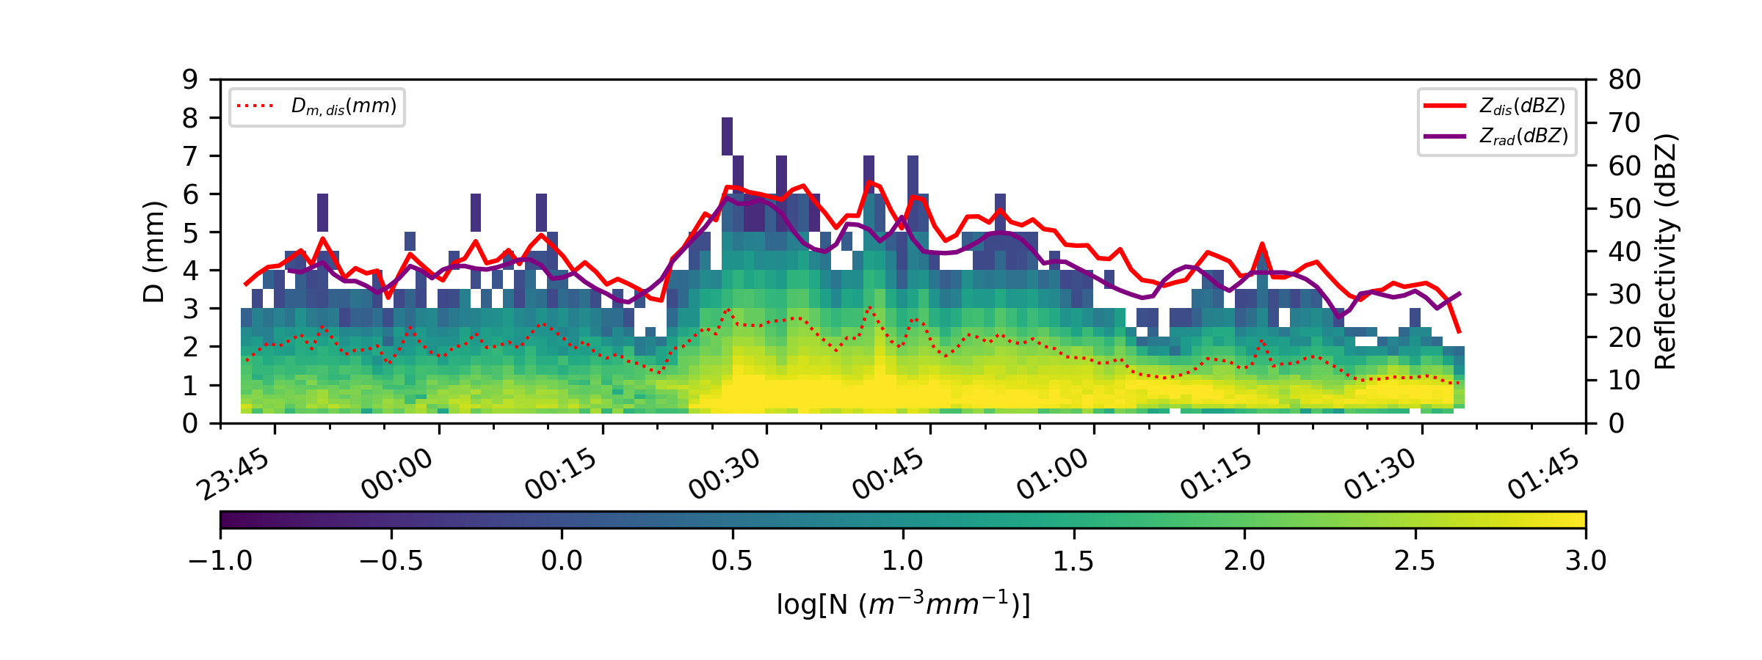
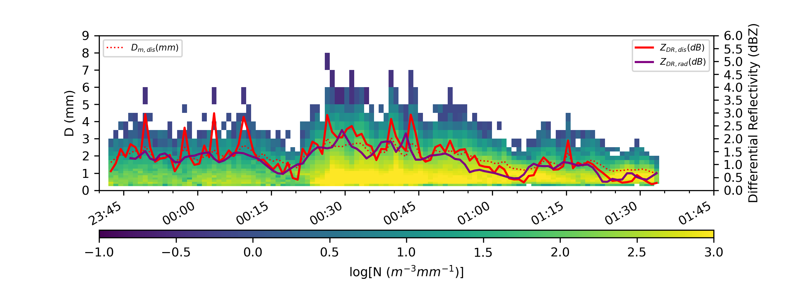
PIPS#1A
Meteograms
Reflectivity
Differential Reflectivity
PIPS#2A
PIPS#3B
PIPS#1B
Notes:
Now, Let's explore the meteograms. Solid purple line denotes radar obs, and the solid red denotes the PIPS obs, left side is reflectivity and from both radar, and PIPS along with DSDs, and similarly right side is the ZDR from radar and PIPS as represented with these solid lines, and also DSDs.
But before we dive in, I'd like to provide you with a quick overview of the deployment strategy for these PIPS.
These figures are arranged in a same way as pips were deployed.

Slide 13
PIPS1A
Meteograms
~2022-03-31 00:17:00 UTC
Reflectivity
Differential Reflectivity
PIPS2A
PIPS3B
PIPS1B
Notes:
For example, PIPS 2A and 3B were positioned at the northern end of the array.
PIPS1A and PIPS1B were deployed, with respective distances of 8 km and 13 km to the south of these collocated PIPS2A and 3B.
Also, notice that there is a drop in reflectivity just ahead of this leading stratiform precip shield near the KGWX radar site, it could be clearly seen here in these meteograms as well.
As the squall line or qlcs traversed the array, a notable event unfolded. An embedded EF1-scale tornado swept through, coming within approximately one kilometer north of the these colocated PIPS around zero zero twenty UTC (00:20 UTC).

Slide 14
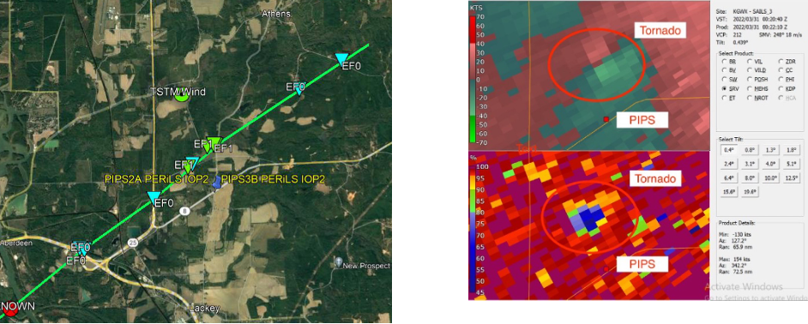
PIPS1A
Meteograms
Reflectivity
Differential Reflectivity
PIPS2A
PIPS3B
PIPS1B
Notes:
We could also see it with this debris signature in this RHOHV figure clearly, along with the surveyed path of the tornado's trajectory.

Slide 15
PIPS#1A
Meteograms
Reflectivity
Differential Reflectivity
PIPS#2A
PIPS#3B
PIPS#1B
Notes:
Now, coming back to the meteograms,
We could see a good agreement between radar retrieved DSD and, the PIPS observed DSDs at the surface.
If we want to dig further into it,

Slide 16
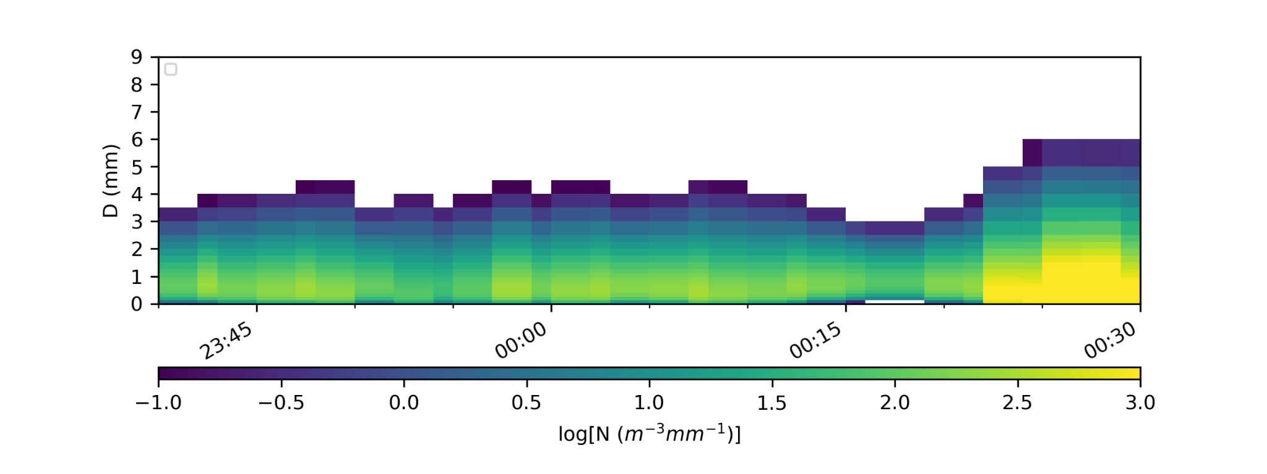
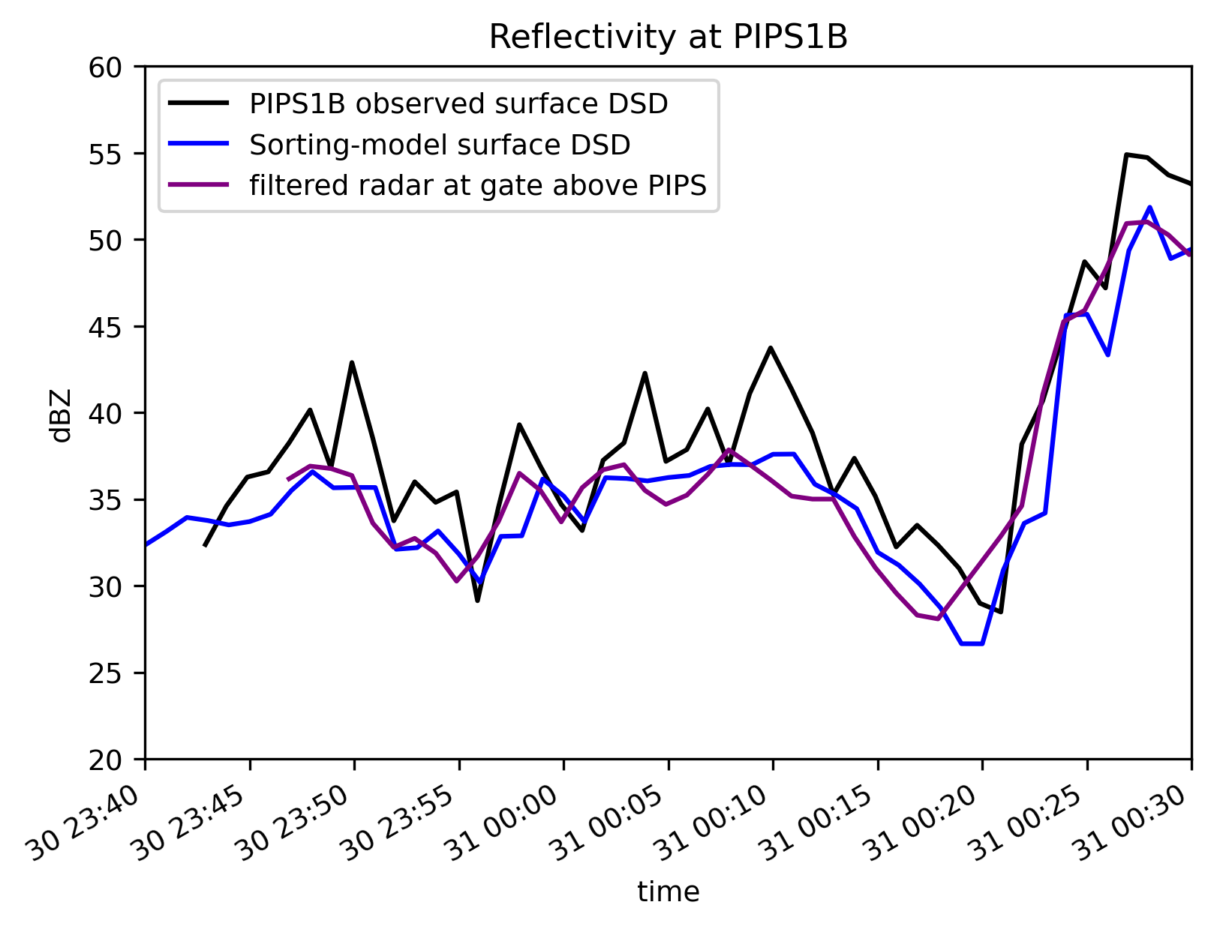
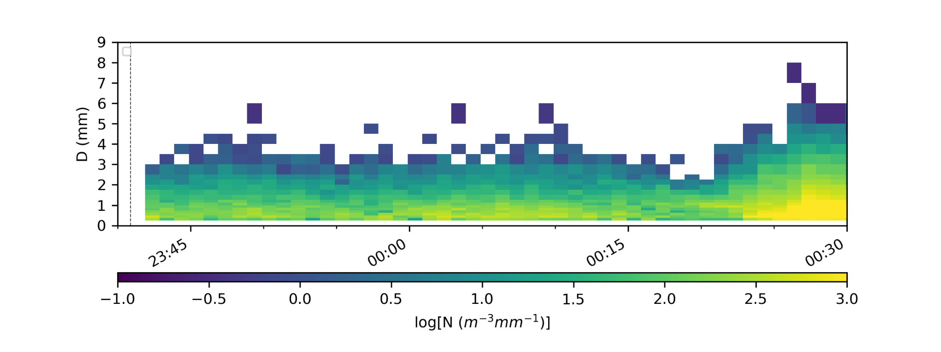
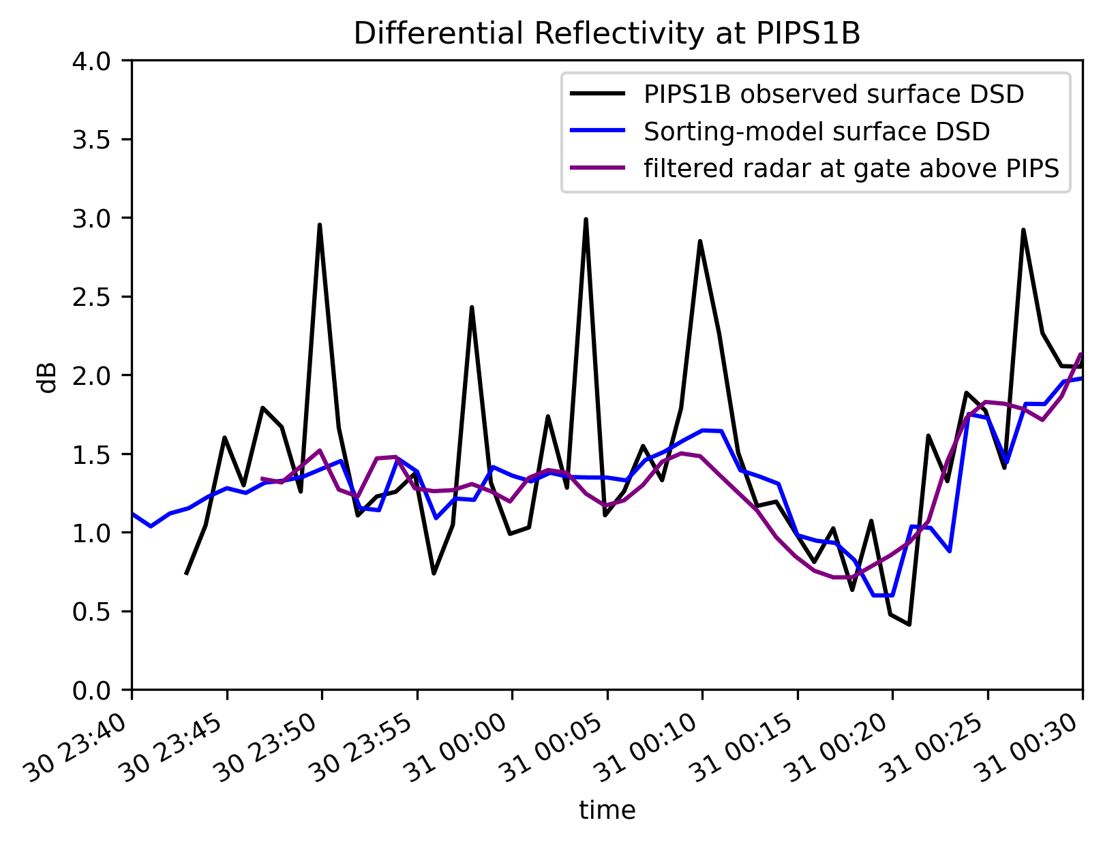
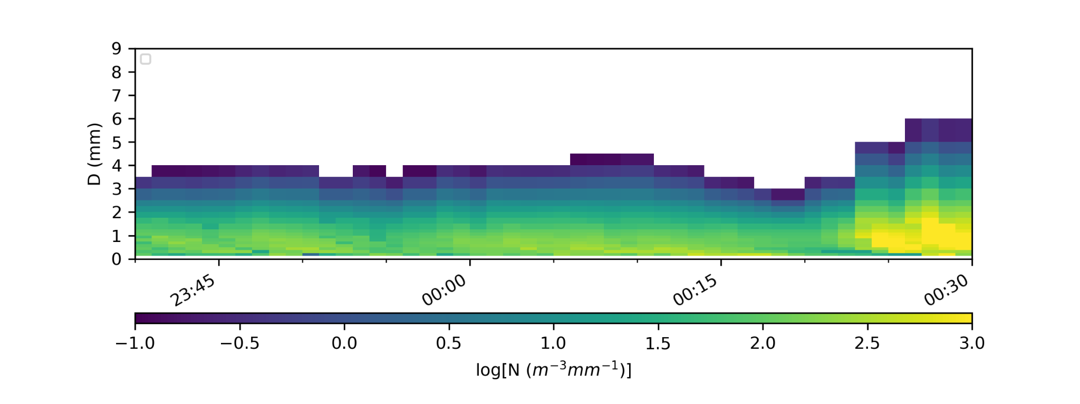
Radar retrieved DSD
PIPS1B observed DSD
Sorting model DSD
Notes:
We could just consider only the time till the leading stratiform precip hit the instruments, i.e. roughly one hour DSD, the first one is the Radar retrieved DSD using constrained gamma model, and some of these columns are constant and this effect is because of nearest neighbour interpolation.
Second one PIPS1B observed DSD at the surface, and third one is the sorting model generated DSD, again at the surface.
This is a very early stuff and we are still working on it, but it still gives us the hints about size sorting, through these light streaks, although its important to point out that the diagonal streaks are in fact not present in the radar retrieved DSD because that is the level where the trajectories are initiated, so no size-sorting effect yet. And we could see that just ahead of the approaching QLCS, how DSD varied, just before the tornado passed through, which is interesting.
Also, these two figures in the right, we are trying to see how well we can recover the Z and ZDR using sorting model, you see spikes in the PIPS ZDR, well we don’t know what it is, these may be due to sampling errors, or quality control issues although we are doing rain only QC, but the key takeaway here is that the overall behavior is quite matching.

Slide 17
Z
ZDR
Radar Level: Filtered lowest elevation
Surface)
Retrieved using sorting model
Notes:
Finally let’s take a look at these animations
The top ones show radar reflectivity and ZDR at radar level, while the bottom ones display sorting model-derived Z and ZDR at the surface.
Remember, these animations won't sync due to irregular radar obs and regular model data.
It shows that we have a close match between model and radar patterns, suggesting that our model for Z and ZDR is performing reasonably well.
This encourages us to proceed confidently with our analysis in the future.

Slide 18
Summary & Future Scope
Takeaways
Described the evolution of leading stratiform DSDs in the 30 March 2022 tornadic QLCS during PERiLS
Applied a simple drop trajectory model to investigate impact of size sorting below the radar level
Modeled surface DSDs agree reasonably well with disdrometer observations
Some evidence of size sorting in detailed evolution of small drop portion of the DSD (more work required)
Future work
Quality control methods for disdrometer data needs to be improved.
Improvement in retrieval techniques e.g., constrained gamma model
Improving the capabilities of the trajectory model (e.g. add evaporation)
Ultimate goal is to better understand the microphysical evolution and relation to low level thermodynamics and stability, and how does it affect tornadogenesis in QLCSs.
Notes:
Let's encapsulate the key takeaways from our investigation and glimpse into the path ahead for further analysis
So, We've traced the evolution of leading stratiform Droplet Size Distributions and development. and then our exploration ventured into applying a trajectory model to delve into the impact of size sorting.
The modeling of surface DSDs aligns with the observations derived from the disdrometer, demonstrating an encouraging level of agreement.
While progressing through the detailed evolution of the smaller segment of the DSD, intriguing hints of size sorting have emerged. However, it's important to underscore that this is a preliminary indication, and more comprehensive work lies ahead.

Slide 19
Summary & Future Scope
Takeaways
Described the evolution of leading stratiform DSDs in the 30 March 2022 tornadic QLCS during PERiLS
Applied a simple drop trajectory model to investigate impact of size sorting below the radar level
Modeled surface DSDs agree reasonably well with disdrometer observations
Some evidence of size sorting in detailed evolution of small drop portion of the DSD (more work required)
Future work
Quality control methods for disdrometer data needs to be improved.
Improvement in retrieval techniques e.g., constrained gamma model
Improving the capabilities of the trajectory model (e.g. add evaporation)
Ultimate goal is to better understand the microphysical evolution and relation to low level thermodynamics and stability, and how does it affect tornadogenesis in QLCSs.
Notes:
Our future work aims to significantly advance key areas. We'll enhance disdrometer data quality control for better analysis and refine retrieval techniques.
Our goal is to thoroughly comprehend microphysical evolution and its connection with low-level thermodynamics and stability, crucial for unraveling the link between microphysics and tornadogenesis in Quasi-Linear Convective Systems (QLCSs). And with that, I conclude this presentation.

Slide 20
References
Dawson, D., Biggerstaff, M., Waugh, S. 2022. PERiLS_2022: Portable In Situ Precipitation Stations (PIPS) Data. Version 0.1 [PRELIMINARY]. UCAR/NCAR - Earth Observing Laboratory. https://data.eol.ucar.edu/dataset/610.027.
Kumjian, M. R., and A. V. Ryzhkov, 2008: Polarimetric Signatures in Supercell Thunderstorms. J. Appl. Meteor. Climatol., 47, 1940–1961, https://doi.org/10.1175/2007JAMC1874.1.
Kumjian, M. R., & Ryzhkov, A. V. (2009). Storm-Relative Helicity Revealed from Polarimetric Radar Measurements. Journal of the Atmospheric Sciences, 66(3), 667–685. https://doi.org/10.1175/2008JAS2815.1
Sherburn, K. D., and M. D. Parker, 2014: Climatology and Ingredients of Significant Severe Convection in High-Shear, Low-CAPE Environments. Wea. Forecasting, 29, 854–877, https://doi.org/10.1175/WAF-D-13-00041.1.
Wurman, J., Kosiba, K. 2022. PERiLS_2022: UI FARM Sounding data. Version 1.0. UCAR/NCAR - Earth Observing Laboratory. https://data.eol.ucar.edu/dataset/610.023.
Zhang, G., Vivekanandan, J., Brandes, E., (2001). A Method for Estimating Rain Rate and Drop Size Distribution from Polarimetric Radar Measurements. IEEE Transactions on Geoscience and Remote Sensing, 39(4), 830–841.

