Slide 1
The Prairie Point, MS, Tornado of PERiLS 2022 IOP 2: Intercomparison of Radar and Damage Observations Placed in the Context of Outstanding Questions Surrounding QLCS Tornadoes
Anthony W. Lyza^{1,2}, Melissa A. Wagner^{1,2}, Michael C. Coniglio^{2,3}, Erik Rasmussen², Anthony E. Reinhart², and A. Addison Alford²
¹Cooperative Institute for Severe and High Impact Weather Research and Operations, University of Oklahoma, Norman, OK
²NOAA/OAR National Severe Storms Laboratory, Norman, OK
³School of Meteorology, University of Oklahoma, Norman, OK
PERiLS Science Meeting
Memphis, TN
16 November 2023

Slide 2
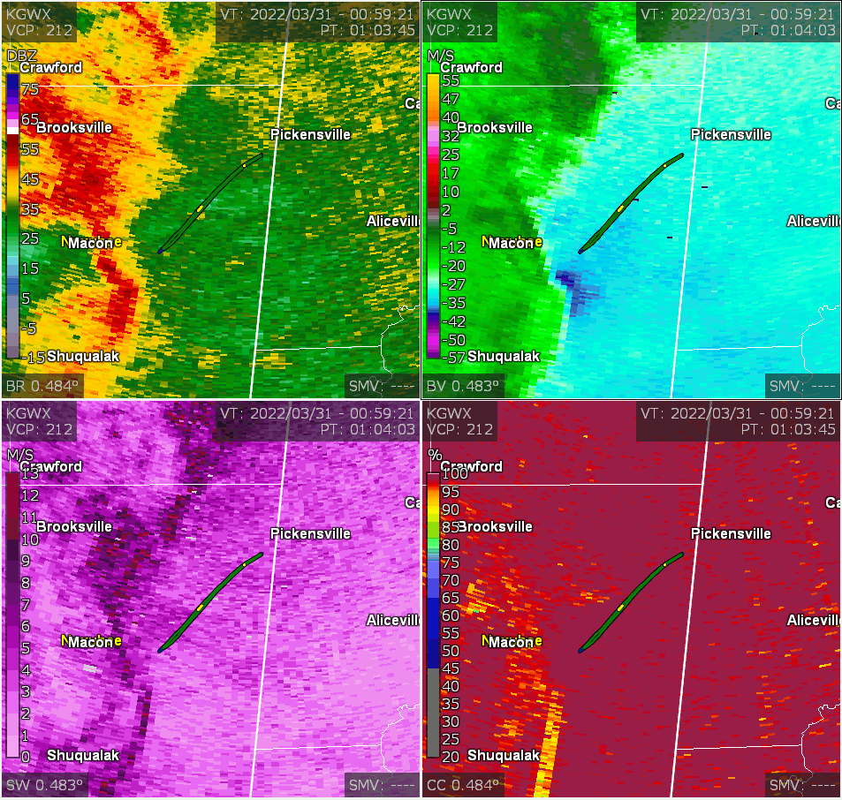
30 March 2022, Prairie Point, MS
Occurred during IOP 2 of the 2022 PERiLS campaign near the community of Prairie Point in Noxubee County in east-central MS

Slide 3
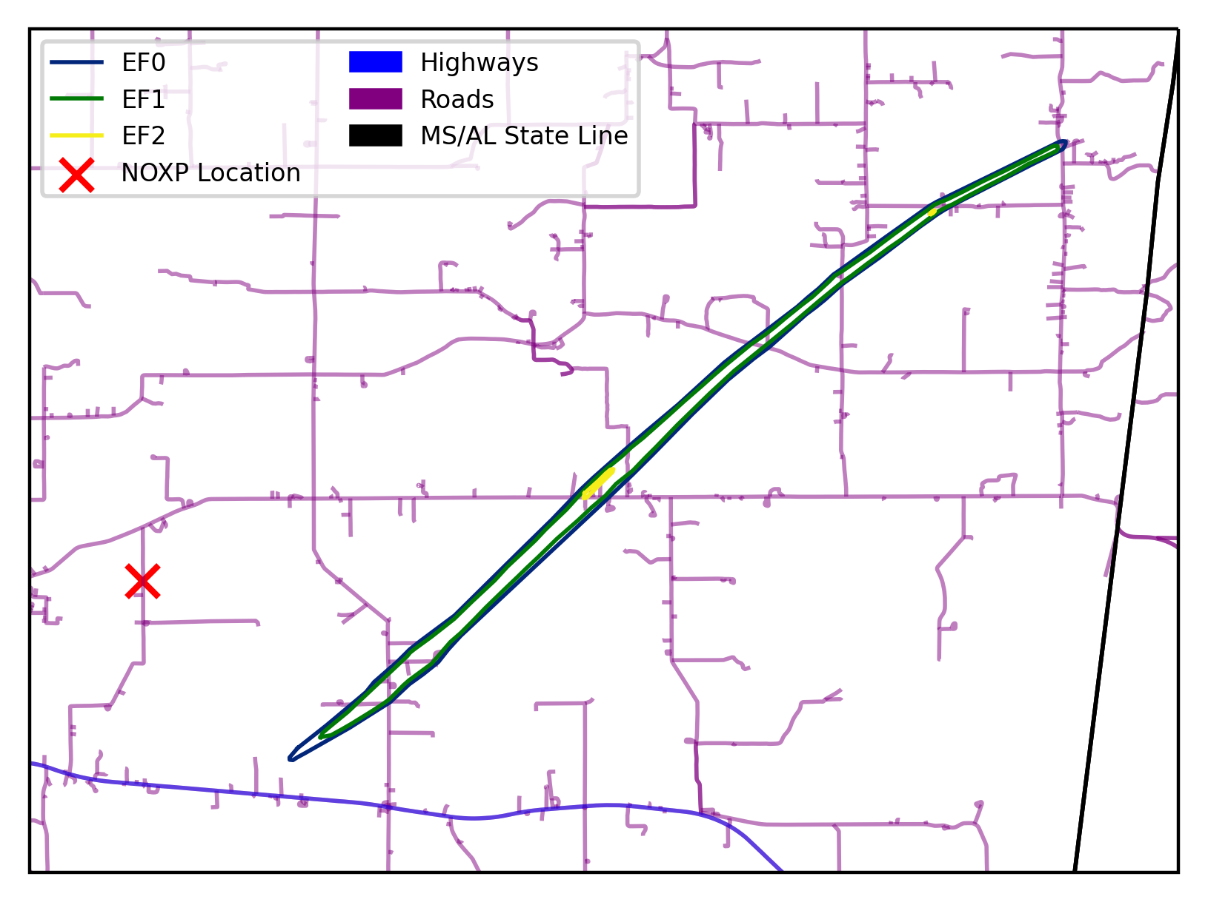
30 March 2022, Prairie Point, MS
Occurred during IOP 2 of the 2022 PERiLS campaign near the community of Prairie Point in Noxubee County in east-central MS
Path length of 17.7 km (11.0 mi), maximum path width of 370 m (400 yd)
Maximum damage intensity: EF2
N
5 km

Slide 4
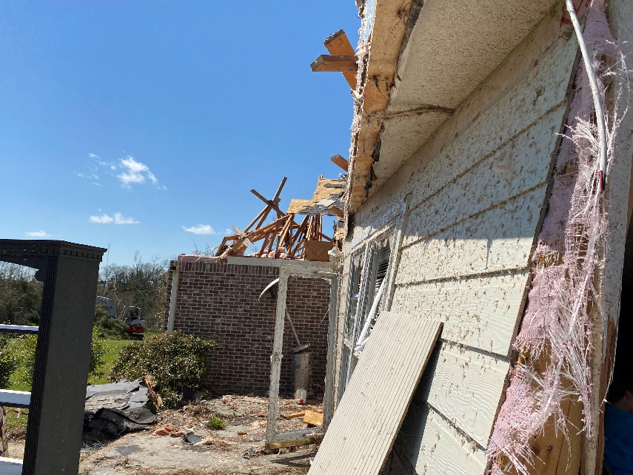
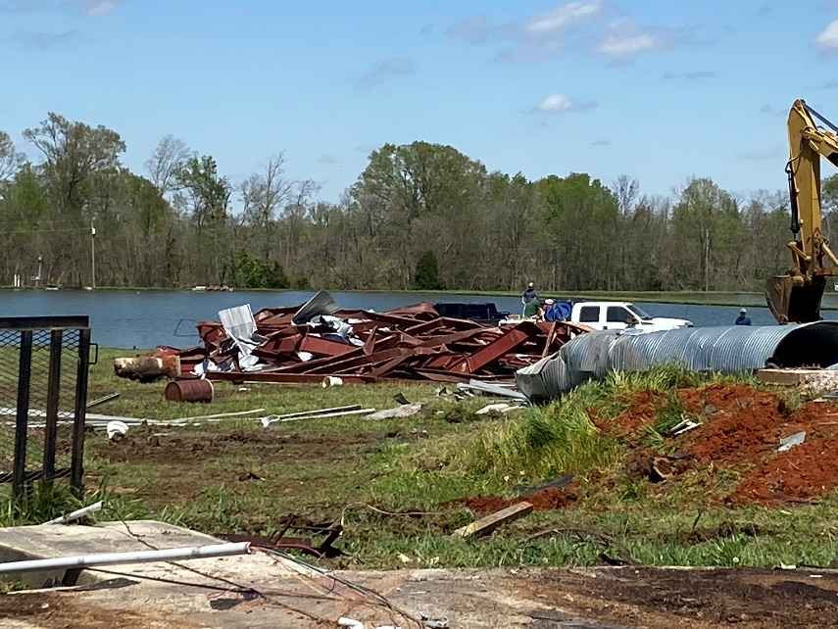
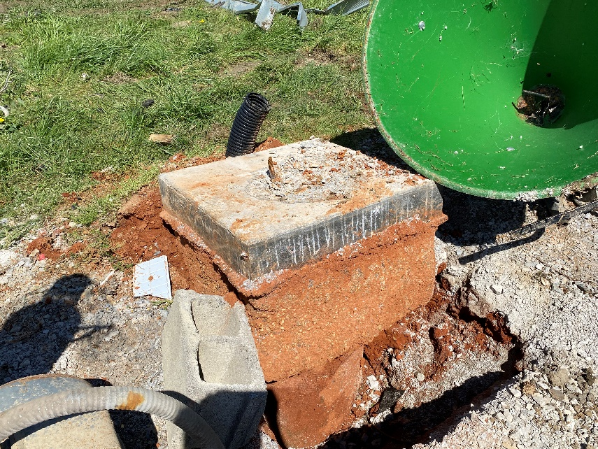
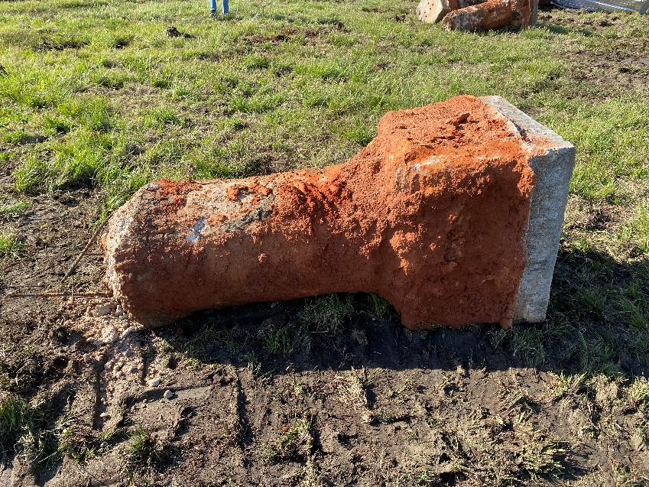
30 March 2022, Prairie Point, MS
Occurred during IOP 2 of the 2022 PERiLS campaign near the community of Prairie Point in Noxubee County in east-central MS
Path length of 17.7 km (11.0 mi), maximum path width of 370 m (400 yd)
Maximum damage intensity: EF2
Estimated 3-s wind gust: 60.4 m s⁻¹ (135 mph)
Formed 4.3 km southeast of the NOAA X-Pol (NOXP) radar site

Slide 5
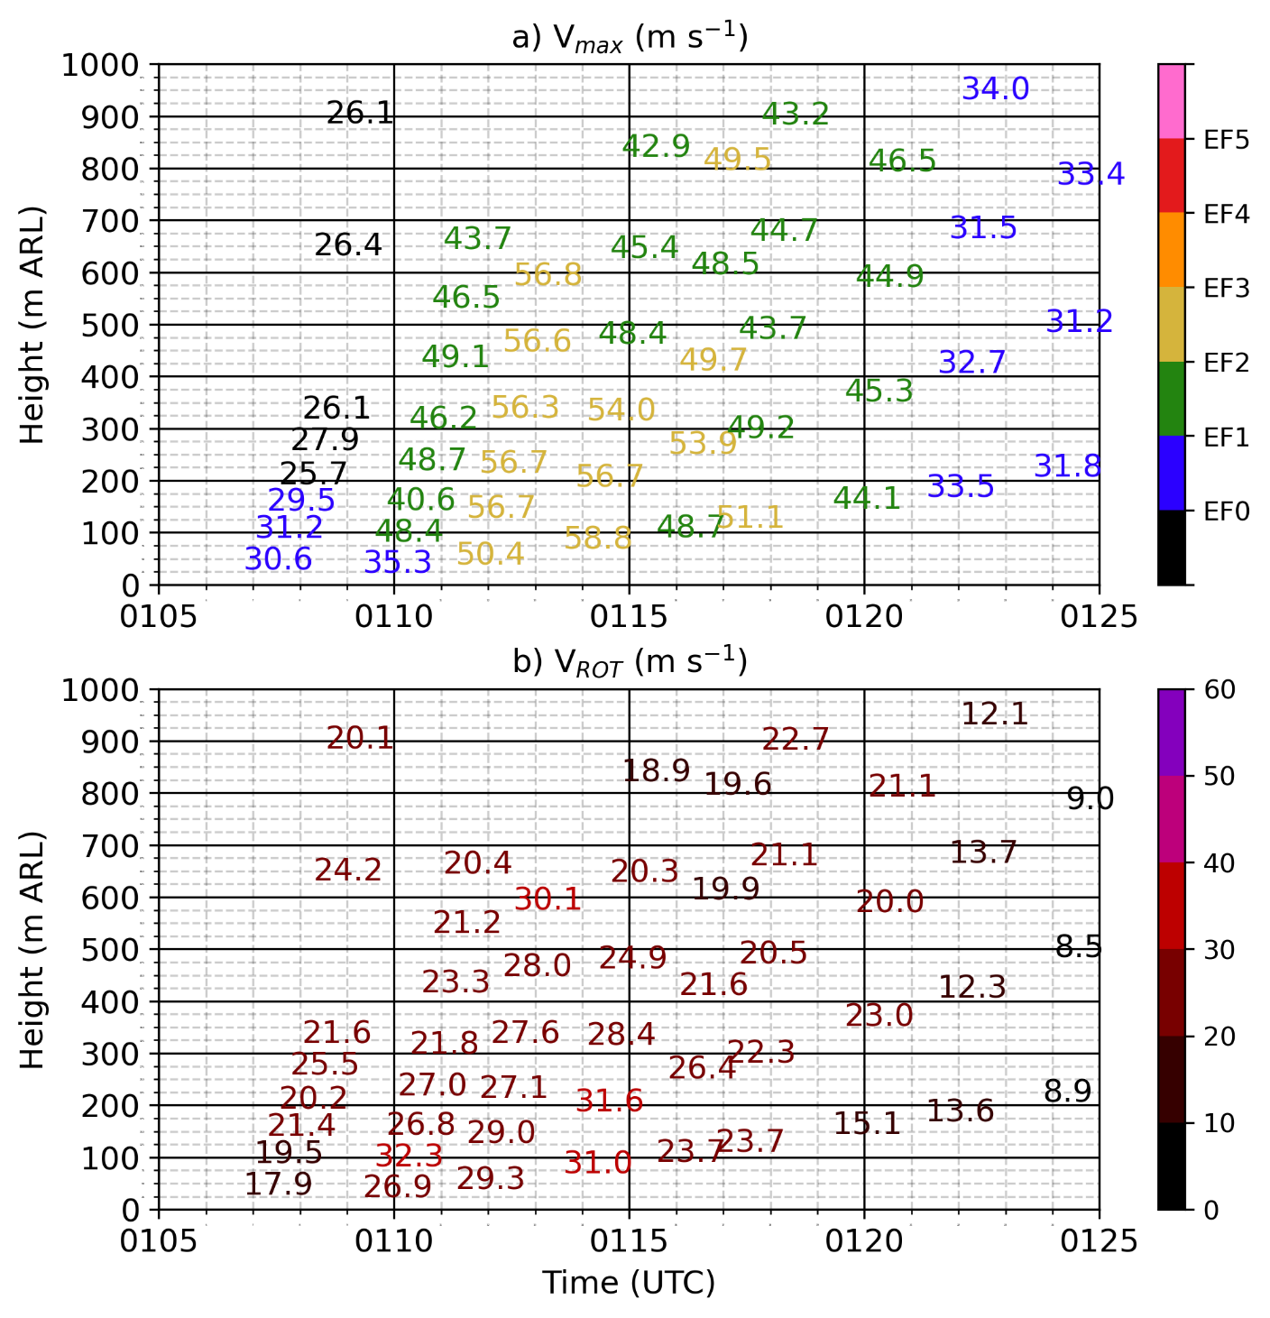
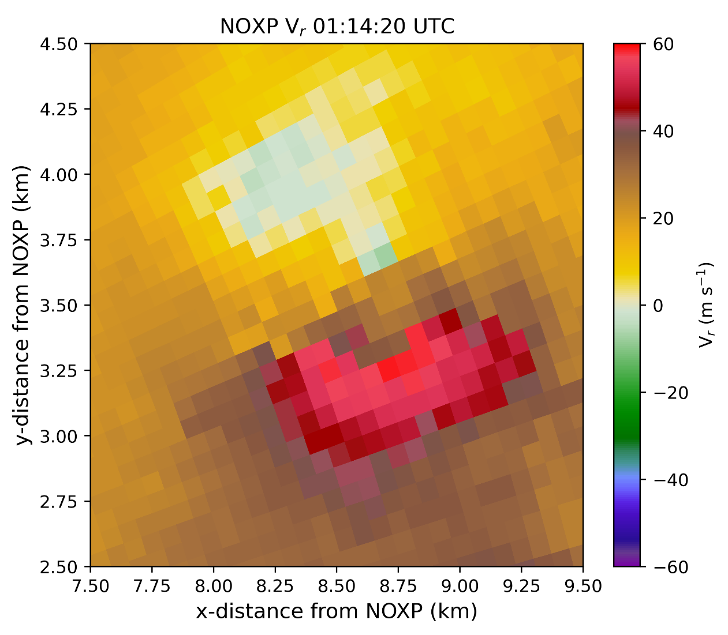
30 March 2022 – NOXP V_{r} Characteristics
58.8 m s⁻¹ (131 mph) at 85 m ARL

Slide 6
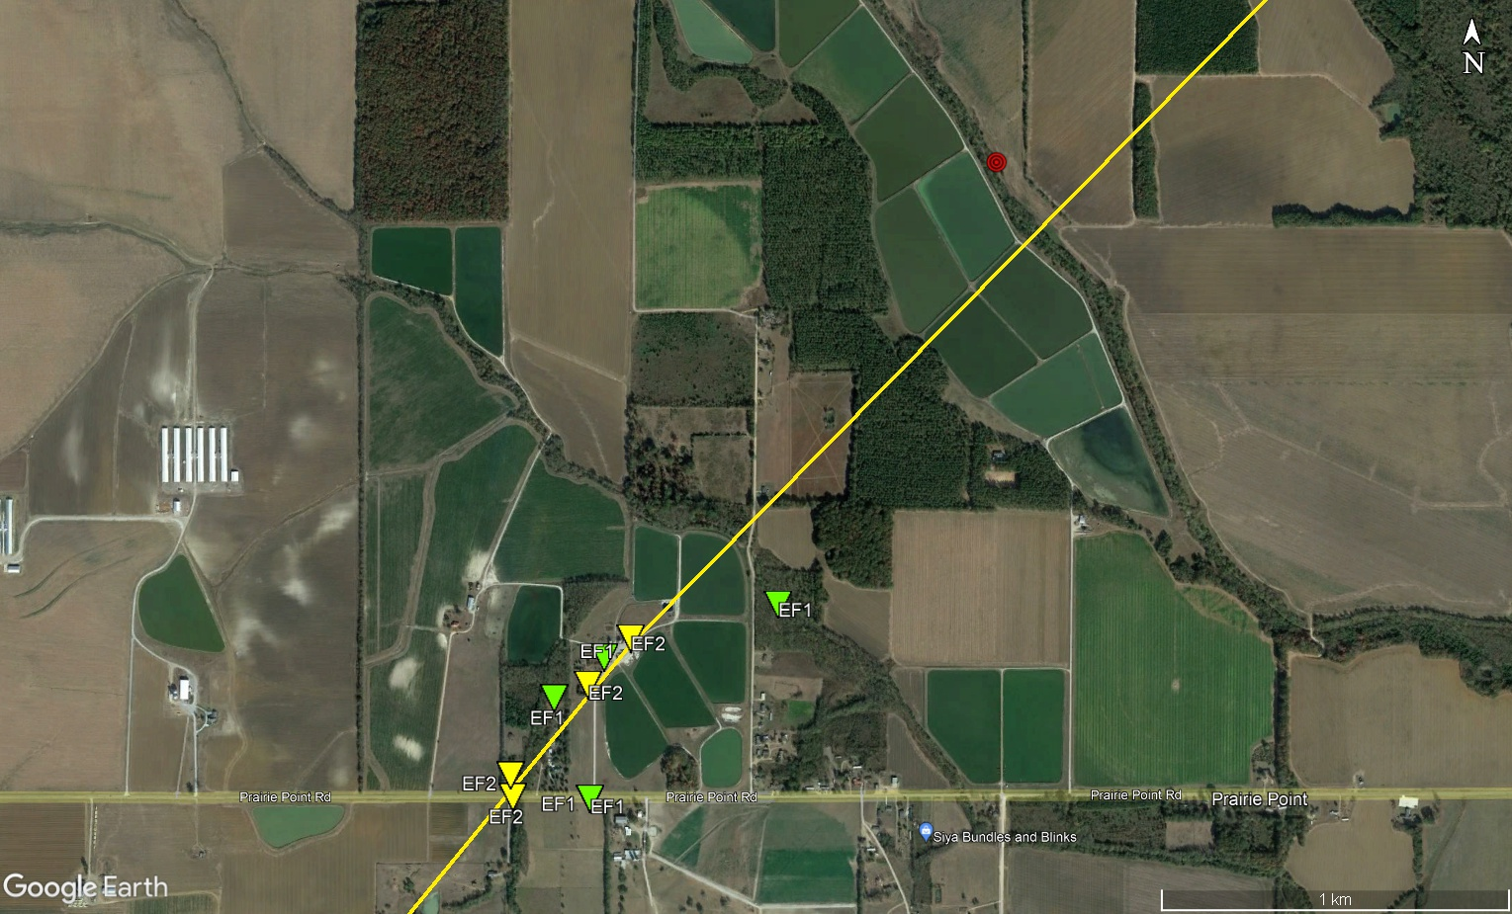
30 March 2022 – NOXP V_{r} Characteristics
Max intensity couplet location
1.7 km
58.8 m s⁻¹ (131 mph) at 85 m ARL
Max damage intensity location
(est. 60.4 m s⁻¹/135 mph)

Slide 7
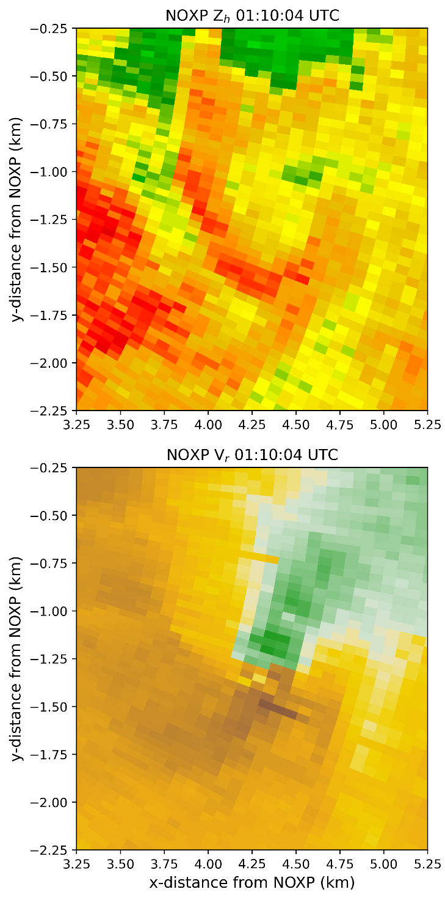
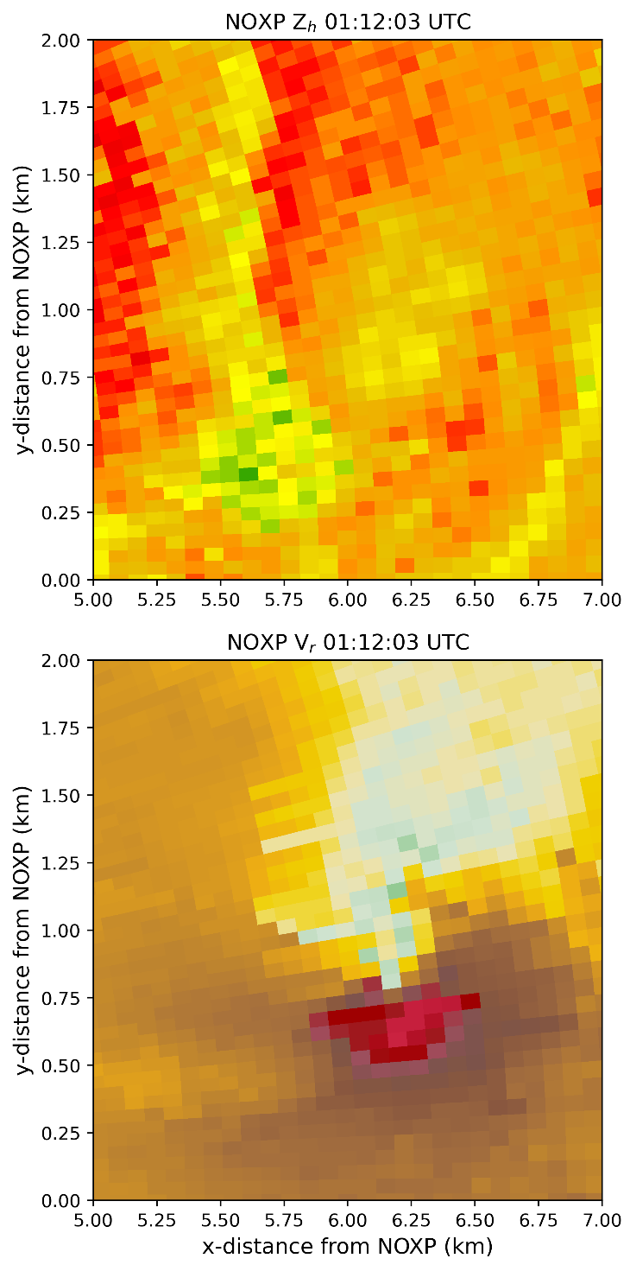
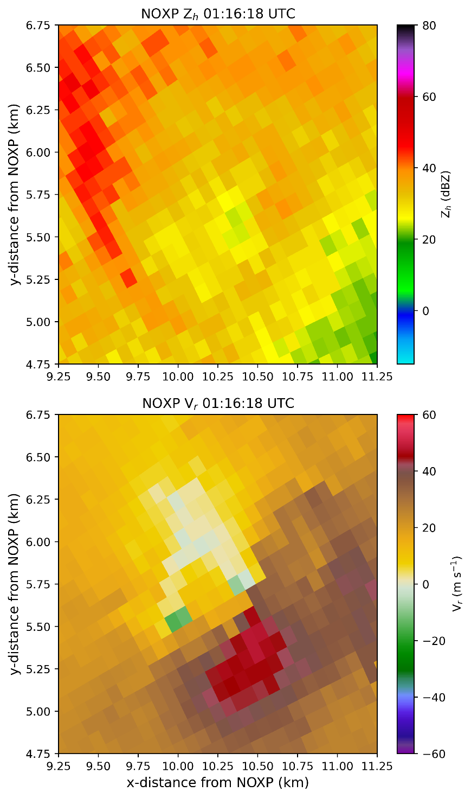
30 March 2022 – NOXP 0.5° V_{r} Characteristics

Slide 8
30 March 2022 – NOXP 0.5° V_{r} Characteristics
Figure credit: Melissa Wagner, CIWRO/NSSL

Slide 9
30 March 2022 – NOXP 0.5° V_{r} Characteristics
Figure credit: Melissa Wagner, CIWRO/NSSL

Slide 10
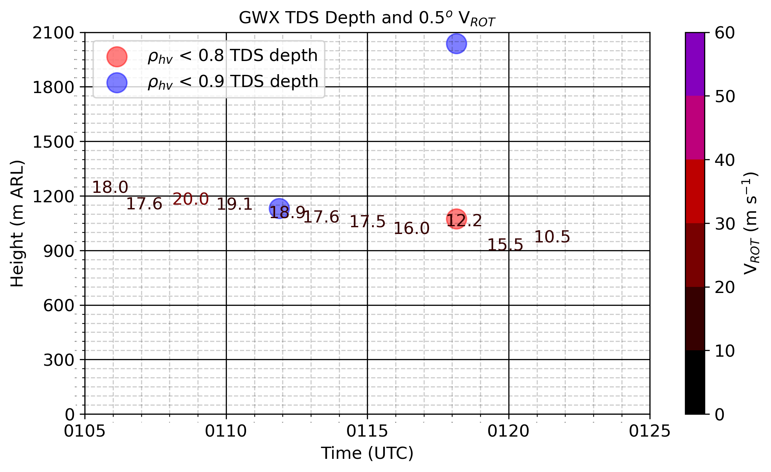
30 March 2022 – GWX Radar Observations

Slide 11
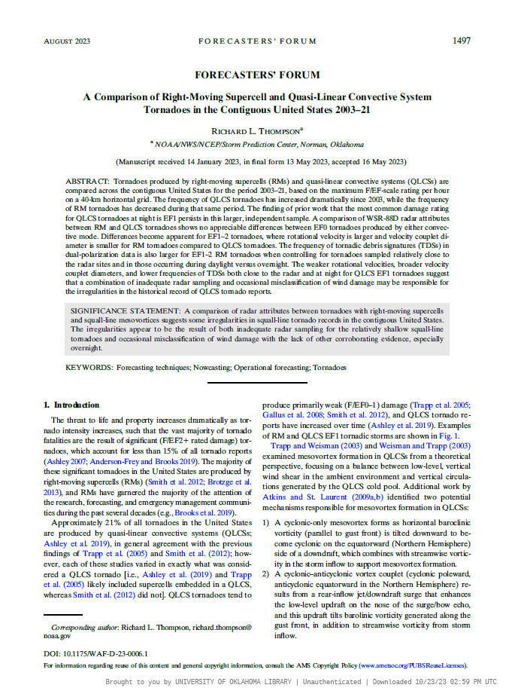
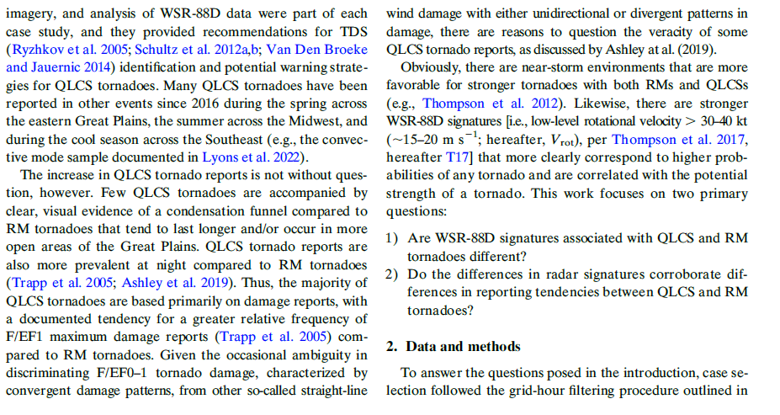
30 March 2022 – Comparison to Thompson (2023)
Thompson (2023, WAF)

Slide 12
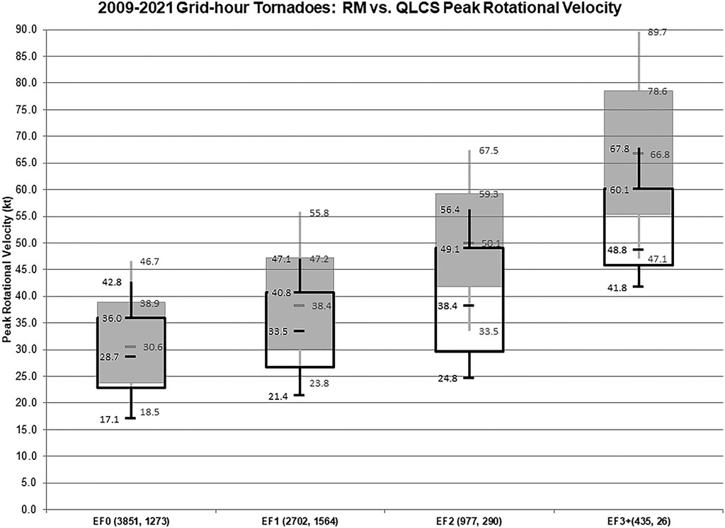
30 March 2022 – Comparison to Thompson (2023)
Supercell: gray
QLCS: outline
X
Prairie Point
Fig. 6 from Thompson (2023)

Slide 13
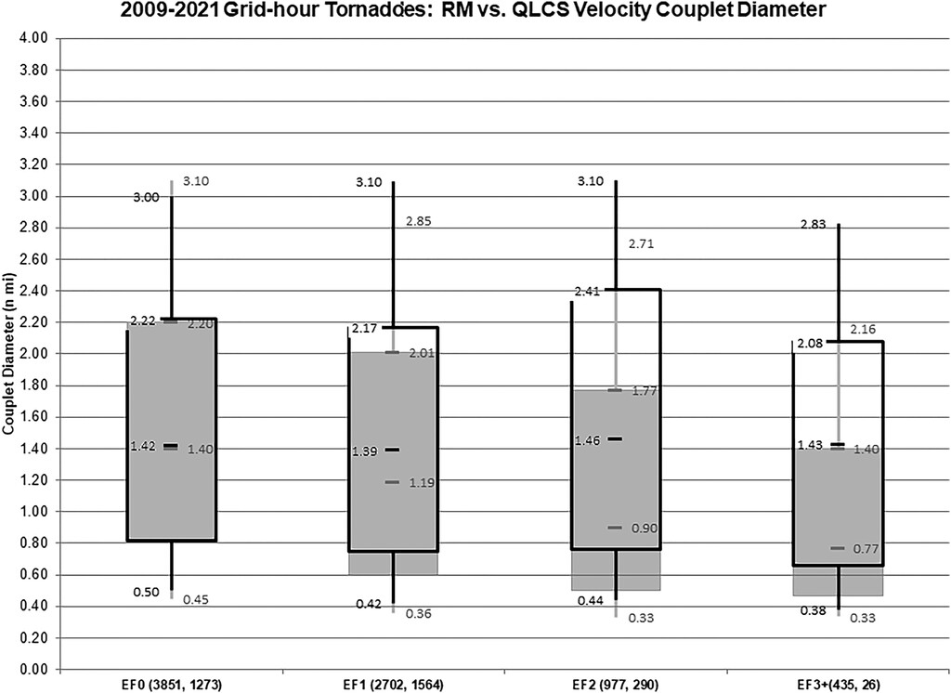
30 March 2022 – Comparison to Thompson (2023)
Supercell: gray
QLCS: outline
Prairie Point
X
Fig. 7 from Thompson (2023)

Slide 14
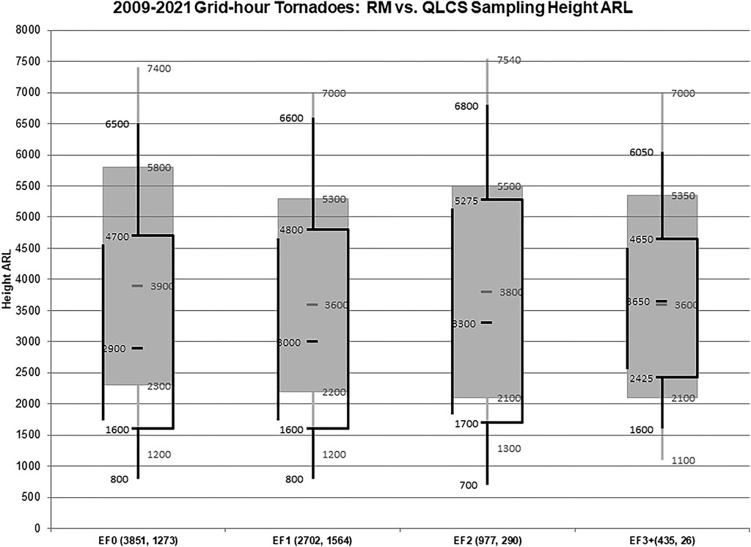
30 March 2022 – Comparison to Thompson (2023)
Supercell: gray
QLCS: outline
Prairie Point
X
Fig. 8 from Thompson (2023)

Slide 15
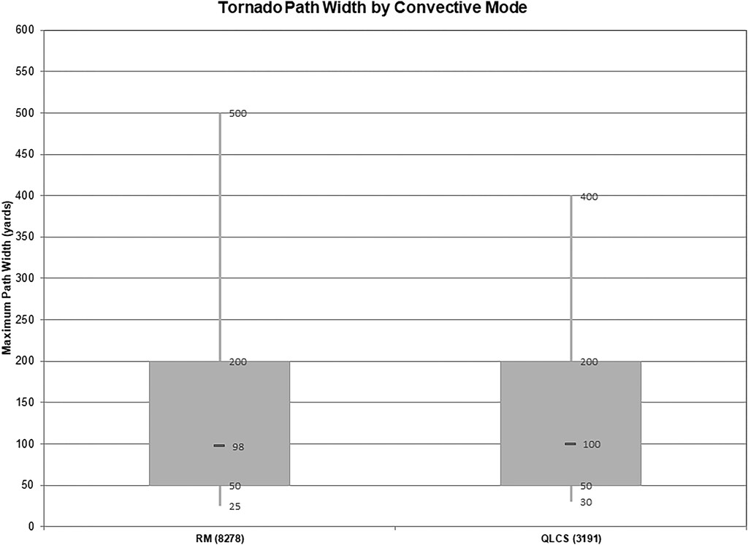
30 March 2022 – Comparison to Thompson (2023)
Prairie Point
X
Fig. 5 from Thompson (2023)

Slide 16
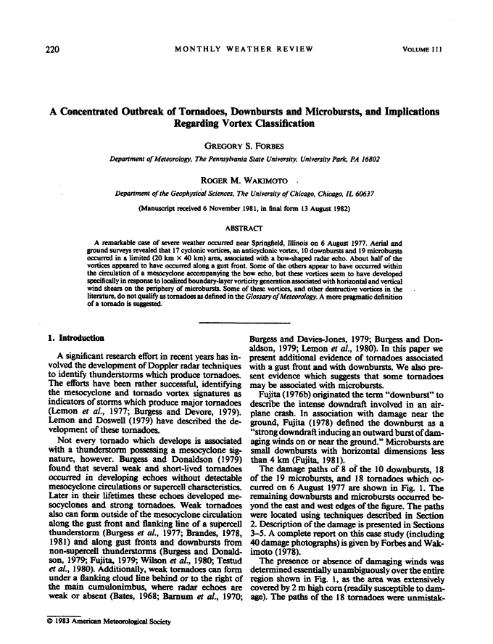
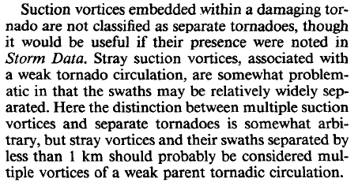
30 March 2022 – Comparison to Forbes and Wakimoto (1983)

Slide 17
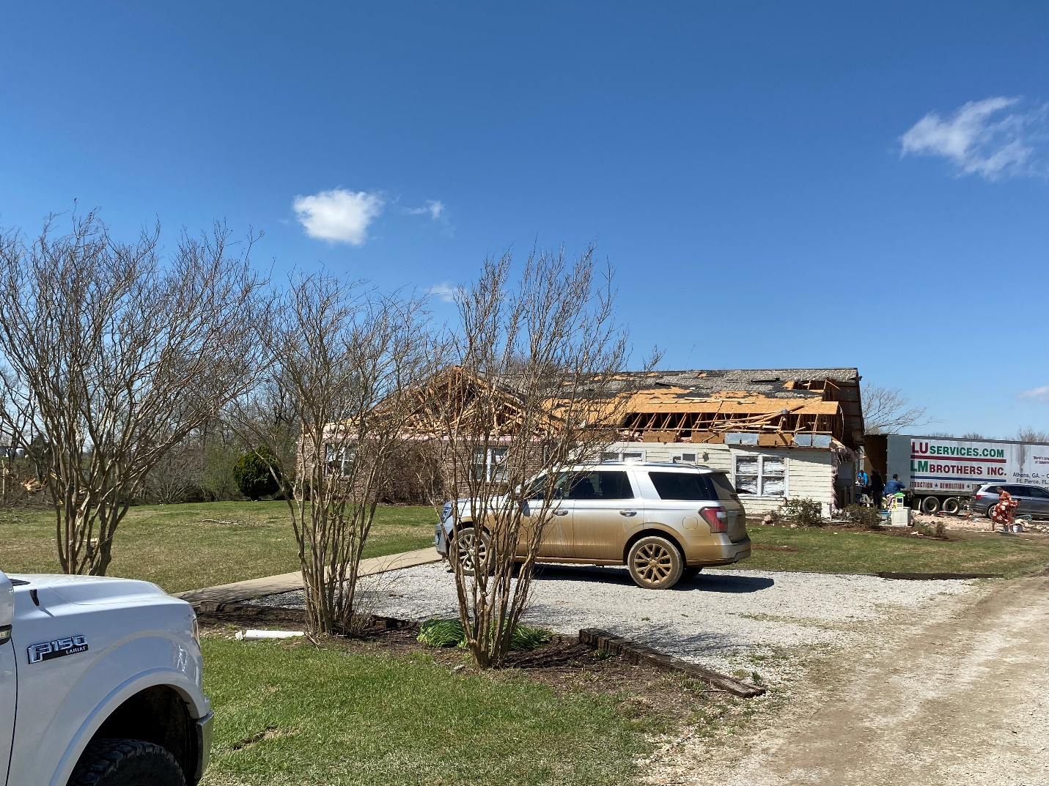
Summary and Acknowledgments
Peak in Doppler velocity closest to surface, consistent with Plains tornado observations*
Radar-observed V_{max} values matched closely to estimated peak wind speeds from damage indicators in surveys for both cases, BUT…unclear how radar observations compare to 3-s, 10-m AGL gust standard for EF scale
Subvortices coarsely resolved by NOXP in Prairie Point tornado, corroborating complicated damage patterns observed in surveys
How common are these multi-vortex structures in QLCSs?
Could this multi-vortex structure, and a background commonality of this structure in QLCS cases, explain some of the observed differences between QLCS and supercell tornado radar characteristics?
Acknowledgments
Funding was provided by NOAA/Office of Oceanic and Atmospheric Research under NOAA-University of Oklahoma Cooperative Agreement NA21OAR4320204, U.S. Department of Commerce.
Contact: anthony.lyza@noaa.gov

