Slide 1
Characterizing Ground Markings and Flow of the Rolling Fork MS Tornado
Melissa Wagner¹, Erik Rasmussen², Mike Coniglio², Dominic Candela¹, Elizabeth Tirone¹, Tony Lyza¹
PERiLS Science Meeting
November 17, 2023
¹Cooperative Institute of Severe and High Impact Weather Research and Operations; ²National Severe Storms Laboratory

Slide 2
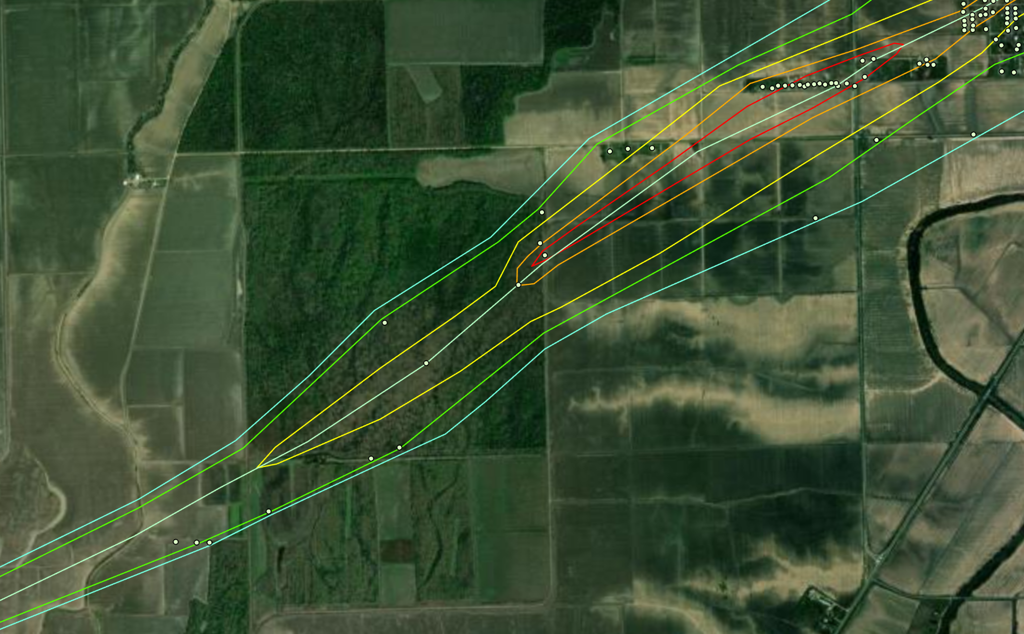
Science Objectives
Correlate storm signatures observed in radar and in-situ data to damage signatures
Understand the role of land cover and topography in tornado evolution (high-resolution imagery, radar, and simulations)
Focus on rural areas (limited DIs) most emphasis (understanding) of damaging winds in urban areas; most damage occurs in rural areas
Infer detailed high-wind info
Density of
EF ratings
SW of Rolling Fork, MS
Notes:
inferring detailed knowledge of wind in rural parts of path… but we really have ~0 data to support these EF contour analyses without the research we are doing.

Slide 3
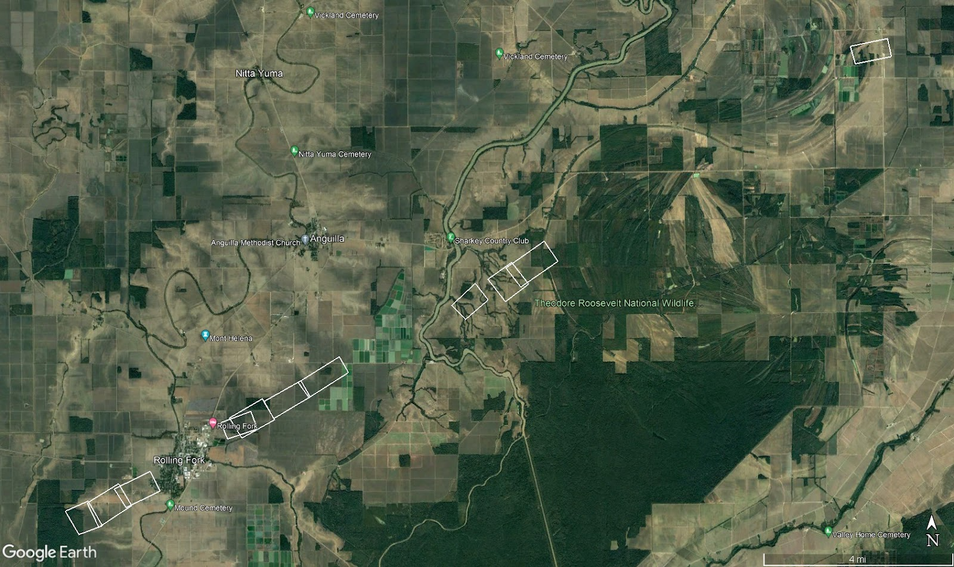
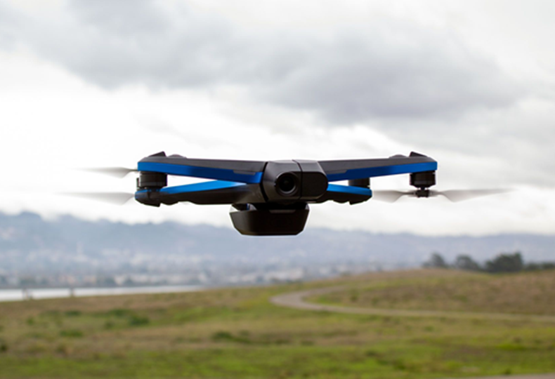
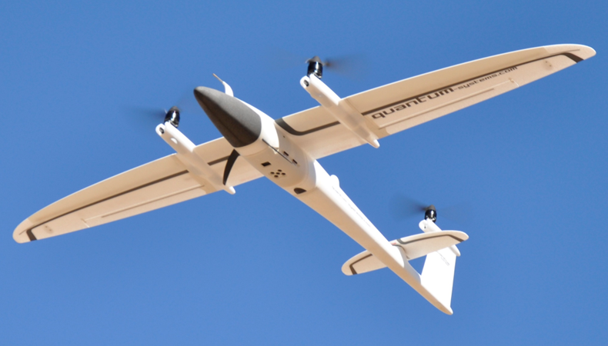
PERiLS IOP 3 Rolling Fork, MS
UAS mapping
Focused on Rural Areas
‘Ground Scours’
Land Cover transitions
Skydio 2
UAS mapping
Trinity F90+
UAS mapping
2 UAS Survey Teams OU/NSSL/CIWRO/NWS/JSU/MSU
Scouting videos (Skydio 2)
Mapping Missions (Trinity F90+)
Ground Surveys (Ground Truth)
UAS mapping

Slide 4
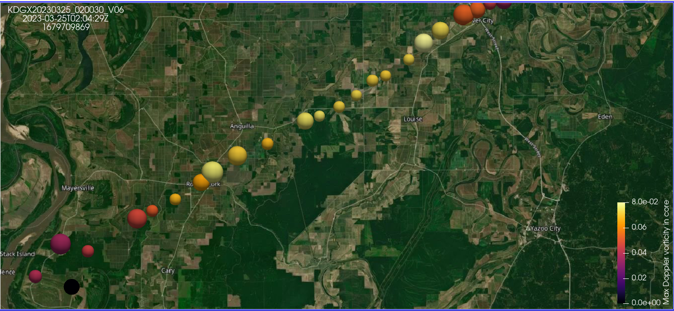
88D KDGX vortex cores
Size: detected core diameter
Color: maximum Doppler vorticity
Rolling Fork
Notes:
Max Doppler vorticity shows an intensifying vortex up to about Rolling Fork, then a pretty constantly intense (steady strong) vortex for a long period of time up to Silver City and then weakening.

Slide 5
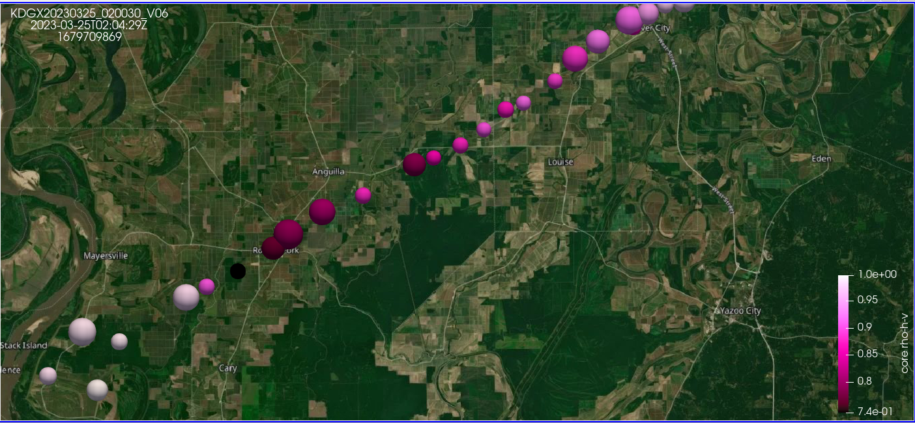
Theodore Roosevelt National Wildlife
88D KDGX vortex cores
Size: detected core diameter
Color: correlation coefficient
Catfish Ponds
Rolling Fork
Indian Bayou Wildlife Area
Notes:
The rho-h-v depression in rolling fork first began near the winding road west of the forest preserve (faint pink) but then went nuts in the forest and stayed debris-laden through rolling fork. It then eased up in the vicinity of the catfish farm, but got more intense again in that wooded area east of the catfish farm. Thereafter, the TDS continued but not as intense as in the rolling fork segment. Makes it tempting to attribute the fluctuations in rho-h-v to land use:

Slide 6
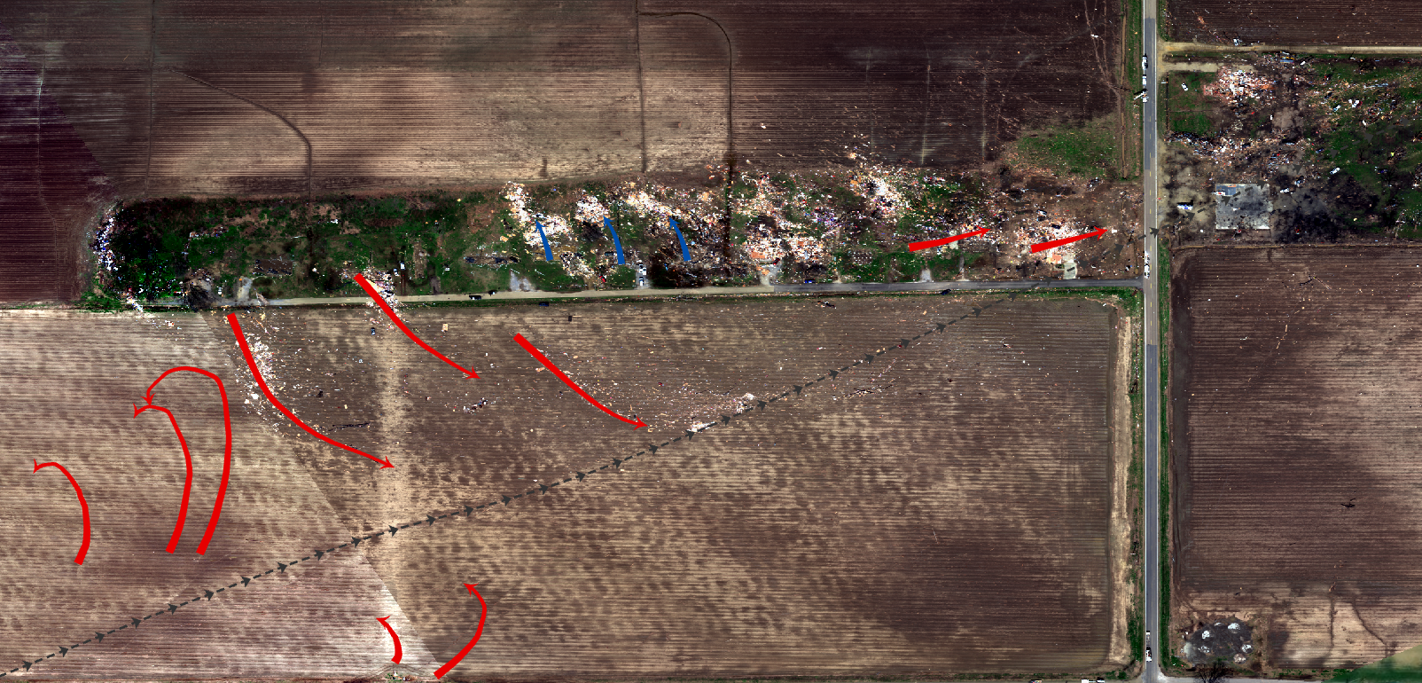
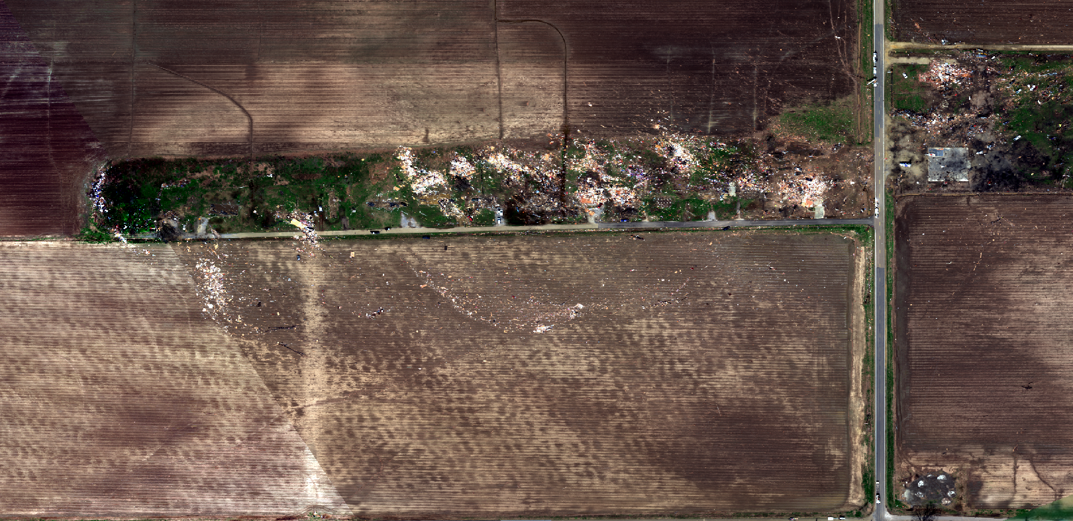
Rolling Fork, MS

Slide 7
Rolling Fork, MS

Slide 8
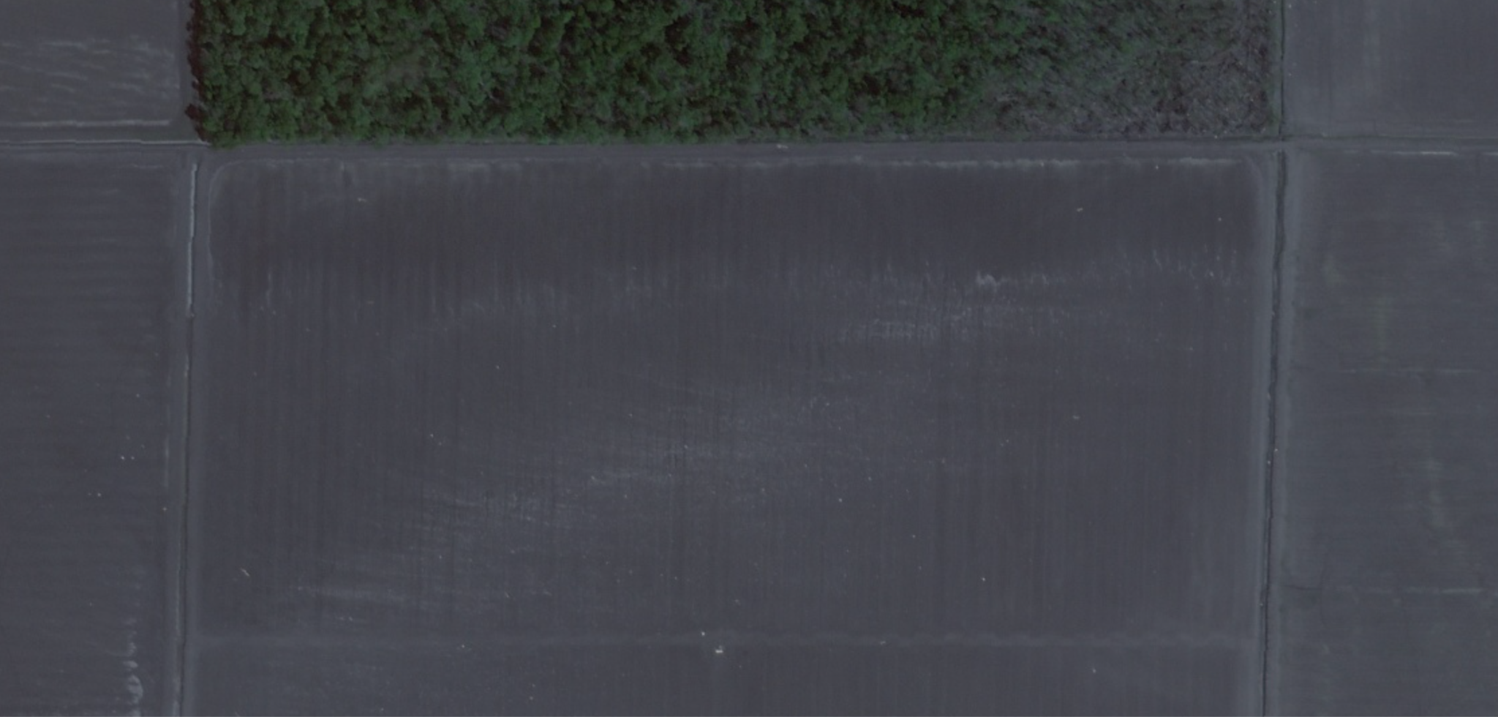
Rolling Fork, MS
Skysat ~50 cm

Slide 9
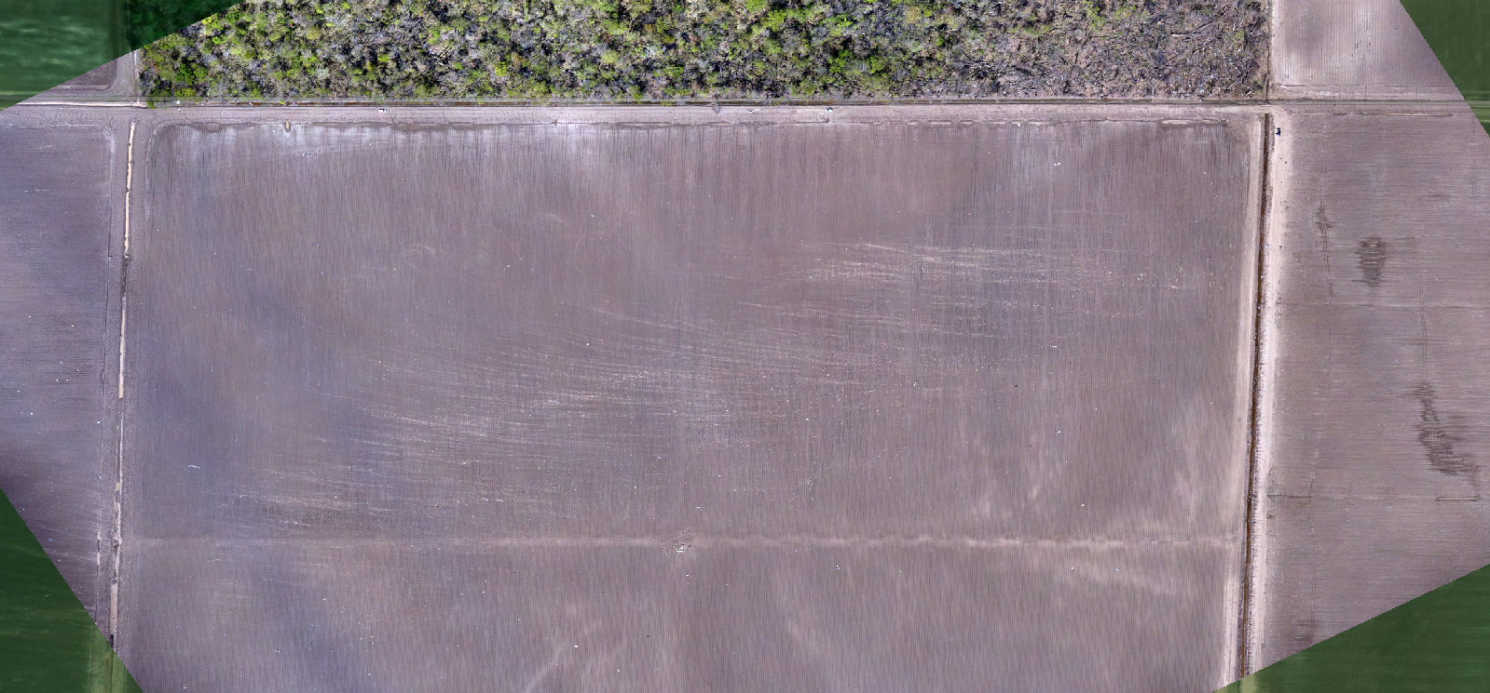
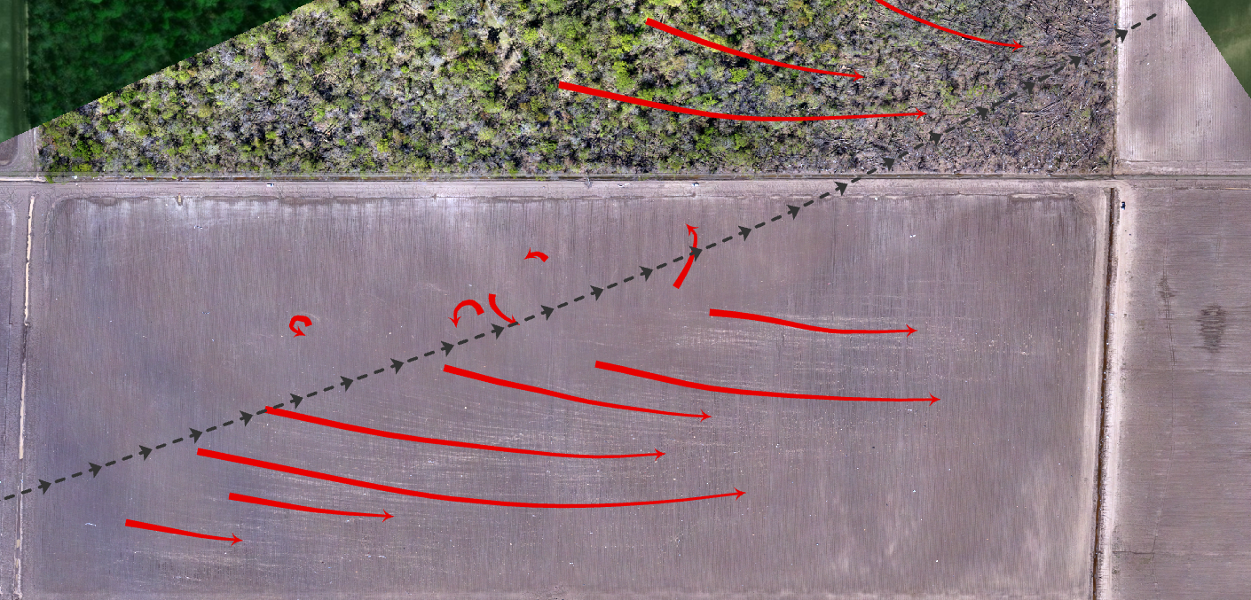
Rolling Fork, MS
Vortex
Motion
UAS ~3 cm

Slide 10
Rolling Fork, MS
Notes:
The red annotations are a fairly classical interpretation of ground marks. But things are likely a lot more complex than inferred in this simple analysis… debris patterns, ground marks, etc. are not a flow snapshot!... in this case they are a time integral of deposition processes. So these flow-like annotations are just for illustration purposes.

Slide 11
Rolling Fork, MS
Skysat ~50 cm

Slide 12
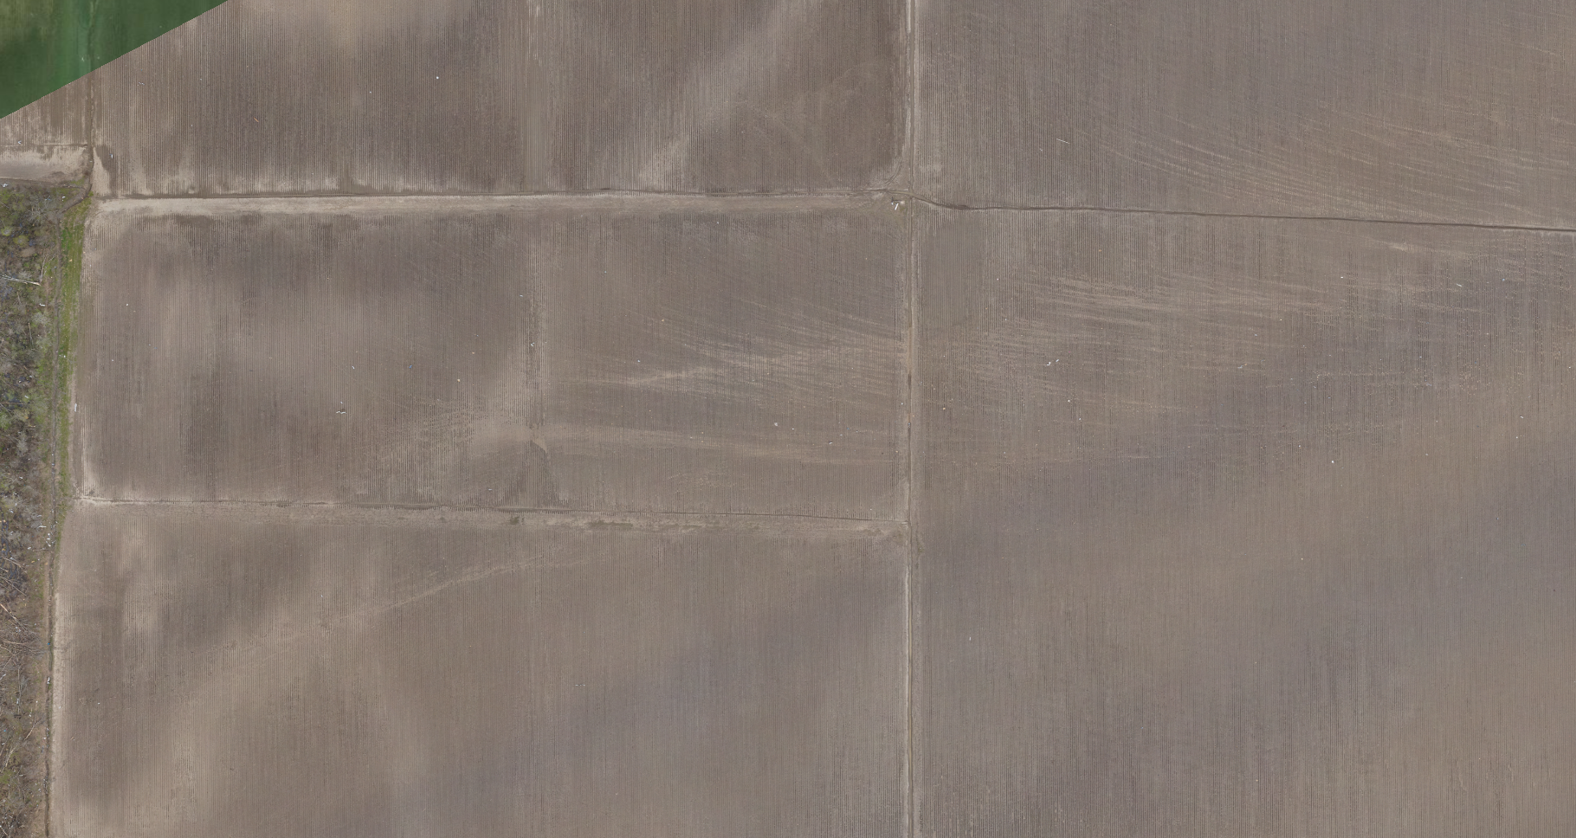
Rolling Fork, MS
UAS ~3 cm
UAS ~3 cm

Slide 13
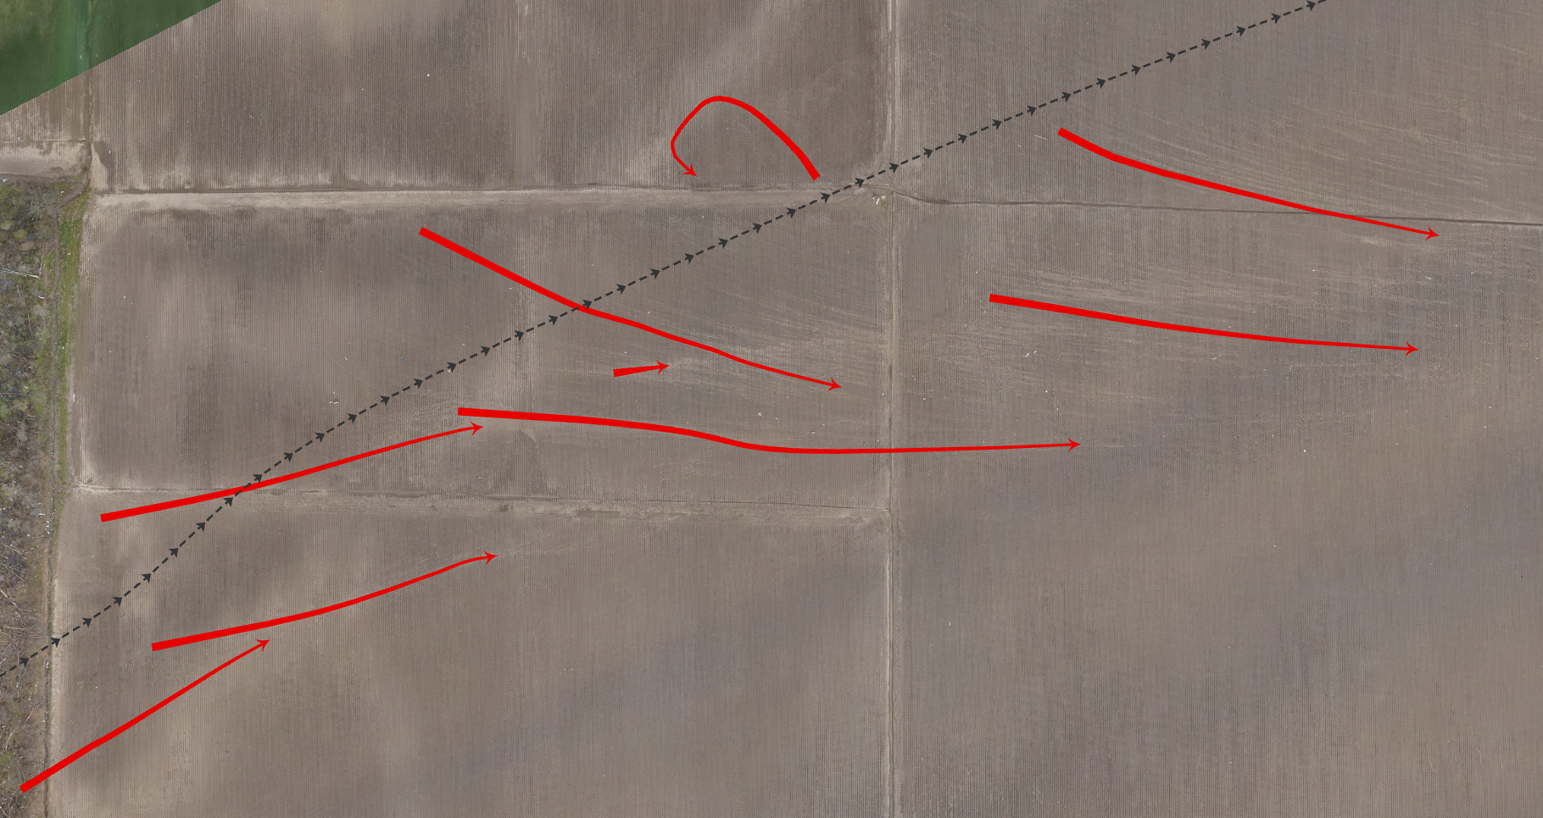
Rolling Fork, MS
UAS ~3 cm
UAS ~3 cm
Notes:
Same comment as Slide 10… and here might be a nice segue into tornado mulch

Slide 14
Rolling Fork, MS
UAS ~3 cm
UAS ~3 cm

Slide 15
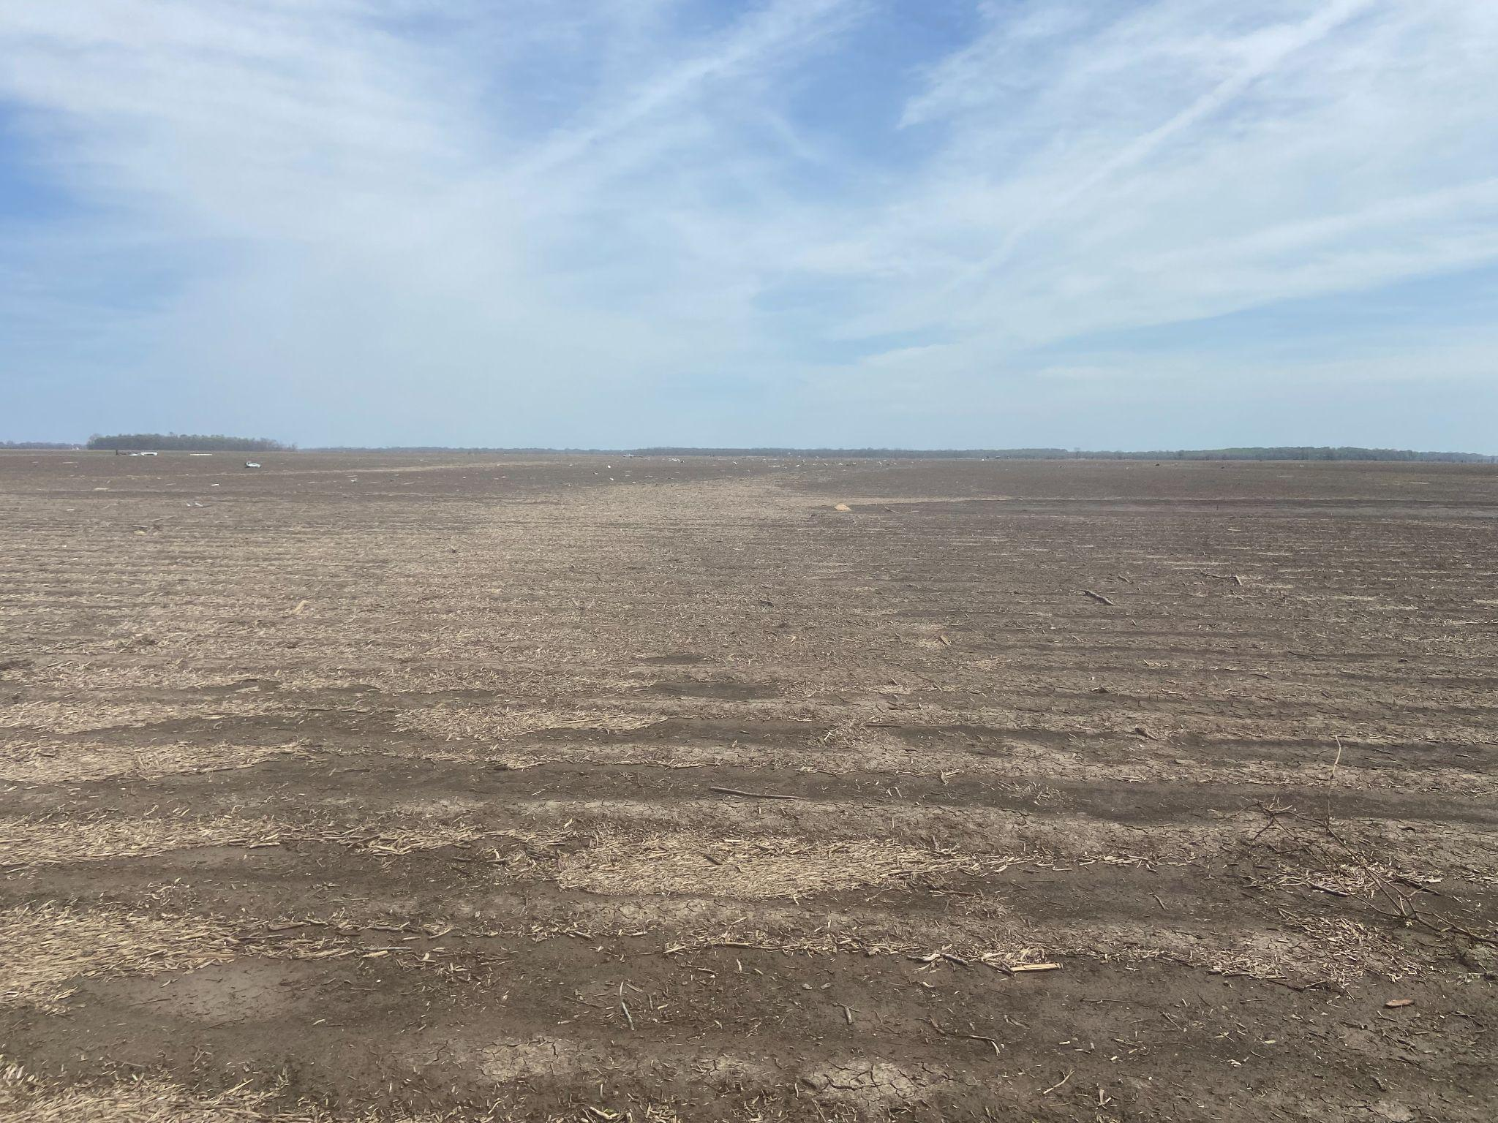
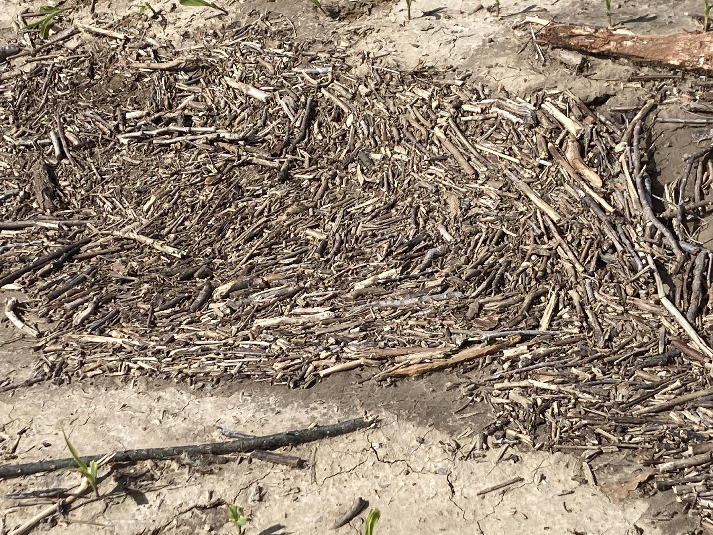
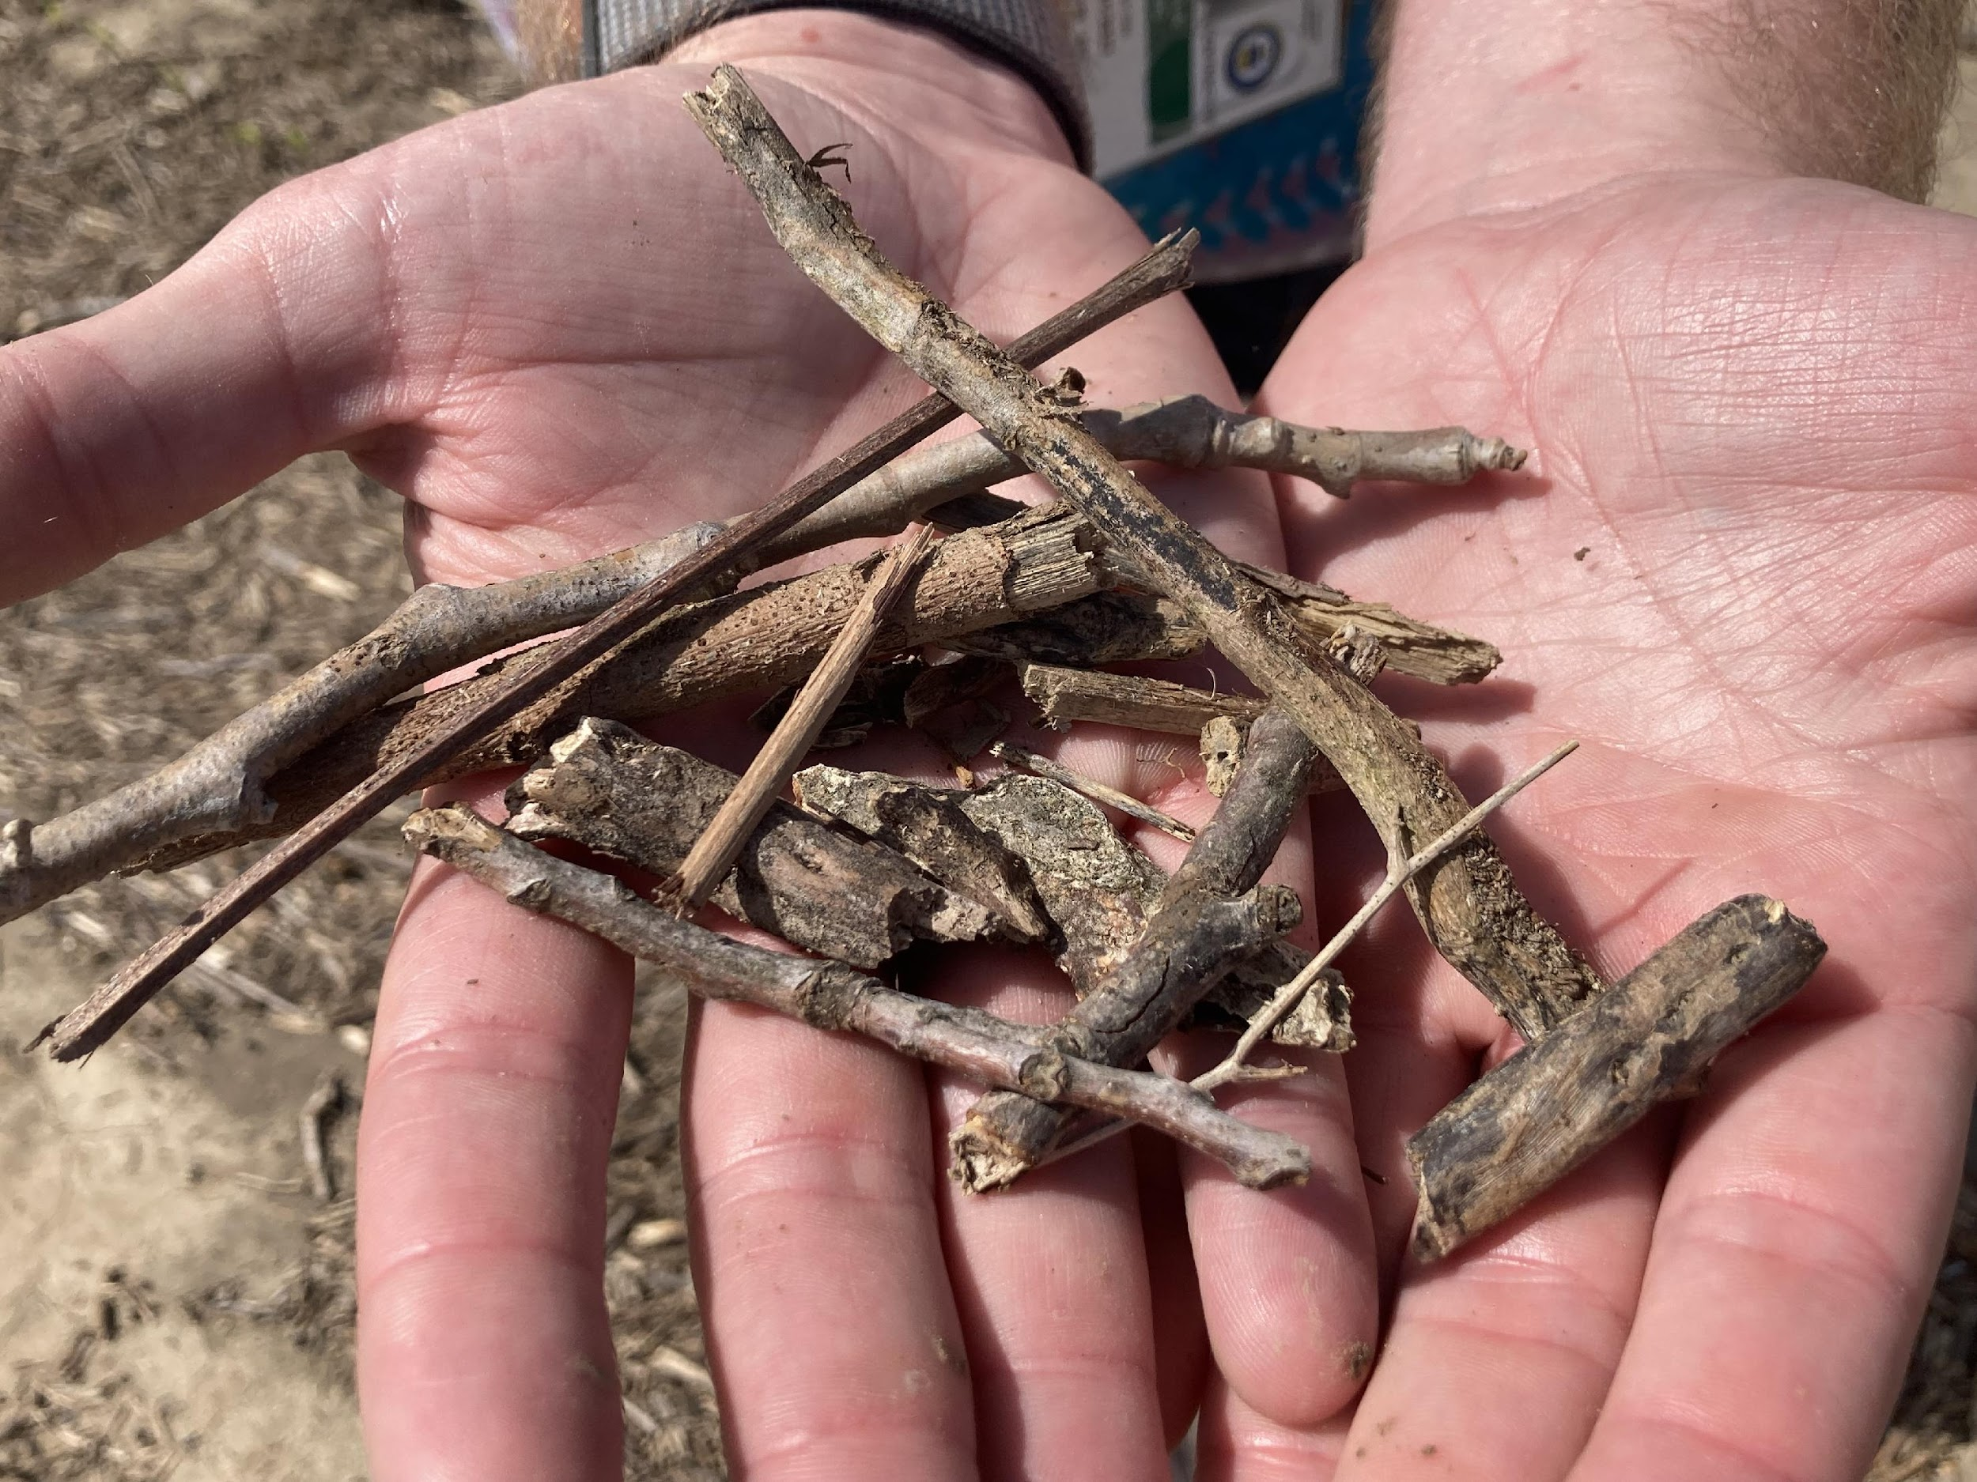
Tornado Mulch
Ground Truth
Satellite-UAS
UAS ~3 cm

Slide 16
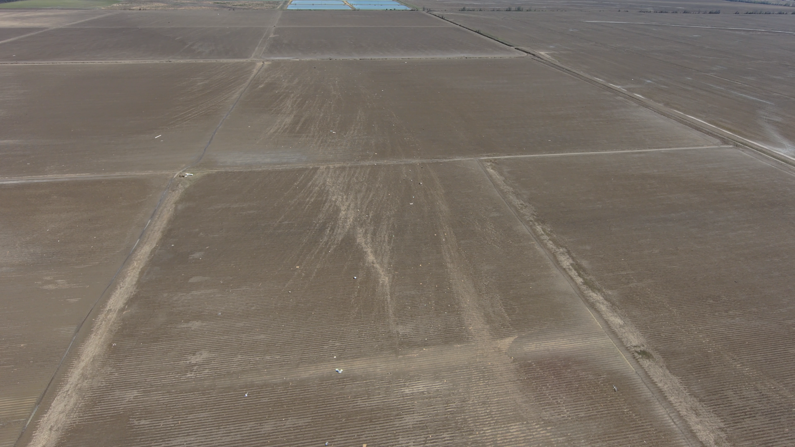
Rolling Fork, MS
Skydio
Lines of Deposition
East-facing
Notes:
Another perspective looking east

Slide 17
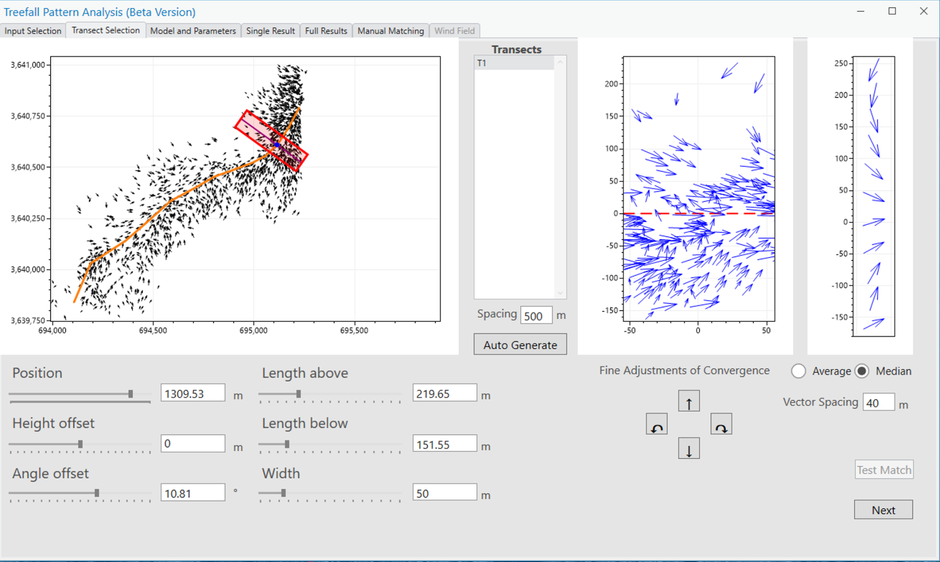
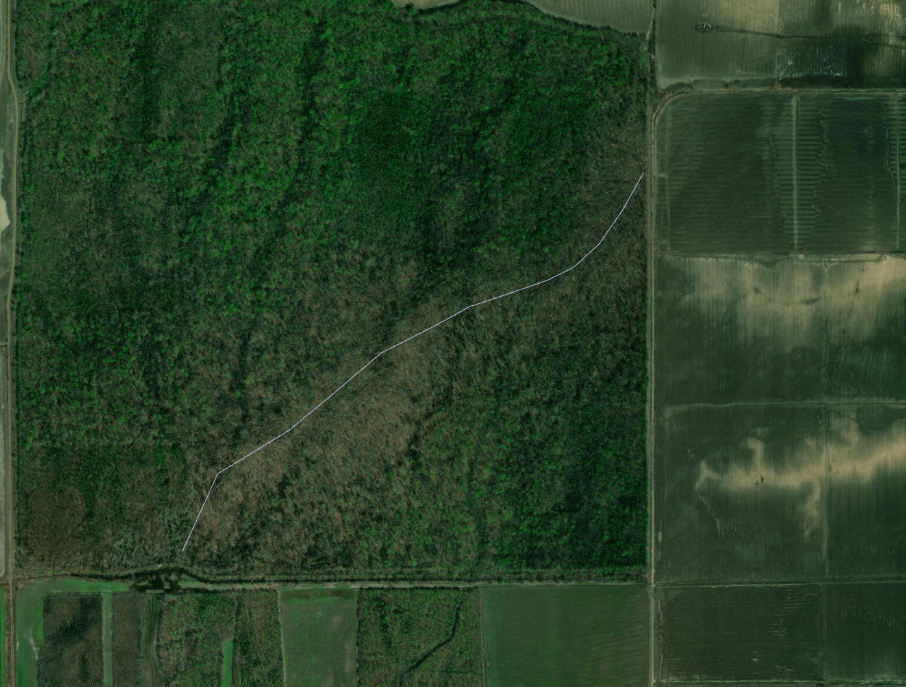
Treefall Analysis and Estimated Near Surface Winds
Wsp 61.0 m/s
Vt 15-25 m/s
Modified Rankine Model
*SW of Rolling Fork
Notes:
Playing with. Not sure how well an axisymmetric translating vortex will represent the damage from what is likely an unsteady asymmetric flow.

Slide 18
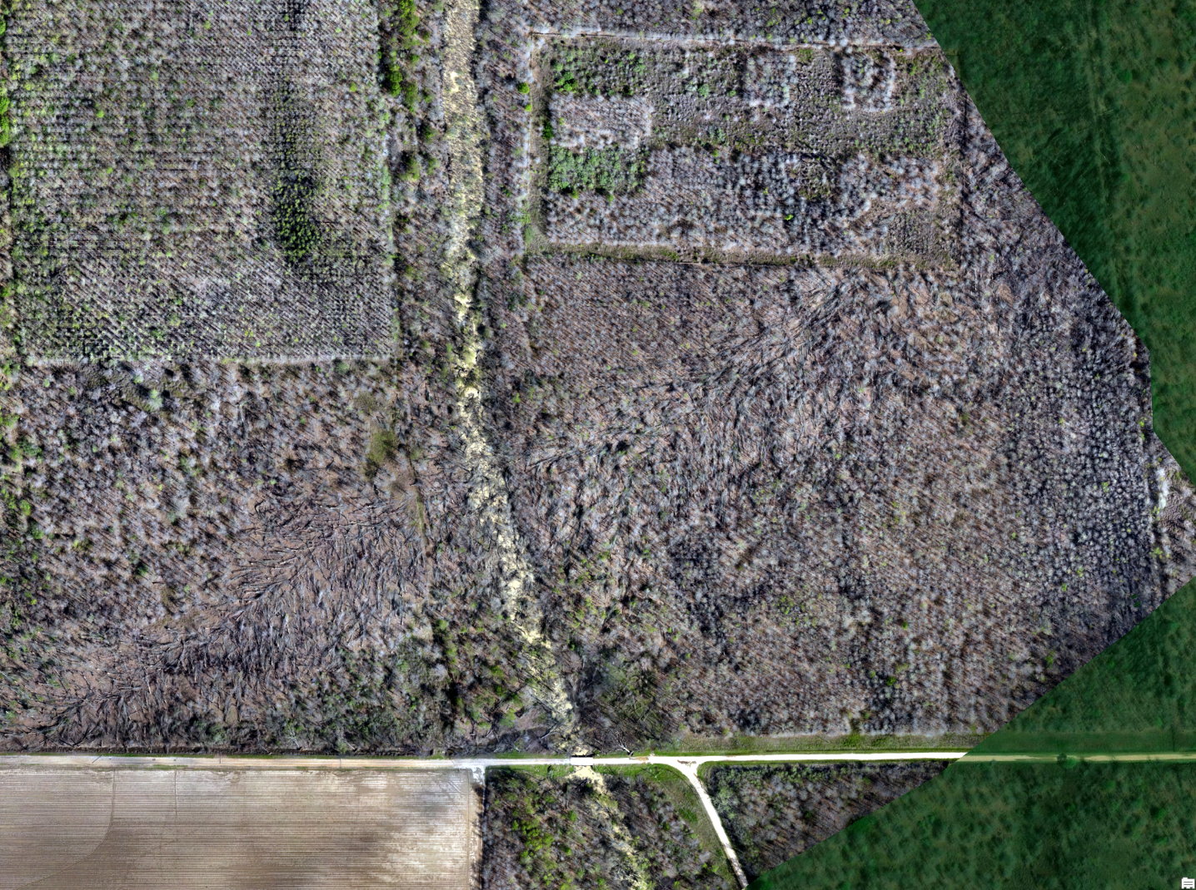
Treefall Analysis and Estimated Near Surface Winds
Min Wsp 61.3 m/s
Vt 15-25 m/s
Modified Rankine Model
*NE of Rolling Fork

Slide 19
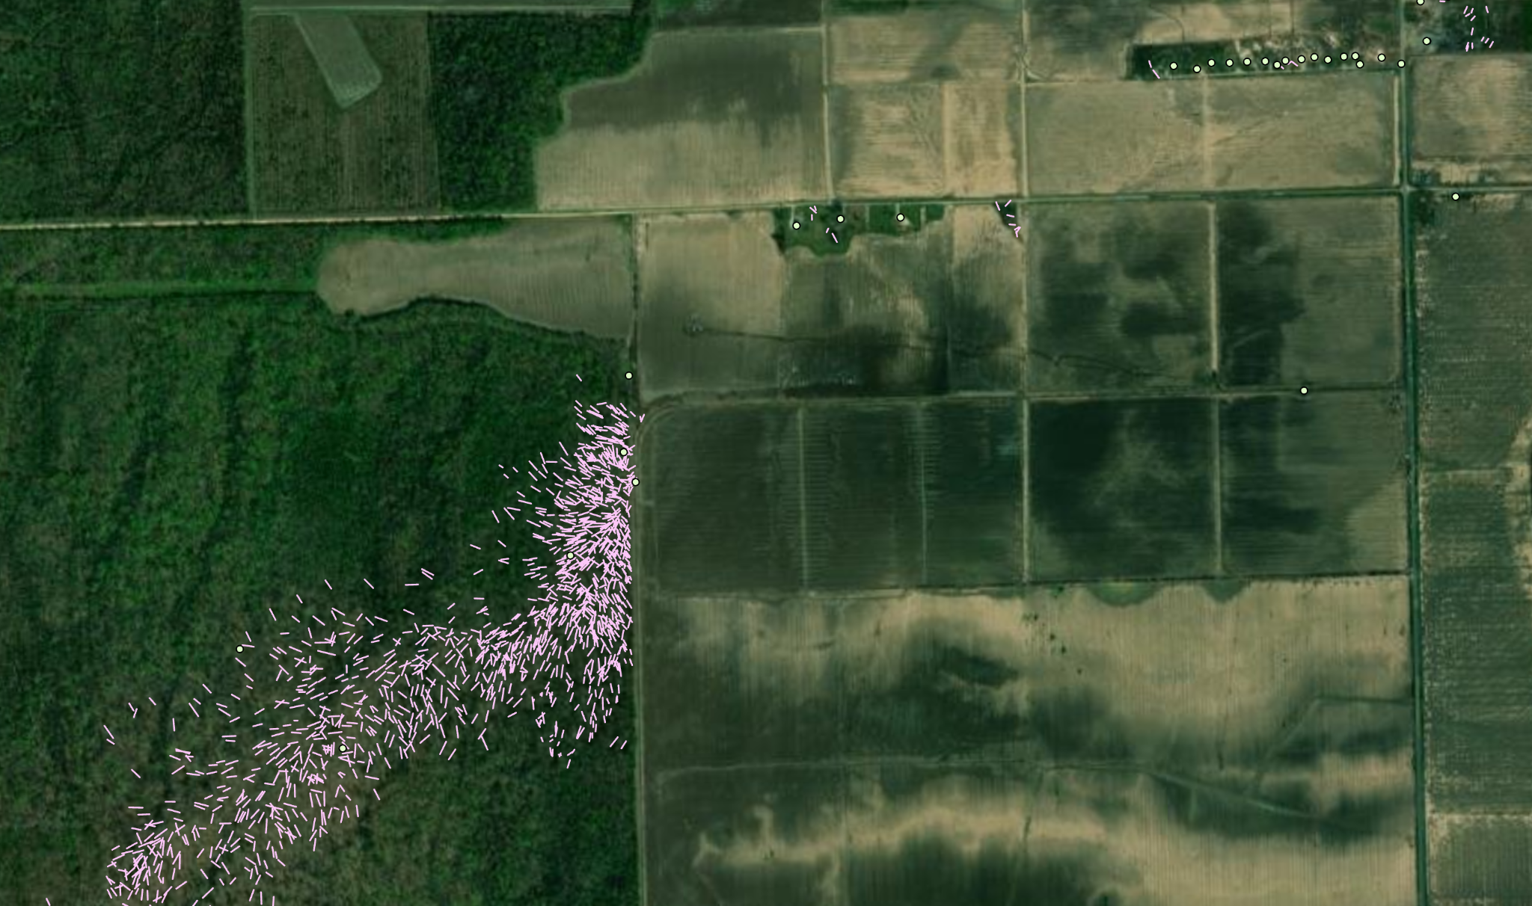
Notes:
Northward jog in track when transitioning from forest to open fields (seeing this pattern within most cases)

Slide 20
Conclusion and Future Work
Micro-Cycloidal
Damage pattern is the damage produced by the SUM of storm winds: pre-tornado, tornado, post-tornado flows
Understand complex flows, land cover, and topography through high-resolution simulations (CM1) and close-range radar
Longitudinal studies to understand optimal data collection windows (damage response and maximum signature)
Multidisciplinary approach
Drift Marks
Concentrated Debris Line

Slide 21
Acknowledgements and Contact Info
NSSL, CIWRO, OU, NWS WFOs, JSU, MSU
Special thanks to Mike Coniglio, Tony Lyza, Erik Rasmussen, Alan Gerard, NOAA UASD & UxS RTO
Contact Info: melissa.a.wagner@noaa.gov
Severe Convective Observations using UAS, Radar, Simulations
Funding Source: NOAA VORTEX-USA program #NA21OAR4320204

