Slide 1
Cold Pool and Vortex Characteristics in Idealized HSLC QLCSs
Jessica M. McDonald
Christopher C. Weiss
Atmospheric Science Group
Texas Tech University
Nov 2023, PERiLS Science Meeting, Memphis TN

Slide 2
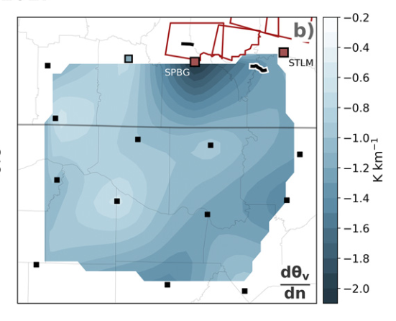
Motivation
McDonald and Weiss (2021) found relatively stronger $θv$ gradients near tornadoes in two QLCSs during VORTEX-SE
Further investigation of PERiLS data set found additional relationships between gradients and MVs
Ostaszewski and Weiss (2023) continued this work
Found stronger gradients during/after QLCS tornadoes
Baroclinically-generated vorticity mechanisms play a role in QLCS vortex development
Tilting of baroclinically generated vortex lines into the vertical by downdraft or updraft (Trapp and Weisman 2003, Wheatley and Trapp 2008, Atkins and St. Laurent 2009, Flournoy and Coniglio 2019, Parker et al. 2020)
Outside of genesis mechanisms, baroclinity/density currents can also strengthen existing vortices
Lee and Wilhelmson 1997b, Marion and Trapp 2021, etc)
From Fig. 14 in McDonald and Weiss 2021

Slide 3
Motivation
McDonald and Weiss (2021) found relatively stronger $θv$ gradients near tornadoes in two QLCSs during VORTEX-SE
Further investigation of PERiLS data set found additional relationships between gradients and MVs
Ostaszewski and Weiss (2023) continued this work
Found stronger gradients during/after QLCS tornadoes
Baroclinically-generated vorticity mechanisms play a role in QLCS vortex development
Tilting of baroclinically generated vortex lines into the vertical by downdraft or updraft (Trapp and Weisman 2003, Wheatley and Trapp 2008, Atkins and St. Laurent 2009, Flournoy and Coniglio 2019, Parker et al. 2020)
Outside of genesis mechanisms, baroclinity/density currents can also strengthen existing vortices
Lee and Wilhelmson 1997b, Marion and Trapp 2021, etc)
From Fig. 14 in McDonald and Weiss 2021
What role does baroclinic vorticity generation play in HSLC QLCS vortices?

Slide 4
Motivation
McDonald and Weiss (2021) found relatively stronger $θv$ gradients near tornadoes in two QLCSs during VORTEX-SE
Further investigation of PERiLS data set found additional relationships between gradients and MVs
Ostaszewski and Weiss (2023) continued this work
Found stronger gradients during/after QLCS tornadoes
Baroclinically-generated vorticity mechanisms play a role in QLCS vortex development
Tilting of baroclinically generated vortex lines into the vertical by downdraft or updraft (Trapp and Weisman 2003, Wheatley and Trapp 2008, Atkins and St. Laurent 2009, Flournoy and Coniglio 2019, Parker et al. 2020)
Outside of genesis mechanisms, baroclinity/density currents can also strengthen existing vortices
Lee and Wilhelmson 1997b, Marion and Trapp 2021, etc)
From Fig. 14 in McDonald and Weiss 2021
What are cold pool and vortex structures in HSLC QLCSs?
What role does baroclinic vorticity generation play in HSLC QLCS vortices?

Slide 5
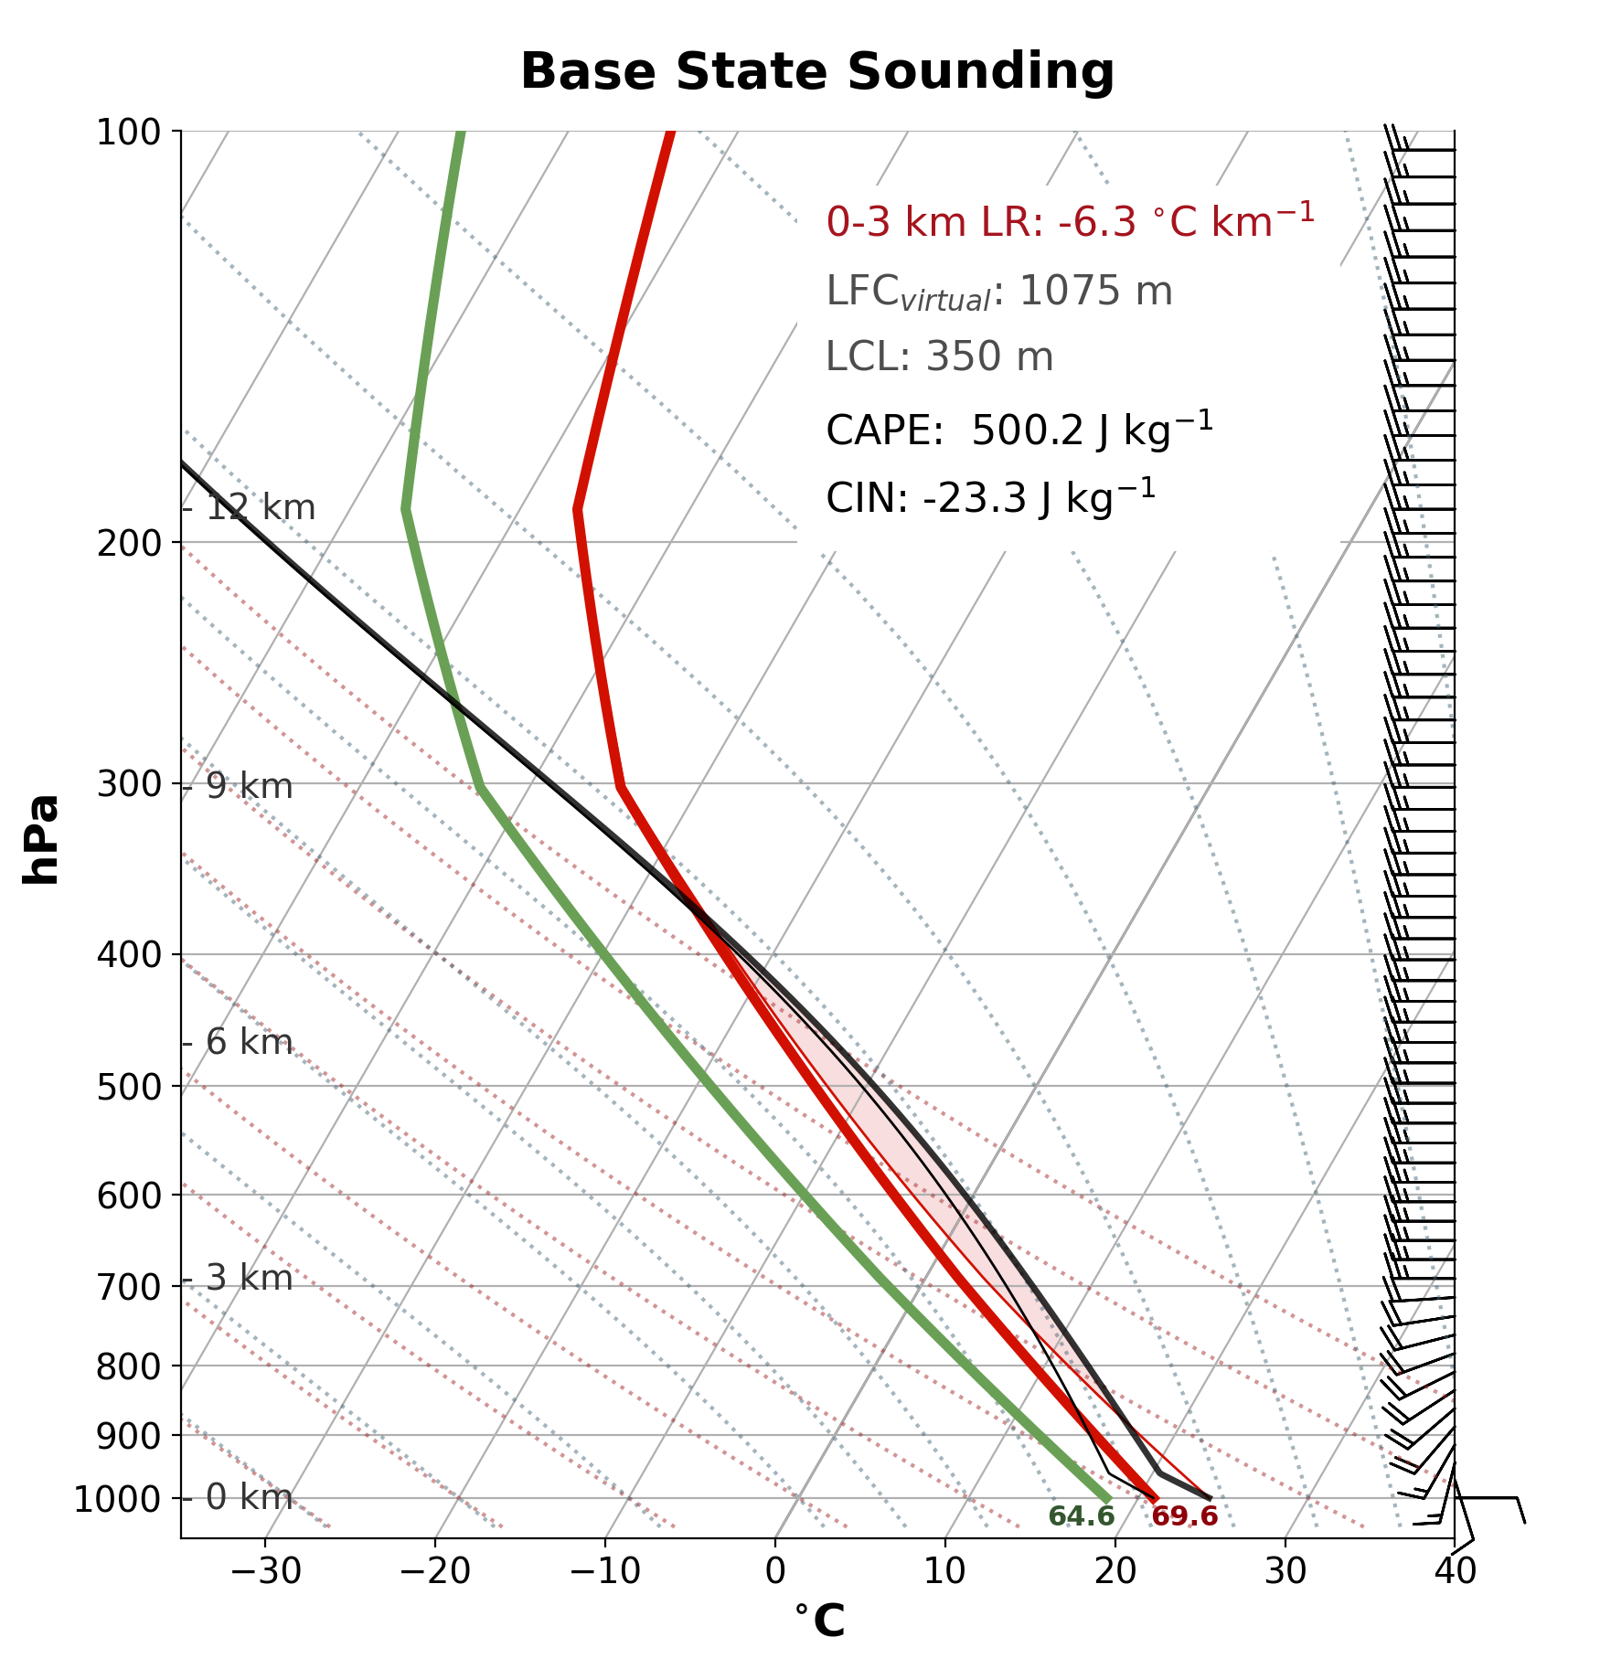
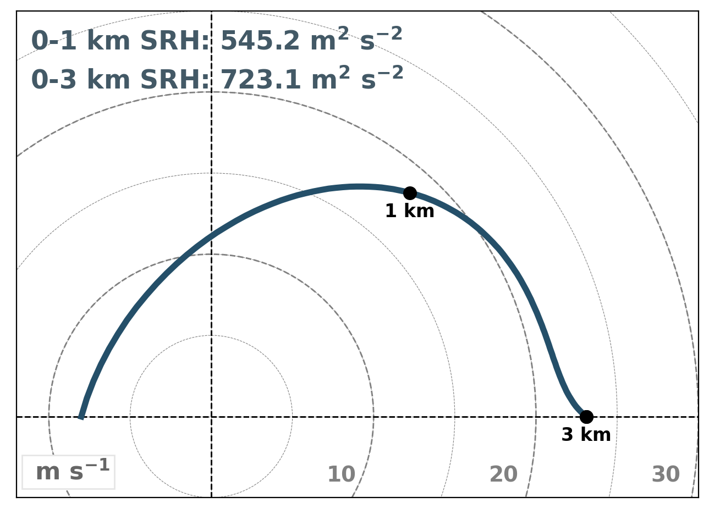
Model Parameters
Sounding based on Sherburn and Parker (2019)
2 different CM1 simulations: varying boundary conditions
Parameter | Description
Model | CM1v19.5 (modified to include several fixes through 19.10)
Domain Size | 309.5 x 202 x 18 km
Horizontal Grid Spacing | Δx = 250 m
Vertical Grid Spacing | Δz = 10 m, stretched to 250 m at 9.75 km (23 grid points in the lowest 1 km)
Lateral Boundaries | X: open radiative, Y: Periodic
Bottom Boundaries | Free-slip OR semislip (C_{d} = 0.01)
Microphysics | NSSL double-moment (hail and graupel)
Coriolis | None
Run time | 43200 s (12 hours)
Grid Translation | Dynamic (Schueth et al., to be submitted)

Slide 6
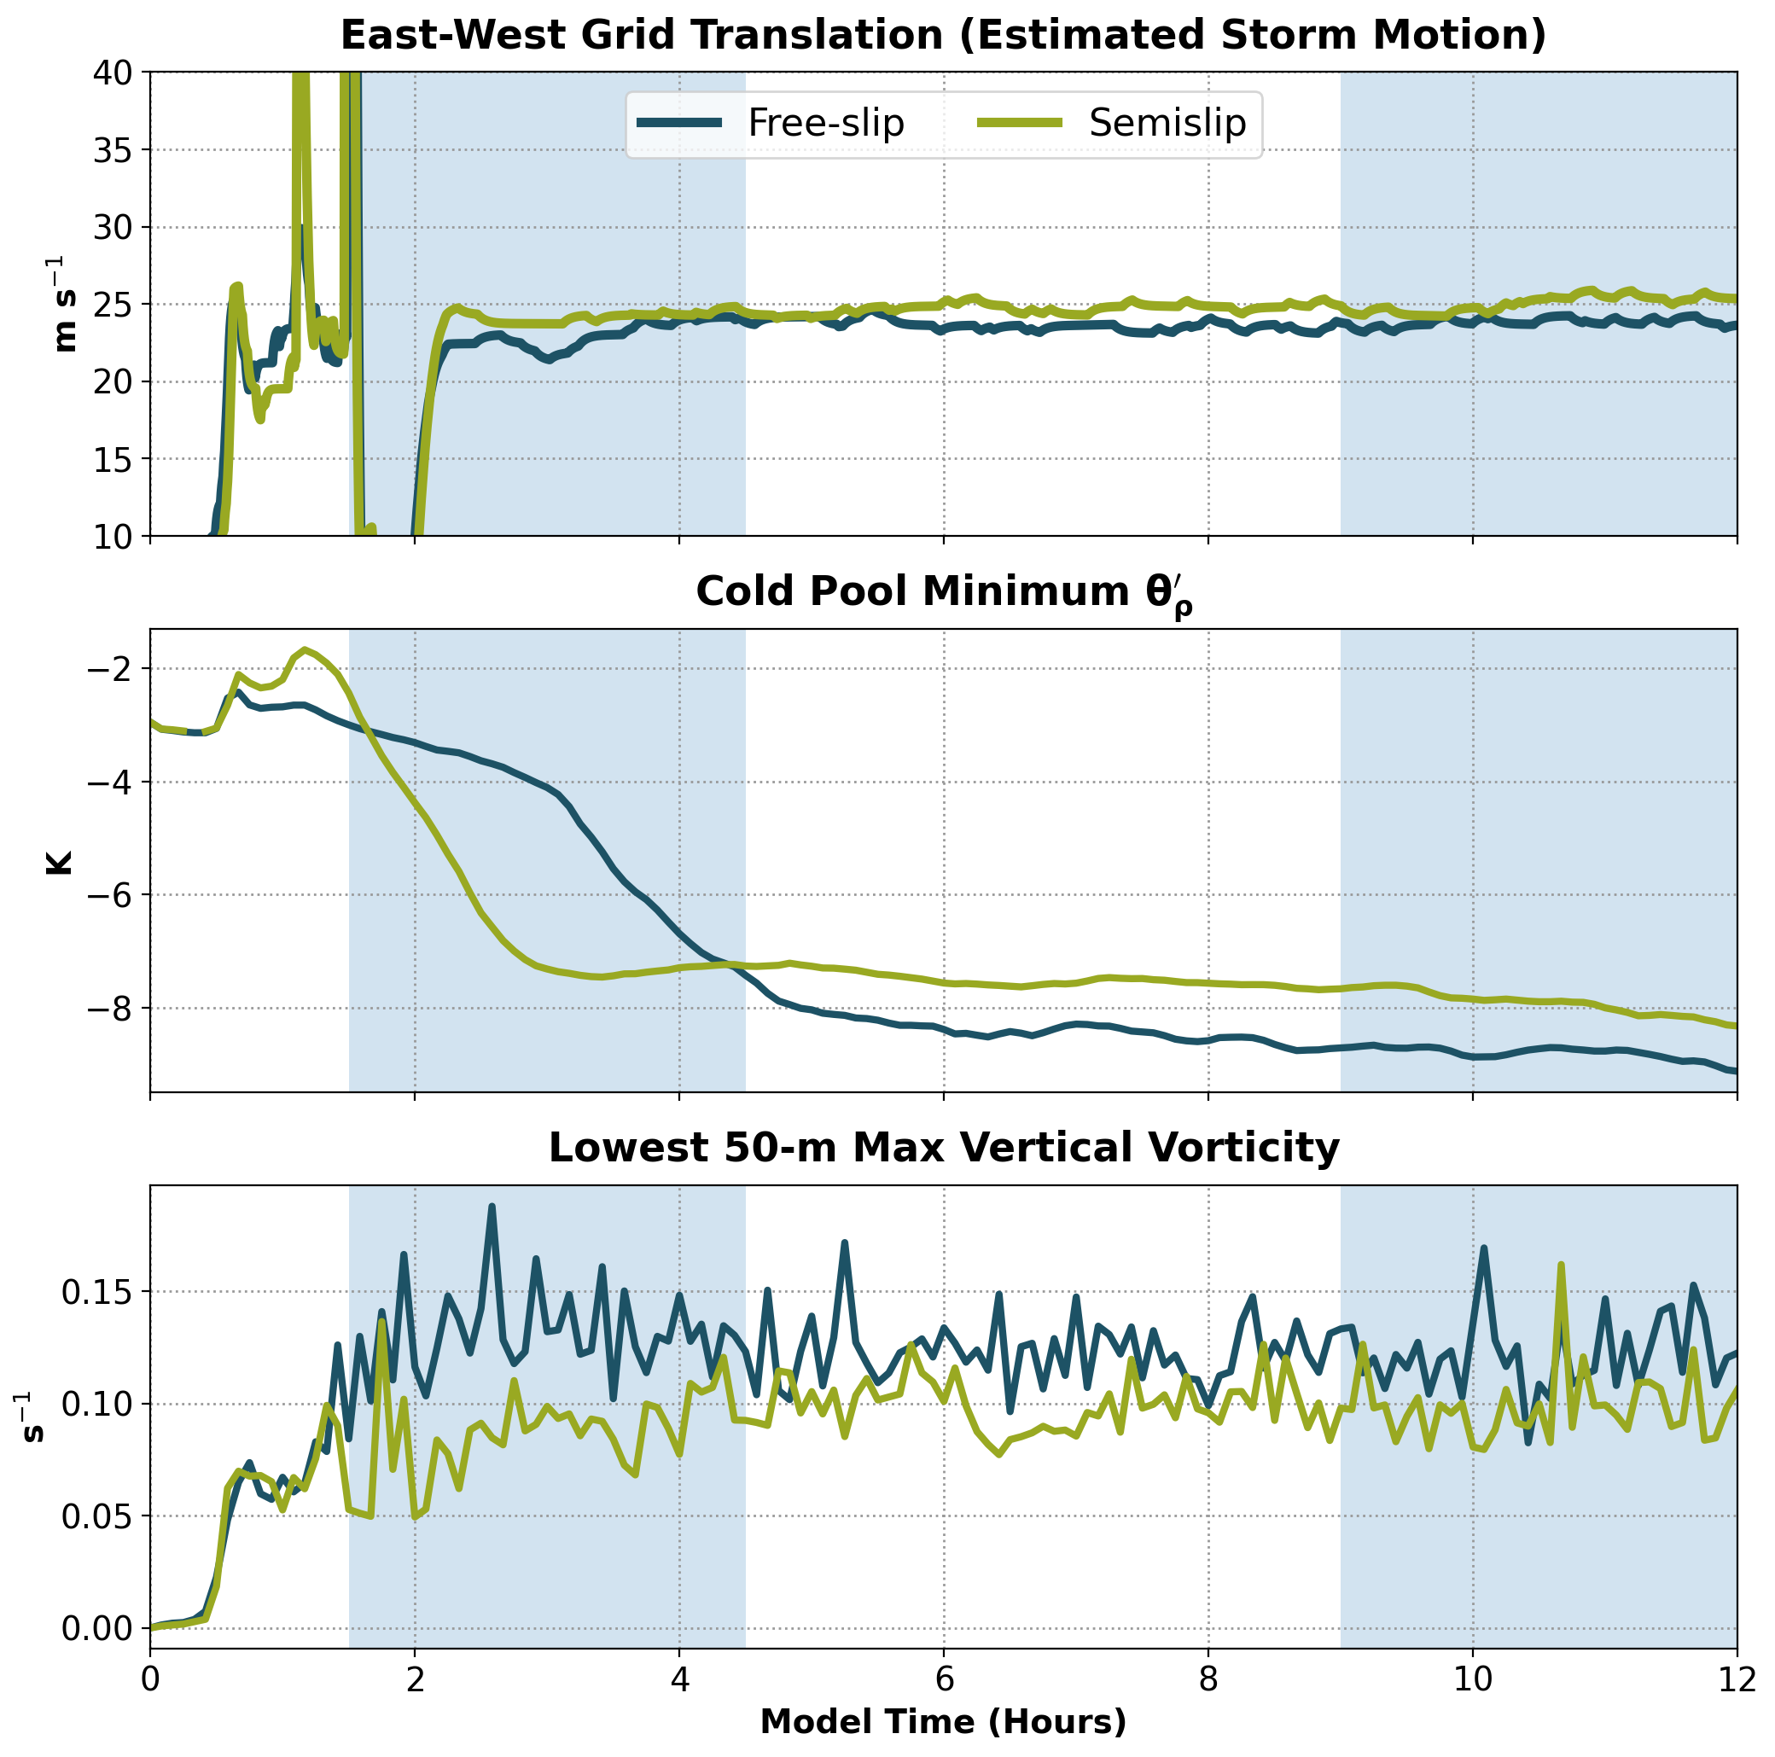
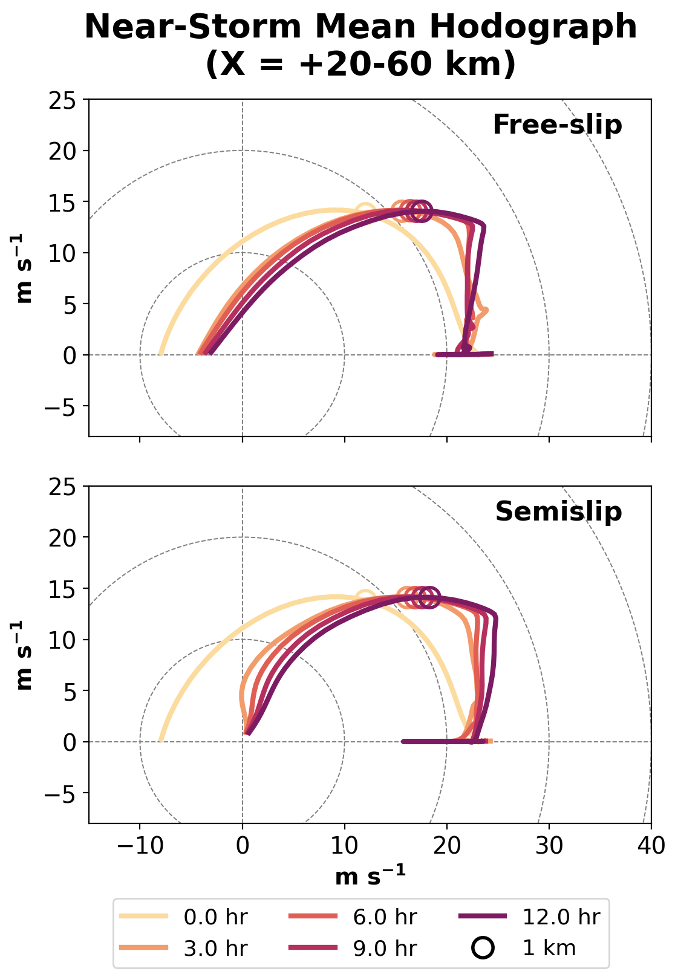
Model Results Overview
Vortex analysis periods

Slide 7
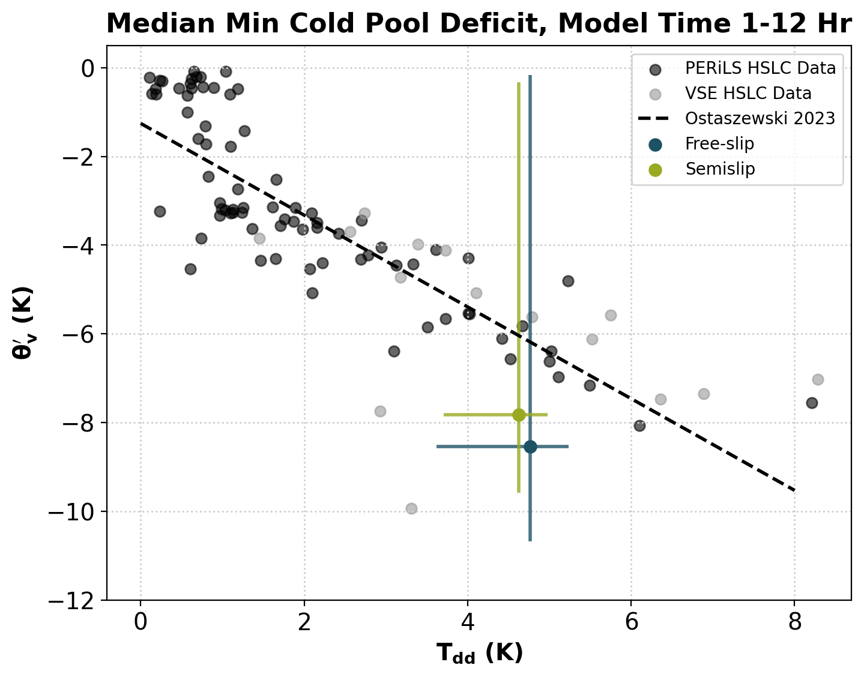
Model Results Overview
Vortex analysis periods
Comparison to observations shows reasonable cold pool deficits and dew point depression
(T-Td) relationship

Slide 8
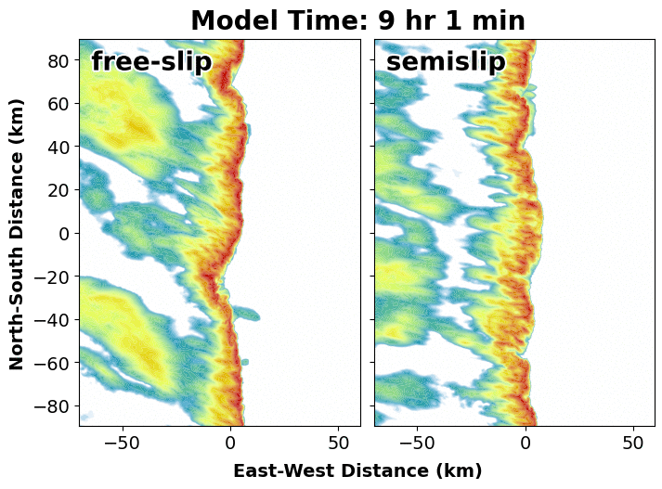
Vortices and TLVs
Okubo-Weiss (OW) = S_{n}² + S_{s}² - ζ ²
S_{n} = normal strain component, S_{s} = shear strain component, ζ = vertical vorticity
－ Vortex definition:
Contiguous object of OW ≤ -0.001 s⁻²
depth ≥ 500 m
lowest grid point < 30 m AGL
Exists for at least 1 minute
－ TLV definition:
Vortex definition
Contains min OW ≤ -0.01 s⁻²
 | N Vortices | N TLVs
Free-slip | 373 | 84
Semislip | 211 | 22

Slide 9
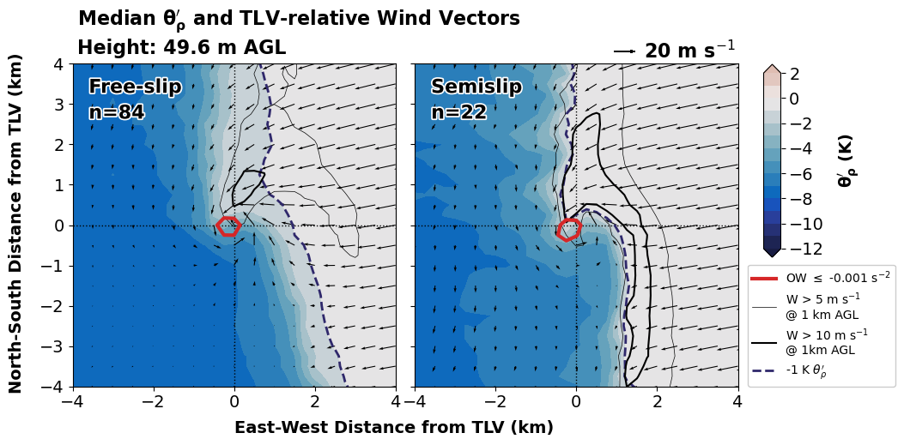
TLVs
Composites around each TLV at their strongest time
Majority/all vortices caused by HSI release
Free-slip vortices are more occluded and have weaker updrafts than semislip

Slide 10
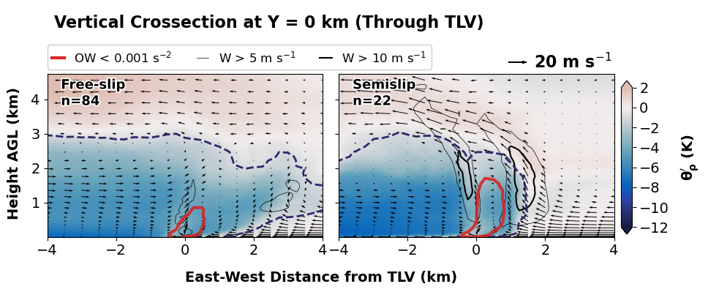
TLVs
Composites around each TLV at their strongest time
Majority/all vortices caused by HSI release
Free-slip vortices are more occluded and have weaker updrafts than semislip
Semislip cold pools are more upright, colder air aloft (relative to environment)
Median cold pool depth is 3 km for both
Semislip vortices are weaker than free-slip, but they’re taller

Slide 11
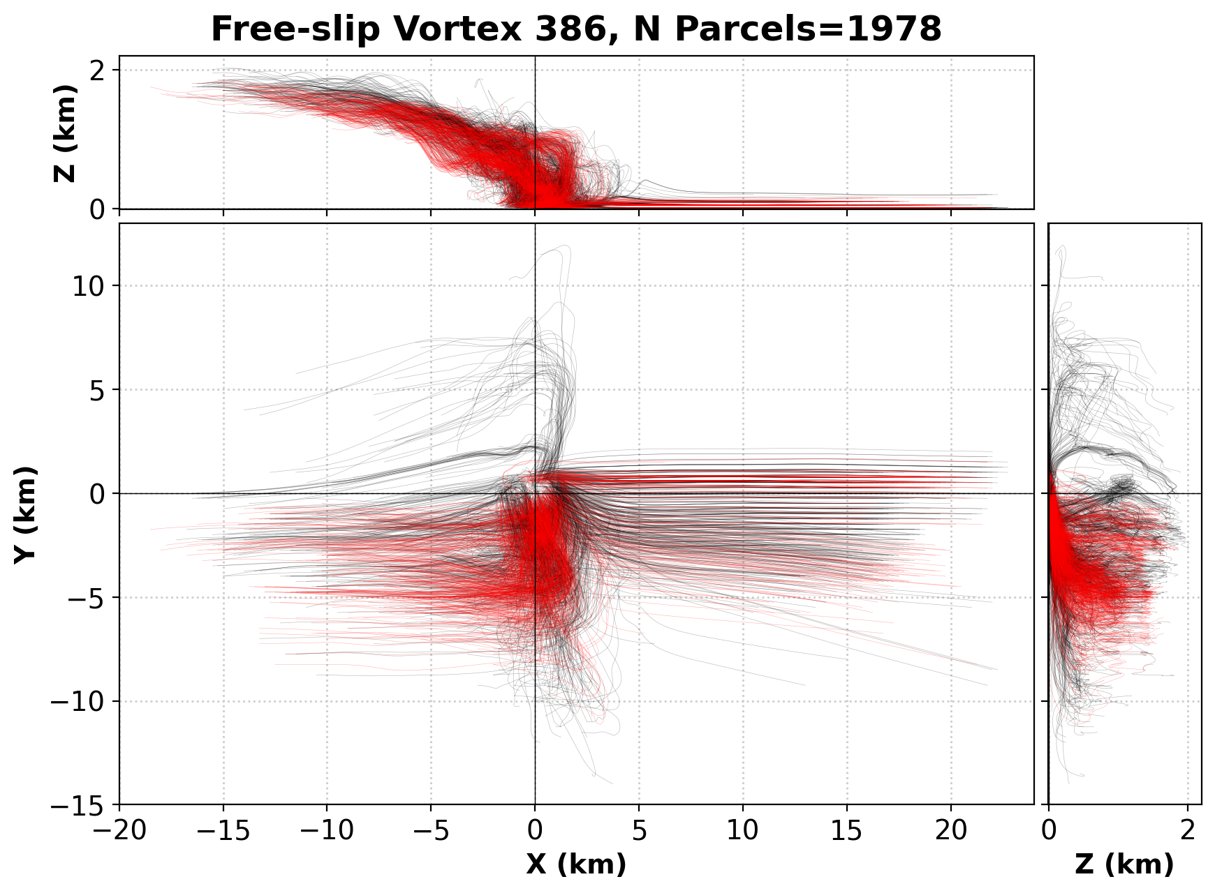
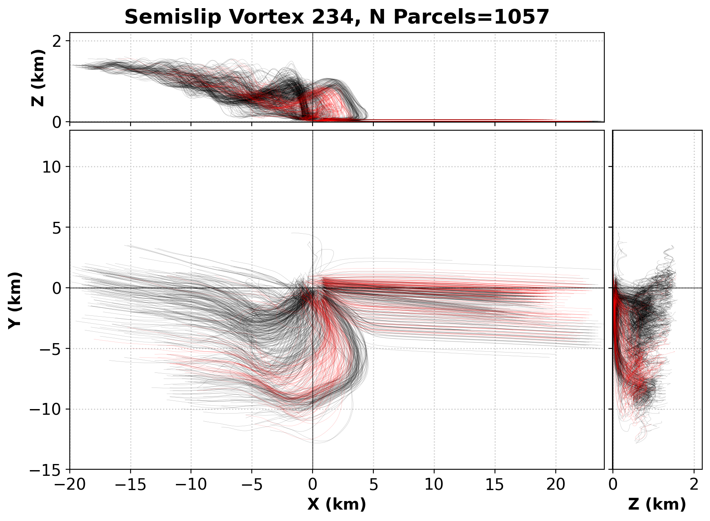
Parcel Trajectories
Typical HSI vortex/TLV from each simulation has 3 source regions for parcels:
A: environmental parcels
B: cold pool parcels that descend and approach the vortex from the south
C: cold pool parcels that descend and immediately enter the vortex from the west
Vortex Parcel
TLV parcel
Duration: 26 min
Max zeta: 0.16 s⁻¹
Max height: 2.3 km
Vortex Parcel
TLV parcel
Duration: 21 min
Max zeta: 0.12 s⁻¹
Max height: 2.2 km

Slide 12
Parcel Trajectories
Typical HSI vortex/TLV from each simulation has 3 source regions for parcels:
A: environmental parcels
B: cold pool parcels that descend and approach the vortex from the south
C: cold pool parcels that descend and immediately enter the vortex from the west
Vortex Parcel
TLV parcel
Duration: 26 min
Max zeta: 0.16 s⁻¹
Max height: 2.3 km
Vortex Parcel
TLV parcel
Duration: 21 min
Max zeta: 0.12 s⁻¹
Max height: 2.2 km
A
A

Slide 13
Parcel Trajectories
Typical HSI vortex/TLV from each simulation has 3 source regions for parcels:
A: environmental parcels
B: cold pool parcels that descend and approach the vortex from the south
C: cold pool parcels that descend and immediately enter the vortex from the west
Vortex Parcel
TLV parcel
Duration: 26 min
Max zeta: 0.16 s⁻¹
Max height: 2.3 km
Vortex Parcel
TLV parcel
Duration: 21 min
Max zeta: 0.12 s⁻¹
Max height: 2.2 km
B
A
A
B

Slide 14
Parcel Trajectories
Typical HSI vortex/TLV from each simulation has 3 source regions for parcels:
A: environmental parcels
B: cold pool parcels that descend and approach the vortex from the south
C: cold pool parcels that descend and immediately enter the vortex from the west
Vortex Parcel
TLV parcel
Duration: 26 min
Max zeta: 0.16 s⁻¹
Max height: 2.3 km
Vortex Parcel
TLV parcel
Duration: 21 min
Max zeta: 0.12 s⁻¹
Max height: 2.2 km
C
C
B
A
A
B

Slide 15
Summary and Future Work
Two HSLC QLCS simulations with varying boundary conditions – Free-slip and semislip
Cold pool deficits match observations fairly well
HSI is main/dominant(???) vortex formation mechanism for the 3-hr period observed
Cold pool composites align with past studies of HSI and different boundary conditions
Vortices have similar parcel source regions, regardless of boundary condition
Future Work:
Vorticity budget analysis of the HSI vortices
Preliminary work suggests that tilting of baroclinically generated vorticity is a source of vertical vorticity
Analysis of the earlier period with more supercell-like vortexgenesis mechanisms
Preliminary work suggests vortices from this time period are taller, stronger, and last longer
Contact: jessica.mcdonald@ttu.edu

